Slide 1

Lets Link
Project by: Tyler Ballard

Slide 2
Overview
What is Lets Link?
How does it work?
What would I need from you!
What I will do for you
Future of Lets Link
User Story
Usecase

Slide 3


What is Lets Link?
Numerous times myself, or others I know have mentioned how they would of done something, or gone somewhere but didn’t have anyone to go with. Welcome Lets Link!
Lets Link is a mobile application designed to promote social interaction in a healthy environment.
Lets Link allows users to meet with other users of the application and accompany one another to a mutually agreed upon activity.
Best of all it is free to use!

Slide 4
How does it work?
Lets Link is a mobile app that will allow you to create a profile and set an active event request notification that will then query a search for people wanting to do the same event, and ask that individual if they would like to go with you.
This allows for users to find companions online, that can then “link up”, and bring back socializing with people in person again in the age of social media.
The application will be a professional, but easy going environment, that will also allow others to leave a review of there experience with you based on a star system so that negative conduct is discouraged.
If you receive a 2-star rating or lower the users’ profile can then be suspended, reviewed, and possibly banned.

Slide 5

What I would need from you!
Information to create a profile i.e., first name, last name, address, email, profile picture, phone number, and password.
A bio about you is also helpful so others can get to know you prior to meeting.
Interests of yours to help refine our search to like minded people.
Lastly enthusiasm, and a positive attitude.

Slide 6
What I will do for you
Create a healthy, social environment to meet new people, and do the things you love.
Ensure your information is safe, and in a future update allow GPS tracking, and an emergency button to ensure your safety.
Help motivate you to put yourself out there, and try new things.
Provide a way to voice any concerns or complaints so that they can be addressed as soon as possible.
Output multiple users profiles all to your phone who have similar interests as you.
Create endless opportunities for you, the user.

Slide 7
Entity Relationship Diagram
Review
First
Last
Open
Closed
Attends
Reviews
Name
Sex
Status
USER
Creates
Activity
Stored In
Link
Activity ID
Interests
DOB
Location
ID
Client ID
Address
Date
Desc.
City
State
Searches
Address

Slide 8
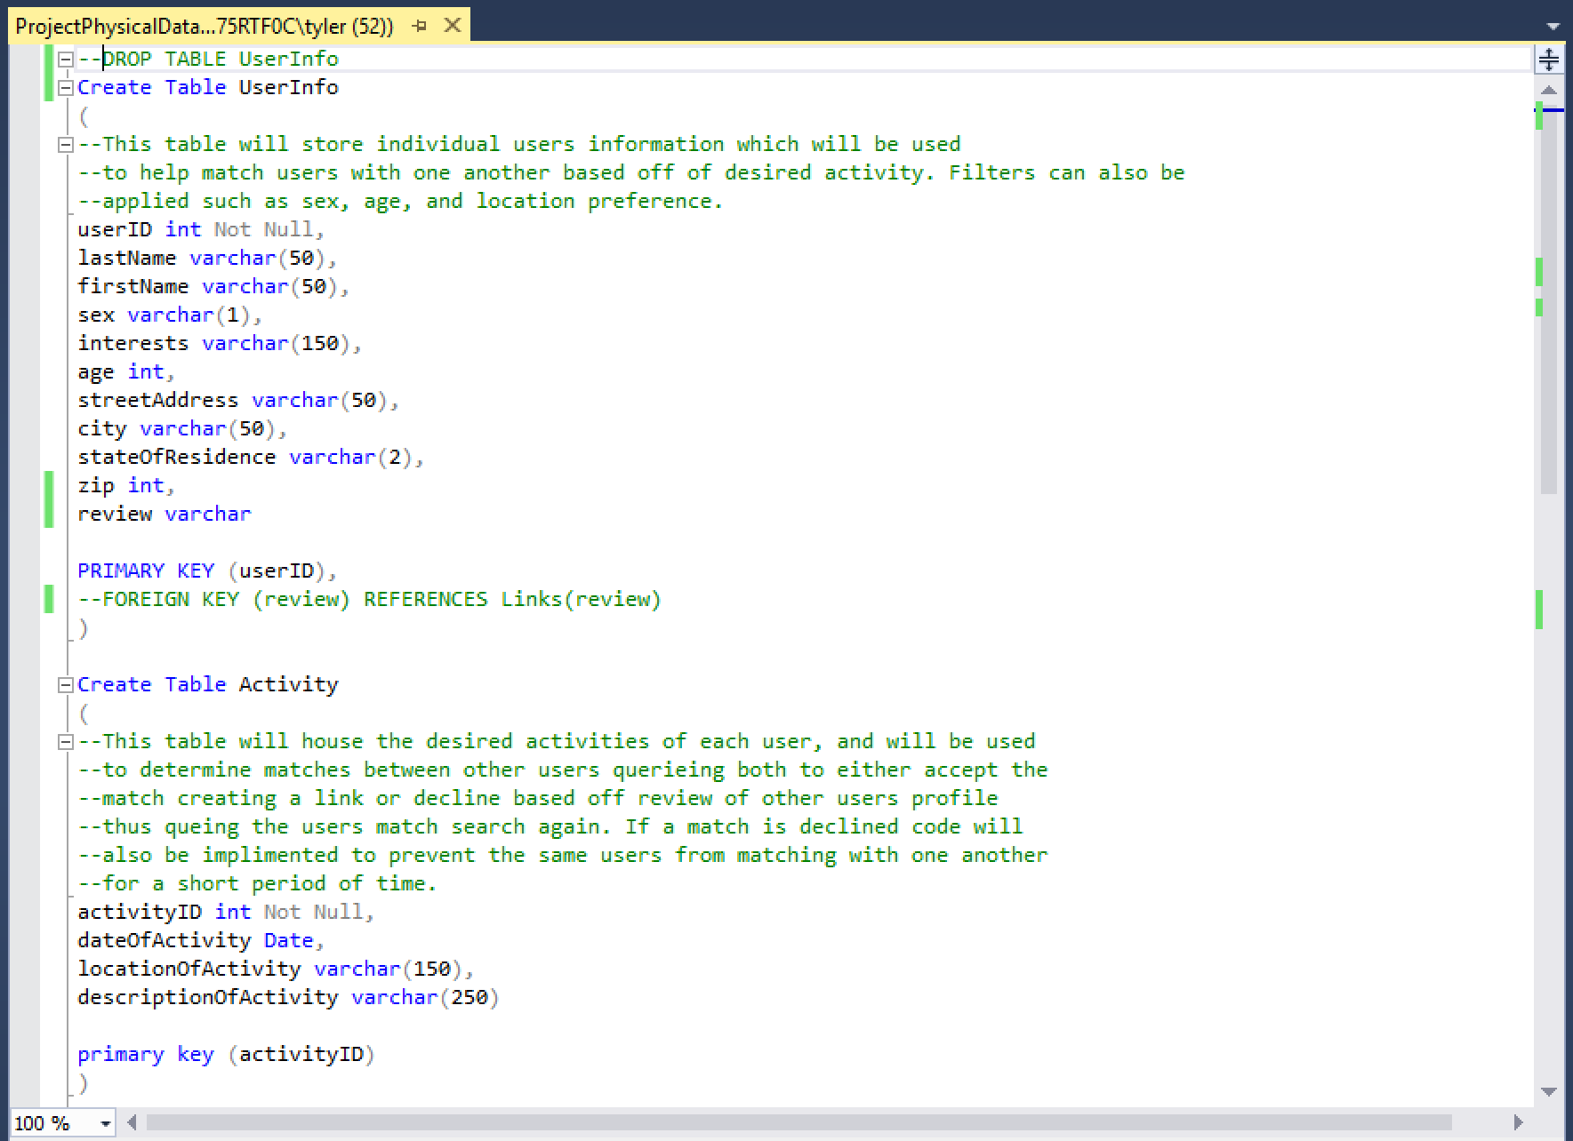
Physical Database Script

Slide 9
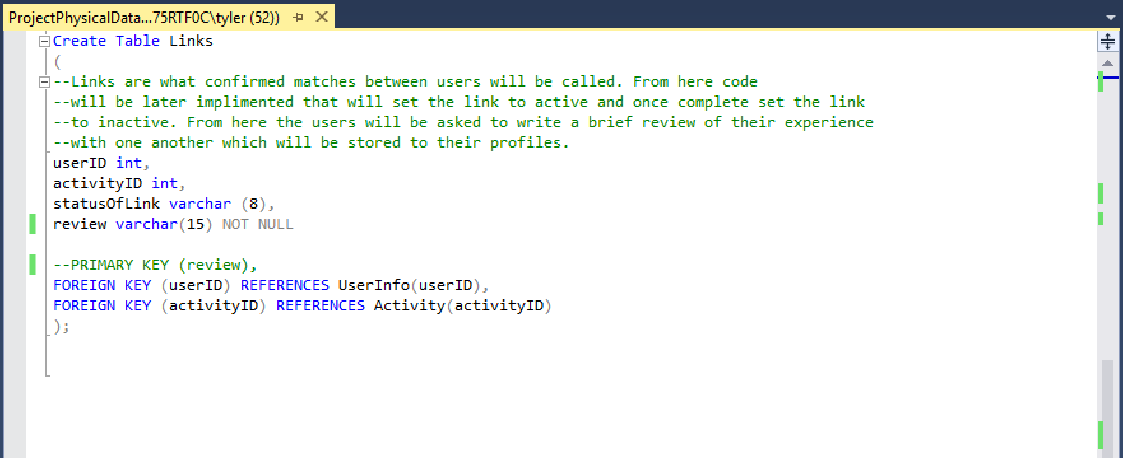
Physical Database Script (cont.)

Slide 10
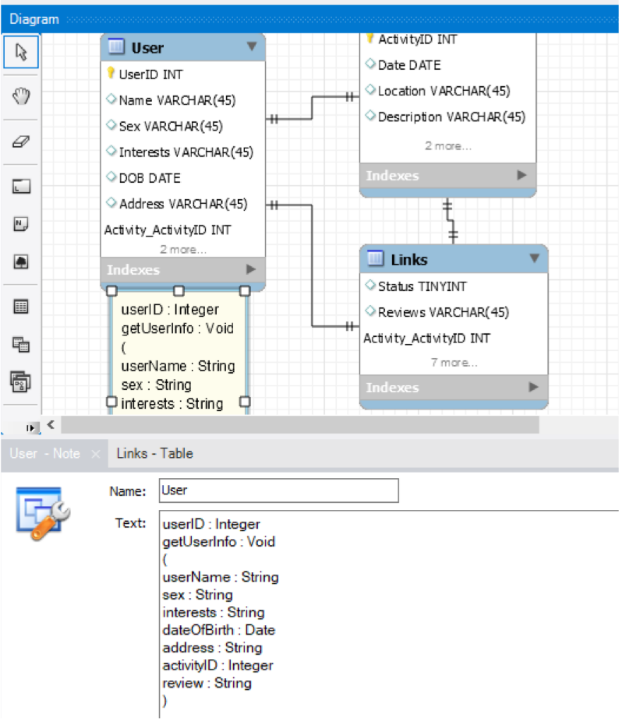
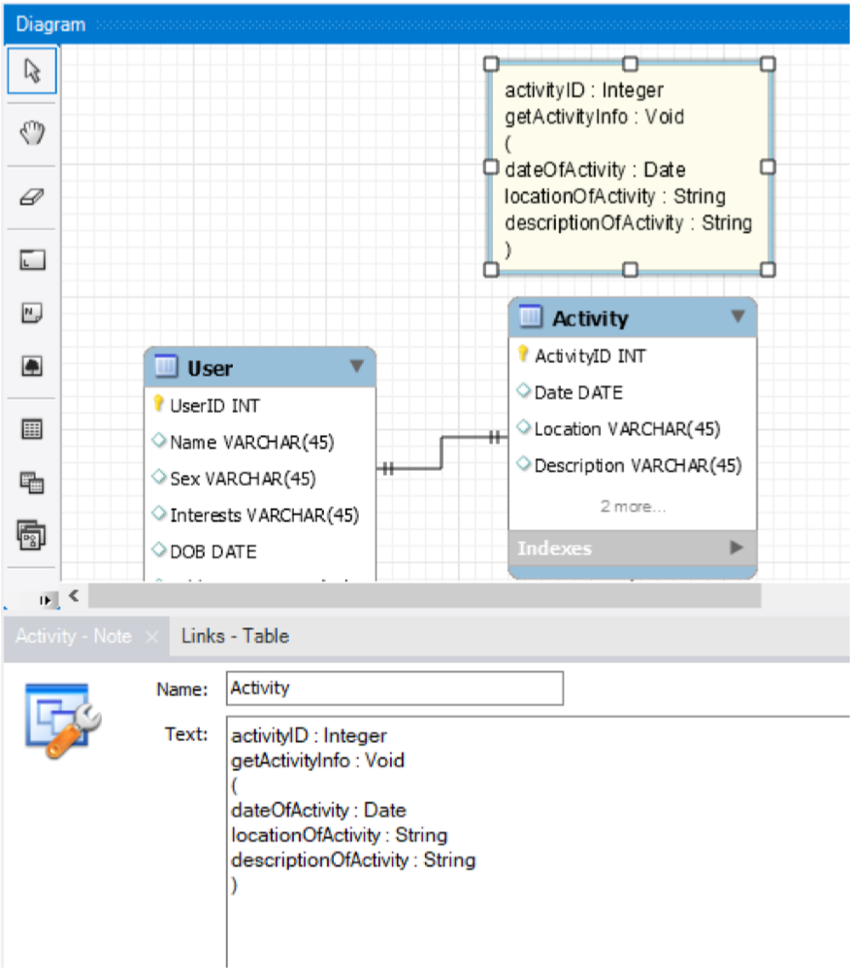
Data Model Class

Slide 11
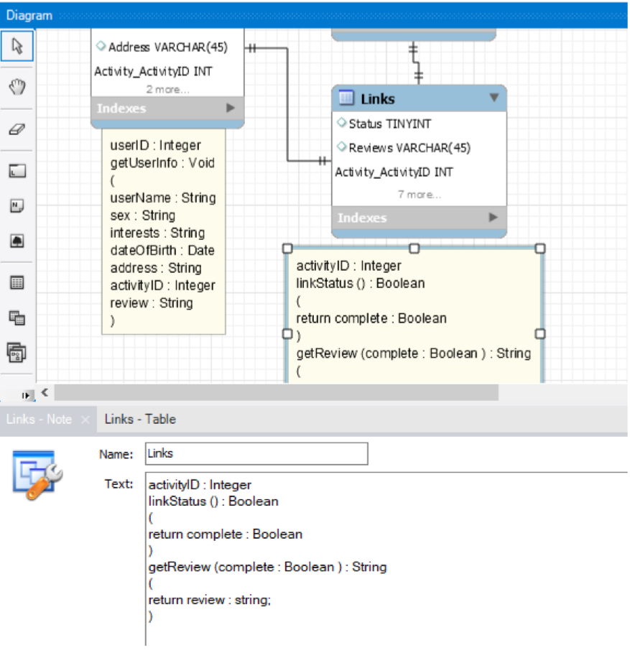
Data Model Class (cont.)

Slide 12

Future of Lets Link
Future updates for Lets Link Include:
GPS tracking.
Security Updates.
Large group Links.
Picture postings of specific activities.
Accommodations for disabled users.
Option to contact business, or property owner to set reservations and pay prior to Link.

Slide 13


User Story
As a individual seeking companionship with others with similar interests.
I want to meet others with positive attitudes, in a organized on the go application in a safe, and secure manner.
So that I can do the things I enjoy to do with others, and meet new people to become potential life long friends.

Slide 14

Usecase
The user will access the application via a mobile device, after which they will sign in or create a new account.
Once logged in the user will create an active activity search, and await a match with an individual with similar interest.
When matched an alert will be displayed to each users mobile device where they can review each others profile and confirm a date, time and location to meet.
Finally everything is arranged the users will wait for the desired date of the activity, meet, hopefully have a great time with each other then mark the activity as complete finalizing their active ‘link’ and then inquiring each to write a review of their experience.

Slide 15
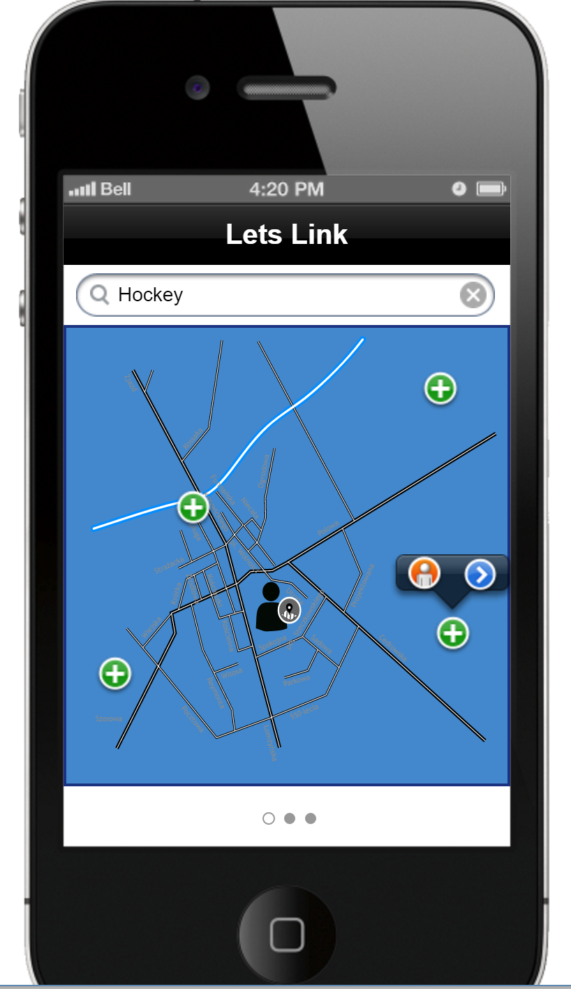
Draft User Interface
The home screen will consist of a quick search bar, that allows the user to quickly search for potential links based off the activity.
This search filters the results so that only posted open links are displayed on a map.
The user then can look at the user’s profile who posted the link, or can directly request the links creator to go to said activity with them forming an active link.

