Slide 1

Capstone Project – I: on
Predictive Analytics for Crop Yield Optimization
Presented by the Batch No. : DS(B2)
G.SRI CHARAN BU21CSEN0500291(TL)
SYED MOISE QURESHI BU21CSEN0500181
T. BHANU SAI BU21CSEN0500100
M. PUSKAR SAI BU21CSEN0500295
Under the Guidance of
Devikanniga D
GITAM
Department of Artificial Intelligence & Data Science
GITAM School of Technology, GITAM (Deemed to be University),
Bengaluru, Karnataka, INDIA.

Slide 2
CONTENTS
Abstract
Introduction
Literature Survey
Problem Statement
Objectives
Requirement Analysis
Identification of tools/technology/algorithms
Final Design Strategy (project workflow/ system design/ DFD/UML design)
Status of Implementation
Testing
Results
Conclusion
PO’s Attainment
Gantt Chart
References

Slide 3
Abstract
This project focuses on using predictive analytics to optimize the yield of groundnut (Arachis hypogaea), a vital oilseed crop grown in many regions.
By leveraging machine learning models, this study aims to predict the potential yield of groundnuts based on various factors, including Crop Area, Crop production, climate conditions (temperature, rainfall), and farm management practices ( fertilizer use, pest control).

Slide 4
Introduction
Groundnut (Arachis hypogaea) is a vital oilseed crop globally, valued for its use in oil production and as a protein-rich food source. Its high demand makes it an important cash crop in regions with favorable climates.
Optimizing groundnut yields is challenging because the crop is sensitive to environmental factors like temperature, rainfall, and farm management practices (fertilizer use, pest control).
This project uses predictive analytics to improve groundnut yields by analyzing historical data, helping farmers make better decisions about managing their crops and resources.

Slide 5
The use of machine learning models helps farmers make better decisions based on data, reducing risks and improving how they use resources for growing groundnuts.
This method not only increases crop yields but also encourages sustainable farming by optimizing the use of water and fertilizers.

Slide 6
Table 1: Literature Survey
S. No. | Paper Details | Summary | Techniques/Algorithms Used | Research Gap
1. | Title: Machine Learning for Large-scale Crop Yield Forecasting. Authors: Paudel, D., Boogaard, H., de Wit, A., Janssen, S., Pylianidis, C., Athanasiadis, I. N. (2021) Dataset: MCYFS database (European Commission’s MARS Crop Yield Forecasting System), crop simulation outputs, weather, remote sensing, and soil data. Publication: ScienceDirect, 2021
This study explores how machine learning can enhance crop yield forecasting by combining it with traditional crop modeling.
The approach was tested on five crops(soft wheat, spring barley, sunflower, sugar beet, potatoes) across three countries.
Support Vector Machine (SVM).
Random Forest.
Decision Tree
The current MAR(Monitoring Agricultural Resources) forecasting system did not use machine learning, missing the opportunity to handle large datasets more effectively.
Future research should focus on improving early-season predictions and combining machine learning with diverse data like weather and crop models for better results across different crops and regions.

Slide 7
Table 2: Literature Survey
S. No. | Paper Details | Summary | Techniques/Algorithms Used | Research Gap
2. | Title: Enhanced Crop Prediction and Soil Analysis Using Machine Learning and Deep Learning. Authors: Prajapati, Y. N., Tomar, S., Singh, P., Gupta, A., Kumar, V., & Arora, N. (2023) Dataset: Data from Kaggle, containing agricultural data with variables such as temperature, rainfall, pH, relative humidity, and crop-related information Publication: IEEE, 2023.
The study presents a crop yield prediction model that uses machine learning (SVM) and deep learning (LSTM, RNN) to help farmers estimate the best crops for their land.
By analyzing factors such as soil nutrients and climate, the model improves yield predictions compared to traditional methods.
SVM
LSTM
Random Forest
Decision Tree
The current model performs well but could be enhanced by combining deep learning techniques like Bi-LSTM.
Further research could focus on refining prediction accuracy and exploring more granular sentiment analysis in the data.

Slide 8
Problem Statement
Groundnut farmers face challenges in maximizing crop yields due to the crop's sensitivity to environmental factors like temperature, rainfall and farm management practices. These challenges, combined with the need for efficient use of resources such as water and fertilizers, make it difficult for farmers to achieve consistent and optimal production.
This project aims to enhance the productivity of groundnut yields ,by applying machine learning models. By analyzing historical data, farmers can make informed, data-driven decisions to improve productivity, reduce risks, and promote sustainable farming practices.

Slide 9
Objectives
The primary objective of this project is to forecast and enhance the crop yield by using predictive analytics based on several factors, such as weather conditions, Crop Area, Crop production, fertilizer use, and pesticide use.
To improve farming decisions by using data and technology to predict how well crops will grow.
To develop a model that helps farmers enhance crop productivity.
This project enable sustainable farming by predicting potential risks and resource optimization.

Slide 10
Requirement Analysis
Software Requirements
Functional Requirements:
Data Collection: Gather data from various sources, including weather stations (temperature, rainfall), and crop records (yield history, farm practices).
Data Preprocessing: Clean and preprocess the collected data by handling missing values, normalizing data, and extracting relevant features for better model performance.
Machine Learning Model Development: Build and train machine learning models such as Random Forest, ANN which will be used to predict groundnut yield.

Slide 11
Non-functional Requirements:
Scalability: The system should be able to handle large amounts of data as more farmers and regions provide input without slowing down or crashing.
Prediction Accuracy: The predictions must be reliable and within an acceptable error range so farmers can trust the results to make critical decisions.
Real-time Data Processing: The system should update predictions quickly whenever new data (like weather changes or soil updates) is added, ensuring farmers always have up-to-date information.

Slide 12
Identification of tools/technology/algorithms
Tools:
Python:
Use Python for data processing, model building, and predictions. Key libraries include:
Pandas for data manipulation and analysis.
Scikit-learn for machine learning algorithms like Random Forest, ANN, etc.
TensorFlow/Keras for advanced machine learning or deep learning models.

Slide 13
Technology:
Machine Learning:
Machine learning models like:
Random Forest for robust classification and regression of crop yield predictions.
Artificial Neural Networks (ANN) for predictive analytics based on multiple variables like weather and fertilizer use.

Slide 14
Algorithms:
Random Forest: A robust ensemble algorithm that builds multiple decision trees, reducing overfitting and improving accuracy. It handles large datasets, identifies key features, and enhances yield predictions by capturing complex relationships.
Artificial Neural Networks (ANN):Effective for capturing complex, non-linear relationships between Fertilizer Quantity and weather data for yield prediction.

Slide 15
Final Design Strategy (project workflow/ system design/ DFD/UML design)
Project Workflow for Groundnut Crop Yield Prediction
1)Data Collection:
Collect historical and real-time data related to groundnut crop yield from various sources:
Weather data: Temperature(°C) and rainfall(in mm).
Fertilizer Quantity: Primary Nutrients (Nitrogen (%), Phosphorus (%), Potassium (%)) and Secondary and Micronutrients(Calcium (%), Sulphur (%), Zinc (%), Boron (%)).
Historical yield data: Groundnut yields data from agricultural records or public datasets like FAO or Kaggle.

Slide 16
2)Data Preprocessing:
Clean and prepare the collected data for use in the model. This includes:
Handling missing or inconsistent data.
Normalizing data to ensure uniformity in scale (e.g., rainfall in mm, temperature in °C).
Feature extraction: Deriving useful features like seasonal variations(Kharif, Rabi, Summer) and cumulative rainfall.

Slide 17
3)Model Selection:
Choose the best machine learning models for predicting groundnut yield:
Random Forest: A robust ensemble algorithm that builds multiple decision trees, reducing overfitting and improving accuracy. It handles large datasets, identifies key features, and enhances yield predictions by capturing complex relationships.
Artificial Neural Networks (ANN):Effective for capturing complex, non-linear relationships between Fertilizer Quantity and weather data for yield prediction.

Slide 18
4)Model Training:
Train selected machine learning models using groundnut yield datasets.
Use publicly available datasets, such as Kaggle's agricultural datasets, government agricultural reports, or research-based yield data specific to groundnut farming in different regions.
Incorporate variables like weather patterns , Crop production, and farm practices for model training.

Slide 19
5)Model Testing:
Validate the trained models using unseen data:
Use a separate portion of the dataset (20-30%) for testing.
Mean Squared Error (MSE): Penalizes large errors.
Root Mean Squared Error (RMSE): Provides error in the same units as the target.
Mean Absolute Error (MAE): Averages absolute prediction errors.
R-squared (R²): Measures the proportion of variance explained by the model.
Accuracy: Ensure that the model predictions align with actual data.

Slide 20
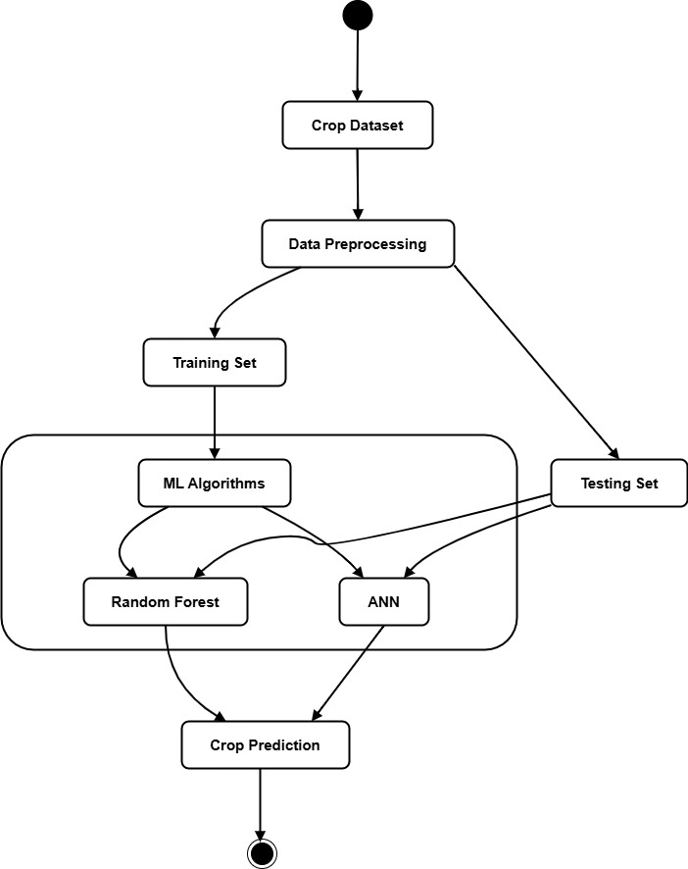
Design Strategy
Fig-1: Models Used for Crop Forecasting

Slide 21
Status of Implementation
Dataset Collection and Preparation: Successfully collected and preprocessed the groundnut crop dataset, ensuring it is ready for analysis and model building.
Exploratory Data Analysis (EDA): Performed detailed analysis using pandas, matplotlib, and seaborn to uncover trends and patterns in crop yield influenced by various factors.
Model Implementation: Developed predictive models using scikit-learn to analyze the impact of key variables on crop yield.
Data Management: Managed data storage and processing using openpyxl for efficient handling of Excel-based datasets.

Slide 22
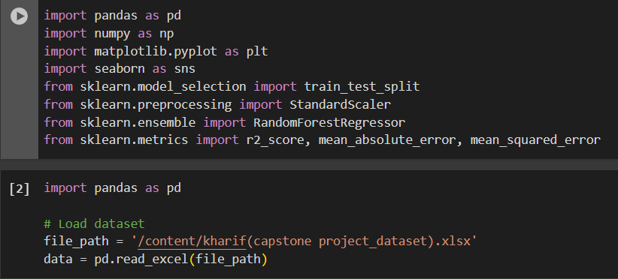

Status of Implementation

Slide 23
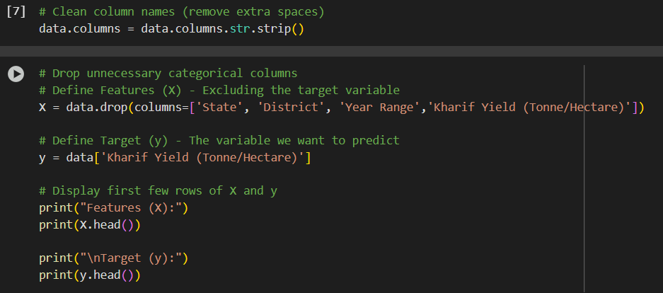
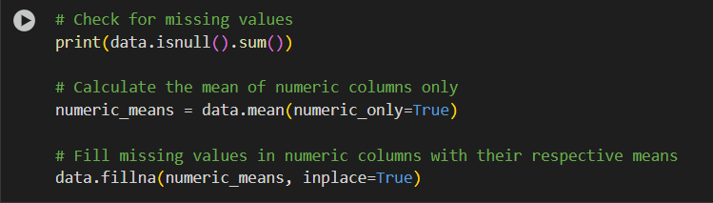

Slide 24
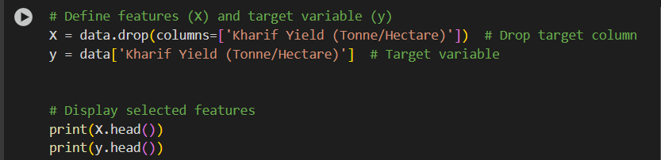
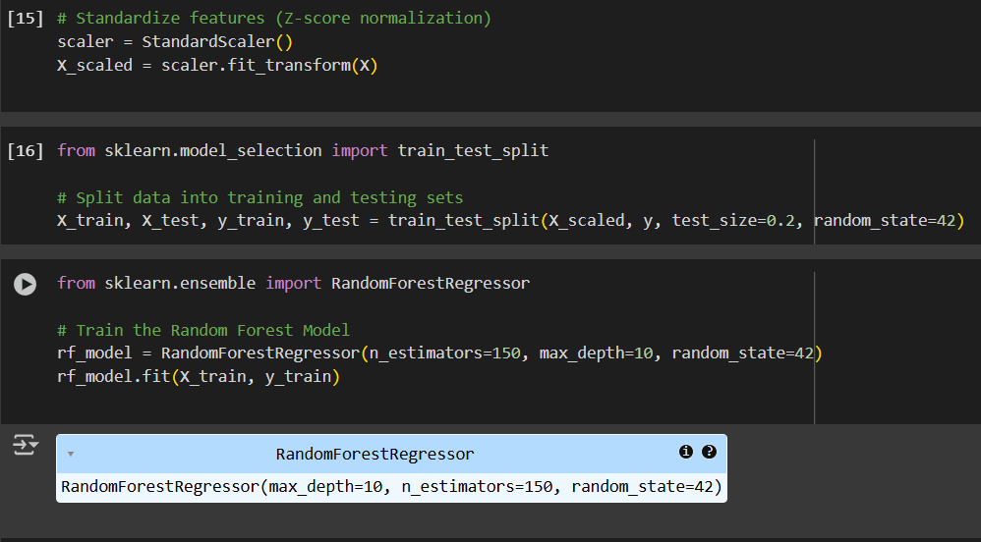

Slide 25
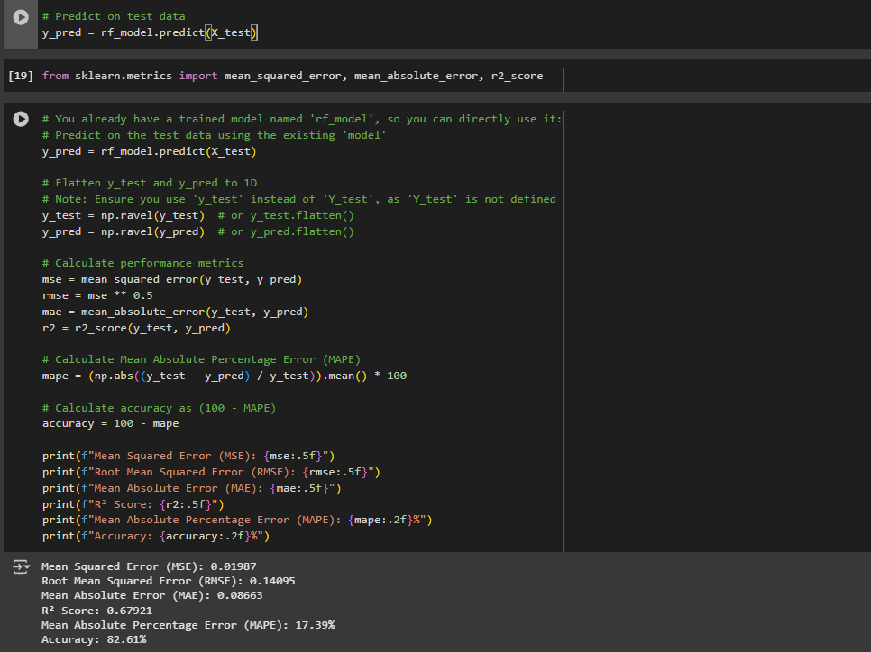

Slide 26
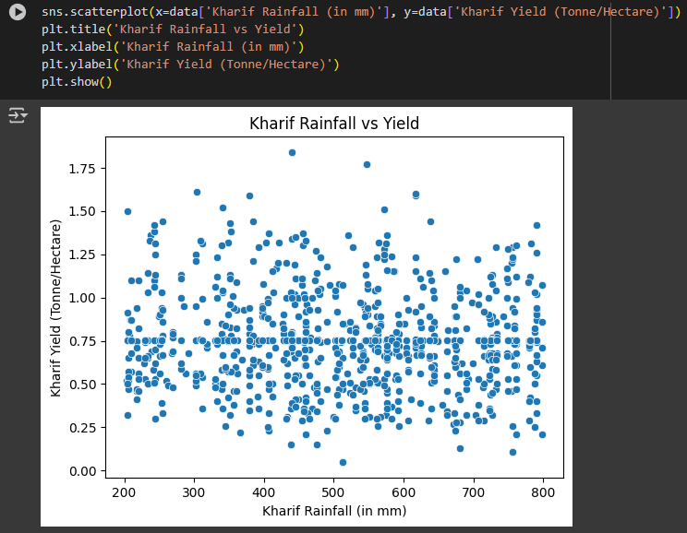

Slide 27
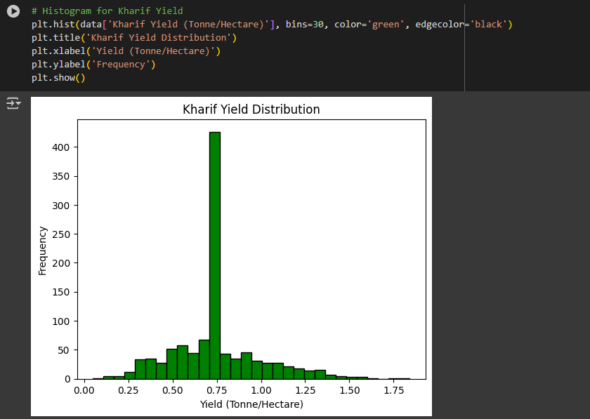

Slide 28
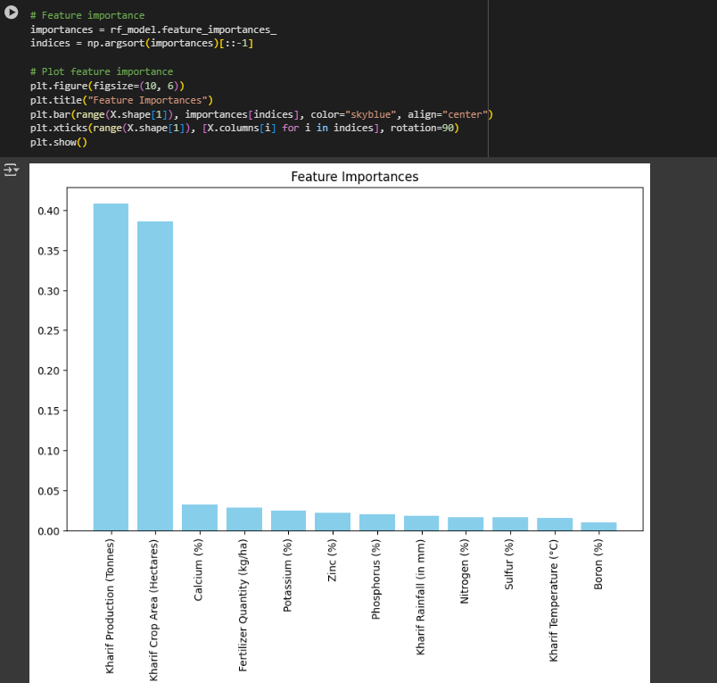

Slide 29
Status of Implementation
Google Collab Link:
Random Forest:
https://colab.research.google.com/drive/1FXJ8TJ5rQ_JYsleS3ZghXoEffkZ_rPd0?usp=sharing
Artificial Neural Networks (ANN):
https://colab.research.google.com/drive/1wOlfgysPWhvO0-wnYxhBWa_zNCcJgQJ_?usp=sharing

Slide 30
Testing
Statistical Testing
Performance Metrics Used:
Mean Squared Error (MSE): Measures the average squared difference between actual and predicted values.
Root Mean Squared Error (RMSE): Determines how far predictions deviate from actual yield values.
2) Unit Testing
Model Training Validation: Ensured the dataset split (train-test split) and model training steps worked as expected.
Feature Importance Analysis: Verified if the model correctly identified the most important features affecting yield

Slide 31
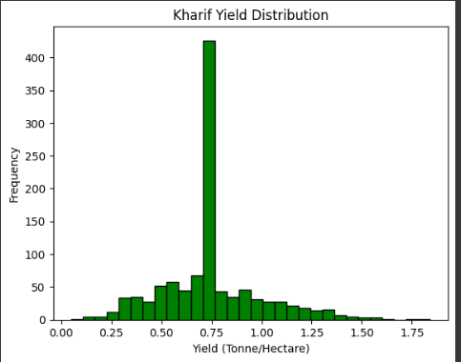
Results
Random Forest Model
Fig-2: Distribution of Kharif Yield (Tonne/Hectare) highlighting the frequency of different yield ranges.

Slide 32
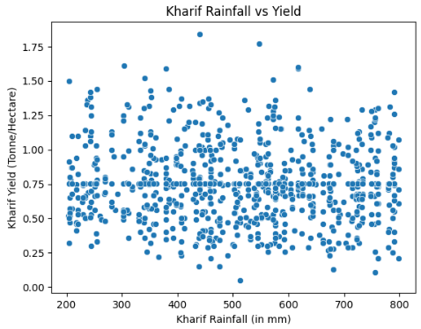
Fig-3: Scatter plot showing the relationship between Kharif Rainfall (in mm) and Kharif Yield (Tonne/Hectare).

Slide 33
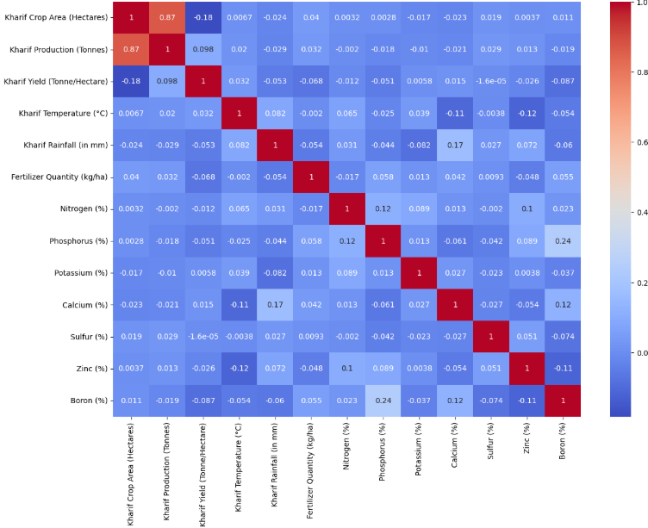
Fig-4: Correlation Heatmap showing relationships between different agricultural factors affecting Kharif yield

Slide 34
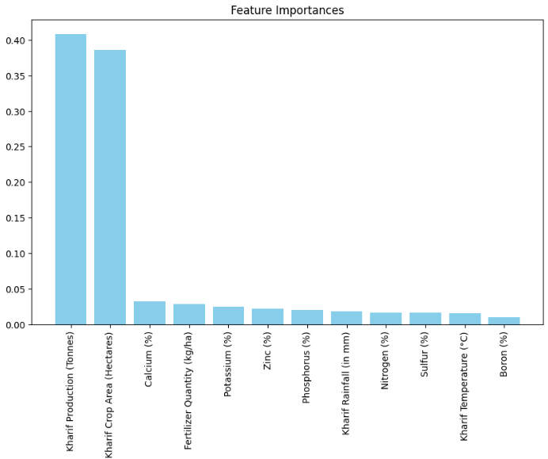
Fig-5: Feature importance analysis from the Random Forest model highlighting the key factors affecting Kharif Yield.

Slide 35
Conclusion
Machine learning and AI have greatly improved the accuracy of crop yield predictions, with techniques like Random Forest and ANN models for delivering solid results.
It's also important to address issues like overfitting and scaling up the models so they can handle larger datasets without losing accuracy.
By overcoming these challenges, we can build more innovative, more reliable prediction tools that can help farmers, make better decisions and improve crop production.

Slide 36
PO’S Attainment
PO1. Domain Knowledge: Apply the knowledge of data science, machine learning, and predictive analytics to solve complex agricultural challenges related to crop yield optimization.
PO2. Problem Analysis: Identify, analyze, and formulate solutions for optimizing groundnut crop yield by leveraging historical data on crop area, fertilizers, and pesticides, utilizing first principles of data analytics and machine learning.
PO3. Model Development: Develop predictive models, primarily using the Random Forest algorithm, complemented by Artificial Neural Networks (ANN), to enhance decision-making for farmers regarding yield improvement strategies.
PO4. Experimental Analysis: Conduct research-based investigations, including data preprocessing, feature selection, model training, and validation, to derive meaningful insights from agricultural datasets.

Slide 37
PO5. Tool Utilization: Utilize modern data science tools and programming languages such as Python, along with machine learning libraries (Scikit-learn, Pandas, Matplotlib), to implement and evaluate predictive models effectively.
PO6. Agriculture and Society: Assess the impact of predictive analytics on farming communities, considering economic, social, and ethical implications of technology-driven agricultural solutions.
PO7. Sustainability and Environment: Understand the role of data-driven solutions in promoting sustainable farming practices, optimizing resource usage, and enhancing yield while minimizing environmental impact.
PO8. Ethical Considerations: Uphold ethical standards in data collection, model transparency, and fair usage of predictive analytics to ensure responsible and unbiased decision-making in agriculture.

Slide 38
PO9. Collaboration and Teamwork: Function effectively as an individual or within a multidisciplinary team, collaborating with agronomists, data scientists, and policymakers to develop scalable agricultural solutions.
PO10. Communication: Communicate findings effectively through reports, data visualizations, and presentations to stakeholders, including farmers, agricultural researchers, and policymakers.
PO11. Project Management: Demonstrate knowledge of project management principles in implementing predictive analytics solutions, ensuring efficiency in model deployment and decision support systems.
PO12. Continuous Learning: Recognize the importance of continuous learning in emerging fields such as AI-driven agriculture, cloud computing, and IoT-based farming solutions for long-term innovation.

Slide 39
Program Specific Outcomes (PSOs)
PSO1. Apply predictive analytics techniques, utilizing Random Forest and ANN models, to analyze key agricultural factors such as crop area, fertilizers, and pesticides to optimize groundnut yield.
PSO2. Design and implement data-driven agricultural solutions for Karnataka’s Kharif season, integrating advanced machine learning algorithms with domain-specific knowledge to enhance crop productivity.
PSO3. Develop expertise in handling large-scale agricultural datasets, ensuring ethical and responsible data-driven decision-making to benefit farmers and contribute to sustainable agriculture.

Slide 40
CO-PO-PSO Mapping:
 | PO1 | PO2 | PO3 | PO4 | PO5 | PO6 | PO7 | PO8 | PO9 | PO10 | PO11 | PO12 | PSO1 | PSO2 | PSO3
CO1 | 3 | 3 | 3 | 3 | 3 | 3 | 3 | 3 | 3 | 3 | 3 | 3 | 3 | 3 | 3
CO2 | 3 | 3 | 3 | 3 | 3 | 3 | 3 | 3 | 3 | 3 | 3 | 3 | 3 | 3 | 3
CO3 | 3 | 3 | 3 | 3 | 3 | 3 | 3 | 3 | 3 | 3 | 3 | 3 | 3 | 3 | 3
CO4 | 3 | 3 | 3 | 3 | 3 | 3 | 3 | 3 | 3 | 3 | 3 | 3 | 3 | 3 | 3
CO5 | 3 | 3 | 3 | 3 | 3 | 3 | 3 | 3 | 3 | 3 | 3 | 3 | 3 | 3 | 3

Slide 41
PO’S ATTAINMENT:
Title of the Project: Predictive Analytics for Crop Yield Optimization
Program Outcomes |  |  |  |  |  |  |  |  |  |  |  | Program Specific Outcomes
PO 1 | PO 2 | PO 3 | PO 4 | PO 5 | PO 6 | PO 7 | PO 8 | PO 9 | PO 10 | PO 11 | PO 12 | PS O1 | PS O2 | PS O3
✔ | ✔ | ✔ | ✔ | ✔ | ✔ | ✔ | ✔ | ✔ | ✔ | ✔ | ✔ | ✔ | ✔ | ✔

Slide 42
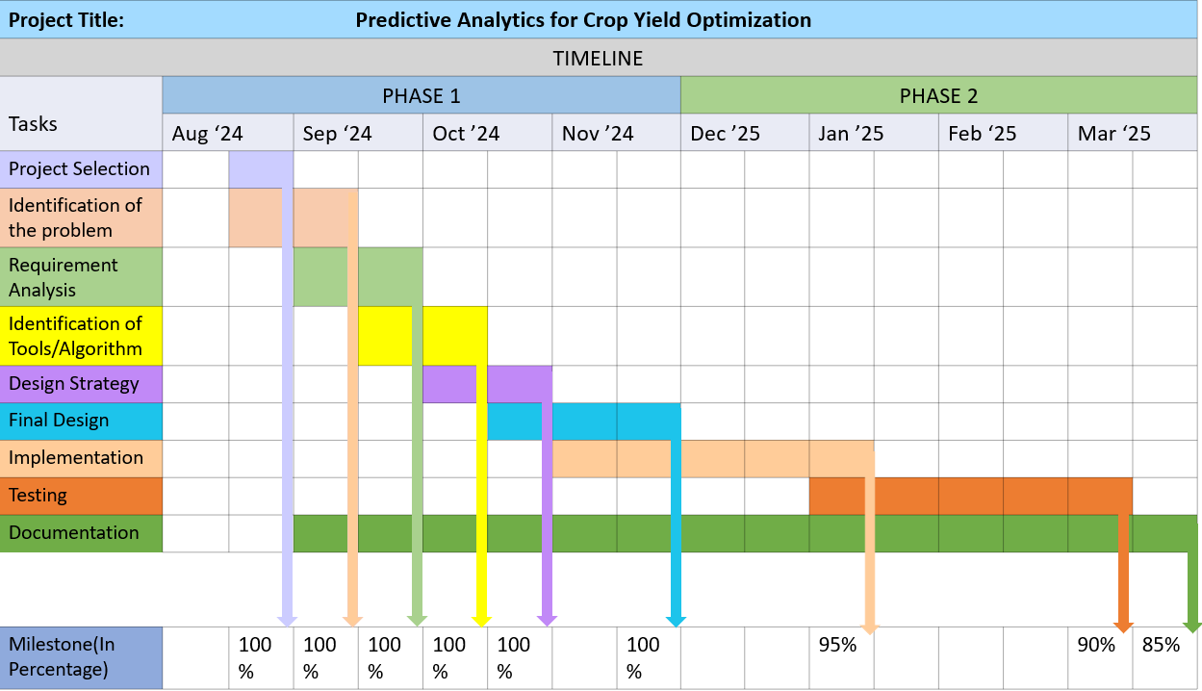
GANTT CHART

Slide 43
References
Paudel, D., Boogaard, H., de Wit, A., Janssen, S., Osinga, S., Pylianidis, C., & Athanasiadis, I. N. (2021). Machine learning for large-scale crop yield forecasting. Agricultural Systems, 187, 103016.
Prajapati, Y. N., Tomar, S., Singh, P., Gupta, A., Kumar, V., & Arora, N. (2023, September). A New Approach of Machine Learning And Deep Learning Algorithms Based Crop Yield Prediction. In 2023 International Conference on Quantum Technologies, Communications, Computing, Hardware and Embedded Systems Security (iQ-CCHESS) (pp. 1-4). IEEE.

Slide 44
Krithika, K. M., Maheswari, N., & Sivagami, M. (2022). Models for feature selection and efficient crop yield prediction in the groundnut production. Research in Agricultural Engineering, 68(3).
Biradar, S. S., Ragini, H. R., & Harshith, K. V. (2024). Modeling and Optimization of Groundnut Production in Vijayapura District of Karnataka, India. J. Exp. Agric. Int, 46(5), 202-219.
Sajindra, H., Abekoon, T., Wimalasiri, E. M., Mehta, D., & Rathnayake, U. (2023). An artificial neural network for predicting groundnut yield using climatic data. AgriEngineering, 5(4), 1713-1736.

Slide 45
Thank You

