Slide 1
Coursera Capstone Project New Business, Toronto Location Recommendations
By: Trevor Birchall
August 2019

Slide 2

Background
With millions of citizens, Toronto has been growing at an ever-changing rate
This python program recommends new business locations based to the type of business, and your desired criteria.

Slide 3
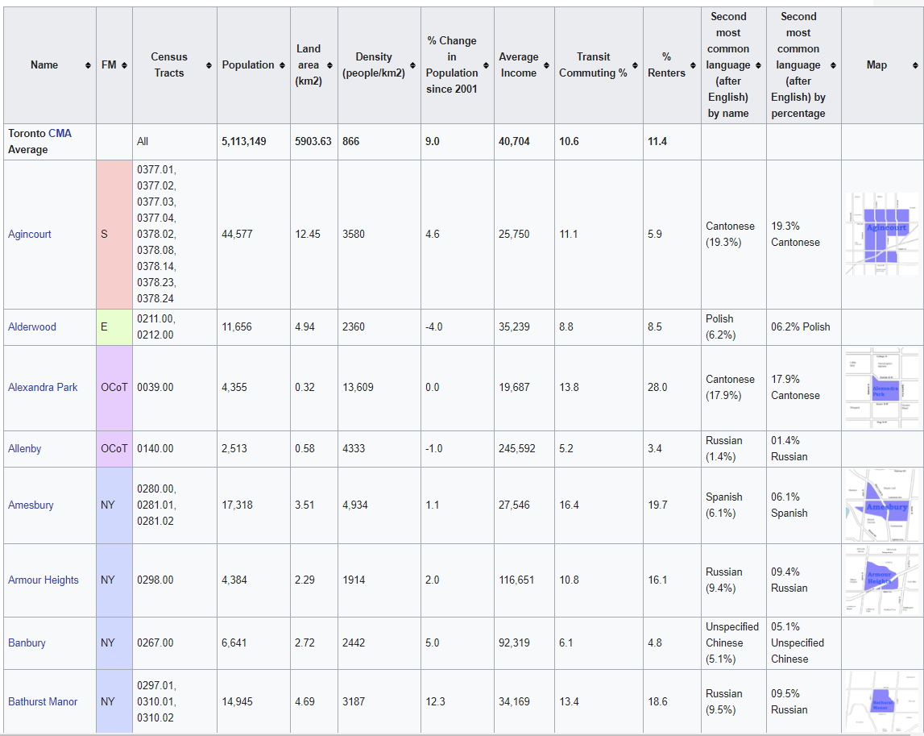
Data required
In order to recommend new business locations we first need the following data
Toronto Neighbourhoods
Population
Population density
Average income
Business Information

Slide 4

Data Preperation
We can scrape most of this data from:
https://en.wikipedia.org/wiki/Demographics_of_Toronto_neighbourhoods
From this we can use the foursquare API to collect business/venue data

Slide 5
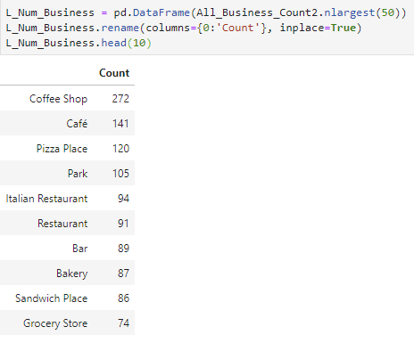
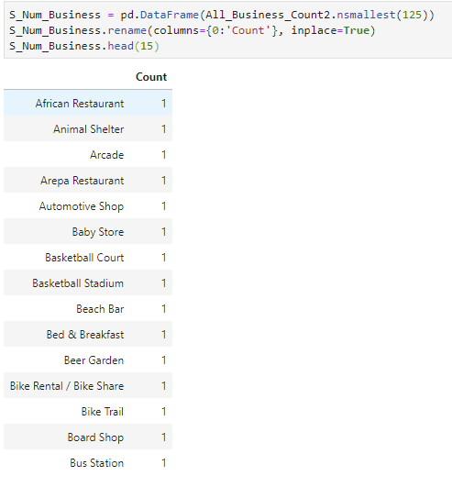
Business Insights
We can list the business types with most and least competitors in Toronto
From this we can suggest potential business types, that have less competition

Slide 6
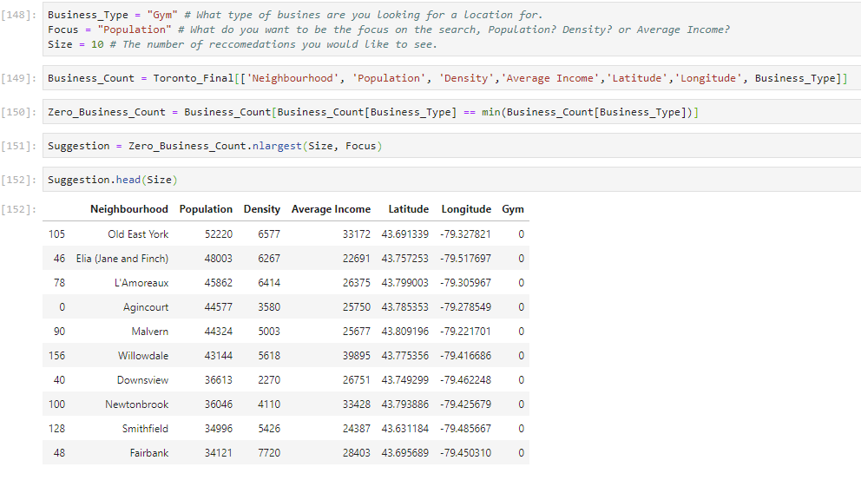
Recommendation
With these insights the program can accept a business type, focus and size
Using these it can suggest good neighbourhoods in Toronto, to open a business of that type

Slide 7
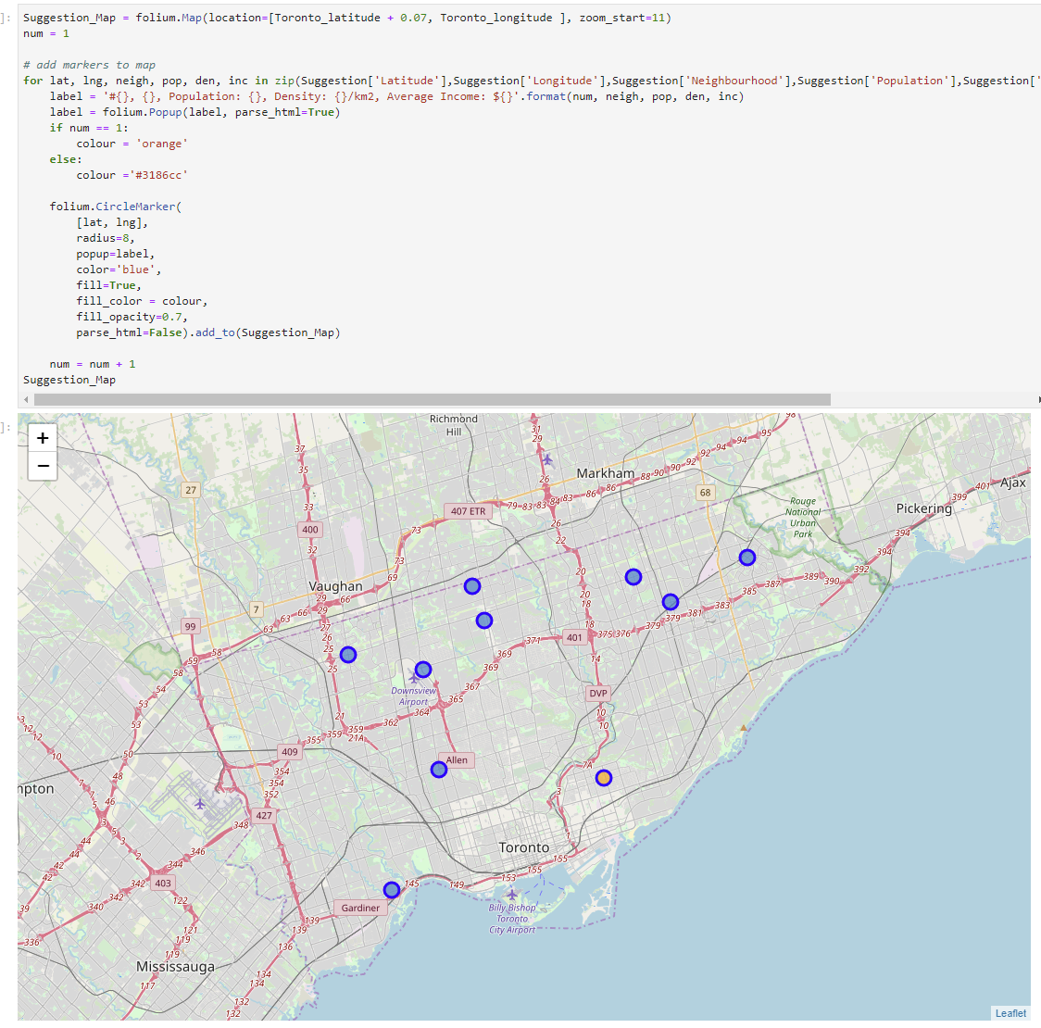
Mapping
We can also the recommendations on a map of Toronto

Slide 8

Conclusion
With Toronto’s large size, and many different distinct neighbourhoods, finding a good location for a new business can be tough.
This system recommends areas in Toronto that meet the given criteria, for a specific business
Considering must be made for the Foursquare data

