Slide 1
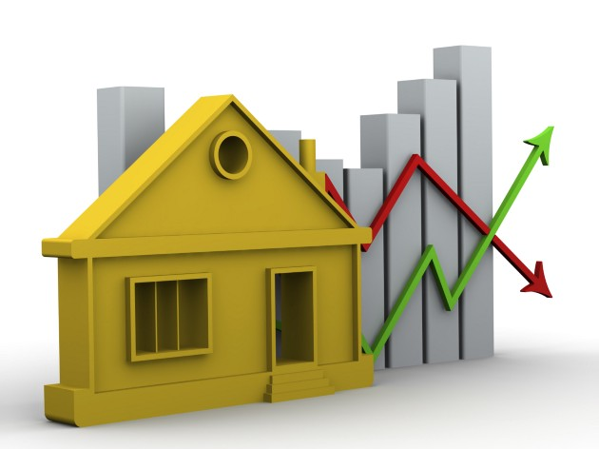
KING-COUNTY-HOUSE-PRICE-PREDICTION
Presented by: Vivian King’asia
Last updated: 03rd July, 2022

Slide 2
Agenda
Introduction
Key Findings
Conclusion
Recommendations

Slide 3
Introduction
King County is a county in the Washington State in the US.
Real estate investors need to understand factors that affect house prices.
To ensure that they invest in the kind of homes that would fetch higher returns for their investments and homes sell the most.
Multiple Linear Regression model was used to predict home prices in this area.
The main stakeholders in this analysis are real estate investors and construction companies.

Slide 4
Key Findings Correlation level of factors in relation to House Prices
Least Correlated Most correlated
Square ft Living Space
Grade
Square ft Above
Square ft Living15
Bathrooms
Bedrooms
Floors
View
Square ft Lot15
Zipcode
Year built

Slide 5
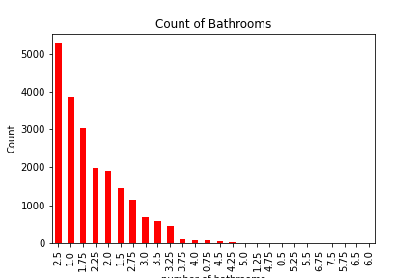
Key Findings Count of Number of Bathrooms in Purchased Houses in King County

Slide 6
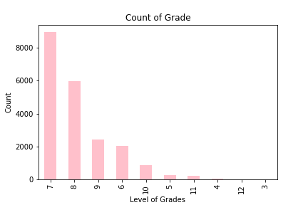
Key Findings Count of overall grade given to the housing unit based on King County grading system

Slide 7
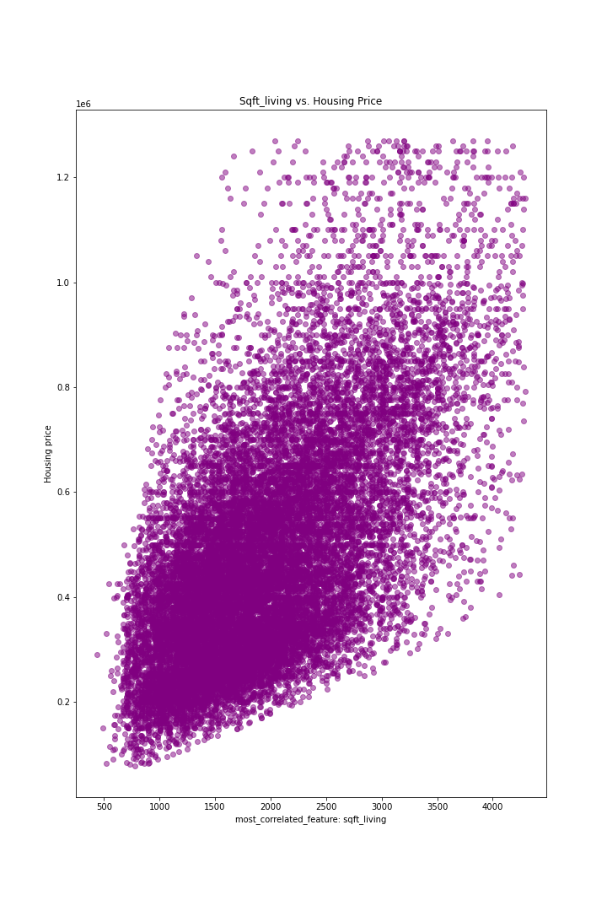
Key Findings Relationship between square ft living space and Price
There is a strong statistical correlation between price and square ft living, when square ft_living increases so does price
Square ft_living
Price

Slide 8
Conclusion
The best predictors for home prices in King County are sqft_living, grade and bathrooms.
The model's findings go against real world assumptions such as bedrooms and geographical locations being huge factors in influencing price.
Real estate investors in KC should use predictors such as sqft_living to determine price of future investments.
Although grade and bathrooms show high correlation with price, there are variations in the bathrooms and grades with 2.5 bathrooms houses being the most sold houses and grade 7 houses being the most sold.

Slide 9
Recommendations
Real estate investors should invest in homes with the optimal grade level; 7, to sell more houses in the area.
Real estate investors have to invest well in the bathrooms with the optimal number of 2.5 to sell more houses.
Although the data shows that the higher the sqft_living space the higher the price, it is evident that population in King County do not buy expensive homes, as reflected in the grade and bathrooms data. Hence, investors should price their homes reasonably to ensure higher sales.

