Slide 1
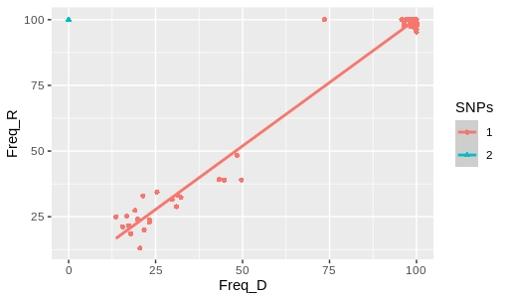
Cluster 01: CL002
Donor:G1011 08/07/2015
Receptor:G1449 22/07/2015
Cluster_distance : 1
Bottleneck_distance: 1

Slide 2
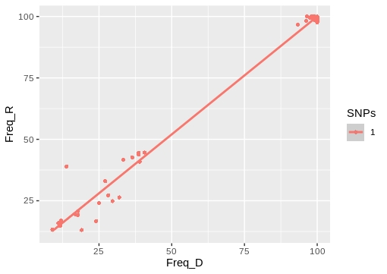
Cluster 02: CL039
Donor:G945 31/05/2015
Receptor:G1023 18/06/2015
Cluster_distance:0
Bottleneck_distance:0

Slide 3
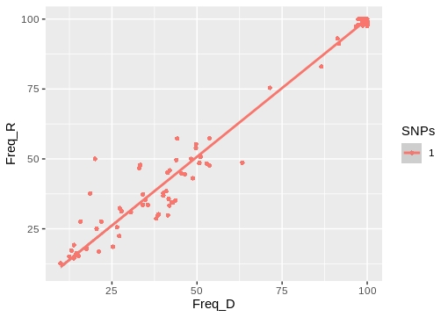
Cluster 03: CL029
Donor:G1128 04/05/2015
Receptor:G1562 10/12/2015
Cluster_distance:0
Bottleneck_distance:0

Slide 4

Cluster 04: CL010
Donor:G1180 09/09/2015
Receptor:G1181 01/09/2015
Cluster_distance:0
Bottleneck_distance:0

Slide 5
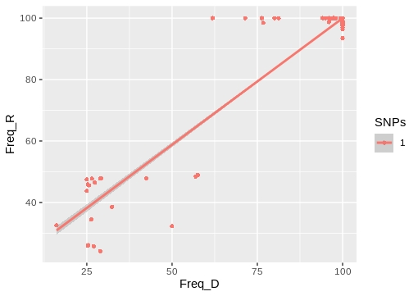
Cluster 05: CL119
Donor: G1285 12/08/2015
Receptor: G1334 16/11/2015
Cluster_distance:0
Bottleneck_distance:0

Slide 6
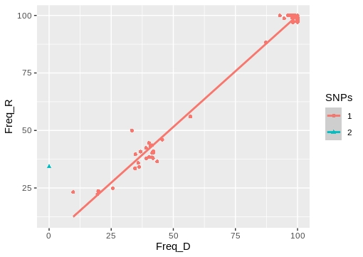
Cluster 06: CL078
Donor:G1494 NA
Receptor:G1495 NA
Cluster_distance:0
Bottleneck_distance:1

Slide 7
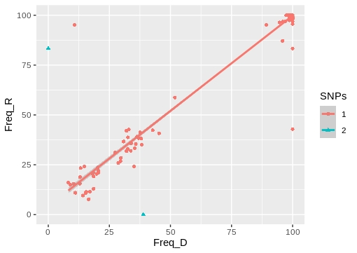
Cluster:07_1 CL037
Donor:G766 30/03/2015
Receptor:G817 18/02/2015
Cluster_distance:0
Bottleneck_distance:2

Slide 8
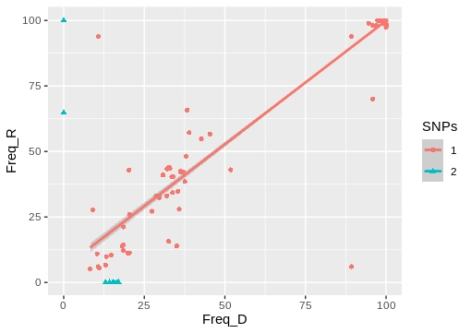
Cluster 07_2: CL037
Donor:G766 30/03/2015
Receptor:G1513 30/01/2016
Cluster_distance:0
Bottleneck_distance:9

Slide 9
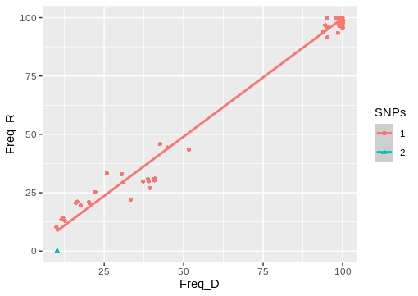
Cluster 08: CL072
Donor:G1544 25/05/2016
Receptor:G1630 27/05/2016
Cluster_distance:0
Bottleneck_distance:1

Slide 10
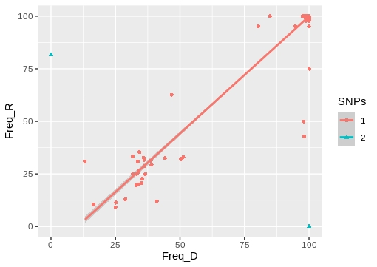
Cluster 09: CL116
Donor:G1564 09/12/2015
Receptor:G1742 29/01/2016
Cluster_distance:0
Bottleneck_distance:2

Slide 11
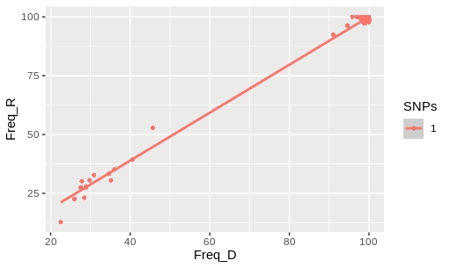
Cluster 10: CL016
Donor:G1570 11/02/2016
Receptor:G1578 10/02/2016
Cluster_distance:0
Bottleneck_distance:0

Slide 12
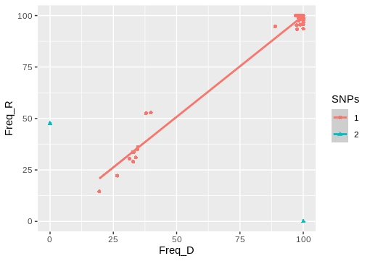
Cluster 11_1: CL091
Donor:G1604 04/05/2016
Receptor:G1986 20/04/2017
Cluster_distance:0
Bottleneck_distance:2

Slide 13
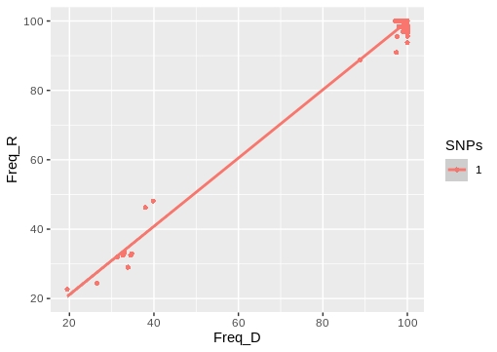
Cluster 11_2: CL091
Donor:G1604 04/05/2016
Receptor:G2020 09/05/2017
Cluster_distance:0
Bottleneck_distance:0

Slide 14
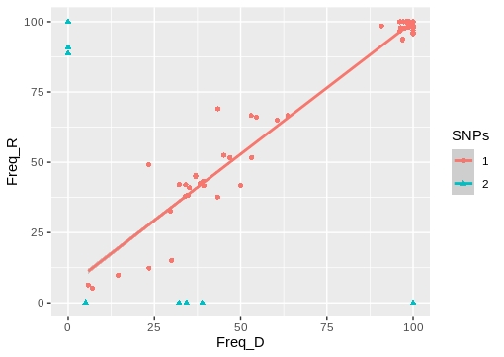
Cluster 12_1: CL069
Donor:G1653 11/08/2016
Receptor:G1648 11/07/2016
Cluster_distance:3
Bottleneck_distance:11

Slide 15
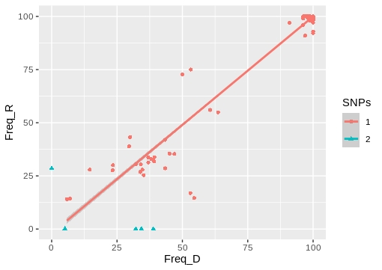
Cluster 12_2: CL069
Donor:G1653 11/08/2016
Receptor:G1785 27/09/2016
Cluster_distance:0
Bottleneck_distance:6

Slide 16
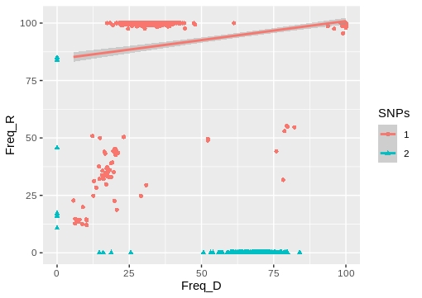
Cluster:13
Donor:G1804
Receptor:G1803
Cluster_distance:0
Bottleneck_distance:294

Slide 17
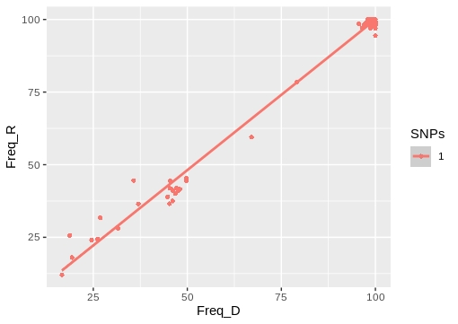
Cluster 14: CL153
Donor:G2154 27/06/2017
Receptor:G2160 05/07/2017
Cluster_distance:0
Bottleneck_distance:0

Slide 18
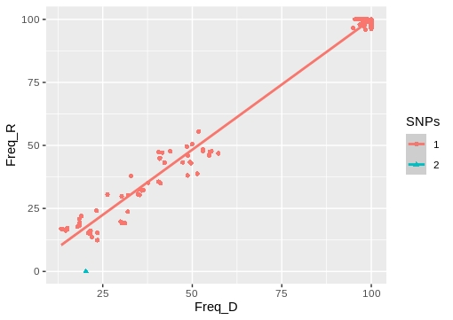
Cluster 15: CL122
Donor:G2157 24/03/2017
Receptor:G2159 09/06/2017
Cluster_distance:0
Bottleneck_distance:1

Slide 19
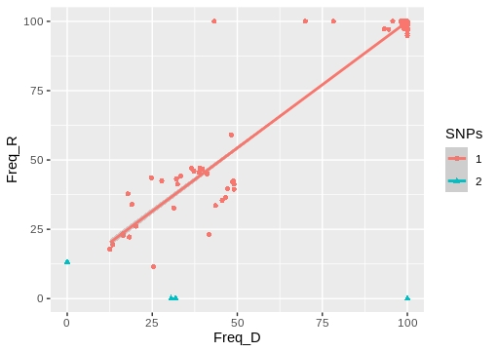
Cluster 16: CL017
Donor:G262 NA
Receptor:G641 27/10/2014
Cluster_distance:0
Bottleneck_distance:4

Slide 20
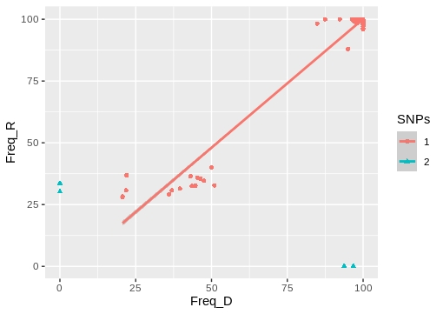
Cluster 17: CL038
Donor: G84 26/02/2014
Receptor:G474 26/02/2014
Cluster_distance:0
Bottleneck_distance:4

Slide 21
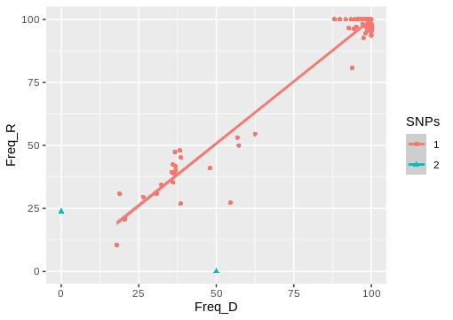
Cluster 18_1: CL019
Donor:G990 30/04/2015
Receptor:G991 28/04/2015
Cluster_distance:0
Bottleneck_distance:2

Slide 22
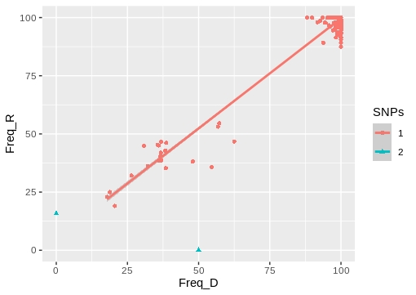
Cluster 18_2: CL019
Donor:G990 30/04/2015
Receptor:G992 19/06/2015
Cluster_distance:0
Bottleneck_distance:2

Slide 23
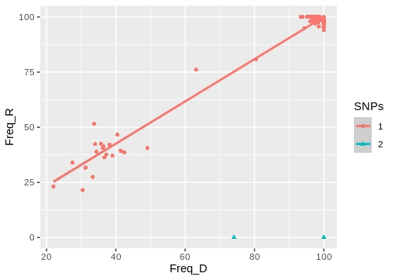
Cluster 19: CL042
Donor:G1258 16/04/2014
Receptor:G128 16/03/2014
Cluster_distance:1
Bottleneck_distance:2

Slide 24
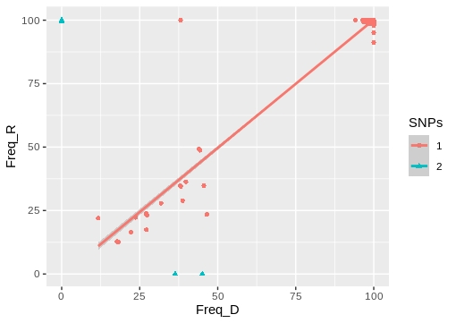
Cluster 20: CL110
Donor:G1359 29/12/2015
Receptor:G1496 11/01/2016
Cluster_distance:1
Bottleneck_distance:4

Slide 25
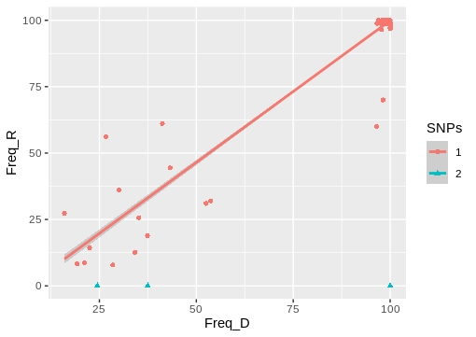
Cluster 21: CL034
Donor:G1537 24/04/2016
Receptor:G1786 11/08/2016
Cluster_distance:1
Bottleneck_distance:4

Slide 26
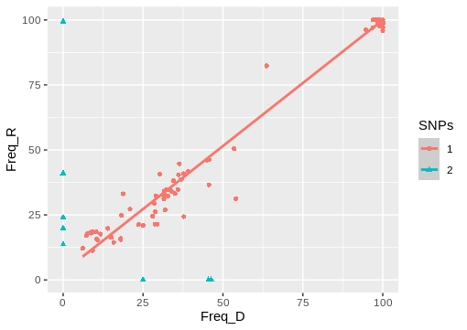
Cluster 22: CL007
Donor:G1590 24/01/2013
Receptor:G249 27/06/2014
Cluster_distance: 1
Bottleneck_distance:8

Slide 27
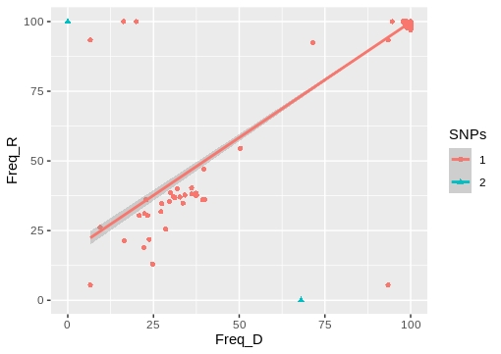
Cluster 23: CL129
Donor:G1711 15/06/2016
Receptor:G2146 25/04/2017
Cluster_distance:1
Bottleneck_distance:2

Slide 28
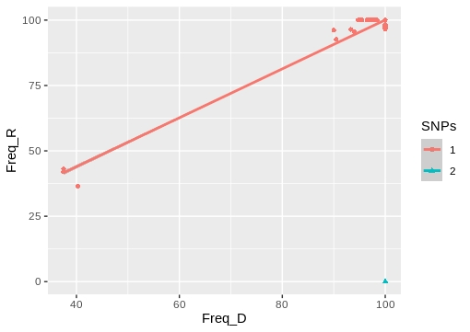
Cluster 24: CL158
Donor:G2316 18/08/2017
Receptor:G2318 18/08/2017
Cluster_distance:1
Bottleneck_distance:1

Slide 29
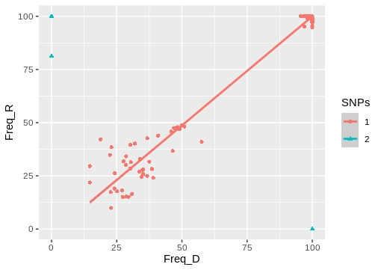
Cluster 25: CL134
Donor:G2326 05/07/2017
Receptor:G2344 28/09/2017
Cluster_distance:1
Bottleneck_distance:3

Slide 30
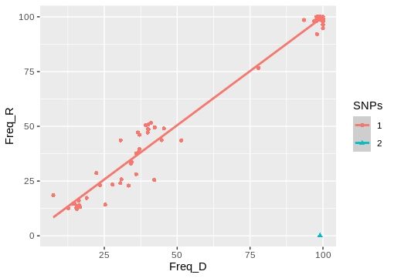
Cluster 26: CL058
Donor:G1199 NA
Receptor:G1200 NA
Cluster_distance:2
Bottleneck_distance:2

Slide 31
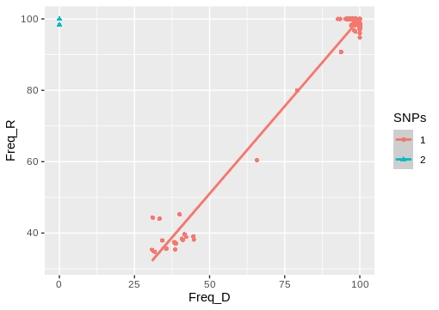
Cluster 27: CL056
Donor:G1360 29/12/2015
Receptor:G1420 25/01/2016
Cluster_distance:2
Bottleneck_distance:2

Slide 32
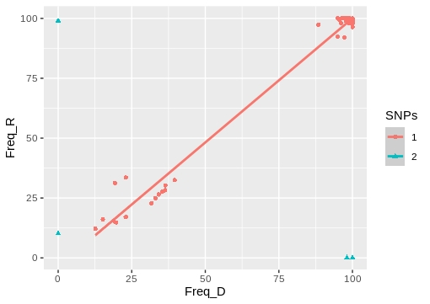
Cluster 28: CL082
Donor:G1693 30/05/2016
Receptor:G1661 22/06/2016
Cluster_distance:3
Bottleneck_distance:5

Slide 33
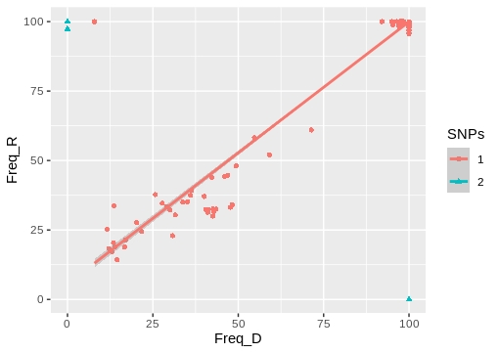
Cluster 29: CL103
Donor:G1915 26/01/2017
Receptor:G1922 03/02/2017
Cluster_distance:8
Bottleneck_distance:8

Slide 34
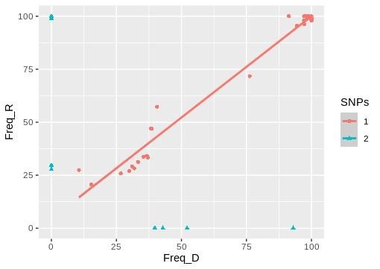
Cluster 30: CL068
Donor:G164 27/06/2014
Receptor:G168 20/06/2014
Cluster_distance:4
Bottleneck_distance:9

Slide 35
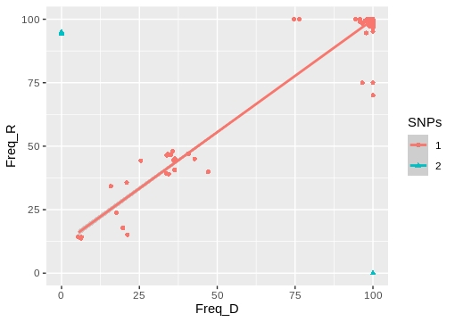
Cluster 31: CL060
Donor:G675 05/02/2015
Receptor:G832 16/04/2015
Cluster_distance:6
Bottleneck_distance:8

Slide 36
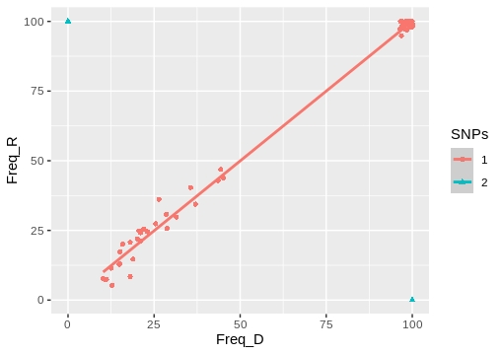
Cluster 32: CL008
Donor:G693 12/03/2015
Receptor:G764 24/03/2015
Cluster_distance:10
Bottleneck_distance:11

Slide 37
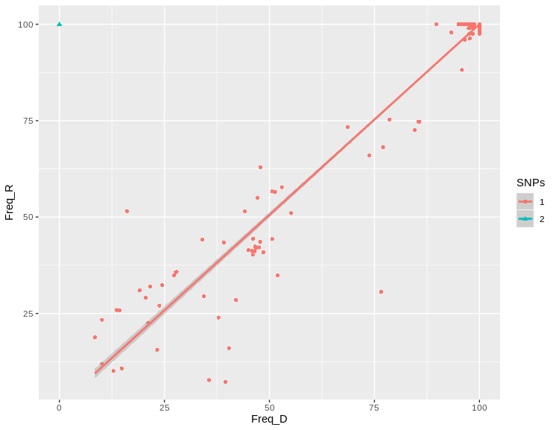
TransPhylo Cluster:CL005
Donor:G114 07/05/2014
Receptor:G815 10/02/2015
Cluster_distance:1
Bottleneck_distance:2

Slide 38
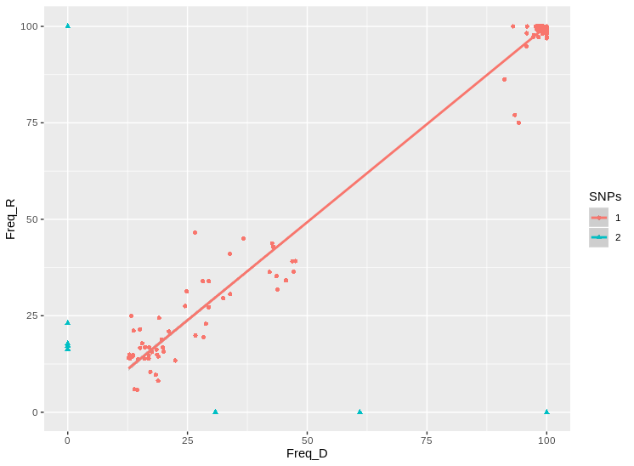
TransPhylo Cluster:CL008
Donor:G1261 22/12/2014
Receptor:G693 12/03/2015
Cluster_distance:5
Bottleneck_distance:13

Slide 39
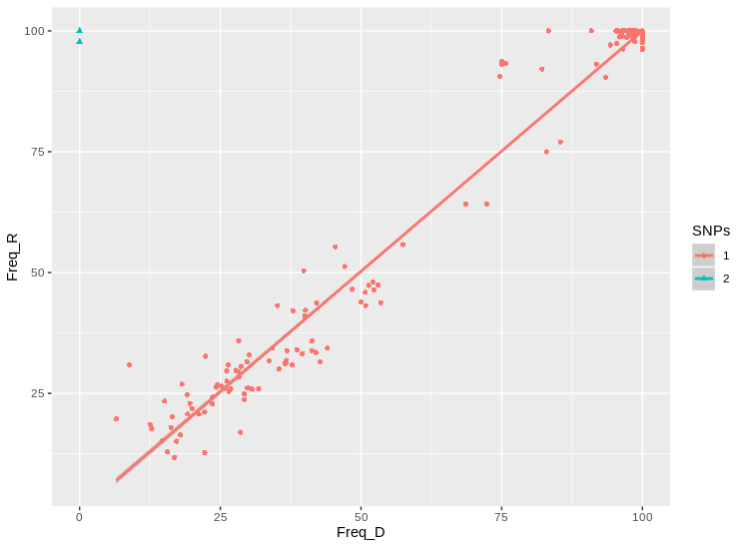
TransPhylo Cluster:CL010
Donor:G76 07/03/2014
Receptor:G1180 09/09/2015
Cluster_distance:2
Bottleneck_distance:2

Slide 40
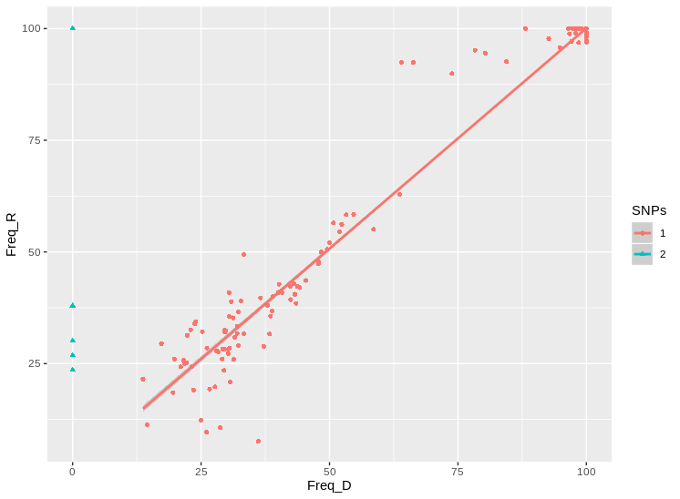
TransPhylo Cluster:CL031
Donor:G271 03/11/2014
Receptor:G1775 23/12/2015
Cluster_distance:2
Bottleneck_distance:6

Slide 41
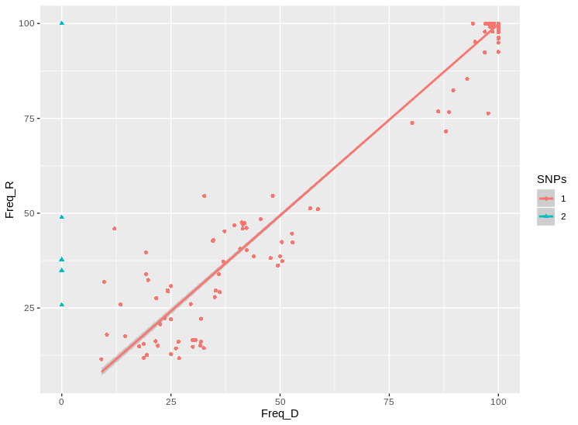
TransPhylo Cluster:CL078
Donor:G1494 NA
Receptor:G871 28/01/2015
Cluster_distance:1
Bottleneck_distance:5

