Slide 1
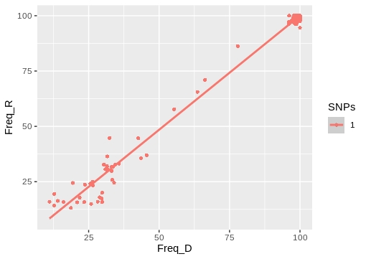
Cluster 04: CL010
Donor:G1180 09/09/2015
Receptor:G1181 01/09/2015
Cluster_distance:0
Bottleneck_distance:0

Slide 2
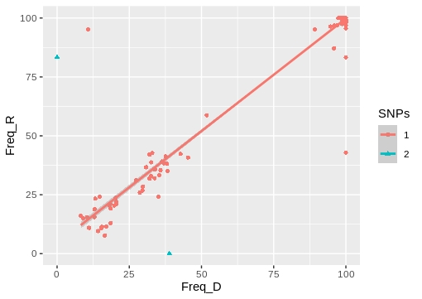
Cluster:07_1 CL037
Donor:G766 30/03/2015
Receptor:G817 18/02/2015
Cluster_distance:0
Bottleneck_distance:2

Slide 3
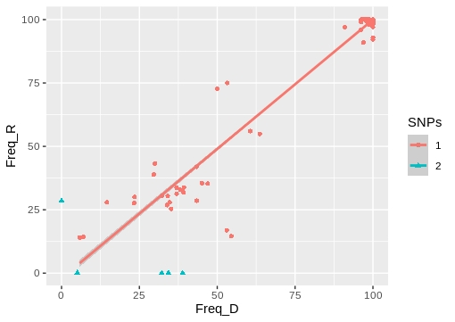
Cluster 12_2: CL069
Donor:G1653 11/08/2016
Receptor:G1785 27/09/2016
Cluster_distance:0
Bottleneck_distance:6

Slide 4
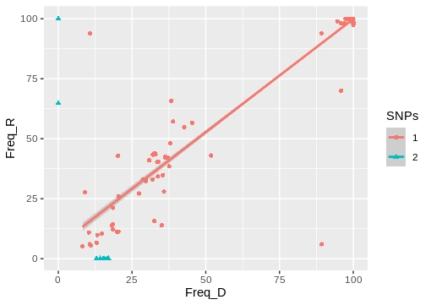
Cluster 07_2: CL037
Donor:G766 30/03/2015
Receptor:G1513 30/01/2016
Cluster_distance:0
Bottleneck_distance:9

Slide 5
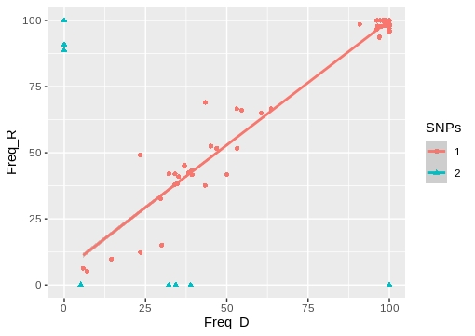
Cluster 12_1: CL069
Donor:G1653 11/08/2016
Receptor:G1648 11/07/2016
Cluster_distance:3
Bottleneck_distance:11

Slide 6
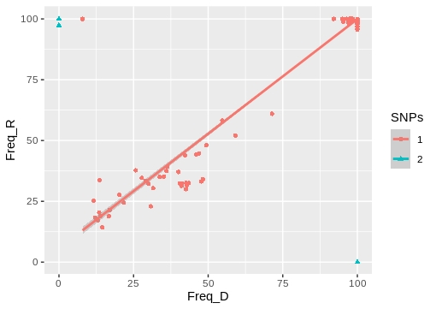
Cluster 29: CL103
Donor:G1915 26/01/2017
Receptor:G1922 03/02/2017
Cluster_distance:8
Bottleneck_distance:8

Slide 7
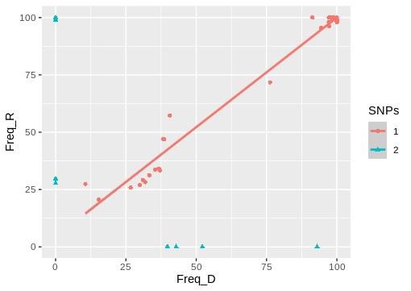
Cluster 30: CL068
Donor:G164 27/06/2014
Receptor:G168 20/06/2014
Cluster_distance:4
Bottleneck_distance:9

Slide 8
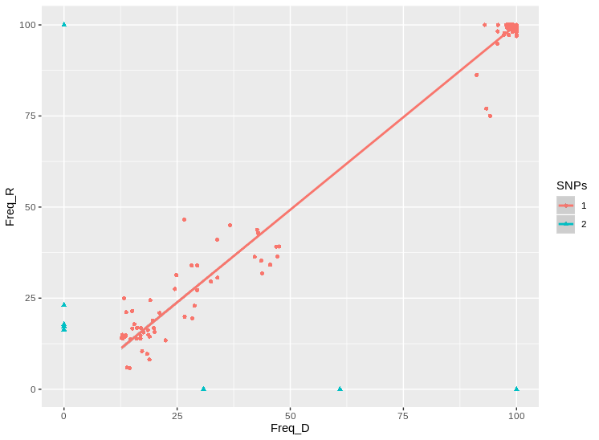
TransPhylo Cluster:CL008
Donor:G1261 22/12/2014
Receptor:G693 12/03/2015
Cluster_distance:5
Bottleneck_distance:13

Slide 9
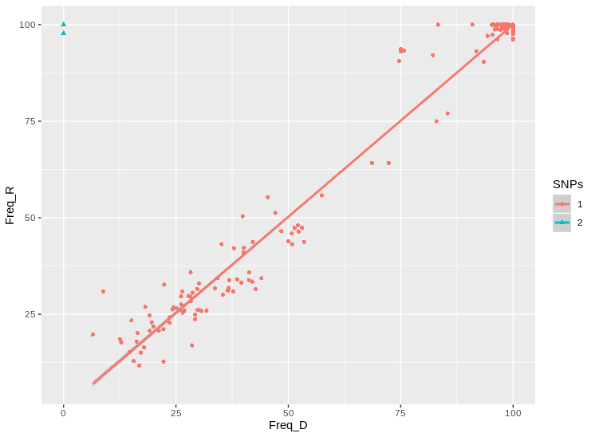
TransPhylo Cluster:CL010
Donor:G76 07/03/2014
Receptor:G1180 09/09/2015
Cluster_distance:2
Bottleneck_distance:2

Slide 10
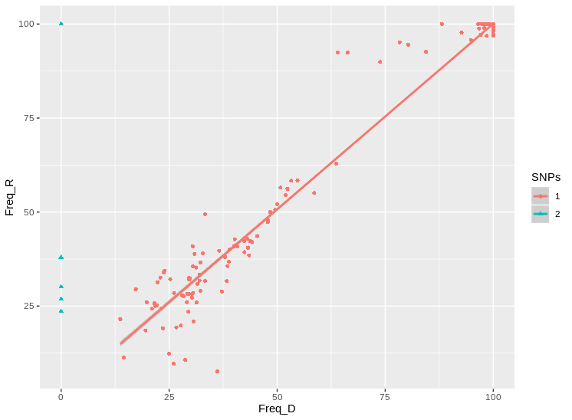
TransPhylo Cluster:CL031
Donor:G271 03/11/2014
Receptor:G1775 23/12/2015
Cluster_distance:2
Bottleneck_distance:6

Slide 11
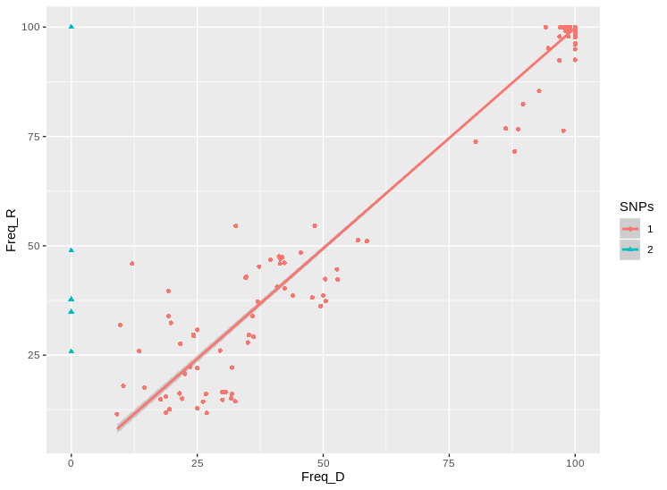
TransPhylo Cluster:CL078
Donor:G1494 NA
Receptor:G871 28/01/2015
Cluster_distance:1
Bottleneck_distance:5

