Slide 1
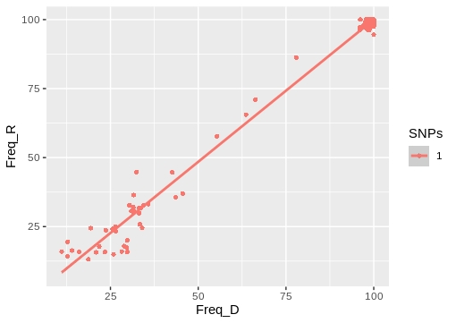
Cluster 04: CL010
Donor:G1180 09/09/2015
Receptor:G1181 01/09/2015
Cluster_distance:0
Bottleneck_distance:0

Slide 2
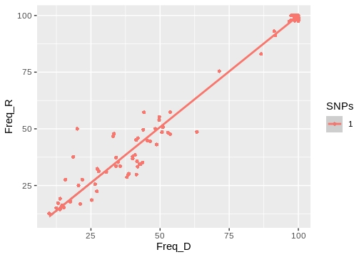
Cluster 03: CL029
Donor:G1128 04/05/2015
Receptor:G1562 10/12/2015
Cluster_distance:0
Bottleneck_distance:0

Slide 3
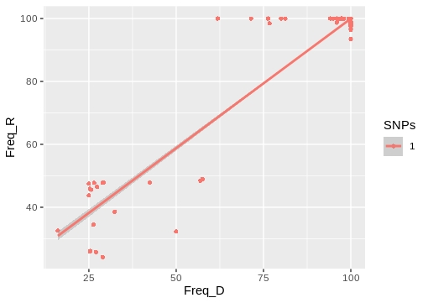
Cluster 05: CL119
Donor: G1285 12/08/2015
Receptor: G1334 16/11/2015
Cluster_distance:0
Bottleneck_distance:0

Slide 4
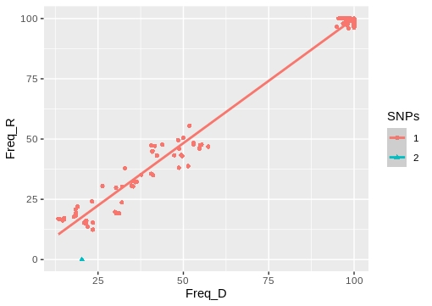
Cluster 15: CL122
Donor:G2157 24/03/2017
Receptor:G2159 09/06/2017
Cluster_distance:0
Bottleneck_distance:1

Slide 5
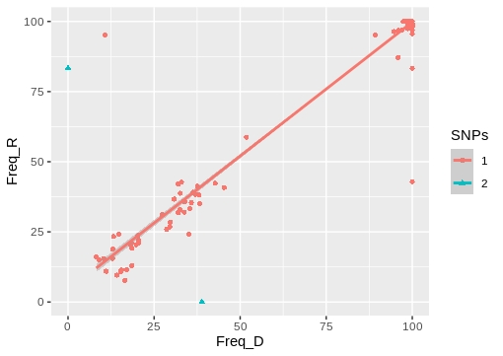
Cluster:07_1 CL037
Donor:G766 30/03/2015
Receptor:G817 18/02/2015
Cluster_distance:0
Bottleneck_distance:2

Slide 6
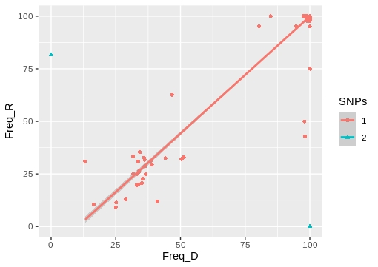
Cluster 09: CL116
Donor:G1564 09/12/2015
Receptor:G1742 29/01/2016
Cluster_distance:0
Bottleneck_distance:2

Slide 7
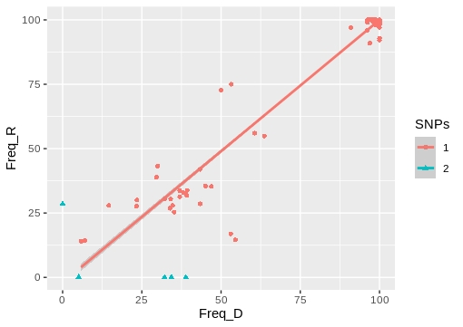
Cluster 12_2: CL069
Donor:G1653 11/08/2016
Receptor:G1785 27/09/2016
Cluster_distance:0
Bottleneck_distance:6

Slide 8
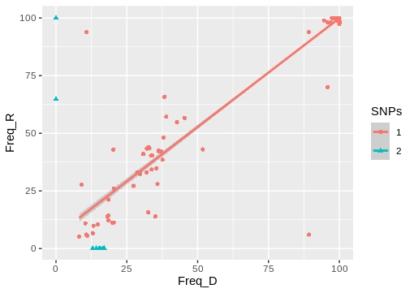
Cluster 07_2: CL037
Donor:G766 30/03/2015
Receptor:G1513 30/01/2016
Cluster_distance:0
Bottleneck_distance:9

Slide 9
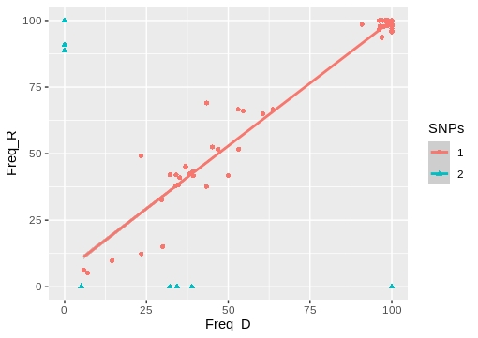
Cluster 12_1: CL069
Donor:G1653 11/08/2016
Receptor:G1648 11/07/2016
Cluster_distance:3
Bottleneck_distance:11

Slide 10
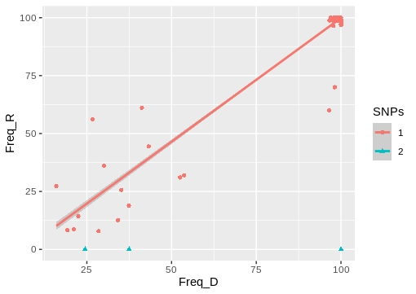
Cluster 21: CL034
Donor:G1537 24/04/2016
Receptor:G1786 11/08/2016
Cluster_distance:1
Bottleneck_distance:4

Slide 11
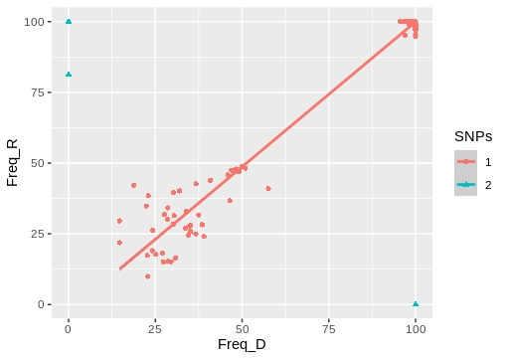
Cluster 25: CL134
Donor:G2326 05/07/2017
Receptor:G2344 28/09/2017
Cluster_distance:1
Bottleneck_distance:3

Slide 12
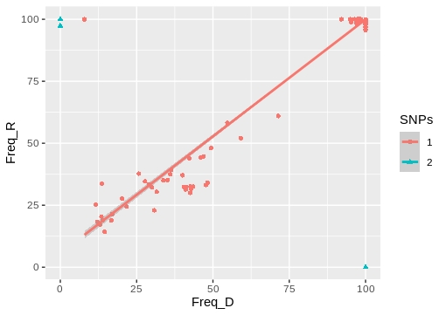
Cluster 29: CL103
Donor:G1915 26/01/2017
Receptor:G1922 03/02/2017
Cluster_distance:8
Bottleneck_distance:8

Slide 13
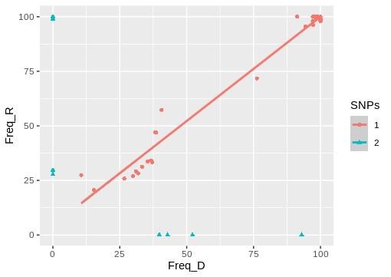
Cluster 30: CL068
Donor:G164 27/06/2014
Receptor:G168 20/06/2014
Cluster_distance:4
Bottleneck_distance:9

Slide 14
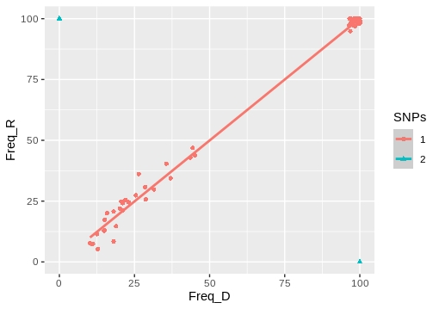
Cluster 32: CL008
Donor:G693 12/03/2015
Receptor:G764 24/03/2015
Cluster_distance:10
Bottleneck_distance:11

Slide 15
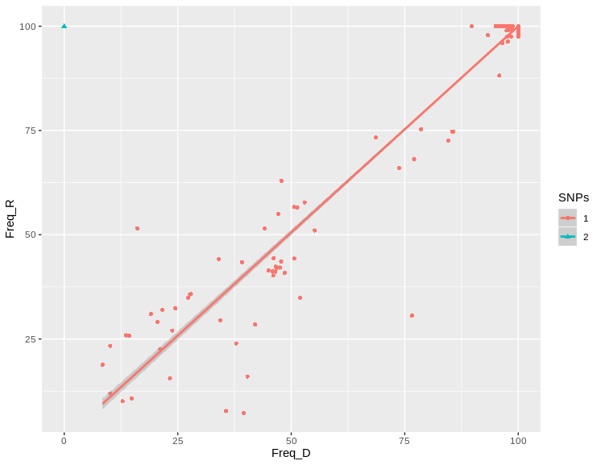
TransPhylo Cluster:CL005
Donor:G114 07/05/2014
Receptor:G815 10/02/2015
Cluster_distance:1
Bottleneck_distance:2

Slide 16
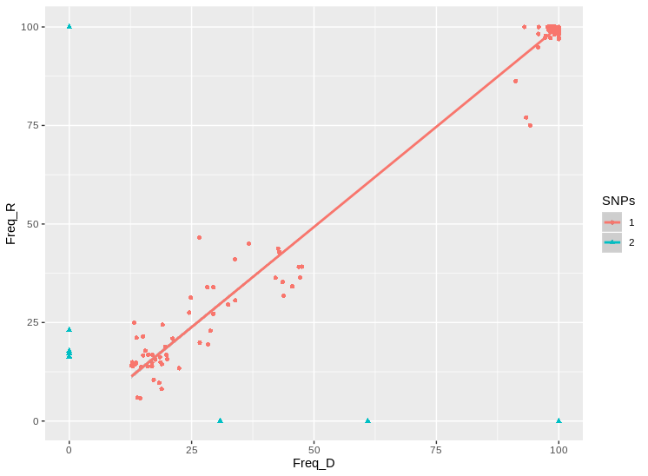
TransPhylo Cluster:CL008
Donor:G1261 22/12/2014
Receptor:G693 12/03/2015
Cluster_distance:5
Bottleneck_distance:13

Slide 17
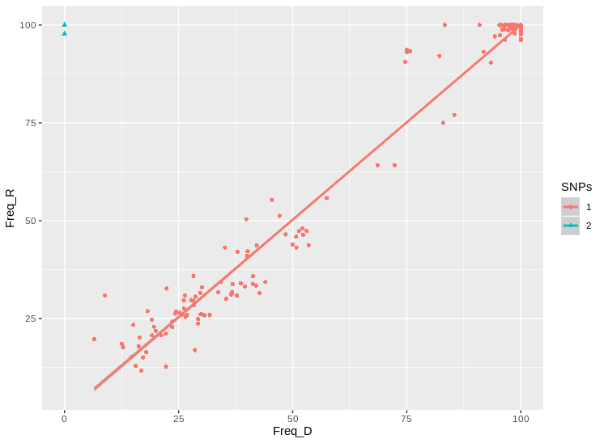
TransPhylo Cluster:CL010
Donor:G76 07/03/2014
Receptor:G1180 09/09/2015
Cluster_distance:2
Bottleneck_distance:2

Slide 18
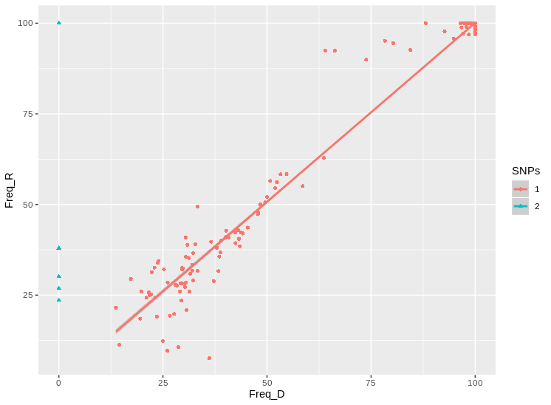
TransPhylo Cluster:CL031
Donor:G271 03/11/2014
Receptor:G1775 23/12/2015
Cluster_distance:2
Bottleneck_distance:6

Slide 19
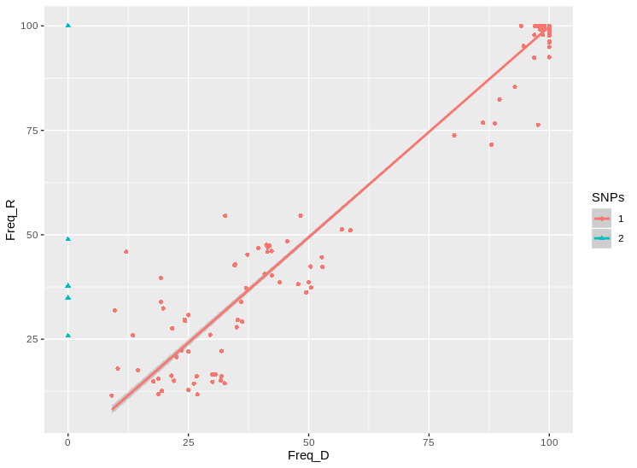
TransPhylo Cluster:CL078
Donor:G1494 NA
Receptor:G871 28/01/2015
Cluster_distance:1
Bottleneck_distance:5

