Slide 1

Tiziano Borrelli
IBM Applied Data Science Capstone Project - The Battle of Neighborhood

Slide 2

Intelligent Spanish House Search Engine
An AI system that will help you to search a real estate in Spain

Slide 3

Introduction
Welcome to: Intelligent Spanish House Search Engine

Slide 4

Introduction to the Problem
Spain a complex real estate market
Intelligent Spanish House Search Engine
An AI system that will help you to search a real estate in Spain
Intuitive Interface
Search in different cities
Filter by property type

Slide 5
How Intelligent Spanish House Search Engine Work?
User Input
Simple User Interface to select the property, the city and extra features
Data Acquisition
Data Gathering via Web Scraping
Data Validation & Clustering
Removing Invalid data
Data Analysis
AI
Clustering Data
Scatter Plot
Area Plot
Histogram
Data Clustering
Model Realization
Model Evaluation
Here an overview of the Process adopted for the solution

Slide 6
User Interface
A simple intuitive way to search your property

Slide 7
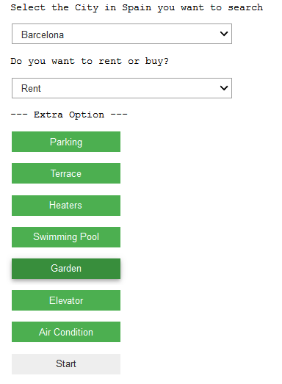
User Interface
Welcome to Intelligent Spanish House Search Engine!
The Simple User Interface allows you:
To search in different city in Spain
Choose between Rent and Buy properties
Select any feature like:
Parking
Terrace
Heaters
Swimming Pool
Garden
Elevator
Air Condition

Slide 8
Report
The dinner is ready!

Slide 9
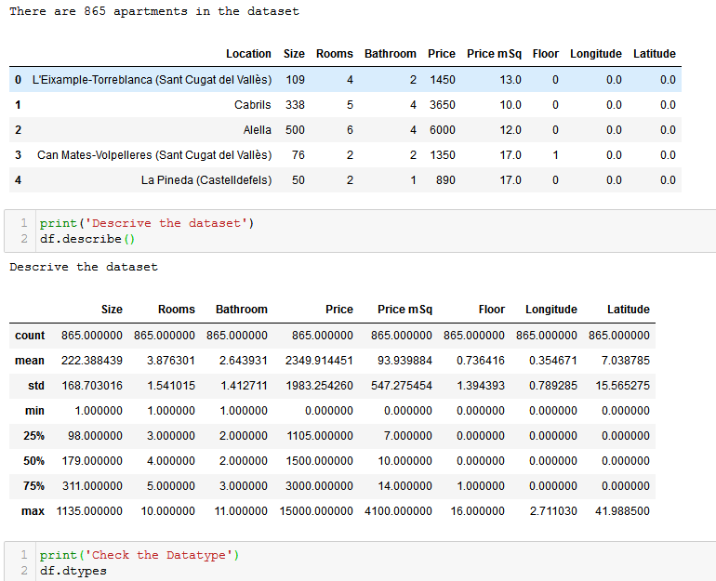
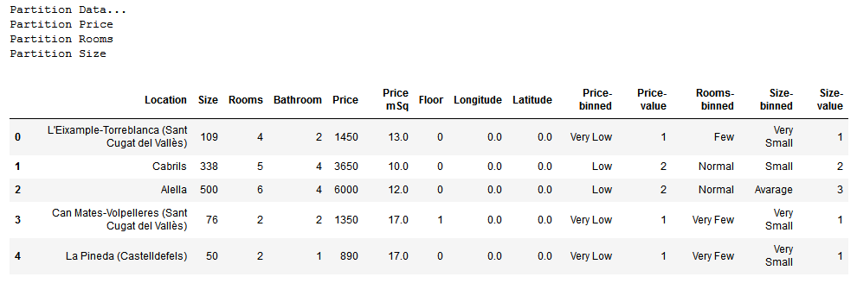
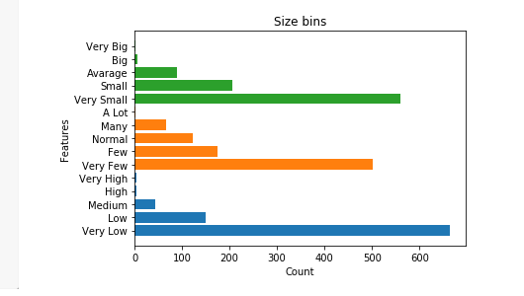
Data Clustering
Apartment Size
Data Partitioned in Apartment Size and Price
Very Small
Small
Average
Big
Very Big
Apartment Price
Very Low
Low
Medium
High
Very High

Slide 10
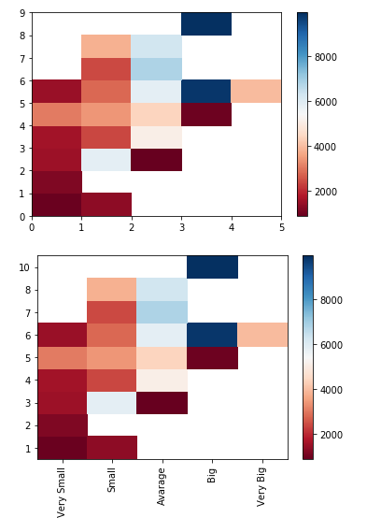
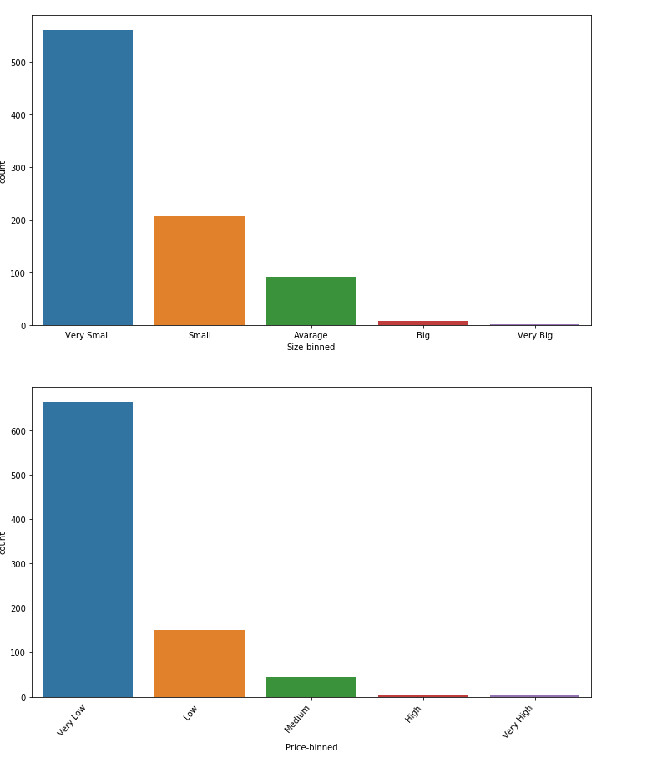
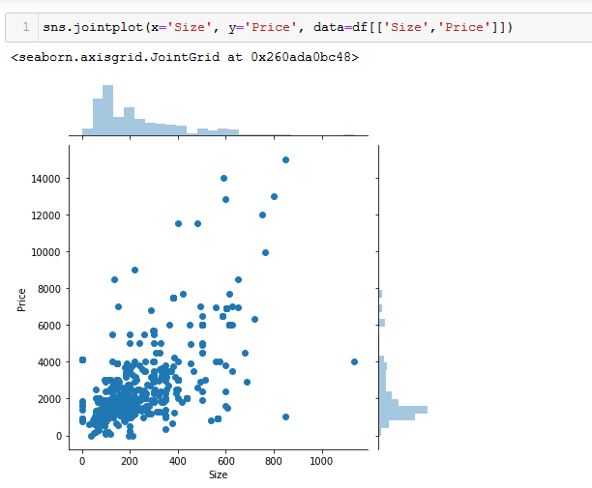
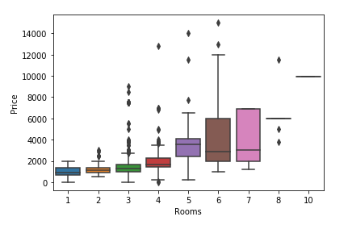
Data Visualization
Report available in Intelligent Spanish House Search Engine
ColorBar: Price per Room / ColorBar: Price per Size
Histogram: Size Bins / Histogram: Price Bins
Join Plot: Price per Size / Box Plot: Price per Room

Slide 11
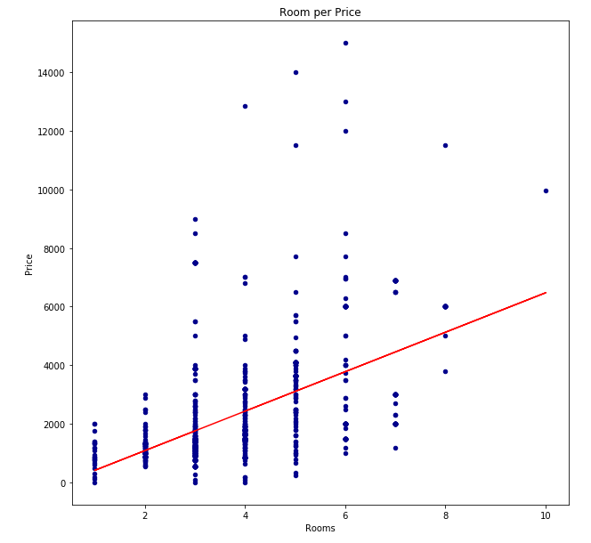
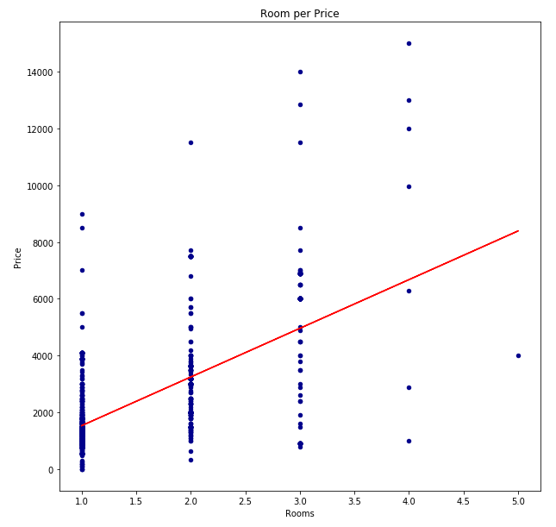
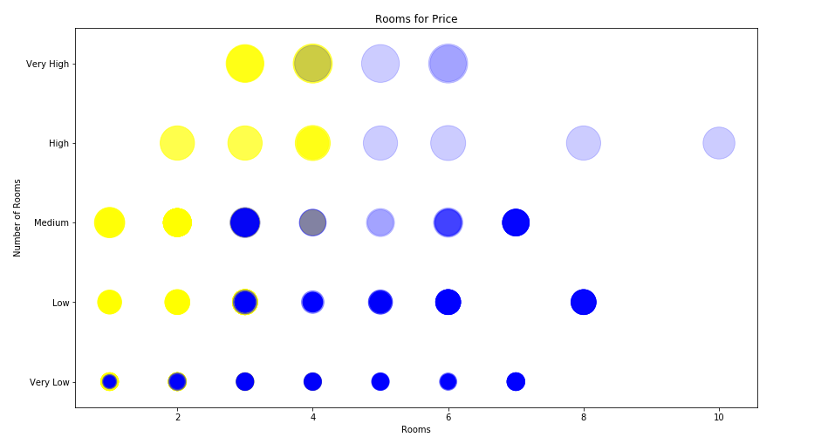
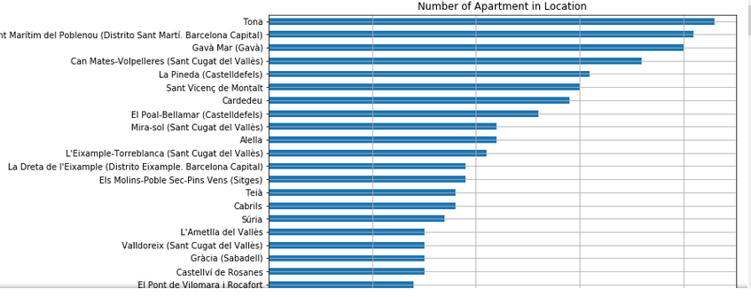
Data Visualization
BobbleBox: Rooms per Price (yellow)
BobbleBox: Size per Price (blu)
Some other example of report available in Intelligent Spanish House Search Engine
Plotbox: Room per Price with fit Line
Plotbox: Size per Price with fit Line
Histogram:
House per District

Slide 12
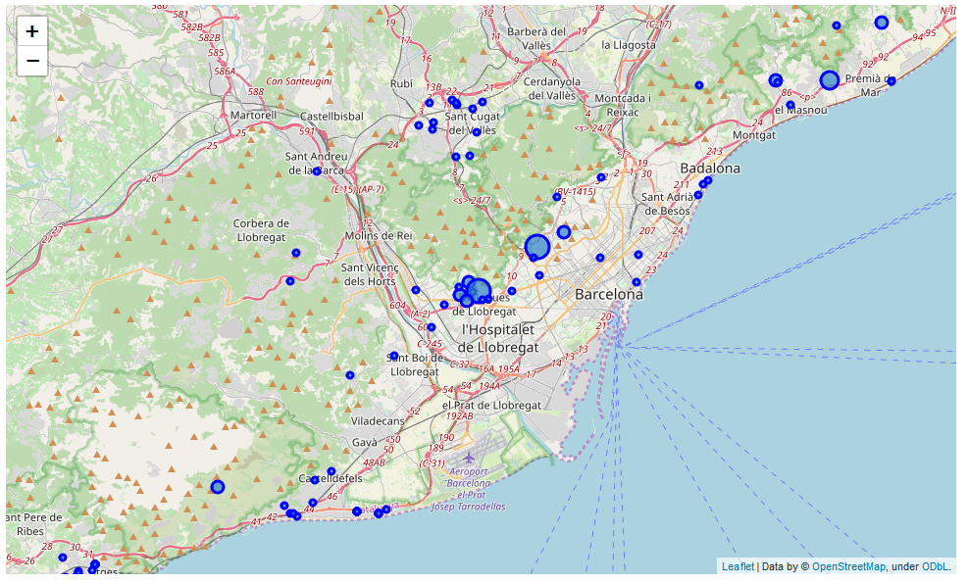
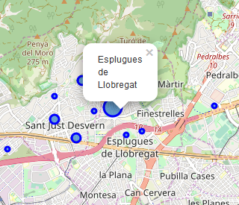
Geo localization
Find your property easy with: Intelligent Spanish House Search Engine
Drop down in your selection

Slide 13
AI
Find the best opportunity!

Slide 14
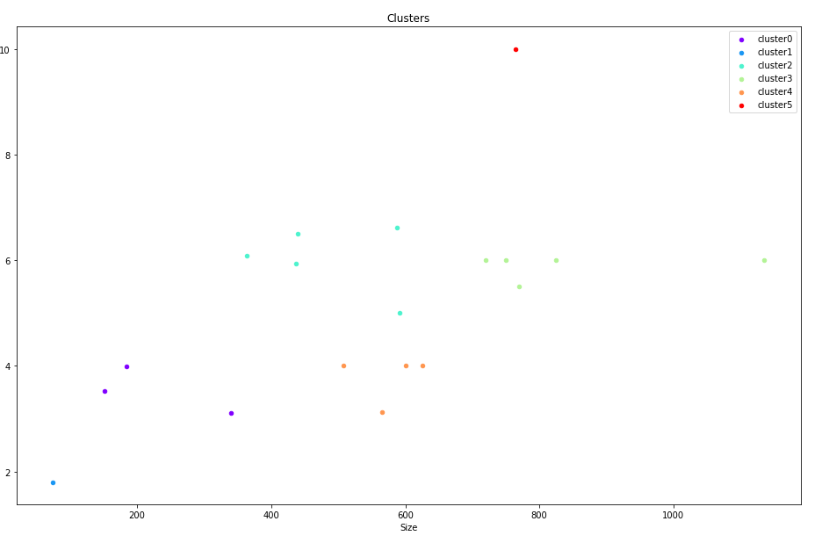

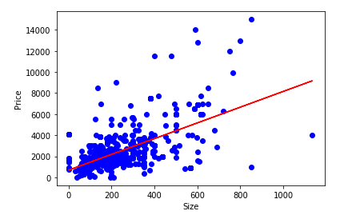
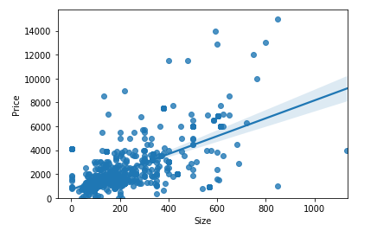
AI
Thanks to A.I. Intelligent Spanish House Search Engine helps you to find the best opportunity for you
Data Clustering
Study of the Coefficients and the Intercept
Data model and evaluated via AI
Data model and evaluated via AI

Slide 15




Thank You
April Hansson
+1 23 987 6554
april@www.proseware.com
www.proseware.com

