Slide 1
PRIVACY ACT AND PROTECTION
Here is where your presentation begins

Slide 2
INTRODUCTION
Management Plan
01
04
PROTECTION IN TERMS OF PRIVACY
Operating Plan
02
05
Marketing Plan
Financial Plan
03
06
Here you could describe the
topic of the section
Here you could describe the
topic of the section
Here you could describe the
topic of the section
Here you could describe the
topic of the section
Here you could describe the
topic of the section
Here you could describe the
topic of the section

Slide 3
INTRODUCTION
PRIVACY ACT
Legislation or regulations
Safeguarding privacy of individuals.
Rights of individuals

Slide 4
PROTECTION IN TERMS OF PRIVACY
PRIVACY
Some of the aspects are :
Security Measures : To ensure the security of data
Data Minimization : Organisations should avoid collecting excess of information
Access Controls : Limiting access to personal data
Data Breach Response : Notify the individuals, authorities and other stakeholders.

Slide 5
Privacy Laws and regulations

Slide 6
GDPR (General Data Protection Regulation)
The GDPR is a data protection law that regulates how companies collect, use, and process personal data of individuals within the European Union.
It came into effect on May 25, 2018, replacing the Data Protection Act.
The GDPR applies to all organizations, regardless of their location.

Slide 7
Principles of GDPR
Key Principles involve for the personal data of an individual.
Lawfulness, Fairness, and Transparency
Accuracy
Purpose Limitation
Storage Limitation
Integrity and Confidentiality
Data Minimization

Slide 8
Rights of Data Subjects
Right to be Informed : The right to know how their data.
Right of Access : Individuals can request access to their personal data.
Right to Data Portability : Individuals can request their data to be transferred to another controller .
Right to Object : Individuals can object to the processing of their personal data
Rights Related to Automated Decision Making and Profiling

Slide 9
COMPETITIVE ADVANTAGE
Them
Us
Mercury is the closest planet to the Sun and the smallest one in the Solar System
Jupiter is, the biggest planet in the Solar System and the fourth-brightest object in the sky

Slide 10
02
MARKET ANALYSIS
You could enter a subtitle here if you need it

Slide 11
TARGET
$50K - $60K
60%
Women
Average spend per customer
25+ Y/O
25- Y/O
Saturn is a gas giant and has rings
Mercury is the smallest planet in the Solar System

Slide 12
MARKET SIZE
5%
Mercury
Saturn
55%
40%
Mars
Mercury is the smallest planet
It’s a gas giant and has rings
Mars is actually a cold place

Slide 13
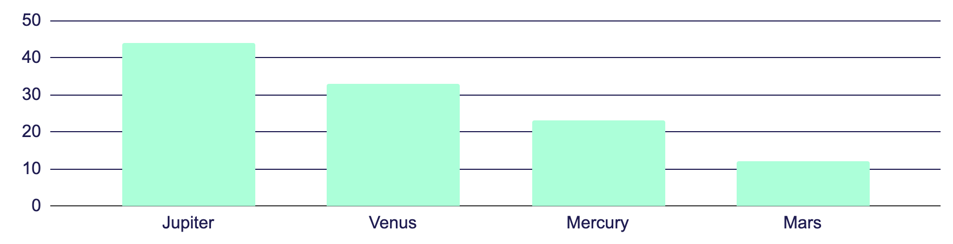
MARKET SHARE
Jupiter
Mercury
Venus
Mars
To modify this graph, click on it, follow the link, change the data and paste the new graph here
Jupiter is the biggest planet of them all
Mercury is the closest planet to the Sun
Venus is the second planet from the Sun
Despite being red, Mars is a cold place

Slide 14
COMPETITION ANALYSIS
Jupiter | Mercury | Venus | Mars
Yes | No | Yes | No
Yes | No | Yes | Yes
No | Yes | No | Yes

Slide 15
03
MARKETING PLAN
You could enter a subtitle here if you need it

Slide 16
OUR SERVICES
Mercury
Venus
Mars
Jupiter
Saturn
Neptune
Mercury is the closest planet to the Sun
Venus is the second planet from the Sun
Despite being red, Mars is actually a cold place
It’s the biggest planet in the Solar System
Saturn is composed of hydrogen and helium
Neptune is the farthest planet from the Sun

Slide 17
BREAK-EVEN ANALYSIS
Big Loss
Break-Even Point
High Profit
Loss
Profit
Mercury is the smallest planet
Jupiter is the biggest planet
Earth is where we live on
Mars is actually a cold place
Saturn has several rings

Slide 18
OUR PLANS
BASIC
STANDARD
PREMIUM
$19.99
$25.99
$30.99
Service 1
Service 2
Service 3
Service 1
Service 2
Service 3
Service 1
Service 2
Service 3
START
START
START

Slide 19
SALES AND DISTRIBUTION
Channel 2
Channel 3
Channel 1
Channel 4
Mercury is the smallest planet
Saturn has several rings
Mars is actually a cold place
Earth is where we live on

Slide 20
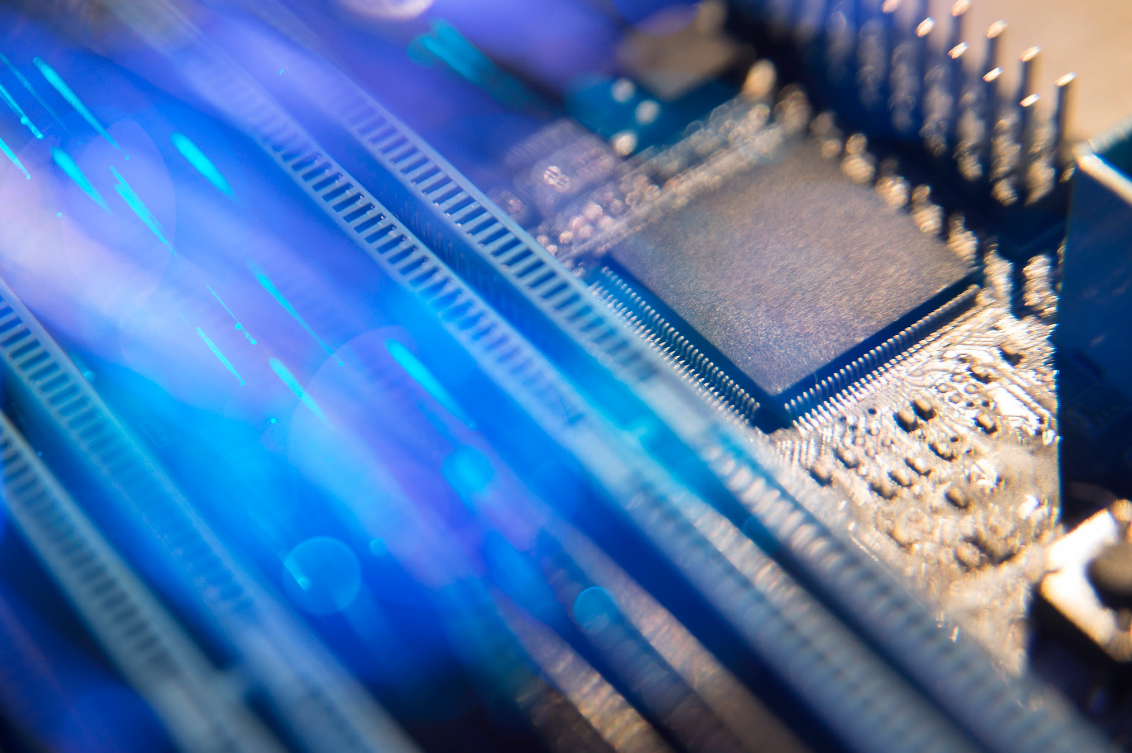
A PICTURE ALWAYS REINFORCES THE CONCEPT
Images reveal large amounts of data, so remember: use an image instead of long texts

Slide 21
ADVERTISING AND PROMOTION
Advertising
PR
Online
Jupiter is a gas giant and the biggest planet in the Solar System
Venus has a beautiful name and is the second planet from the Sun
Despite being red, Mars is actually a cold place full of iron oxide dust

Slide 22
04
MANAGEMENT PLAN
You could enter a subtitle here if you need it

