Slide 1
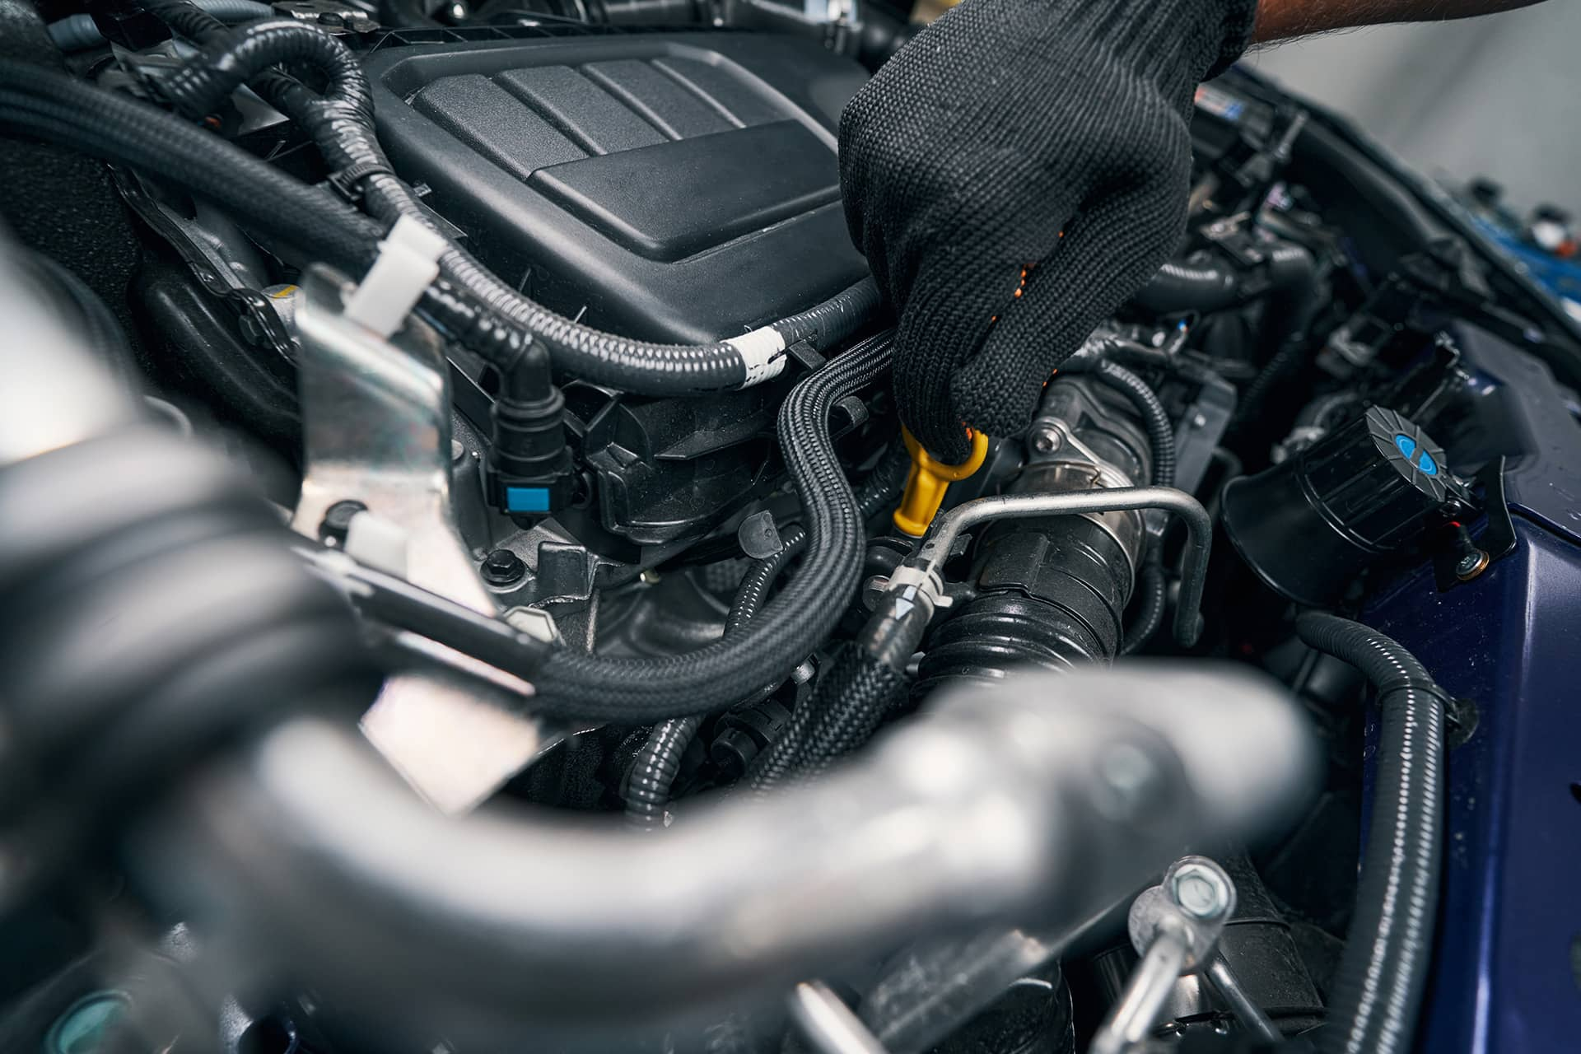



Introduction to CarMech Solutions

Slide 2
Prepare By :
Name : | Tadhani Brijeshkumar Hareshbhai
Roll no : | 134
Enrollment no : | 22002171210188
Batch : | B4
Branch : | CSE
Topic : | Car Service

Slide 3
Overview
Introduction to Our Car Service Website
Our Services
Service Pricing and Packages
Book an Appointment Online
Why Choose Us?
Contact Us for Inquiries or Support

Slide 4

Welcome to Our Carmech Solutions
We are committed to providing you with the best car service experience possible. Our team of experienced professionals is dedicated to making sure that you arrive at your destination safely and comfortably. From airport transfers to corporate events, we offer a range of services to meet your needs.

Slide 5
Our Services
Repairs & Maintenance
Detailing & Valeting
Custom
Upgrades
From oil changes to engine diagnostics, we offer comprehensive repair and maintenance services to keep your vehicle running smoothly.
Restore the luster of your car with our professional interior and exterior detailing services, guaranteed to leave your vehicle looking pristine.
Explore our range of custom upgrade options, including performance enhancements, custom paintwork, and body kit installations.

Slide 6
Service Pricing and Packages
Advanced Package
Basic Package
Premium Package
Includes regular maintenance services at an affordable price.
Comprehensive car diagnostics and repairs with a 20% discount.
Exclusive services with a dedicated personal mechanic and fast-track appointments.

Slide 7
Book an Appointment Online
1.Select Service
Choose your desired service from the available options.
2.Pick Date and Time
Select a convenient date and time for your appointment.
3.Confirm & Book
Finalize your booking and receive a confirmation email.

Slide 8
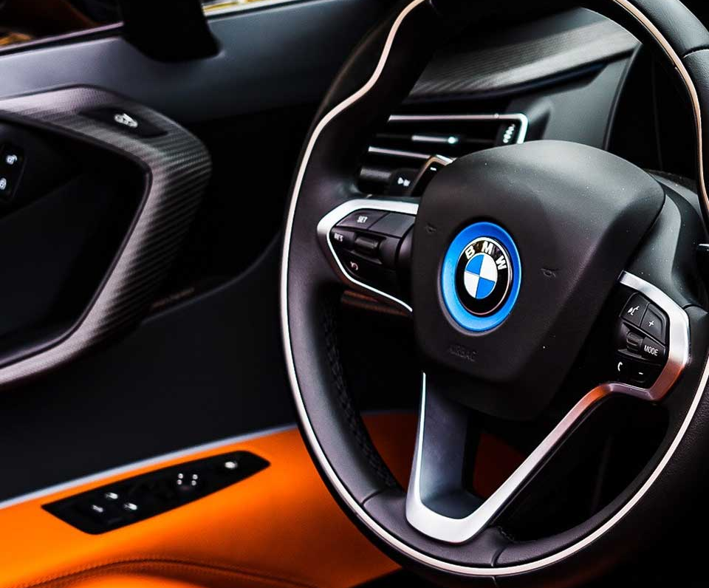
Why Choose Us?
→ At our car service, we go above and beyond to provide exceptional customer service and reliable transportation solutions. With our team of experienced drivers and a fleet of well-maintained vehicles, we ensure a comfortable and safe journey for all our clients.

Slide 9

Thanks!
Do you have any questions?
abc123@gmail.com
+91 12345 67890
Carmachsolution.com

