Slide 1
Object Counter

Slide 2
Introduction
Object counter is a device which counts object passing from above it or by touching it. But main work of object counter is the counting of object or things

Slide 3
Components
- IC 4026
- Resistor
- 9V battery
- Jumper wires
- 7 segment display
- IR sensor
- Bread board

Slide 4
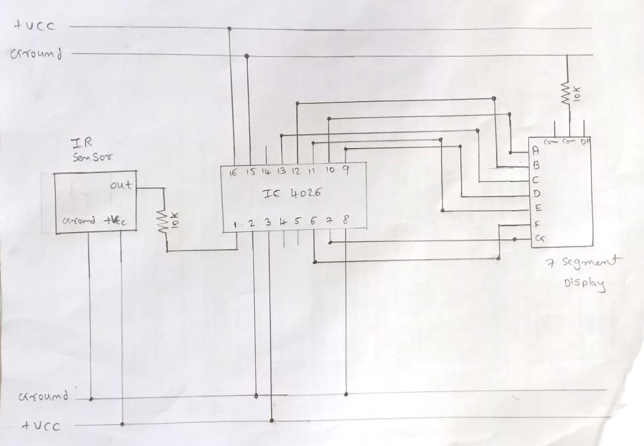
Circuit diagram

Slide 5
Merits
01
02
03
Versatility
Localization
Multiple object detecction

Slide 6
Demerits
01
02
03
Complexity
Training data
False positiveness

Slide 7
Do you have any questions?
youremail@freepik.com
+91 620 421 83
yourcompany.com
THANKS

