Slide 1
Graph Homomorphism and Gradually Varied Functions
DIMACS Mixer II, Oct. 21,2008
Li CHEN
DIMACS Visitor
Department of Computer Science and Information Technology
Affiliated Member of Water Resource Research Institute
University of the District of Columbia
4200 Connecticut Avenue, N.W.
Washington, DC 20008
Office Tel: (202) 274-6301
Email: lchen@udc.edu, www.udc.edu/prof/chen

Slide 2
Definition of Graph Homomorphism
Graph homomorphism maps adjacent vertices to adjacent vertices between two graphs.

Slide 3
Gradually varied function
The gradually varied function in discrete space preserves that the value change of neighborhood is limited respect to the center point

Slide 4
How???
How theses two topics are highly related ?

Slide 5
Absolute retracts vs. gradually varied extension
We will first introduce absolute retracts in graph homomorphism and P. Hell and Rival’s theorem for reflexive graphs (1987).
Then we discuss why gradually varied functions are important to digital spaces, and the necessary and sufficient condition of the existence of gradually varied extension (Chen, 1989).
At the last, we discuss the generalization of related concepts to discrete surface immersion and graph homomorphic extension (Agnarsson and Chen, 2006).

Slide 6
Retract and absolute retract
A retract is a homomorphism or edge-proving map “f” from a graph G to its sub-graph H such that f(h)=h for all h in H.
H is called an absolute retract if any G, that G contains H and d(x,y) in H is equal d(x,y) in G, can retract to H.

Slide 7
Hell&Rival’s Result
Theorem (Hell&Rival 1987): Let H be a (reflexive) graph. H is an absolute retract if only if H has no m-holes for m>=3.
A hole of the graph H is a pair (K, \delta), where K is a nonempty set of vertices and \delta is a function from K to the nonnegative integers such that no h \in V(H) has d_{H}(h,k)<=\delta(k) for all k\in K. A (K,\delta ) hole is called an m-hole if |K|=m.

Slide 8
The Gradually Varied Function:
Gradual variation: let f: D→{1, 2,…,n}, if a and b are adjacent in D implies |f(a)- f(b)| ≤1, point (a,f(a)) and (b,f(b)) are said to be gradually varied.
A 2D function (surface) is said to be gradually varied if every adjacent pair are gradually varied.

Slide 9
The Gradually Varied Surface (Continue)
Remarks:
This concept was called ``discretely continuous'' by Rosenfeld (1986) and ``roughly continuous'' by Pawlak (1995).
A gradually varied function can be represented by lambda-connectedness introduced by Chen (1985).

Slide 10
Real Problems: Image Segmentation
(Gray scale) image segmentation is to find all gradually varied components in an image. (Strong requirement, use split-and-merge technique)
(Gray scale) image segmentation is to find all connected components in which for any pair of points, there is a gradually varied path to link them. (Weak requirement, use breadth-first-search technique) Example

Slide 11
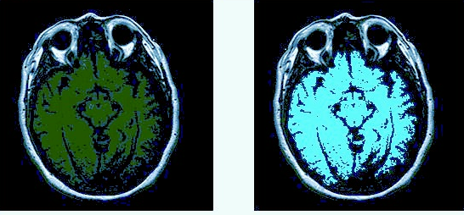
Example: lambda-connected Segmentation

Slide 12
Real Problems: Discrete Surface Fitting
Given J⊆D, and f: J→{1,2,…n} decide if there is a F: D→{1,2,…,n} such that F is gradually varied where f(x)=F(x), x in J.
Theorem (Chen, 1989) the necessary and sufficient condition for the existence of a gradually varied extension F is: for all x,y in J, d(x,y)≥ |f(x)-f(y)|, where d is the distance between x and y in D.

Slide 13
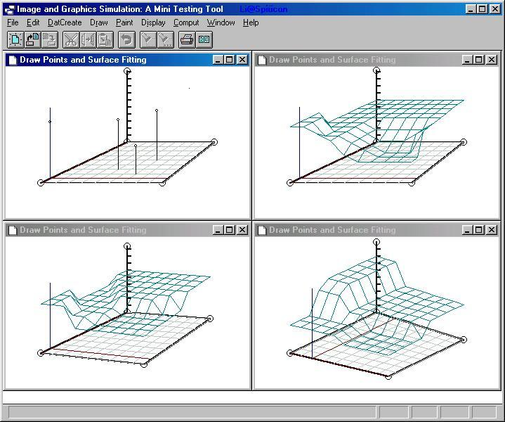
Example: GVS fitting

Slide 14
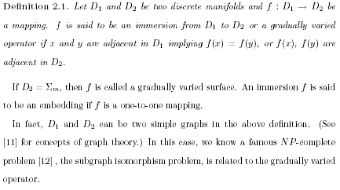

Graph Immersion
Li Chen, Gradually varied surfaces and gradually varied functions, 1990. in Chinese
Li Chen, Discrete Surfaces and Manifolds, SPC, 2004 . Chapter 8

Slide 15
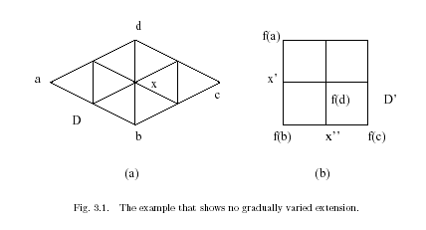
Not Every Pair of D, D’ have GV Extension

Slide 16
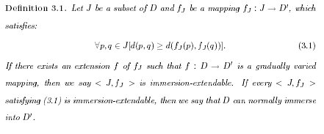
Normally Immersion/GV Mapping

Slide 17
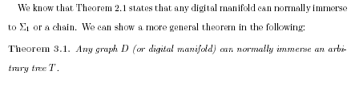

The Main Results of GVF

Slide 18
GVF and Graph Homomorphism
GV mapping is similar to Homomorphic Mapping to reflexive graphs (every node has a loop)
Helly Property :
  Let X1, ...,Xn be n subsets with respect to a Universal set. Helly means that if Xi ∩Xj ≠ ∅ for all i,j then
    ∩{i=1} ^{n} Xi is not empty
  A graph has the Helly Property means that for each node i: Xi^{k} means a k-ball centered at node i. For N1, ...,Nm are any elements in ∪ {Xi^{k} | for all i, k} , {N1, ...,Nm} has Helly, we will say that the graph has Helly.

Slide 19
Helly
“If you have a collection
N_{r_1}(x_1), N_{r_2}(x_2),...,N_{r_k}(x_k) of such balls/neighborhoods. In the graph G, that are pairwise nonempty
(that is, N_{r_i}(x_i)\cap N_{r_j}(x_j) is nonempty for every
pair i,j from {1,2,...,k}), then their total intersection
\Cap_{i=1}^k N_{r_i}(x_i) is also nonempty.
This is the Helly-condition.”

Slide 20
Main Results
Theorem
  For a graph G the following are equivalent:
  1. G can be the range-graph of any normal immersion. (G has the Extension Property (reflexive) ).
  2. G is an absolute retract (reflexive).
  3. G has the Helly property (reflexive).
  *G. Agnarsson and L. Chen, On the extension of vertex maps to graph homomorphisms, Discrete Mathematics, Vol 306, No 17, 2006.

Slide 21
Easy understanding
Main Theorem: For a reflexive graph G the following are equivalent:
  1. G has the Extension Property
  2. G is an absolute retract.
  3. G has the Helly property.
The alternate representation of the theorem:
For a discrete manifold M the following are equivalent:
  1. Any discrete manifold can normally immerse to M
  2. Reflexivized M is an absolute retract.
  3. M has the Helly property.

Slide 22
Differences of Immersion and Retract
Absolute retract must be defined on reflexive graph to suit graph homomorphism—edge preserving
Absolute retract has better connection to classical graph theory
Immersion allows shrinking an edge to a vertex.
Immersion has better meaning in graph/shape deformation
Gradually varied surface is a type of discrete surfaces
Discrete and digital surfaces are hot topics in computer vision and computer graphics.

Slide 23
Problems
Gradually varied segmentation using divide-and-conquer (split-and-merge) vs. Typical statistical method, how to deal with noise in gradually varied segmentation.
Gradually connected segmentation using breadth-first-search is similar to typical region-growing method.
Fast gradually varied fitting algorithm development in the case of Jordan-separable-domain.
Gradually varied fitting vs. numerical fitting: We are working on Ground Water project supported by USGS and UDC WRRI.
Gradually varied fitting is not unique. How do we select a best one for different application? Random surface model?

Slide 24
References
G. Agnarsson and L. Chen, On the extension of vertex maps to graph homomorphisms, Discrete Mathematics, Vol 306, No 17, pp 2021-2030, Sept. 2006.
L. Chen, The necessary and sufficient condition and the efficient algorithms for gradually varied fill, Chinese Sci. Bull. 35 (10) (1990) 870^873.
L. Chen, Random gradually varied surface fitting, Chinese Sci. Bull. 37 (16) (1992) 1325^1329.
L. Chen, Discrete surfaces and manifolds, Scientific and Practical Computing, Rockville, Maryland, 2004
P. Hell, I. Rival, Absolute retracts and varieties of reflexive graphs, Canad. J. Math. 39 (3) (1987) 544^567.
P. Hell, J. Ne^etril, Graphs and homomorphisms, Oxford Lecture Series in Mathematics and its Applications, vol. 28, Oxford University Press, Oxford, 2004.

Slide 25

Acknowledgements
Many thanks to DIMACS and Professor Feng Lu for providing me the opportunity to visit the center.
Please contact me at lchen@udc.edu if you are interested in related research.

