Slide 1
Outside In
Viewer Technology
Outside In Viewer Technology

Slide 2
Outside In Family of OEM Technologies
Outside In Technology
  Outside In Viewer Technology
  Outside In Text Access/Content Access
  Outside In Remote Filter Access
Notes:
Use Active X rather than C API

Slide 3
Outside In Viewer Technology Advantages
Best possible fidelity
Best performance
  Creates near instantaneous view of a document without the native application
Broadest range of formats
  225 file formats: legacy and current word processing, database, spreadsheet, graphic, presentation, and compressed formats
Most platform choices
  Windows and UNIX flavors
Notes:
Not launching many applications, just one application up and running all the time

Slide 4
Outside In Viewer Technology Features
Clipboard
  Copy and paste an RTF version into the clipboard, allowing data to be moved between dissimilar applications
Printing
  Anything that can be viewed can be printed, making the viewer the only way to get a hardcopy if the application isn’t available
  DrawPage creates bitmaps for thumbnails and faxing
Numerous customization options
  Feature control
Internationalization features
  Double-byte enabled, localizable

Slide 5
Outside In Viewer Technology Architecture
Application
Outside In Viewer Specification
View Window
WP
SS
BMP
TREE
MET
HEX
Display
Chunker
Cache
A
B
C
D
E
F
G
Etc.
FI
Filters
Notes:
OIVT Architecture
Filter layer: are 225 file formats
Chunker layer: is a series of lists, and acts similarly to a cache to create a dynamic method of storing data.
Chunk size is 4k
Display layer: selects how the data is to be displayed
View Window layer: displays the data in a viewable window
API layer: our API governing the aforementioned
Application layer: the application requesting the view

Slide 6
Outside In Viewer Technology in Action...
1. A view window is opened
Application
2. The file is opened

Outside In Viewer Specification
View Window
□
3. A filter is selected
WP
SS
BMP
TREE
MET
HEX
4. The file is decoded
■

Chunker
5. A display engine is chosen
❍
●
A
B
C
D
E
F
G
Etc.
FI
6. The file is displayed
Notes:
Recursive processes

Slide 7
Outside In Text Access/Content Access Features
Extract text
  Automatic translation into a particular character set, such as Unicode or ANSI.
Character offset
  Valuable for search engines/index engines
  Offset used by Annotation API to highlight hits in view window
Access document properties (CA)
  Headers/footers
  Author, keywords, version notes, carbon copy, checked by, subject, etc.
Supports graphic documents’ text blocks (CA)
Notes:
Character offsets tie into the viewer technology
Lucent using in text to speech conversion (Doc to text)

Slide 8
Outside In Text/Content Access Architecture
Application
Outside In Viewer Specification
View Window
Content
Access
Text
Access
WP
SS
BMP
TREE
MET
HEX
Chunker
A
B
C
D
E
F
G
Etc.
FI

Slide 9
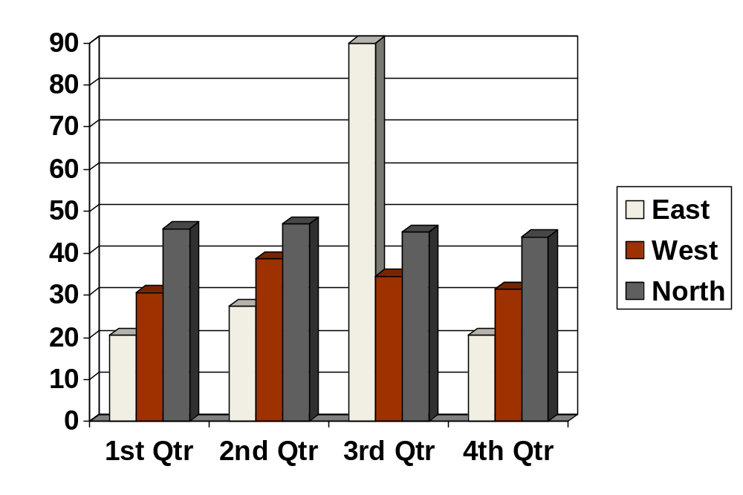

Here are some samples of viewing functionality
Here is a chart
This is a table with 4 cells. This is cell 1 | Cell 2
Cell 3 | Cell 4
Here is a bitmap of the Outside In logo

Slide 10
Outside In
Viewer Technology

