Slide 2
Outside In Technology

Slide 3
Program Agenda
1
Business Drivers
ISV Requirements
Outside In Overview
Optional Live Demo
Why Oracle Outside In
Competitive Overview
Q & A
2
3
4
5
6
7

Slide 4

Business Drivers
A perfect storm of opportunity:
Data volume is projected to grow 800% over the next 5 years
80% of that information will be unstructured
Virtually all ISV applications, regardless of market, can enhance their value with the ability to access, transform and control unstructured information
A perfect storm of opportunity

Slide 5
ISV Requirements
Support for a broad range of unstructured information sources and output targets
Output must be normalized for efficient machine consumption
Must support a high throughput, server environment
Developer must have control over analysis and delivery

Slide 6
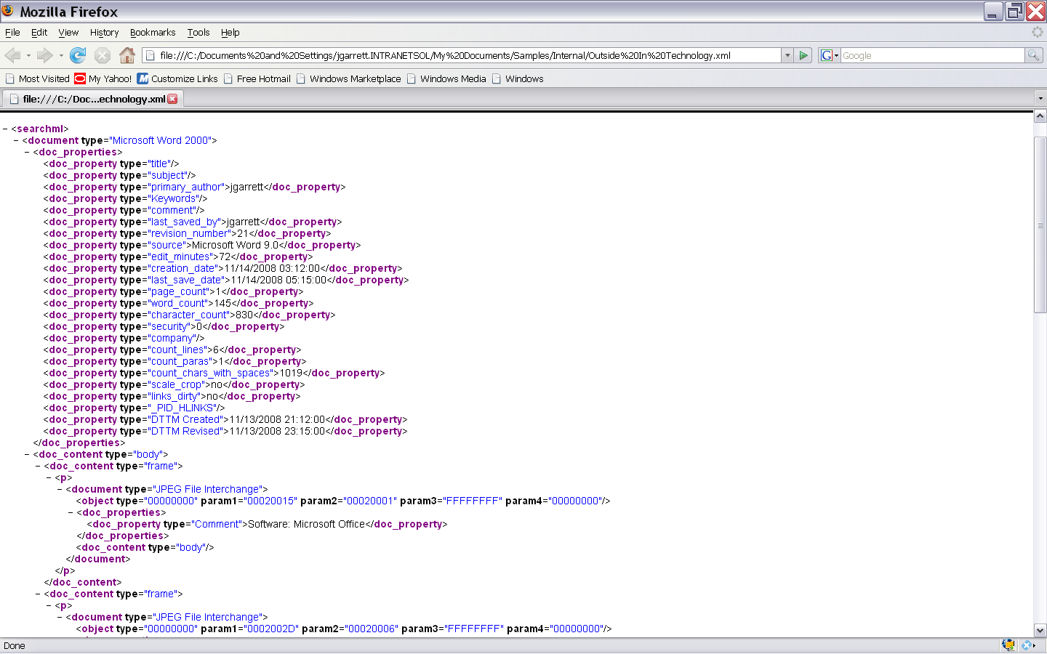
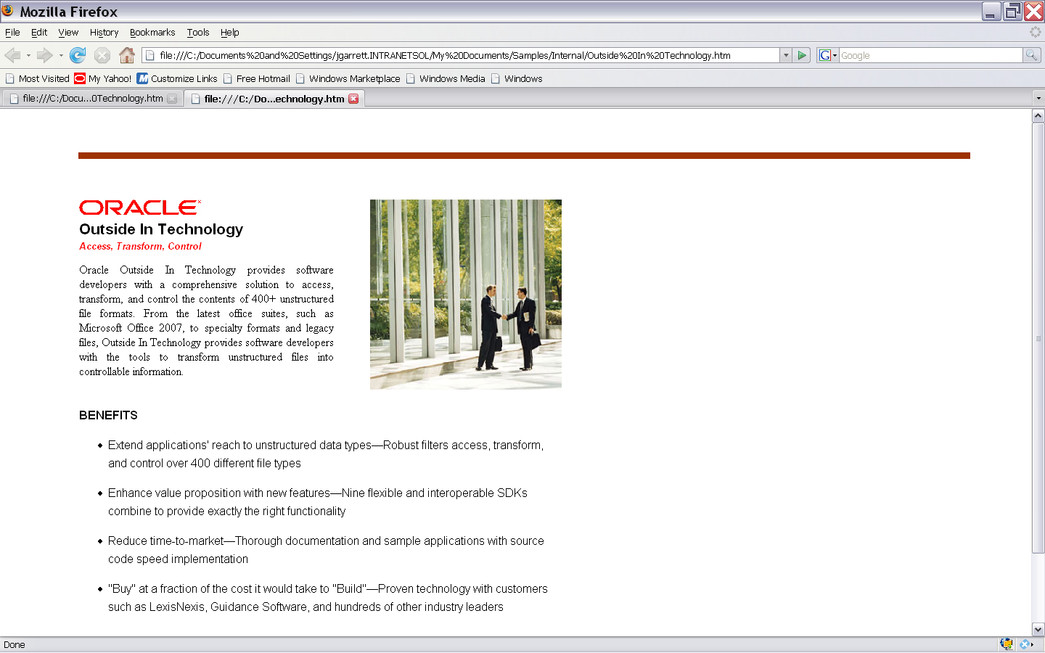
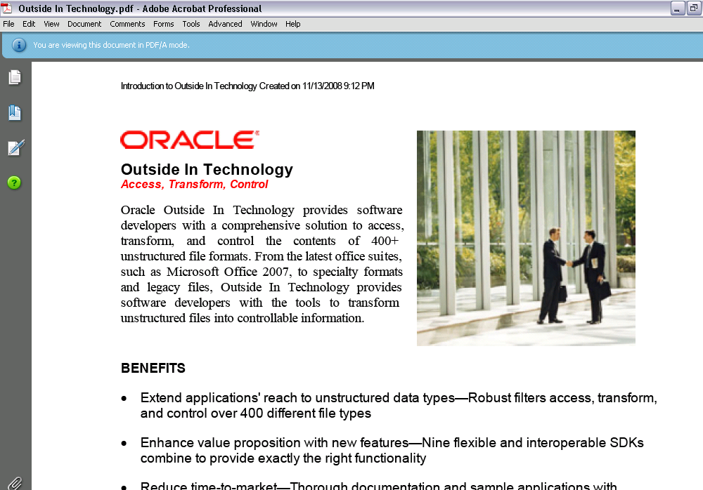
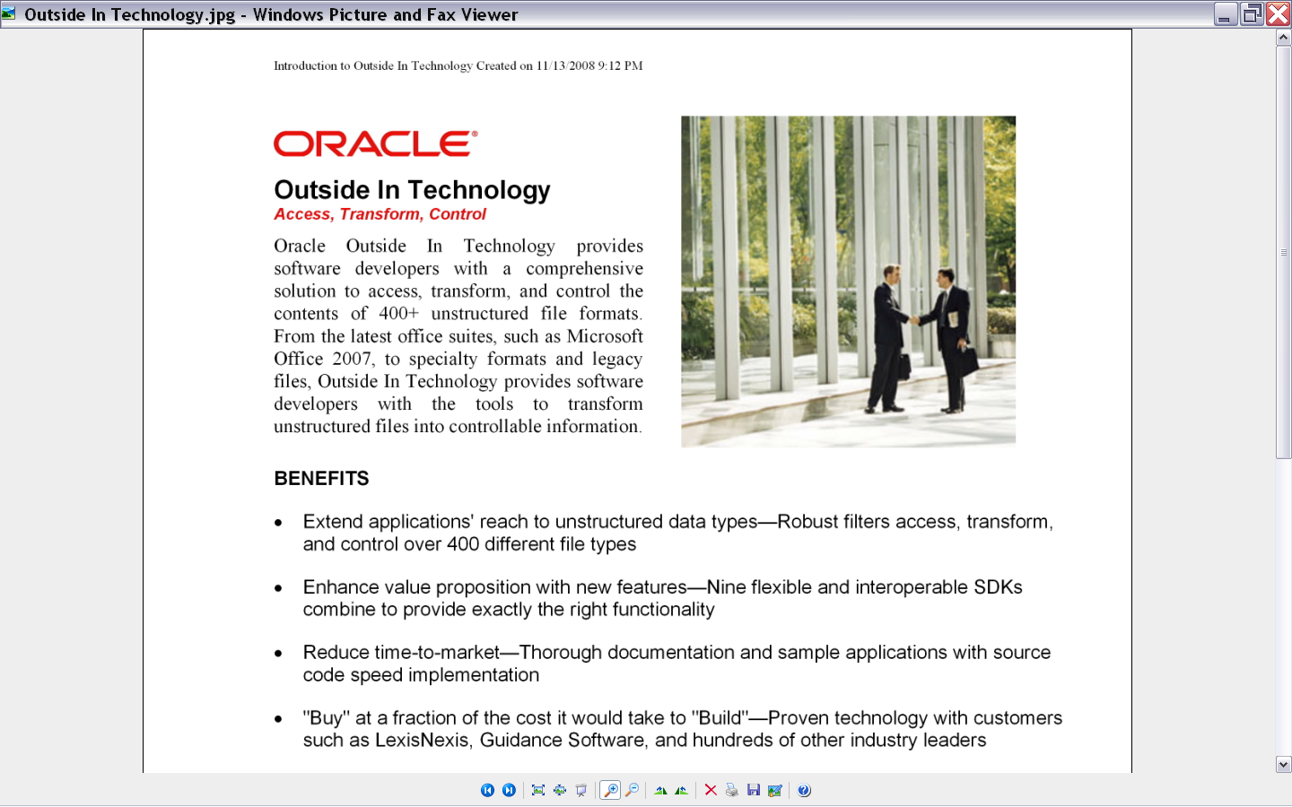
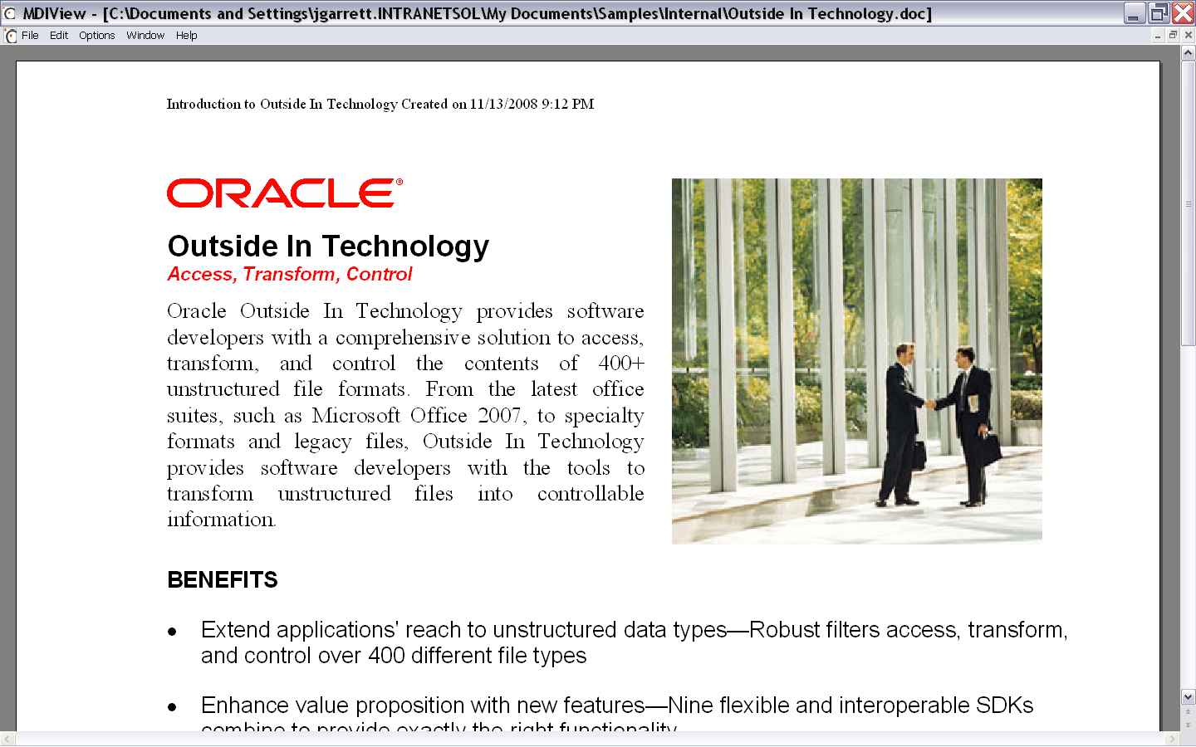
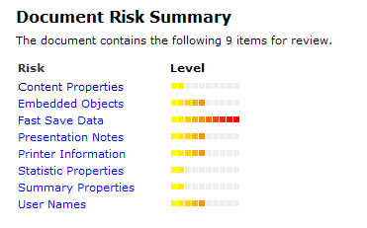
Solution Overview
Embeddable software components that enable ISV applications to extract, view, convert and scrub unstructured information—all from a single core technology.
Convert to HTML & High-Fidelity HTML5
Extract & normalize
Convert to PDF
Convert to Image
View
Scrub risky data

Slide 7
Benefits & Examples
Value | Example
Content findability | Extract properties and content to create index for search Extract “hidden” information for forensics or compliance Extract content from embedded objects and other muti-level formats
User convenience | Quick document preview Easily share and collaborate on documents Enhance search result display or folder display with thumbnail for visual identification
User efficiency | Extract properties to organize content Quick document preview without launching application
Developer efficiency | Extract, convert, render and scrub from multiple input formats to multiple output formats across multiple platforms with one core technology One core technology for numerous use cases Choice of multiple APIs including, C, Java, .NET Support for multiple platforms including many flavors of Windows, Linux, Unix and Solaris Interoperability between SDKs for quick extension of functionality

Slide 8
Extraction Options & Uses Cases
Requirement
Use Cases
Consider…
Real-time analysis
Security
Content Access
Clean Content
Forensics
Extraction
BI
Persistent analysis
Search & Discovery
Search Export
XML Export
Text Analytics
“Crawlable” index with ability to display content from one source
Storage & Archiving
HTML Export
Cloud apps
CRM

Slide 9
Conversion Options & Use Cases
Requirement
Use Case
Consider…
Browser display of document
Content Applications
HTML Export
Portal
Conversion
Static representation of document; document preview
Legal & Compliance
Image Export
Search or any app with document preview
Distributable representation of document
Storage & Archiving
PDF Export
Legal & Compliance

Slide 10
Optional Live Demo

Slide 11
Why Oracle?
Market Leadership
Hundreds of partners with thousands of applications processing millions of documents daily – Proven technology
Expertise
25+ years in business – 15 years average engineer tenure – recognized file format and file parsing experts
Product Breadth & Depth
10 SDKs – 600+ input formats – 14 conversion output formats including XML, HTML, HTML5, PDF and Image – Multiple APIs – 20+ operating systems
Support
Commitment
Sophisticated support systems and knowledgeable staff – Well designed and documented SDKs – Sample source code demonstrating numerous implementations
Significant, ongoing investment
Instant credibility with proven technology
Equipped to solve hard problems
Rapid response to changing market environment
Reduce engineering time and expense; quick response to customers
Long-term, stable partnership reduces rework

Slide 12
Competitive Overview
Solution | Strengths | Weaknesses
Outside In | Proven technology Product breadth & depth Multiple APIs Sophisticated support system Cross platform No requirement for native application | Rendered output never an exact replica of original
Native Applications | Fidelity to original when rendering | Can be expensive Limited platforms (Windows) Stability Performance
Open Source | Low out of pocket cost | Inconsistent quality Lack of support needed for ISVs Potential intellectual property issues
Commercial competitors | Generalists can be aggressive on price Specialists have very good quality (i.e. Adobe) | Lack overall functionality of OIT Specialist (i.e. Adobe) can be quite expensive

