Slide 1

A-Team Marketing
WifeAlert Rebranding

Slide 2

Alternative Name, Logo, and Tagline
ProtectPro:
Personal safety, technologized.

Slide 3
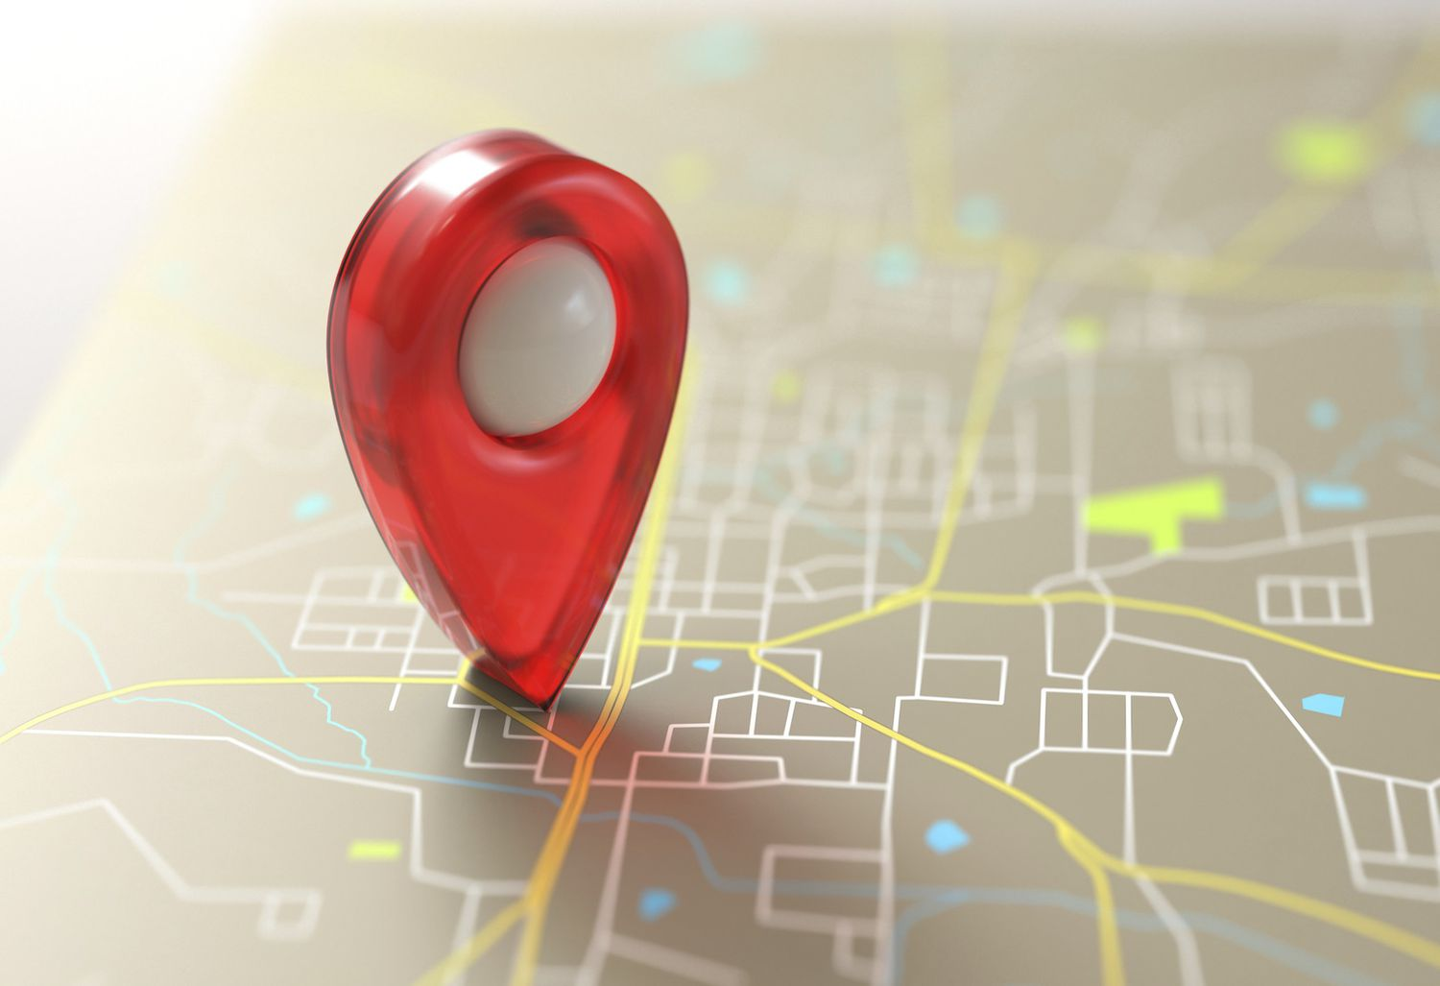
ProtectPro: Alternative Pitch
• Share your location with trusted family and friends on your terms.
• Easily enable or disable location sharing with a single tap.
• Prevent abduction of the ones you hold dear.
• Data is stored encrypted on a decentralized open-source network, preventing misuse.

Slide 4
Marketing Materials: Email Campaign
We have composed the following marketing email. If selected, we will send it out to 1.2 million people using Mailchimp.
Dear Potential Customer,
In today's fast-paced, connected world, staying safe and in touch with your loved ones is more important than ever, but traditional location tracking technologies often come at the cost of your privacy and personal freedom.
That's why we created ProtectPro - a revolutionary location sharing platform that puts you in control.
With ProtectPro, you can:
• Share your location with trusted family and friends, on your terms.
• Easily enable or disable location sharing with a single tap.
• Prevents abduction with minors.
• Allows for easier parenting.
• Rest assured your data is secure, encrypted, and never misused.
With ProtectPro You decide who can see your location, and you can revoke access at any time. Our decentralized, open-source architecture ensures your personal information stays private and in your hands.
You stay safely connected without sacrificing your autonomy. Take the pill for ProtectPro today and take control of your connections.

Slide 5

Marketing Materials: Online Image Advertisements
We have created the following image advertisement, which is to be displayed through Google Ads. We can create further similar images to aid in the campaign if selected.

Slide 6
Marketing Materials: Video Advertisement
We have produced the following video advertisement to be displayed through YouTube and similar video platforms.

Slide 7
Cost of Campaign
The base cost of producing the marketing materials and distributing marketing emails will be approximately $30000. This number excludes the cost of online advertising. Because of the nature of this type of advertising, the amount spent can be varied. We will allow you to decide the final budget for online advertisement distribution through Google Ads and YouTube, but we will advise that you allocate at least $10000-20000 in addition to the base cost.
The cost will also depend on the length of the campaign, also chosen by you. The campaign will run for approximately one month initially but can be lengthened if needed. For each additional month, production costs will not be incurred, but the online advertisement budget will need to be replenished.
Our team intends to oversee the campaign through its conclusion, and if our strategy proves ineffective, we will reevaluate at no additional cost to you.

