Slide 1
Progress Meeting
S&P Global
January 30, 2024
Misael M. Morales
Carlos Torres-Verdin, Michael Pyrcz

Slide 2
Executive Summary
Raw well logs are noisy, composed of multiple runs, and affected by environmental factors.
e.g., temperature, salinity, wellbore effects, …
Petrophysical analysis and interpretation requires corrected well logs for accurate subsurface characterization and formation evaluation.
Sweet spot detection, reservoir-seal detection, sand-shale differentiation, ….
Automated Shale Baseline Correction
Automated Mineral Composition Estimation
Anisotropic Resistivity Inversion

Slide 3
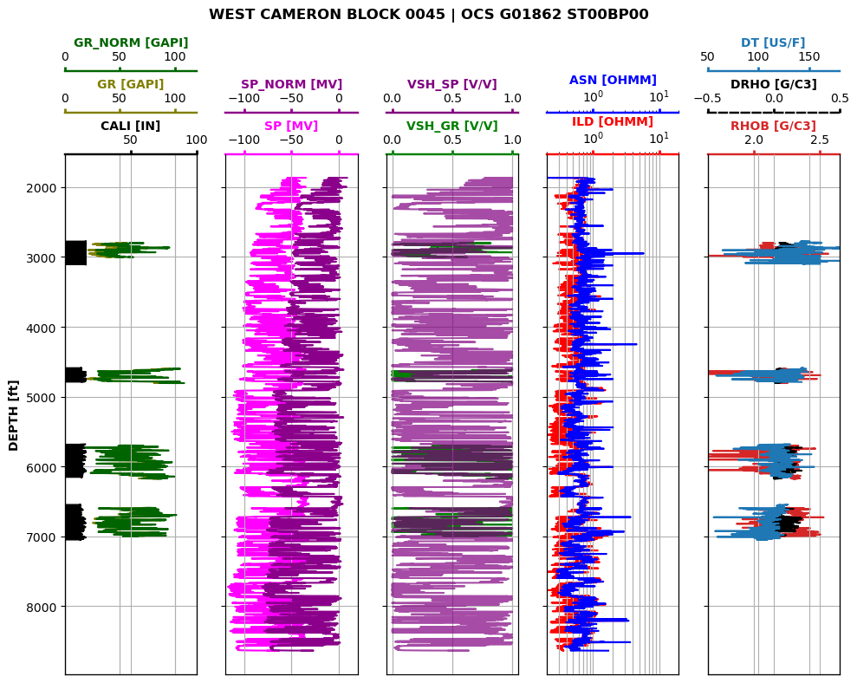
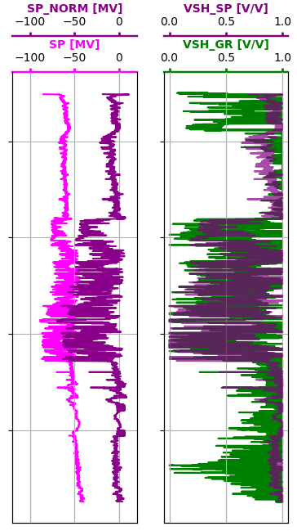
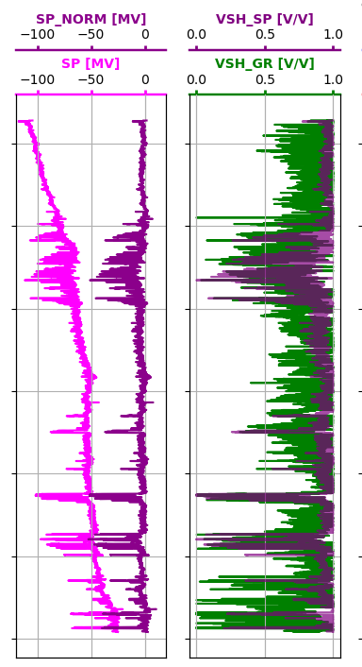
Automated Shale Baseline Correction
Detect trends and anomalies in raw log data and apply an automatic correction algorithms to obtain baseline-corrected well logs.

Slide 4
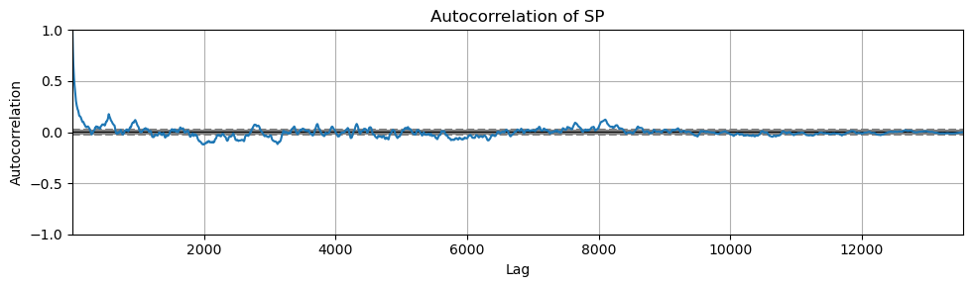
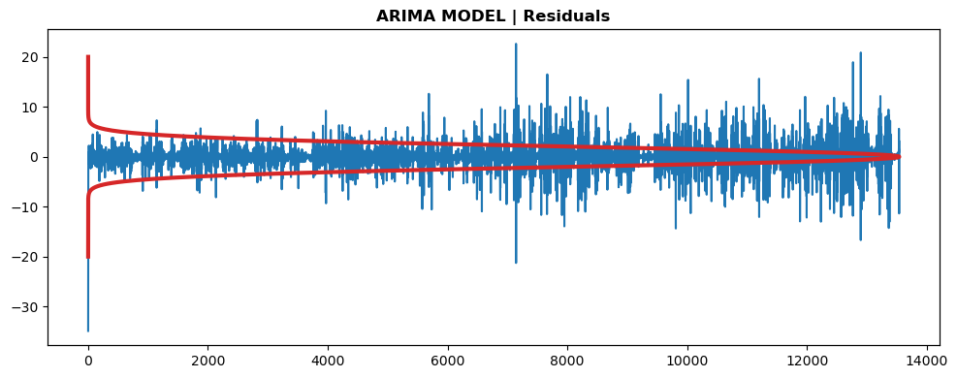
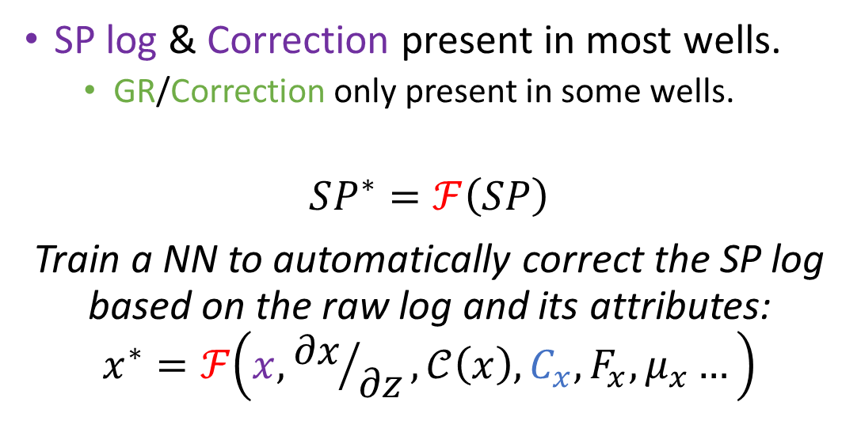
Automated Shale Baseline Correction
SP log & Correction present in most wells.
GR/Correction only present in some wells.
$$SP^{∗}=ℱ\left(SP\right)$$
Train a NN to automatically correct the SP log based on the raw log and its attributes:
$$x^{∗}=ℱ\left(x,{∂x}/{∂z},𝒞\left(x\right),C_{x},F_{x},μ_{x}…\right)$$
Notes:
Raw log, derivative, coherence, autocorrelation, FFT, mean filter, etc.

Slide 5
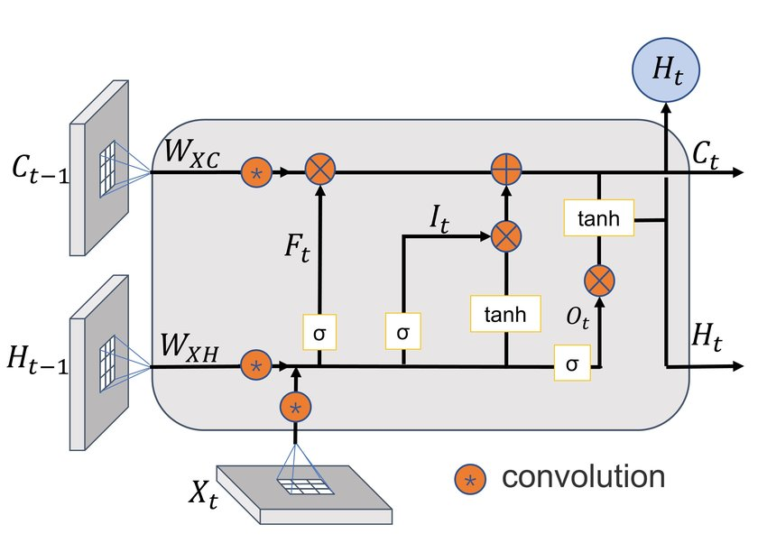


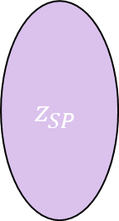
z
SP
$$\frac{∂SP}{∂z}$$
$$…$$
SP*
Encoder
$$z_{SP}$$
Decoder
Conv
LSTM
Upsampling
LeakyReLU
Batch Norm
Batch Norm
LeakyReLU
Conv Transp
Max Pool
LSTM
Conv-LSTM layer

Slide 6
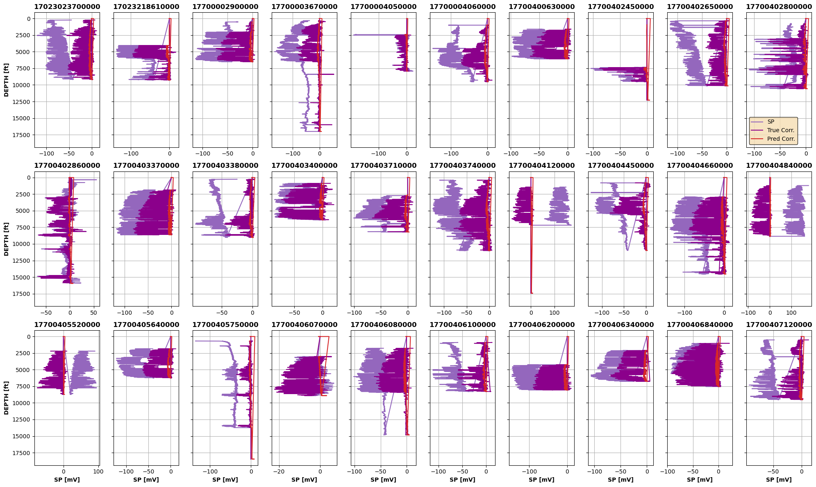
Testing Set

Slide 7
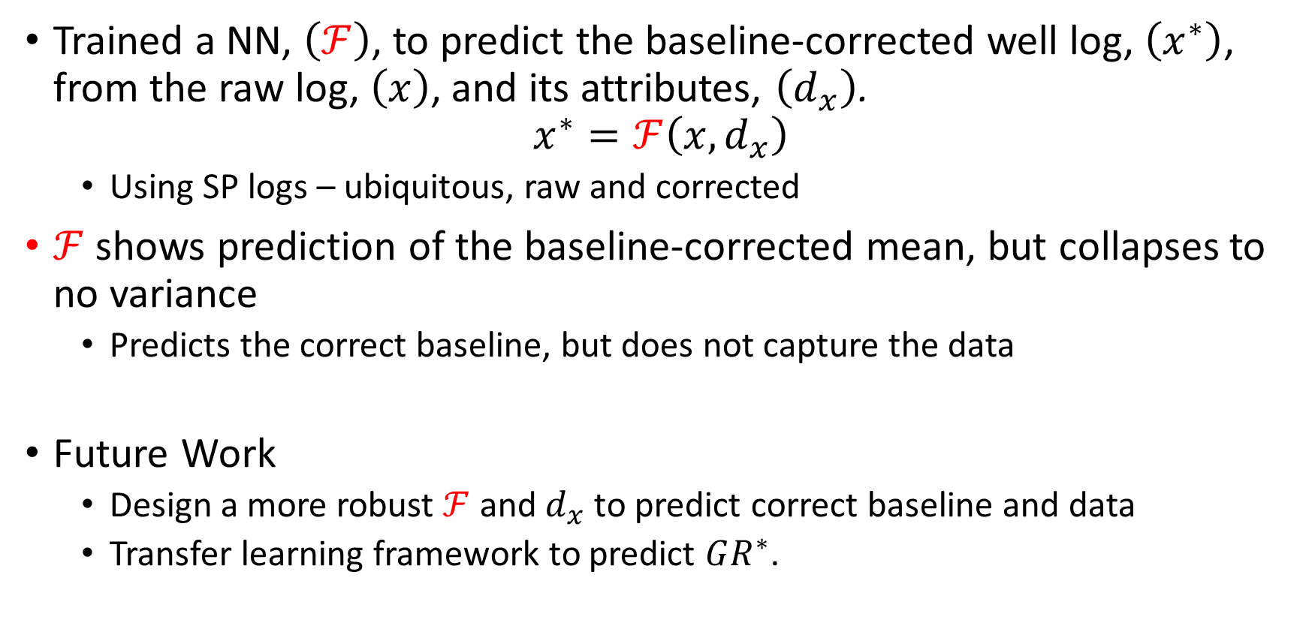
Findings and future work
Trained a NN, $\left(ℱ\right)$, to predict the baseline-corrected well log, $\left(x^{∗}\right)$, from the raw log, $\left(x\right)$, and its attributes, $\left(d_{x}\right)$.
$$x^{∗}=ℱ\left(x,d_{x}\right)$$
Using SP logs – ubiquitous, raw and corrected
$ℱ$ shows prediction of the baseline-corrected mean, but collapses to no variance
Predicts the correct baseline, but does not capture the data
Future Work
Design a more robust $ℱ$ and $d_{x}$ to predict correct baseline and data
Transfer learning framework to predict $GR^{∗}$.

Slide 8
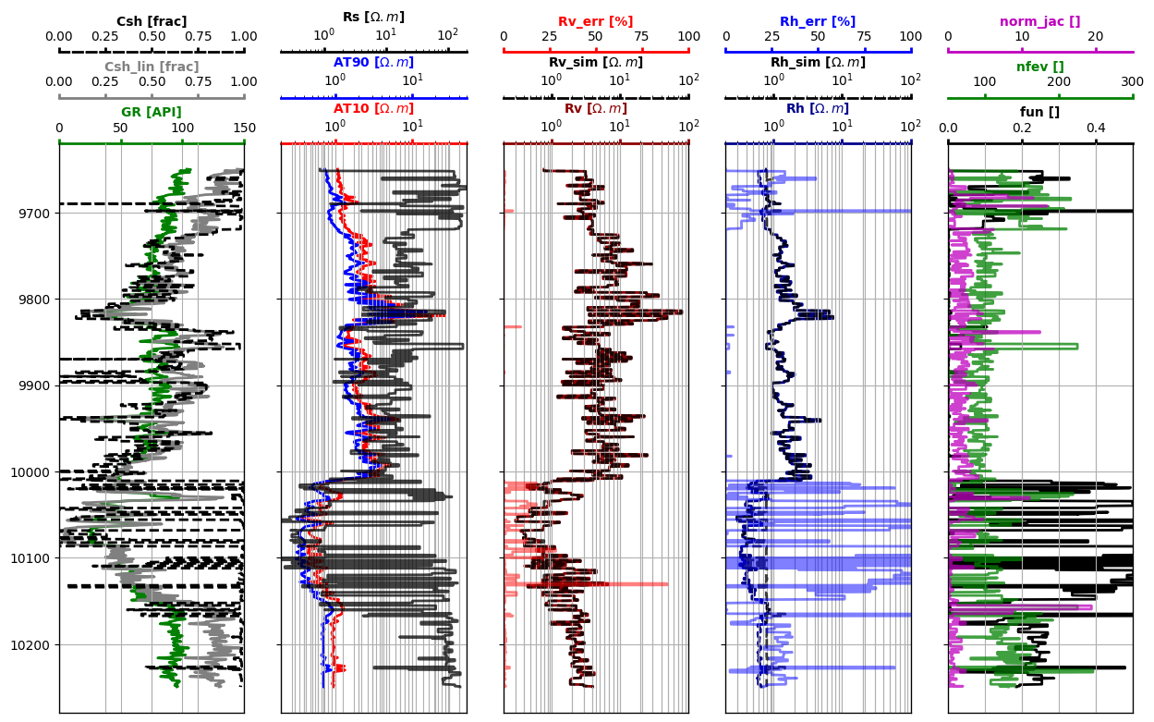
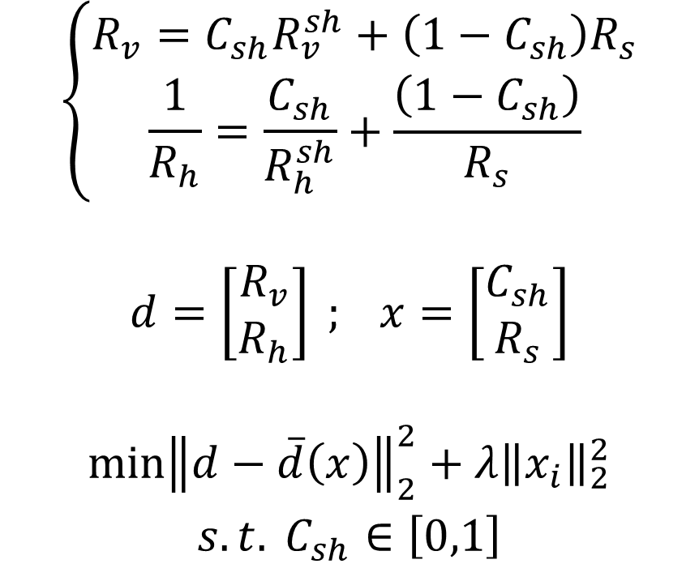
Automated Anisotropic Resistivity Inversion
(Nonlinear inversion with Automatic Differentiation framework for UQ)
$$\left\{\begin{aligned}R_{v}=C_{sh}R_{v}^{sh}+\left(1−C_{sh}\right)R_{s} \\ \frac{1}{R_{h}}=\frac{C_{sh}}{R_{h}^{sh}}+\frac{\left(1−C_{sh}\right)}{R_{s}}&\end{aligned}\right.$$
$$d=\left[\begin{aligned}R_{v} \\ R_{h}\end{aligned}\right] ; x=\left[\begin{aligned}C_{sh} \\ R_{s}\end{aligned}\right]$$
$$\begin{matrix}\min{{\left\|d−\overline{d}\left(x\right)\right\|}_{2}^{2}+λ{\left\|x_{i}\right\|}_{2}^{2}} \\ s.t. C_{sh}∈\left[0,1\right]\end{matrix}$$

Slide 9
Automated Mineral Composition Estimation
Rock classification based on core data (Leverett; Winland; Lorenz)

Slide 10
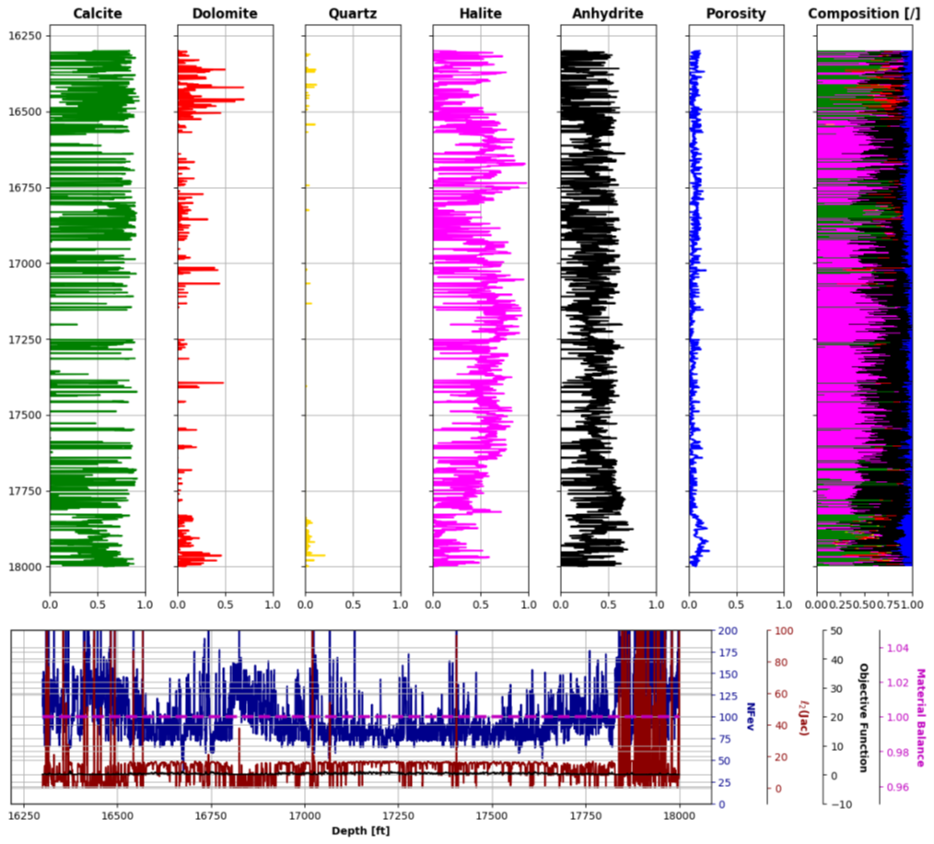
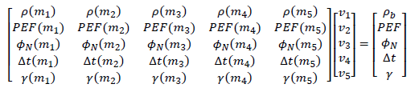
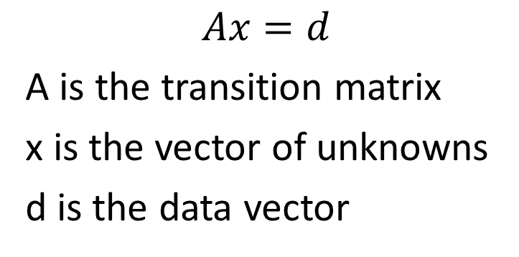
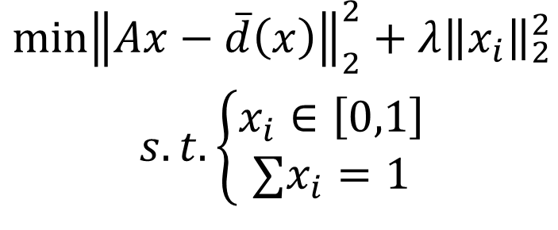
Automated Mineral Composition Estimation
(Mineral inversion)
$$Ax=d$$
A is the transition matrix
x is the vector of unknowns
d is the data vector
$$\begin{matrix}\min{{\left\|Ax−\overline{d}\left(x\right)\right\|}_{2}^{2}+λ{\left\|x_{i}\right\|}_{2}^{2}} \\ s.t. \left\{\begin{aligned}x_{i}∈\left[0,1\right] \\ ∑x_{i}=1\end{aligned}\right.\end{matrix}$$

