Slide 1
Progress Meeting
December 08, 2023
Misael M. Morales
Carlos Torres-Verdin, Michael Pyrcz

Slide 2
Executive Summary
Raw well log data is often noisy, composed of multiple runs, and affected by environmental factors.
e.g., temperature, salinity, wellbore effects, …
Petrophysical analysis and interpretation requires corrected well logs for accurate subsurface characterization.
Sweet spot detection, reservoir-seal detection, …
Automatic well log baseline correction
Detect trends and anomalies in raw log data and apply an automatic correction algorithms to obtain baseline-corrected well logs.

Slide 3
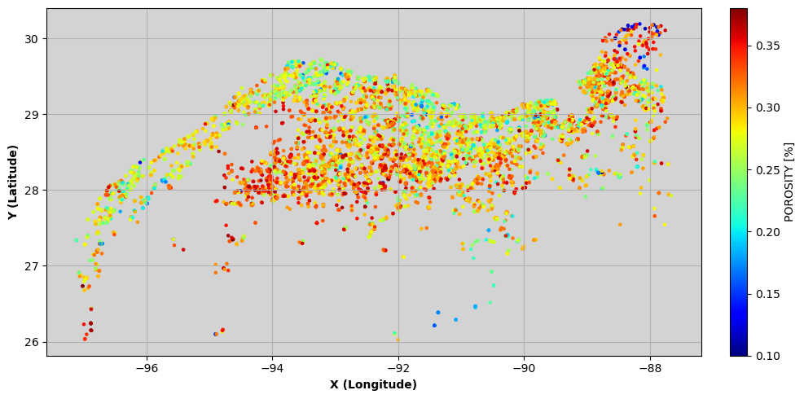
CCS_Sand_wells1
Spatial context of well log data in the Gulf of Mexico (data from S&P Global)

Slide 4
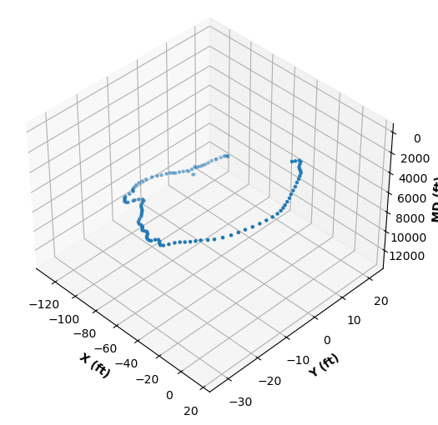
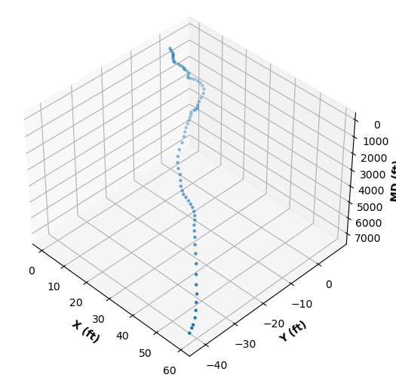
UT dir surveys
API 177004037400
API 427064023000

Slide 5
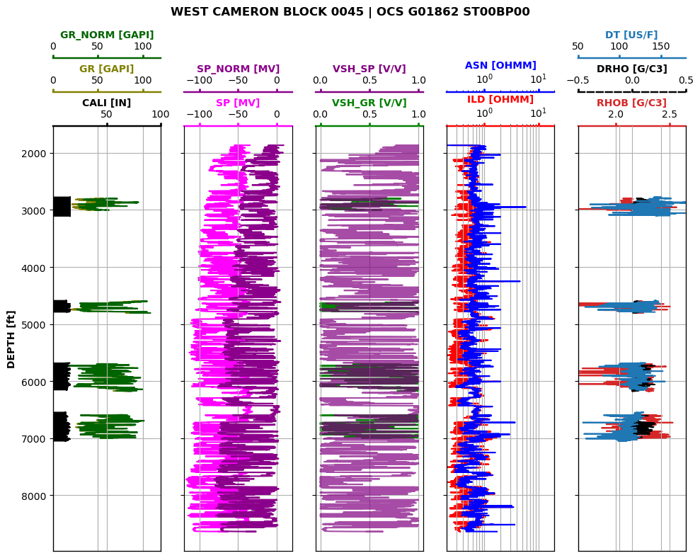
Example of a typical well log suite from the provided library

Slide 6
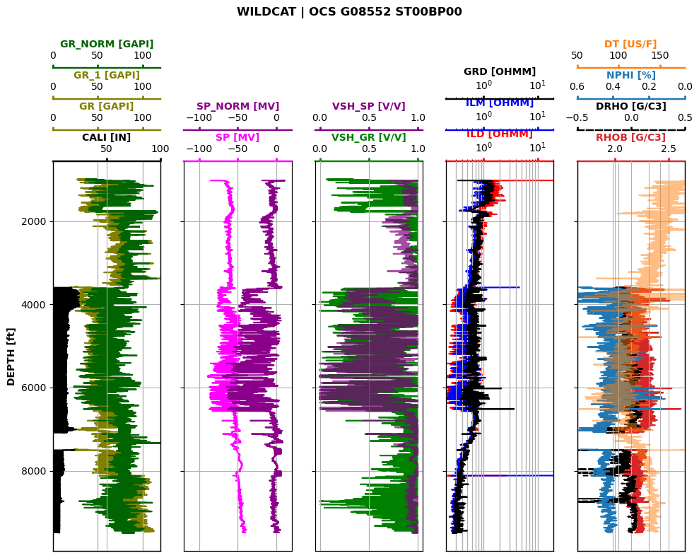
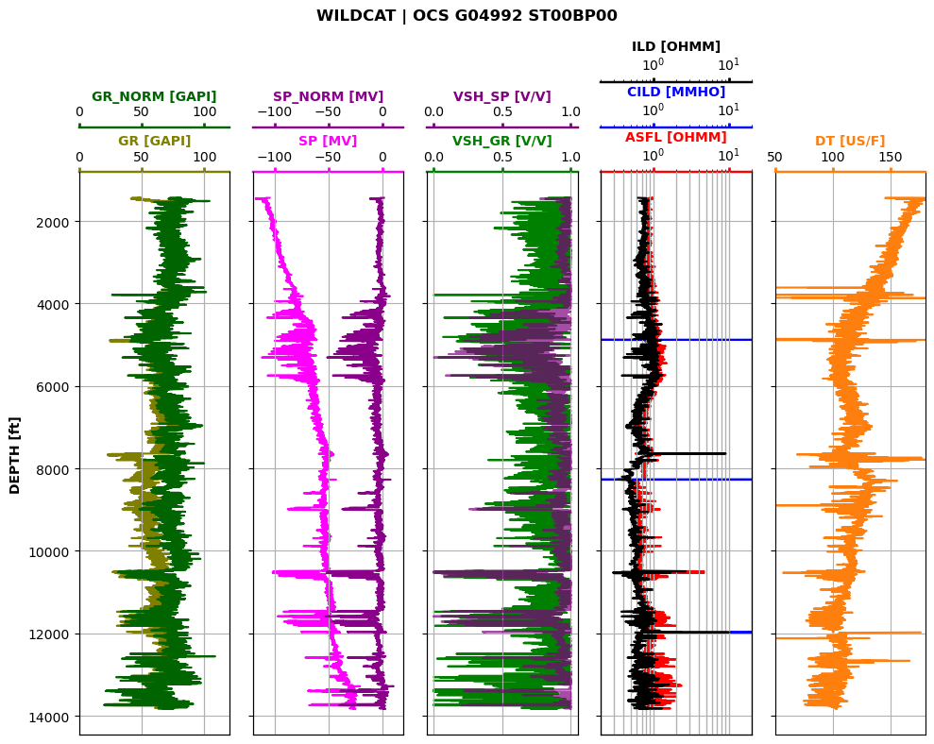
Example of an overcomplete well log suite from the provided library

Slide 7
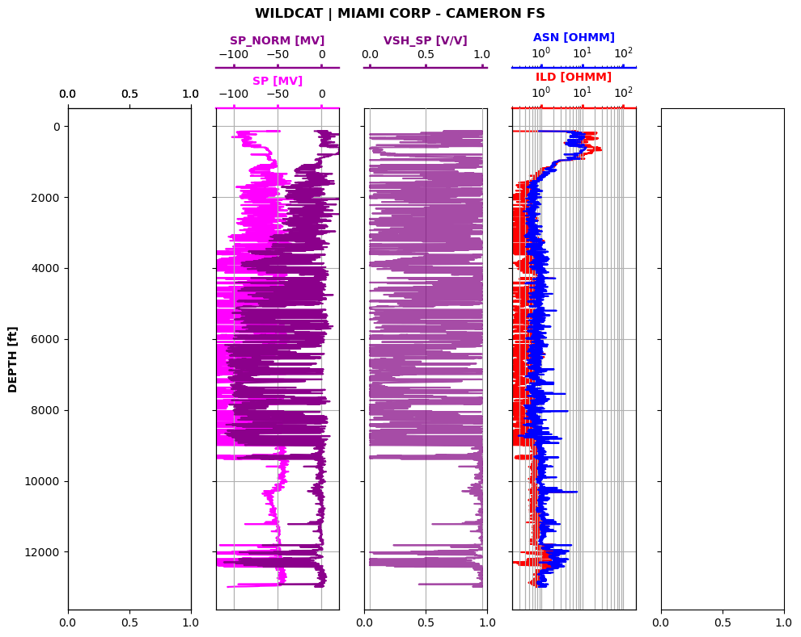
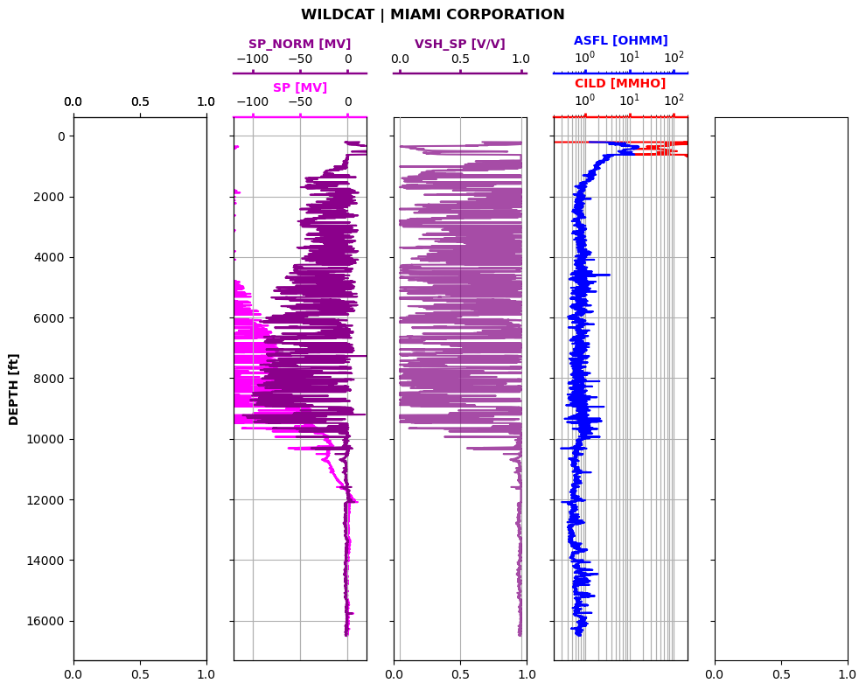
Example of an undercomplete well log suite from the provided library

Slide 8
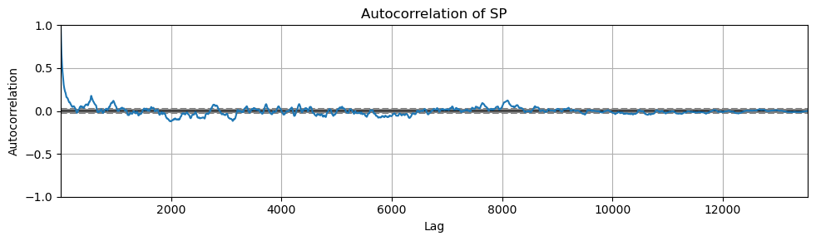
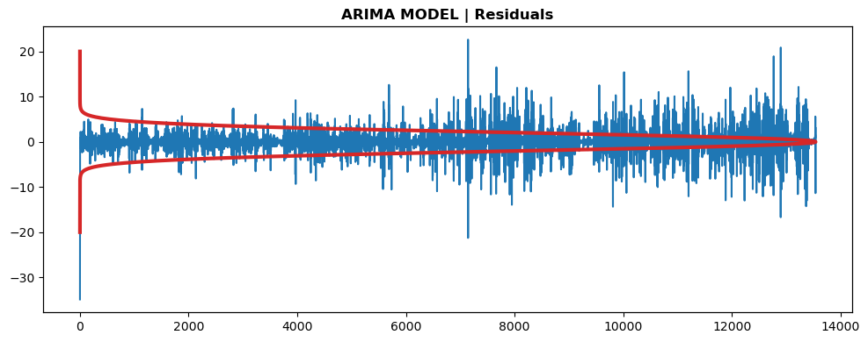
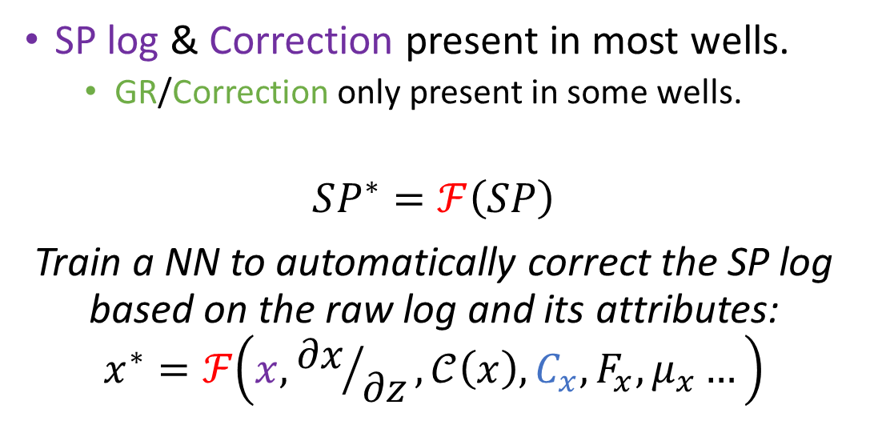
Baseline Correction
SP log & Correction present in most wells.
GR/Correction only present in some wells.
$$SP^{∗}=ℱ\left(SP\right)$$
Train a NN to automatically correct the SP log based on the raw log and its attributes:
$$x^{∗}=ℱ\left(x,{∂x}/{∂z},𝒞\left(x\right),C_{x},F_{x},μ_{x}…\right)$$
Notes:
Raw log, derivative, coherence, autocorrelation, FFT, mean filter, etc.

Slide 9




$$\left(x,d_{x}\right)$$
$$ℱ$$
$$x^{∗}$$
$$\text{Train} \text{a} \text{NN} \text{to} \text{automatically} \text{correct} \text{the} \text{SP} \text{log} \text{based} \text{on} \text{the} \text{raw} \text{log} \text{and} \text{its} \text{attributes}\text{:}$$
$$x^{∗}=ℱ\left(x,{∂x}/{∂z},𝒞\left(x\right),C_{x},F_{x},μ_{x}…\right)$$
Learn the baseline correction mapping operator $𝓕$ from $\left(x,d_{x}\right)$ to $x^{∗}$ such that:
$$x^{∗}=ℱ\left(x,d_{x}\right)$$

Slide 10
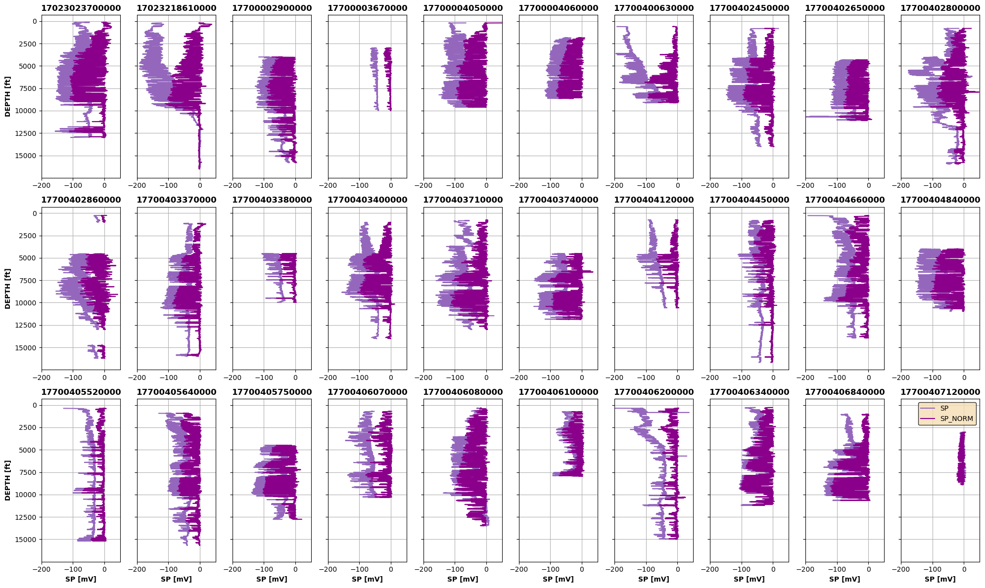
Testing Set

Slide 11
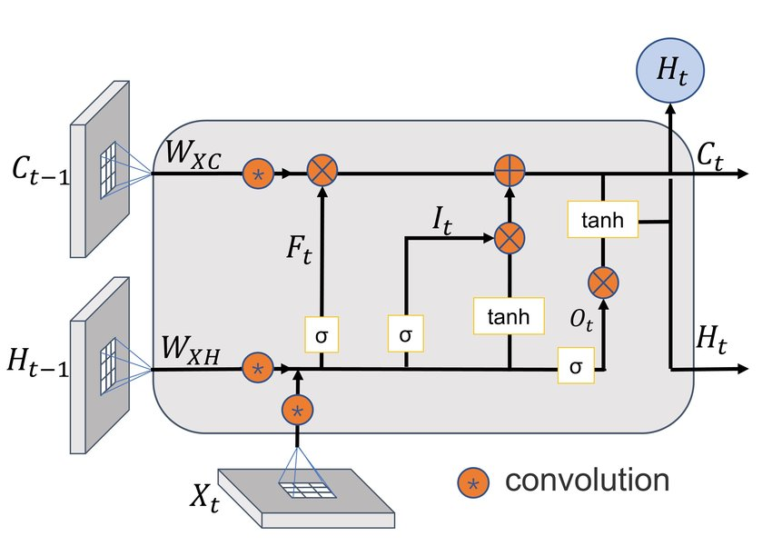


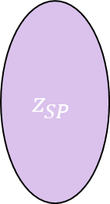
Spatiotemporal Encoder-Decoder model
z
SP
$$\frac{∂SP}{∂z}$$
$$…$$
SP*
Encoder
$$z_{SP}$$
Decoder
Conv
LSTM
Upsampling
LeakyReLU
Batch Norm
Batch Norm
LeakyReLU
Conv Transp
Max Pool
LSTM
Conv-LSTM layer

Slide 12
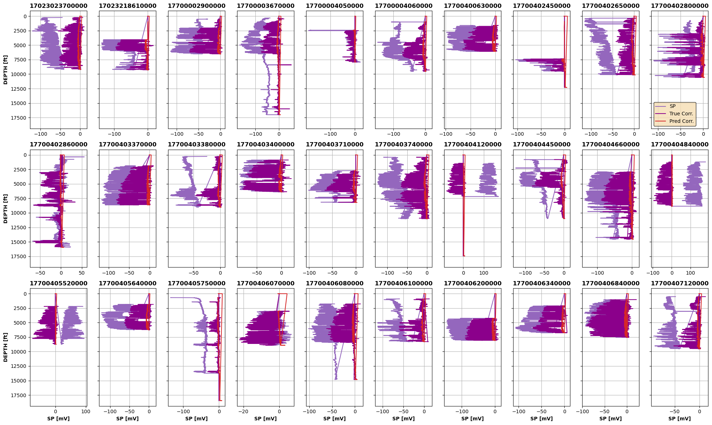
Testing Set

Slide 13
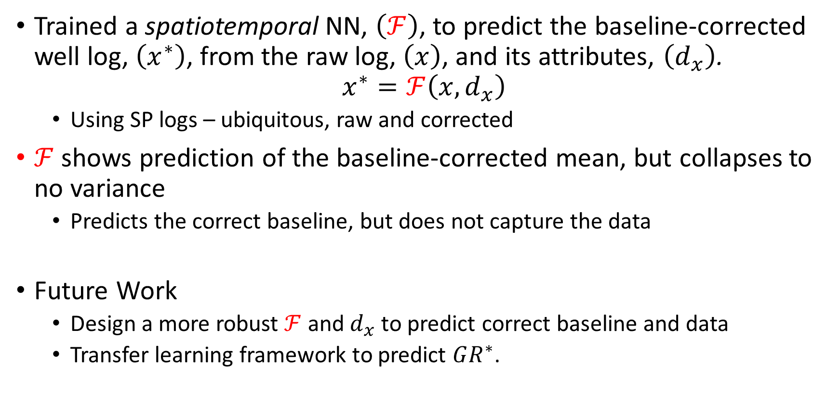
Findings and future work
Trained a spatiotemporal NN, $\left(ℱ\right)$, to predict the baseline-corrected well log, $\left(x^{∗}\right)$, from the raw log, $\left(x\right)$, and its attributes, $\left(d_{x}\right)$.
$$x^{∗}=ℱ\left(x,d_{x}\right)$$
Using SP logs – ubiquitous, raw and corrected
$ℱ$ shows prediction of the baseline-corrected mean, but collapses to no variance
Predicts the correct baseline, but does not capture the data
Future Work
Design a more robust $ℱ$ and $d_{x}$ to predict correct baseline and data
Transfer learning framework to predict $GR^{∗}$.

