Slide 1
Progress Meeting
S&P Global
February 15, 2024
Misael M. Morales,
Carlos Torres-Verdín, Michael Pyrcz

Slide 2
Executive Summary
Raw well logs are noisy, composed of multiple runs, and affected by environmental factors.
e.g., temperature, salinity, wellbore effects, …
Petrophysical analysis and interpretation requires corrected well logs for accurate subsurface characterization and formation evaluation.
Sweet spot detection, reservoir-seal detection, sand-shale differentiation, ….
Automated Shale Baseline Correction
*Anisotropic Resistivity Inversion
*Automated Core2Log Rock Classification
*Automated Mineral Composition Estimation

Slide 3
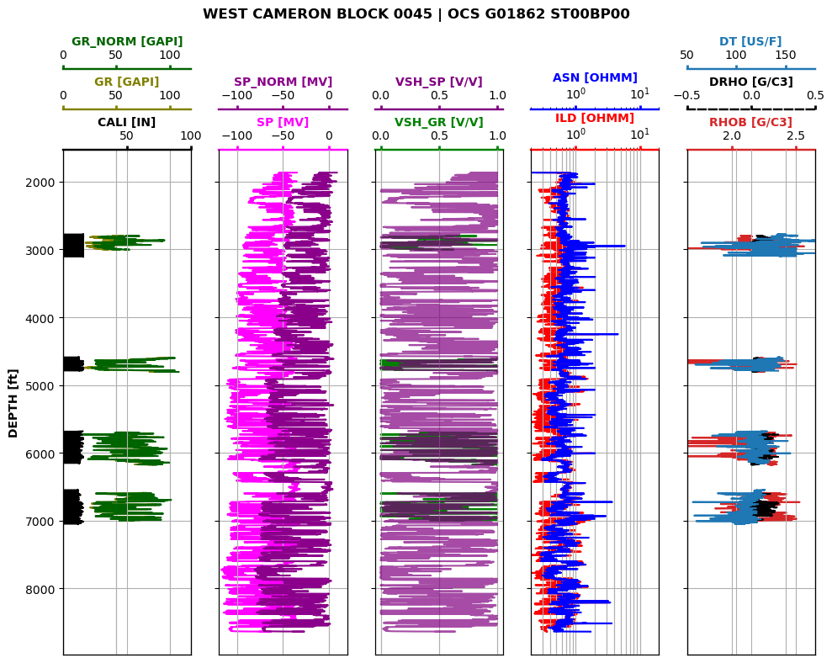
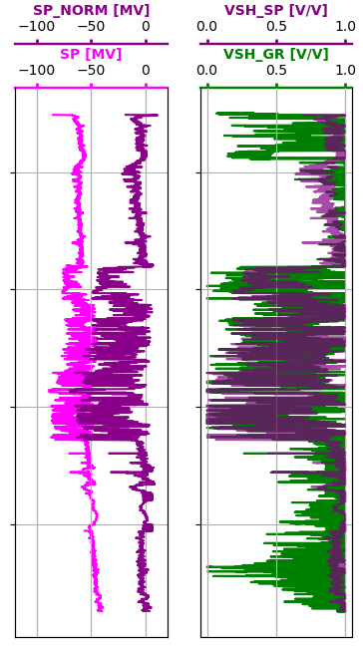
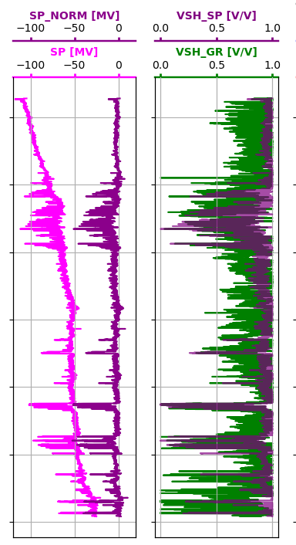
Automated Shale Baseline Correction
Detect trends and anomalies in raw log data and apply an automatic correction algorithms to obtain baseline-corrected well logs.

Slide 4
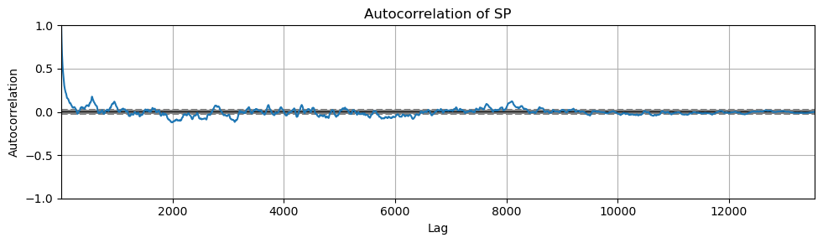
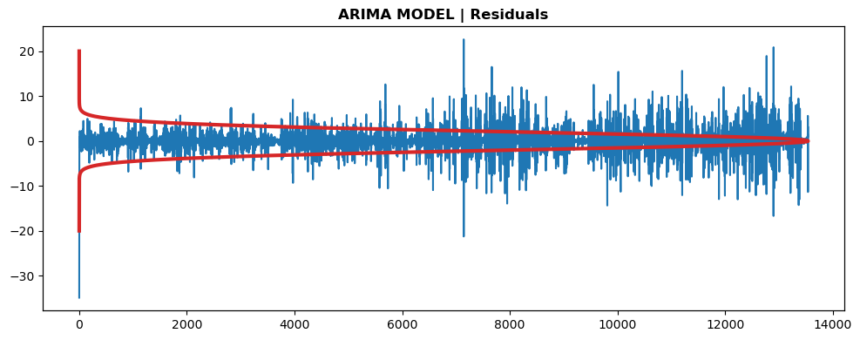
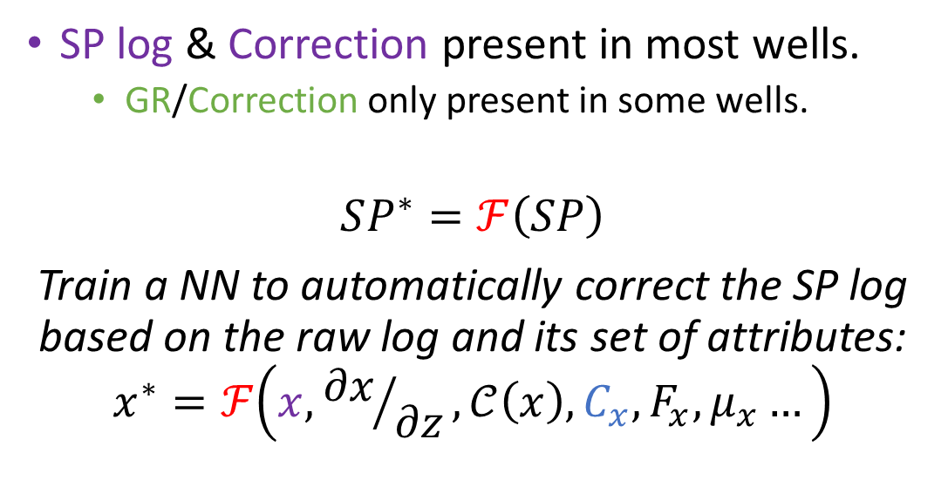
Automated Shale Baseline Correction
SP log & Correction present in most wells.
GR/Correction only present in some wells.
$$SP^{∗}=ℱ\left(SP\right)$$
Train a NN to automatically correct the SP log based on the raw log and its set of attributes:
$$x^{∗}=ℱ\left(x,{∂x}/{∂z},𝒞\left(x\right),C_{x},F_{x},μ_{x}…\right)$$
Notes:
Raw log, derivative, coherence, autocorrelation, FFT, mean filter, etc.

Slide 5
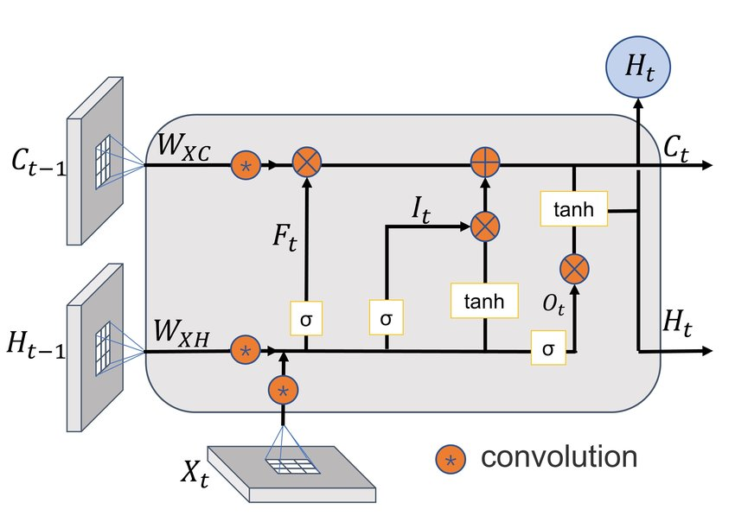


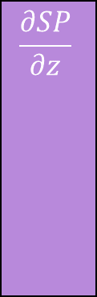
Residual concatenation
z
SP
$$\frac{∂SP}{∂z}$$
$$…$$
SP*
$$z_{SP}$$
Encoder
Decoder
Conv
LSTM
ReLU
Upsampling
Batch Norm
Batch Norm
ReLU
Conv
Conv-LSTM layer
Max Pool
LSTM

Slide 6
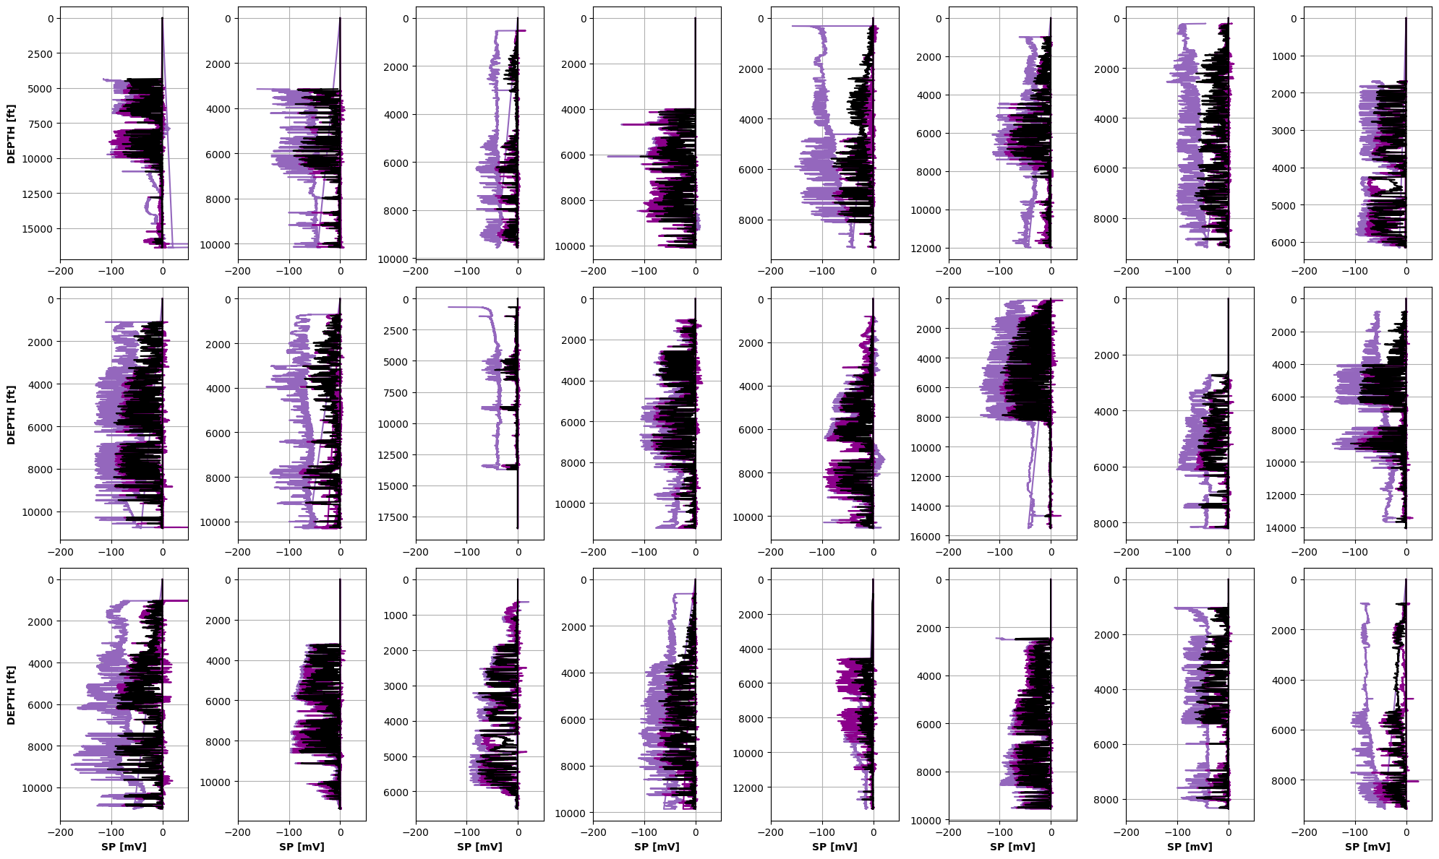
Testing Set

Slide 7
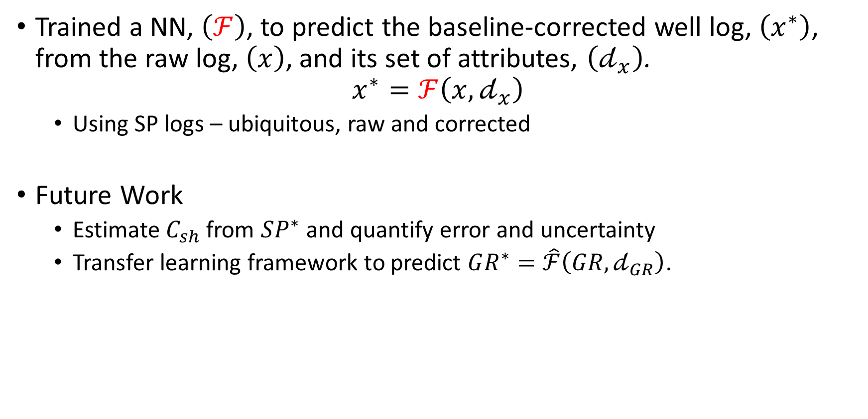
Findings and future work
Trained a NN, $\left(ℱ\right)$, to predict the baseline-corrected well log, $\left(x^{∗}\right)$, from the raw log, $\left(x\right)$, and its set of attributes, $\left(𝒹_{x}\right)$.
$$x^{∗}=ℱ\left(x,𝒹_{x}\right)$$
Using SP logs – ubiquitous, raw and corrected
Future Work
Estimate $C_{sh}$ from $SP^{∗}$ and quantify error and uncertainty
Transfer learning framework to predict $GR^{∗}=\hat{ℱ}\left(GR,𝒹_{GR}\right)$.

Slide 8
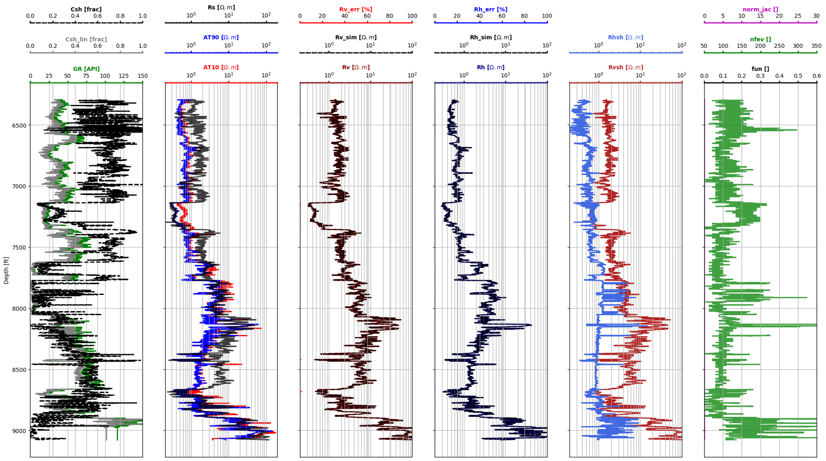
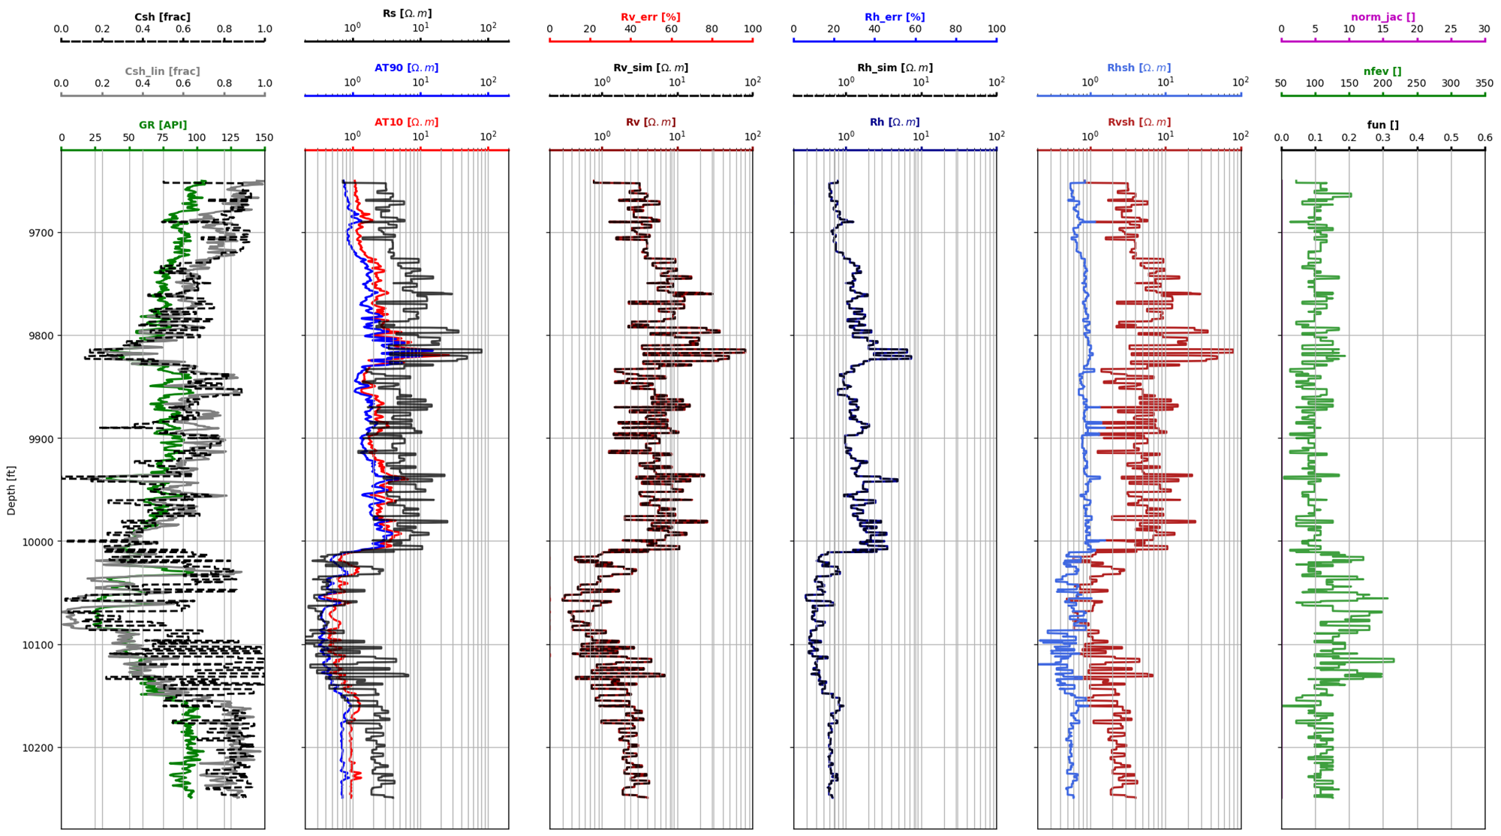
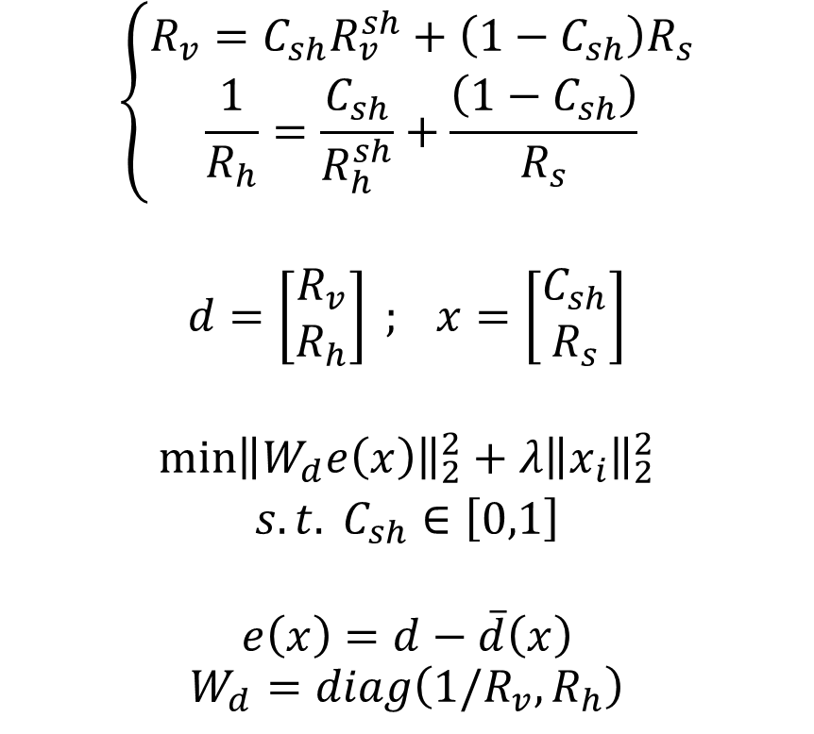
1. Automated Anisotropic Resistivity Inversion
(Nonlinear inversion with Automatic Differentiation framework for UQ)
$$\left\{\begin{aligned}R_{v}=C_{sh}R_{v}^{sh}+\left(1−C_{sh}\right)R_{s} \\ \frac{1}{R_{h}}=\frac{C_{sh}}{R_{h}^{sh}}+\frac{\left(1−C_{sh}\right)}{R_{s}}&\end{aligned}\right.$$
$$d=\left[\begin{aligned}R_{v} \\ R_{h}\end{aligned}\right] ; x=\left[\begin{aligned}C_{sh} \\ R_{s}\end{aligned}\right]$$
$$\begin{matrix}\min{{\left\|W_{d}e\left(x\right)\right\|}_{2}^{2}+λ{\left\|x_{i}\right\|}_{2}^{2}} \\ s.t. C_{sh}∈\left[0,1\right]\end{matrix}$$
$$e\left(x\right)=d−\overline{d}\left(x\right)$$
$$W_{d}=diag\left({1/R}_{v}, R_{h}\right)$$

Slide 9
2. Automated Core2Log Rock Classification
(Continuous rock classification based on core data)

Slide 10
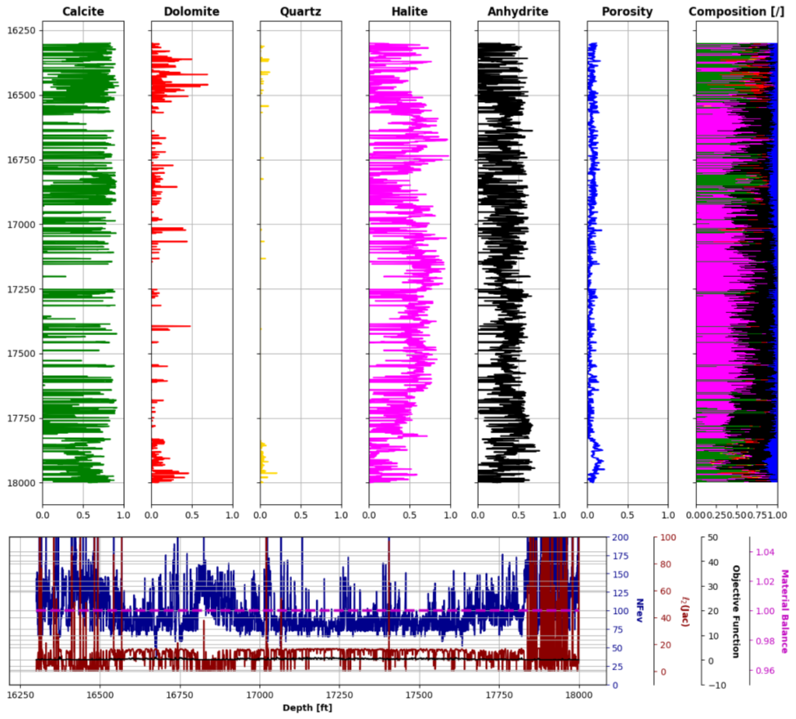
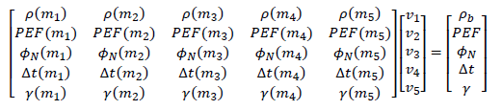
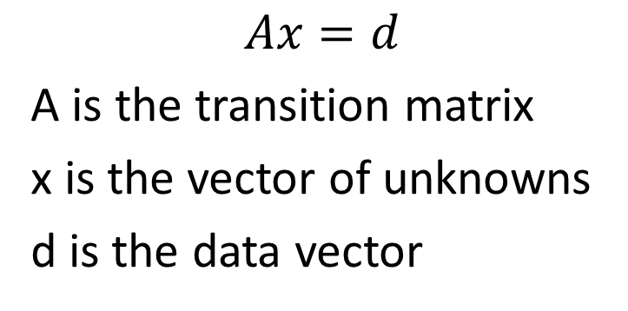
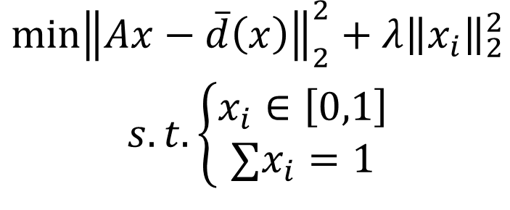
3. Automated Mineral Composition Estimation
$$Ax=d$$
A is the transition matrix
x is the vector of unknowns
d is the data vector
$$\begin{matrix}\min{{\left\|Ax−\overline{d}\left(x\right)\right\|}_{2}^{2}+λ{\left\|x_{i}\right\|}_{2}^{2}} \\ s.t. \left\{\begin{aligned}x_{i}∈\left[0,1\right] \\ ∑x_{i}=1\end{aligned}\right.\end{matrix}$$

Slide 11
End

Slide 13



Residual concatenation
$$ξ$$
$$\hat{ξ}$$
$$z$$
Encoder
Decoder
Conv1D
Batch Norm
ReLU
Dropout
Max Pool
Conv1D
Batch Norm
ReLU
Dropout
UpSampling

