Slide 1
Well log baseline correction and Normalization
via Latent space analysis
S&P Global – Update meeting
May 5th, 2023
Misael M. Morales
Graduate Research Assistant, The University of Texas at Austin
Michael J. Pyrcz
Professor, The University of Texas at Austin
Carlos Torres-Verdín
Professor, The University of Texas at Austin

Slide 2
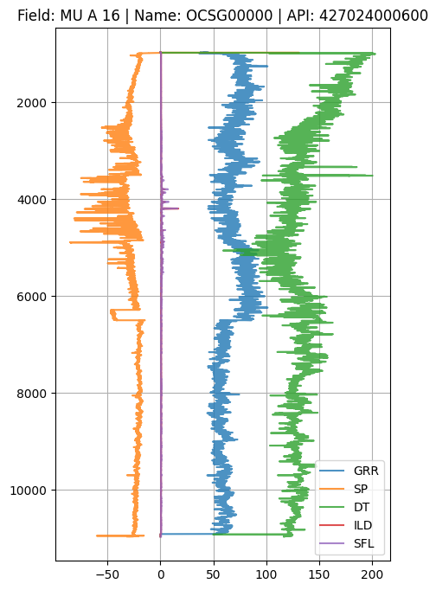
Outline
Executive Summary
Motivation
Dimensionality Reduction
Latent Space Well Log Analysis
Conclusions & Future Work
Well pad 1
Well Log Baseline Correction and Normalization via Latent Space Analysis

Slide 3
Outline
Executive Summary
Motivation
Dimensionality Reduction
Latent Space Well Log Analysis
Conclusions & Future Work
Well pad 1
Well Log Baseline Correction and Normalization via Latent Space Analysis

Slide 4
Executive Summary
Well log analysis requires expert petrophysical evaluation and interpretation to understand changes in lithology, environmental effects, and data issues.
Multivariate analysis enhances well log analysis by incorporating a suite of logs to make more robust predictions and inference of the subsurface.
Dimensionality reduction is a suitable technique for salient feature analysis in latent space for multivariate well log data.
Multivariate latent space clustering provides better-informed well log inference.
Well pad 1
Well Log Baseline Correction and Normalization via Latent Space Analysis

Slide 5
Outline
Executive Summary
Motivation
Dimensionality Reduction
Latent Space Well Log Analysis
Conclusions & Future Work
Well pad 1
Well Log Baseline Correction and Normalization via Latent Space Analysis

Slide 6
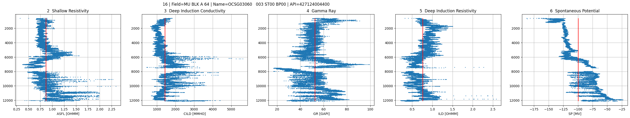
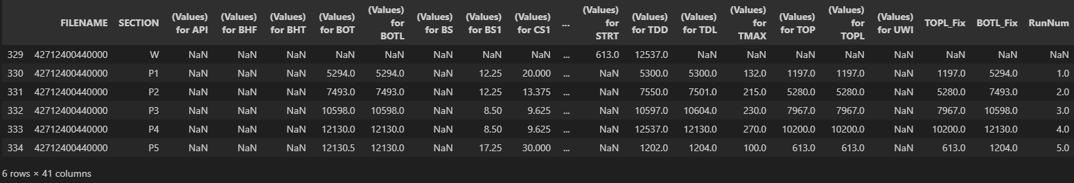
Motivation
Different baselines in well logs can be attributed to:
Changes in lithology
Multiple runs on different environments
Well Log Baseline Correction and Normalization via Latent Space Analysis

Slide 7
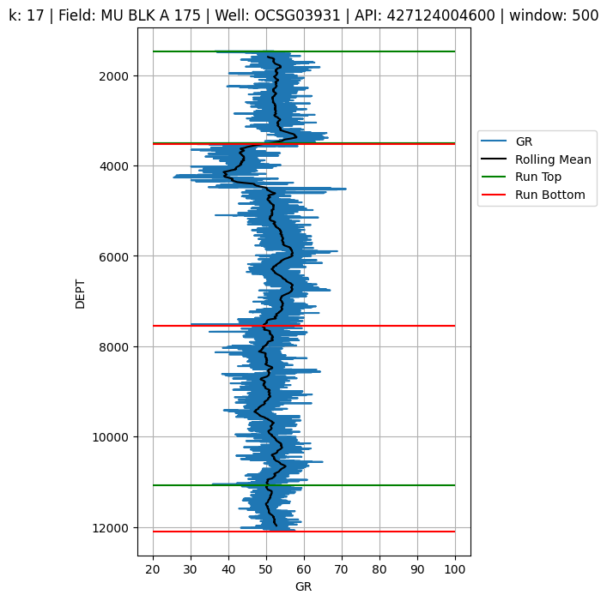
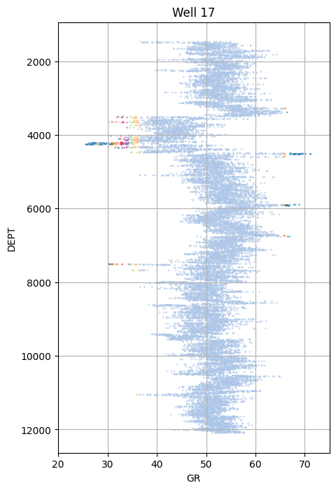
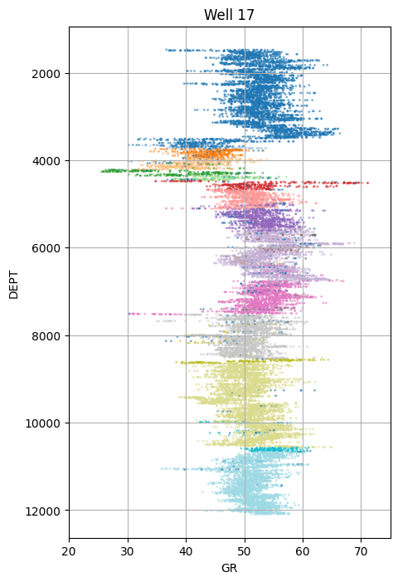
Motivation
Multivariate analysis enhances inference and improves our understanding of well logs.
GR, Rolling Mean, and Log Runs
Cluster predictions using only GR
Cluster predictions using all mnemonics
Well Log Baseline Correction and Normalization via Latent Space Analysis

Slide 8
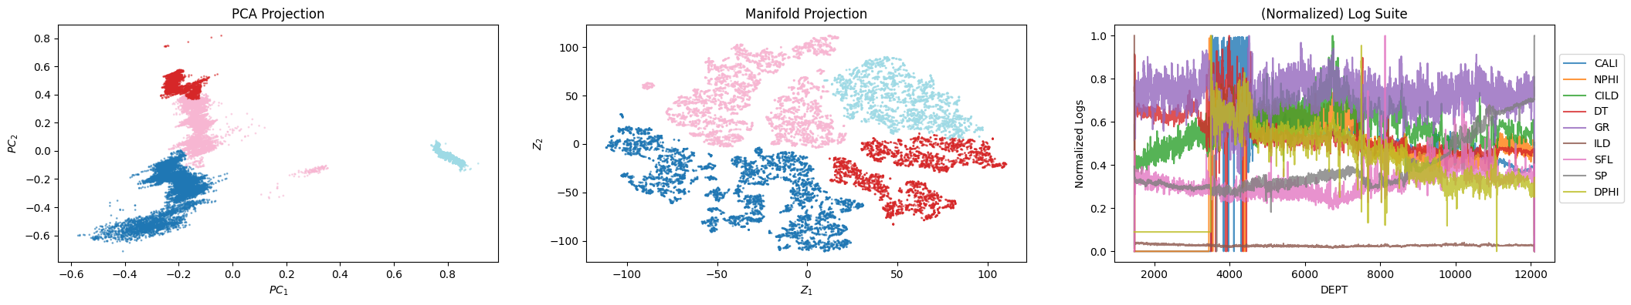
Motivation
For each well, we have a suite of logs
In some cases, we have over 20 mnemonics for a single well!
To leverage the high-dimensional space, but exploit latent features in the data:
Apply dimensionality reduction
Perform clustering in latent space, conditioned to the number of runs in each well
This workflow provides a data-driven approach to enhanced well log analysis
Well Log Baseline Correction and Normalization via Latent Space Analysis

Slide 9
Outline
Executive Summary
Motivation
Dimensionality Reduction
Latent Space Well Log Analysis
Conclusions & Future Work
Well pad 1
Well Log Baseline Correction and Normalization via Latent Space Analysis

Slide 10
Dimensionality Reduction
A suite of well logs is often redundant and can be reduced into salient latent components.
Dimensionality Reduction is an efficient method for modeling and understanding of the subsurface, exploiting the hidden features and information in data.
A wide array of techniques can be applied for subsurface dimensionality reduction.
PCA, SVD, Dictionary Learning, FFT, DWT, Manifold Learning
Deep Learning-based AutoEncoders
We recommend to work in latent space for subsurface modeling and well log analysis.
Well Log Baseline Correction and Normalization via Latent Space Analysis

Slide 11
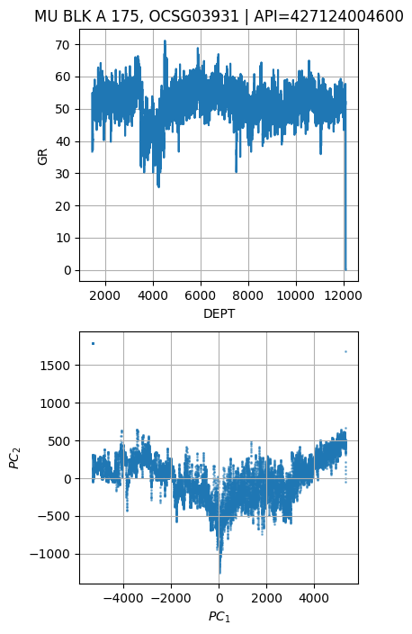
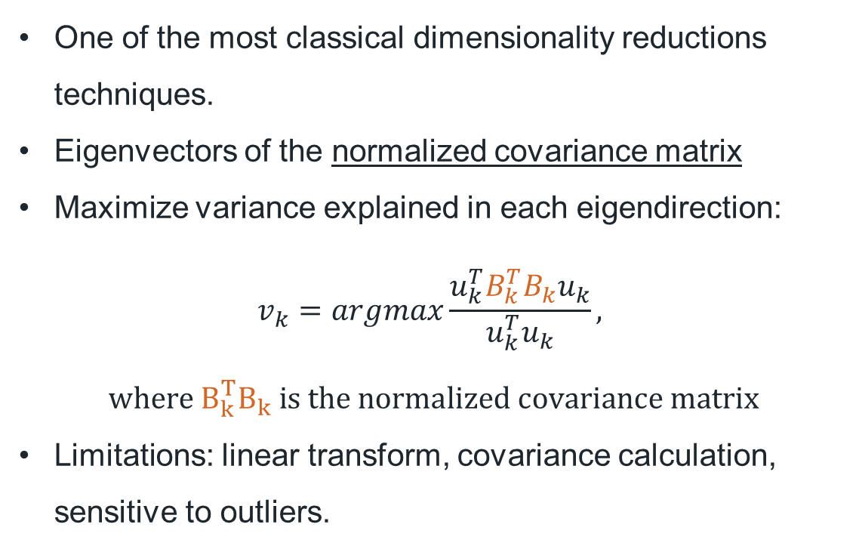
Dimensionality Reduction: PCA
One of the most classical dimensionality reductions techniques.
Eigenvectors of the normalized covariance matrix
Maximize variance explained in each eigendirection:
$$v_{k}=argmax\frac{u_{k}^{T}B_{k}^{T}B_{k}u_{k}}{u_{k}^{T}u_{k}},$$
$$where B_{k}^{T}B_{k} is the normalized covariance matrix$$
Limitations: linear transform, covariance calculation, sensitive to outliers.
Well Log Baseline Correction and Normalization via Latent Space Analysis

Slide 12
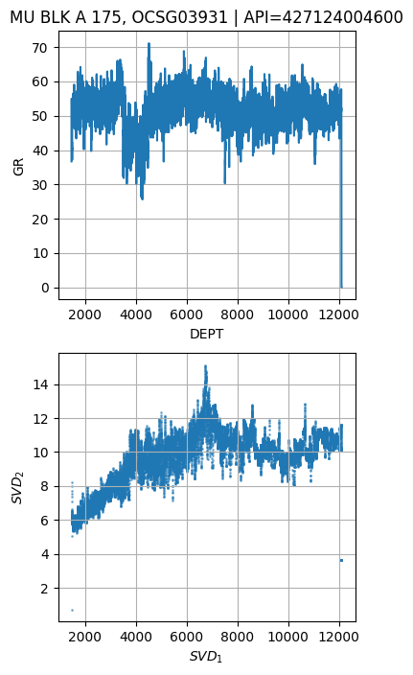
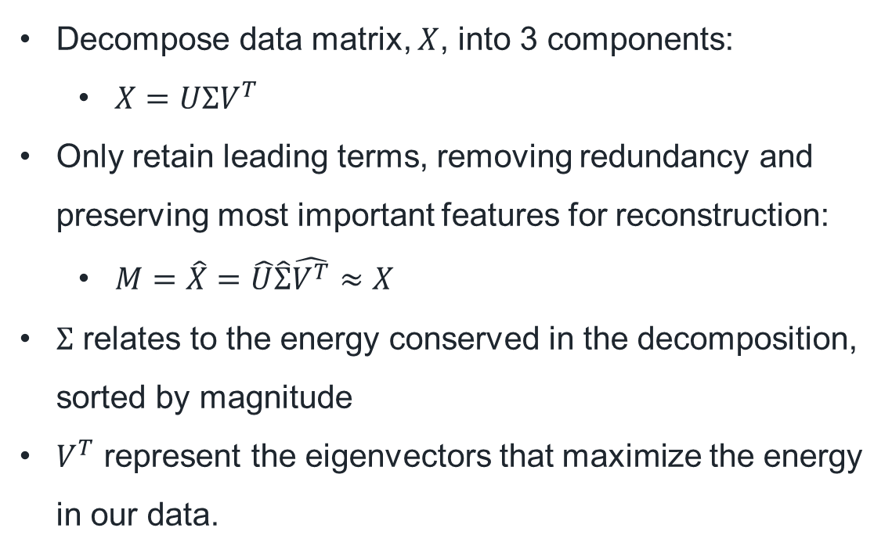
Dimensionality Reduction: SVD
Decompose data matrix, $X$, into 3 components:
$X=UΣV^{T}$
Only retain leading terms, removing redundancy and preserving most important features for reconstruction:
$M=\hat{X}=\hat{U}\hat{Σ}\hat{V^{T}}≈X$
$Σ$ relates to the energy conserved in the decomposition, sorted by magnitude
$V^{T}$ represent the eigenvectors that maximize the energy in our data.
Well Log Baseline Correction and Normalization via Latent Space Analysis

Slide 13
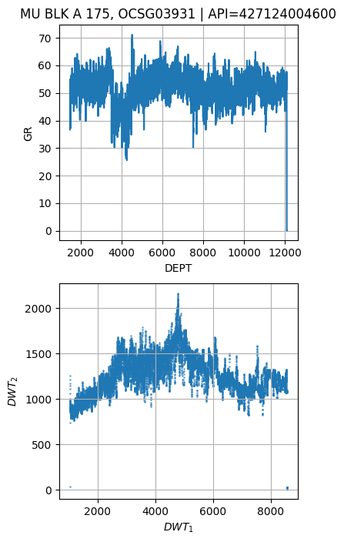
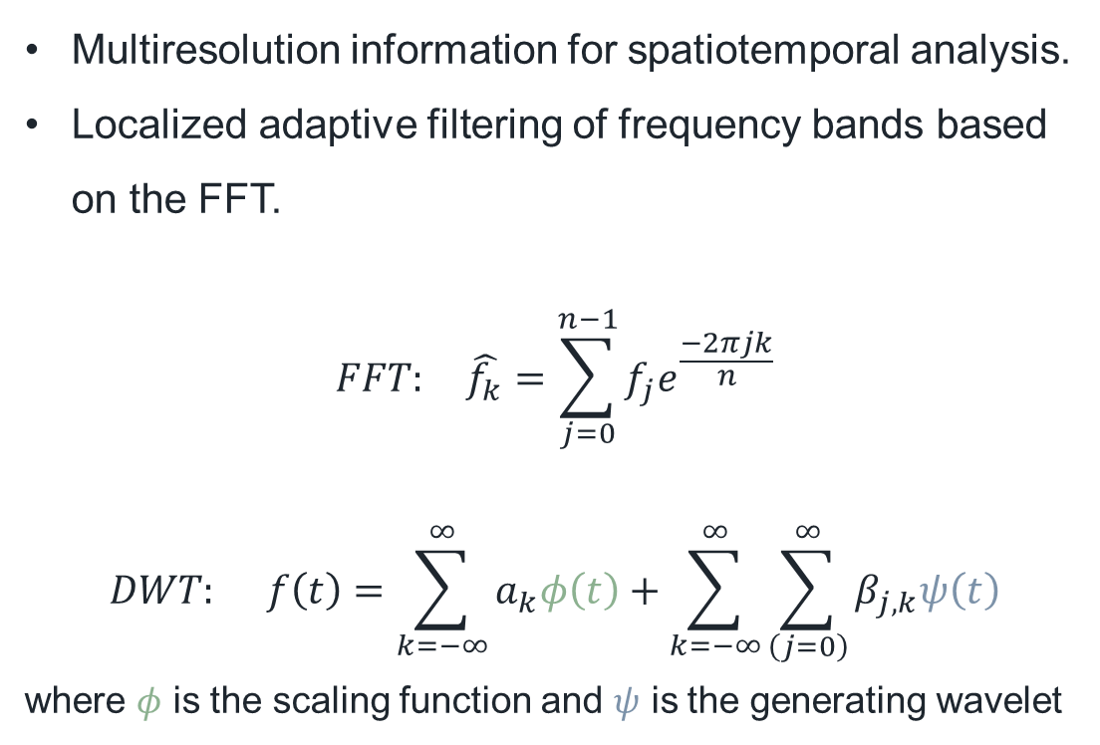
Dimensionality Reduction: DWT
Multiresolution information for spatiotemporal analysis.
Localized adaptive filtering of frequency bands based on the FFT.
$$FFT: \hat{f_{k}}=\sum_{j=0}^{n−1}{f_{j}e^{\frac{−2πjk}{n}}}$$
$$DWT: f\left(t\right)=\sum_{k=−∞}^{∞}{a_{k}φ\left(t\right)}+\sum_{k=−∞}^{∞}{\sum_{\left(j=0\right)}^{∞}{β_{j,k}ψ\left(t\right)}}$$
where $φ$ is the scaling function and $ψ$ is the generating wavelet
Well Log Baseline Correction and Normalization via Latent Space Analysis

Slide 14
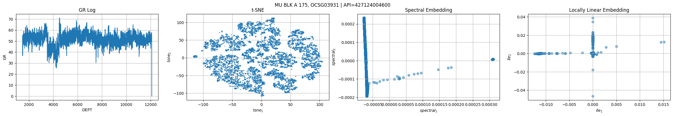
Dimensionality Reduction: Manifolds
Nonlinear projections of data into a 2D manifolds.
Retains high-dimensional structure of the data, but in lower-dimensional space.
Provides an advantage over linear methods (e.g., PCA)
Many different techniques exist:
MDS, Isomap, LLE, Spectral, t-SNE, etc.
Well Log Baseline Correction and Normalization via Latent Space Analysis

Slide 15
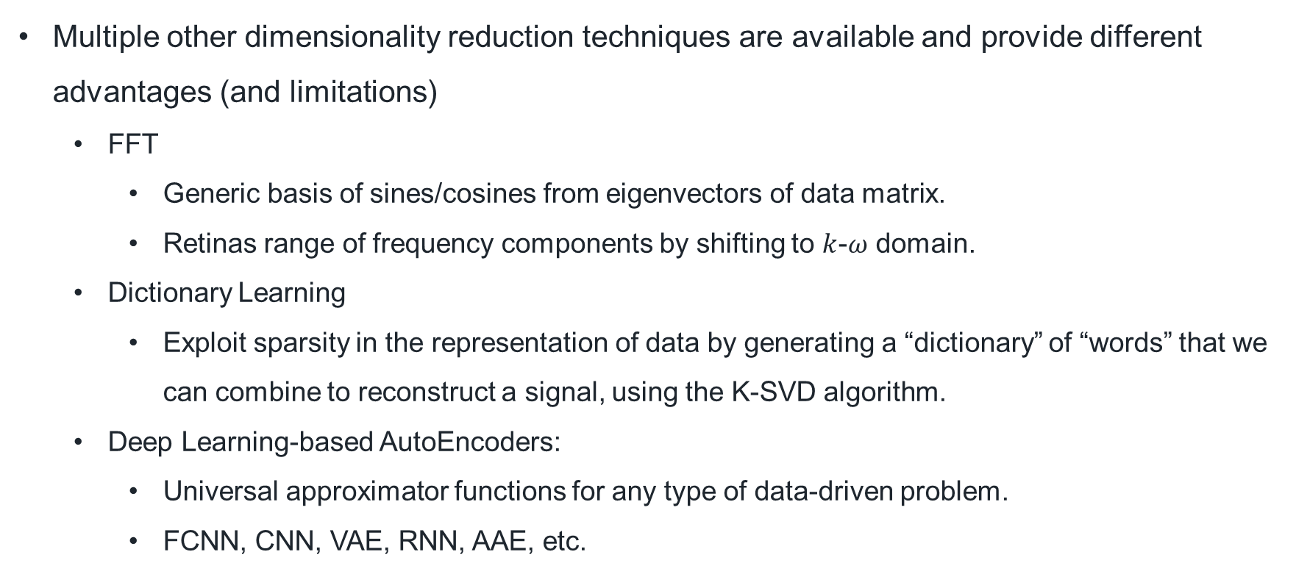
Dimensionality Reduction: Other
Multiple other dimensionality reduction techniques are available and provide different advantages (and limitations)
FFT
Generic basis of sines/cosines from eigenvectors of data matrix.
Retinas range of frequency components by shifting to $k$-$ω$ domain.
Dictionary Learning
Exploit sparsity in the representation of data by generating a “dictionary” of “words” that we can combine to reconstruct a signal, using the K-SVD algorithm.
Deep Learning-based AutoEncoders:
Universal approximator functions for any type of data-driven problem.
FCNN, CNN, VAE, RNN, AAE, etc.
Well Log Baseline Correction and Normalization via Latent Space Analysis

Slide 16
Outline
Executive Summary
Motivation
Dimensionality Reduction
Latent Space Well Log Analysis
Conclusions & Future Work
Well pad 1
Well Log Baseline Correction and Normalization via Latent Space Analysis

Slide 17
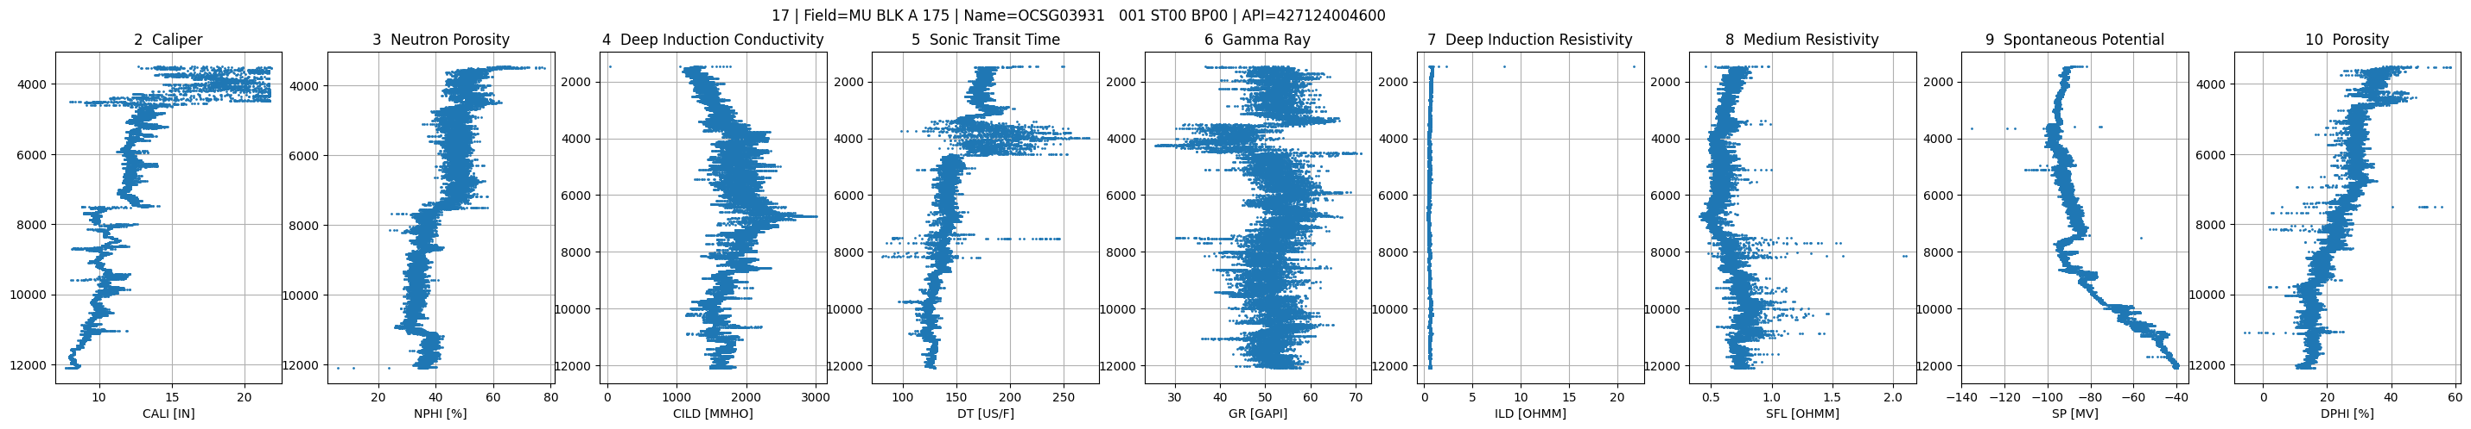
Latent Space Well Log Analysis
Can we find different clusters in our well log data?
Do these represent changes in lithology or different log runs?
How does using the well log suite (multivariate) improve inference vs. single-log (e.g., GR)?
Does the latent representation improve our inference?
Well Log Baseline Correction and Normalization via Latent Space Analysis

Slide 18
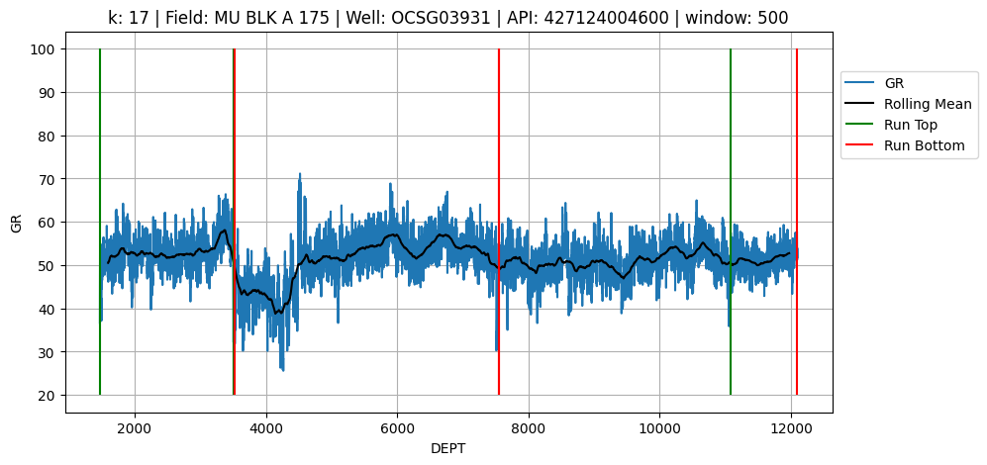
Latent Space Well Log Analysis: 427124004600
Well Log Baseline Correction and Normalization via Latent Space Analysis

Slide 19
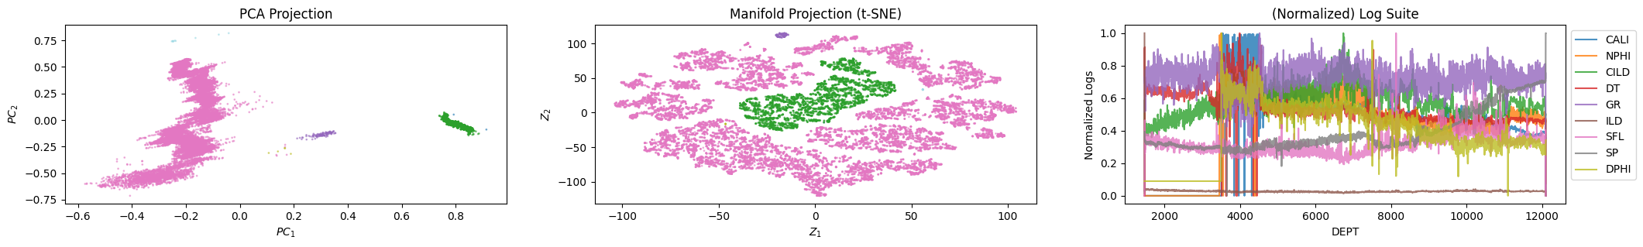
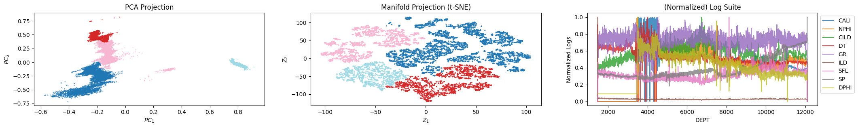
Latent Space Well Log Analysis: 427124004600
Cluster using the high-dimensional log suite (DBSCAN):
Cluster using the latent-space projections (Agglomerative, n_clusters=n_runs):
Well Log Baseline Correction and Normalization via Latent Space Analysis

Slide 20
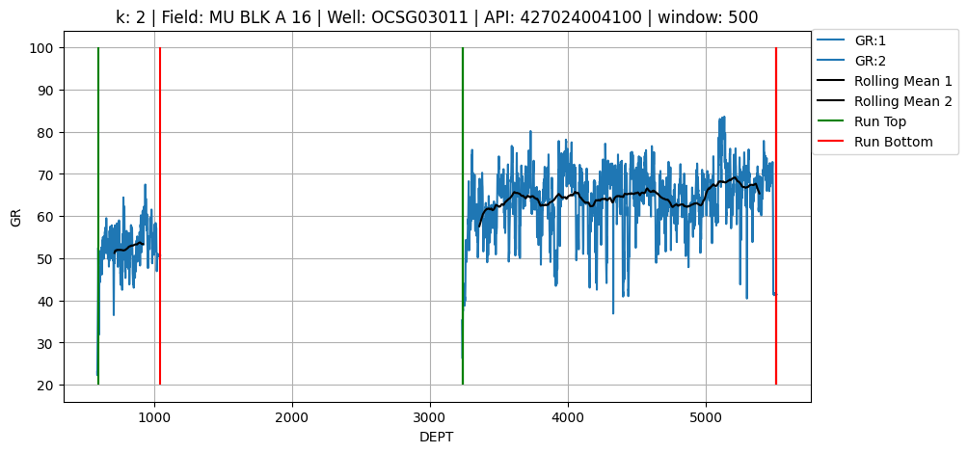
Latent Space Well Log Analysis: 427024004100
Well Log Baseline Correction and Normalization via Latent Space Analysis

Slide 21
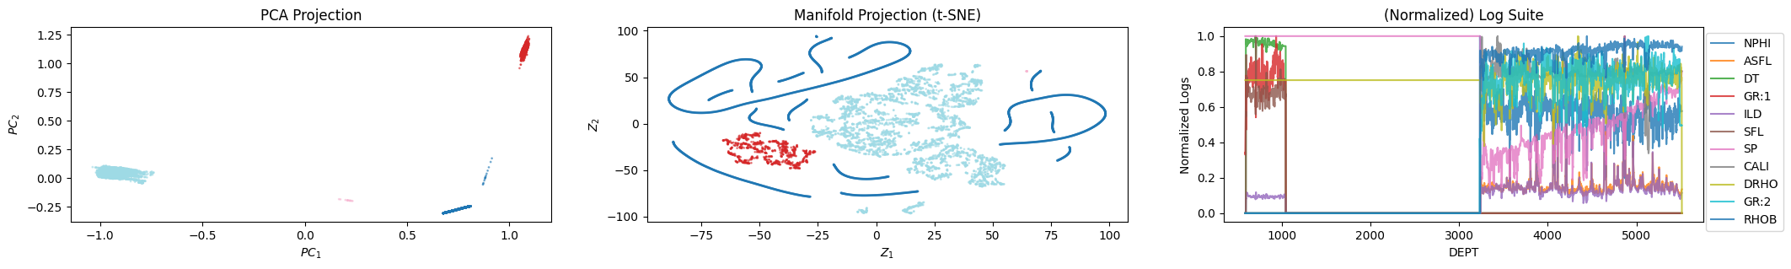
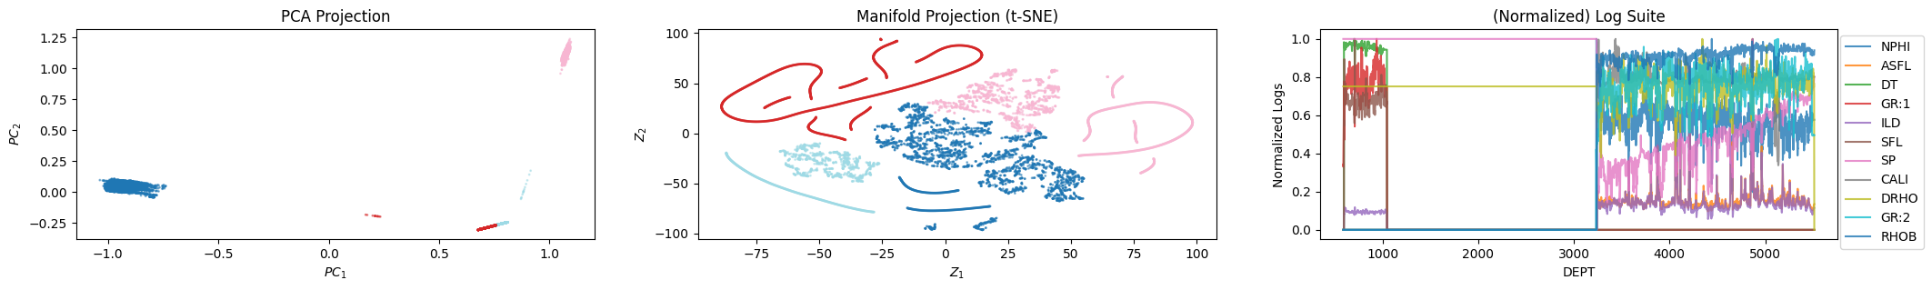
Latent Space Well Log Analysis: 427024004100
Cluster using the high-dimensional log suite (DBSCAN):
Cluster using the latent-space projections (Agglomerative, n_clusters=n_runs):
Well Log Baseline Correction and Normalization via Latent Space Analysis

Slide 22
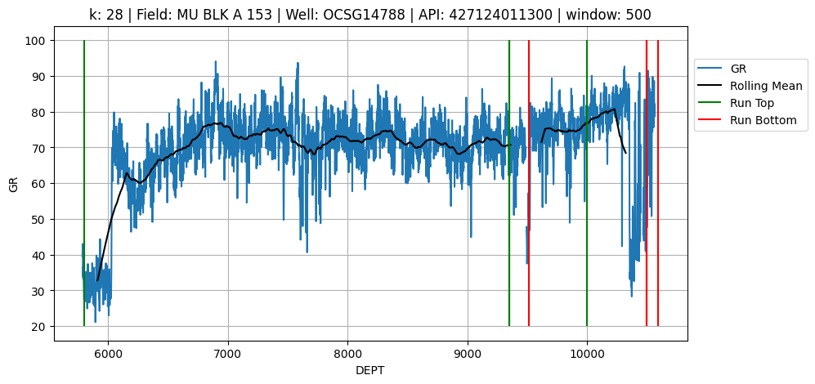
Latent Space Well Log Analysis: 427124011300
Well Log Baseline Correction and Normalization via Latent Space Analysis

Slide 23
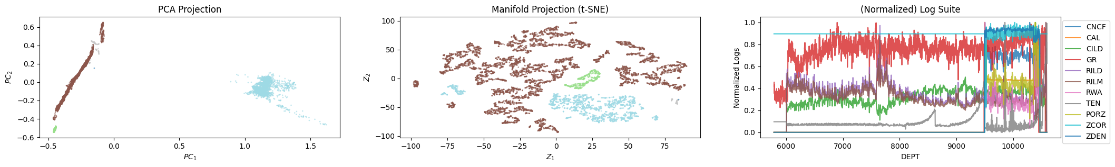
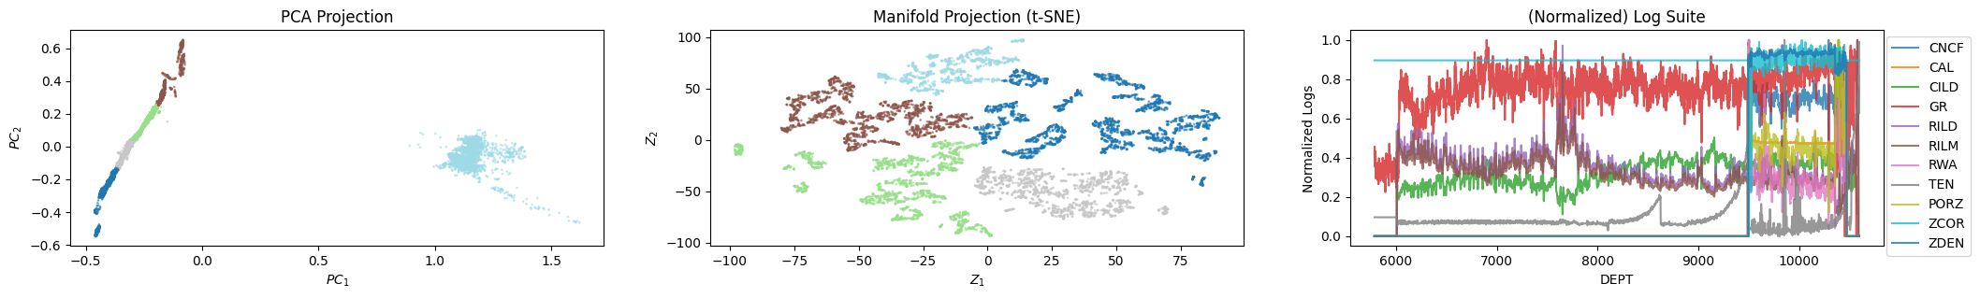
Latent Space Well Log Analysis: 427124011300
Cluster using the high-dimensional log suite (DBSCAN):
Cluster using the latent-space projections (Agglomerative, n_clusters=n_runs):
Well Log Baseline Correction and Normalization via Latent Space Analysis

Slide 24
Outline
Executive Summary
Motivation
Dimensionality Reduction
Latent Space Well Log Analysis
Conclusions & Future Work
Well pad 1
Well Log Baseline Correction and Normalization via Latent Space Analysis

Slide 25
Conclusions
Different log runs can affect readings:
How do we know if a change in baseline is a change in lithology or an effect of a different log run?
Multivariate analysis allows for more robust inference using a suite of well logs.
Dimensionality reduction provides an efficient method to retain salient features and improves our ability to interpret and analyze a suite of well logs.
More on dimensionality reduction: github.com/misaelmmorales/Dimensionality-Reduction
Well Log Baseline Correction and Normalization via Latent Space Analysis

Slide 26
Future Work
Can we use the latent feature space to reconstruct our logs?
Will this allow for baseline-corrected or normalized predicted logs?
Hyperparameter tuning and model selection for:
Dimensionality reduction technique
Latent-space clustering technique
Model checking and testing for different well log suites
Deep Learning-based automatic dimensionality reduction, clustering, and reconstruction.
Well Log Baseline Correction and Normalization via Latent Space Analysis

Slide 27










Acknowledgments
Appreciation for the support from the DIRECT member companies.
Well pad 1
Well Log Baseline Correction and Normalization via Latent Space Analysis

Slide 28
Thank You
Q & A
S&P Global – Update meeting
May 5th, 2023
Misael M. Morales
Graduate Research Assistant, The University of Texas at Austin
Michael J. Pyrcz
Professor, The University of Texas at Austin
Carlos Torres-Verdín
Professor, The University of Texas at Austin

Slide 29
Detect sand-vs-shale from SP

