Slide 1
Progress Meeting
December 08, 2023

Slide 2
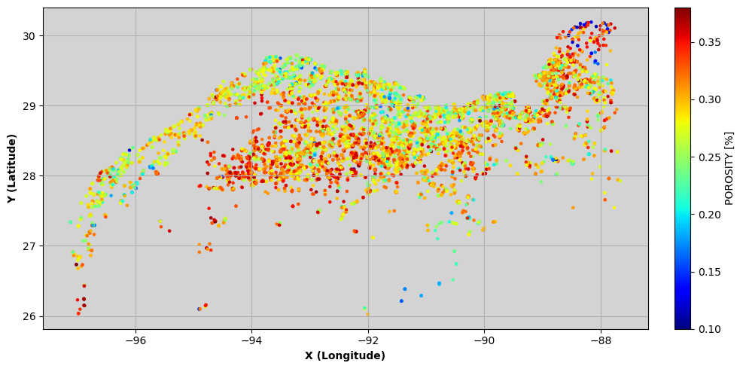
CCS_Sand_wells1

Slide 3
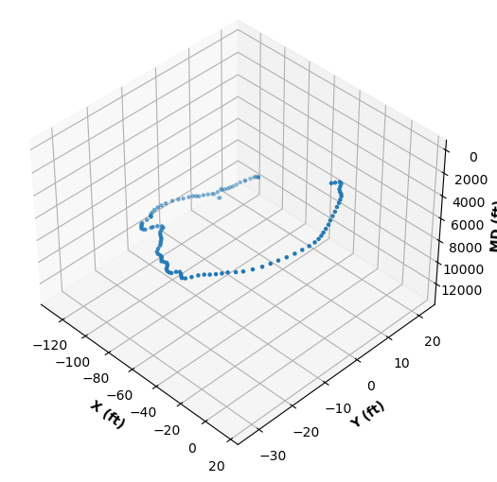
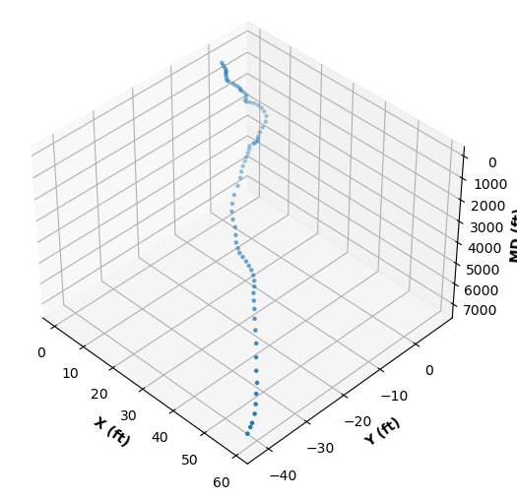
UT dir surveys
177004037400
427064023000

Slide 4
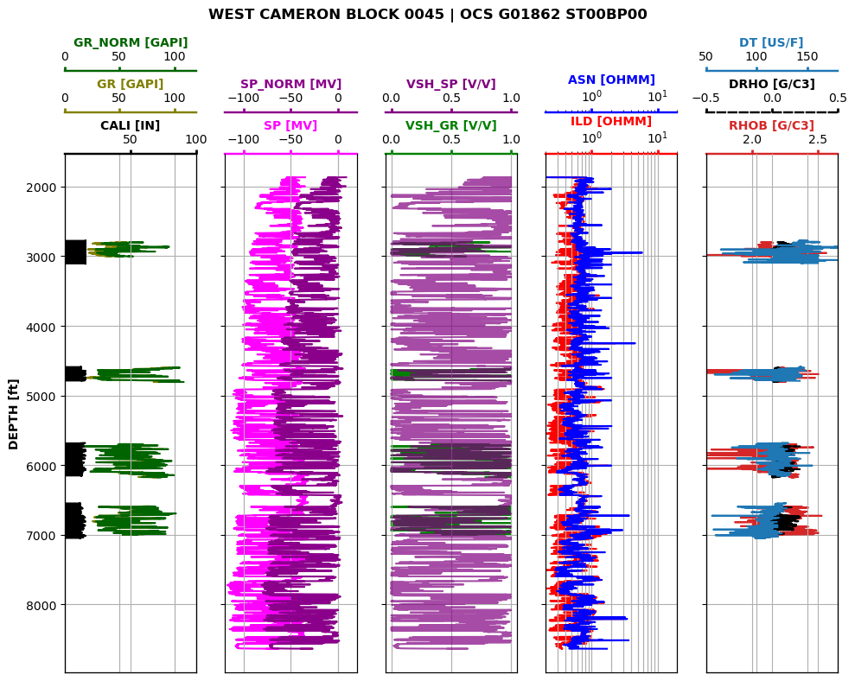

Slide 5
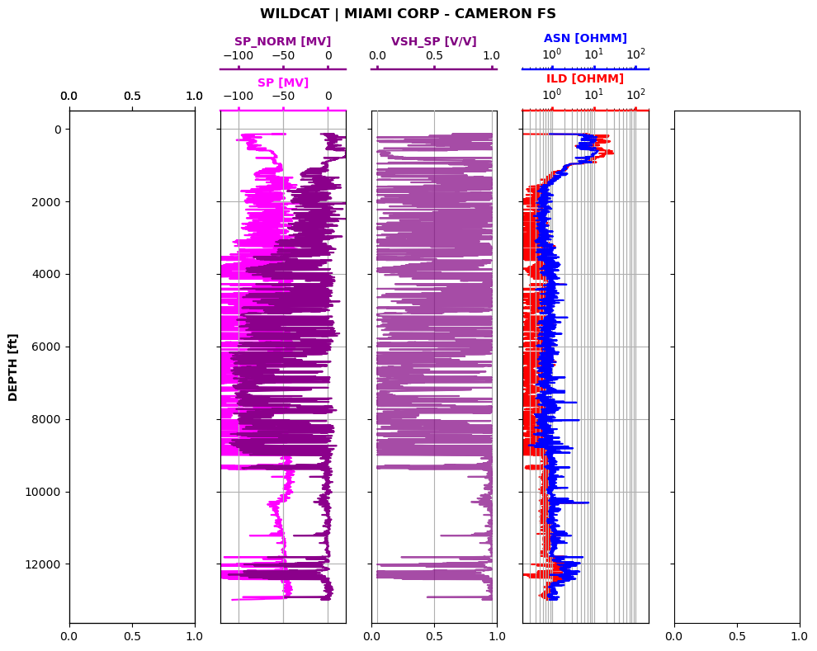

Slide 6
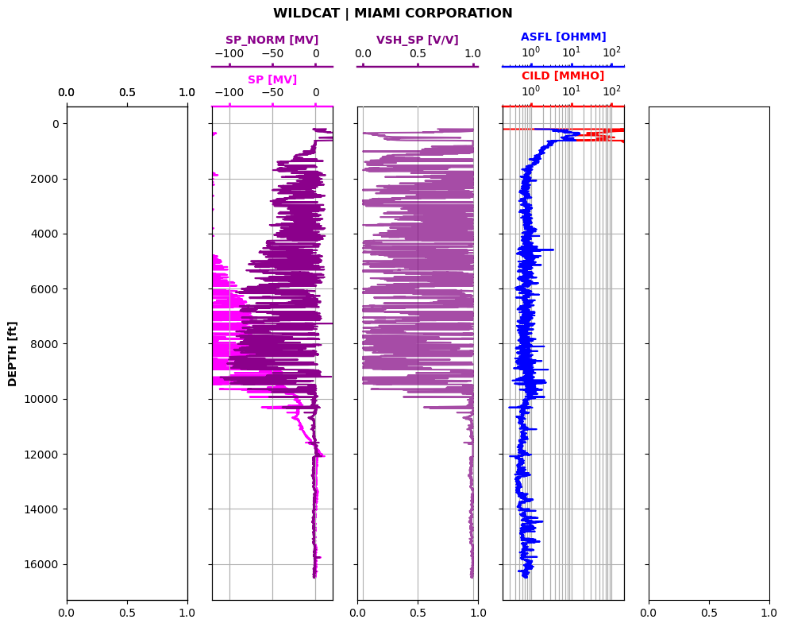

Slide 7
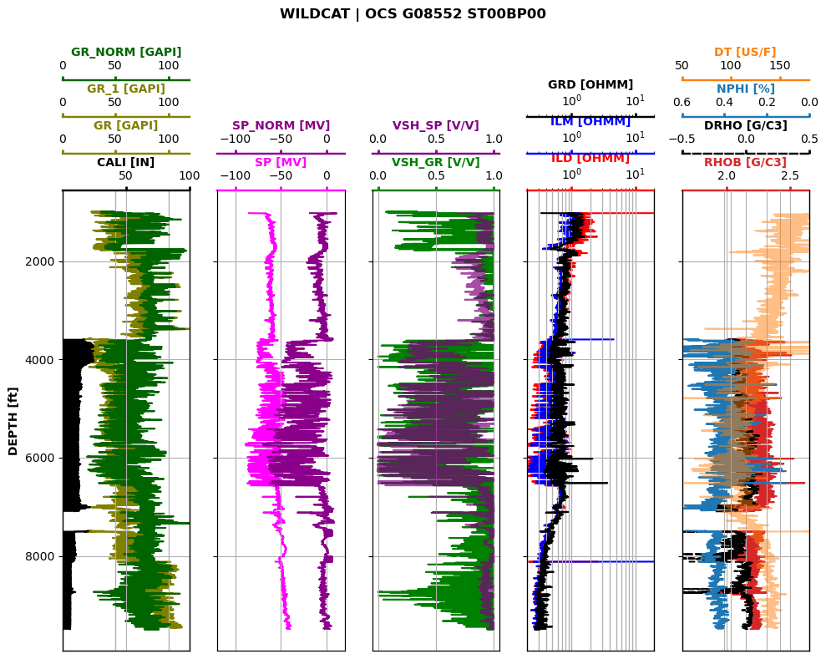

Slide 8
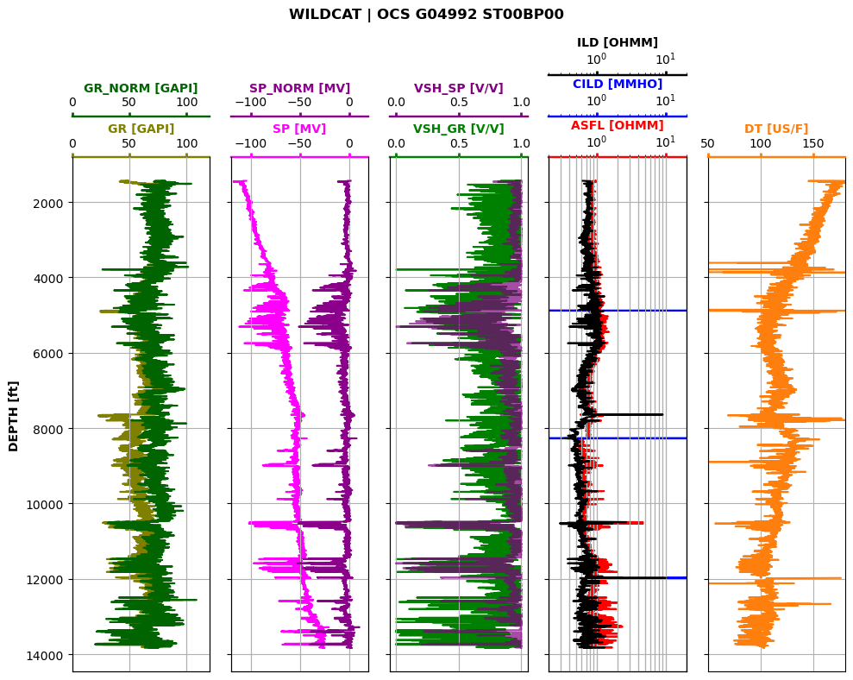

Slide 9
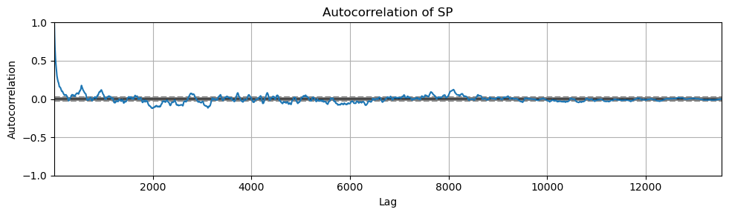
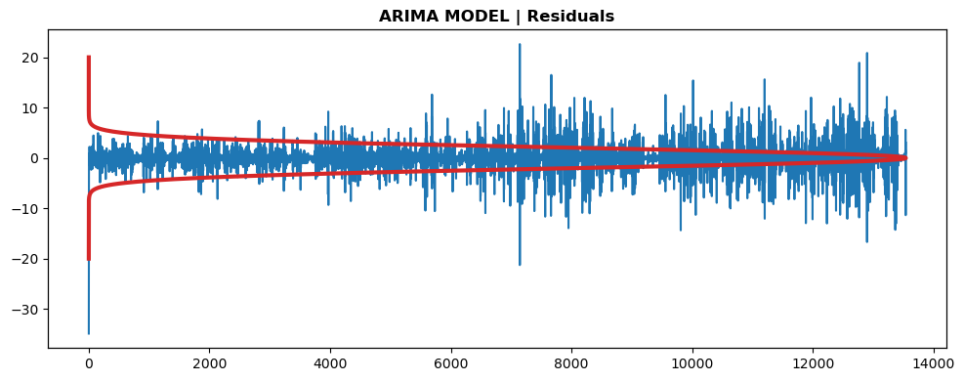
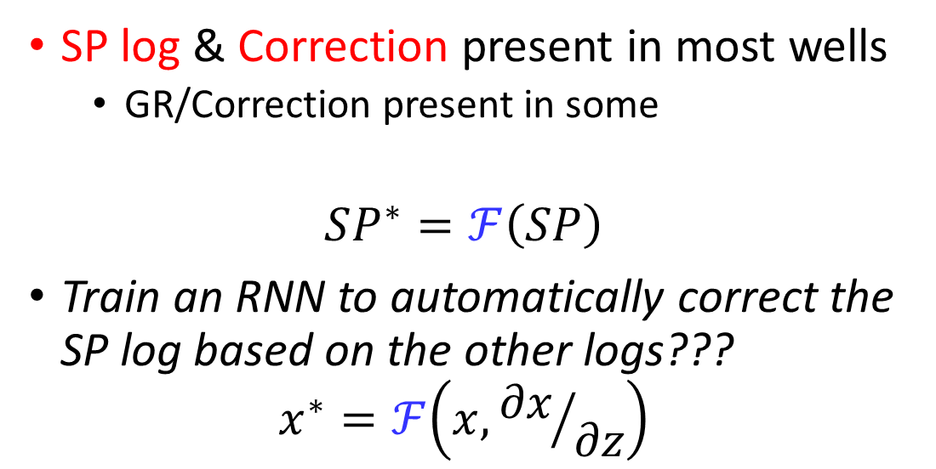
Baseline Correction
SP log & Correction present in most wells
GR/Correction present in some
$$SP^{∗}=ℱ\left(SP\right)$$
Train an RNN to automatically correct the SP log based on the other logs???
$$x^{∗}=ℱ\left(x,{∂x}/{∂z}\right)$$

Slide 10
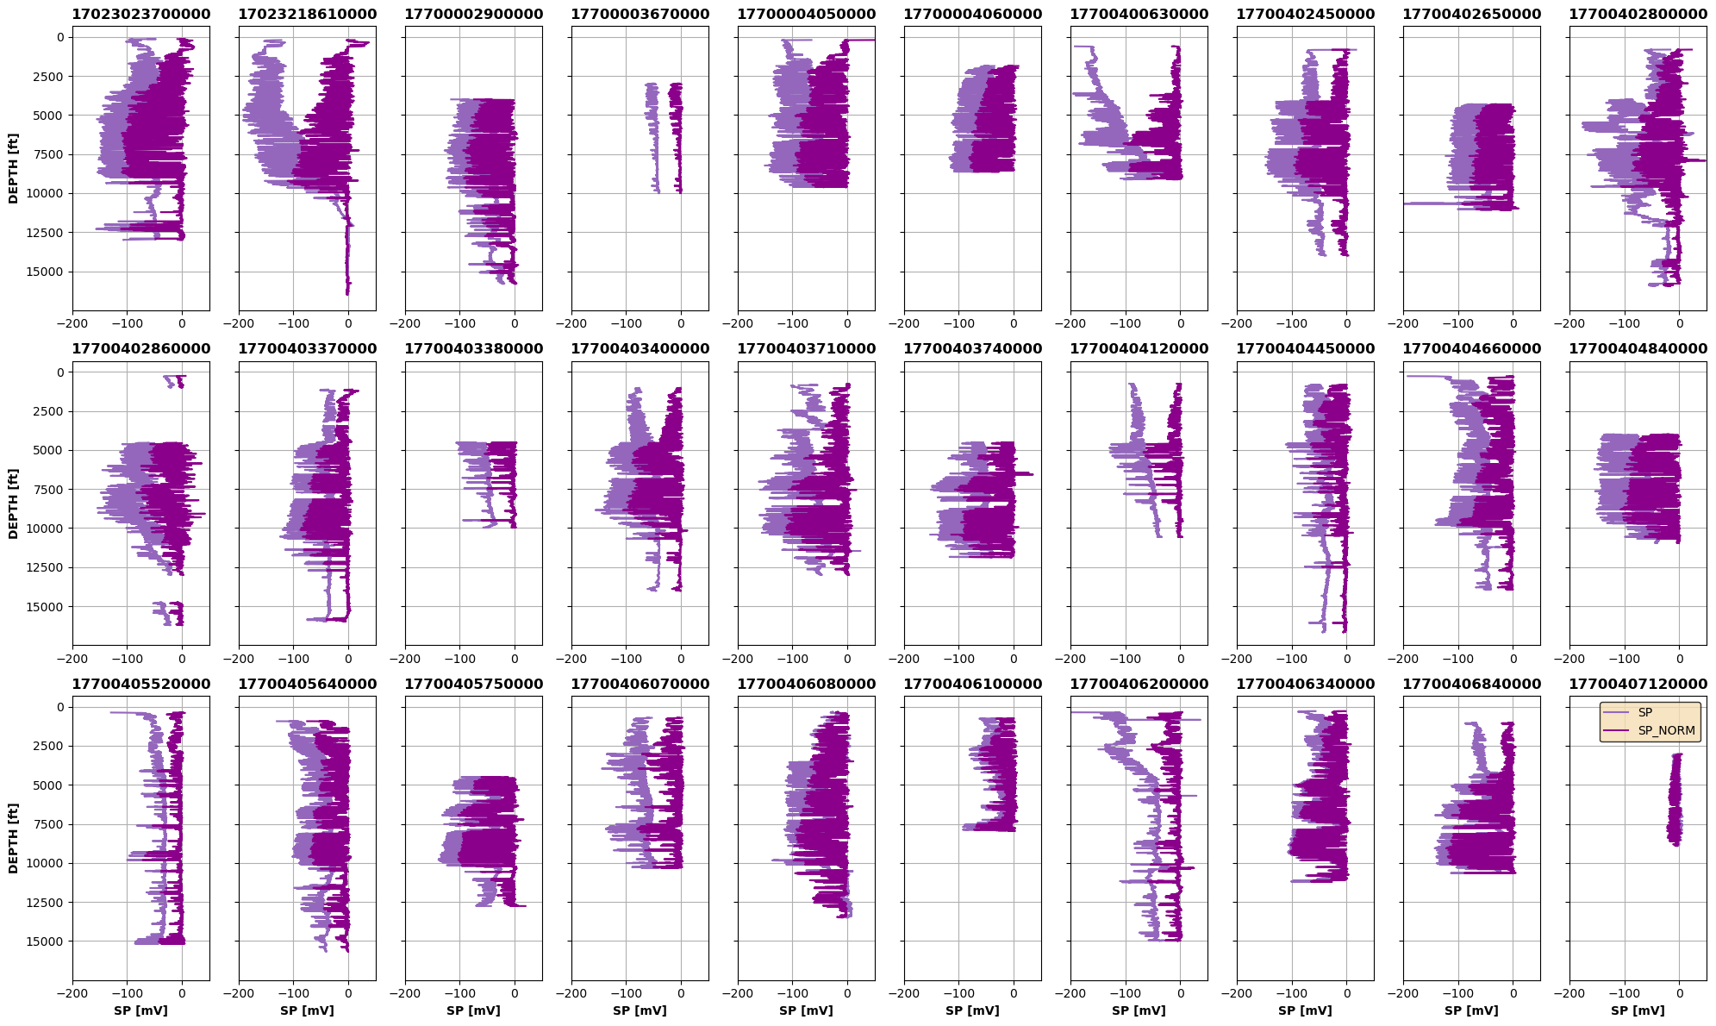

Slide 11

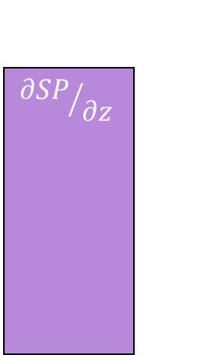
z
SP
$${∂SP}/{∂z}$$
SP*
Encoder
$$z_{SP}$$
Decoder
Conv
LSTM
Upsampling
LeakyReLU
Batch Norm
Batch Norm
LeakyReLU
Conv Transp
Max Pool
LSTM

Slide 12
