Slide 1
S&P Global review:
well-log data imputation and forecasting with uncertainty
May 5, 2023
Eduardo Maldonado Cruz
Dr. Michael Pyrcz
The University of Texas at Austin

Slide 2
Contents
Objective
Introduction
Missing well-log data imputation with uncertainty
Well-log data forecasting with uncertainty
Key takeaways

Slide 3
Contents
Objective
Introduction
Missing well-log data imputation with uncertainty
Well-log data forecasting with uncertainty
Key takeaways

Slide 4
Objective
Perform well-log data imputation and forecasting with uncertainty using information from other well-logs.
Propagate the uncertainty to other applications that use well-log data as input.

Slide 5
Contents
Objective
Introduction
Missing well-log data imputation with uncertainty
Well-log data forecasting with uncertainty
Key takeaways

Slide 6
Introduction to machine learning
Machine Learning studies algorithms and models that improve their performance on a specific task progressively and focuses on estimating the model $\hat{f}\left(x\right)$ for inference or prediction.
ML algorithms build a mathematical model based on sample data known as “training data”.
The ML model internal variables are called parameters

Slide 7
Supervised learning
Supervised learning involves learning with guidance to approximate the function $\hat{f}\left(x\right)$ to predict response feature $\hat{y}$ for given $x_{1}, x_{2}, …, x_{n}$ predictor features.
ML performance is based on three factors: data that is used by the program, a metric that quantifies the error, and a feedback mechanism.
 | $$\overset{Response}{\hat{y}}=\overset{\text{Model}}{\hat{f}}\overset{Predictors}{\left(x_{1},x_{2},…,x_{n}\right)}+\overset{Random error}{ε},$$ | 1

Slide 8
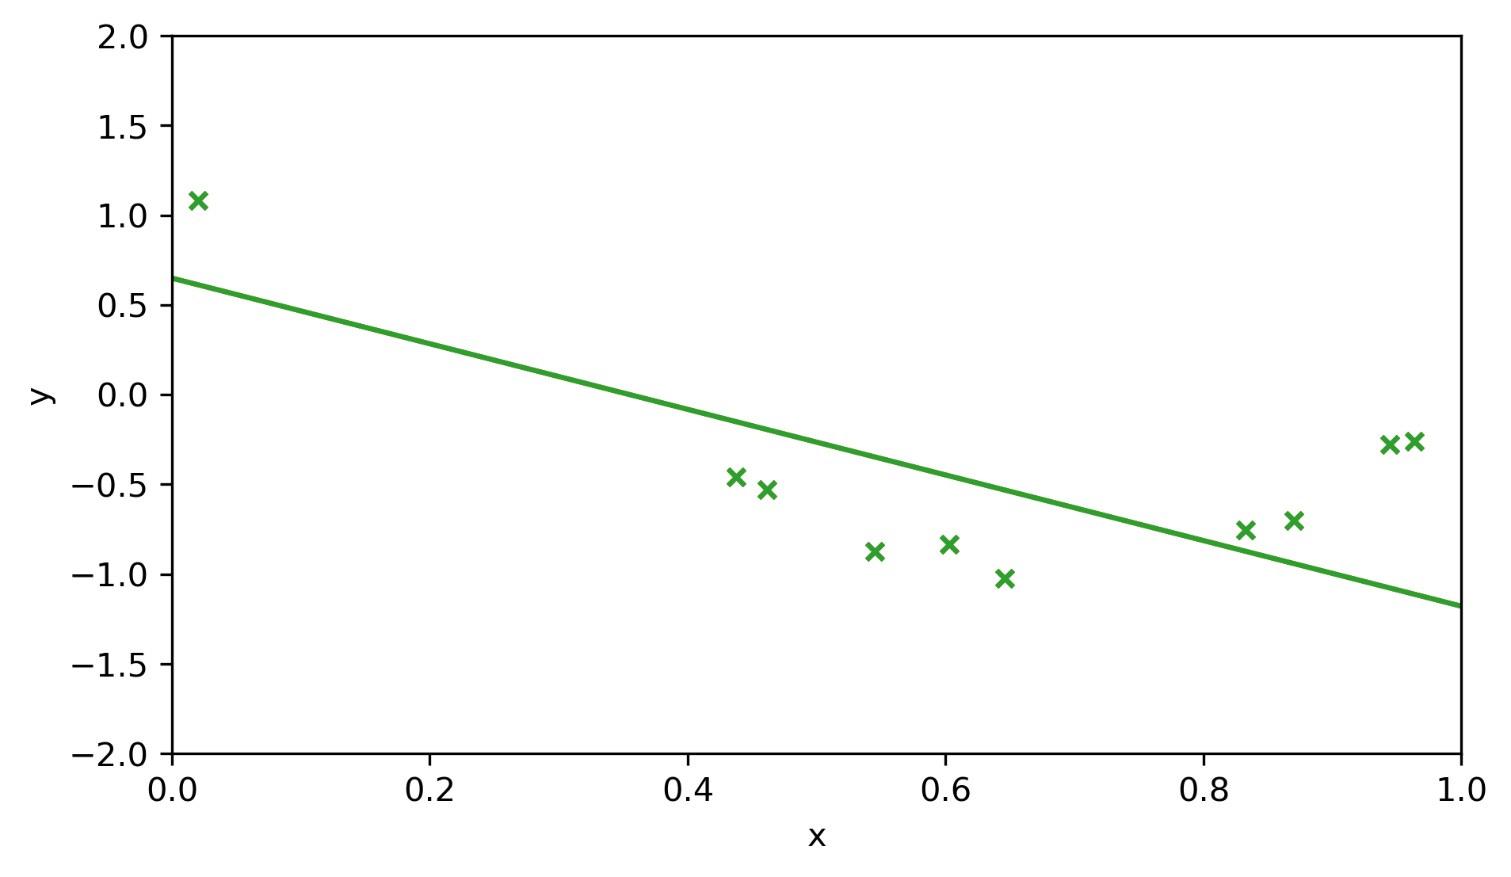
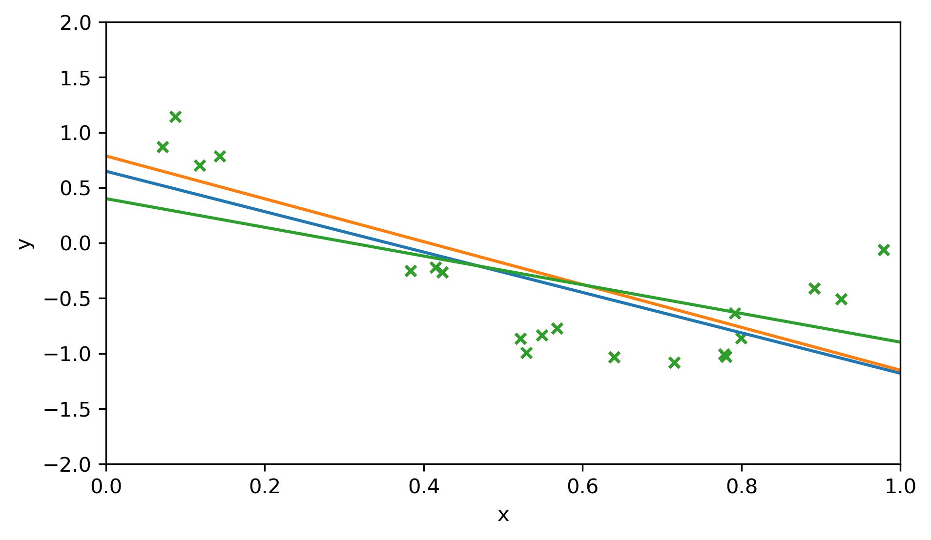
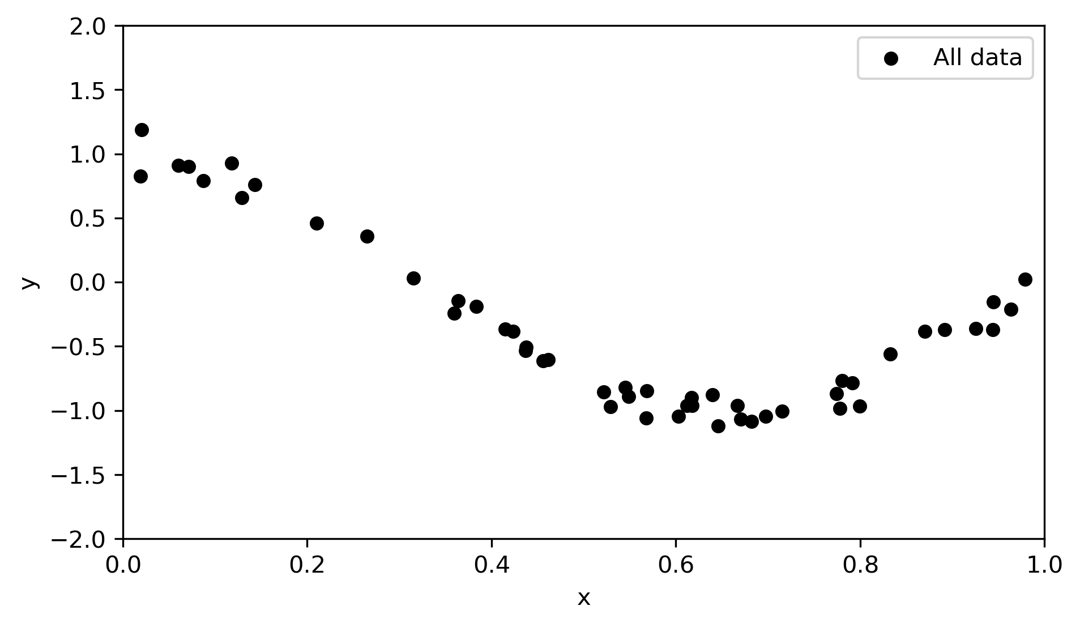
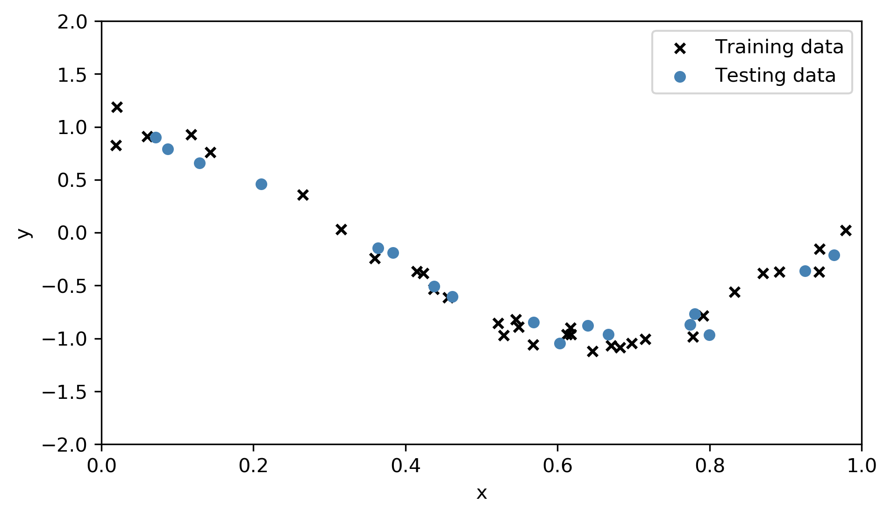
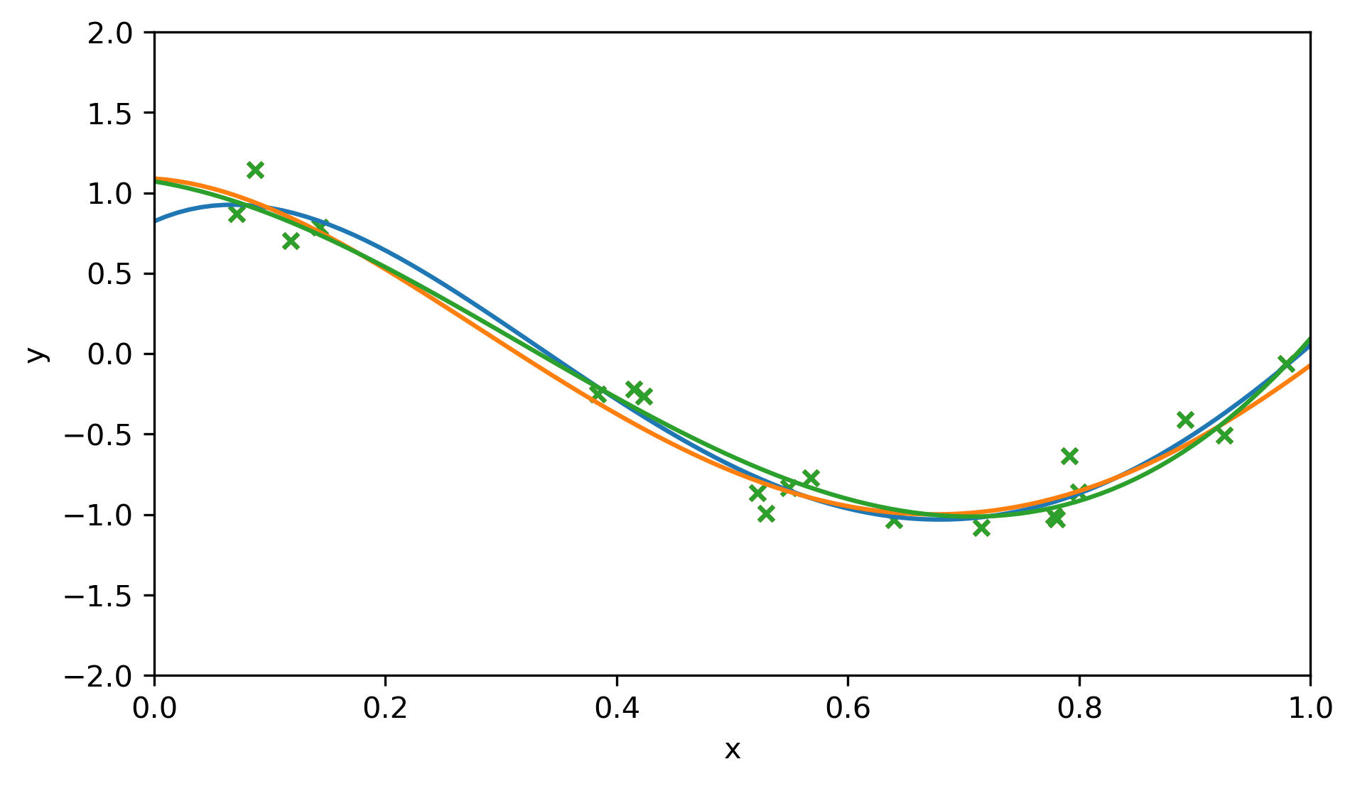
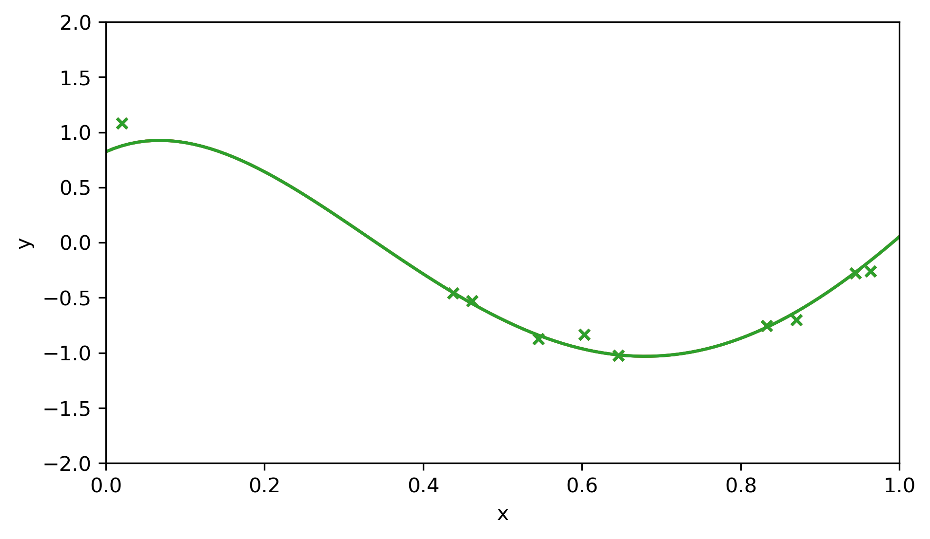
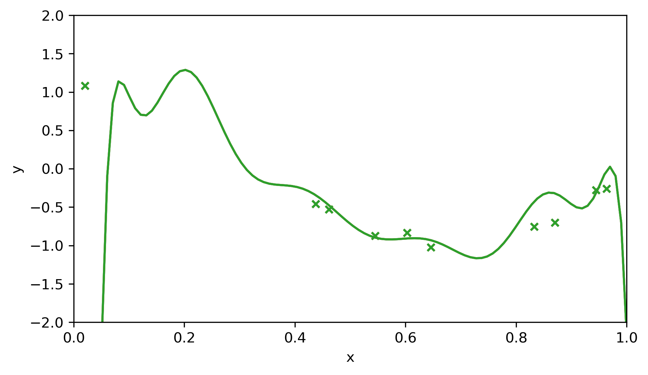
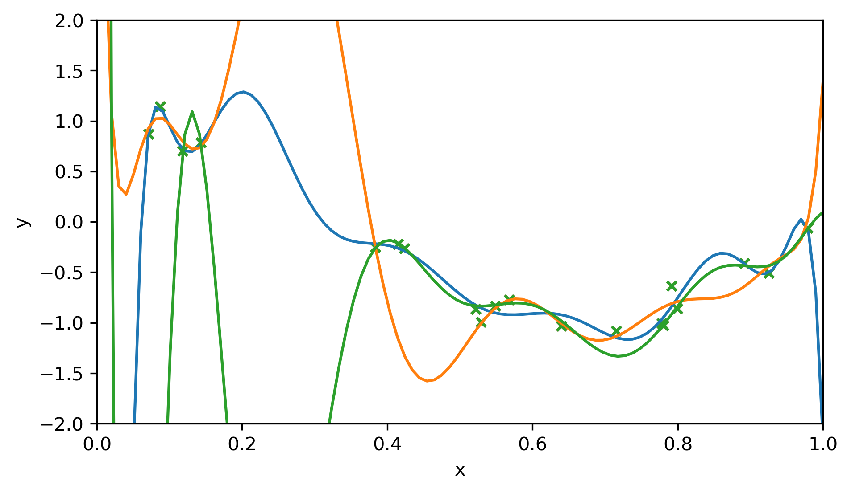
Building a machine learning model
Split the data into training and testing
Build models over a range of hyperparameters, increasing the model complexity
Train the model parameters with training data
Check each best fit model with withheld testing data
Tune the model hyperparameters with testing data
Figure 1 - Example of building a machine learning model

Slide 9
Overfit
After training a ML model, testing measures the performance on a withheld from model training dataset called “testing data.”
It provides essential information about the generalization ability of the model.
Potential of the model to calculate low error predictions over combinations of predictor features not covered during training.
Underfit
Overfit
Optimum level of complexity
Figure 2 - Example of overfit, high accuracy in training but low accuracy in testing

Slide 10
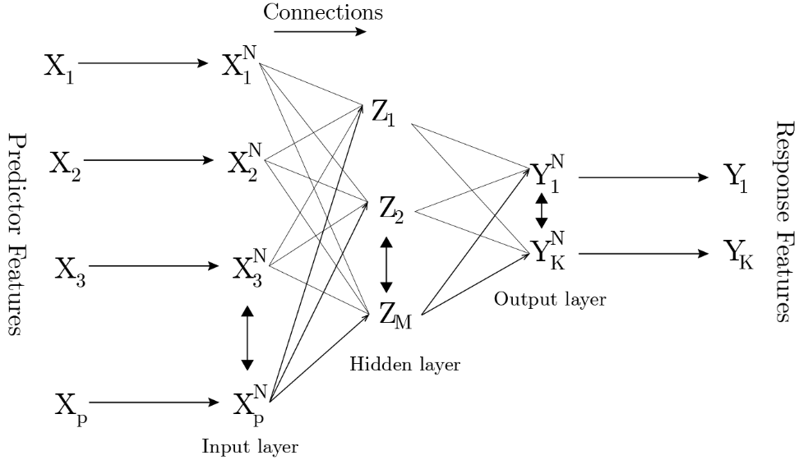
Artificial Neural Networks
$$Z_{m}=σ\left(α_{0},m+\sum_{p=1}^{P}{α_{m,p}X_{p}}\right)$$
Artificial Neural networks (ANN) is a type of supervised learning.
ANN consists of nodes, connections and a series of layers $L_{1},…,L_{l}$
Through many connected nodes the ANN represents non-linear patterns.
The activation function is a non-linear transform of the linear combinations of the inputs to a node
Figure 3 - Schematic of an artificial neural network (Pyrcz, 2020), an input layer, a hidden layer, and an output layer.

Slide 11
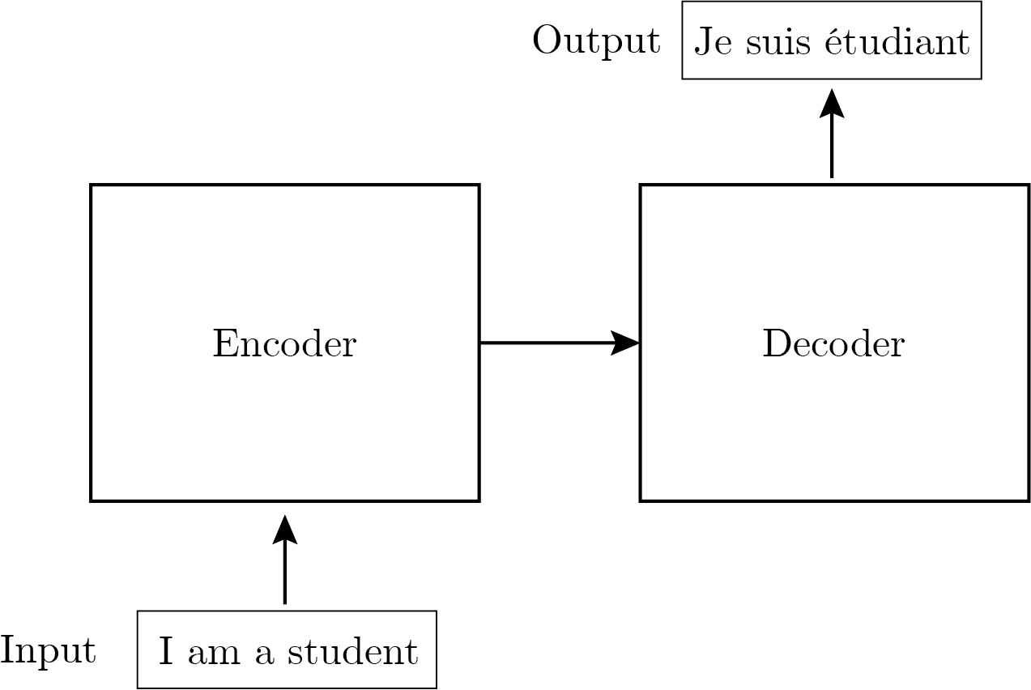
Transformer
The transformer is a type of neural network architecture (Vaswani et al., 2017) that introduces the attention mechanism and is used for natural language processing.
Given a sequence the attention mechanism allows the model to focus on different parts of an input sequence when making forecasts.
The attention heads produces attention weights that indicate importance of each element in the input.
Figure 4 – Oversimplified example of a Transformer

Slide 12
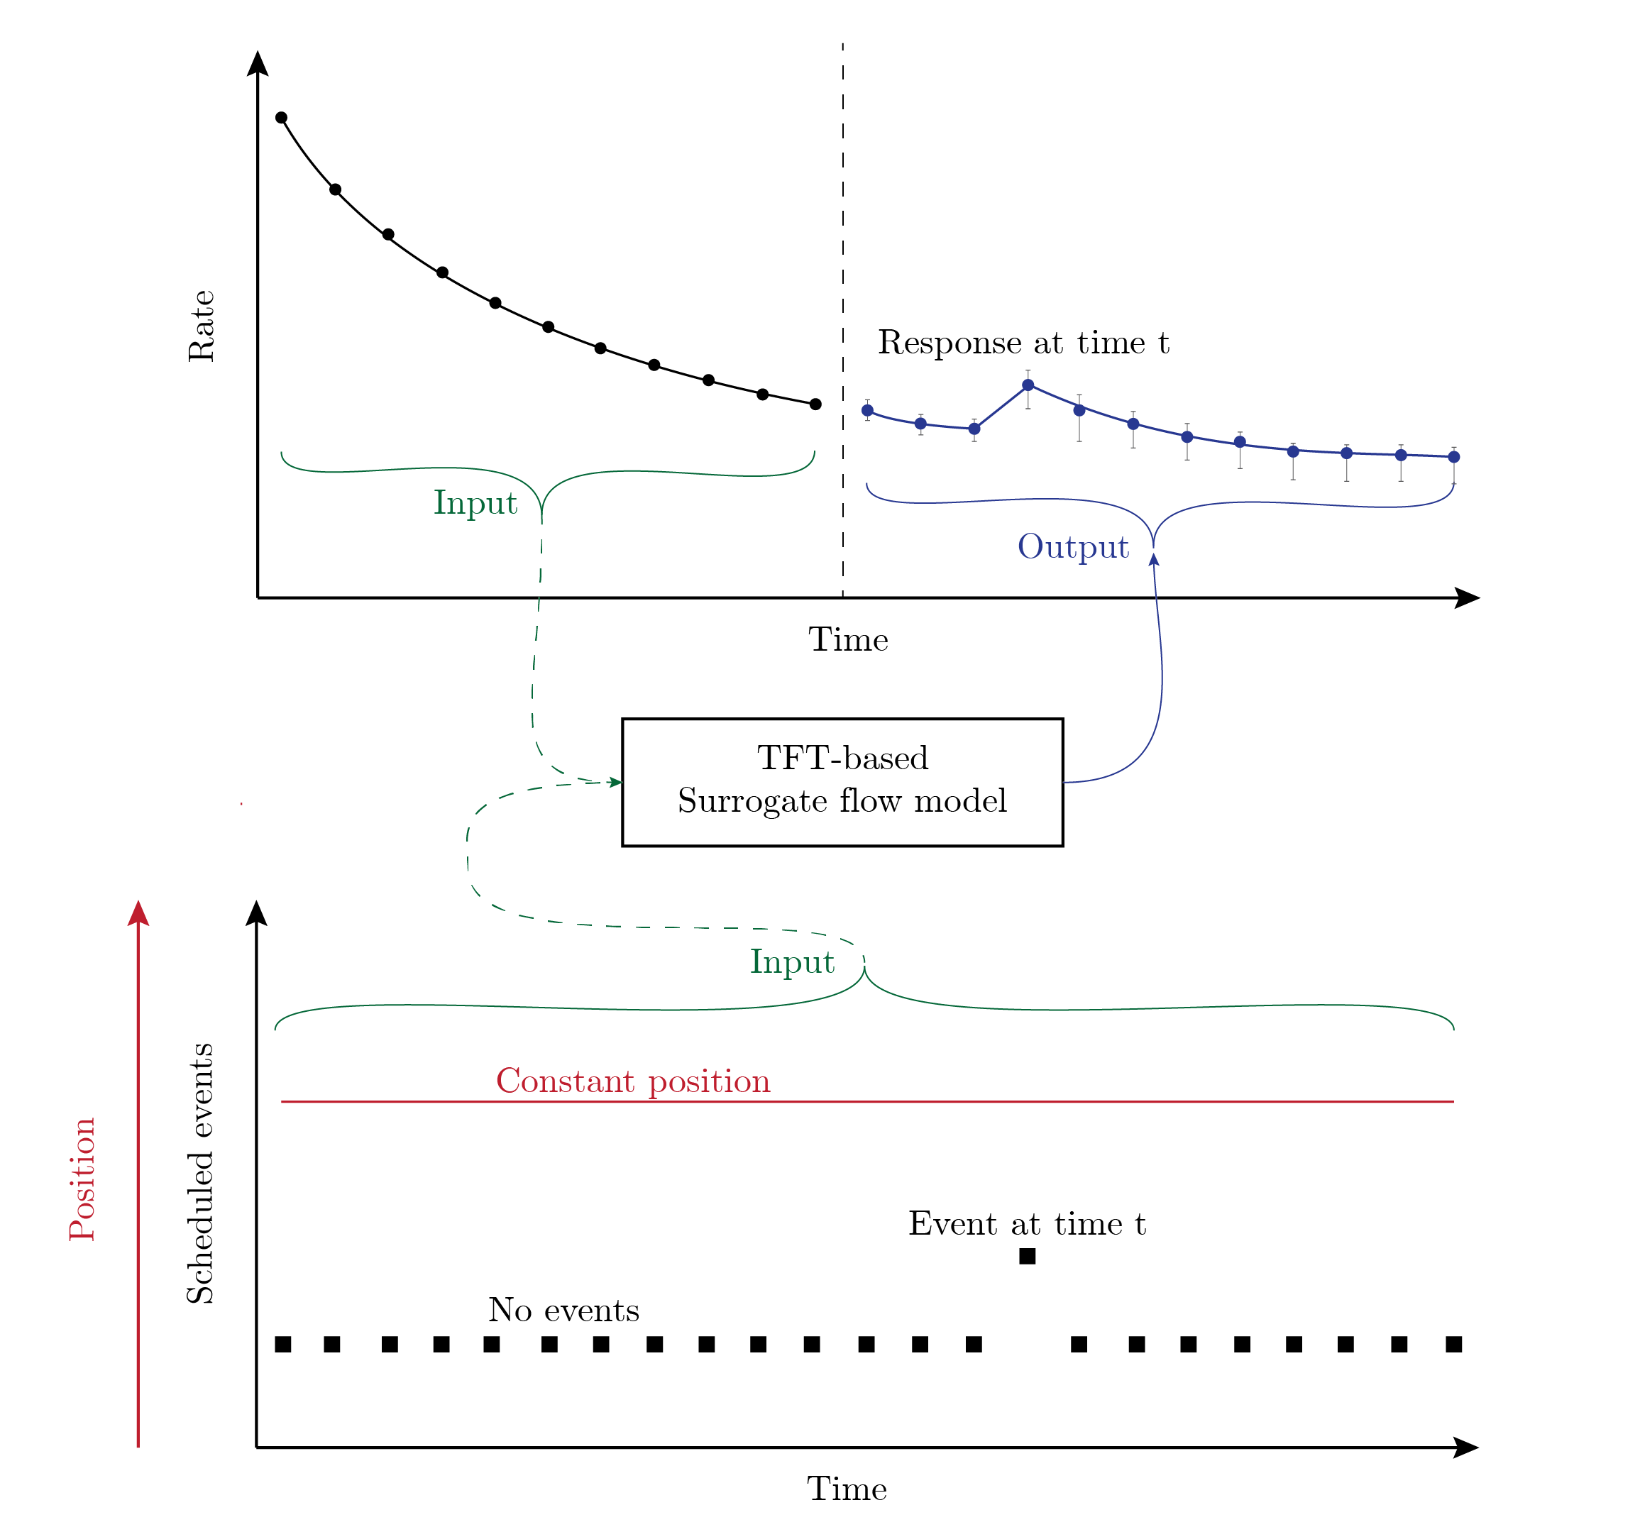
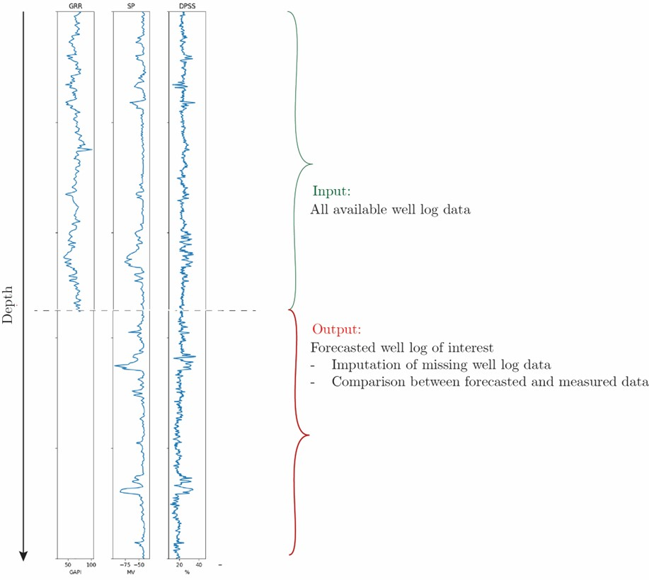
Temporal fusion transformer
Variant of the Transformer architecture (Lim et al., 2021) for time series forecasting.
Uses the attention mechanism to indicate importance of each element in the input.
Allows the inclusion of static variables.
Spatial Fusion Transformer
Systematic measurement errors
Normalization of well logs
Impact of a bad caliper
Geologic or company component?
Figure 5 – Temporal fusion transformer and our approach, spatial fusion transformer (Maldonado-Cruz and Pyrcz, in review)

Slide 13
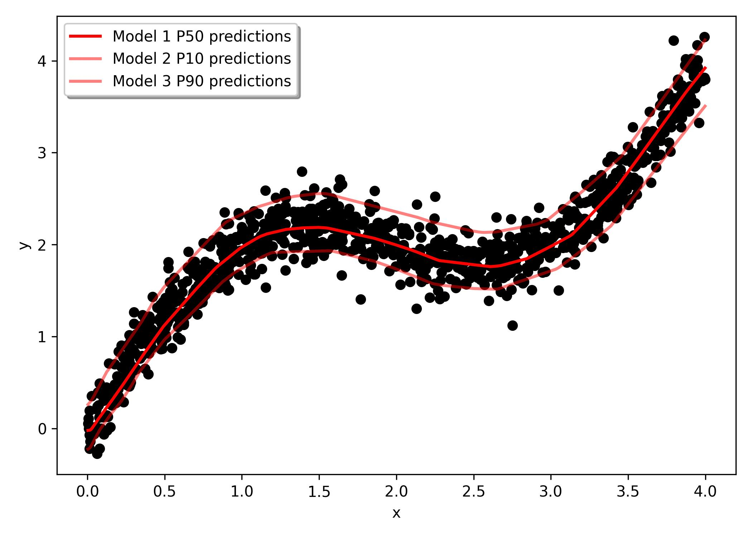
Uncertainty estimation via quantile inference
Quantile inference involves using deep neural networks to learn conditional quantile functions through regression:
Quantile inference is a method for estimating uncertainty when the response feature is not normally distributed.
Figure 6 – Example of quantile inference

Slide 14
Contents
Objective
Introduction
Missing well-log data imputation with uncertainty
Well-log data forecasting with uncertainty
Key takeaways

Slide 15
Missing well-log data imputation with uncertainty
Highlights:
Automatic predictor feature selection based on Feature Importance
Neural network trained with quantile loss function (No assumption in the shape of the distribution).
Visualization, petrophysics, signal processing, and feature engineering
Perform model training by minimizing quantile loss function
No
Minimum quantile loss?
Yes
Output: Model trained to forecast quantiles

Slide 16
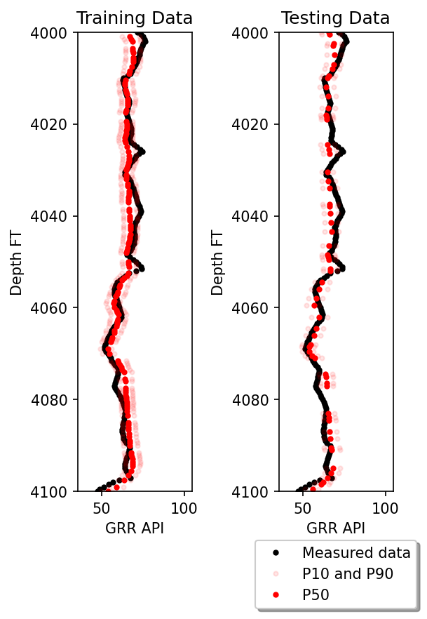
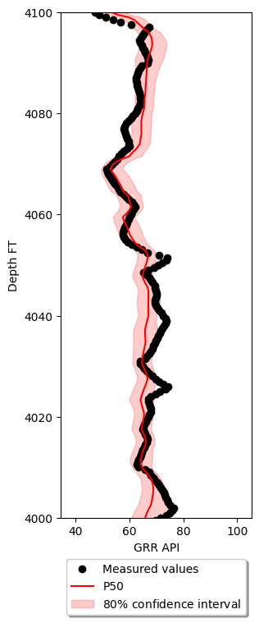
Missing well-log data imputation with uncertainty
Prediction examples with uncertainty, 80% confidence interval.
Figure 7 – Example of well-log data imputation with uncertainty

Slide 17
Contents
Objective
Introduction
Missing well-log data imputation with uncertainty
Well-log data forecasting with uncertainty
Key takeaways

Slide 18
Well-log data forecasting with uncertainty
Visualization, petrophysics, signal processing, and feature engineering
Highlights:
Predicting in depth, anticipating next measurements
Anticipate the response feature based on observed predictor features.
Highlight zones of interest
Identify systematic error in measurements
Perform model training by minimizing quantile loss function
No
Minimum quantile loss?
Yes
Output: SFT-based for well log data forecasting with uncertainty and interpretable outputs
For every time step in the testing dataset, extract attention heads and perform interpretability using SHAP values

Slide 19
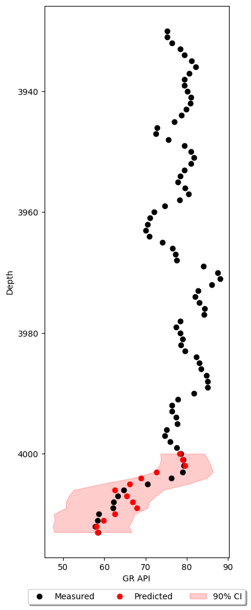
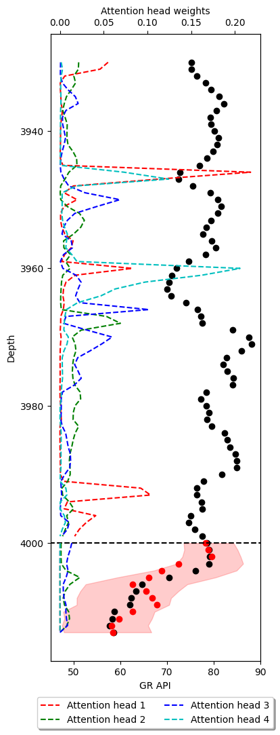
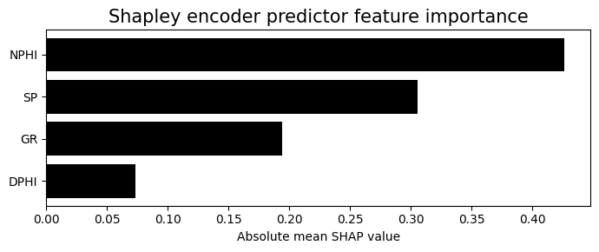
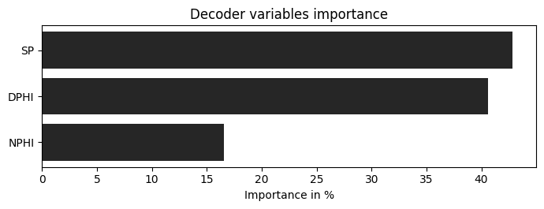
Well-log data forecasting with uncertainty
Prediction examples with uncertainty, 90% confidence interval.
Encoded predictor feature
Decoder prediction
Figure 8 – Example of well-log data prediction with uncertainty

Slide 20
Contents
Objective
Introduction
Missing well-log data imputation with uncertainty
Well-log data forecasting with uncertainty
Key takeaways

Slide 21
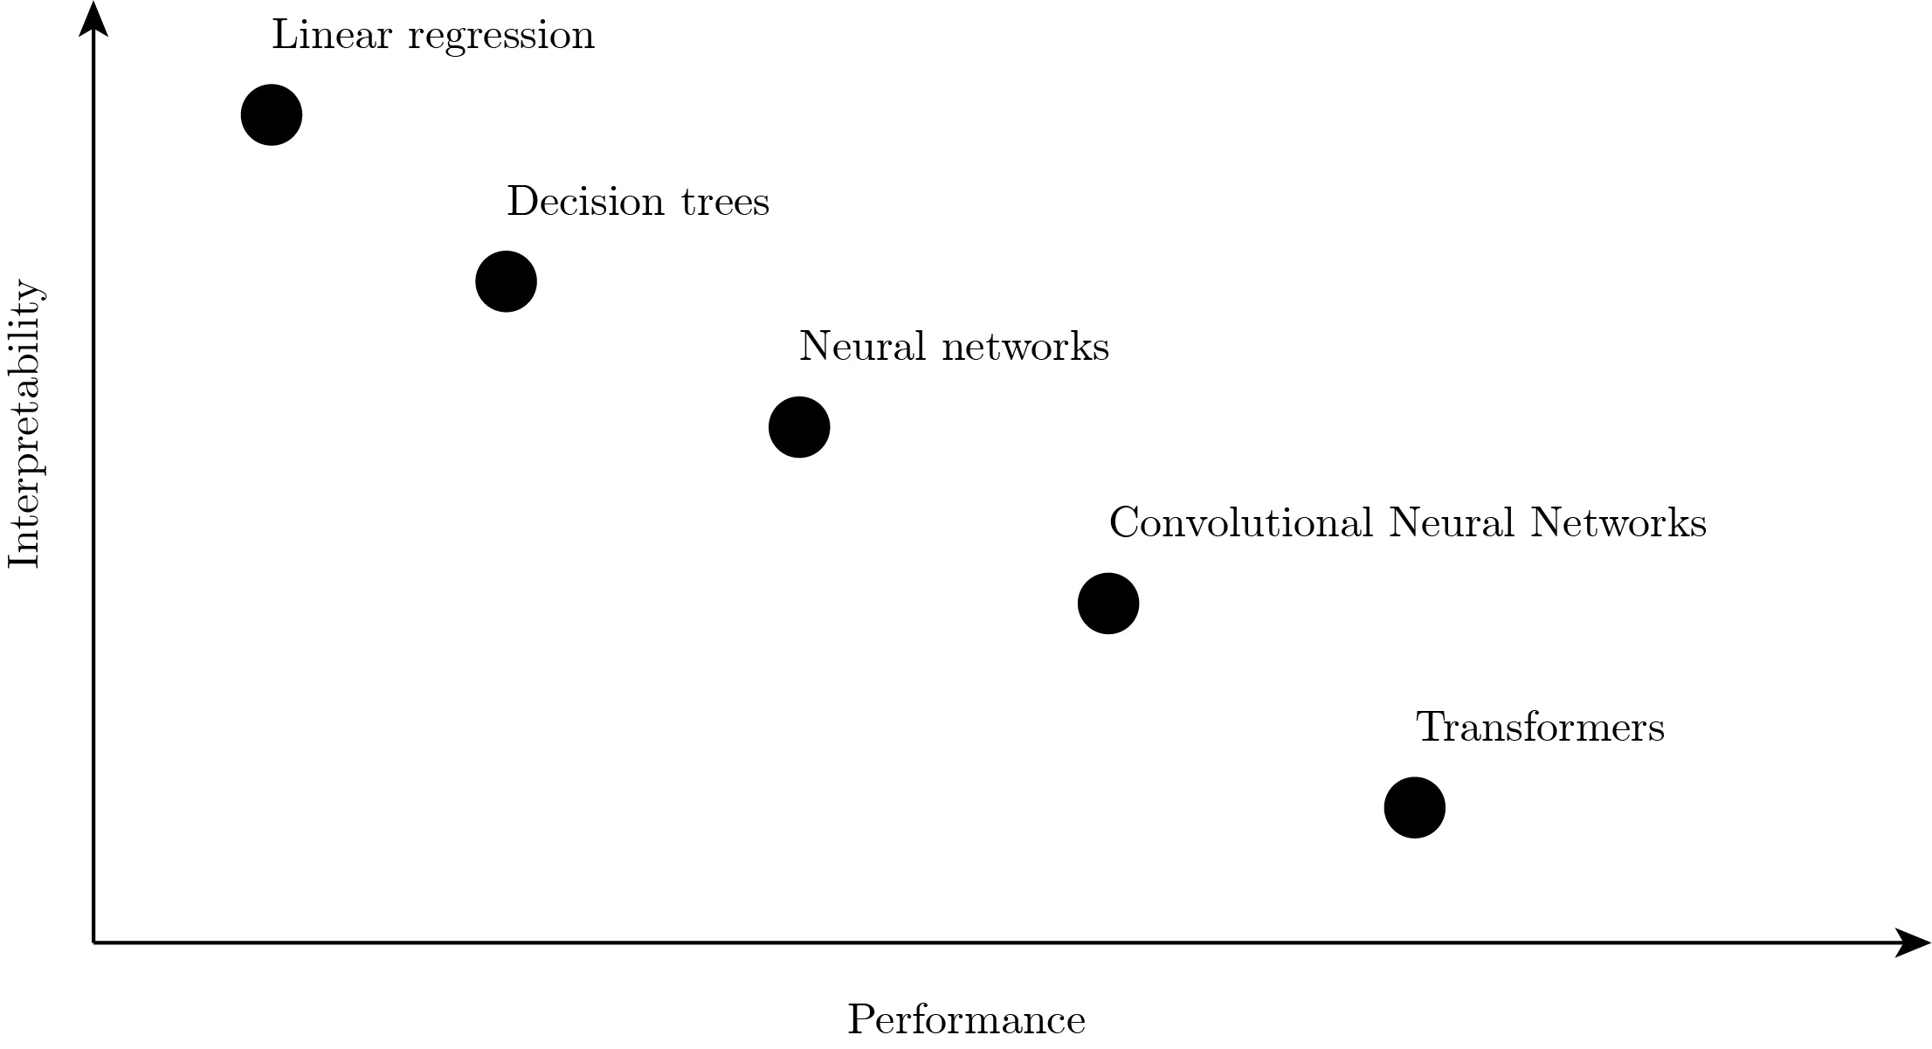
Key points
We propose two methods to perform well-log imputation and forecasting with uncertainty using information from other well-logs.
The uncertainty estimation is limited to the uncertainty present in the training data.
Interpretability, as the performance of the models increase, interpretability decreases
Figure 9 – Model interpretability versus performance

Slide 22


