Slide 1
S&P GLOBAL
FEATURE IMPUTATION TO SUPPORT WELL BASED PREDICTION MODELS USING DISCREPANCY MODELLING
May 5, 2023
Laaiba Akmal
Graduate Research Assistant, The University of Texas at Austin

Slide 2
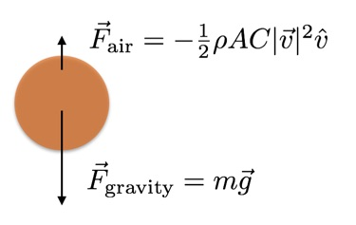
Motivation: To resolve missing well log data for use in future machine learning models
Objective:
To apply a physics-based model for well log feature imputation
To predict SP from GR logs and learn missing components
Seeking inspiration from a 1- D simple physics model - Free Falling Object with Air Resistance
Resolving the discrepancy between Free Fall with and without Air Resistance by incorporating physics.

Slide 3
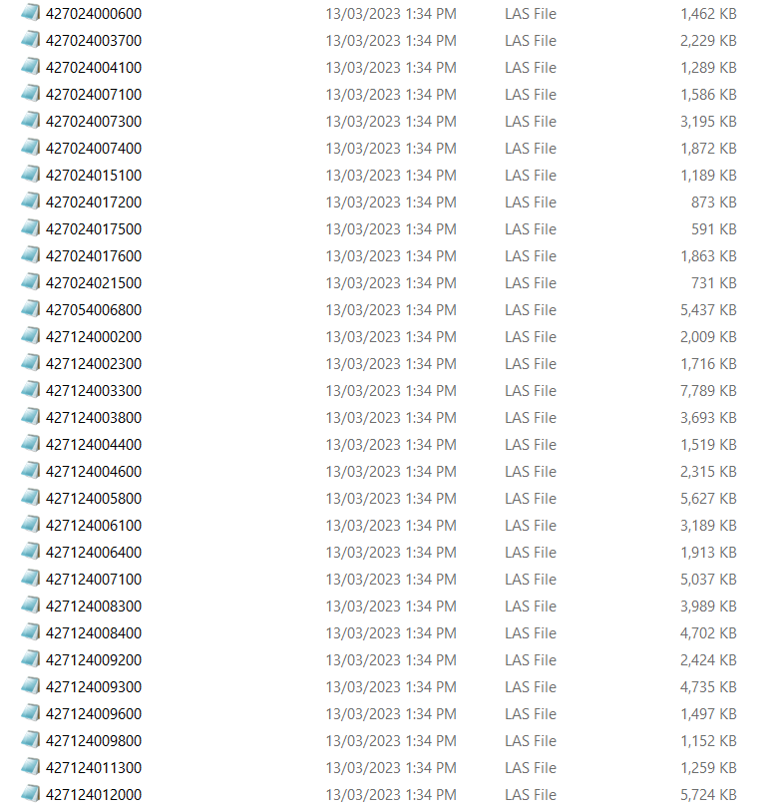
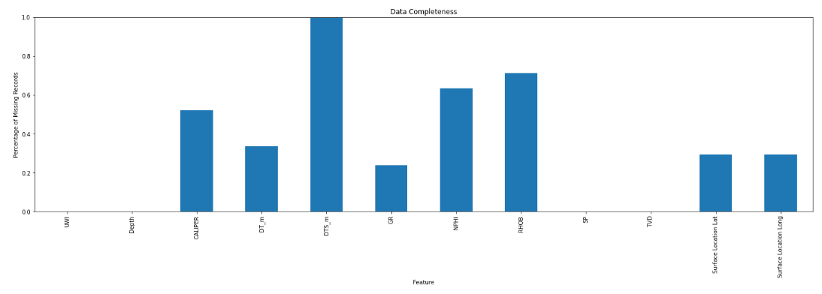
High Level Data Overview:
Well Data Completeness of 208 wells

Slide 4
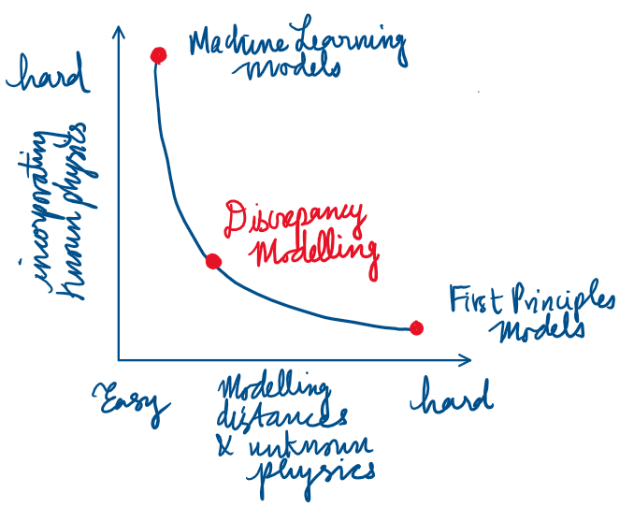
Proposed Method: Physics based Discrepancy Modeling
Discrepancy is the mismatch between simulator predictions and real-world observations, given that the 'true' parameters of the simulator are known.
$$\frac{ⅆ}{ⅆt}x=f\left(x\right)+δg\left(x\right)$$
Idealized Model + Discrepancy
Model discovery starting with partial knowledge of physics
To resolve missing/ simplified physics, numerical approximations, simplified assumptions
First principles physics model is used to enforce constraints/laws.
What is not captured by the first principles physics is modelled by the discrepancy with some Machine Learning Algorithm.
In the context of dynamical systems, traditional approaches of DM include Kalman filtering and data assimilation. However, this assumes that the mismatch between the model and the measurements are given by normally distributed variables (ie random processes). In several systems, the residuals reveal deterministic structures that dictate the observed time evolution. ML algorithms such as NN can be used to learn this missing physics.

Slide 5
Building a Discrepancy Model
Two main approaches:
1) Learning Missing Deterministic Physics (DP):
Learning the discrepancy model i.e. learning
missing physics to be appended to approximate
Dynamics. The discrepancy dynamics are the dynamical error
between measurement derivatives and approximate dynamics
2) Modelling Systematic State Space Residuals (SSR):
Discrepancy model acts as a correction to approximate
state-space solutions. State-space models are used to
approximate the behavior of a physical system over time
based on mathematical equations and initial conditions.
There are four fundamentally different methods to demonstrate the mathematical implementations of discrepancy modeling:
(i) the sparse identification of nonlinear dynamics (SINDy),
(ii) dynamic mode decomposition (DMD)
(iii) Gaussian process regression (GPR)
(iv) neural networks (NN)
Can be used as a hybrid framework to combine domain knowledge from first principles and data driven model discovery to provide a more comprehensive modelling space

Slide 6
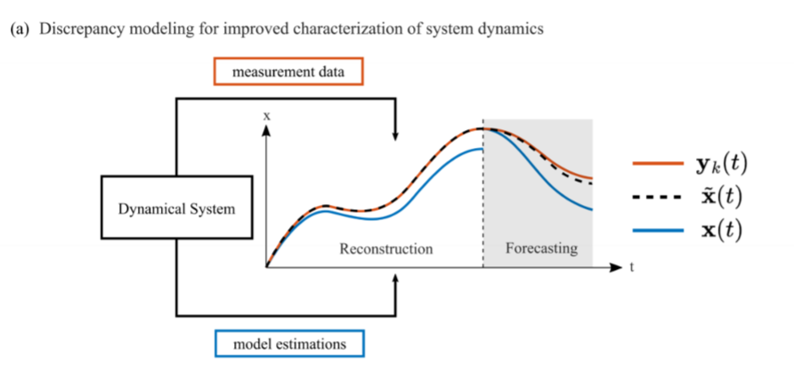
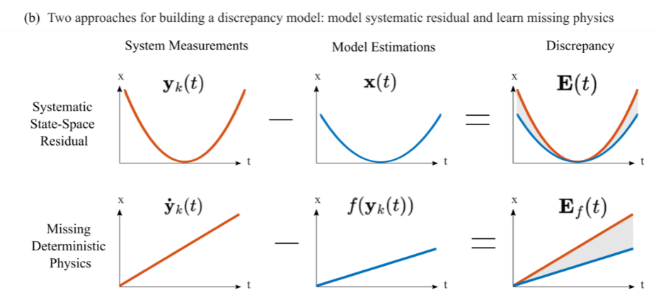






















Slide 7
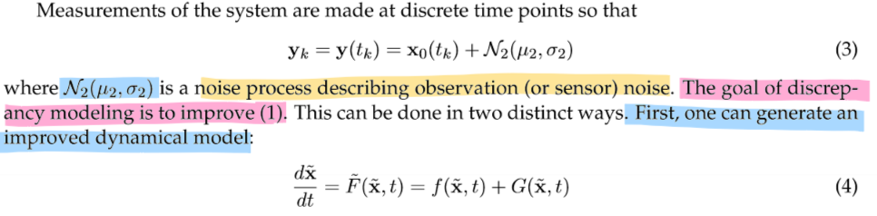
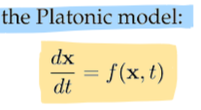
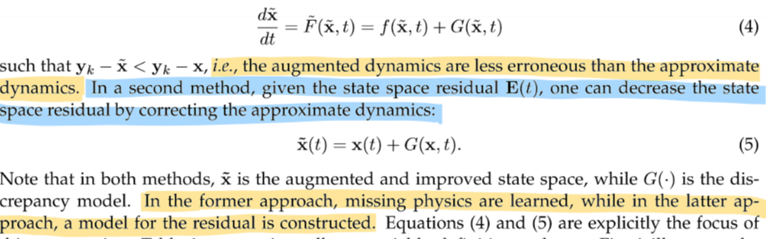

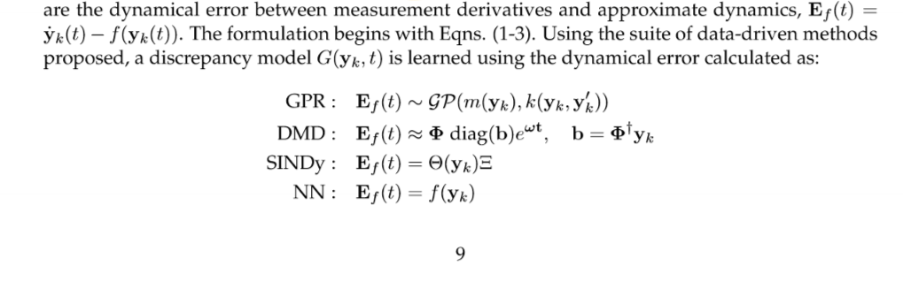

















Deterministic Physics Based Model
https://arxiv.org/abs/2203.05164#:~:text=Specifically%2C%20we%20use%20four%20fundamentally,)%20neural%20networks%20(NN).

Slide 8
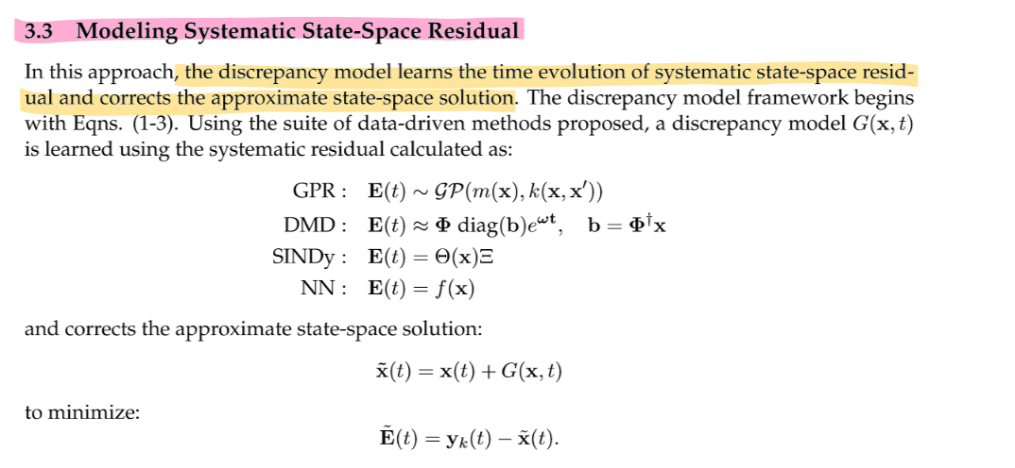


Slide 9

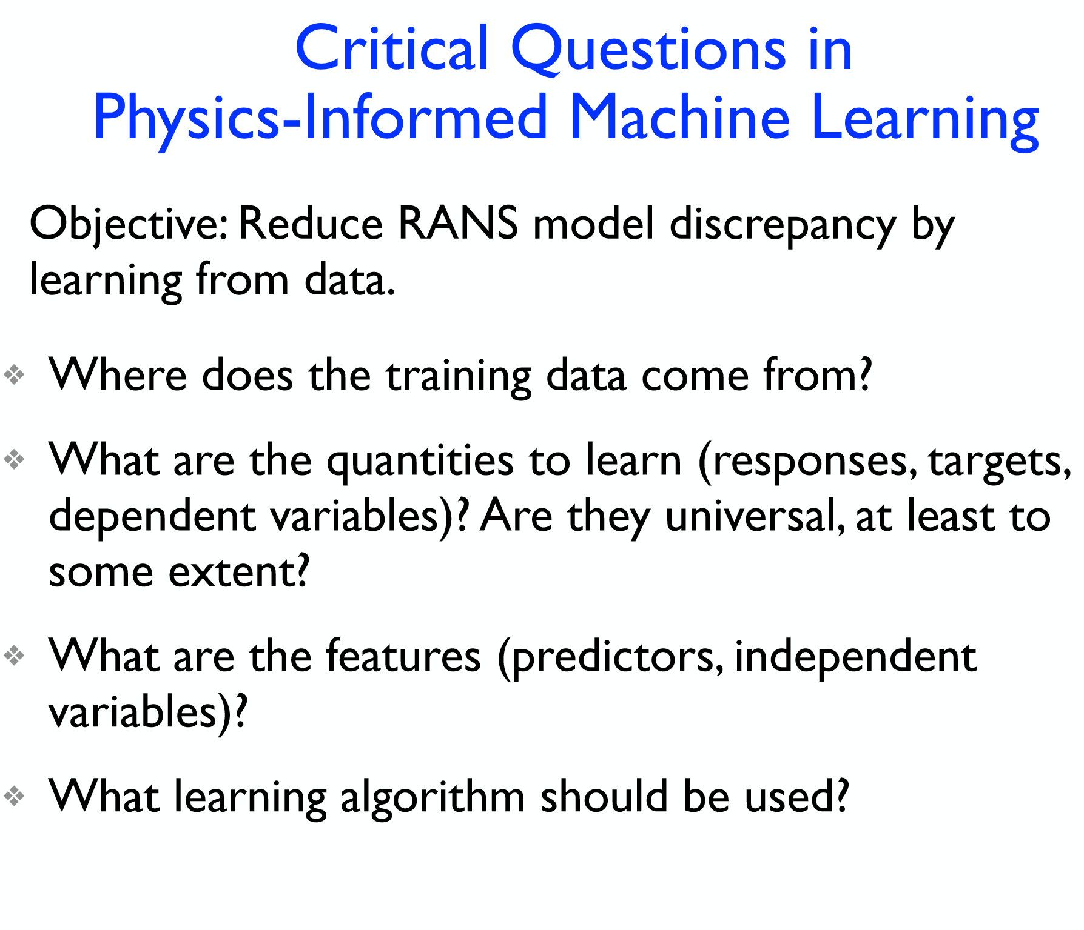
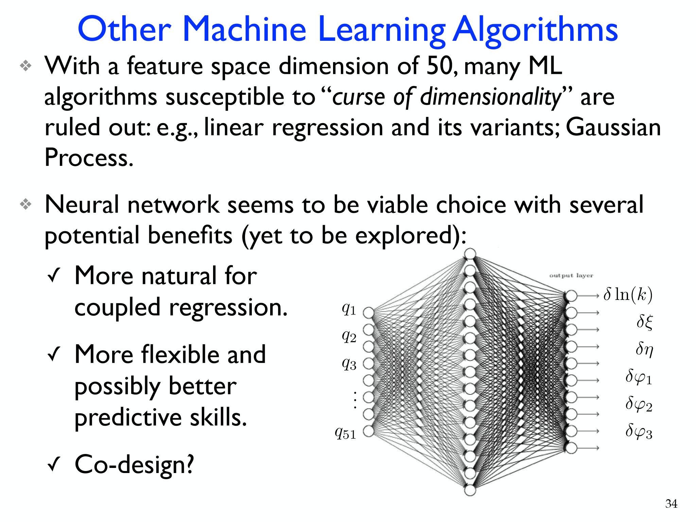
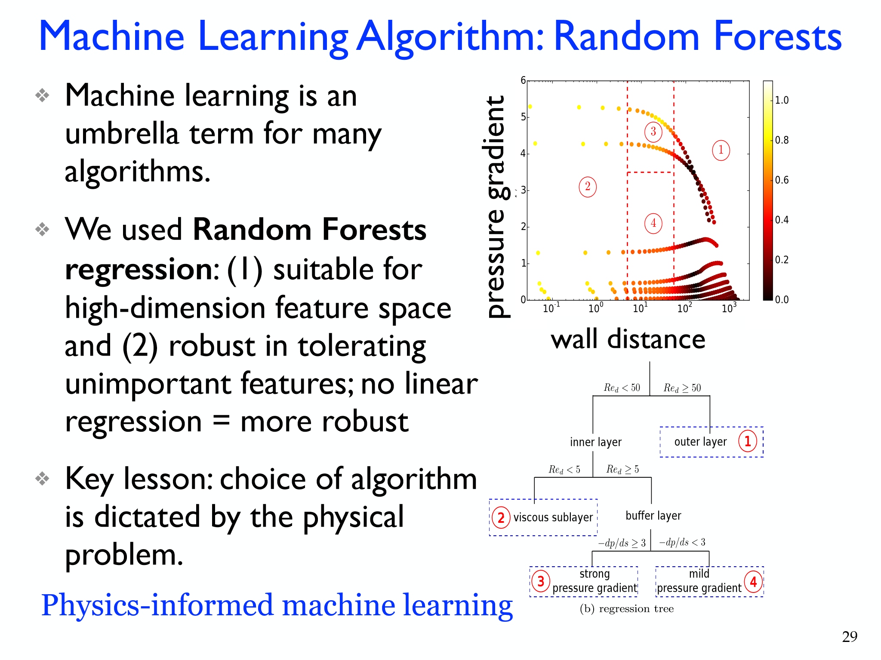








Considerations for building Discrepancy Model based on existing projects and applications.
Notes:
RANS: Reynolds Averaged Navier Stokes (RANS) Simulation

Slide 10
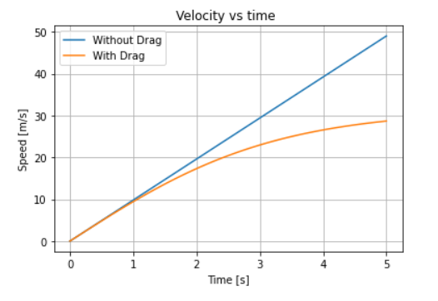
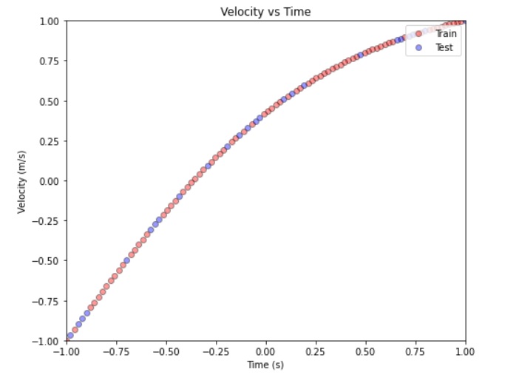
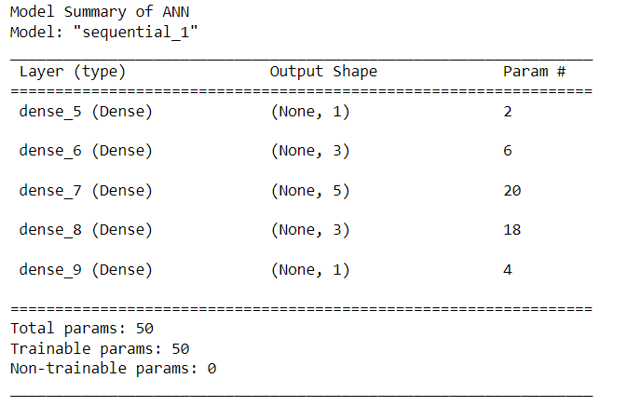
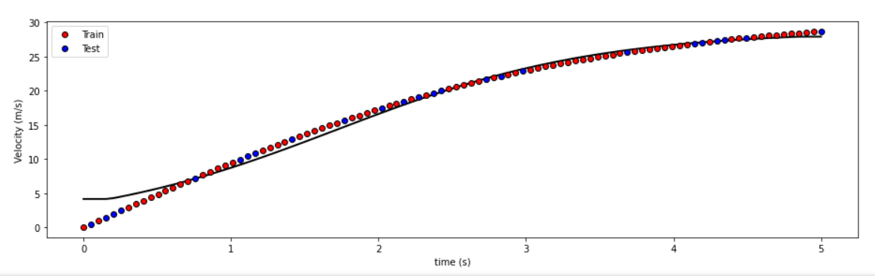
Preliminary Results as applied to 1D Physics Model: Free Falling Object with Air Resistance

Slide 11
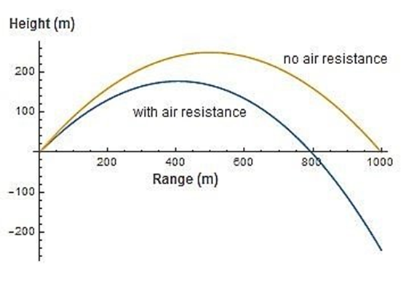
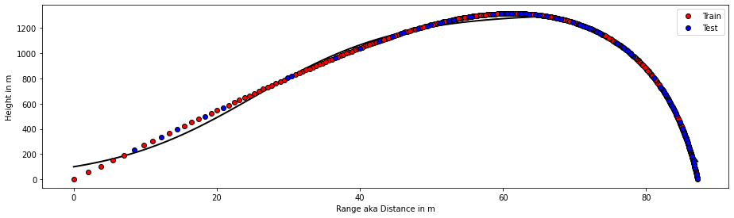
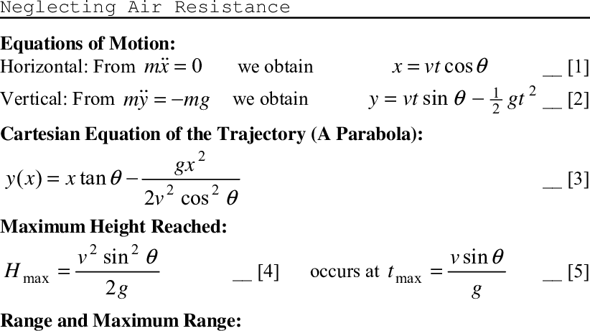
2D Physics Model: Projectile Motion
Purpose:
Understand how we learn physics through discrepancy modelling:
scales vary
sparse data
complicated physics
Test the capabilities of discrepancy modeling

Slide 12
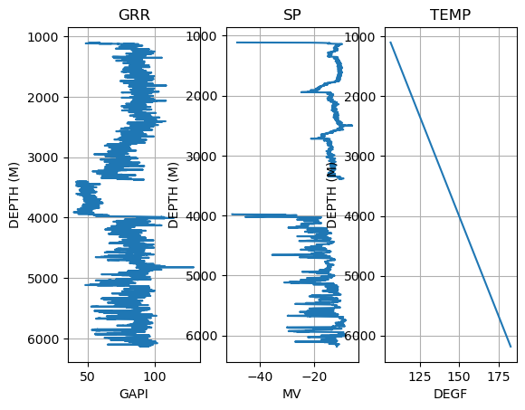
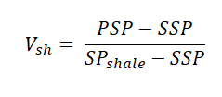
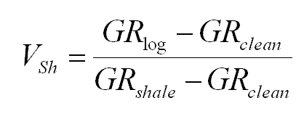
Discrepancy models start with some initial partial knowledge about physics. GR and SP measure different properties of the rock formation. The challenge is to fit this problem into our discrepancy model framework.
GR measures natural gamma radiation emitted by rock formation. GR is used as a diagnostic tool to infer composition of surrounding rock formations.
SP measures the electrical potential difference between the formation water and drilling fluid. SP is used as a tool to detect the nature of permeable zones as well as the fluid content.
Where:
V shale= volume of shale
PSP= pseudo static spontaneous potential (maximum SP of shaly formation)
SSP= static spontaneous potential of a nearby thick clean sand
#427024007100

Slide 13
Action Item for Next Update Meeting:
Select the correct logs for feature imputation
Solidify the concept of physics-based modelling applied to the 1D and 2D system.
Revisit physics relationships between these logs and determine what can realistically be modelled.
Develop a more cohesive workflow to display code during the next update meeting.
Notes from this Update Meeting:
Take out the first SP run
Consider correcting for sonic and density logs (SP/GR had to be corrected by hand since they had different issues.
The proposed workflow/ method can be applied to a larger data set on Murray’s end
The goal is CCUS screening to detect for sands and clay rich seals. Do not necessarily need to stick to a traditional workflow.

Slide 14


