Slide 1
Autoencoders for outlier detection in high-dimensional data.
May 5th, 2023
Midé Mabadeje, PhD. Candidate
Dr. Michael Pyrcz, Professor
The University of Texas at Austin

Slide 2
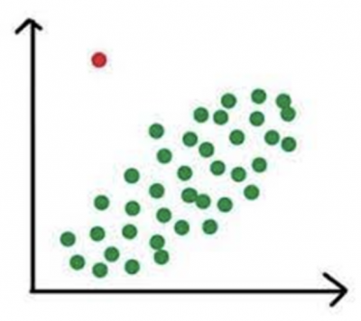
Introduction
Outliers: observations that constitute an exception to the general trend observed in the data; observations that are distributed differently than the majority of the observations
Detecting outliers can contribute to:
Understanding causal mechanisms
New research directions triggered by the existence of an exception
Discovery of errors or anomalies in observations

Slide 3
Outlier Detection Applications
A host of applications can benefit from robust and generalizable outlier detection methods – outlier detection should not be done merely to discard data points that disconfirm the model.
Examples:
Data cleaning, identification of erroneous observations
Financial fraud detection
Healthcare/ diagnosis
Detection of bot activity
Identification of anomalous geological features via reservoir characterization
Identification of equipment degradation and failure during production.

Slide 4
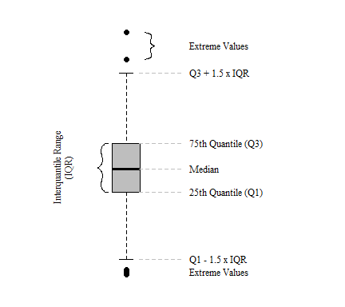
Methods for Outlier Detection
Most methods rely on identifying unusual distance between the outlying point and the inlying data.
Visual inspection
Z-Score analysis
Tukey’s box and whiskers plot
Isolation forest (IF)
Local outlier factor method (LOF)

Slide 5
Outliers in High-Dimensional Data
Outlier detection in high-dimensional data is more challenging.
Visualization cannot be done at high dimensions.
Outlier structure becomes more complex: unusual combinations of feature values.
As dimensionality increases, the space between points becomes more uniform and sparse.

Slide 6
Existing Methods for High Dimensional Outlier Detection
Local Outlier Factor
Use Mahalanobis distance to address curse of dimensionality
Can be paired with dimensionality reduction techniques to improve performance
Sensitive to hyperparameter selection
Isolation Forests
Uses random splitting using trees to isolate anomalies
Sensitive to hyperparameter selection
Does not perform well on datasets with varying data distributions
Limitations: lacks robustness and has distribution assumption

Slide 7
Motivation
Oil and gas datasets are complex with high dimensionality due to engineering and geological constraints, makes outlier identification across spaces challenging.
Outlier identification is important :
Identifying productive zones e.g., sweet spots, facies of interests
Anomaly detection
Erroneous inferences and decision making

Slide 8
Proposal
To build a method for outlier detection for high-dimensional datasets using an auto-encoder to reduce dimensionality and to implement this method to detect outliers.
Advantages to using an auto-encoder for data reduction in outlier detection:
Does not assume linear relationship between features
No distributional assumption
Flexible regarding data type (can be used to reconstruct continuous, discrete, mixed data)
Unsupervised; can be trained on unlabeled data
Forward and backward route
Note: No method will perform equally well on all datasets. Our proposal is to consider a technique that has significant advantages in detecting outliers in high-dimensional datasets across different scenarios.

Slide 9
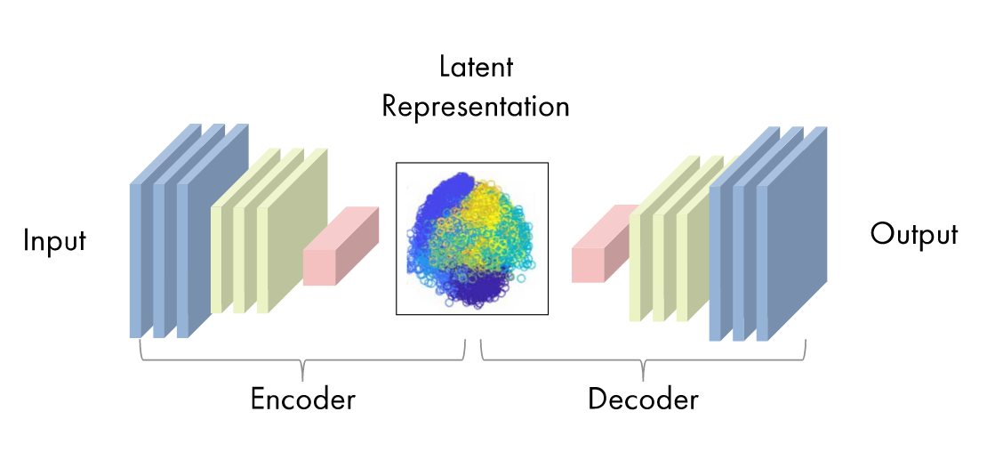
Autoencoders (AE)
AE consists of 4 main steps: encoder, bottleneck, decoder, and reconstruction loss
Source: https://www.mathworks.com/discovery/autoencoder.html

Slide 10
Density Based Clustering of Application with Noise (DBSCAN)
DBSCAN is a maximal set of density connected points, grows over complicated connected patterns.
Steps:
Visit data samples at random
Check neighborhood
If enough points, start a new cluster or add to an adjacent cluster
If not enough points, assign as an outlier
Stop when all samples are visited
Parameters: radius, $ε$ , and minimum sample, $n_{pts}$.

Slide 11
Proposed Workflow for Outlier Detection (AE-DBSCAN)
Split dataset into train and test size e.g., 80:20
Train and tune the hyperparameters of the autoencoder using appropriate loss function e.g., MSE
Using the trained AE, project all data into the latent space
Perform DBSCAN in the latent space to identify outliers
Tune the DBSCAN parameters i.e., min samples, epsilon and obtain the optimal DBSCAN results
Set all clusters formed via density reachability to cluster 1, denoted as inliers, and elsewhere outliers
Decode the DBSCAN identified outliers using the decoder network

Slide 12
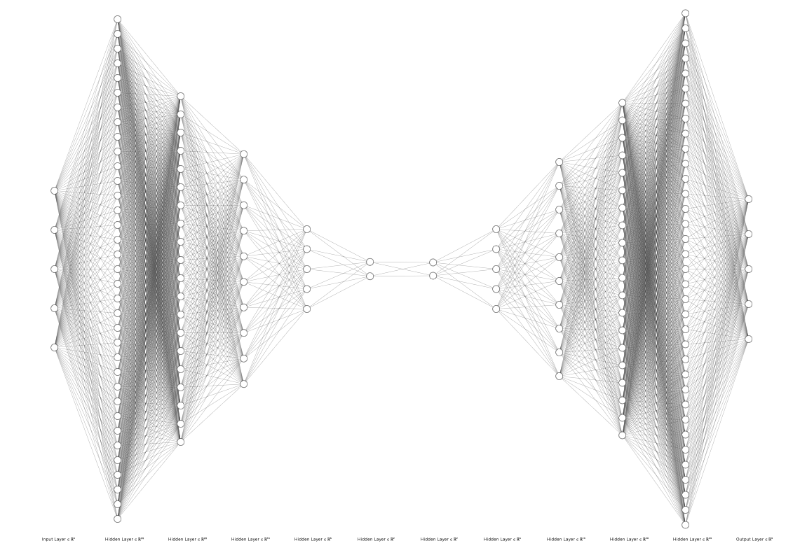
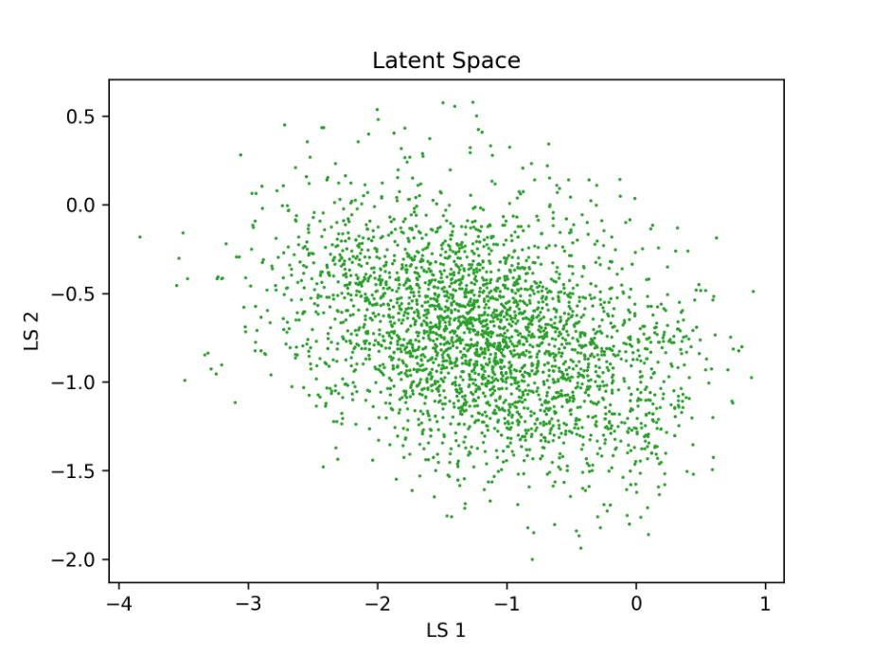
Encoder Network
Decoder Network
Bottleneck
Multidimensional dataset
Outliers in original space
Outliers in latent space
DBSCAN
AE-DBSCAN for Multidimensional Outlier Detection

Slide 13
Results Outline
Outlier detection with simulated data
Constructed a toy dataset to train and test the auto-encoder method
2) Evaluation and Comparison
Performance evaluation using MSE threshold and visualization
Performance comparison between proposed auto-encoder method and alternative methodologies (e.g., IF, LOF, and DBSCAN in highly dimensional space) to detect multivariate outliers in both synthetic and real data
Note: Without labels for our dataset we cannot assess and compare the accuracy, we visually inspect the outlier points.

Slide 14
Results: Synthetic Dataset

Slide 15
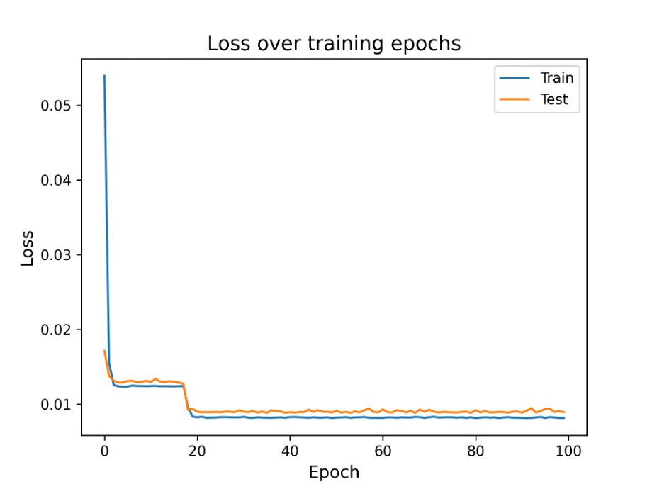
Results: Synthetic Dataset
Training AE on synthetic data: Epochs = 100, Batch size = 32, Input size = 3000 x 4

Slide 16
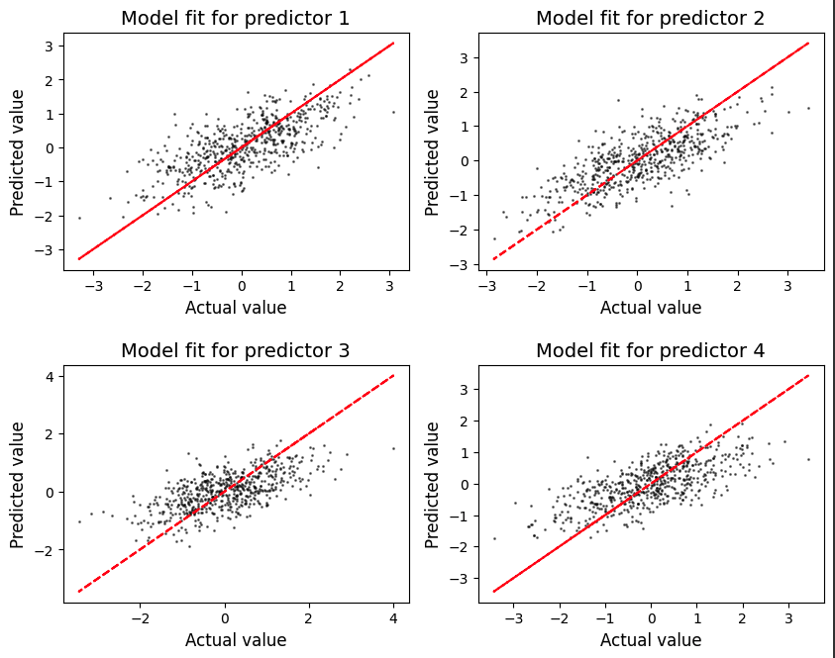
Results: Synthetic Dataset
Model reconstruction: evaluating the performance of the AE decoder in replicating the test set from the synthetic data

Slide 17
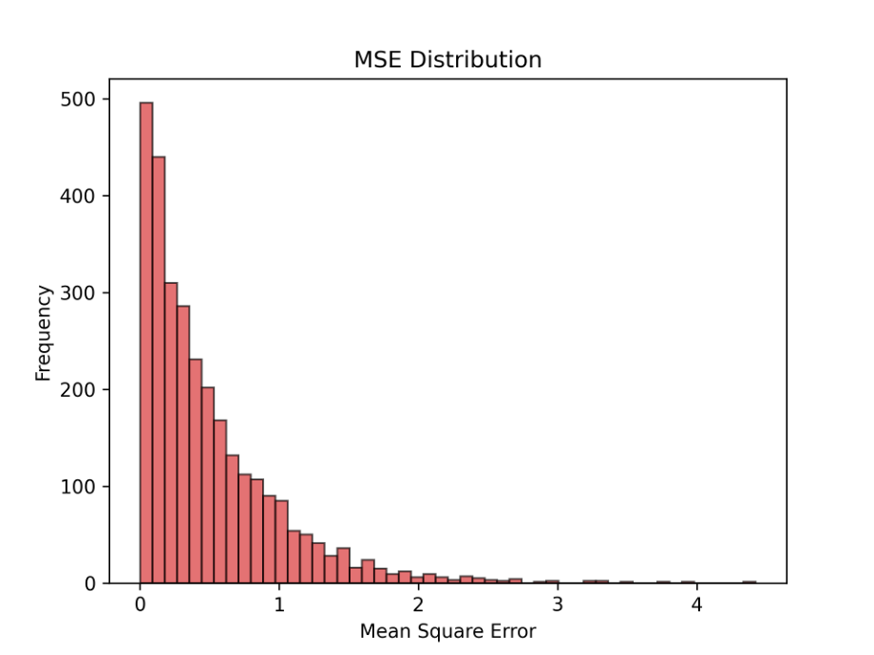
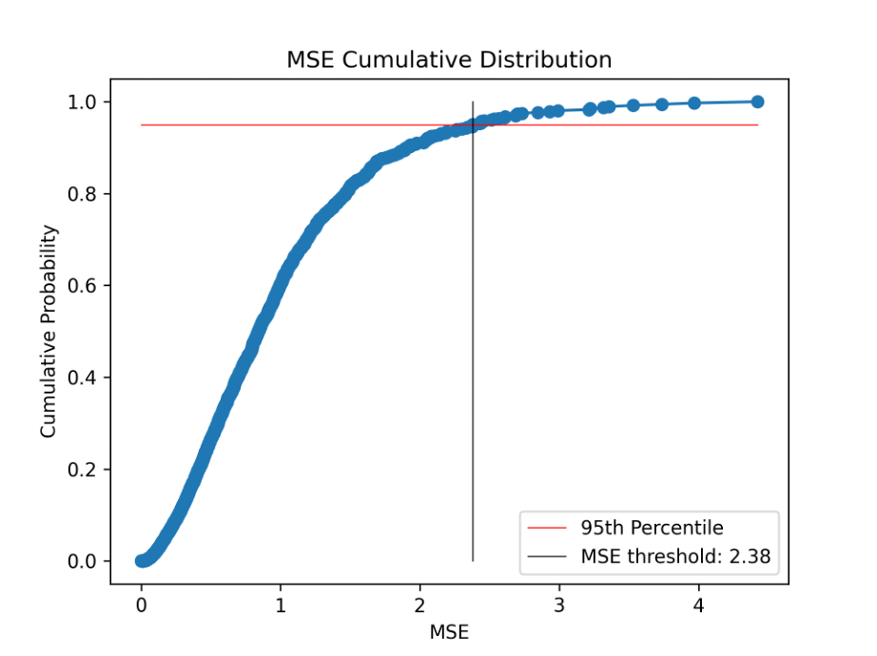
Results: Synthetic Dataset
Workflow testing with MSE in latent space to find outliers: Identify 95th percentile threshold using MSE CDF
with MSE in latent space

Slide 18
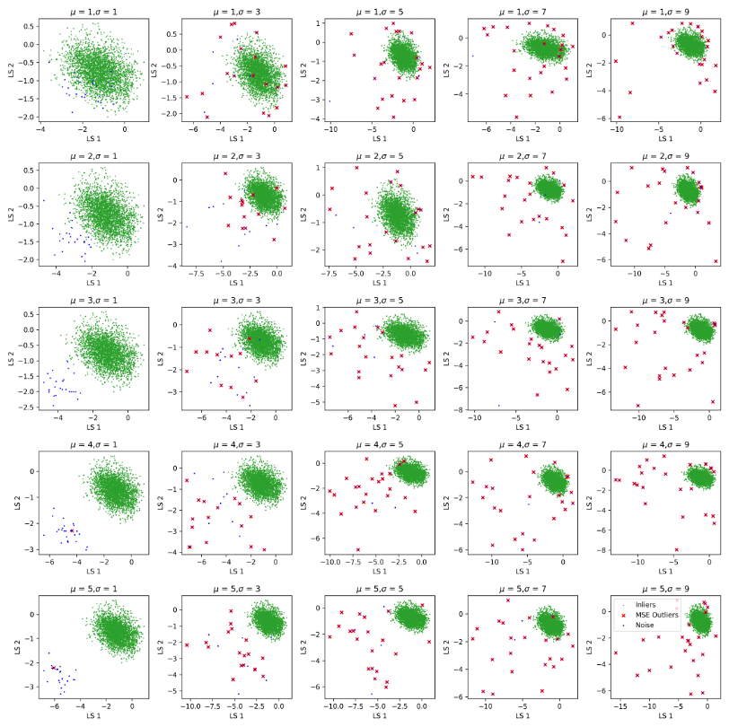
MSE Threshold
Outlier detection appears unsatisfactory
Inliers erroneously marked as outliers in some cases and vice-versa

Slide 19
MSE Threshold
Outlier detection appears unsatisfactory
Inliers erroneously marked as outliers in some cases and vice-versa

Slide 20
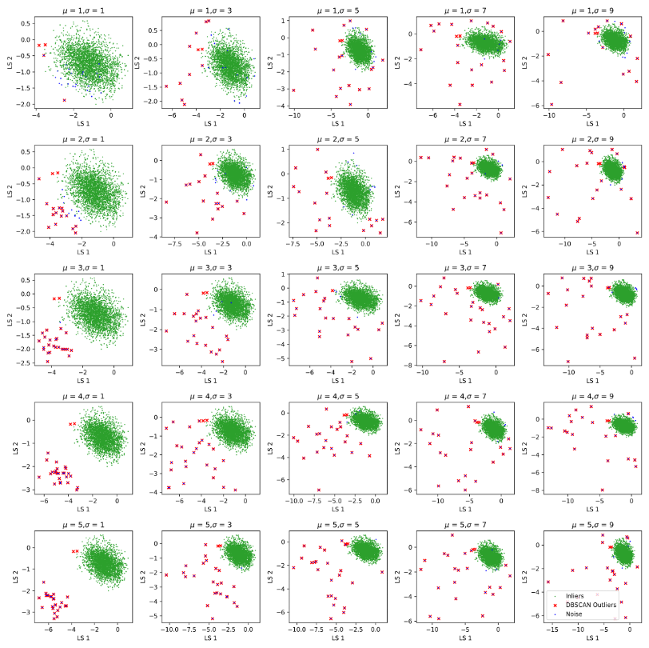
Proposed AE-DBSCAN
DBSCAN in latent space to identify outliers
Improvement in outlier detection relative to the MSE threshold method
Most infused noise points are correctly classified
A few noise points are inliers opposed to outliers

Slide 21
Proposed AE-DBSCAN
DBSCAN in latent space to identify outliers
Improvement in outlier detection relative to the MSE threshold method
Most infused noise points are correctly classified
A few noise points are inliers opposed to outliers

Slide 22
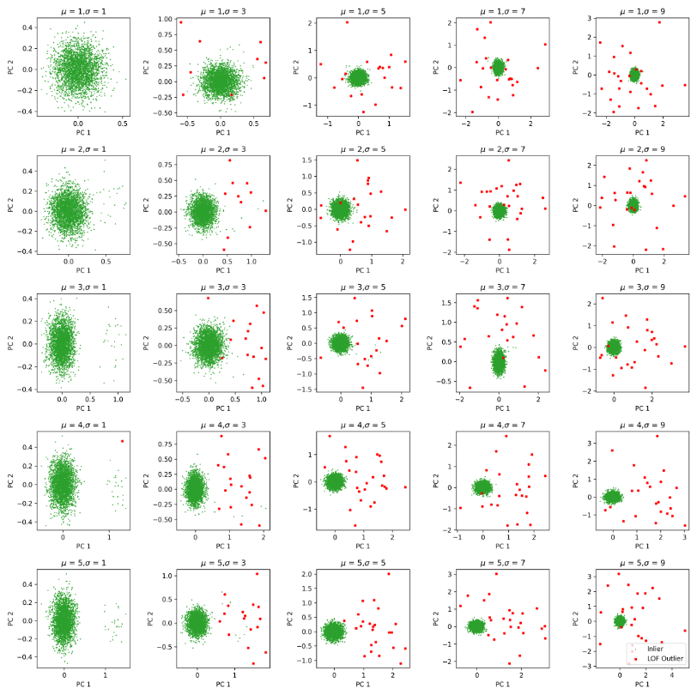
DBSCAN in n-D Space
DBSCAN performed on the high dimensional data input without AE
Low dimensional space visualized with PCA
DBSCAN does not recognize outliers (see column 1)

Slide 23
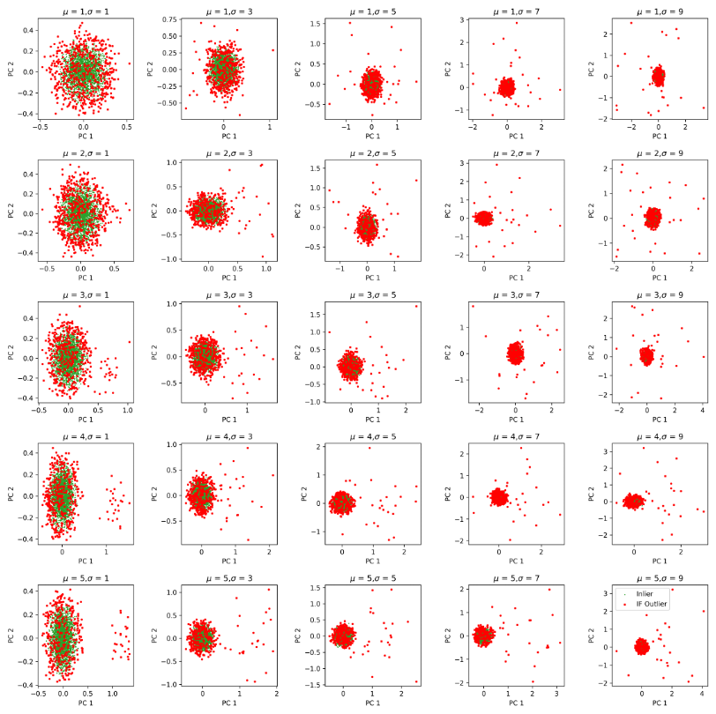
Isolation Forest Outlier Detection
Performed on high dimensional data
Outlier detection appears unsatisfactory
High false positives for outlier identification

Slide 24
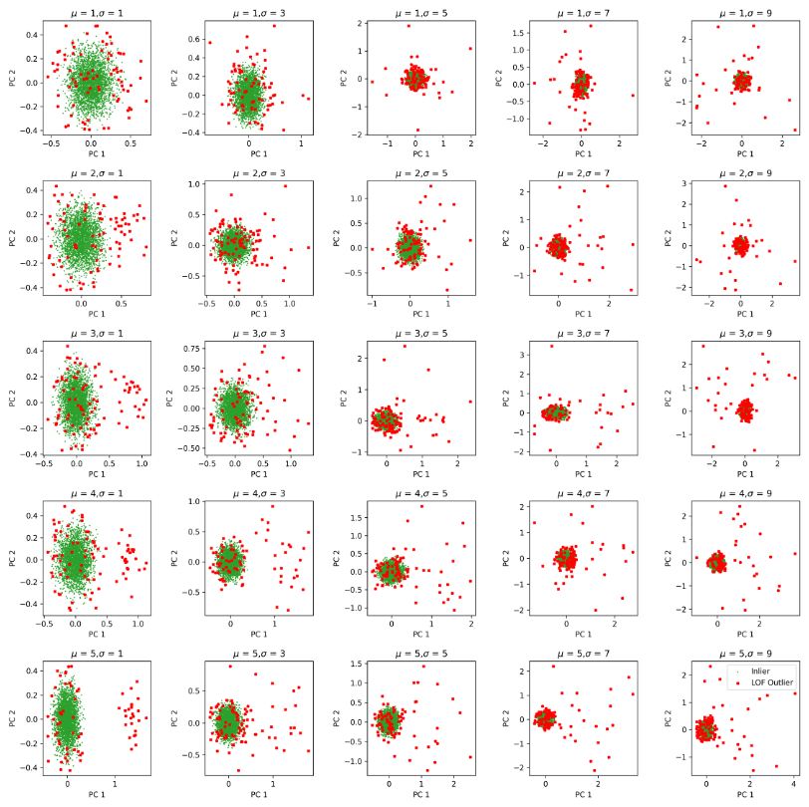
Local Outlier Factor Method
Performed on high dimensional data
Outlier detection shows improvement relative to IF, but still unsatisfactory
Medium amount of false positives wrt. IF

Slide 25
Results: Actual Dataset

Slide 26
Conclusions
AE-DBSCAN in the latent space for outlier detection performed better than an autoencoder paired with MSE threshold for outlier detection.
Other methods for multivariate outlier detection performed poorly.

Slide 27
Future Steps
Implement joint probability threshold in the latent space for AE-DBSCAN.
Refine hyperparamter tuning for methods in proposed AE-DBSCAN.
Try on actual data.

Slide 28
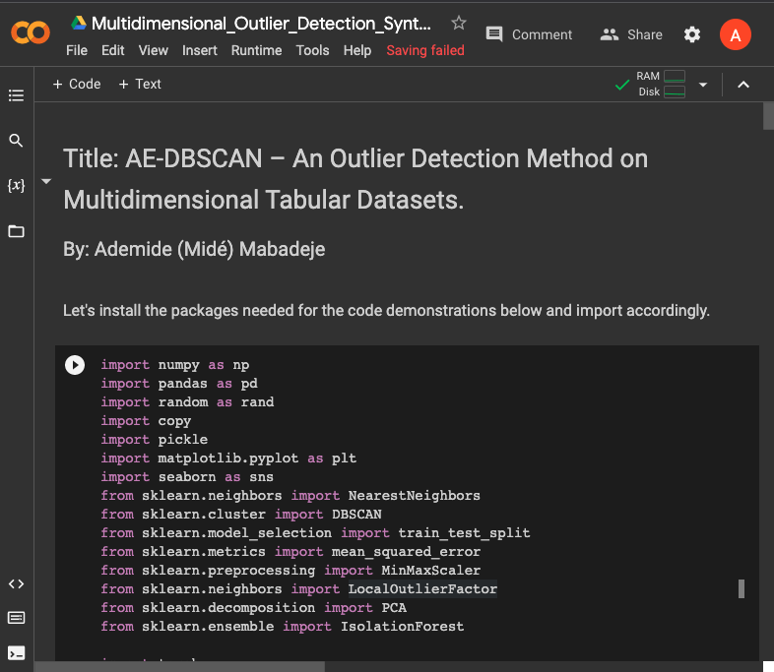
Try it Out. !
Demonstrates preprocessing steps and methods used.
Includes equations and diagnostic plots for demonstrative purposes.

Slide 29
THANK YOU.
Questions or Comments?
33

Slide 30


