Slide 1
Progress Meeting
December 08, 2023

Slide 2
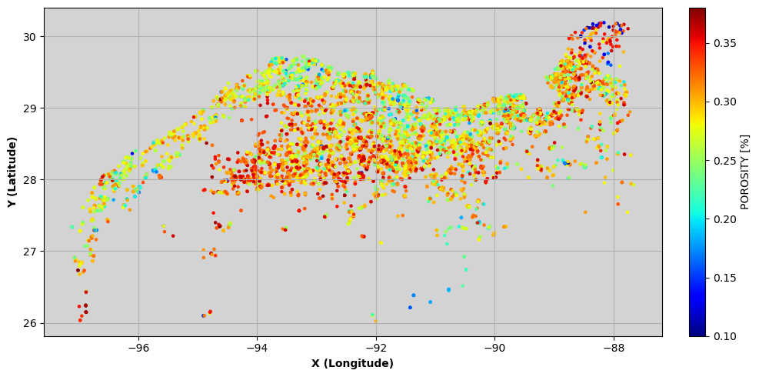
CCS_Sand_wells1

Slide 3
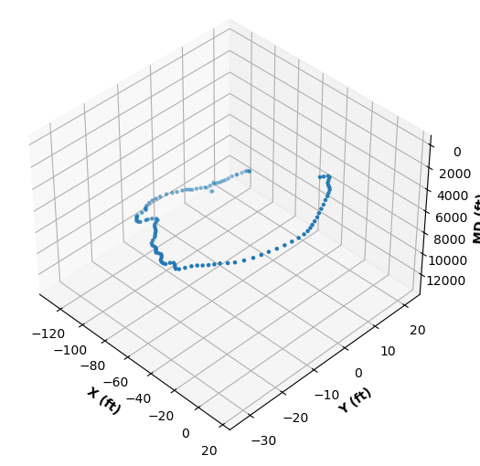
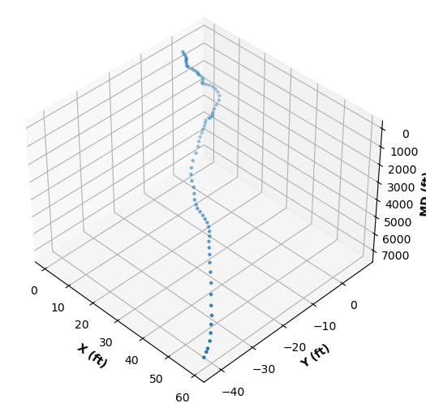
UT dir surveys
177004037400
427064023000

Slide 4
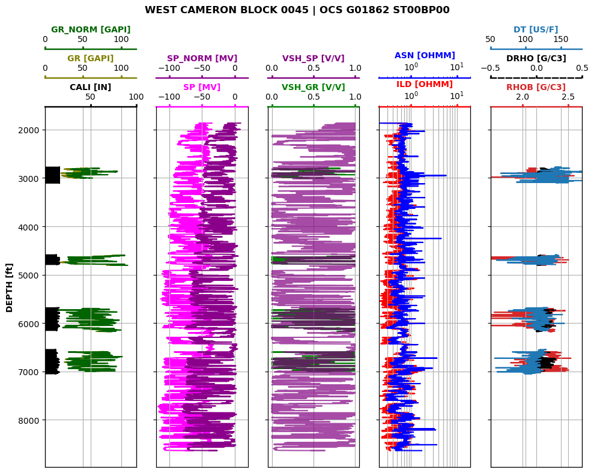

Slide 5
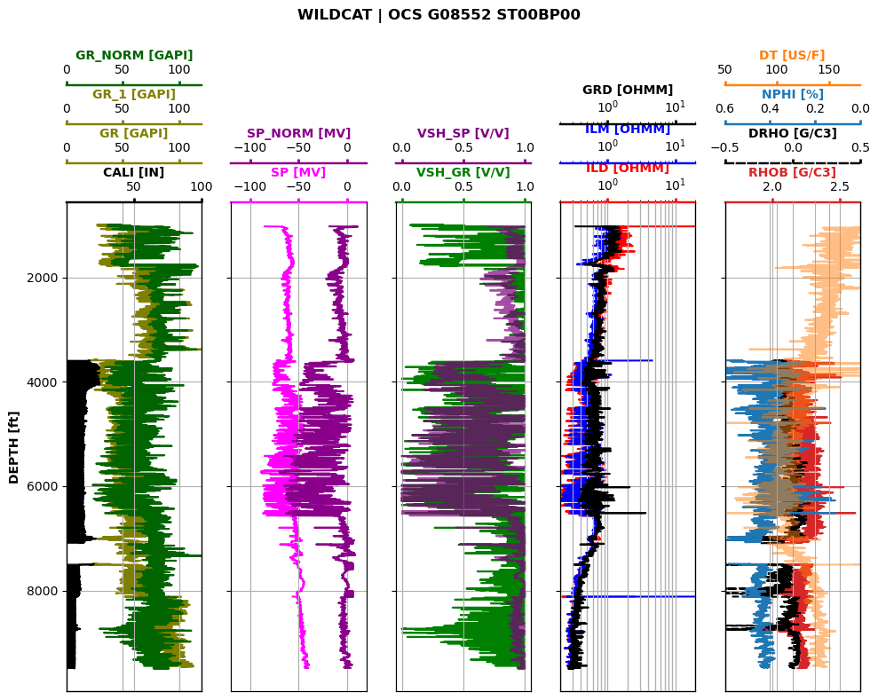
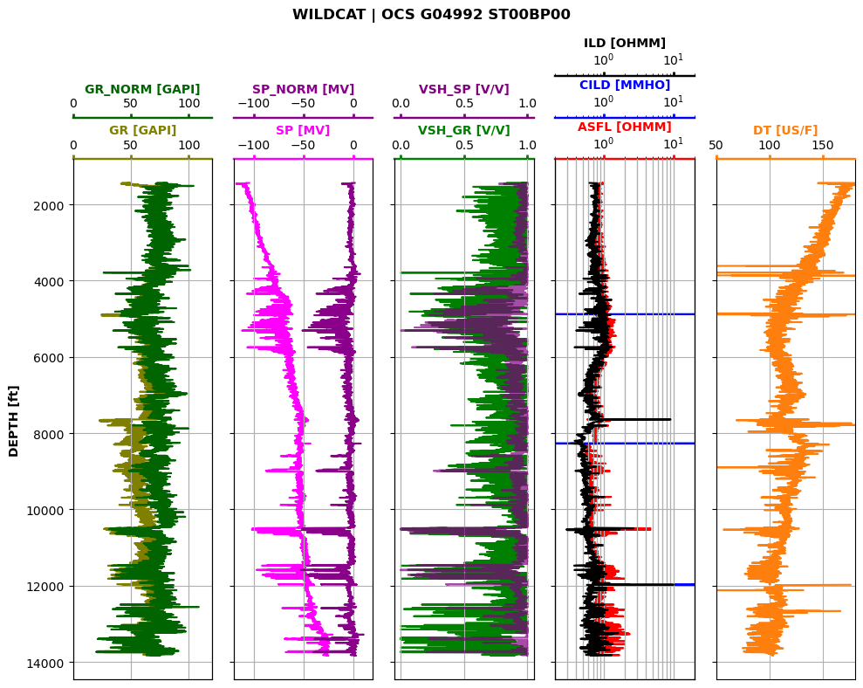

Slide 6
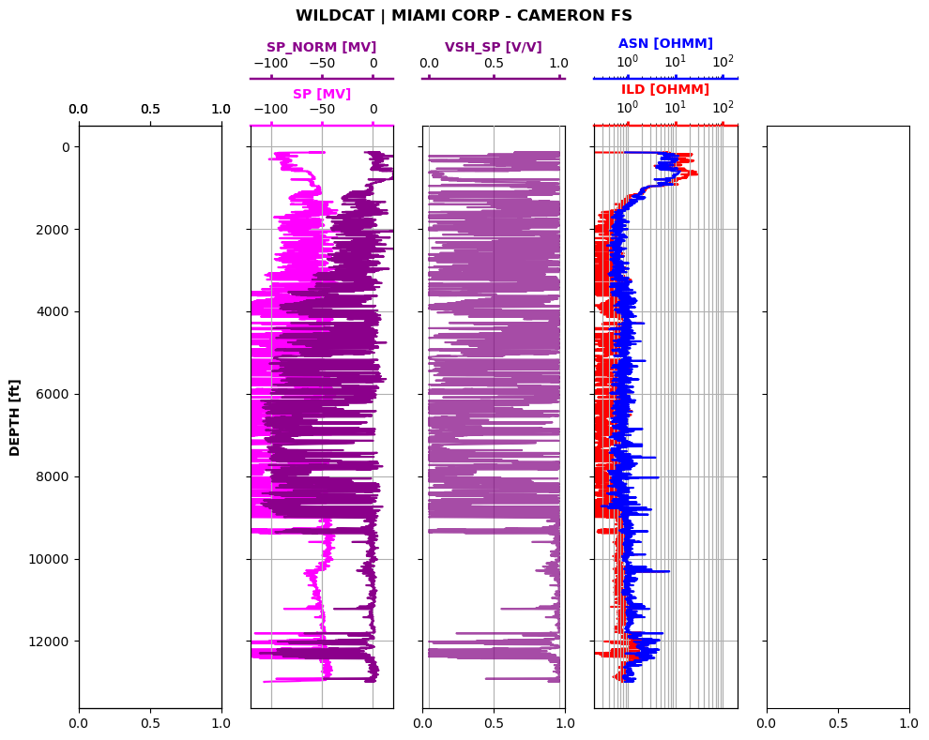
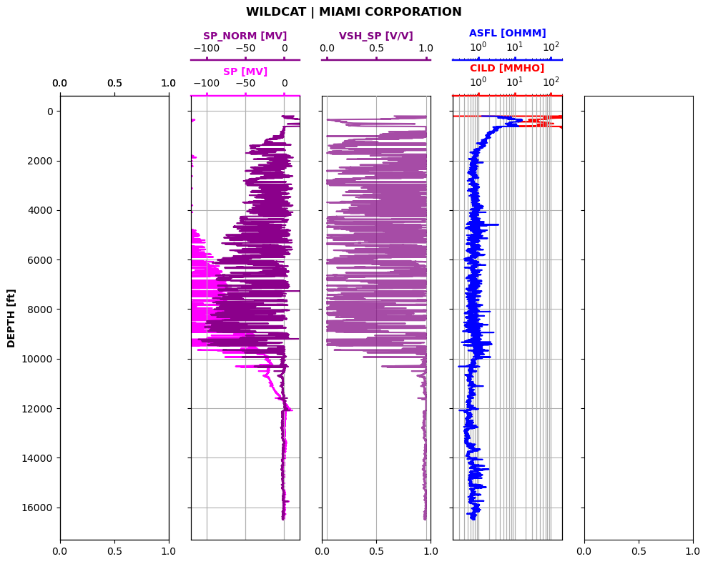

Slide 7
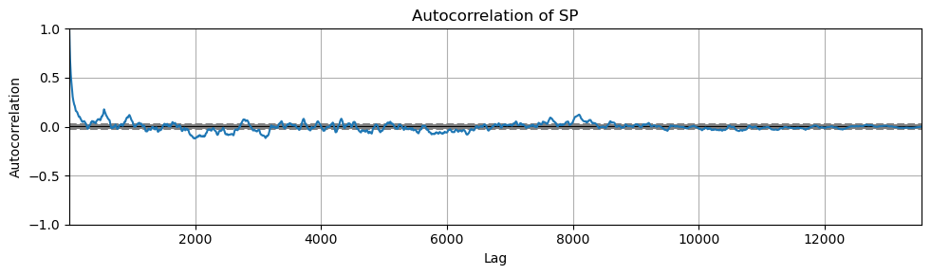
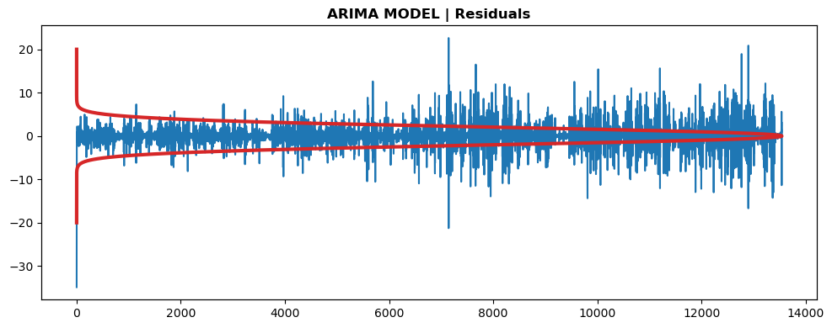
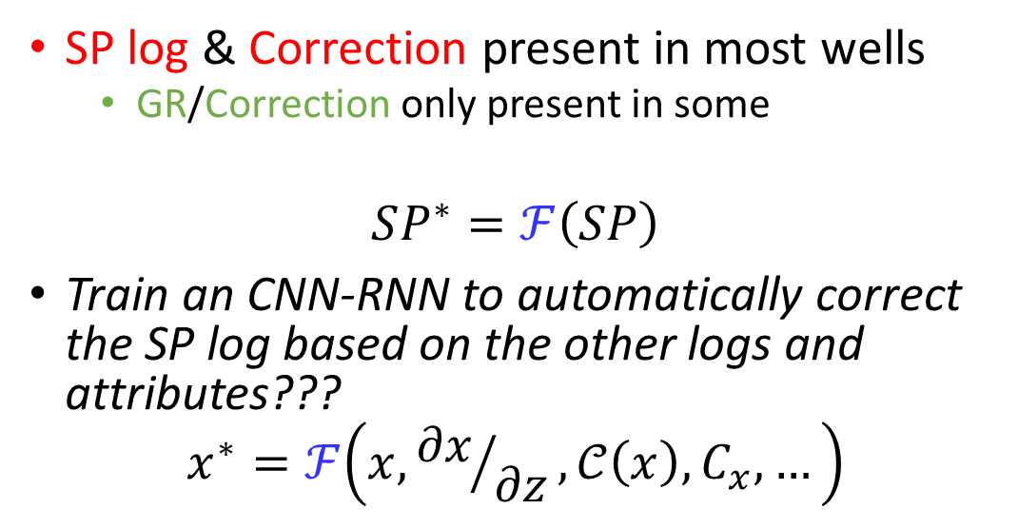
Baseline Correction
SP log & Correction present in most wells
GR/Correction only present in some
$$SP^{∗}=ℱ\left(SP\right)$$
Train an CNN-RNN to automatically correct the SP log based on the other logs and attributes???
$$x^{∗}=ℱ\left(x,{∂x}/{∂z},𝒞\left(x\right),C_{x},…\right)$$

Slide 8


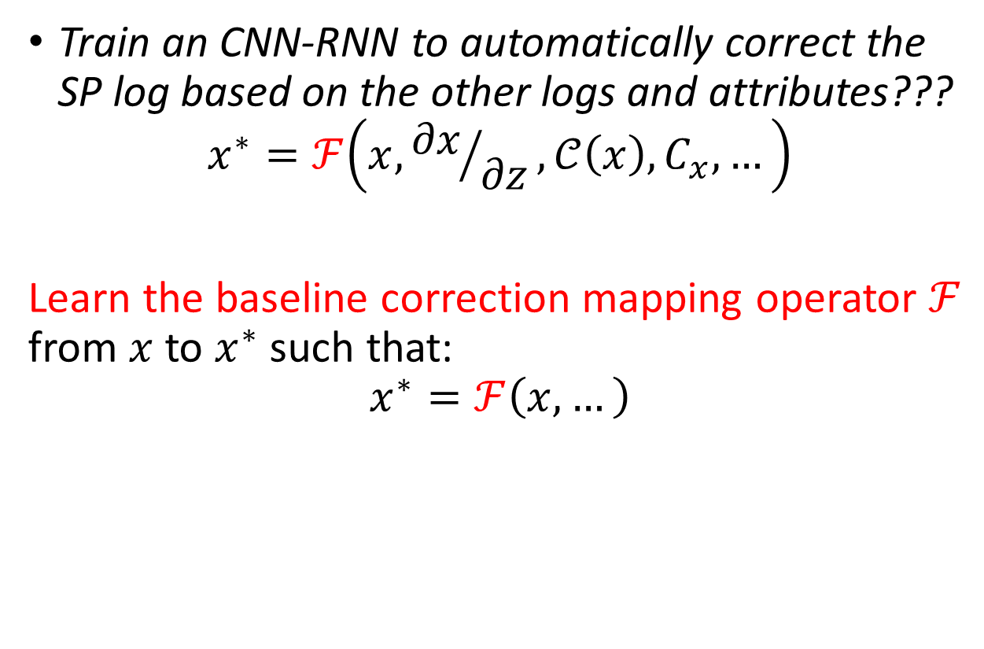

$$x$$
$$ℱ$$
$$x^{∗}$$
Train an CNN-RNN to automatically correct the SP log based on the other logs and attributes???
$$x^{∗}=ℱ\left(x,{∂x}/{∂z},𝒞\left(x\right),C_{x},…\right)$$
Learn the baseline correction mapping operator $ℱ$ from $x$ to $x^{∗}$ such that:
$$x^{∗}=ℱ\left(x,…\right)$$

Slide 9
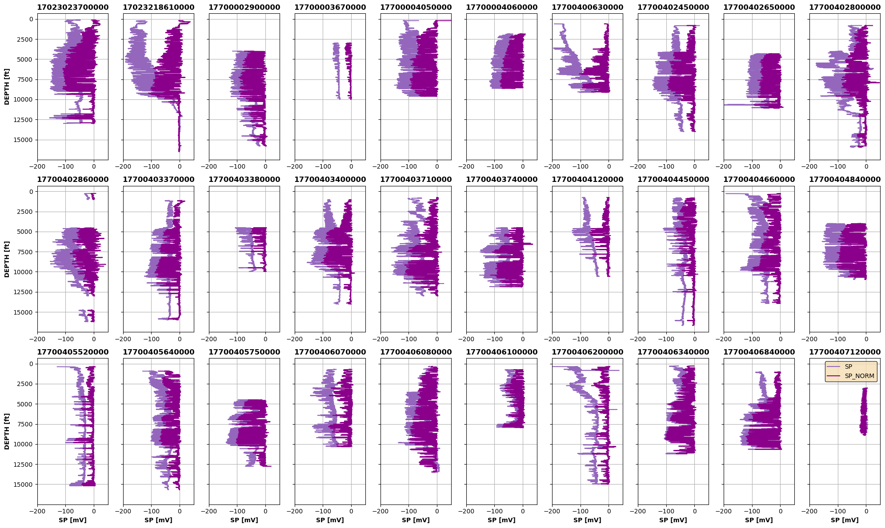

Slide 10
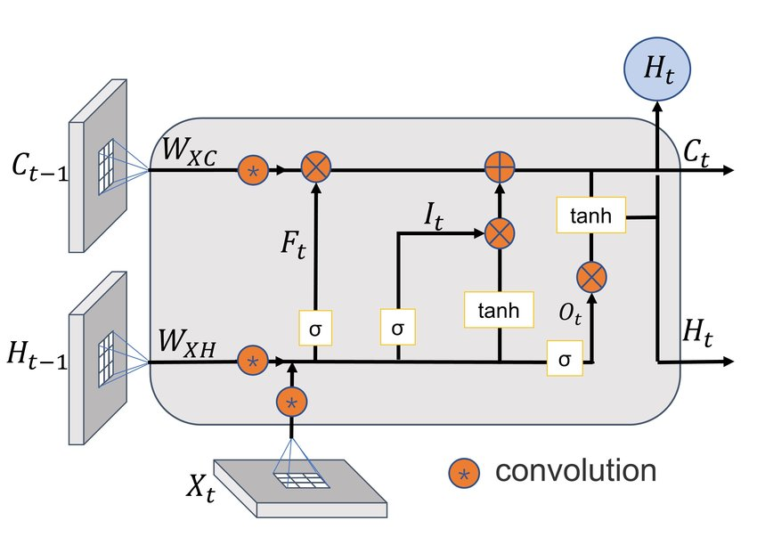
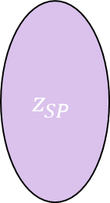


z
SP
$$\frac{∂SP}{∂z}$$
$$…$$
SP*
Encoder
$$z_{SP}$$
Decoder
Conv
LSTM
Upsampling
LeakyReLU
Batch Norm
Batch Norm
LeakyReLU
Conv Transp
Max Pool
LSTM
Conv-LSTM

Slide 11
