Slide 1








$$64$$
$$64$$
$$3$$
$$3$$
$$4$$
$$4$$
$$64$$
$$64$$

Slide 2













$$\left(1×1×C\right)$$
$$\left(1×1×C\right)$$
$$Squeeze$$
$$⊗$$
$$64$$
$$64$$
$$Excite$$
$$4$$
$$4$$
$$64$$
$$64$$

Slide 3










$$H,W$$
$$H,W$$
$$H,W$$
$$C$$
$$N$$
$$G=1$$
$$N$$
$$G=2$$
$$N$$
$$G=C$$
Instance Normalization
Group Normalization
Batch Normalization

Slide 4








$$f\left(y\right)$$
$$f\left(y\right)$$
$$f\left(y\right)=y$$
$$f\left(y\right)=y$$
$$f\left(y\right)=0$$
$$y$$
$$y$$
$$f\left(y\right)=αy$$

Slide 5



















$$H_{t}$$
$$W_{XC}$$
$$C_{t−1}$$
$$C_{t}$$
$$F_{t}$$
$$I_{t}$$
$$tanh$$
$$σ$$
$$σ$$
$$tanh$$
$$O_{t}$$
$$W_{XH}$$
$$σ$$
$$H_{t−1}$$
$$H_{t}$$
$$X_{t}$$

Slide 6
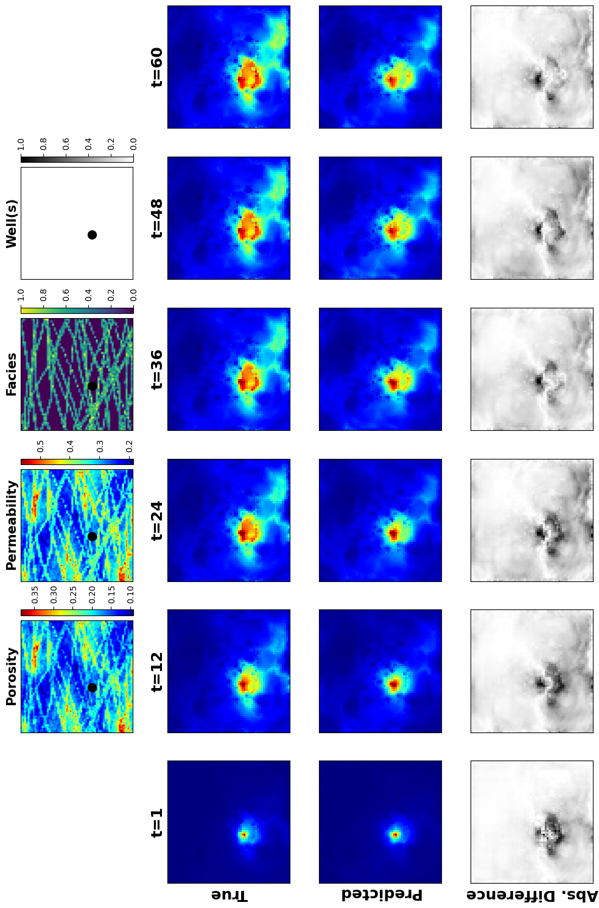
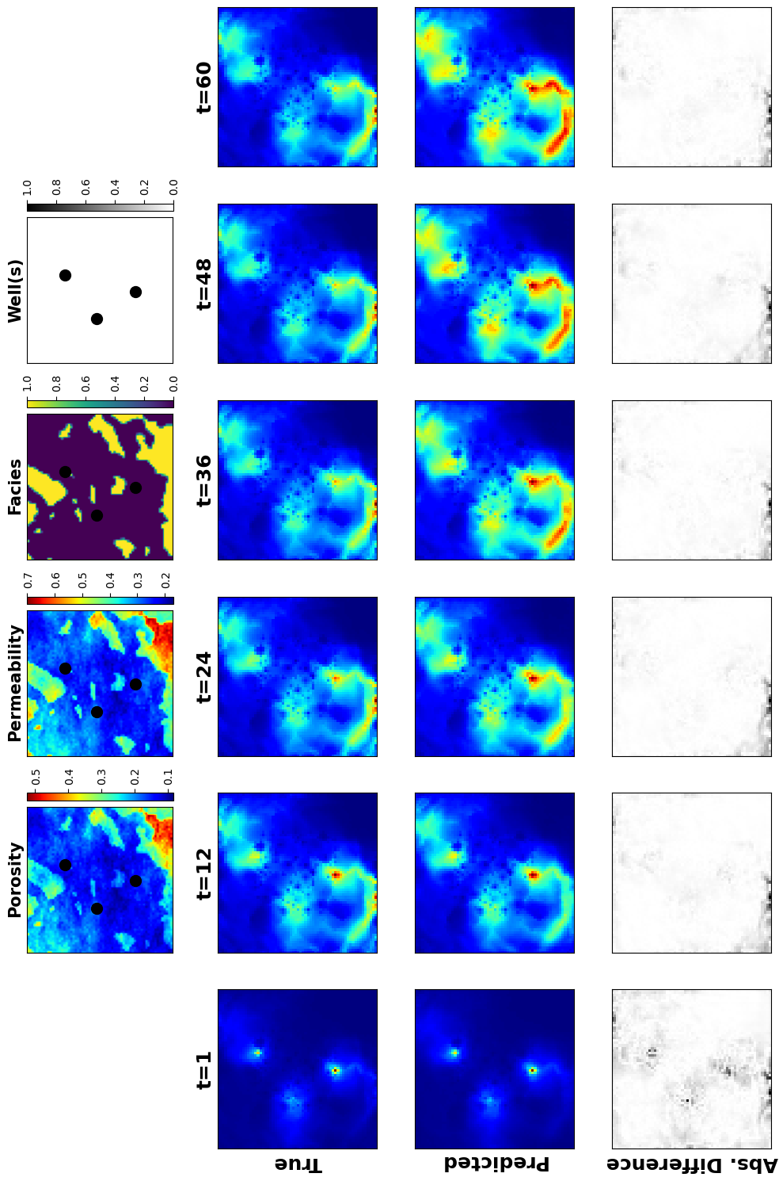
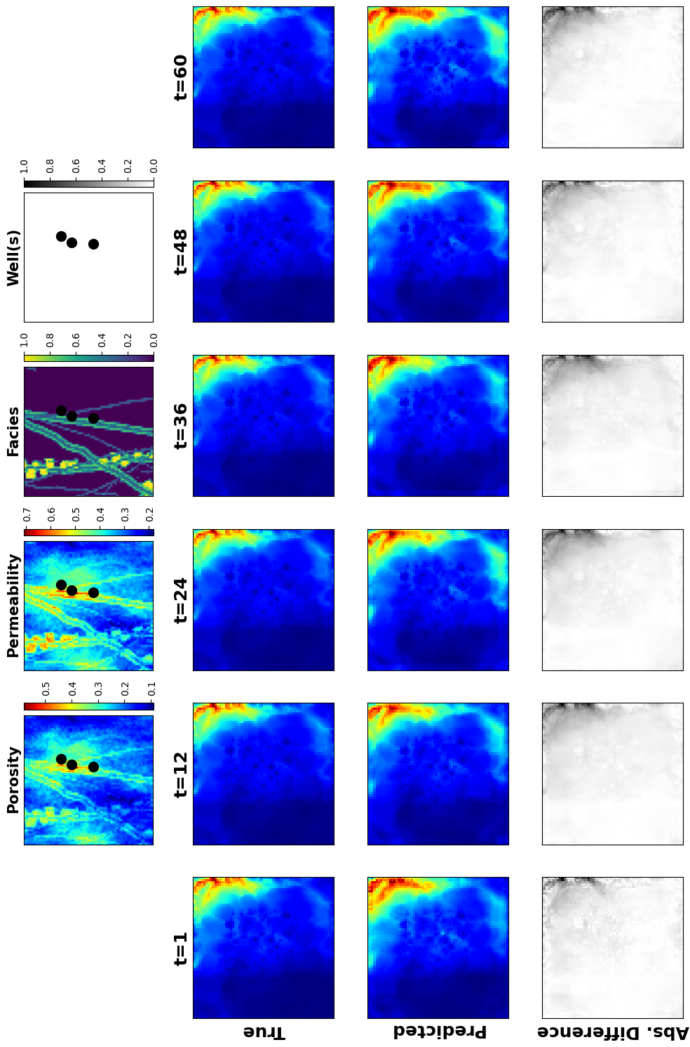

Slide 7
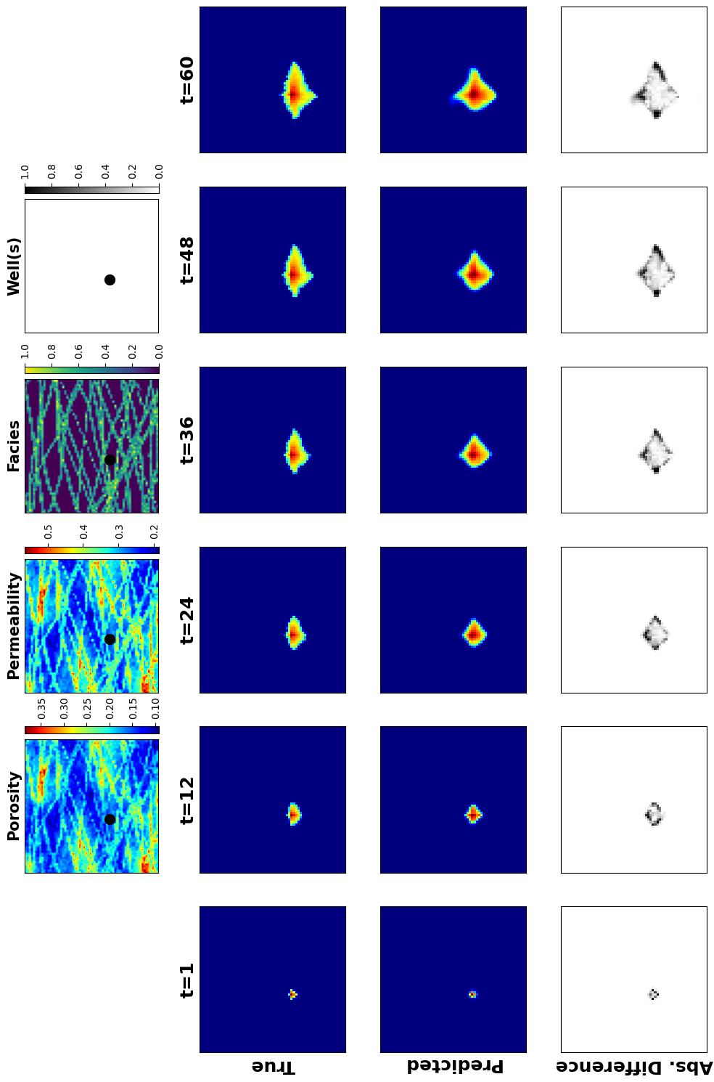
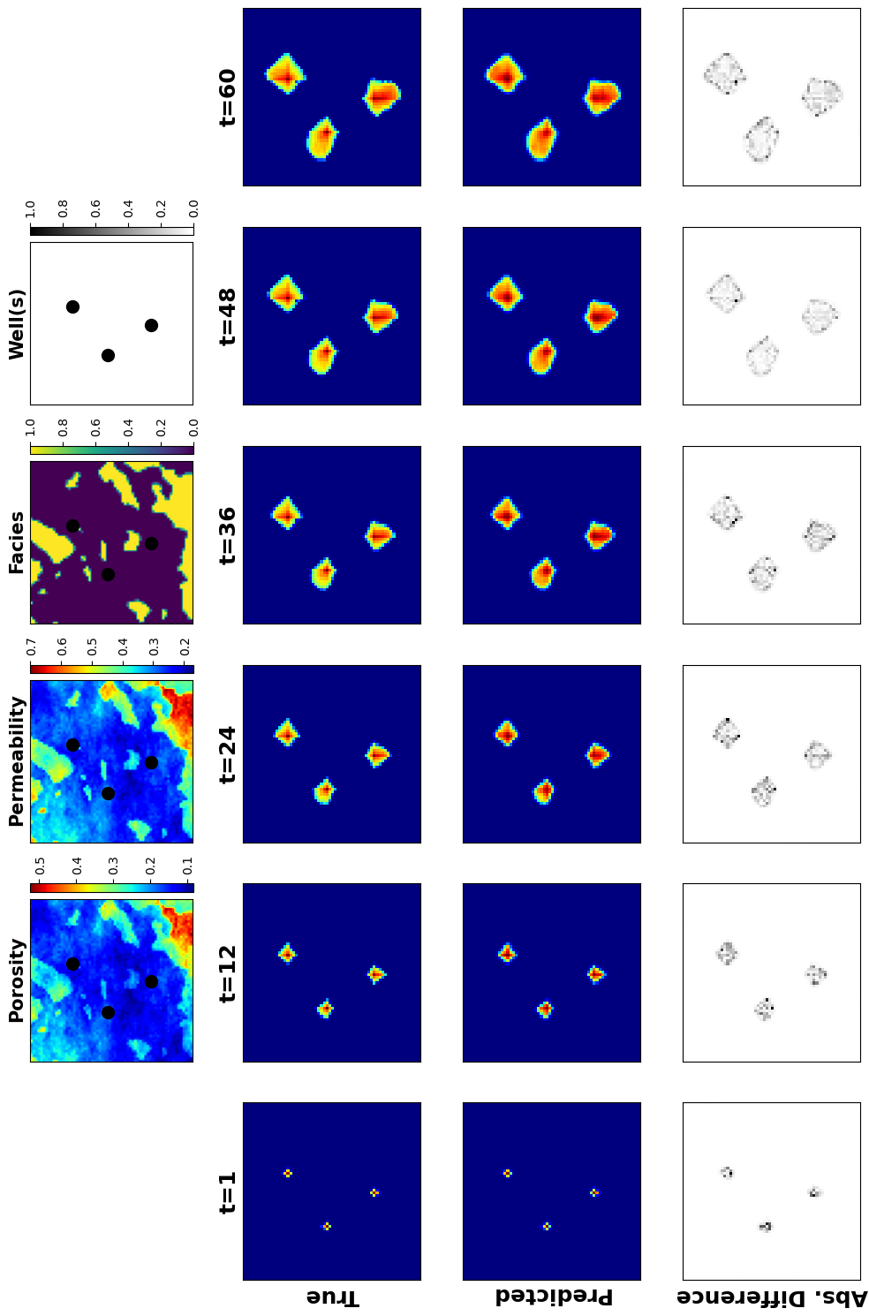
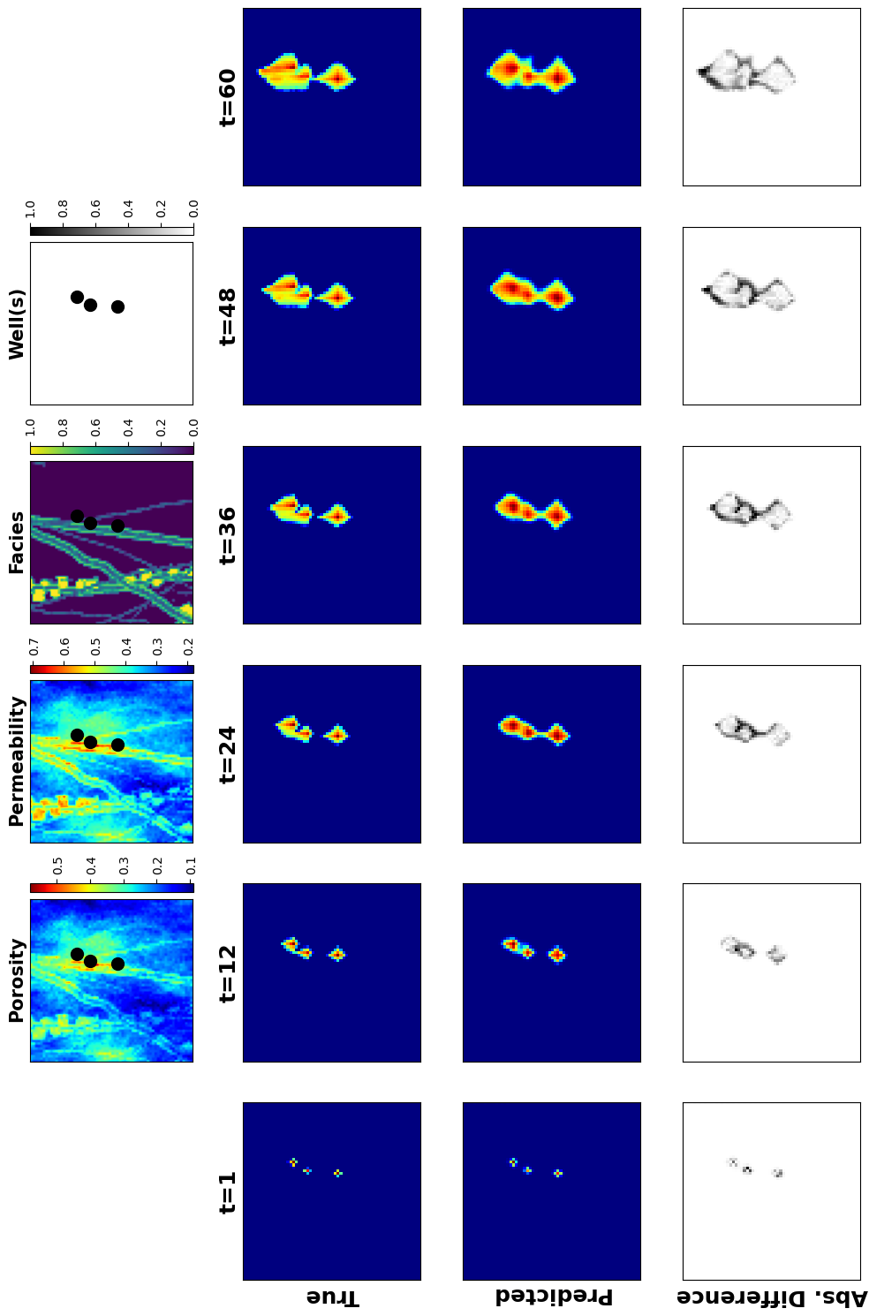

Slide 8




























Encoder
Decoder
$$X$$
$$y^{0}$$
$$z_{X}^{1}$$
$$z_{X}^{2}$$
$$z_{y_{0}}^{3}$$
$$z_{X}^{2}$$
$$z_{y_{0}}^{2}$$
$$z_{X}^{1}$$
Separable Conv
Squeeze & Excite
Separable Conv
Separable Conv
Squeeze & Excite
$$z_{X}^{3}$$
Squeeze & Excite
$$z$$
Conv-LSTM
Conv-LSTM
Conv-LSTM
$$y^{1}$$
$$y^{0}$$
$$z_{y_{0}}^{3}$$
$$z_{X}^{2}$$
$$z_{y_{0}}^{2}$$
$$z_{X}^{1}$$
$$z_{y_{1}}^{3}$$
$$z_{y_{1}}^{2}$$
Conv-LSTM
Conv-LSTM
Conv-LSTM
$$.. .$$
…
…
$$y^{t}$$
$$.. .$$
$$z_{y_{0}}^{3}$$
$$z_{y_{0}}^{2}$$
$$y^{t−1}$$
$$y^{0}$$
$$z_{X}^{2}$$
$$z_{X}^{1}$$
Conv-LSTM
Conv-LSTM
Conv-LSTM
$$z_{y_{t}}^{3}$$
$$z_{y_{t}}^{2}$$

