Slide 1
Spatiotemporal
cnn-rnn proxy model
for co2 monitoring
ExxonMobil visit day
April 26th, 2023
Misael M. Morales
Graduate Research Assistant, The University of Texas at Austin
Michael J. Pyrcz
Professor, The University of Texas at Austin
Carlos Torres-Verdín
Professor, The University of Texas at Austin

Slide 2
Outline
Executive Summary
Motivation
CNN-RNN Proxy for CO2 Monitoring
Reservoir modeling
Numerical simulation
Data processing
Deep learning model
Results
Conclusions & Future Work
Well pad 1

Slide 3
Executive Summary
Accurate and detailed subsurface models are too large and/or redundant for practical data science applications.
Physics-based forward reservoir simulation is very time consuming and computationally expensive.
We design a forward simulator for CO2 monitoring using a deep learning architecture that exploits the latent space dynamics, while integrating spatial structure (CNN) and temporal structure (RNN).
We recommend to work in latent space for subsurface modeling, characterization, and simulation.
Well pad 1

Slide 4
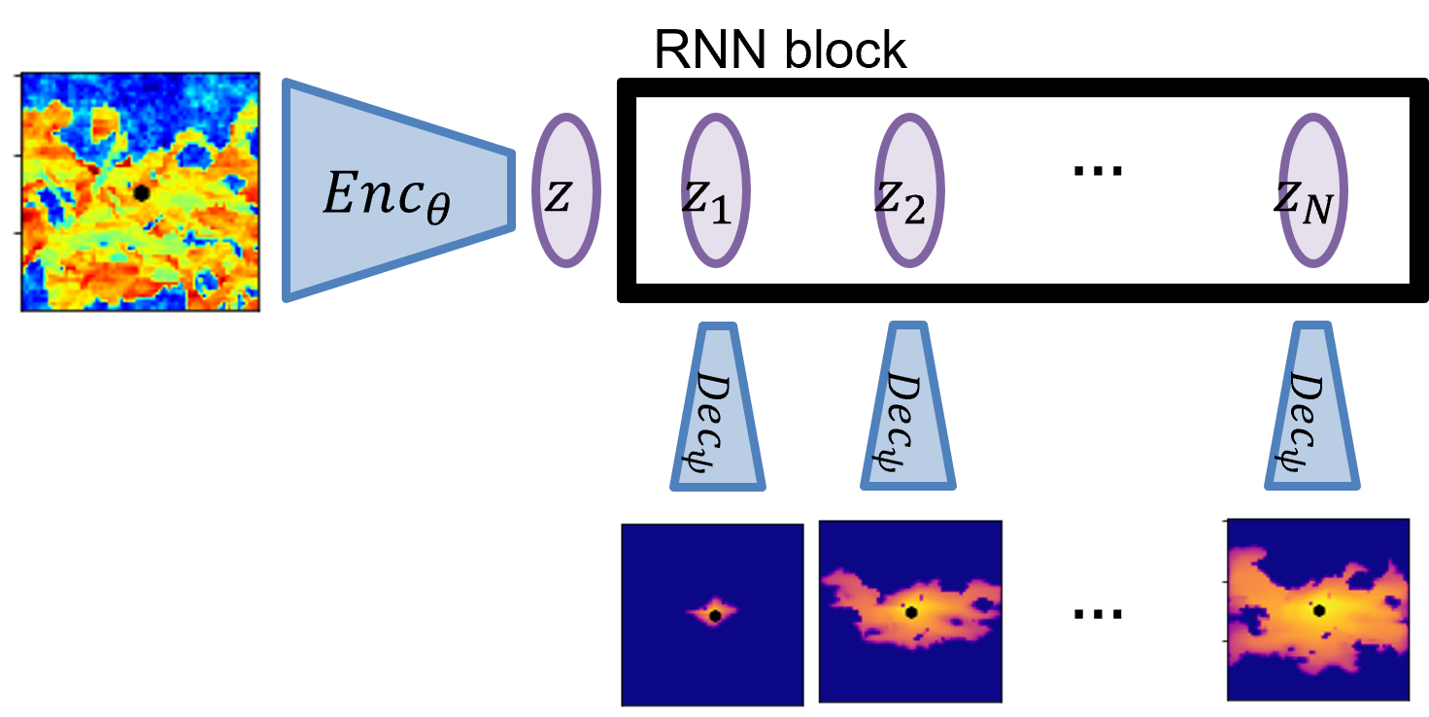
Motivation
There tends to be a high degree of correlation and structure in 2D/3D subsurface data, which makes it a perfect candidate for latent space analysis and modeling.
Encoder-Recurrent-Decoder architectures allow for efficient latent space representation and forward modeling of subsurface data.
CNN-RNN architecture

Slide 5
Recent Literature
Maldonado-Cruz & Pyrcz, (2022) J Pet. Sci. Eng.:
U-Net for surrogate flow model under geologic uncertainty
Generate saturation maps based on different PV injected from the permeability/porosity realizations
Jo, Pan, Santos, Jung & Pyrcz, (2021) J Pet. Sci. Eng.:
Machine learning-assisted history matching
Using GAN for automatic history matching of deepwater lobe systems
Alakeely & Horne, (2020) SPE Res. Eval. Eng.:
Deep learning models for downhole signal predictions
Comparison of CNN and RNN for the prediction of downhole rates, pressure, choke setting, etc.
Kim & Durlofsky, (2022) ArXiV:
CNN-RNN for robust optimization and closed-loop management
CNN-LSTM architecture from to predict production rates from permeability maps
Kaur, Fomel, et. al., (2022) GeoSci World Interpretation:
Seismic Inversion via CNN-RNN architecture
Used a CNN-Transformer architecture to predict permeability from seismic response
We propose a new method for image-to-image forward modeling from static model ($φ,k,facies$) to dynamic response ($P\left(t\right),S\left(t\right))$, exploiting spatiotemporal latent space dynamics, applied to CO2 monitoring.
Notes:
Recent advances in Deep Learning applications in petroleum engineering and subsurface modeling (as well as seismic reservoir characterization/inversion)
None have developed image-to-image (or image-to-timelapse images) deep learning proxy!

Slide 6
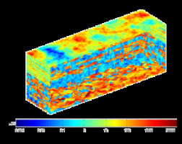
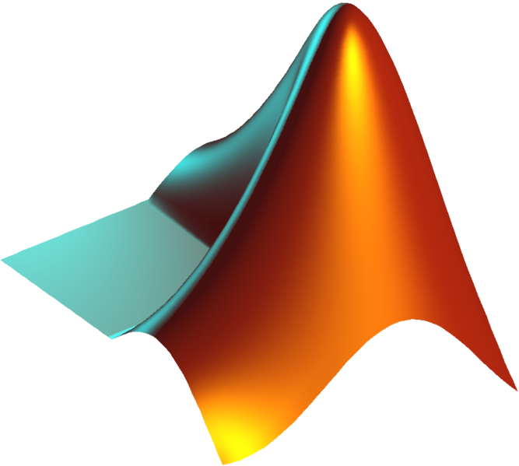


Motivation
Develop a deep learning framework for forward reservoir simulation of CO2 migration.
Exploit latent space dynamics for timelapse predictions using a CNN-RNN architecture.
Proposed workflow is separated in four parts:
1. Reservoir Model
(SPE10)
2. Numerical Simulation
(MRST)
3. Data Processing
(Python)
4. Deep Learning
(Keras)
Notes:
This project is composed of 4 main parts (reservoir model, numerical simulation, data processing, and the deep learning-based proxy model
The proxy model is CNN-RNN-CNN encoder-decoder structure that exploits latent space dynamics to model a timelapse of saturation from a static permeability input.

Slide 7
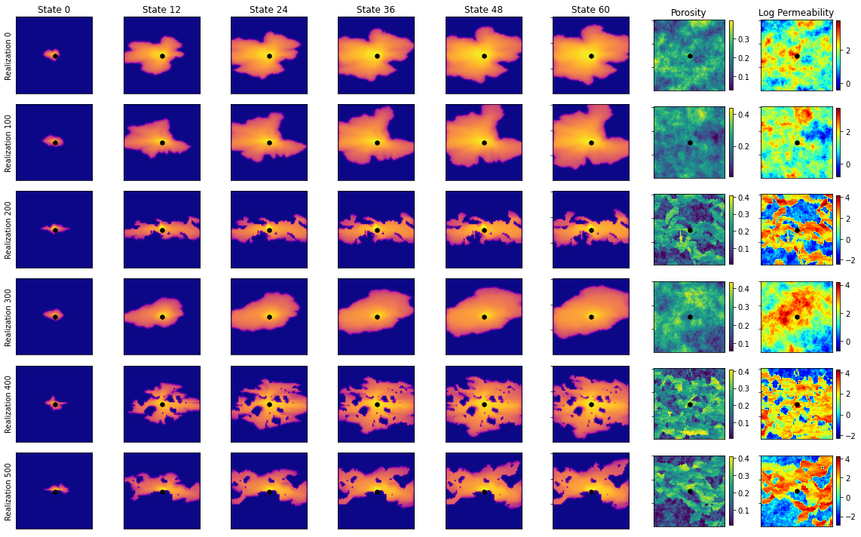
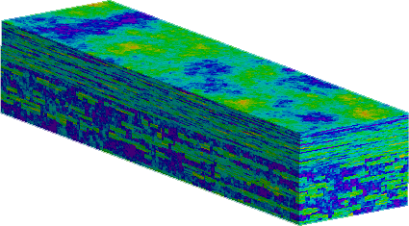
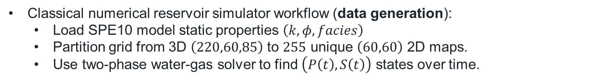


Reservoir Modeling
Classical numerical reservoir simulator workflow (data generation):
Load SPE10 model static properties $\left(k, φ,facies\right)$
Partition grid from 3D $\left(220,60,85\right)$ to $255$ unique $\left(60,60\right)$ 2D maps.
Use two-phase water-gas solver to find $\left(P\left(t\right),S\left(t\right)\right)$ states over time.
SPE10 model
CNN-RNN Proxy
partition
grid
reservoir
simulation
$$\left(220, 60, 85\right)$$
Tarbert (Gaussian) + Ness (fluvial)
Simulator inputs $\left(60,60\right)×255$
Timelapse saturation states
Pros: accepted as ground truth (accurate)
Cons: computationally expensive
Notes:
Data comes from SPE10
We partition the 220x60x85 model into 255 x (60,60) realizations and use MRST to forward-simulate CO2 injection. We collect 60 saturation states (60 months) for each realization

Slide 8
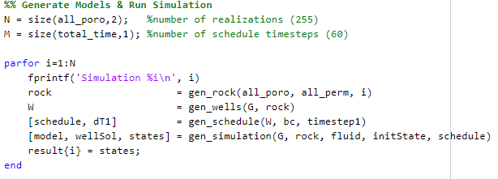
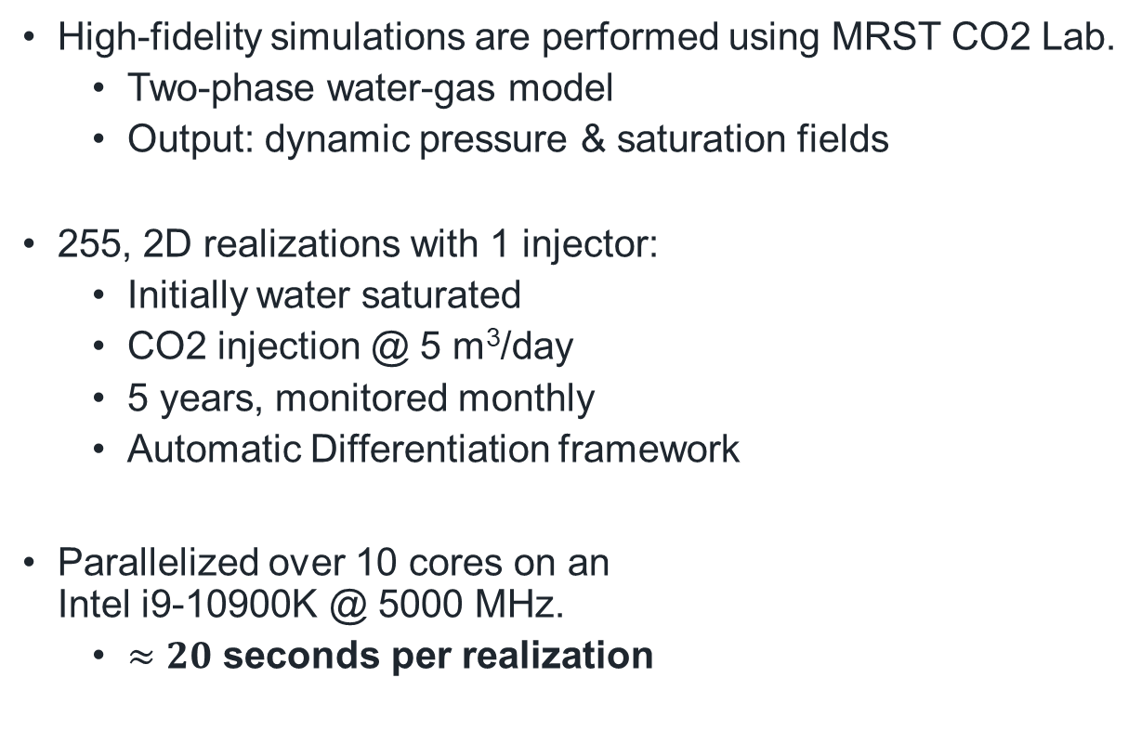
Numerical Simulation
High-fidelity simulations are performed using MRST CO2 Lab.
Two-phase water-gas model
Output: dynamic pressure & saturation fields
255, 2D realizations with 1 injector:
Initially water saturated
CO2 injection @ 5 m³/day
5 years, monitored monthly
Automatic Differentiation framework
Parallelized over 10 cores on an Intel i9-10900K @ 5000 MHz.
$≈20$ seconds per realization
CO2-Brine relative perm curves
MRST simulator code
HFS input and outputs
Notes:
Numerical simulation is done using MRST (in parallel)
CO2Lab module in MRST provides a simplified model for CO2 injection. We use most of the default parameters for CO2 properties
Inject for 5 years, monitored monthly (60 states)
Inject 5 m^3 per day
One injector in the center

Slide 9
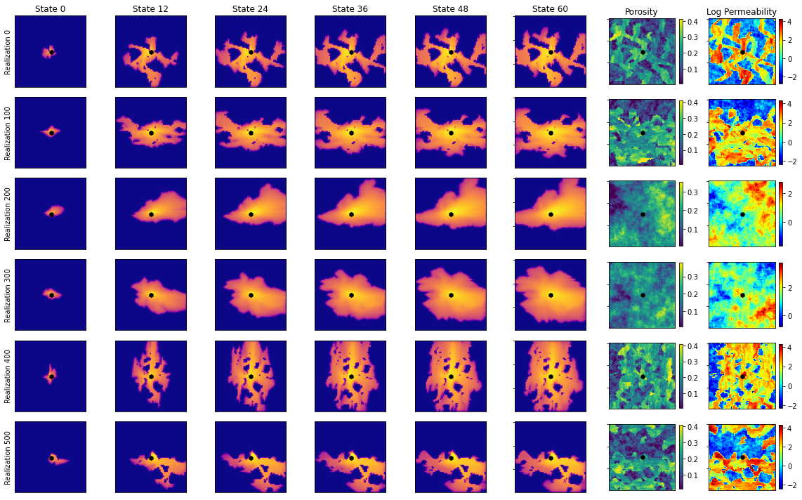
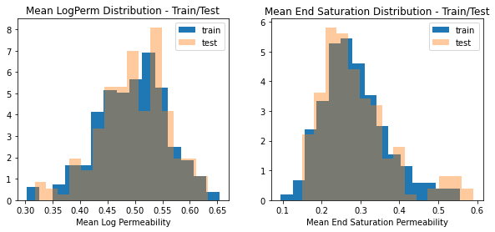
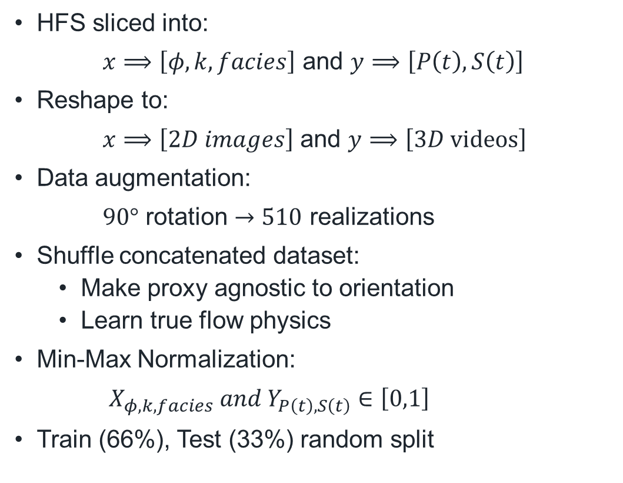
Data Processing
HFS sliced into:
$x⟹\left[φ,k,facies\right]$ and $y⟹\left[P\left(t\right),S\left(t\right)\right]$
Reshape to:
$x⟹\left[2D images\right]$ and $y⟹\left[3D \text{videos}\right]$
Data augmentation:
$90°$ rotation $→510$ realizations
Shuffle concatenated dataset:
Make proxy agnostic to orientation
Learn true flow physics
Min-Max Normalization:
$X_{φ,k,facies} and Y_{P\left(t\right),S\left(t\right)}∈\left[0,1\right]$
Train (66%), Test (33%) random split
Augmented permeability & saturation data
Train/Test distribution for mean input & output
Notes:
Data from MRST is then pre-processed in order to have better machine learning
6 preprocessing steps

Slide 10
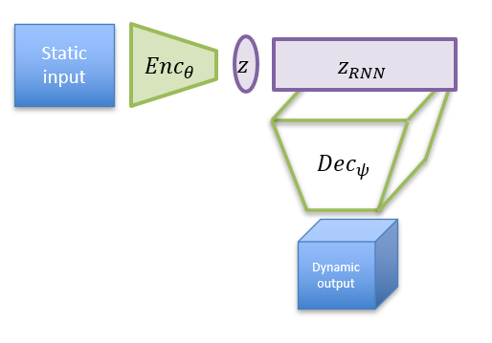
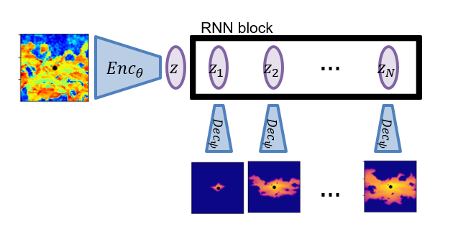
CNN-RNN Proxy
Encoder-recurrent-decoder architecture to predict dynamic saturation states from permeability
unfold
Folded CNN-RNN architecture
Unfolded CNN-RNN architecture
Notes:
Schematic of the CNN-RNN model
Left = “Folded” model, where we clearly see the encoder-recurrent-decoder architecture
Right = “Unfolded” model, where we can visualize the latent space dynamics, meaning that the latent vector is expanded into 125 features (5,5,5), and updated according to the saturation map (60,60,60)

Slide 11
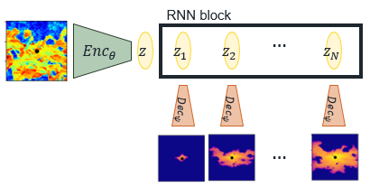






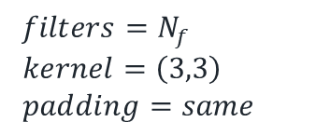





CNN-RNN Proxy
The Encoder
Overall
CNN-RNN
architecture
$$Enc_{θ}$$
$$z$$
$$\left(None, 60, 60, 1\right)$$
Convolutional block
Conv Block 1
$ℓ_{2}$ regularization
$filters=N_{f}$
$kernel=\left(3,3\right)$
$padding=same$
Conv Block 2
LeakyReLU activation
Conv Block 3
$$N_{f}=8$$
Conv2D
Conv2D
BatchNorm
LeakyReLU
MaxPool2D
Conv Block 4
$$N_{f}=16$$
$$\left(None, 3, 3, 64\right)$$
$$N_{f}=32$$
$$N_{f}=64$$
$$\frac{N_{x}}{2},\frac{N_{y}}{2}, 2N_{c}$$
$$N_{x}, N_{y}, N_{c}$$
Notes:
Encoder section
Contains 4 convolutional blocks
Each convolutional block has Conv2D(LeakyRelu)-Conv2D(l2norm)-BatchNorm-LeakyReLu-MaxPool --- the pooling reduces dimensions

Slide 12

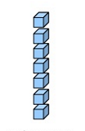








CNN-RNN Proxy
The Recurrent Block
Overall
CNN-RNN
architecture
$$\left(None, 3, 3, 64\right)$$
Flatten
Recurrent block
RepeatVector
Flatten
RepeatVector
GRU
Reshape
GRU
Reshape
$$\left(None, 125, 576\right)$$
$$\left(None, 5, 5, 5, 128\right)$$
$$\left(None, 125, 128\right)$$
$$3, 3, 64$$
$$5, 5, 5, 128$$
$$dropout$$
$$return$$
$$sequences$$
Notes:
Recurrent section
We flatten the latent space, Z (576)
Repeat it 125 times
Apply recurrent layer (GRU, many-to-many) such that (125,576)->(125,128)
Reshape into (5,5,5128) … (length, width, height, channels)

Slide 13
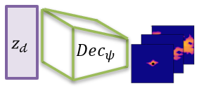








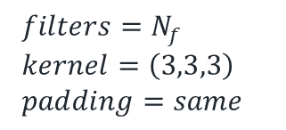


CNN-RNN Proxy
The Decoder
Overall
CNN-RNN
architecture
$$\left(None, 5, 5, 5, 128\right)$$
ConvT Block 1
Transpose Convolutional block
$ℓ_{2}$ regularization
$filters=N_{f}$
$kernel=\left(3,3,3\right)$
$padding=same$
ConvT Block 2
$$N_{f}=64, stride=1$$
LeakyReLU activation
ConvT Block 3
ConvT3D
ConvT3D
ConvT3D
BatchNorm
LeakyReLU
$$N_{f}=32, stride=N_{s}$$
Output Block
$$N_{f}=16, stride=1$$
$$\left(None, 60, 60, 60, 1\right)$$
$$2N_{x}, 2N_{y}, 2N_{z},\frac{N_{c}}{N_{s}}$$
$$N_{x}, N_{y}, N_{z},N_{c}$$
$$Stride=1$$
$$Stride=N_{s}$$
Notes:
Decoder section
Contains 3 Transpose-Convolutional blocks, and an Output block
Each transpose convolutional block has ConvT3D(LeakyRelu)-ConvT3D(LeakyRelu)-ConvT3D(l2norm)-BatchNorm-LeakyReLu ---- the strides increase dimensions

Slide 14
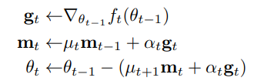

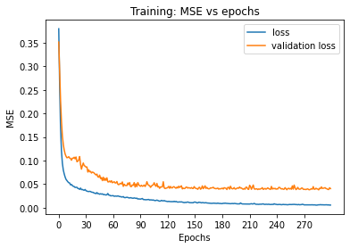
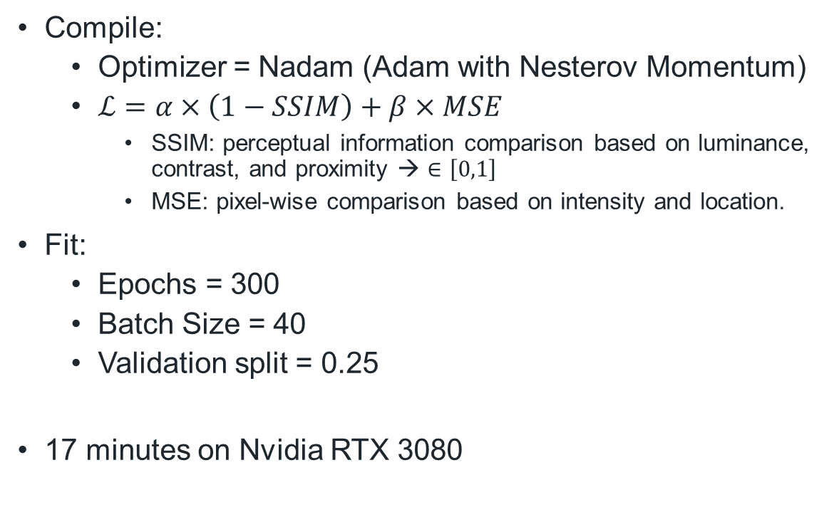
CNN-RNN Proxy
Compile:
Optimizer = Nadam (Adam with Nesterov Momentum)
$ℒ=α×\left(1−SSIM\right)+β×MSE$
SSIM: perceptual information comparison based on luminance, contrast, and proximity → $∈\left[0,1\right]$
MSE: pixel-wise comparison based on intensity and location.
Fit:
Epochs = 300
Batch Size = 40
Validation split = 0.25
17 minutes on Nvidia RTX 3080
Nadam optimizer formulation
CNN-RNN Training process
Notes:
We then compile and fit the model
We use Nadam, Nesterov Adam. A slight update in the momentum calculation. Works better than Adam for this problem (very small learning rate)
Use a Loss function that combines MSE (pixel-wise) and SSIM (overall image)
SSIM ~ luminance, contrast, perceptual information
Overfit! ☹

Slide 15
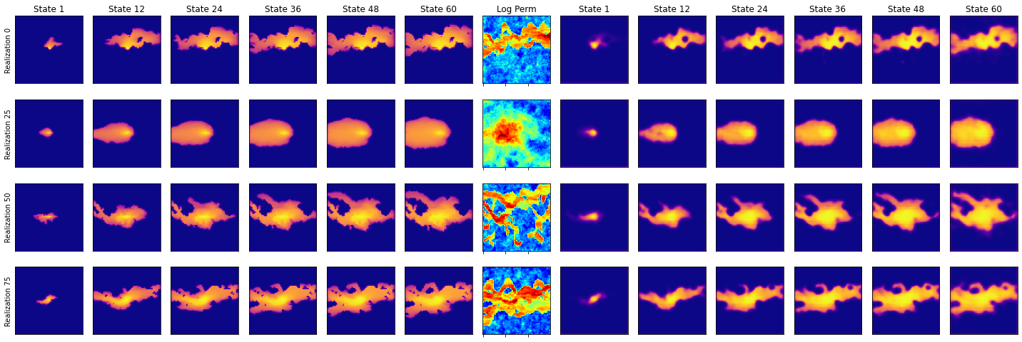
CNN-RNN Proxy
Training: MSE=0.016 | SSIM=0.867
Training samples
Training inputs
Training predictions
Notes:
Training predictions
Very good!

Slide 16
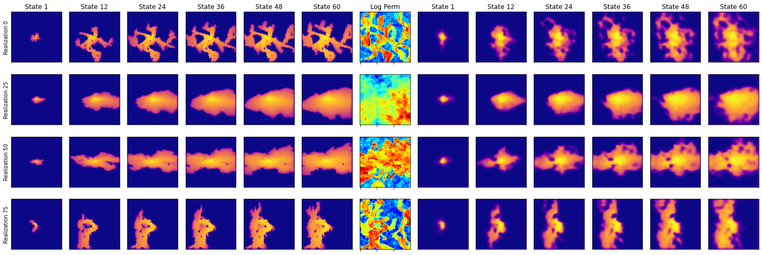
CNN-RNN Proxy
Testing: MSE=0.040 | SSIM=0.653
Testing samples
Testing inputs
Testing predictions
Notes:
Testing Predictions
Not so good, but still useful. Can be improved!

Slide 17
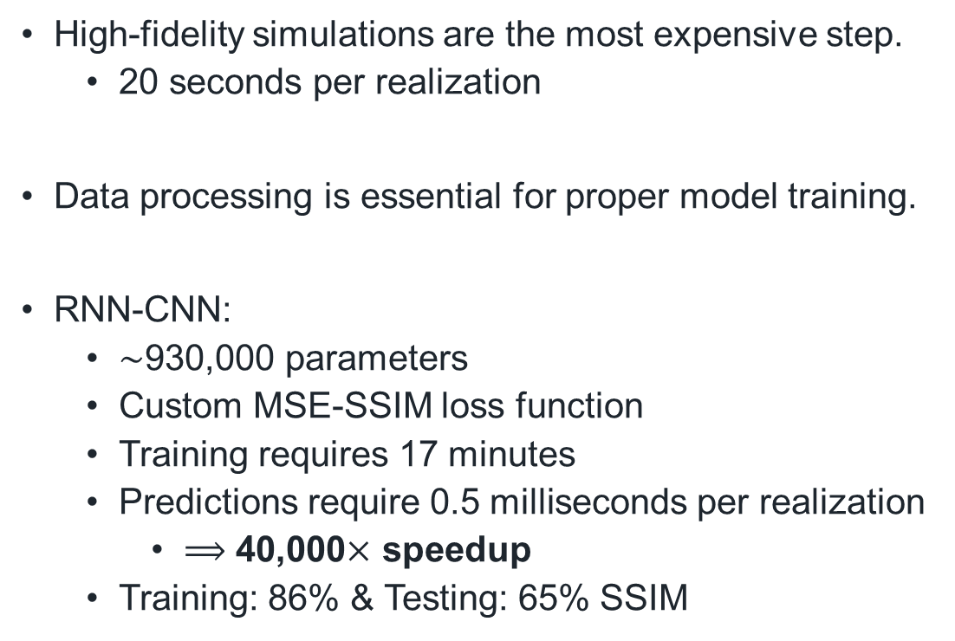
Reservoir Model
(SPE10)
Numerical Simulation
(MRST)
Conclusions
High-fidelity simulations are the most expensive step.
20 seconds per realization
Data processing is essential for proper model training.
RNN-CNN:
$\sim$930,000 parameters
Custom MSE-SSIM loss function
Training requires 17 minutes
Predictions require 0.5 milliseconds per realization
$⟹$ 40,000$×$ speedup
Training: 86% & Testing: 65% SSIM
Data Processing
(Python)
Deep Learning
(Keras)
Notes:
Significant speedup in the forward simulation
Architecture can be used for other applications

Slide 18
Conclusions
Subsurface data must be treated in reduced-dimensional space for efficiency, at little or no loss of detail.
Convolutional layers are efficient for dimensionality reduction and data reconstruction.
Recurrent layers serve as simulation time-stepping in latent space.
We recommend to work in reduced-dimensional space when dealing with subsurface models and data, and to use deep learning-based proxy models for computational efficiency.

Slide 19
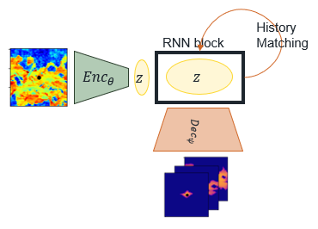
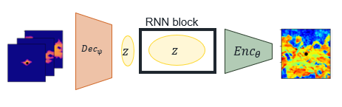
Future Work
Utilize Keras’ TimeDistributed layer for equal-filtering Decoder block.
Extend to 3D
Apply model to other subsurface flow problems:
Groundwater flow
Contaminant transport
Geothermal flows
Hydrocarbon production
Modify model for:
Uncertainty quantification
Inverse modeling
History matching / model calibration
Closed-loop / Robust optimization
CNN-RNN for latent-space history matching
CNN-RNN for inverse modeling

Slide 20
References
Maldonado-Cruz, Eduardo, and Michael J Pyrcz. (2022) “Fast Evaluation of Pressure and Saturation Predictions with a Deep Learning Surrogate Flow Model.” Journal of petroleum science & engineering 212
Kim, Y. D., & Durlofsky, L. J. (2022). "Convolutional-Recurrent Neural Network Proxy for Robust Optimization and Closed-Loop Reservoir Management." arXiv preprint arXiv:2203.07524.
Kaur, Harpreet et al. (2022) “Time-Lapse Seismic Data Inversion for Estimating Reservoir Parameters Using Deep Learning.” Interpretation (Tulsa) 10.1
S. Pan, S.L. Brunton, and J.N. Kutz (2022) "Neural Implicit Flow: a mesh-agnostic dimensionality reduction paradigm of spatio-temporal data." arXiv preprint arXiv:2204.03216
Joon, Shams, Dawuda, Ismael, Morgan, Eugene, and Sanjay Srinivasan. (2022) "Rock Physics-Based Data Assimilation of Integrated Continuous Active-Source Seismic and Pressure Monitoring Data during Geological Carbon Storage." SPE Journal.
Gonzalez, Keyla, and Siddharth Misra. (2022) “Unsupervised Learning Monitors the Carbon-Dioxide Plume in the Subsurface Carbon Storage Reservoir.” Expert systems with applications 201
K.G. Gurjao, E. Gildin, R. Gibson, and M. Everett. (2022) "Estimation of Far-Field Fiber Optics Distributed Acoustic Sensing DAS Response Using Spatio-Temporal Machine Learning Schemes and Improvement of Hydraulic Fracture Geometric Characterization." SPE Hydraulic Fracturing Technology Conference and Exhibition, USA
Salazar, Jose J et al. (2022) “Fair Train-Test Split in Machine Learning: Mitigating Spatial Autocorrelation for Improved Prediction Accuracy.” Journal of petroleum science & engineering 209:109885–.
Tang, Meng, Yimin Liu, and Louis J Durlofsky. (2021) “Deep-Learning-Based Surrogate Flow Modeling and Geological Parameterization for Data Assimilation in 3D Subsurface Flow.” Computer methods in applied mechanics and engineering 376:113636–.
H. Jo, Y. Cho, M.J. Pyrcz, H. Tang, and P. Fu (2021) "Machine learning-based porosity estimation from spectral decomposed siesmic data." arXiv preprint arXiv:2111.13581
Wen, Gege, Catherine Hay, and Sally M Benson. (2021) “CCSNet: A Deep Learning Modeling Suite for CO2 Storage.” Advances in water resources 155:104009–.
Alsulaimani, Thamer , and Mary Wheeler. (2021) "Reduced-Order Modeling for Multiphase Flow Using a Physics-Based Deep Learning." SPE Reservoir Simulation Conference
E.J.R. Coutinho, M.J. Aqua and E. Gildin. (2021) "Physics-Aware Deep-Learning-Based Proxy Reservoir Simulation Model Equipped with State and Well Output Prediction." SPE Reservoir Simulation Conference, Virtual.
Ciriello, V., Lee, J. & Tartakovsky, D.M. (2021) "Advances in uncertainty quantification for water resources applications." Stoch Environ Res Risk Assess 35, 955–957
Pan, W., Torres-Verdín, C. & Pyrcz, M.J. (2021) "Stochastic Pix2pix: A New Machine Learning Method for Geophysical and Well Conditioning of Rule-Based Channel Reservoir Models." Nat Resour Res 30, 1319–1345
Wu, Hao et al. (2021) “A Multi-Dimensional Parametric Study of Variability in Multi-Phase Flow Dynamics During Geologic CO2 Sequestration Accelerated with Machine Learning.” Applied energy 287:116580–.
Santos, J.E., Yin, Y., Jo, H. et al. (2021) "Computationally Efficient Multiscale Neural Networks Applied to Fluid Flow in Complex 3D Porous Media." Transp Porous Med 140, 241–272
Chan, S., Elsheikh, A.H. (2020) "Data-driven acceleration of multiscale methods for uncertainty quantification: application in transient multiphase flow in porous media." Int J Geomath 11,3
Cheung, S.W., Chung, E.T., Efendiev, Y. et al. (2020) "Deep global model reduction learning in porous media flow simulation." Comput Geosci 24, 261–274
Almasov, Azad , Onur, Mustafa , and Albert C. Reynolds. (2020) "Production Optimization of the CO2 Huff-N-Puff Process in an Unconventional Reservoir Using a Machine Learning Based Proxy." SPE Improved Oil Recovery Conference, Virtual
Jiang, Chiyu lmaxr et al. (2020) “MESHFREEFLOWNET: A Physics-Constrained Deep Continuous Space-Time Super-Resolution Framework.” SC20: International Conference for High Performance Computing, Networking, Storage and Analysis. IEEE 1–15.
J. Nagoor Kani, Elsheikh, A.H. (2019) "Reduced-Order Modeling of Subsurface Multi-phase Flow Models Using Deep Residual Recurrent Neural Networks." Transp Porous Med 126, 713–741
Jayne, Richard S, Hao Wu, and Ryan M Pollyea. (2019) “Geologic CO2 Sequestration and Permeability Uncertainty in a Highly Heterogeneous Reservoir.” International journal of greenhouse gas control 83.C:128–139.
K.-A. Lie. (2019) "An Introduction to Reservoir Simulation Using MATLAB/GNU Octave: User Guide for the MATLAB Reservoir Simulation Toolbox (MRST)." Cambridge University Press
Brunton, Steven L., and Jose Nathan Kutz. (2019) "Data-Driven Science and Engineering: Machine Learning, Dynamical Systems, and Control." 1st ed. Cambridge University Press
Guo, Zhenyu, and Albert C Reynolds. (2018) “Robust Life-Cycle Production Optimization With a Support-Vector-Regression Proxy.” SPE journal 23.6:2409–2427
Naraghi, Morteza Elahi, Spikes, Kyle , and Sanjay Srinivasan. (2017) "3D Reconstruction of Porous Media From a 2D Section and Comparisons of Transport and Elastic Properties." SPE Res Eval & Eng 20:342–352
Ampomah, W et al. (2017) “Optimum Design of CO2 Storage and Oil Recovery Under Geological Uncertainty.” Applied energy 195
J. Nagoor Kani, Elsheikh, A.H. (2017) "DR-RNN: A deep residual recurrent neural network for model reduction." arXiv preprint arXiv:1709.00939

Slide 21










Acknowledgments
Appreciation for the support from the DIRECT member companies.
Well pad 1

Slide 22
Thank You
Q & A
ExxonMobil visit day
April 26th, 2023
Misael M. Morales
Graduate Research Assistant, The University of Texas at Austin
Michael J. Pyrcz
Professor, The University of Texas at Austin
Carlos Torres-Verdín
Professor, The University of Texas at Austin

Slide 23
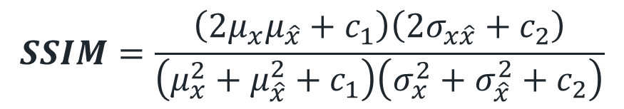
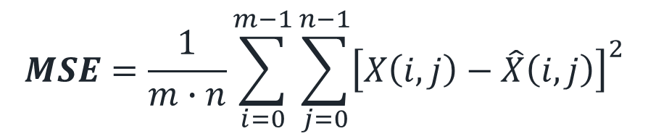
MSE and SSIM formulas:
$$MSE=\frac{1}{m∙n}\sum_{i=0}^{m−1}{\sum_{j=0}^{n−1}{{\left[X\left(i,j\right)−\hat{X}\left(i,j\right)\right]}^{2}}}$$
$$SSIM=\frac{\left(2μ_{x}μ_{\hat{x}}+c_{1}\right)\left(2σ_{x\hat{x}}+c_{2}\right)}{\left(μ_{x}^{2}+μ_{\hat{x}}^{2}+c_{1}\right)\left(σ_{x}^{2}+σ_{\hat{x}}^{2}+c_{2}\right)}$$
A pixel-wise comparison based on intensity and location
A perceptual information comparison including luminance, contrast, and proximity
$X$ is the original data matrix $m$ and $n$ are the dimensions ($X^{m×n}$)
$\hat{X}$ is the reconstructed data matrix $c_{1}$ and $c_{2}$ are stability constants

Slide 24

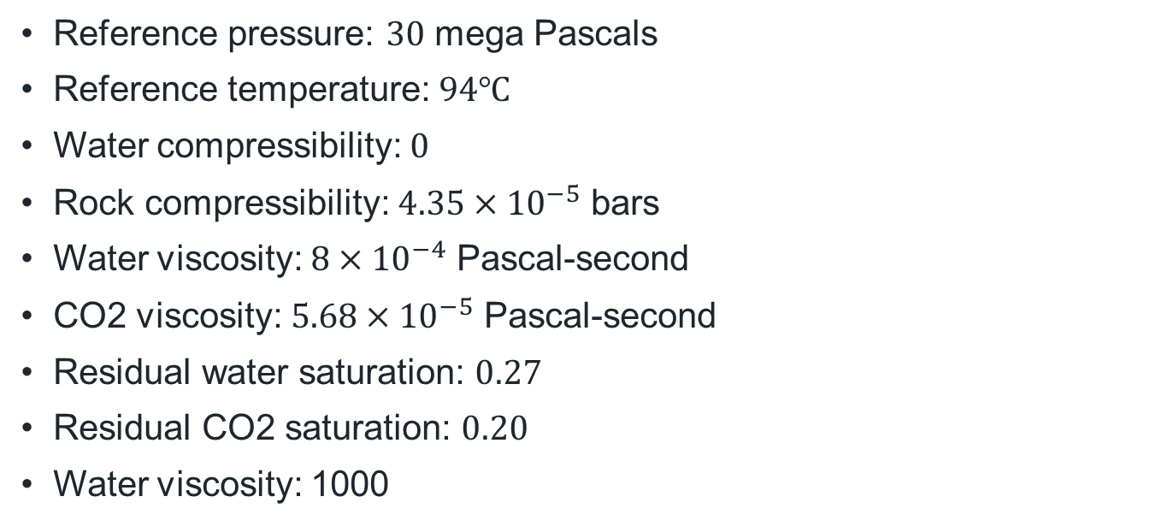
Simulation Variables
Reference pressure: $30$ mega Pascals
Reference temperature: $94℃$
Water compressibility: $0$
Rock compressibility: $4.35×{10}^{−5}$ bars
Water viscosity: $8×{10}^{−4}$ Pascal-second
CO2 viscosity: $5.68×{10}^{−5}$ Pascal-second
Residual water saturation: $0.27$
Residual CO2 saturation: $0.20$
Water viscosity: 1000
Grid size: 60x60x1
Grid dimensions: 20x10x5 ft
Initial reservoir pressure: $3000$ psia
Initial reservoir saturation: $\left[0,1\right]$ - $\left[gas,water\right]$
Total simulation time: 5 years
Monitor steps: 1 month
Total steps: 60
Wellbore radius: 0.05
AD Solver: TwoPhaseWaterGasModel

Slide 25
Proxy Model Variables
L2 regularization: 1e-4
LeakyReLU alpha: 0.3
RNN dropout: 0.2
Nadam learning rate: 5e-4

