Slide 1
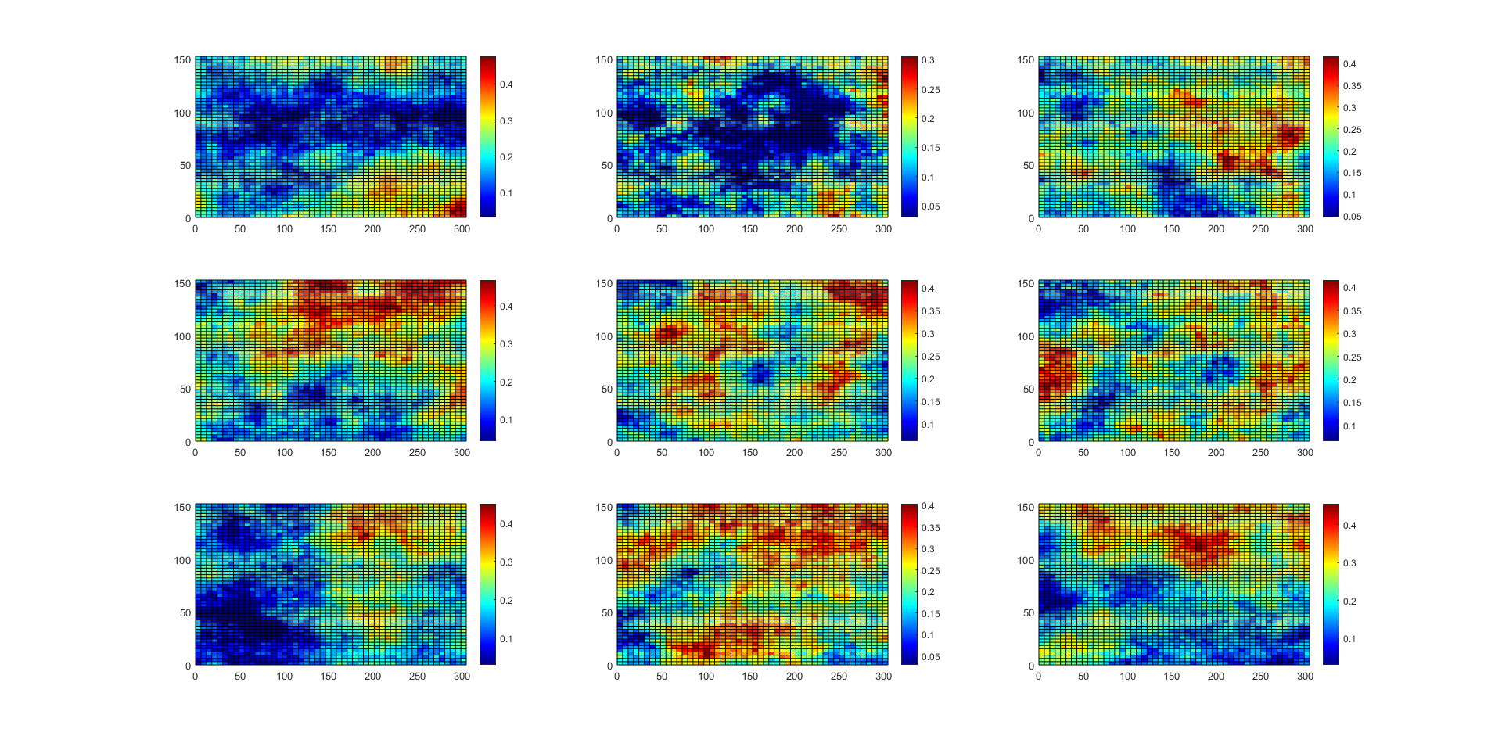
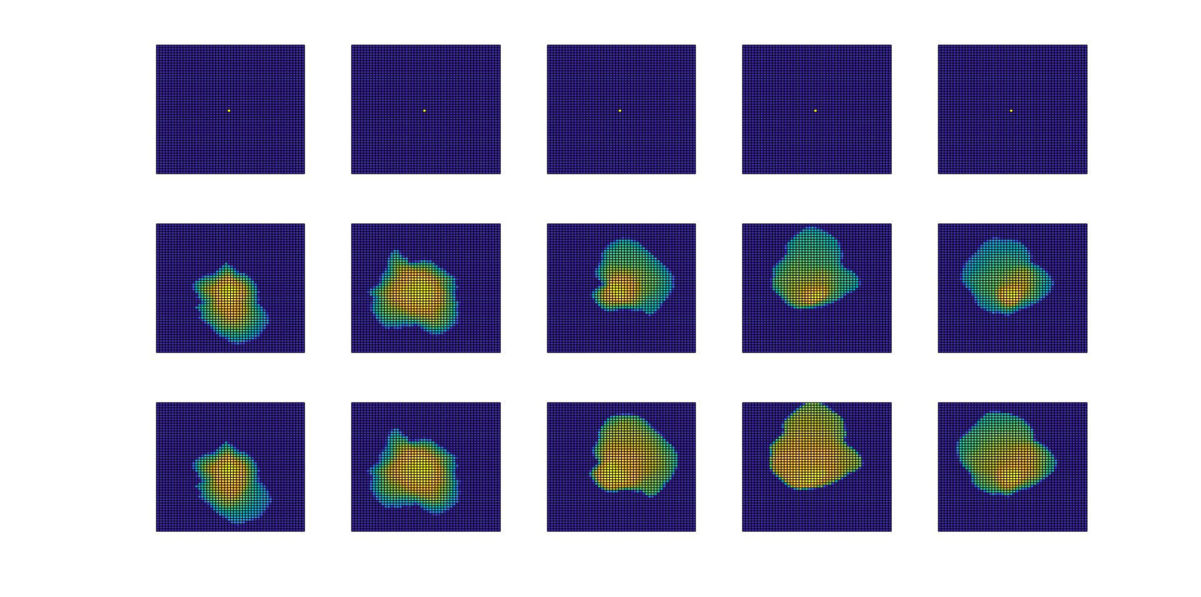



















Note that the single LSTM cell stride the input y_w of length n_lag one point at a time to produce an output of length 10 (in this example).
If return_sequence=True then the output of each stride will be returned, i.e. instead of output of length 10, the output will take a shape of (6,10) – one output of length 10 for 6 strides across the entire length of n_lag. This will be important later for other applications.
https://github.com/rsyamil/timeseries-rnn
RNN block
$$z$$
$$z_{1}$$
$$z_{2}$$
$$…$$
$$z_{N}$$
$$Enc_{θ}$$
$$…$$
$$Dec_{ψ}$$
$$Dec_{ψ}$$
$$Dec_{ψ}$$
For a single realization:
Realization 1
RNN block
$$Enc_{θ}$$
$$z$$
$$z_{1}$$
$$z_{2}$$
$$…$$
$$z_{N}$$
$$…$$
Realization 2
$$Dec_{ψ}$$
$$Dec_{ψ}$$
$$Dec_{ψ}$$
$$…$$
Realization 3
State 1
State 2
State N

Slide 2
RNN block
$$Enc_{θ}$$
$$z$$
$$z_{1}$$
$$z_{2}$$
$$…$$
$$z_{N}$$
$$Dec_{ψ}$$
$$Dec_{ψ}$$
$$Dec_{ψ}$$
$$…$$

