Slide 1
Sentinel
Every answer comes with its evidence.
A document checker that is confidently wrong is worse than no checker at all - because nobody goes back and looks.
DuoCode · Tang Chye Fong · Lim Yee Teng · Asia Pacific University
duocode-sentinel.vercel.app · github.com/TCF1209/duocode-sentinel
Averis x Monash Hackathon 2026 · Final Round
Notes:
We're DuoCode. Sentinel is built on one rule: it never reports anything it cannot prove. Everything in the next five minutes is evidence for that sentence. (0:00-0:15)

Slide 2
The problem - and the fourth case
01
Classify
02
Extract
03
Compare
04
Ask for help
Tell message types apart: comparison requests, new SI requests, invoice queries, general mail, spam.
For comparison requests, read the SI and BL attachments and pull the matching shipment fields.
Surface any mismatched fields, showing the SI and BL values side by side.
When it can't finish on its own, escalate to a person with full context instead of guessing or failing silently.
The organisers' own four capabilities. The SI is the reference; the goal is to catch incorrect details before the draft is finalised.
Finding the right emails takes time
Manual comparison is easy to get wrong
The same fact looks different
A document request that is overlooked never reaches the checking step.
Names, ports, quantities and weight across two documents; a missed discrepancy is a correction, a delay, rework.
One document says 'Port of Loading', the other 'Load Port' - the system has to know they are the same field.
The fourth case: sometimes the check cannot be done at all - an unreadable scan, a blank field, the wrong document. That has to reach a person with the reason attached, not be guessed at. Sentinel does all four.
CRITERION 5 · SOLUTION EFFECTIVENESS & USER VALUE
Notes:
A shipping desk gets five kinds of mail in one inbox. For a document check someone compares the Shipping Instruction against the draft Bill of Lading - seven fields, by hand. Miss one and it's a correction, a delay, rework. And there's a fourth case the statement names: sometimes the check can't be done - an unreadable scan, a blank field, the wrong document. That has to reach a person with the reason, not be guessed at. Sentinel does all four. (0:15-0:40)

Slide 3
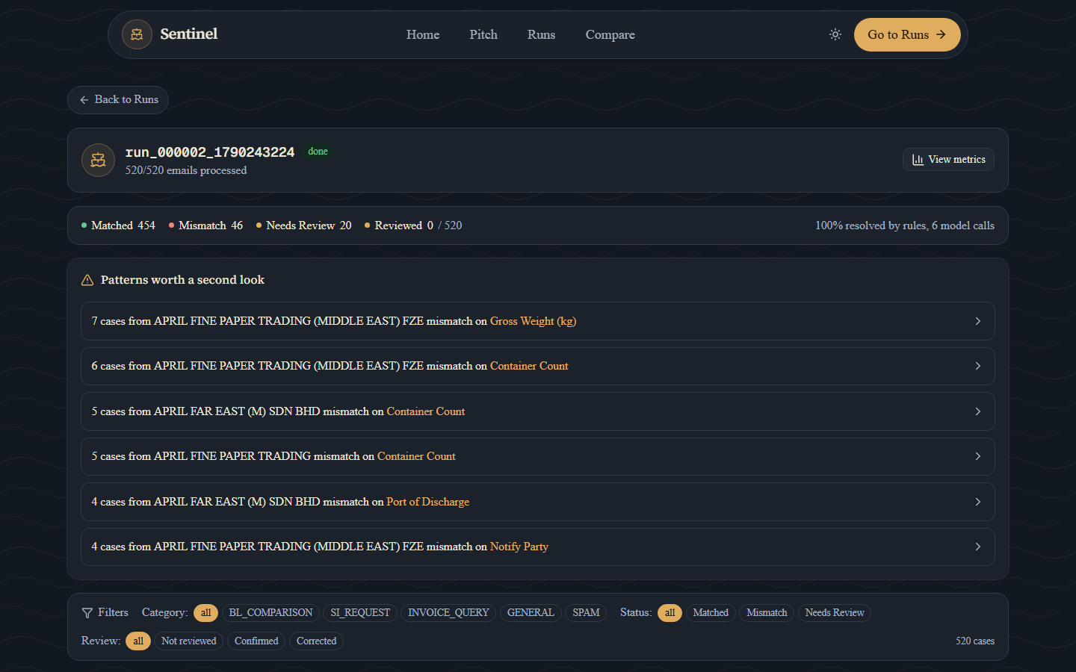
What it does, end to end
520
emails, classified and routed
46
mismatches, with the fields that differ
20
sent to a person - with the reason and what to do
12.7 s
for the whole inbox, on a free-tier container
duocode-sentinel.vercel.app · sdoc-sentinel-api.onrender.com - deployed from the repository by the committed render.yaml and vercel.json.
CRITERION 1 · END-TO-END FUNCTIONALITY
Notes:
This is the whole inbox, live on Render and Vercel - not a sample, the organisers' 520 emails. Every email classified, every document pair compared, every case Sentinel can't decide sent to a person with the reason attached. Thirteen seconds. You'll press the button yourself in a minute. Do not say the accuracy here - that is slide 6. (0:40-1:05)

Slide 4
How it decides
can veto the comparison
Classify
Intake
Extract
Compare
GATE
Decide
Six stages, one direction. The gate runs after the comparison: a value we cannot find again in the document it was read from is never reported as a discrepancy - it becomes a question for a person, with both readings attached.
Labels by meaning, values exactly
Rules first, model second
One stateless pipeline library
Never a similarity score. A threshold loose enough to forgive a scan artefact also merges two real companies - and this data has them.
Every stage tries a deterministic answer before a model, and records which one answered (decided_by). The model is asked only where the rules admit they cannot read.
No web framework or database in backend/sdoc. The CLI, the API and the tests run the same code, so the thing scored is the thing demonstrated.
Scaling, as built: state sits behind one class in one file (store.py) - Postgres is a one-file change · one worker on purpose · throughput is more copies of a stateless library · cost does not scale with volume on this inbox · per-desk rules slot into the existing stage boundaries.
CRITERION 2 · ARCHITECTURE & SCALABILITY
Notes:
Six stages, one direction. Two choices carry the design. Values are compared exactly after canonicalising, never by similarity - a threshold loose enough to forgive a scan artefact also merges two real companies, and the data has those. And the gate after the comparison can overrule it: a value we cannot find again in the document it was read from is never reported as a discrepancy - it becomes a question for a person. The pipeline is a stateless library with no web or database in it, which is also the scaling story: throughput is more copies of it; the state sits behind one class in one file. (1:05-1:40)

Slide 5
Where the AI is - and why it is aimed
C
Classify - an email the rules cannot separate
asked only when the rule score is ambiguous; a closed five-way answer, never free text
168
→
2
R
Read - a field label the table has never seen
asked only about fields no rule resolved; every value must be found again in the document before it is adopted
cases forced to a human on wording we invented - rules alone vs rules + model, 188 documents
False discrepancies: 0 both ways. Recall bought by guessing would have shown up there; it didn't.
S
See - a scanned page with no text layer
transcribed for the reviewer, never fed into a comparison - the case stays in review
gpt-5-mini, structured output. One rule for all three: nothing the model returns is adopted until it is found again in the document.
$0.0013 per document at the published rates · cached · $2 ceiling per run. On this inbox: 0 classifier calls, 0 extractor calls, 6 scans read out for the reviewer - every decision is a rule's, and that is measured, not assumed.
CRITERION 3 · TECHNOLOGY INTEGRATION
Notes:
A judge in the first round said we use AI less than most teams. True, and measured. On this inbox the rules answer all 520 and the scoring is all-or-nothing per email, so a model that is almost always right costs places. The model goes only where the rules admit they can't read: an ambiguous email, a label we've never seen, a scanned page. On documents with wording we invented, rules alone send 168 of 188 cases to a human; with the model, two - and false discrepancies stay at zero, because nothing the model says is adopted until we find it again in the source. You'll see both in the demo: a scan read out for the reviewer, and four unknown labels read on request. (1:40-2:20)

Slide 6
How we know it holds
Not memorised
Attacked ourselves
What we haven't fixed
1.0000 on four datasets, three from seeds we never developed against - 225 planted defects caught with the exact field set, 80/80 escalations correct.
16 kinds of damage, 3,008 perturbed documents, 20,496 field reads, no answer key. Thirteen modes at zero movement; silent wrong values 982 -> 0.
email_145: a wrapped party name cut short to exactly what the other document says leaves the repair nothing to repair, and one real mismatch in 3,008 perturbed documents is reported as a match.
The obvious guard would flag 92% of genuine party fields - worse than the gap - so it stays open and written down (ADVERSARIAL.md 5.2).
A real carrier's form
Engineering
CMA CGM's public SI template, from outside the generator: four fields held, one bug found and fixed the same day.
596 tests, 0 failing; CI on every push; a container that runs as a non-root user with no secret baked in; every value carries its evidence.
A defect we hide is worse than one we miss.
A perfect score on the dataset you were handed proves you didn't memorise it. It doesn't prove the reader works - so we went looking for the failures ourselves.
CRITERION 4 · ENGINEERING QUALITY & ROBUSTNESS
Notes:
A perfect score on the dataset you were handed proves you didn't memorise it. It doesn't prove the reader works. So we attacked our own reader - three thousand perturbed documents, sixteen kinds of damage, no answer key. Thirteen of sixteen don't move. OCR noise used to produce 982 silently wrong values; it produces zero now, because a damaged number is refused instead of parsed short. Then we fed it a real carrier's template from outside the generator, and it found a bug we fixed the same day. And the one we haven't fixed is on the slide, because a defect we hide is worse than one we miss. (2:20-2:55)

Slide 7
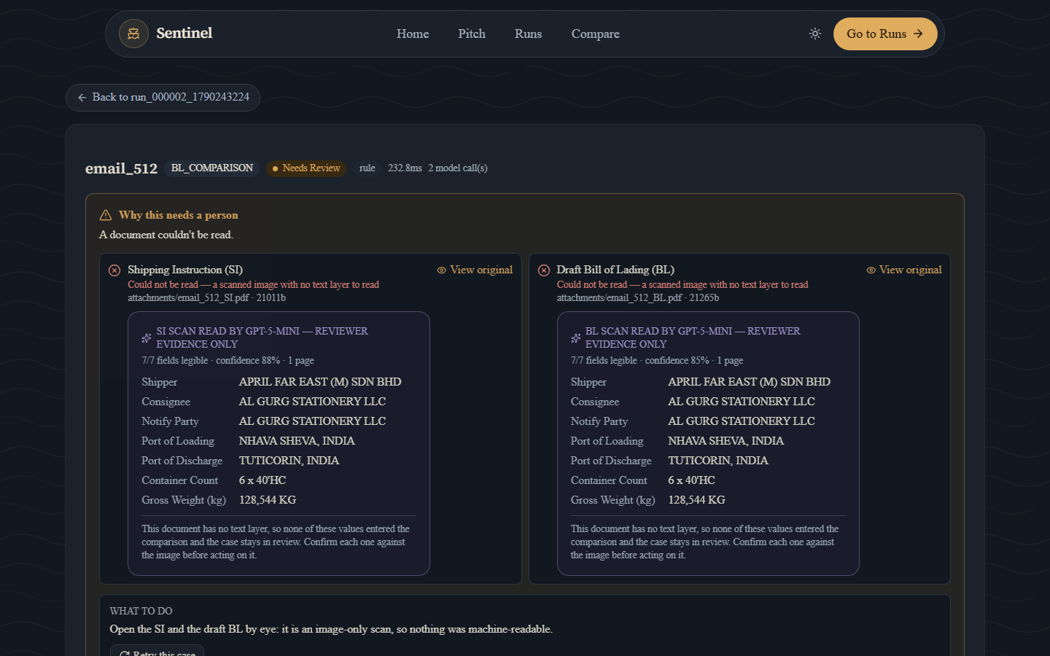
Live demo
90 seconds, on the deployed URLs
1
Start a run with the model tier on - the organisers' full inbox, 520 emails
2
Patterns worth a second look - one shipper, one field, six times
3
A mismatch case - under every value, the line it was read from
4
A scanned case - the page read out for the reviewer; the case still in review, decided per field
5
Compare, unfamiliar labels: model off, then on - 'model answered'
Fallback if the venue network fails: the same inbox on the laptop, 1.5 s, no network - only the model beat changes.
Notes:
At the mismatch case: 'Under every value - the line it was read from. A reviewer never has to open the source document to trust this.' At the scan: 'No text layer, so Sentinel did not decide. But the model read the page for the reviewer - seven fields, and it says which ones it couldn't read rather than guessing. The case stays in review; the person decides, per field.' At Compare, off: 'wording our table has never seen - the honest answer is can't read it, and it says which labels.' On: 'the model reads them, every value re-located in the document before it's adopted, and it surfaces the real discrepancy - badge says model answered.' (2:55-4:25)

Slide 8
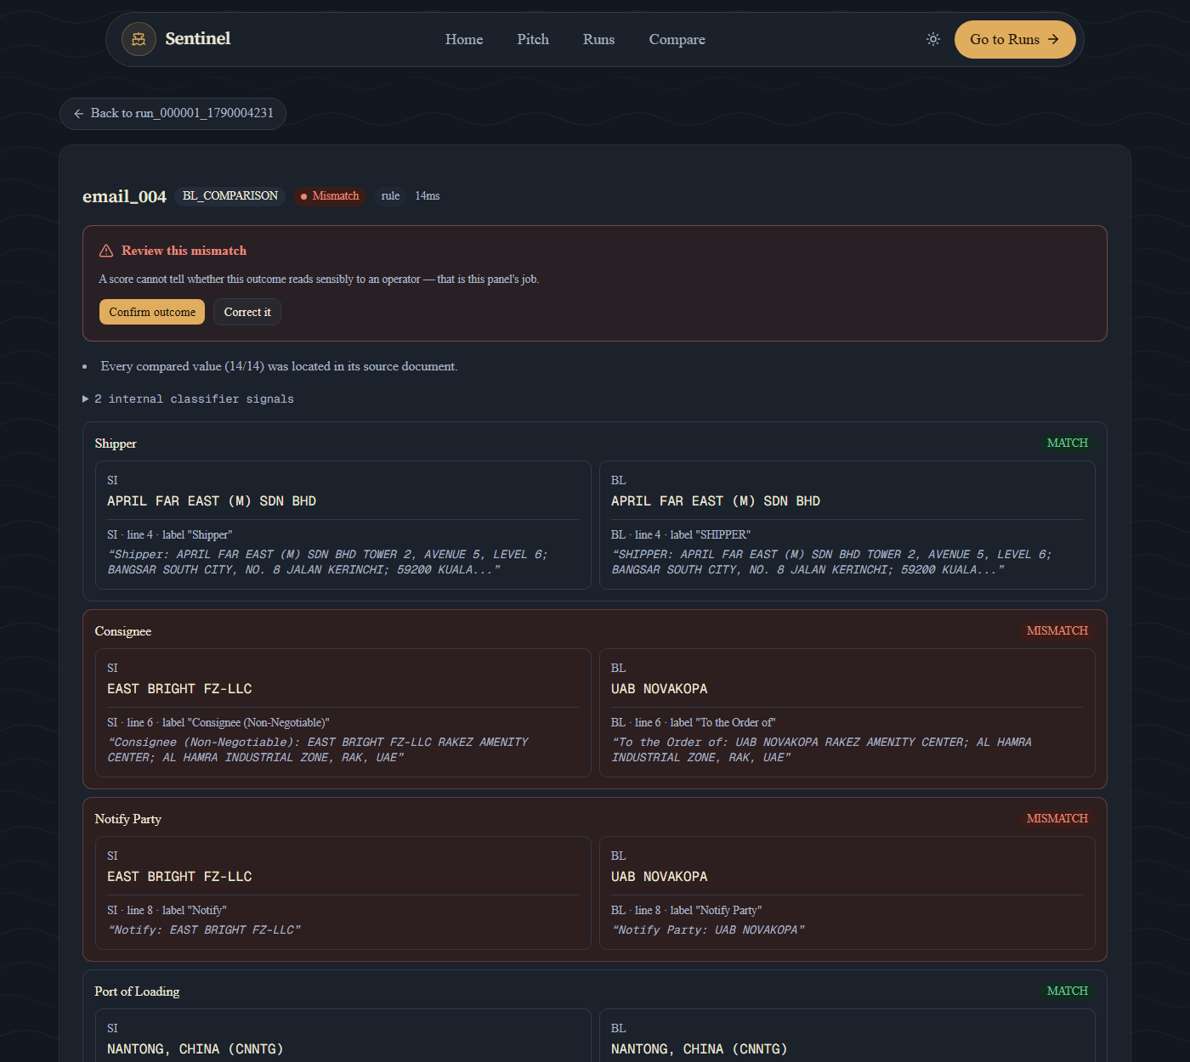
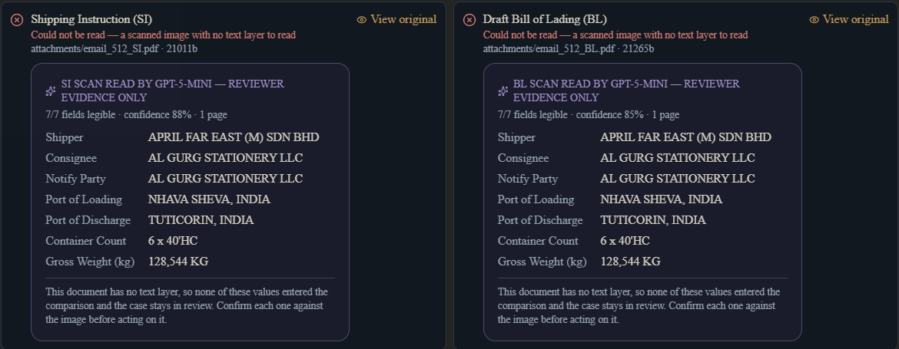
What a reviewer gets
A mismatch: the two fields that differ, and under every value the document, the line and the label it was read from.
A scan: the model's reading as reviewer evidence, marked as such - nothing entered the comparison.
Correct a single field, with how often this shipper was wrong on it beside the box
Patterns worth a second look: the same shipper's repeated mistakes, grouped
A reply draft built from the corrected outcome, not the stale one
Every escalation carries the reason and what to do about it
CRITERION 6 · USER EXPERIENCE & DIFFERENTIATION
Notes:
Every other checker shows you a verdict. This one shows you the line, lets you correct a single field, groups the same shipper's repeated mistakes, and drafts the reply from the corrected outcome - not the stale one. Fifteen seconds; the demo already did the work. (4:25-4:40)

Slide 9
Impact, and what comes next
11 hours
13 seconds
Next, in order
→
1
Per-desk rules
520 emails, 124 document pairs. Eleven hours is a conservative estimate (20 s an email, 4 min a pair), not a measurement; thirteen seconds is measured. Every decision on that inbox was a rule's.
a label table and an escalation policy per desk, selected by the code the inbox already carries
First deployment: one desk, not a region
The inbox already carries four desk codes (AFEMY 35, AIE 30, AFRT 29, AFPTME 22 emails). Sentinel sits beside the desk's existing check until the measures below have held for a full cycle of its carriers.
2
Corrections feed the label table
every confirmed correction is a labelled example of wording we could not read - the one place this system should learn
Measure | Today (graded inbox) | The pilot watches
Escalation rate | 20 of 220 requests (9.1%), all correct | precision at 1.0 as unfamiliar templates grow
False alarms | 0 of 46 defects; 0 across 16 perturbation modes | the weekly number
Reviewer minutes per escalation | not measured yet | the pilot's first new measurement
3
The database
one file; the demo does not need it yet, a pilot will
Cheap because the model is aimed, not because it is absent.
CRITERION 7 · IMPACT & FUTURE POTENTIAL
Notes:
520 emails and 124 document pairs is, at a conservative estimate, about eleven hours of desk work. Sentinel does it in thirteen seconds and every decision on that inbox was a rule, so it costs nothing to run - cheap because the model is aimed, not because it's absent. The first deployment is one desk, with three numbers we'd watch; two of them we can already show you and the third is what the pilot is for. Say 'at a conservative estimate' aloud, always. (4:40-4:58)

Slide 10
Every answer comes with its evidence.
Sentinel, by DuoCode
github.com/TCF1209/duocode-sentinel · duocode-sentinel.vercel.app
Notes:
Sentinel, by DuoCode. Every answer comes with its evidence. Thank you. (4:58-5:00)

