Slide 1
Fun with Allegro

Slide 2

Bool data type
A type can only be assigned by two values
0 – means false.
1 – means true.
You can just assign true or false to a bool variable.
(eg:
A data type that in lots of programming language
Java, C++ and so on
Allegro implements a bool data type in itself

Slide 3
Outline
01
Introduction
02
Draw something!
03
Deal with event !
04
Play some music!
05
Supplementary

Slide 4
Outline
01
Introduction
02
Draw something!
03
Deal with event !
04
Play some music!
05
Supplementary

Slide 5
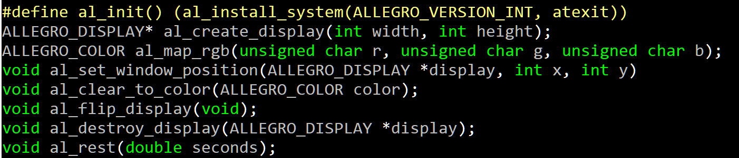
Hello to Allegro
The functions of allegro

Slide 6
Hello to Allegro
The functions of allegro
A define of other function that return “Bool” type

Slide 7
Hello to Allegro
The functions of allegro
A function that return “the pointer of ALLEGRO_DISPLAY” type

Slide 8
Hello to Allegro
The functions of allegro
A function that return “ALLEGRO_COLOR” type

Slide 9
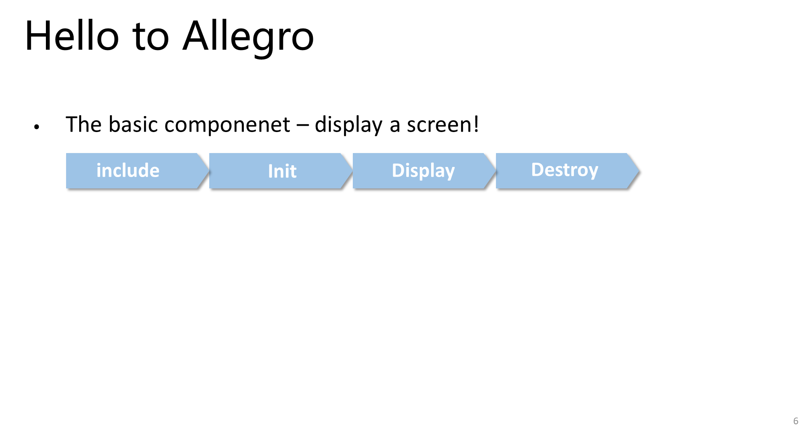
window!

Slide 10
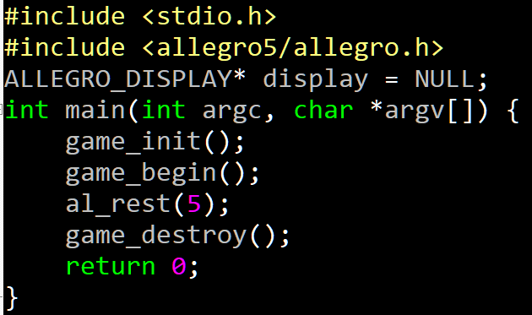
window!
Include the function in <allegro5/allegro.h>.

Slide 11
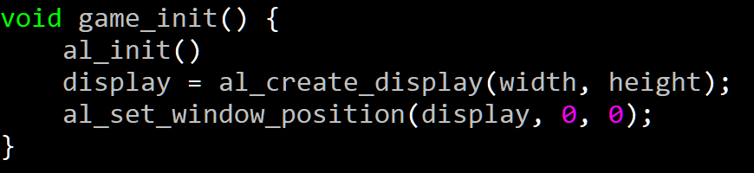
window!
Initialize the function in <allegro5/allegro.h>.

Slide 12
window!
Set the window with width and height

Slide 13
window!
Set the window with position

Slide 14
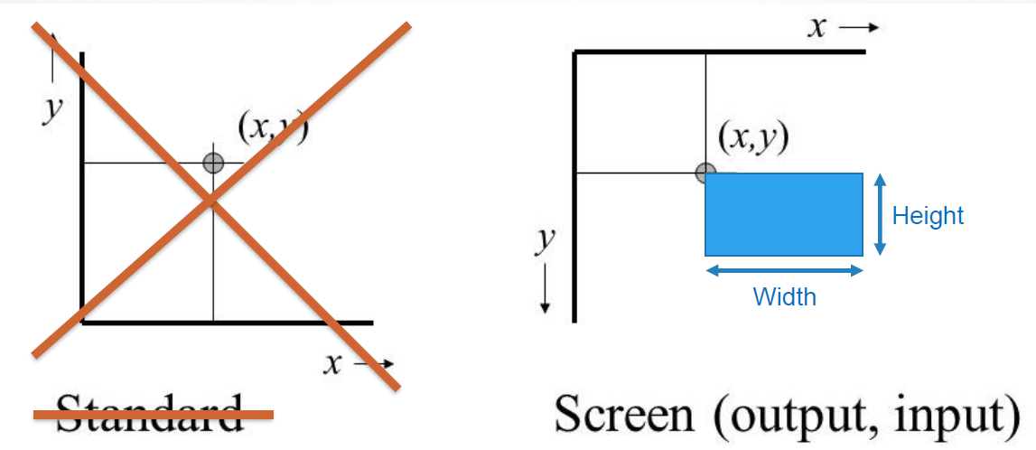
window!
Position of window

Slide 15
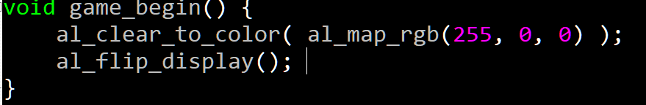
window!
Fill the window with red

Slide 16
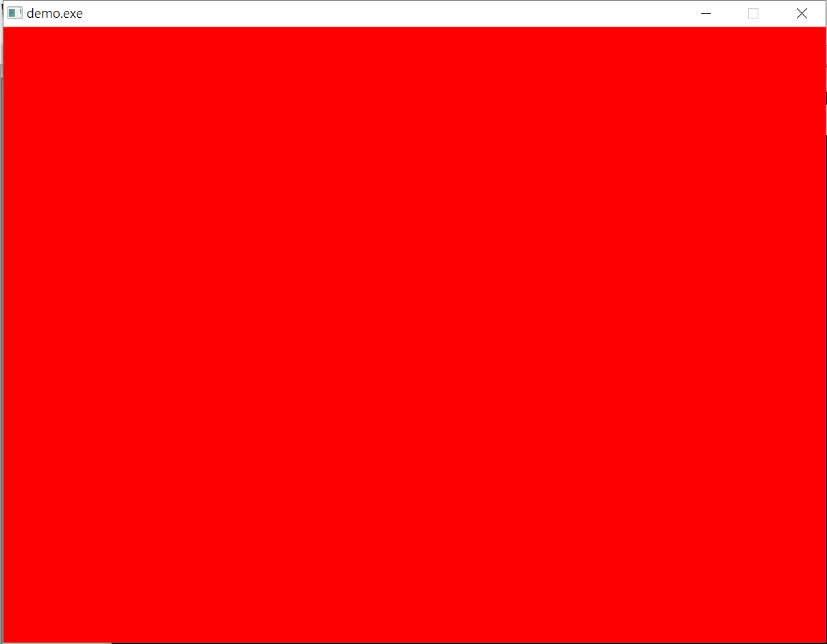
window!
Buffer
Not display yet!

Slide 17
window!
Display the result

Slide 18
window!
Buffer
al_flip_display()

Slide 19
window!
Stop the program for 5 seconds so the window you create will stay for 5 seconds

Slide 20
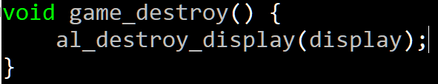
window!
Release the memory of the variable

Slide 21
Practice
Finish task 1!!

Slide 22
Outline
01
Introduction
02
Draw something!
03
Deal with event !
04
Play some music!
05
Supplementary

Slide 23
Draw text
Draw some text on the window
Include
Init
Display
Destroy
include

Slide 24

Draw text
Draw some text on the window
Include
Init
Display
Destroy
include
Head file of font and ttf(字體)

Slide 25
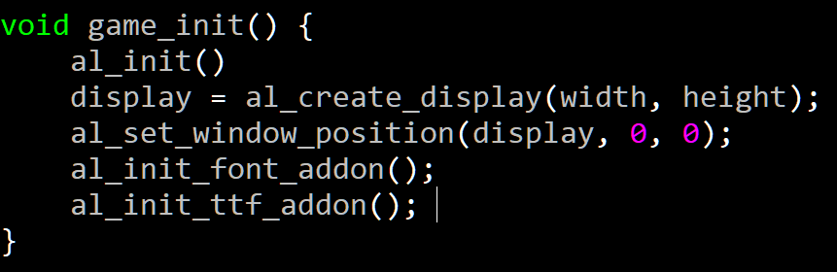
Draw text
Draw some text on the window
Include
Init
Display
Destroy
include
initialize file of font and ttf(字體)

Slide 26
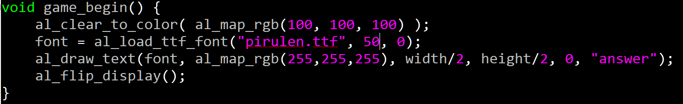
Draw text
Draw some text on the window
Include
Init
Display
Destroy
include
Load the font

Slide 27
Draw text
Draw some text on the window
Include
Init
Display
Destroy
include
The path of the font file

Slide 28
Draw text
Draw some text on the window
Include
Init
Display
Destroy
include
The size of the font

Slide 29
Draw text
Draw some text on the window
Include
Init
Display
Destroy
include
Usually 0, but you can put other two flags:
ALLEGRO_TTF_NO_KERNING: not use any kerning(間距調整)
ALLEGRO_TTF_MONOCHROME: Load as a monochrome font (Which means no anti-aliasing of the font is done)
Eg: al_load_ttf_font("pirulen.ttf", 50, ALLEGRO_TTF_NO_KERNING);

Slide 30
Draw text
Draw some text on the window
Include
Init
Display
Destroy
include
Draw text into buffer

Slide 31
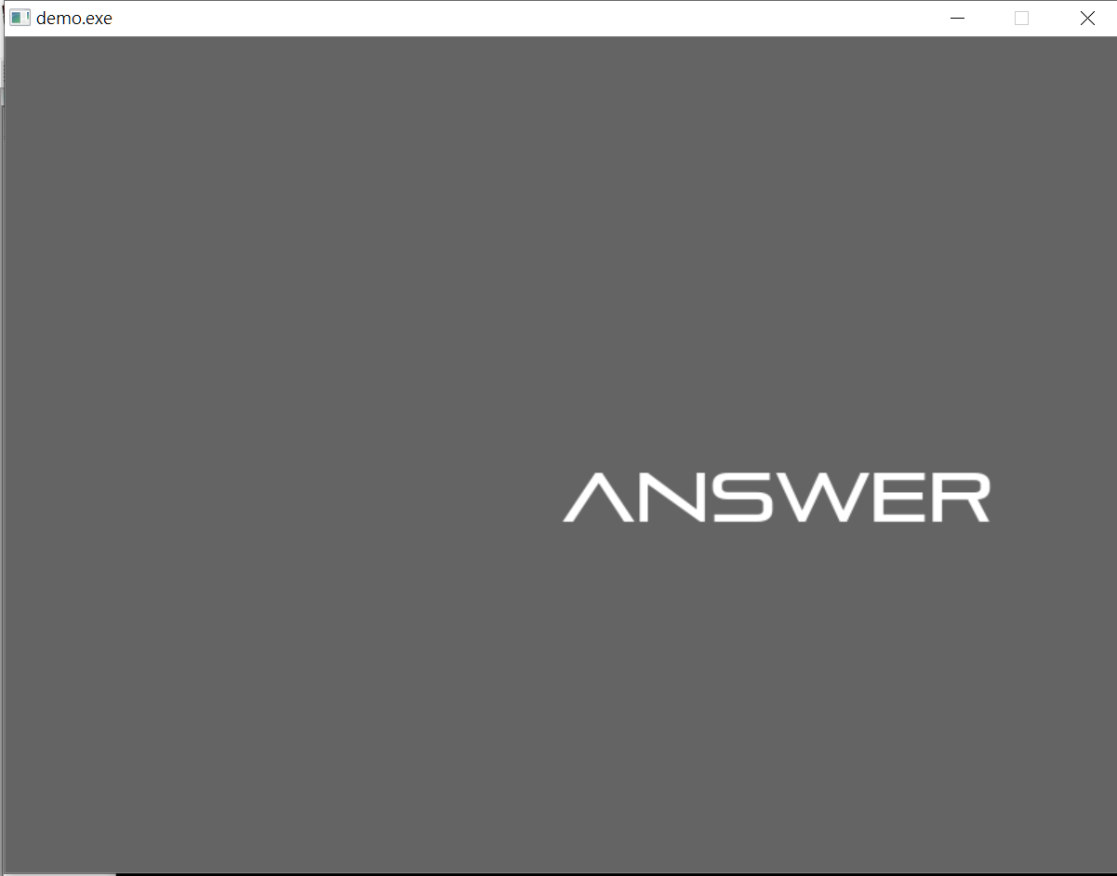
Draw text
Draw some text on the window
Include
Init
Display
Destroy
include
Set the color of text
Color white

Slide 32
Draw text
Draw some text on the window
Include
Init
Display
Destroy
include
The position of the text
Position (width/2, height/2)

Slide 33
Draw text
Draw some text on the window
Include
Init
Display
Destroy
include
You can put three different flags here:
ALLEGRO_ALIGN_LEFT: text align-left( you can use 0 instead )
ALLEGRO_ALIGN_CENTRE: text align-center
ALLEGRO_ALIGN_RIGHT: text align-right

Slide 34
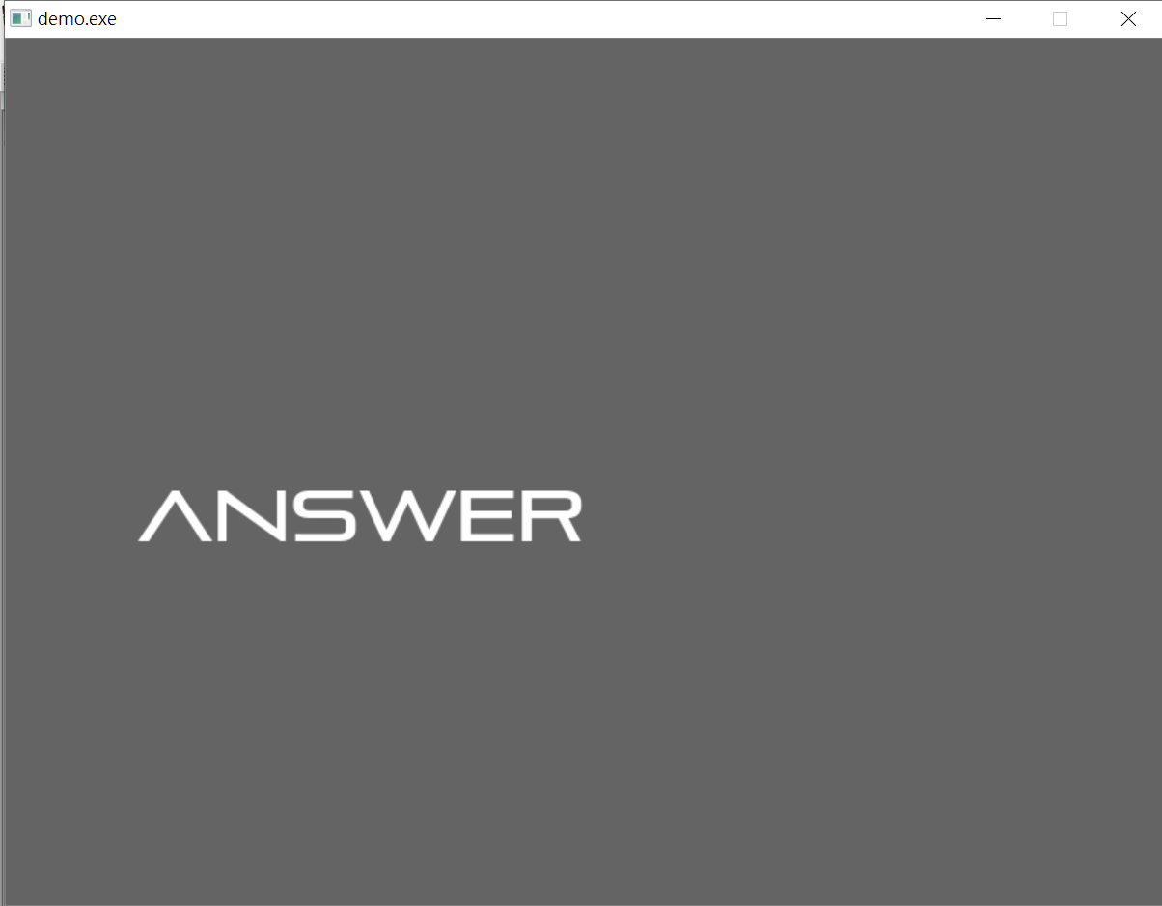
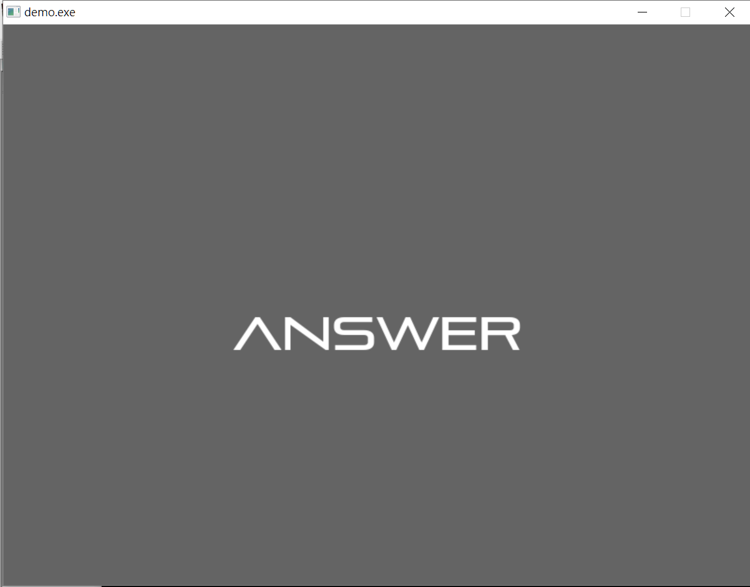
Draw text
Draw some text on the window
Include
Init
Display
Destroy
include
Text align-right
Text align-center
Text align-left

Slide 35
Draw text
Draw some text on the window
Include
Init
Display
Destroy
include
The text you want to show

Slide 36
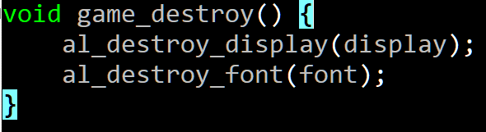
Draw text
Draw some text on the window
Include
Init
Display
Destroy
include
Release the memory of font

Slide 37
Draw rectangle
Draw rectangle on the window
Include
Init
Display
Destroy
include

Slide 38
Draw rectangle
Draw rectangle on the window
Include
Init
Display
Destroy
include
Include the head file can draw some basic things

Slide 39
Draw rectangle
Draw rectangle on the window
Include
Init
Display
Destroy
include
Initialize primitive functions

Slide 40
Draw rectangle
Draw rectangle on the window
Include
Init
Display
Destroy
include
Draw a hollow rectangle

Slide 41

Draw rectangle
Draw rectangle on the window
Include
Init
Display
Destroy
include
The position of the up left corner of rectangle

Slide 42
Draw rectangle
Draw rectangle on the window
Include
Init
Display
Destroy
include
The position of the down right corner of rectangle

Slide 43
Draw rectangle
Draw rectangle on the window
Include
Init
Display
Destroy
include
The color of the rectangle
Color white

Slide 44
Draw rectangle
Draw rectangle on the window
Include
Init
Display
Destroy
include
The width of edges of the rectangle
The width of edges of the rectangle is 2

Slide 45
Draw rectangle
Draw rectangle on the window
Include
Init
Display
Destroy
include
No need to destroy

Slide 46
Draw picture
Draw picture on the window
Include
Init
Display
Destroy
include

Slide 47
Draw picture
Draw picture on the window
Include
Init
Display
Destroy
include
Include the head file can draw picture on the window

Slide 48

Draw picture
Draw picture on the window
Include
Init
Display
Destroy
include
Initialize the image function

Slide 49

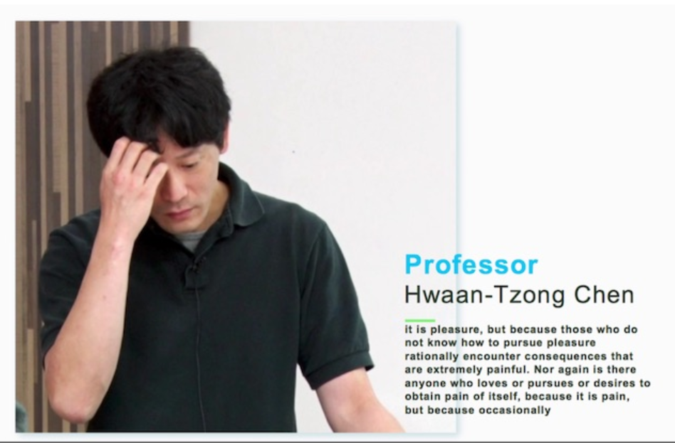
Draw picture
Draw picture on the window
Include
Init
Display
Destroy
include
Store the image in to variable “img”
img:

Slide 50
Draw picture
Draw picture on the window
Include
Init
Display
Destroy
include
Draw the image into buffer
Use al_flip_display(), to show the image on the window
img:
buffer:

Slide 51
Draw picture
Draw picture on the window
Include
Init
Display
Destroy
include
The position of the up left corner of the image

Slide 52
Draw picture
Draw picture on the window
Include
Init
Display
Destroy
include
Usually 0, but you can put other two flags:
1. ALLEGRO_FLIP_HORIZONTAL: flip the image horizontally
2. ALLEGRO_FLIP_VERTICAL: flip the image vertically

Slide 53
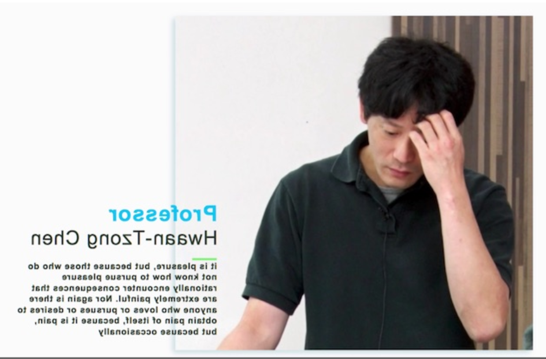
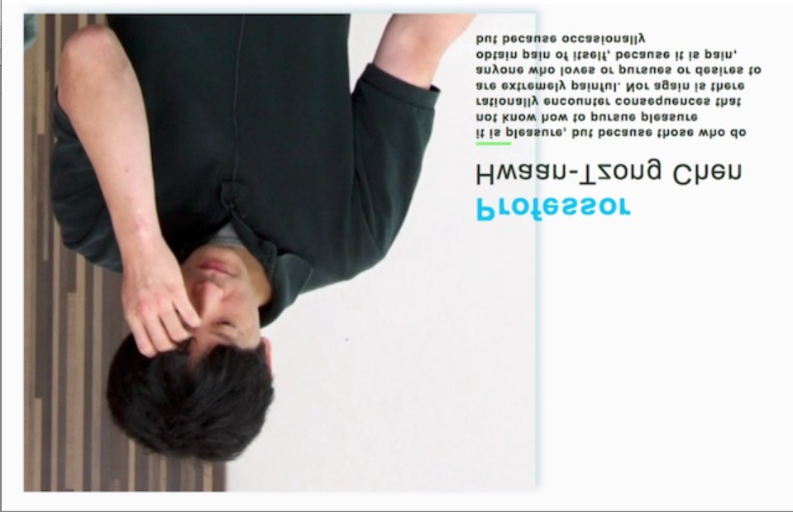
Draw picture
Draw picture on the window
Include
Init
Display
Destroy
include
ALLEGRO_FLIP_HORIZONTAL
0
ALLEGRO_FLIP_VERTICAL

Slide 54
Draw picture
Draw picture on the window
Include
Init
Display
Destroy
include
Release the memory of the image

Slide 55
Practice
Finish task 2!!

Slide 56
Outline
01
Introduction
02
Draw something!
03
Deal with event !
04
Play some music!
05
Supplementary

Slide 57
queue
The one that enters the queue first will also exit first (because he/she gets serviced first)

Slide 58
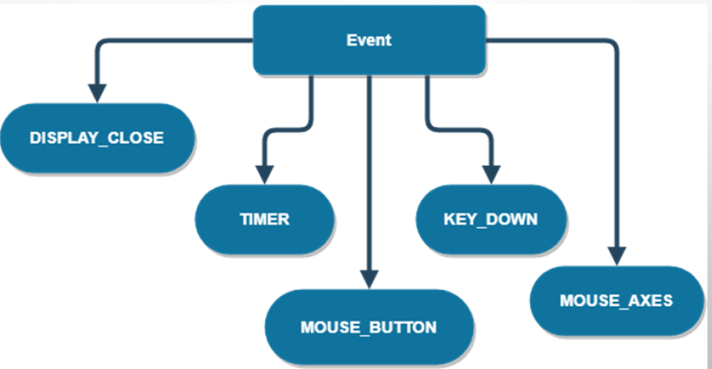
Type of event

Slide 59



Event queue
A queue that store event
New event in
Event that got out to process
Event queue

Slide 60
Event queue
A queue that store event
Event that got out to process
Event queue

Slide 61
Event queue
A queue that store event
Event that got out to process
Event queue

Slide 62
Event queue
A queue that store event
Event that got out to process
Event queue

Slide 63
Event queue
A queue that store event
Event that got out to process
Event queue

Slide 64
event
The process flow of event
If program not be terminated
Include
Init
Check event
Process event
Update
Draw
Destroy
If don’t have any event

Slide 65
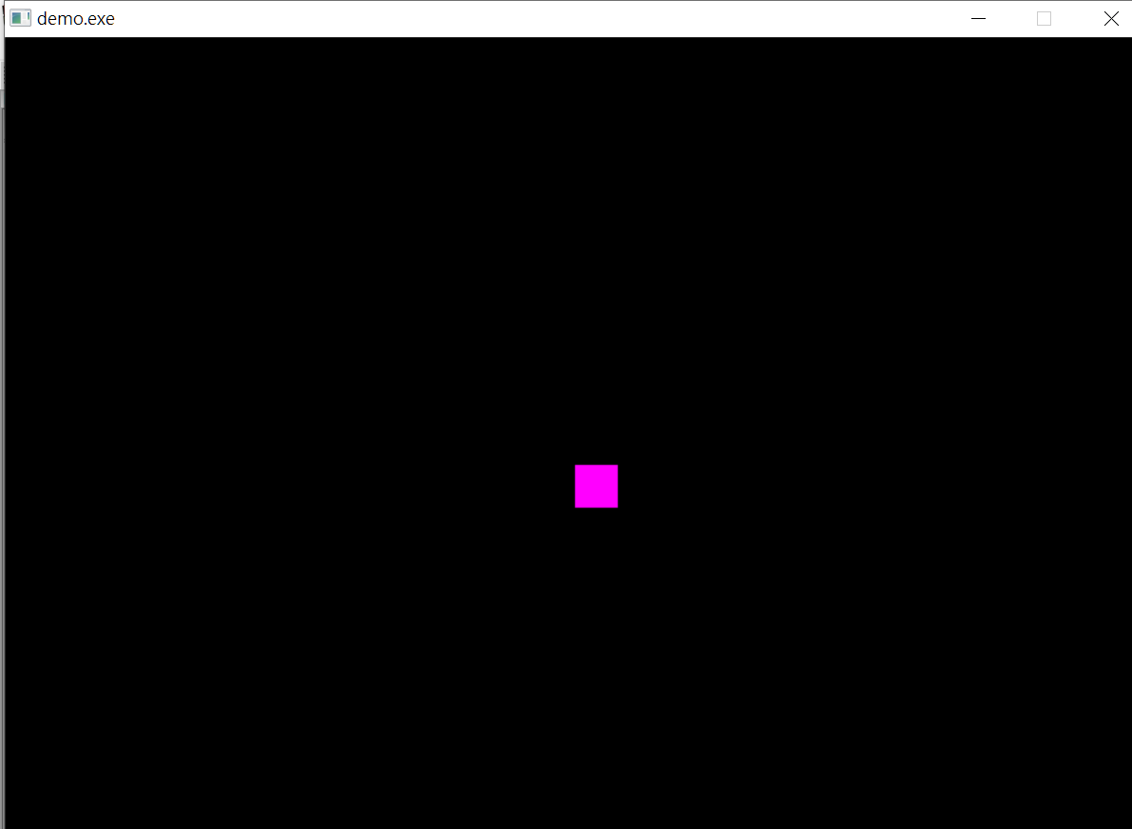
event
Take a program that you can move the rectangle around as example.
Use “WASD” to control the movement of rectangle.
Pressed “ESC” to terminate the program.

Slide 66
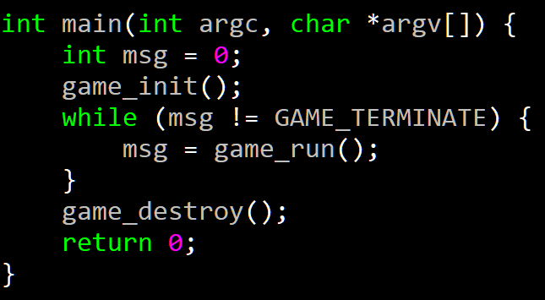
event
The process flow of event
Include
If program not be terminated
Init
Check event
Process event
Update
Draw
Destroy
If don’t have any event

Slide 67
event
The process flow of event
Include
If program not be terminated
Init
Check event
Process event
Update
Draw
Destroy
If don’t have any event
Create event queue

Slide 68
event
The process flow of event
Include
If program not be terminated
Init
Check event
Process event
Update
Draw
Destroy
If don’t have any event
Install keyboard

Slide 69
event
The process flow of event
Include
If program not be terminated
Init
Check event
Process event
Update
Draw
Destroy
If don’t have any event
Register keyboard event by using al_register_event_source() ,
get the keyboard event source by using al_get_keyboard_event_source()

Slide 70
event
The process flow of event
Include
If program not be terminated
Init
Check event
Process event
Update
Draw
Destroy
If don’t have any event
The loop that process the event

Slide 71
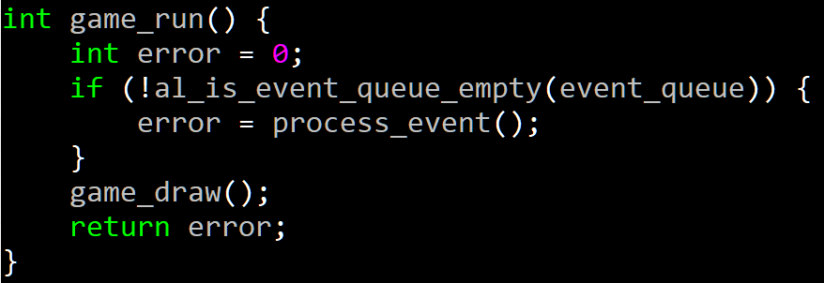
event
The process flow of event
Include
If program not be terminated
Init
Check event
Process event
Update
Draw
Destroy
If don’t have any event
Bool al_is_event_queue_empty_(ALLEGRO_EVENT_QUEUE *)
is a bool function that check if there is any event in the event queue.

Slide 72
event
The process flow of event
Include
If program not be terminated
Init
Check event
Process event
Update
Draw
Destroy
If don’t have any event
If there doesn’t exist any event then draw what you have

Slide 73
event
The process flow of event
Include
If program not be terminated
Init
Check event
Process event
Update
Draw
Destroy
If don’t have any event
If there’ exists some event in the event queue, then process the event

Slide 74
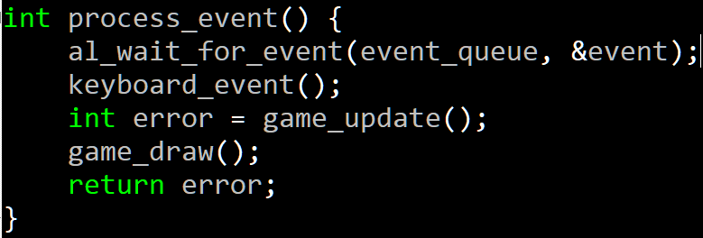
event
The process flow of event
Include
If program not be terminated
Init
Check event
Process event
Update
Draw
Destroy
If don’t have any event
Use
void al_wait_for_event(ALLEGRO_EVENT_QUEUE *queue, ALLEGRO_EVENT *ret_event) to get the event
Your program will stop and wait for event.

Slide 75
event
The process flow of event
Include
If program not be terminated
Init
Check event
Process event
Update
Draw
Destroy
If don’t have any event
Process keyboard event

Slide 76
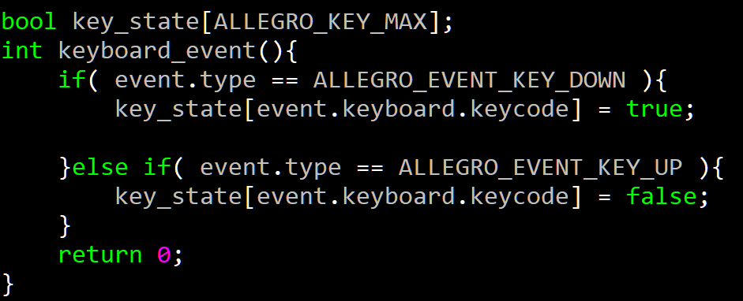
event
The process flow of event
Include
If program not be terminated
Init
Check event
Process event
Update
Draw
Destroy
If don’t have any event
1. Declare a global array “key_state” to determine the state of certain key. If the state is false means the key is being pressed, otherwise not being pressed
2. “event.type” can get the type of event
3. “even.keyboard.keycode” can get which key cause the event

Slide 77
event
The process flow of event
Include
If program not be terminated
Init
Check event
Process event
Update
Draw
Destroy
If don’t have any event
Update variables depend on the event

Slide 78
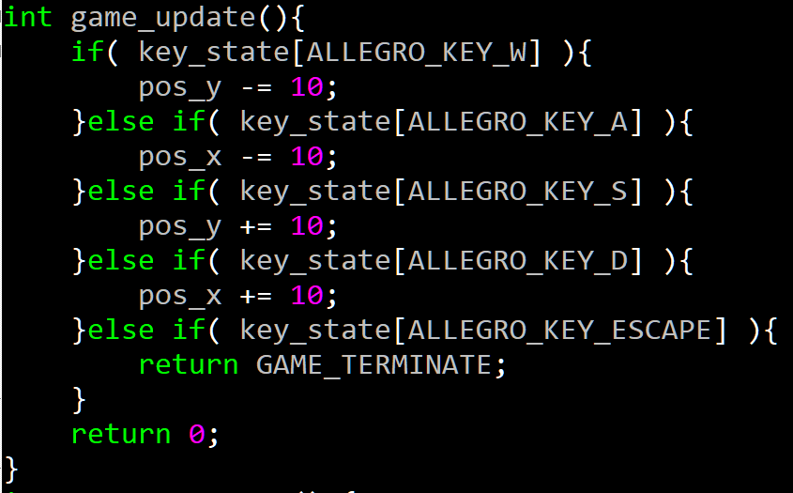
event
The process flow of event
Include
If program not be terminated
Init
Check event
Process event
Update
Draw
Destroy
If don’t have any event
Update the position of rectangle base on which key is being pressed.

Slide 79
event
The process flow of event
Include
If program not be terminated
Init
Check event
Process event
Update
Draw
Destroy
If don’t have any event
Draw what you want

Slide 80
event
The process flow of event
Include
If program not be terminated
Init
Check event
Process event
Update
Draw
Destroy
If don’t have any event
Destroy event queue

Slide 81
event
The process flow of event
Include
If program not be terminated
Init
Check event
Process event
Update
Draw
Destroy
If don’t have any event
Destroy event queue

Slide 82
Outline
01
Introduction
02
Draw something!
03
Deal with event !
04
Play some music!
05
Supplementary

Slide 83
Display sound
Include
Init
Display
Destroy
include

Slide 84

Display sound
Include
Init
Display
Destroy
include
Include the head file can display sound

Slide 85

Display sound
Include
Init
Display
Destroy
include
Initialize audio addon

Slide 86
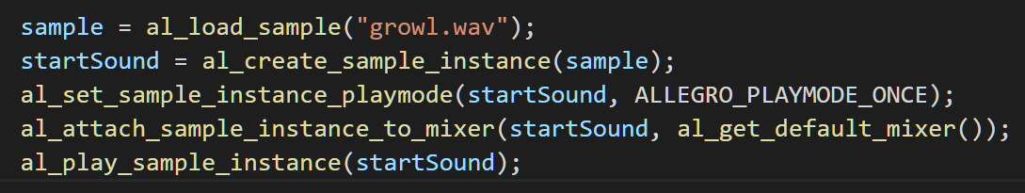
Display sound
Include
Init
Display
Destroy
include
Load the sound instance

Slide 87
Display sound
Include
Init
Display
Destroy
include
Create a sound instance so that it can be attach into mixer

Slide 88
Display sound
Include
Init
Display
Destroy
include
Set the play mode, you can use:
ALLEGRO_PLAYMODE_ONCE
ALLEGRO_PLAYMODE_LOOP

Slide 89
Display sound
Include
Init
Display
Destroy
include
Attach the sound into mixer so that it can be played with multiple sound

Slide 90
Display sound
Include
Init
Display
Destroy
include
Play the sample.

Slide 91
Display sound
Include
Init
Display
Destroy
include
You can use this function to stop the sample

Slide 92
Display sound
Include
Init
Display
Destroy
include
Destroy the sample instance

Slide 93
Outline
01
Introduction
02
Draw something!
03
Deal with event !
04
Play some music!
05
Supplementary

Slide 94
AI
~Use finite state machine!!!
Chase the opponent
Monster attack1
Something trigger!
Chase the opponent
Monster idle
Monster move
Monster attack2
Monster attack3
A massive attack so the monster rest for a while

Slide 95
AI
~Use finite state machine!!!
Monster idle
Monster move
Monster attack1
Monster attack2
Monster attack3
Draw the stop monster
Draw the moving animation
Draw the attack1 animation
Draw the attack2 animation
Draw the attack3 animation
By using states, we can easy draw the animation of monster

Slide 96
Special effect sound
~Use finite state machine!!!
Monster idle
Monster move
Monster attack1
Monster attack2
Monster attack3
Display the sound of panting
Display the sound of moving
Display the sound of attack1
Display the sound of attack2
Display the sound of attack3
Just judge the state then use al_play_sample(*ALLEGRO_SAMPLE)

Slide 97
Display video
Use something like mp4 to jpg to transfer the video into images.
Load the images into an array. You can use sprintf to manipulate the path of image
Set a timer as the fps of your video.
Set a event queue to get the timer event.
Each time the timer trigger display the image on the screen
Plus the index of array by 1 to display the next image.
Then you get the effect of display video!

Slide 98
The End~

