Slide 1

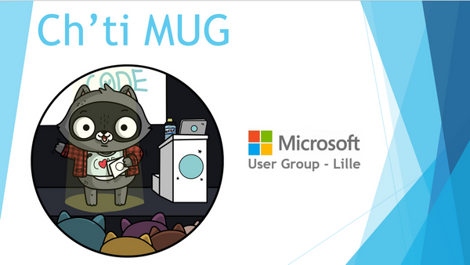


Découverte .NET 5 et son écosystème
Par Guillaume Chervet le jeudi 17 septembre 2020
@guiChervet
Co-BBL

Slide 2
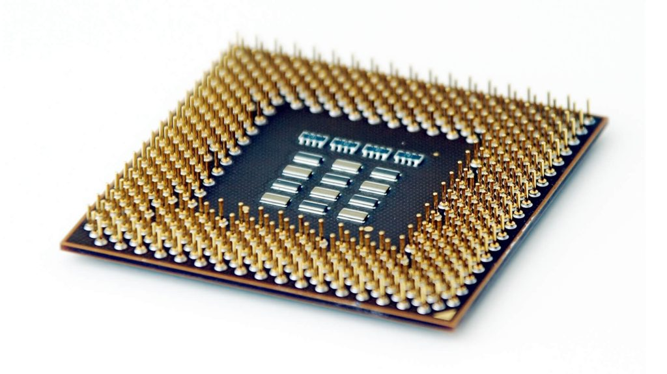
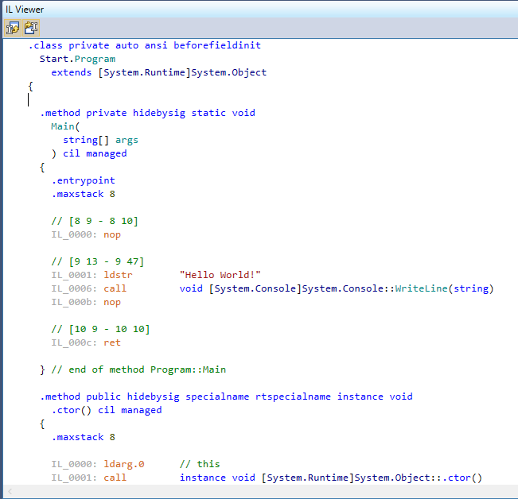
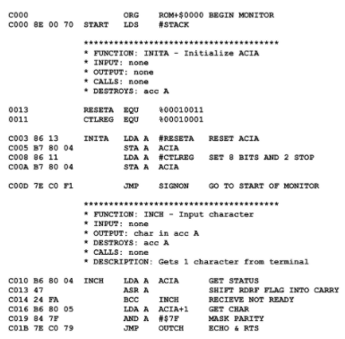
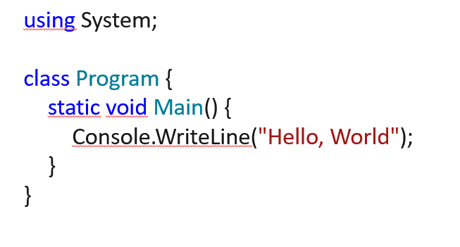
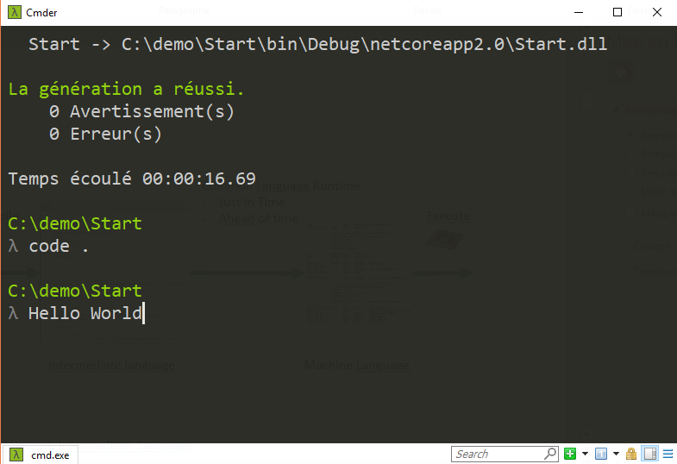
Common Language Runtime
(virtual machine)
Just In Time
Compile
Execute
Code
C#, F#, VB
Intermediate Language
Machine Language
https://en.wikipedia.org/wiki/Common_Intermediate_Language

Slide 3
Compile
Ahead of time
Execute
Code
C#, F#, VB
Machine Language
https://en.wikipedia.org/wiki/Common_Intermediate_Language

Slide 4
Asynchrony
Multithreaded
Parallelism

Slide 5
Lightness
Deployment flexibility
Multi-platform
Development tools
Open source
Supported by Microsoft
Notes:
Simon

Slide 6
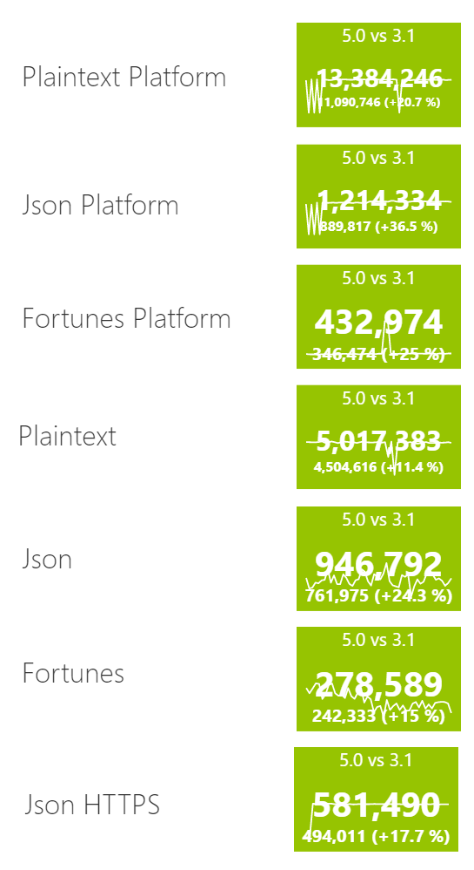
.NET 5 is performant
https://www.techempower.com/benchmarks/

Slide 7

Nuget as package manager
https://www.nuget.org/

Slide 8
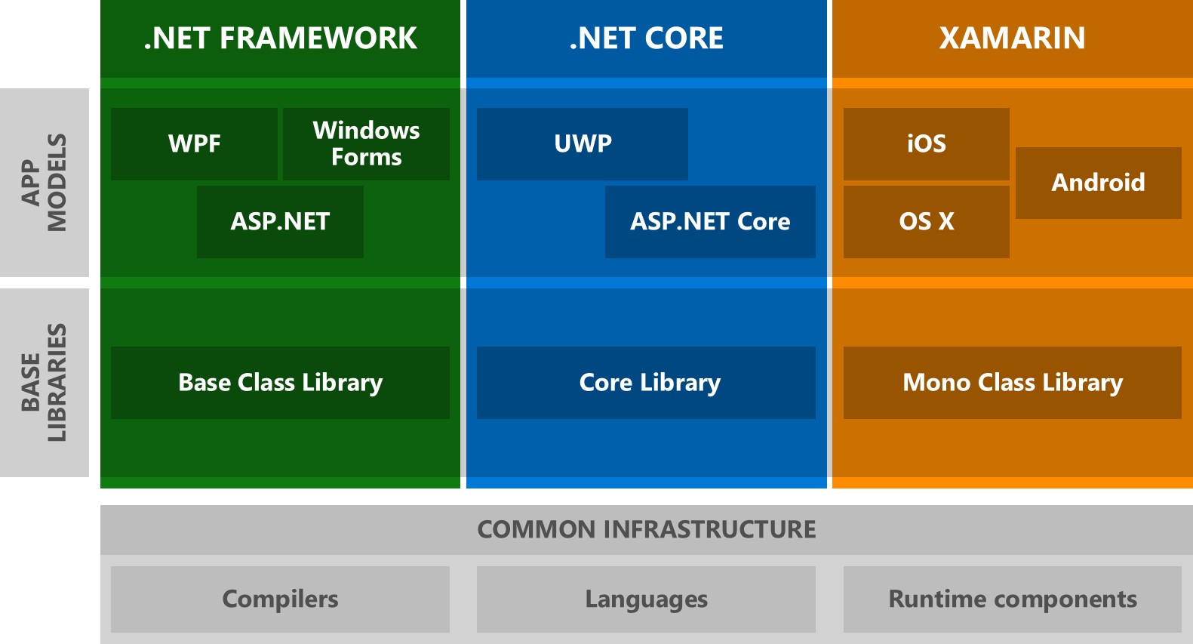
History

Slide 9
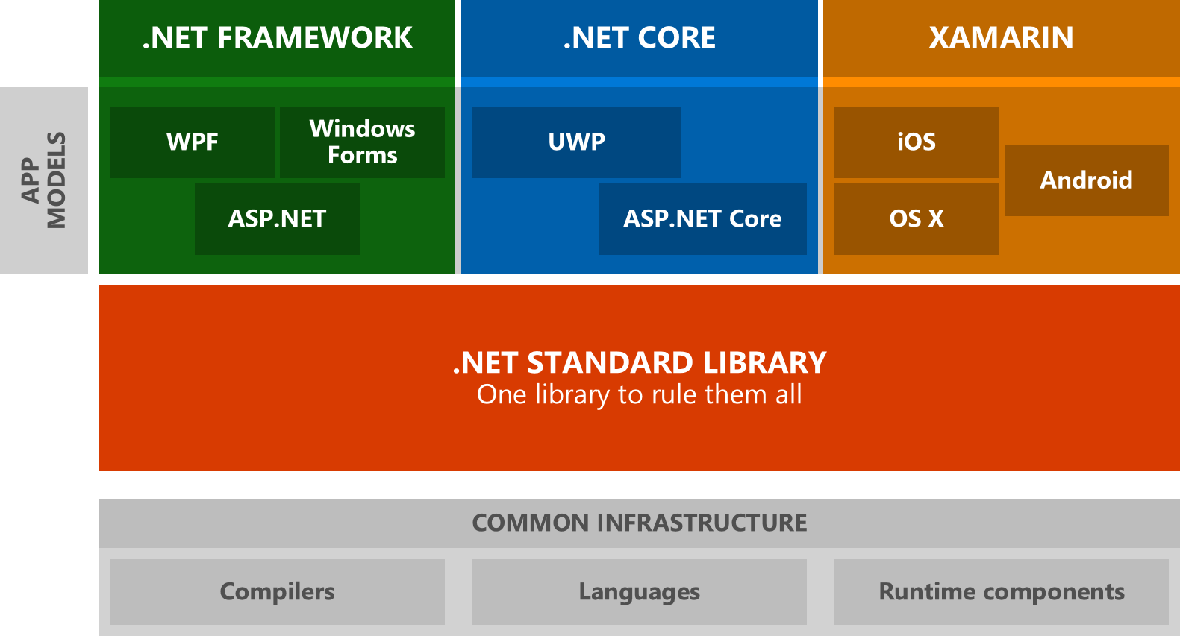
History

Slide 10
.NET Vision - .NET 5 to 6 « wave »
Single SDK, one BCL, unified toolchain
Cross-plateform native UI
Cross-plateform web UI
Cloud native investments
Continue improvements in speed, size, diagnostics, Azure service
https://devblogs.microsoft.com/dotnet/the-future-of-net-standard

Slide 11
Use netstandard2.0 to share code between .NET Framework and all other platforms.
Use netstandard2.1 to share code between Mono, Xamarin, and .NET Core 3.x.
Use net5.0 for code sharing moving forward.
https://devblogs.microsoft.com/dotnet/the-future-of-net-standard

Slide 12
Dealing with OS-specific APIs
private static string GetLoggingDirectory() { if (OperatingSystem.IsWindows()) { using (RegistryKey key = Registry.CurrentUser.OpenSubKey(@"Software\Fabrikam")) { if (key?.GetValue("LoggingDirectoryPath") is string configuredPath) return configuredPath; } } string exePath = Process.GetCurrentProcess().MainModule.FileName; string folder = Path.GetDirectoryName(exePath); return Path.Combine(folder, "Logging"); }
https://devblogs.microsoft.com/dotnet/the-future-of-net-standard/

Slide 13
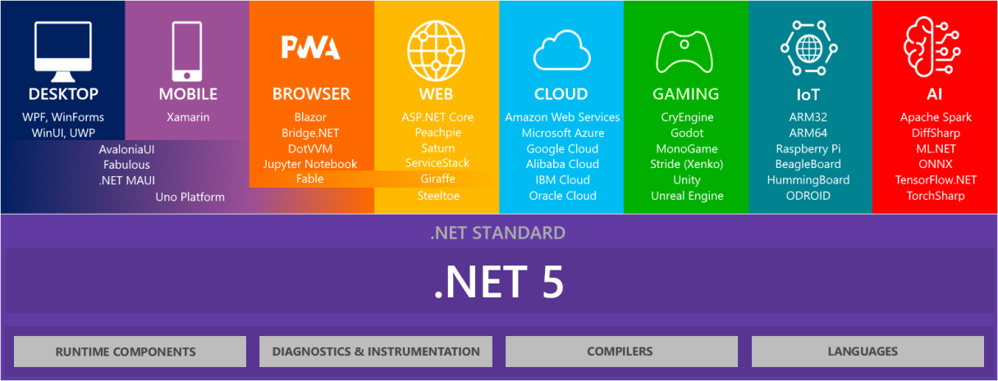

Slide 14
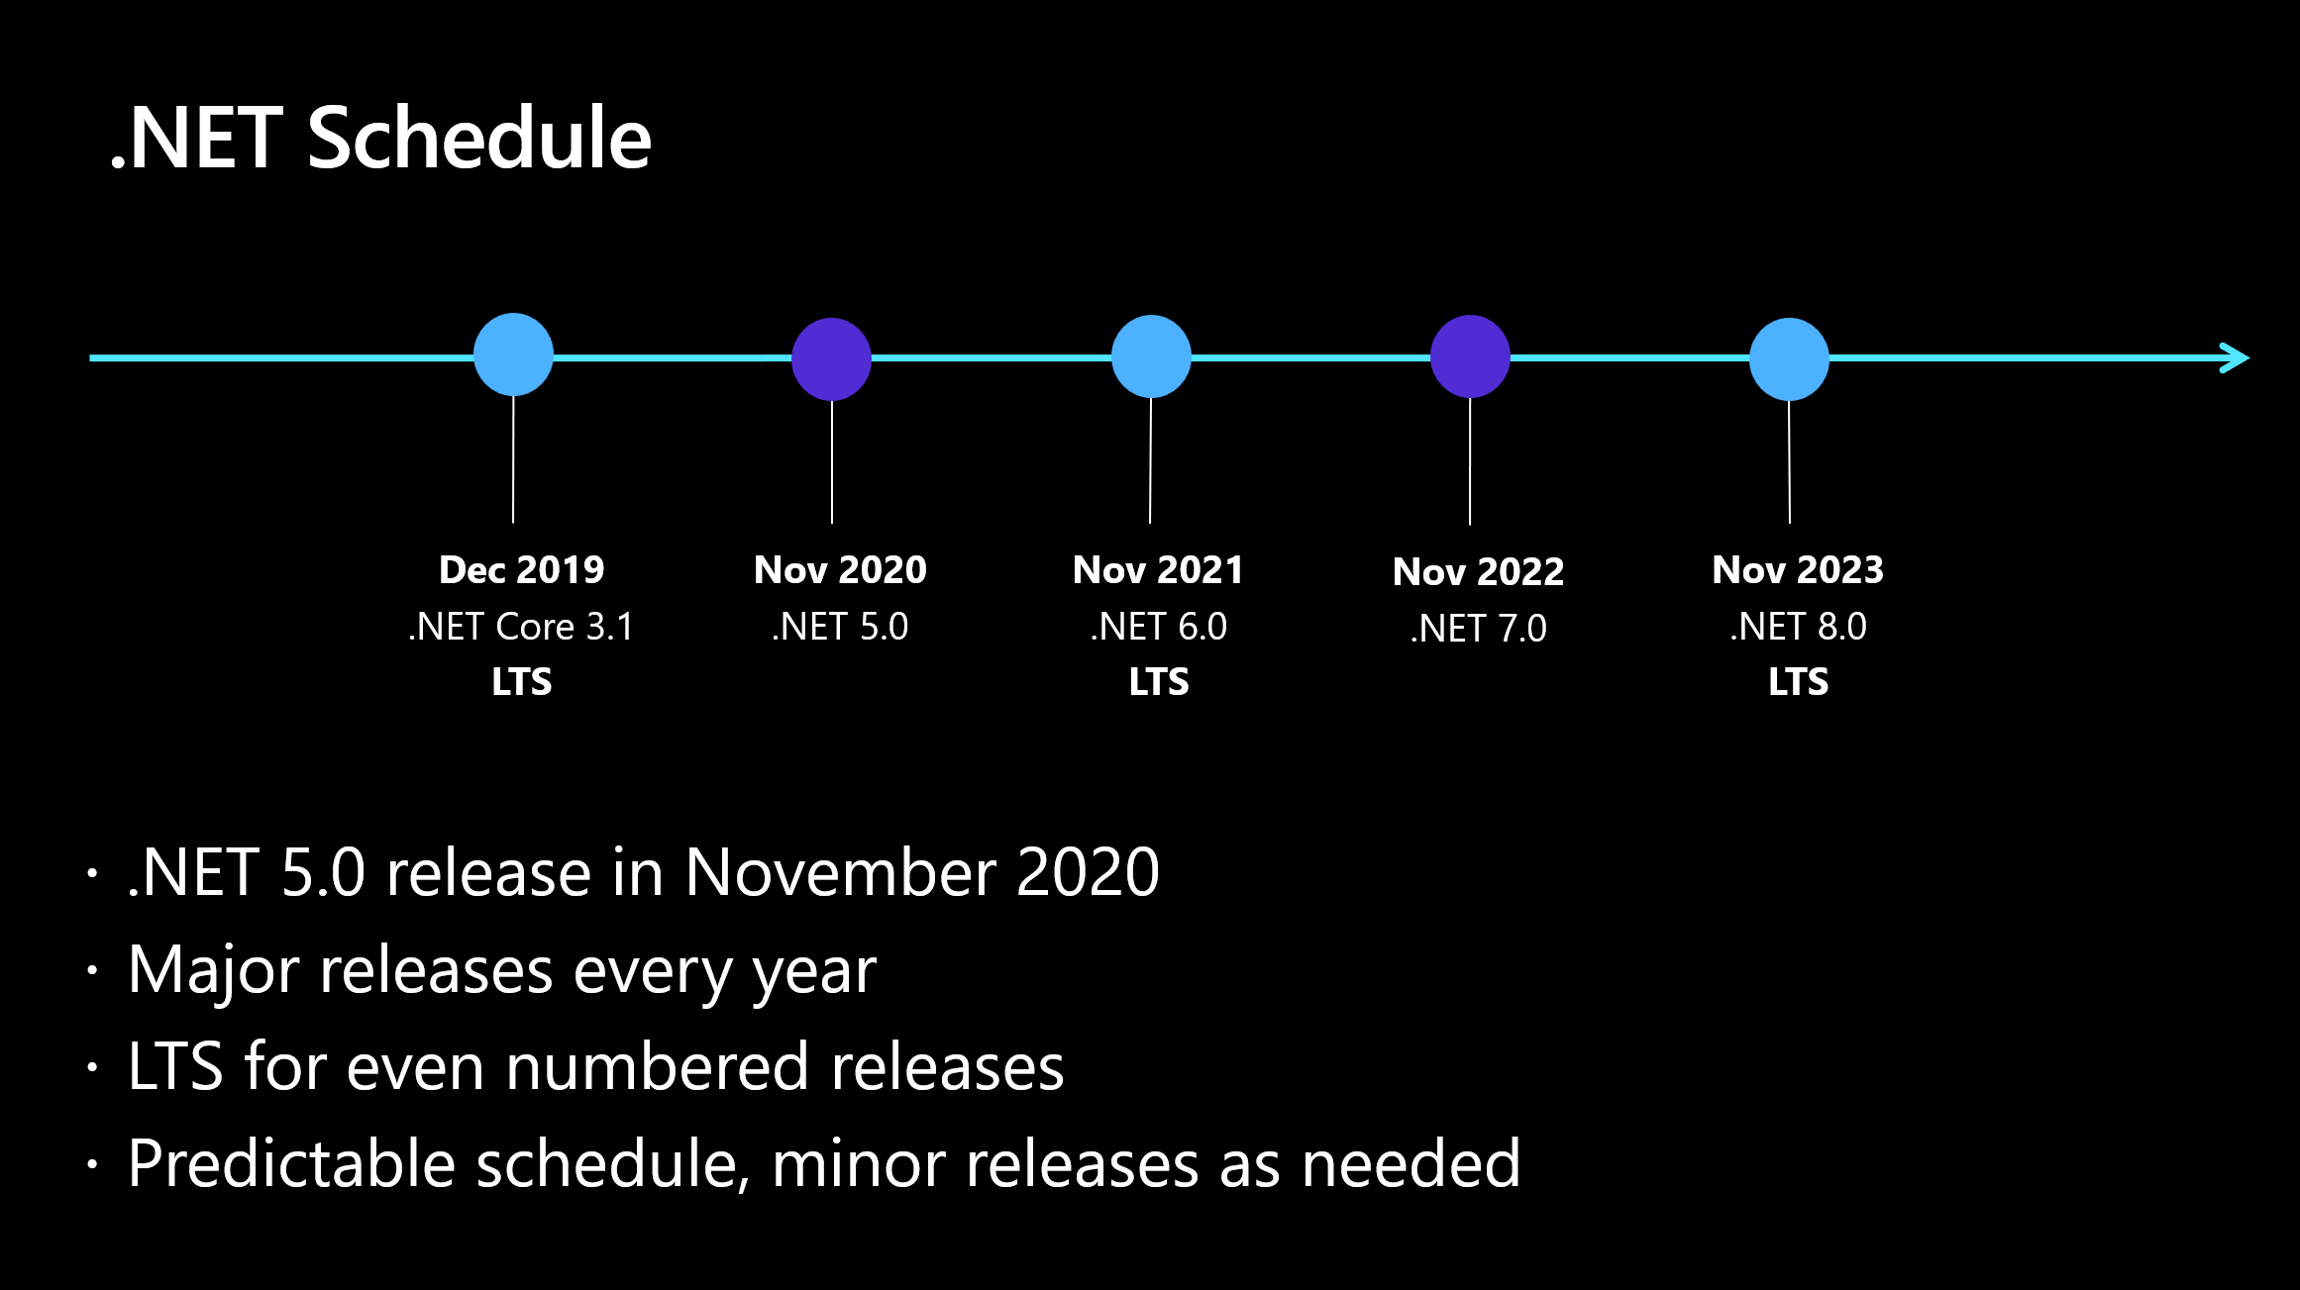

Slide 15
.NET 5 | .NET 6 | .NET 7
net5.0 | net6.0 | net7.0
 | net6.0-android | net7.0-android
 | net6.0-ios | net7.0-ios
net5.0-windows | net6.0-windows | net7.0-windows
net5.0-someoldos
https://devblogs.microsoft.com/dotnet/the-future-of-net-standard/

Slide 16
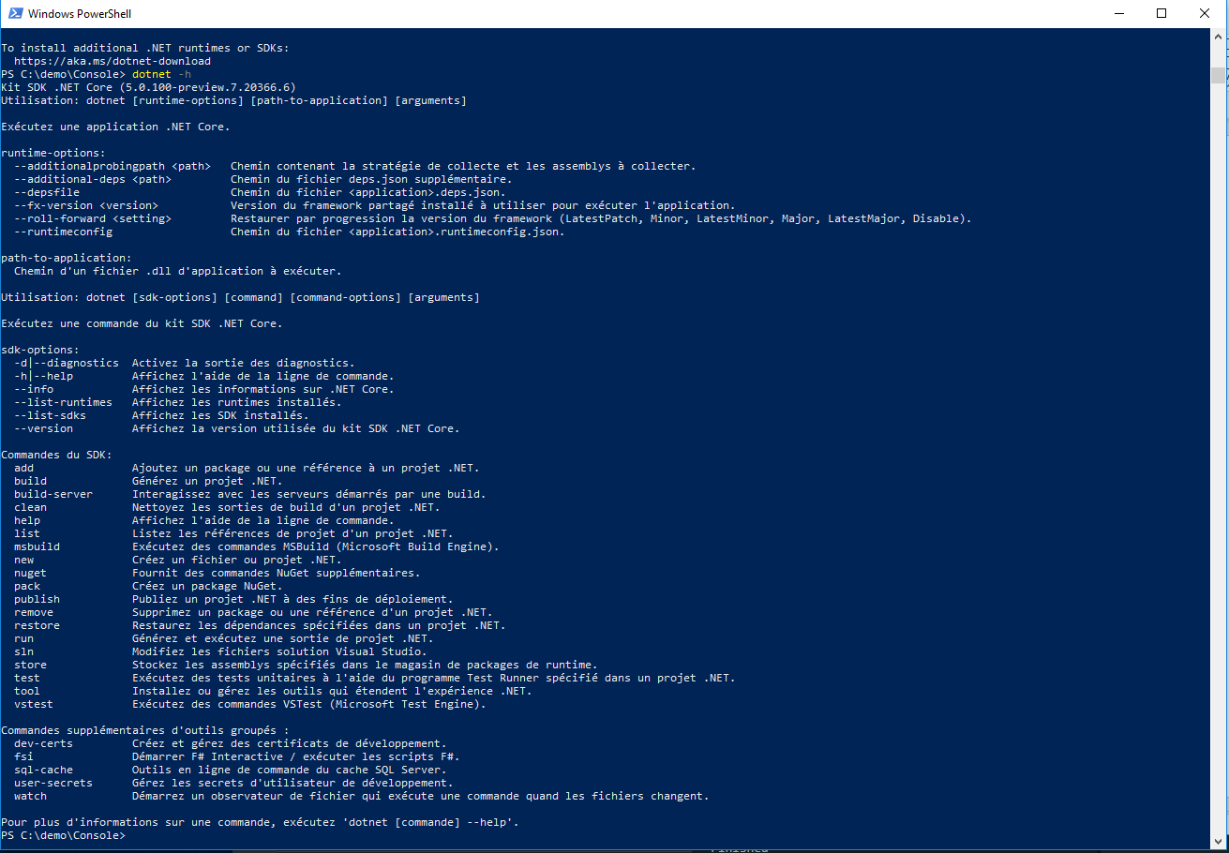
Dotnet cli
> dotnet --help

Slide 17
Publish
> dotnet publish Console.csproj -r win-x64 --self-contained=true /p:PublishSingleFile=true /p:IncludeNativeLibrariesInSingleFile=true
Exemples de Runtime identifier :
win-x64
linux-x64
osx-x64
https://docs.microsoft.com/fr-fr/dotnet/core/rid-catalog&WT.mc_id=DOP-MVP-5003370
https://docs.microsoft.com/fr-fr/dotnet/core/tools/dotnet-publish?WT.mc_id=DOP-MVP-5003370

Slide 18
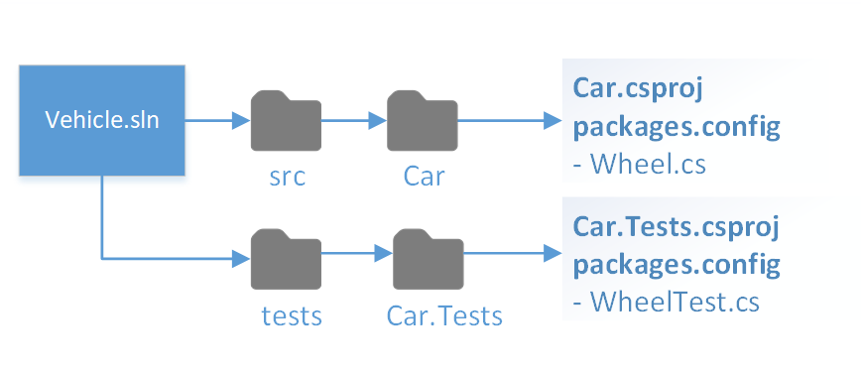
Project structure
https://docs.microsoft.com/fr-fr/dotnet/core/porting/project-structure?WT.mc_id=DOP-MVP-5003370

Slide 19
https://platform.uno/

Slide 20
http://avaloniaui.net/

Slide 21
https://github.com/dotnet/interactive
https://github.com/dotnet/interactive/blob/main/samples/docker-image/readme.md

