Slide 2
Microsoft and Ecosysteme dotnet
Virtual(s) Machine and intermediate language
C# Language
Nuget Package manager
dotnet tool
Visual Studio & Visual studio online
Dotnet et docker
Entity Framework (Core)
ASP.NET (Core)
Xamarin
WPF&UWP (Windows required)
WebAssembly avec Blazor

Slide 3
Build librairy
Consome librairy
Publish nuget
Consome from nuget
Add database
Add web application
Add mobile application

Slide 4
Éco système Microsoft et dotnet
Guillaume Chervet

Slide 5
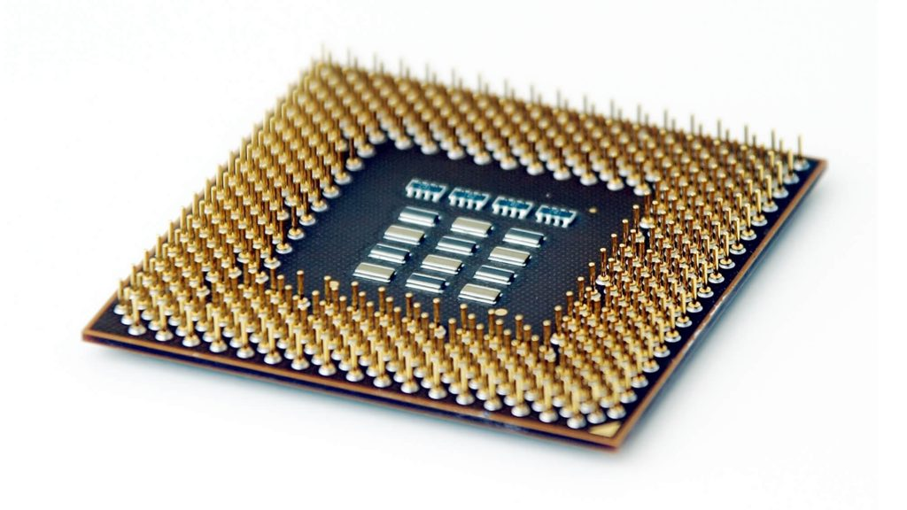
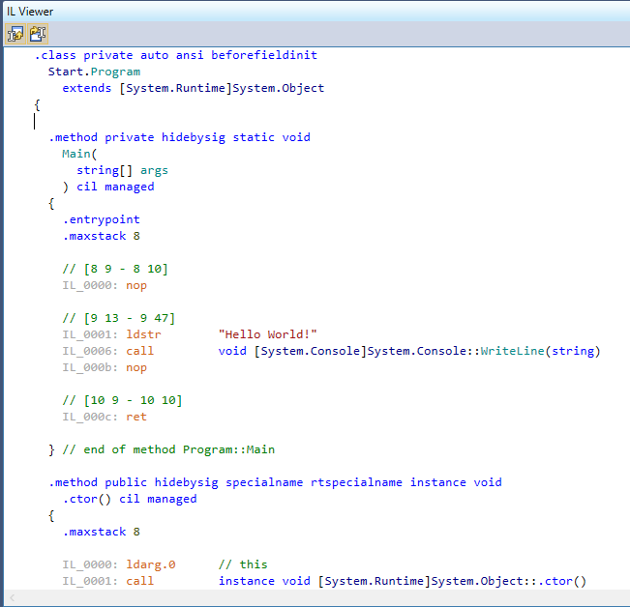
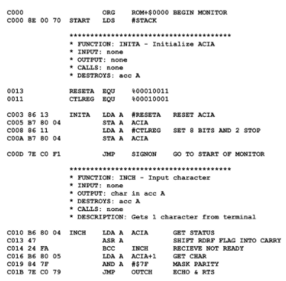
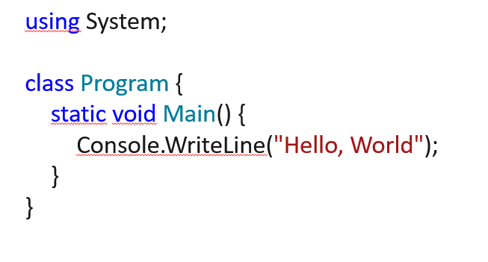
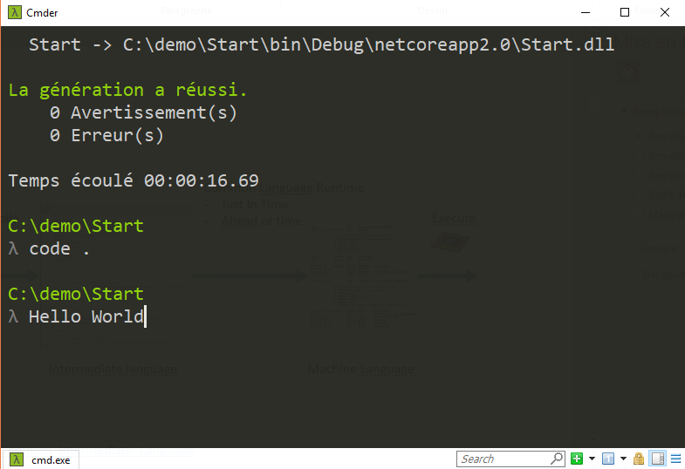
Common Language Runtime
(virtual machine)
Just In Time
Compile
Execute
Code
C#, F#, VB
Intermediate Language
Machine Language
https://en.wikipedia.org/wiki/Common_Intermediate_Language

Slide 6
Compile
Ahead of time
Execute
Code
C#, F#, VB
Machine Language
https://en.wikipedia.org/wiki/Common_Intermediate_Language

Slide 7
Asynchrony
Multithreaded
Parallelism

Slide 8

Nuget as package manager
https://www.nuget.org/

Slide 9
Lightness
Deployment flexibility
Multi-platform
Development tools
Open source
Supported by Microsoft
Notes:
Simon

Slide 10
History State .NET in 2017
.NET Framework for Windows
Mono for Xamarin
dotnet core
https://www.youtube.com/watch?v=jardGqFgzS0&feature=emb_title
Notes:
Simon

Slide 11
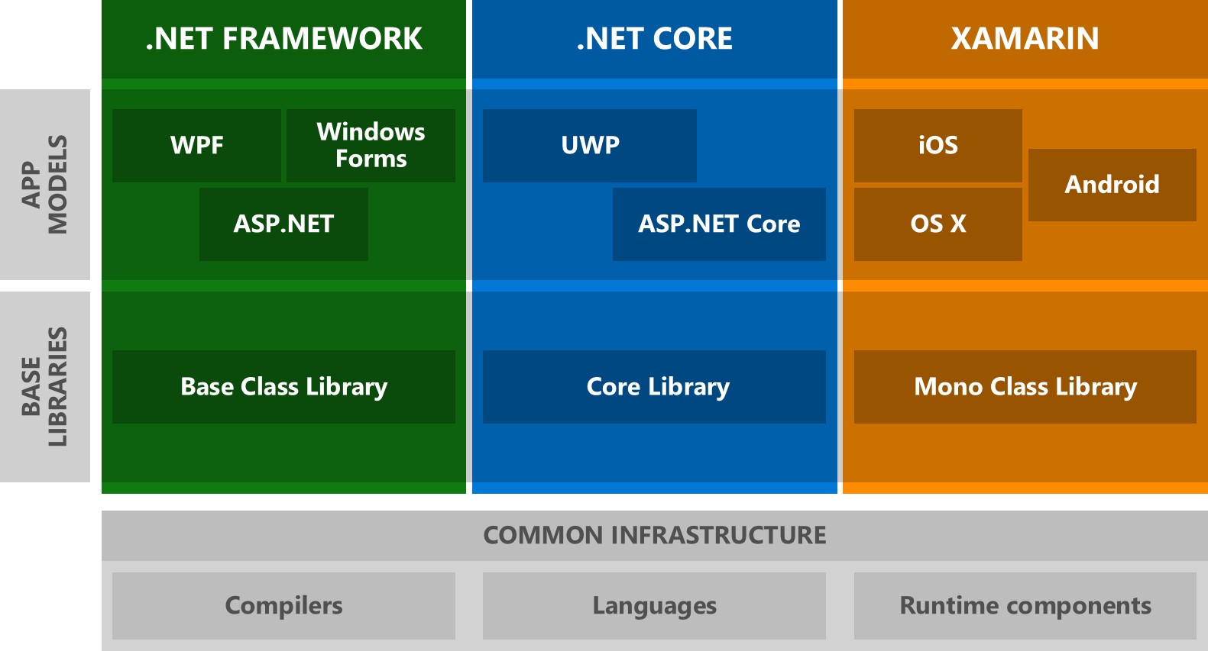
History

Slide 12
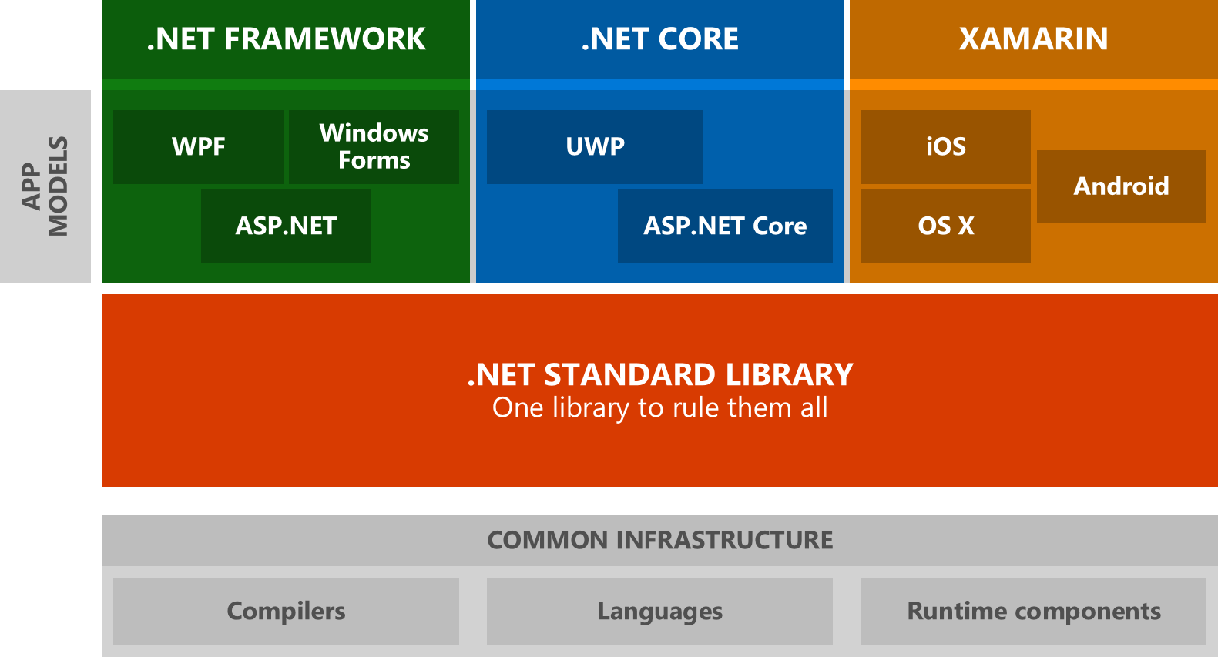
History

Slide 13
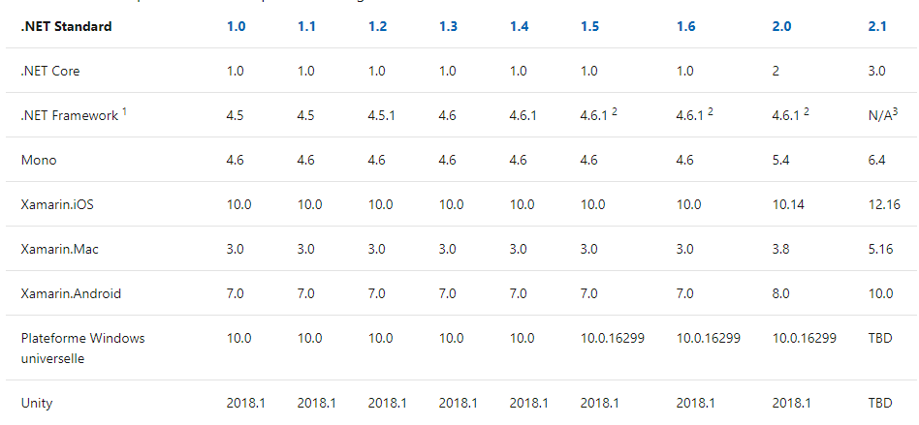
History
https://docs.microsoft.com/fr-fr/dotnet/standard/net-standard?WT.mc_id=DOP-MVP-5003370

Slide 14
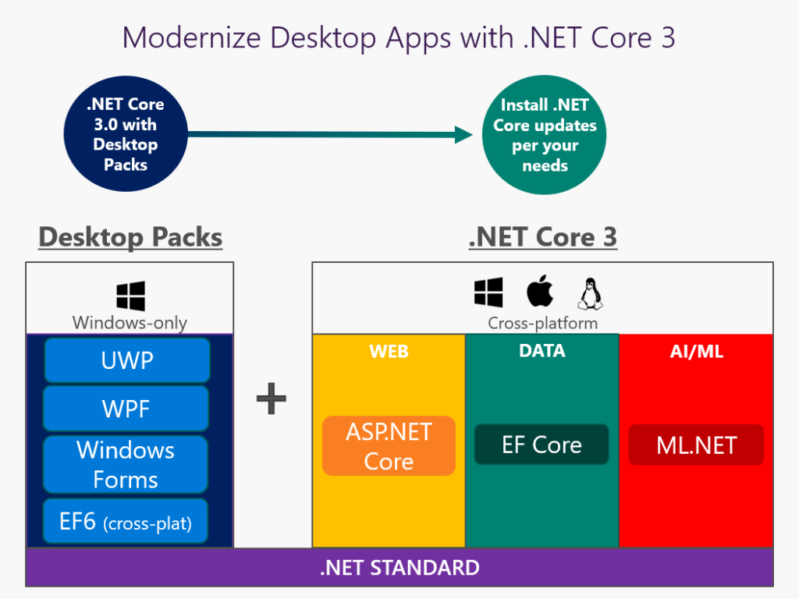
History
https://www.infoq.com/fr/news/2019/06/dotnet-core-past-present-future/

Slide 15
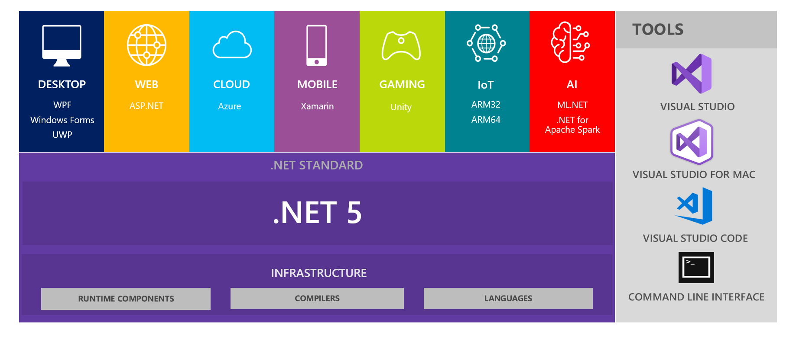


Slide 16
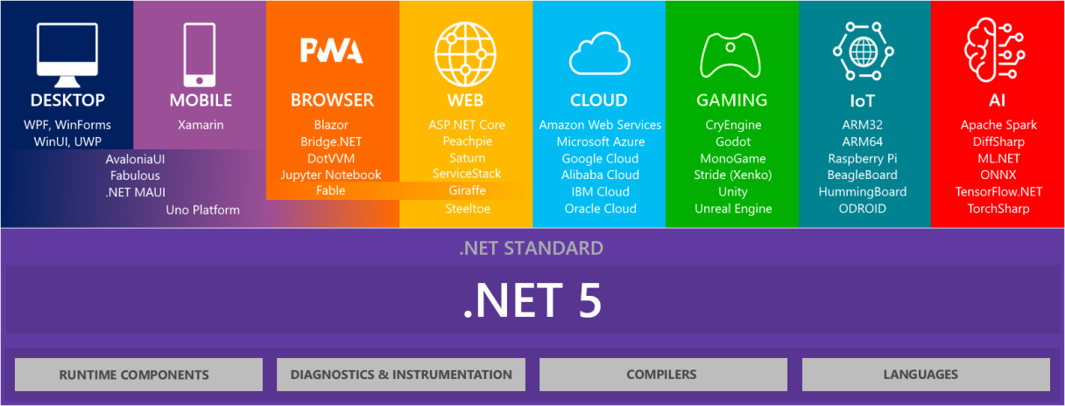

Slide 17
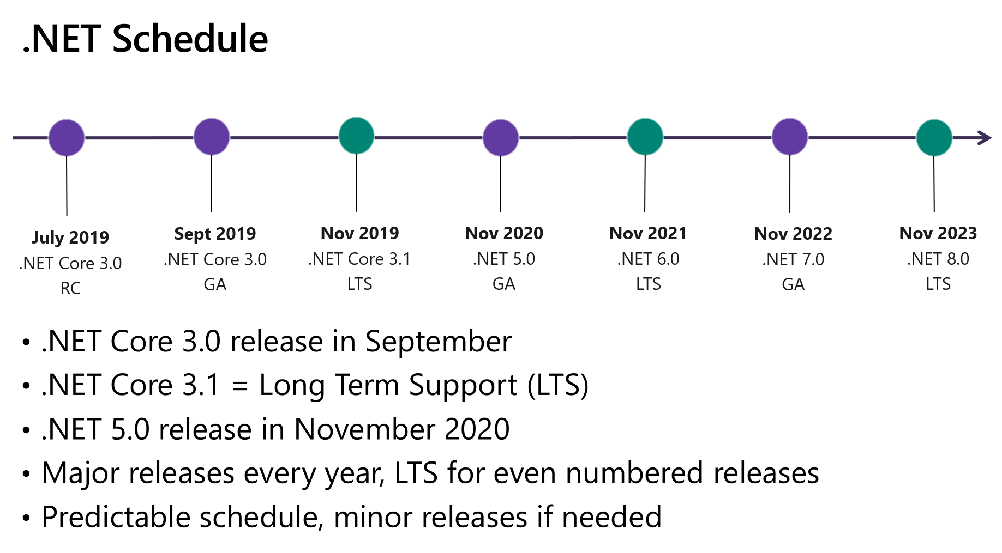

Slide 18
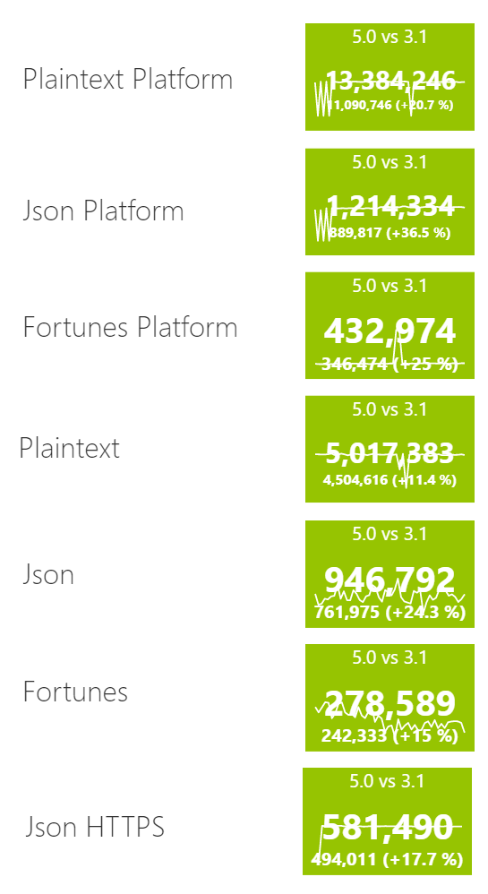
Progression axis
Performance
Lighter executable
Faster startup
https://www.techempower.com/benchmarks/

Slide 19
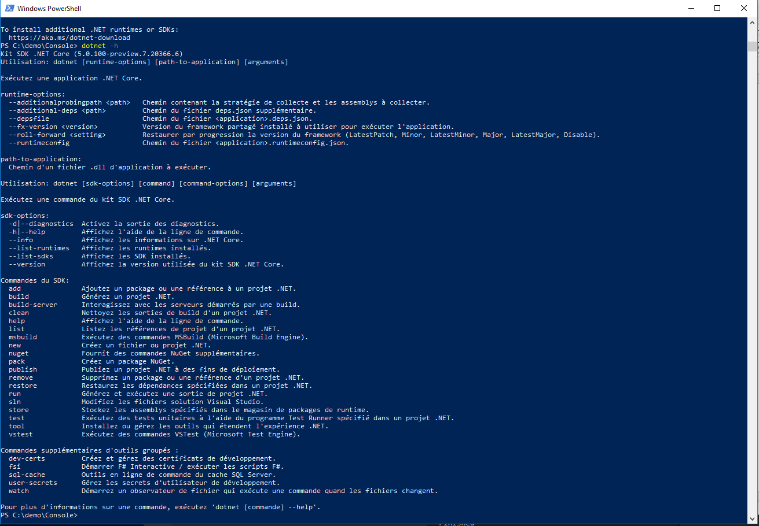
Dotnet cli
> dotnet --help

Slide 20
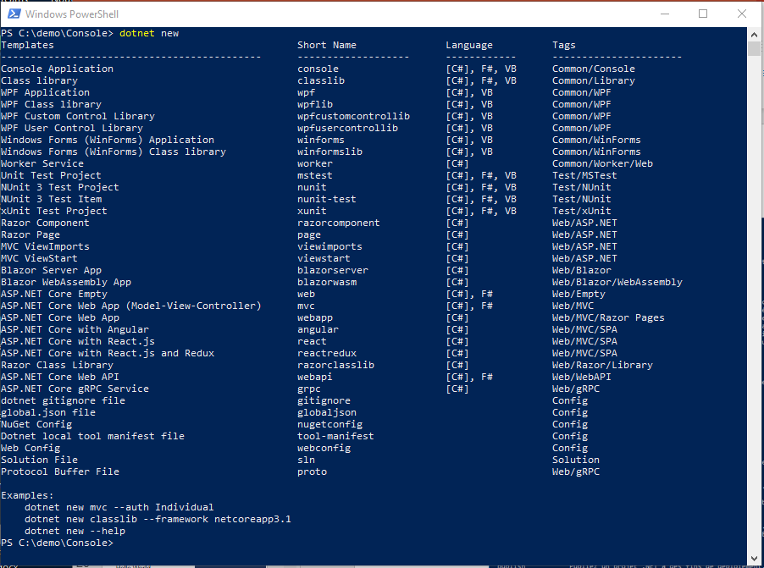
Dotnet cli
> dotnet new

Slide 21
Hello World
> dotnet new console -o Demo
> cd Demo
> dotnet run
using System;
namespace Demo {
class Hello {
static void Main() {
Console.WriteLine("Hello, World");
}
}
}
https://docs.microsoft.com/fr-fr/dotnet/csharp/tour-of-csharp/?WT.mc_id=DOP-MVP-5003370

Slide 22
Demo.csproj
<Project Sdk="Microsoft.NET.Sdk">
<PropertyGroup>
<OutputType>Exe</OutputType>
<TargetFramework>net5.0</TargetFramework>
</PropertyGroup>
</Project>

Slide 23
Publish
> dotnet publish Demo.csproj -r win-x64 --self-contained=true /p:PublishSingleFile=true /p:IncludeNativeLibrariesInSingleFile=true
Exemples de Runtime identifier :
win-x64
linux-x64
osx-x64
https://docs.microsoft.com/fr-fr/dotnet/core/rid-catalog
https://docs.microsoft.com/fr-fr/dotnet/core/tools/dotnet-publish?WT.mc_id=DOP-MVP-5003370

Slide 24
Exercise
Install the lastest version of .net5
Use dotnet cli for building a «console» application
Publish your application as an independant executable file optimized for your OS

Slide 25
global.json
> dotnet new globaljson --sdk-version 3.0.100
{
"sdk": {
"version": "2.2.200",
"rollForward": "latestMajor "
}
}
(disable, latestMajor, latestFeature, latestPatch)

Slide 26
Exercise
Generate « global.json » adapted to your current dotnet sdk version

Slide 27
Dockerfile
FROM mcr.microsoft.com/dotnet/core/sdk:5.0 AS build
WORKDIR /src
COPY . .
RUN dotnet publish "Console.csproj" -c Release -r linux-x64 /p:PublishSingleFile=true -o /publish
FROM mcr.microsoft.com/dotnet/core/runtime-deps:5.0 AS final
WORKDIR /app
COPY --from=build /publish .
ENTRYPOINT ["/app/Console"]
docker build . –t demo
docker run -it --rm demo
https://hub.docker.com/_/microsoft-dotnet-core

Slide 28
Exercise
On windows install WSL 2
Install docker (use WSL 2)
Add a Dokerfile to your project
Build then execute a docker image to run your « Hello World »

Slide 29
Namespace
> dotnet build
using System;
class Program {
static void Main() {
Console.WriteLine("Hello, World");
}
}
https://docs.microsoft.com/fr-fr/dotnet/standard/assembly/?WT.mc_id=DOP-MVP-5003370

Slide 30
Namespace
> dotnet build
class Program {
static void Main() {
System.Console.WriteLine("Hello, World");
}
}
https://docs.microsoft.com/fr-fr/dotnet/standard/assembly/?WT.mc_id=DOP-MVP-5003370

Slide 31
Arguments
class Program {
static void Main(string[] args) {
System.Console.WriteLine("Hello " + args[0]);
}
}
dotnet run -- Guillaume
# Or
Demo.exe Guillaume

Slide 32
Fibonacci
class Program {
public static int Fib(int i) {
if(i<=2) return 1;
return Fib(i-2) + Fib(i-1);
}
}

Slide 33
Parse string to int
try {
int result = System.Int32.Parse(input);
System.Console.WriteLine(result);
} catch (FormatException) {
System.Console.WriteLine($"Unable to parse '{input}'");
}
https://docs.microsoft.com/fr-fr/dotnet/csharp/programming-guide/types/how-to-convert-a-string-to-a-number?WT.mc_id=DOP-MVP-5003370

Slide 34
Parse string to int
if (Int32.TryParse("-105", out int j)) Console.WriteLine(j);
else Console.WriteLine("String could not be parsed."); // Output: -105
https://docs.microsoft.com/fr-fr/dotnet/csharp/programming-guide/types/how-to-convert-a-string-to-a-number?WT.mc_id=DOP-MVP-5003370

Slide 35
Exercise
Create a program which take 1 argument as input and compute Fibbonacci from that argument
Run it: dotnet run -- 44

Slide 36
ReadLine
using System;
public class Example {
public static void Main() {
string line = Console.ReadLine();
if (line != null) Console.WriteLine("Result: " + line);
}
}

Slide 37
csproj : Use C# 9 Preview
<Project Sdk="Microsoft.NET.Sdk">
<PropertyGroup>
<OutputType>Exe</OutputType>
<TargetFramework>net5.0</TargetFramework>
<LangVersion>preview</LangVersion>
</PropertyGroup>
</Project>

Slide 38
Top level statements
int Fib(int i) {
if(i<=2) return 1;
return Fib(i-2) + Fib(i-1);
}
System.Console.WriteLine(Fib(int.Parse(args[0])));
dotnet run – 24

Slide 39
Pattern matching
int Fib(int i) =>
i switch
{
int when i<=2 => 1,
_ => Fib(i-2) + Fib(i-1)
};
System.Console.WriteLine(Fib(int.Parse(args[0])));
https://www.youtube.com/watch?v=bEfBfBQq7EE&feature=youtu.be

Slide 40
F# version
let rec Fib n =
match n with
| 1 | 2 -> 1
| n -> Fib(n-1) + Fib(n-2)
let x = Fib(24)
printf "%i" x

Slide 41
Exercise
Create a new console application using F# language
Run it
Update it with Fibonacci code
Run it
Download and install dotpeek : https://www.jetbrains.com/decompiler
Open your .dll and inspect .il generic code

Slide 42
Using foreach with arrays
int[] numbers = { 4, 5, 6, 1, 2, 3, -2, -1, 0 };
foreach (int i in numbers) {
System.Console.Write("{0} ", i);
}
// Output: 4 5 6 1 2 3 -2 -1 0

Slide 43
Mesure time
using System;
using System.Collections.Generic;
using System.Threading.Tasks;
using System.Diagnostics;
Stopwatch stopwatch = new Stopwatch();
stopwatch.Start();
Thread.Sleep(2000);
stopwatch.Stop();
TimeSpan stopwatchElapsed = stopwatch.Elapsed;
Console.WriteLine(Convert.ToInt32(stopwatchElapsed.TotalMilliseconds));

Slide 44
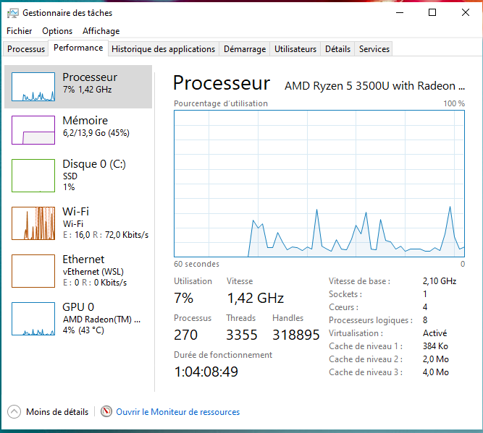
taskmgr

Slide 45
Exercise
Update the program to be able to take n argument as input and compute n Fibbonacci
Update your program to be able to mesure elapsed time
Run it with : dotnet run -- 44
Run it with : dotnet run -- 44 44 44 44
What do you see ?
Don’t forget to checkout your CPU

Slide 46
Task
using System;
using System.Threading;
using System.Threading.Tasks;
Action<object> action = (object obj) => { Console.WriteLine("Task={0}, obj={1}, Thread={2}", Task.CurrentId, obj, Thread.CurrentThread.ManagedThreadId); };
// Construct a started task
Task t2 = Task.Factory.StartNew(action, "beta");
// Block the main thread to demonstrate that t2 is executing
t2.Wait();
https://docs.microsoft.com/fr-fr/dotnet/api/system.threading.tasks.task?view=netcore-3.1&WT.mc_id=DOP-MVP-5003370

Slide 47
Task<TResult>
using System;
using System.Threading.Tasks;
var t = Task<int>.Run( () => {
// Just loop.
int max = 1000000; int ctr = 0;
for (ctr = 0; ctr <= max; ctr++) {
if (ctr == max / 2 && DateTime.Now.Hour <= 12) { ctr++; break; }
}
return ctr; } );
Console.WriteLine("Finished {0:N0} iterations.", t.Result); } }
// The example displays output like the following:
// Finished 1,000,001 loop iterations.
https://docs.microsoft.com/fr-fr/dotnet/api/system.threading.tasks.task-1?view=netcore-3.1&WT.mc_id=DOP-MVP-5003370

Slide 48
Exercise
Update the program in order to use Task<int>
Run it with : dotnet run -- 44
Run it with : dotnet run -- 44 44 44 44
What do you see ?
Don’t forget to checkout your CPU

Slide 49
Project organization

Slide 50
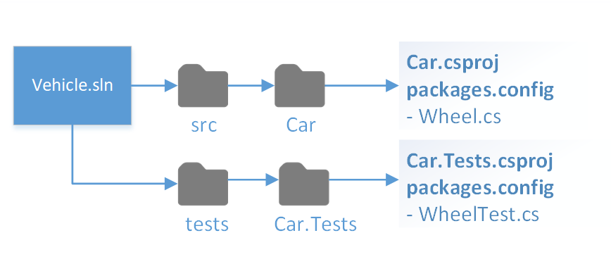
Project structure
https://docs.microsoft.com/fr-fr/dotnet/core/porting/project-structure?WT.mc_id=DOP-MVP-5003370

Slide 51
cd..
mkdir Fibonacci
mkdir Fibonacci \src
move .\demo .\Fibonacci\src
cd Fibonacci

Slide 52
Project solution file: sln
dotnet new sln
dotnet sln Fibonacci.sln add .\src\Demo\Demo.csproj
type Fibonacci.sln

Slide 53
Library : Fibonacci.csproj
<Project Sdk="Microsoft.NET.Sdk">
<PropertyGroup>
<TargetFramework>net5.0</TargetFramework>
</PropertyGroup>
</Project>
dotnet new classlib –o .\src\Fibonacci

Slide 54
using System; using System.Collections.Generic; using System.Diagnostics; using System.Threading.Tasks; namespace Fibonacci { public static class Compute { public static IList<int> Execute(string[] args) { var tasks = new List<Task<int>>();
return results; } } }
https://docs.microsoft.com/fr-fr/dotnet/csharp/programming-guide/classes-and-structs/static-classes-and-static-class-members?WT.mc_id=DOP-MVP-5003370

Slide 55
Tests: Fibonacci.Tests.csproj
<Project Sdk="Microsoft.NET.Sdk"> <PropertyGroup> <TargetFramework>net5.0</TargetFramework> <IsPackable>false</IsPackable> </PropertyGroup> <ItemGroup> <PackageReference Include="Microsoft.NET.Test.Sdk" Version="16.6.1" /> <PackageReference Include="xunit" Version="2.4.1" /> <PackageReference Include="xunit.runner.visualstudio" Version="2.4.3"> <IncludeAssets>runtime; build; native; contentfiles; analyzers; buildtransitive</IncludeAssets> <PrivateAssets>all</PrivateAssets> </PackageReference> <PackageReference Include="coverlet.collector" Version="1.3.0"> <IncludeAssets>runtime; build; native; contentfiles; analyzers; buildtransitive</IncludeAssets> <PrivateAssets>all</PrivateAssets> </PackageReference> </ItemGroup> </Project>
dotnet new classlib –o .\tests\Fibonacci.Tests

Slide 56
using Xunit; namespace Fibonacci.Tests { public class FibonacciUnitTest { [Fact] public void Execute44ShouldRetrun701408733() { var result = Compute.Execute(new[] {"44"}); Assert.Equal(701408733, result[0]); } } }

Slide 57
Add reference between projects
dotnet add "./src/Demo/Demo.csproj" reference "./src/Fibonacci/Fibonacci.csproj"
dotnet add "./tests/Fibonacci.Tests/ Fibonacci.Tests.csproj" reference "./src/Fibonacci/Fibonacci.csproj"
<Project Sdk="Microsoft.NET.Sdk"> <ItemGroup> <ProjectReference Include="..\..\src\Fibonacci\Fibonacci.csproj" /> </ItemGroup> </Project>

Slide 58
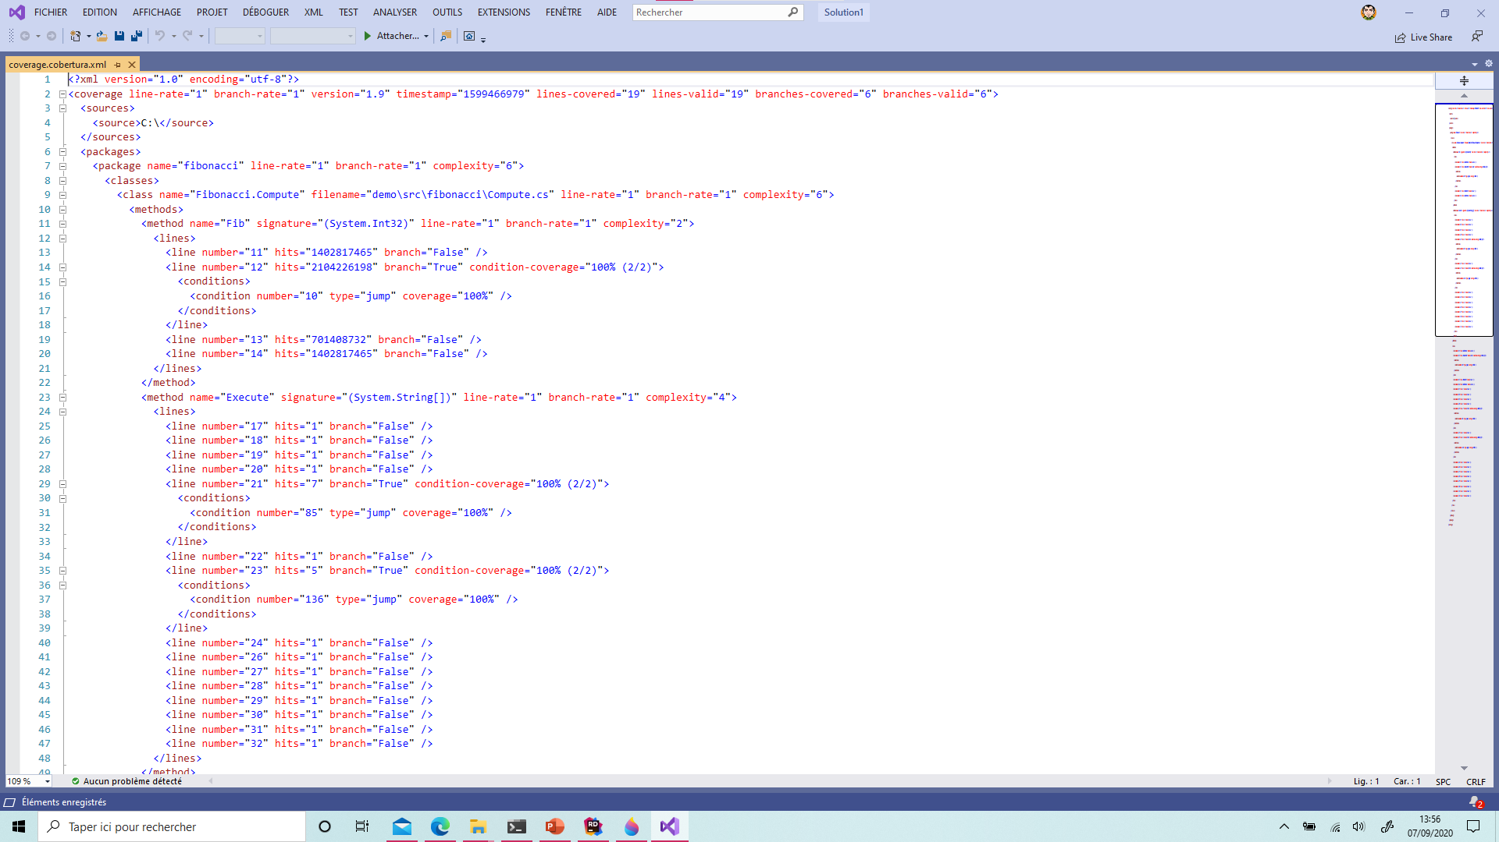
cd .\tests\Fibonacci.Tests
dotnet test --collect:"XPlat Code Coverage"
https://github.com/coverlet-coverage/coverlet

Slide 59
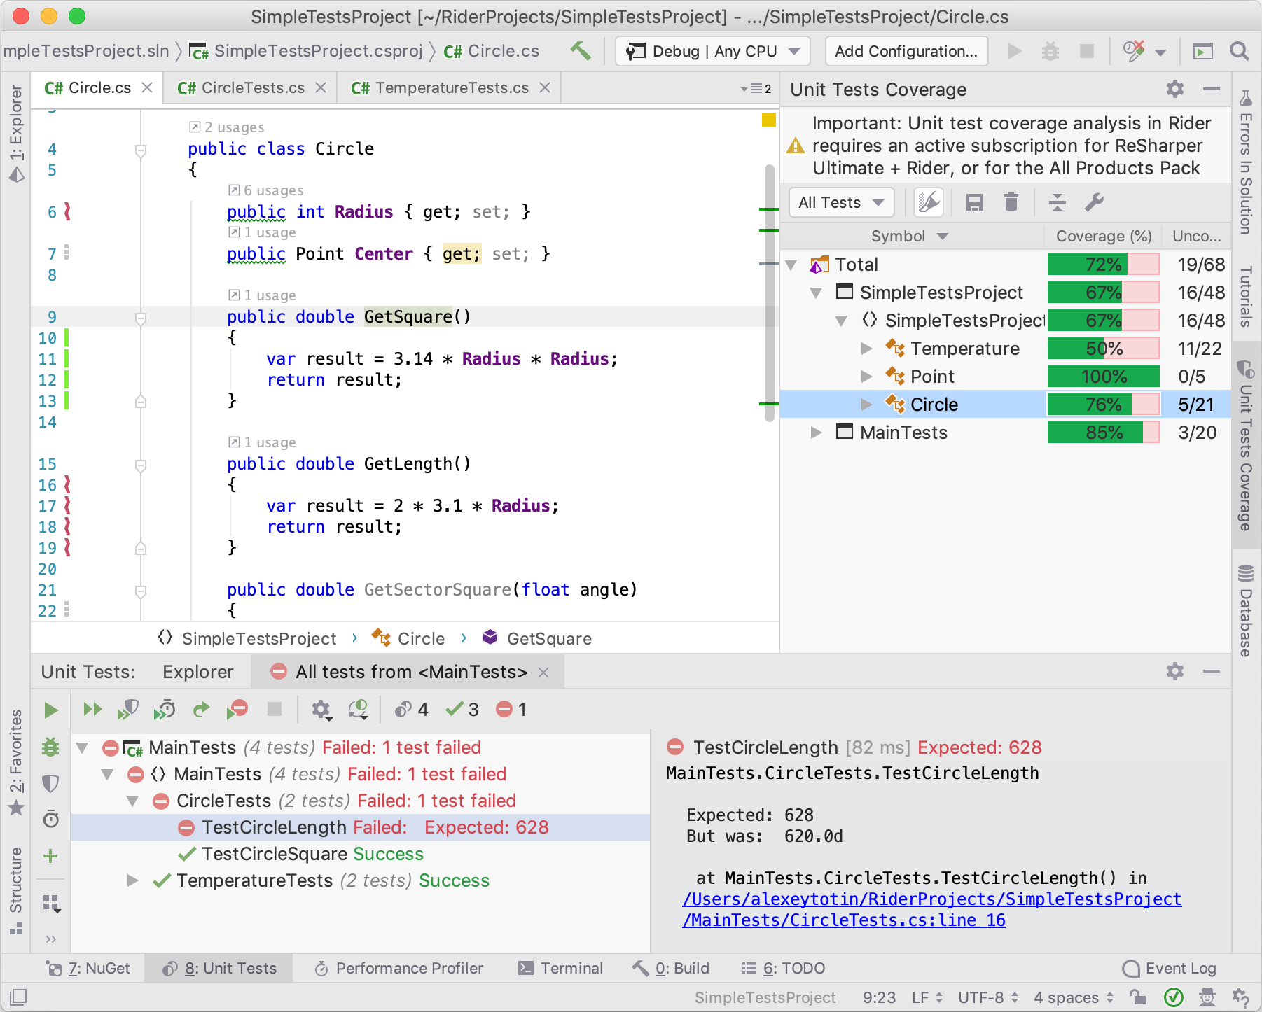
https://blog.jetbrains.com/dotnet/2019/04/10/code-coverage-macos-linux-rider-2019-1/

Slide 60
Exercise, use command line
Re-organize your project in order to respect dotnet project file structure, move you demo folder to « ./src/Demo »
Add a library project named « Fibonacci » using dotnet in the « ./src » directory
Add a project test « xunit » named « Fibonacci.Tests » using dotnet inside the « ./tests » directory
Create a solution file name « fibonacci.sln »
Reference the 3 projects inside .sln file, your project sould be organized like below :
fibonacci.sln
src/Fibonacci
src/Demo
tests/Fibonacci.Tests

Slide 61
Publish library to Nuget

Slide 62
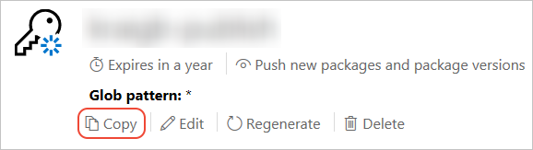
Publish to nuget.org
https://www.nuget.org/users/account/LogOn?returnUrl=%2F
https://docs.microsoft.com/fr-fr/nuget/nuget-org/publish-a-package?WT.mc_id=DOP-MVP-5003370#create-api-keys

Slide 63
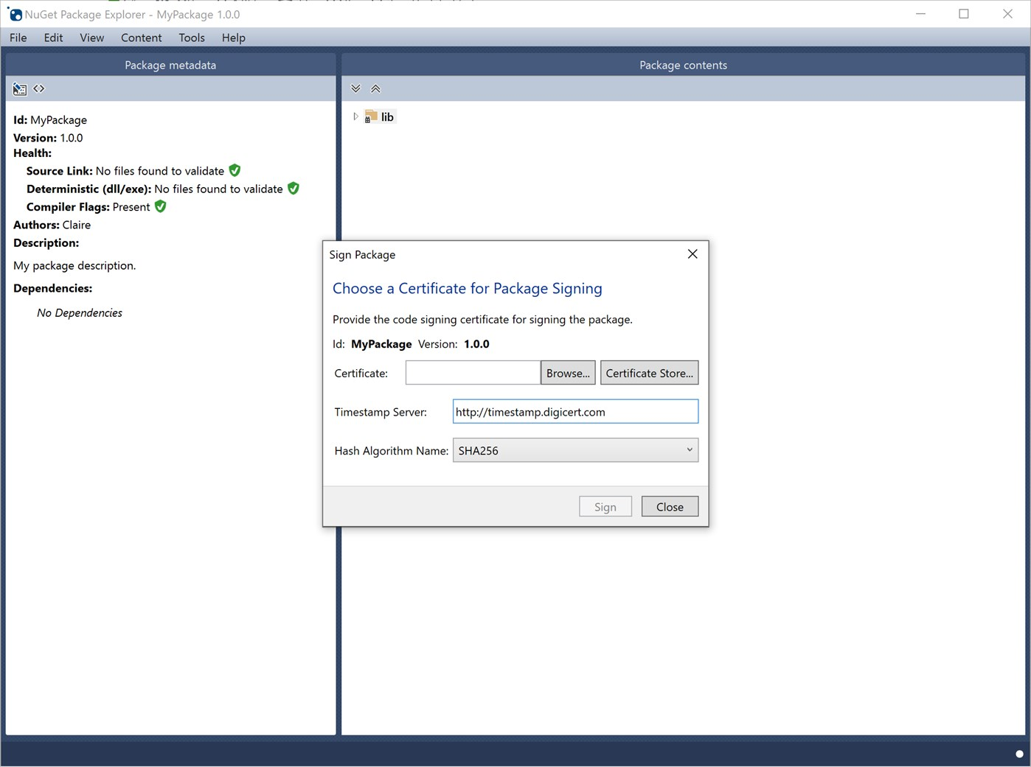
https://www.microsoft.com/fr-fr/p/nuget-package-explorer/9wzdncrdmdm3?activetab=pivot:overviewtab

Slide 64
dotnet pack .\src\Fibonacci\Fibonacci.csproj -p:PackageVersion=1.0.0
https://docs.microsoft.com/en-us/dotnet/core/tools/dotnet-pack?WT.mc_id=DOP-MVP-5003370

Slide 65
<Project Sdk="Microsoft.NET.Sdk"> <PropertyGroup> <TargetFramework>netstandard2.0</TargetFramework> <PackageId>Guillaume.Chervet.Fibonacci</PackageId> </PropertyGroup> </Project>
https://docs.microsoft.com/fr-fr/dotnet/core/tools/csproj?WT.mc_id=DOP-MVP-5003370

Slide 66
dotnet nuget push .\src\Fibonacci\bin\Debug\Guillaume.Chervet.Fibonacci.1.0.0.nupkg --api-key oy2kun6t2nkrn4fyax5qfdzvqidma3rujgsyax233ihz2y --source https://api.nuget.org/v3/index.json
https://docs.microsoft.com/fr-fr/nuget/nuget-org/publish-a-package?WT.mc_id=DOP-MVP-5003370

Slide 67
Consume package from Nuget

Slide 68
Add database

Slide 69
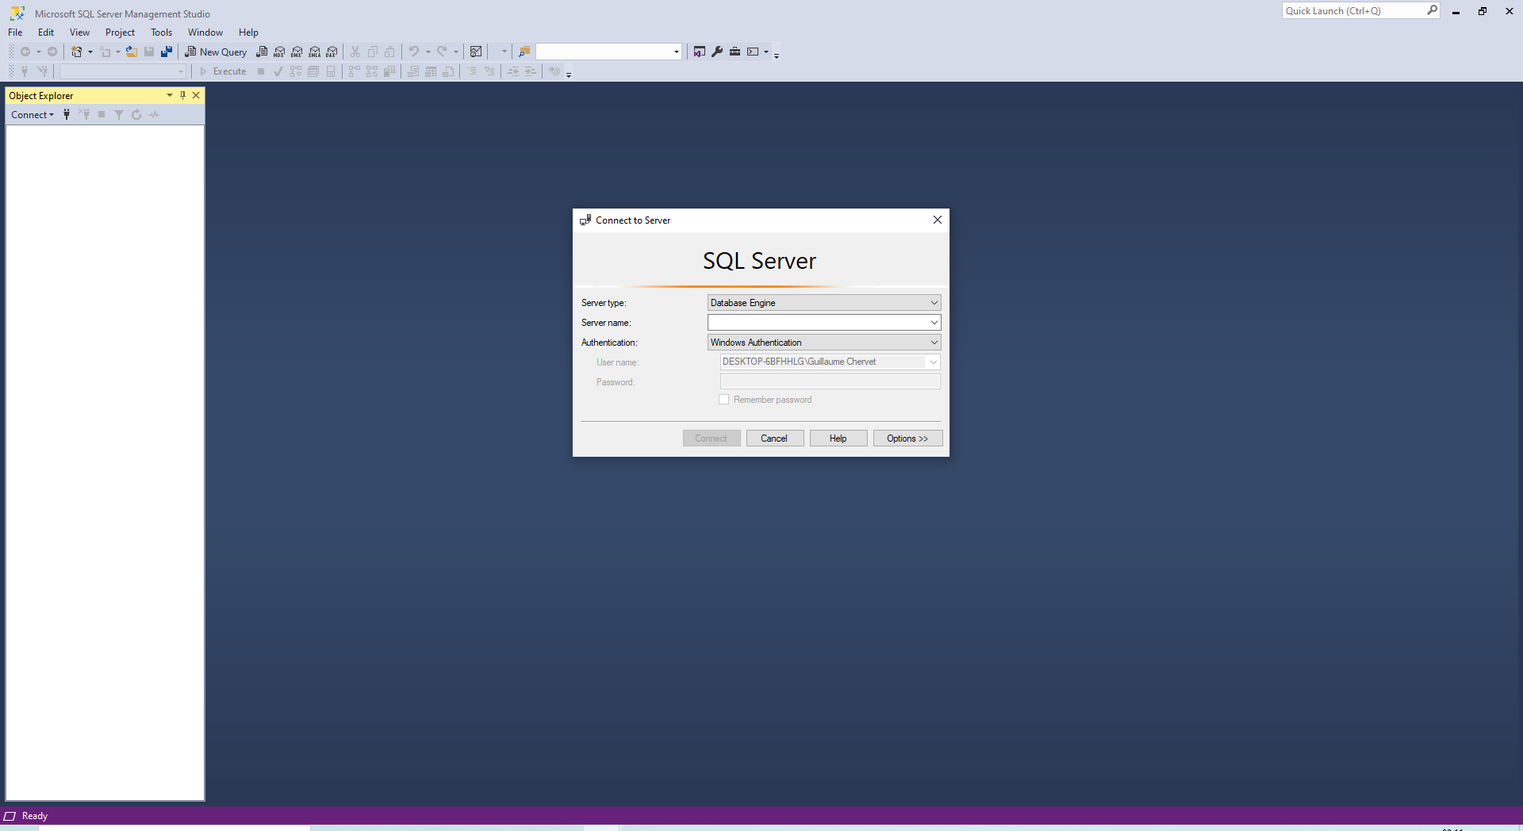
https://docs.microsoft.com/fr-fr/sql/ssms/download-sql-server-management-studio-ssms ?WT.mc_id=DOP-MVP-5003370

Slide 70
Continuous integration

Slide 71
Add web API

Slide 72
Add mobile/windows/linux application

Slide 73
csproj
<Project Sdk="Microsoft.NET.Sdk.Web"> <PropertyGroup> <TargetFramework>net5.0</TargetFramework> </PropertyGroup> </Project>

Slide 74
using System.Text.Json; using Microsoft.AspNetCore.Builder; using Microsoft.AspNetCore.Hosting; using Microsoft.AspNetCore.Http; using Microsoft.Extensions.Hosting; public class Program { public static void Main(string[] args) { CreateHostBuilder(args).Build().Run(); } public static IHostBuilder CreateHostBuilder(string[] args) { return Host.CreateDefaultBuilder(args) .ConfigureWebHostDefaults(webBuilder => { webBuilder.Configure(app => { app.UseRouting(); app.UseEndpoints(endpoints => { endpoints.MapGet("/users", async context => { await context.Response.WriteAsync( JsonSerializer.Serialize(new {Name = "James", Age = 10})); }); }); }); }); } }
https://twitter.com/davidfowl/status/1295792080216657921/photo/1

Slide 75
Exercise
Create a simple api using « dotnet new »
Run it
Remove redirection from HTTP to HTTPS for building a simpler docker
Create a dockerfile
Run your application from docker
docker build . –t web
docker run --it -p 5003:80 --rm web

