Slide 1

COURSE CODE/TITLE: CEF440/INTERNET PROGRAMMING(J2EE) AND MOBILE PROGRAMMING Topic: MOBILE APP DEVELOPMENT PROCESS Group 8
Instructor: dr. eng. nkemeni valery
Academic year:
2024/2025

Slide 2
INTRODUCTION
Definition:
Internet Programming (J2EE): Development of web-based applications using J2EE framework for scalable and secure enterprise applications.
Mobile Programming: Focuses on developing applications for mobile devices, employing various platforms and technologies.
Purpose of the Report:
To analyze types of mobile applications, programming languages, frameworks, and key aspects like architecture, requirement engineering, and cost estimation.

Slide 3
INTRODUCTION
Scope and Objectives:
Comparative analysis of mobile app types, programming languages, frameworks, architectures, requirement engineering techniques, and cost estimation.

Slide 4
Types of Mobile Apps
Native Apps:
Developed specifically for one platform (iOS or Android).
Optimized for performance and full access to device features.
Progressive Web Apps (PWAs):
Web applications that function like native apps using modern web technologies.
Can be installed on devices for offline use.

Slide 5
Types of Mobile Apps
Hybrid Apps:
Combine elements of native and web apps.
Built using web technologies but deployed as native apps.

Slide 6
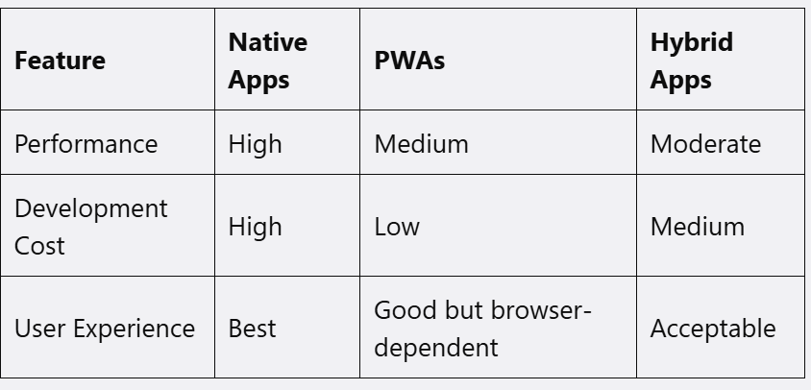
Comparative Analysis of Apps Types

Slide 7
Mobile App Programming Languages
Kotlin:
Statically typed, primarily for Android. Concise syntax, null safety.
Swift:
Statically typed, primarily for iOS. Modern syntax, strong performance.
JavaScript:
Dynamically typed. Used in mobile via frameworks like React Native. Versatile with a large ecosystem.
Dart:
Statically typed, used with Flutter for cross-platform development. Hot reload feature for faster development.

Slide 8
Mobile Apps Development Framework
Native (Swift/Kotlin): Best for high-performance apps needing deep hardware integration.
Flutter (Google): Cross-platform, customizable widgets, ideal for MVPs.
React Native (Meta): Enables cross-platform development with reusable code, good for social apps.
Xamarin (Microsoft): Uses C#, integrates well with Microsoft tools, suited for enterprise solutions.
Ionic (Web-Based): Utilizes web technologies, best for simple apps and PWAs.

Slide 9
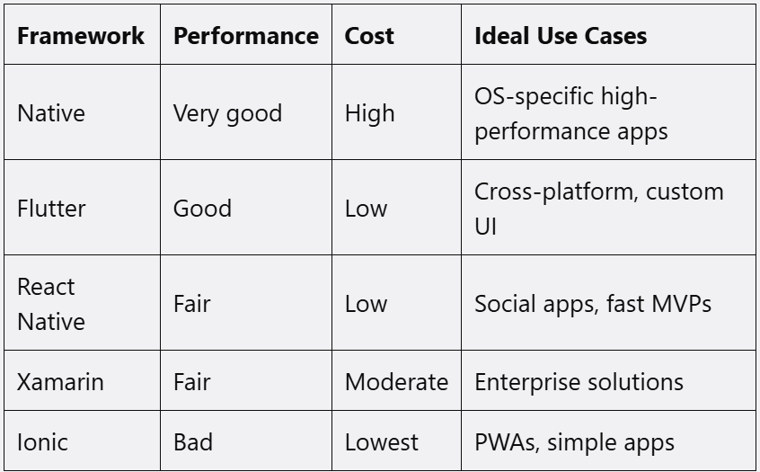
Comperative Analysis of Frameworks

Slide 10
Mobile Application Architecture
Common Architectures:
MVC (Model-View-Controller): Separates application into three components for organized code.
MVVM (Model-View-ViewModel): Reduces direct connection between View and Model, improving testability.
Clean Architecture: Separates concerns into distinct layers for scalability.

Slide 11
Mobile Application Architecture
Design Patterns:
Singleton Pattern: Ensures a single instance of a class.
Observer Pattern: Defines dependencies between objects; changes in one trigger updates in others.
Factory Pattern: Provides an interface for creating objects without specifying their exact classes.

Slide 12
Requirement Engineering for Mobile App
Methods for Collecting User Requirements:
Interviews: Direct discussions for deep insights.
Surveys: Cost-effective for large groups.
Prototyping: Early models for feedback.
Techniques for Analyzing Requirements:
Requirement Modeling: Visual representations of processes.
Card Sorting: Organizes features based on user input.

Slide 13
Requirement Engineering for Mobile App
Common Challenges:
Ambiguity in requirements, changing requirements, and communication barriers.

Slide 14
Mobile App Development Cost Estimation
Key Cost Factors:
Platform Selection: Native apps are costlier but offer better performance.
Feature Complexity: Basic features vs. advanced functionalities.
Design Requirements: UI/UX complexity impacts costs.
Estimation Models:
Feature-Based Breakdown: List features and assign hours.
Agile Estimation: Costs per sprint for iterative development.

Slide 15
Conclusion
Summary of Findings:
Native apps excel in performance; PWAs and hybrid apps offer cross-platform solutions.
Kotlin and Swift are preferred for native apps; JavaScript and Dart for cross-platform.
Proper architecture and requirement engineering are crucial for success.
Recommendations:
Choose native apps for performance, hybrid/PWAs for wider reach.
Implement MVVM or Clean Architecture for scalability

