Slide 1
第二堂社課

Slide 2
Program Structure
A class consists of:
– The class name. Class names begin with a capital letter.
– The body of the class surrounded with braces { …}
— Data (called fields)
— Operations (called methods)

Slide 3
Java Packages
A package provides a namespace for the class.
– This is a folder in which the class will be saved.
– The folder name (the package) is used to uniquely identify the class.
– Package names begin with a lowercase letter.

Slide 4
The main Method
It is a special method that the JVM recognizes as the
starting point for every Java program.
It surrounds the entire body with braces { }.

Slide 5
Output

Slide 6
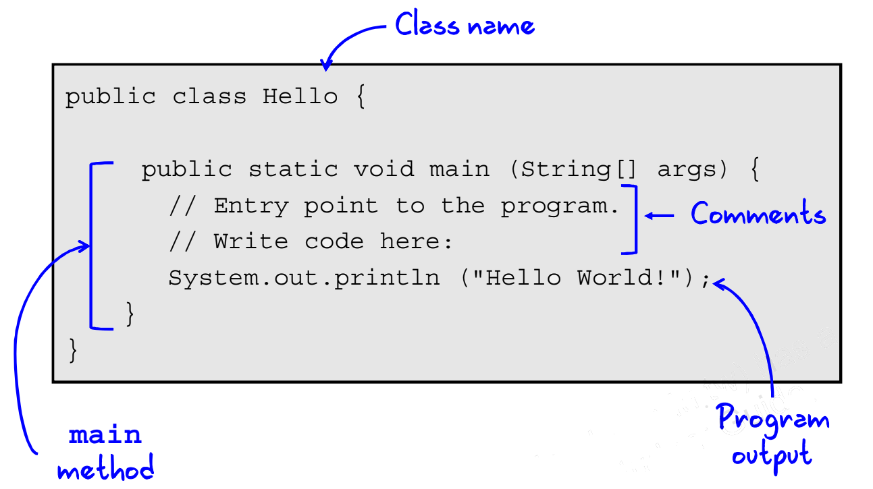
Overview Structure

Slide 7
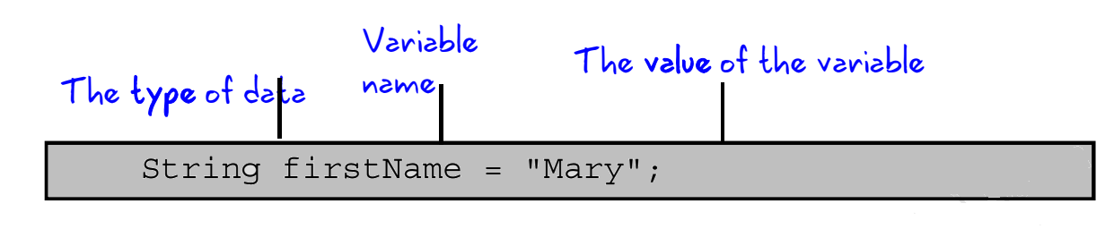
Variables
• A variable refers to something that can change.
– Variables can be initiated with a value.
– The value can be changed.
– A variable holds a specific type of data.

Slide 8
Variable Types
Some of the types of values a variable can hold:
– String (example: "Hello")
– int (examples: -10, 0, 2, 10000)
– double (examples: 2.00, 99.99, -2042.09)
– boolean (true or false)
– If uninitialized, variables have a default value:
– String: null
– int: 0
– double: 0.0
– boolean: false

Slide 9
Naming a Variable
Guidelines:
• Begin each variable with a lowercase letter. Subsequent
words should be capitalized:
– myVariable
• Names are case-sensitive.
• Names cannot include white space.
• Choose names that are mnemonic and that indicate to the
casual observer the intent of the variable.
– outOfStock (a boolean)
– itemDescription (a String)

Slide 10
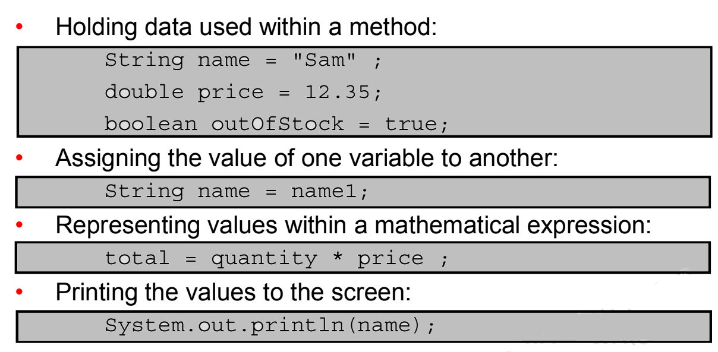
Uses of Variables

Slide 11
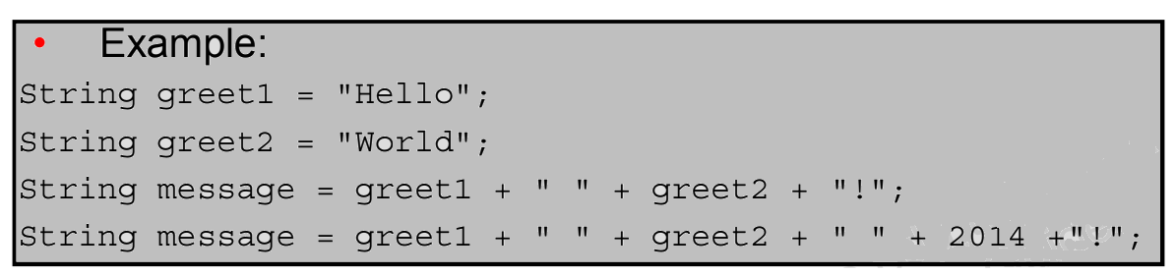
String Concatenation
• String variables can be combined using the '+' operator.
– stringVariable1 + stringVariable2
– stringVariable1 + "String literal"
– stringVariable1 + "String literal" +stringVariable2

Slide 12
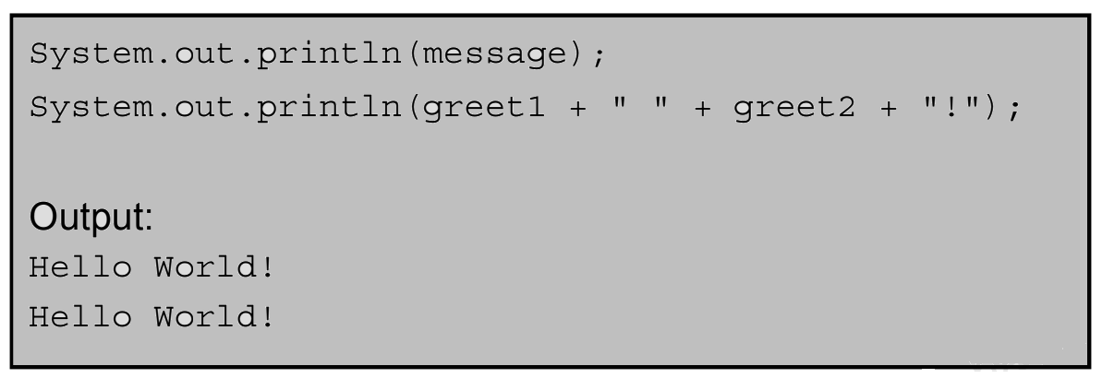
String Concatenation Output
You can concatenate String variables within a method call:

Slide 13
Increment and Decrement Operators (++ and --)
The long way:
age = age + 1;
count = count – 1;
The short way:
age++;
count--;

Slide 14
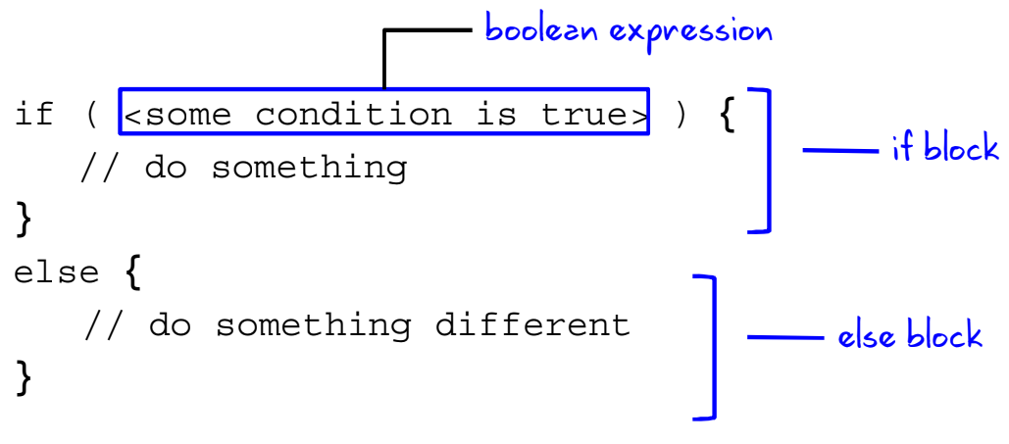
The if/else Statement

Slide 15
Boolean Expressions
A boolean expression is a combination of variables, values,and operators that evaluate to true or false.
• length > 10;
• size <= maxSize;
• total == (cost * price);
• weight != 70;

Slide 16
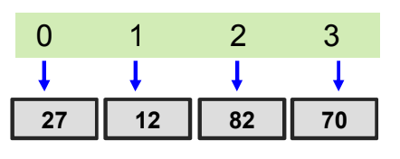
Arrays
• An array is an indexed container that holds a set of values
of a single type.
• Each item in an array is called an element.
• Each element is accessed by its numerical index.
• The index of the first element is 0 (zero).
– A four-element array has indices: 0, 1, 2, 3.

Slide 17
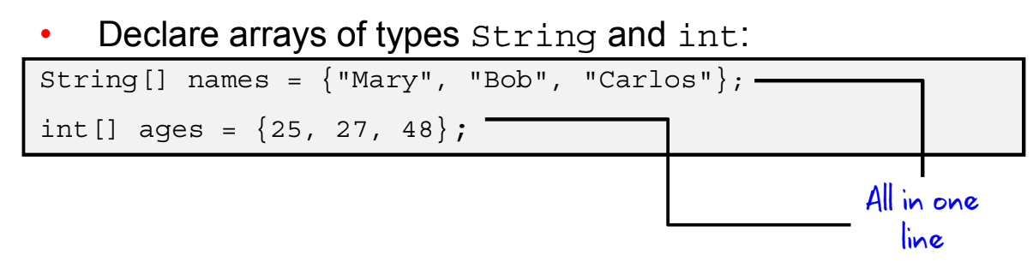
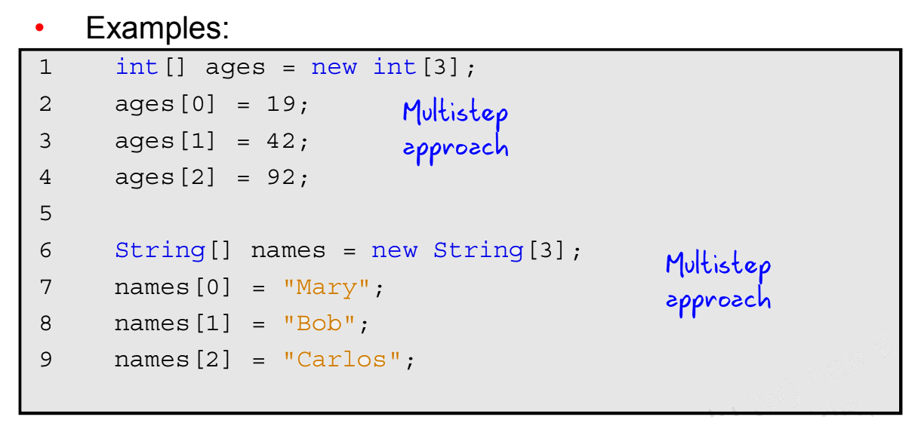
Declaring and Initializing an Array

Slide 18
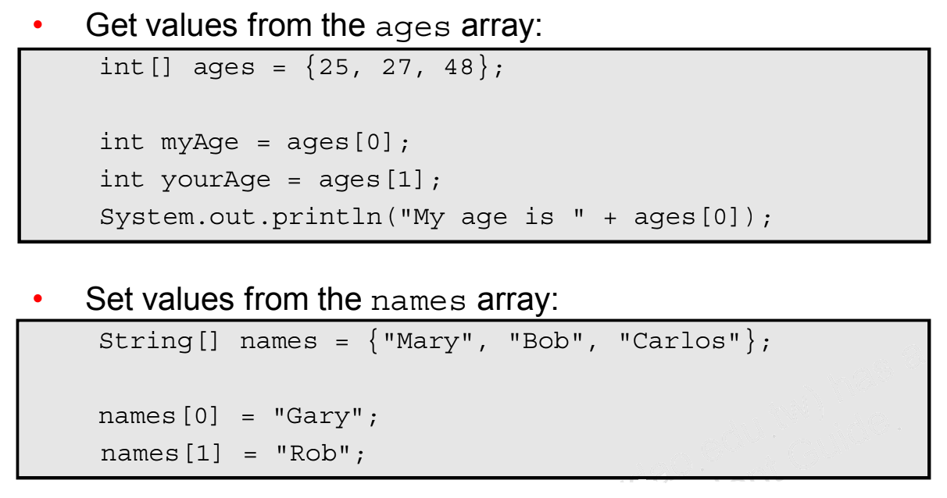
Accessing Array Elements

