Slide 1
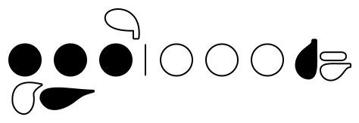
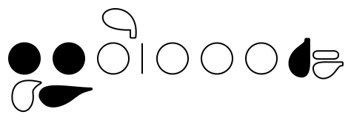
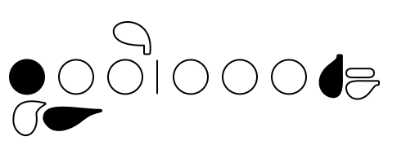
Flute
Hot Cross Buns, Concert G
Fingering Diagram
G
A
B

Slide 2
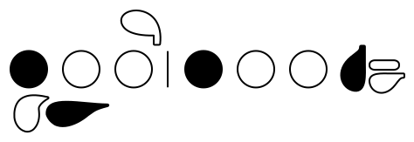
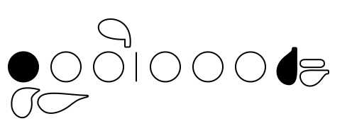
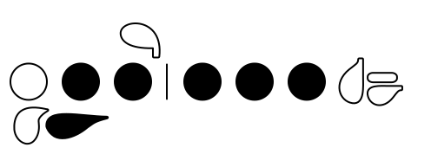
Flute
Hot Cross Buns, Concert Bb
Fingering Diagram
Bb
C
D

Slide 3
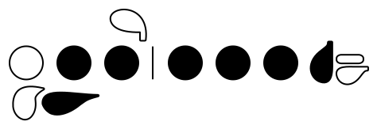
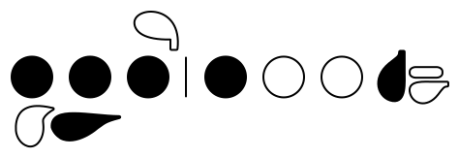
Flute
Hot Cross Buns, Concert Eb
Fingering Diagram
Eb
F
G

Slide 4
Flute
Hot Cross Buns, Concert F
Fingering Diagram
F
G
A

Slide 5
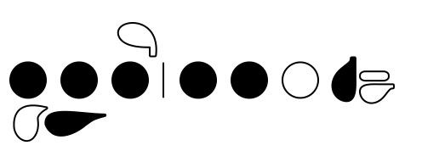
Flute
Rain, Rain - Concert G
Fingering Diagram
B
D
E

Slide 6
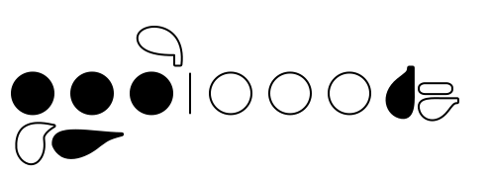
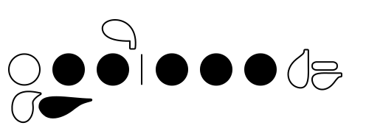
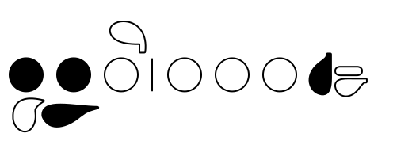
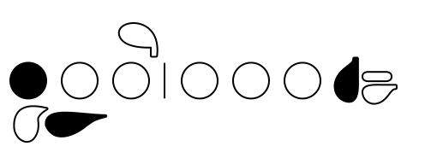
Flute
Concert G Pentatonic Scale
Fingering Diagram
G
D
A
E
B

Slide 7
Flute
Concert Bb Major Scale
Fingering Diagram
Bb
C
D
Eb
F
G
A

Slide 8
Flute
D!
Fingering Diagram
D

