Slide 1
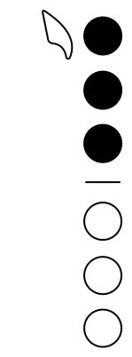
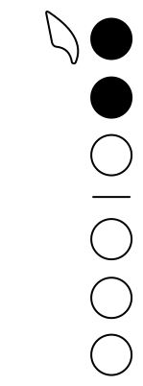
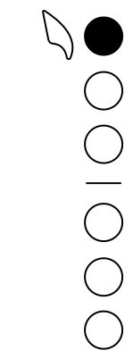
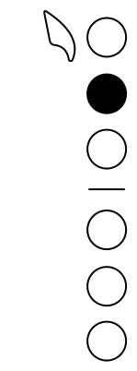




Saxophone
Concert Bb Major Scale
Fingering Diagram
G
A
B
C
D
E
F#
G

Slide 2
Saxophone
Hot Cross Buns, Concert Bb
Fingering Diagram
G
A
B

Slide 3
Saxophone
Hot Cross Buns, Concert Eb
Fingering Diagram
C
D
E

Slide 4
Saxophone
Hot Cross Buns, Concert F
Fingering Diagram
D
E
F#

Slide 5
Saxophone
Rain, Rain - Concert Bb
Fingering Diagram
B
D
E

Slide 6

Saxophone
Rain, Rain - Concert Eb
Fingering Diagram
E
G
A

Slide 7
Saxophone
Concert Bb Major Pentatonic Scale
Fingering Diagram
G
A
B
D
E

Slide 8
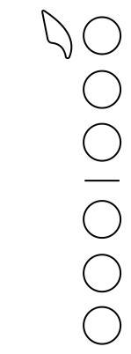
Saxophone
C#
Fingering Diagram
C#

