Slide 1
HOS UDW2P Converter
NWT JIP
Xu Haihua, Harrif Santo, Law Yun Zhi, Prof. Allan Magee
Technology Centre for Offshore and Marine, Singapore
Notes:
The data are solved in folder: D:\WP1\potentialFlowCompare
The python scripts are:
1 - Compare_Regular_Wave_v2.ipynb
2 - Compare_Irregular_Wave.ipynb

Slide 2
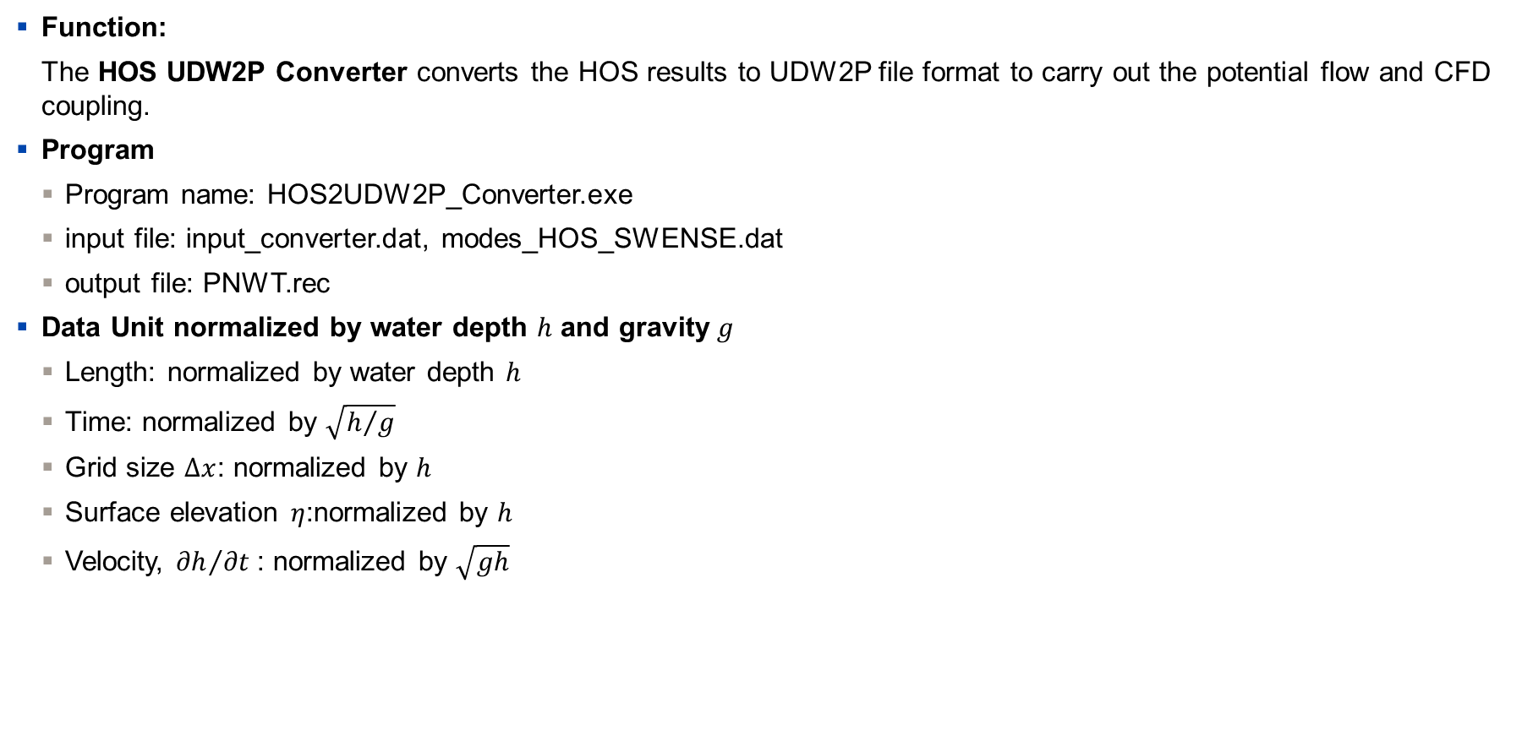
Sketch of Domain for HOS and UDW2P
Function:
The HOS UDW2P Converter converts the HOS results to UDW2P file format to carry out the potential flow and CFD coupling.
Program
Program name: HOS2UDW2P_Converter.exe
input file: input_converter.dat, modes_HOS_SWENSE.dat
output file: PNWT.rec
Data Unit normalized by water depth $h$ and gravity$g$
Length: normalized by water depth $h$
Time: normalized by $\sqrt{h/g}$
Grid size $Δx$: normalized by $h$
Surface elevation $η$:normalized by $h$
Velocity, ${∂h}/{∂t}$: normalized by $\sqrt{gh}$
UDW2P Left BC
(xmin)
UDW2P Right BC
(xmax)
HOS Right BC
(Periodic)
HOS Left BC
(Periodic)
UDW2P Domain
Wave From right BC
Wave to left BC
HOS Domain
: HOS Domain
Fig 1. Sketch of Domain for HOS and UDW2P
: UDW2P

Slide 3
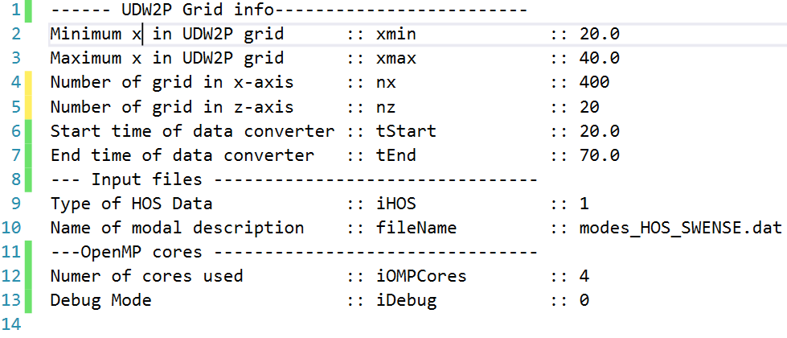
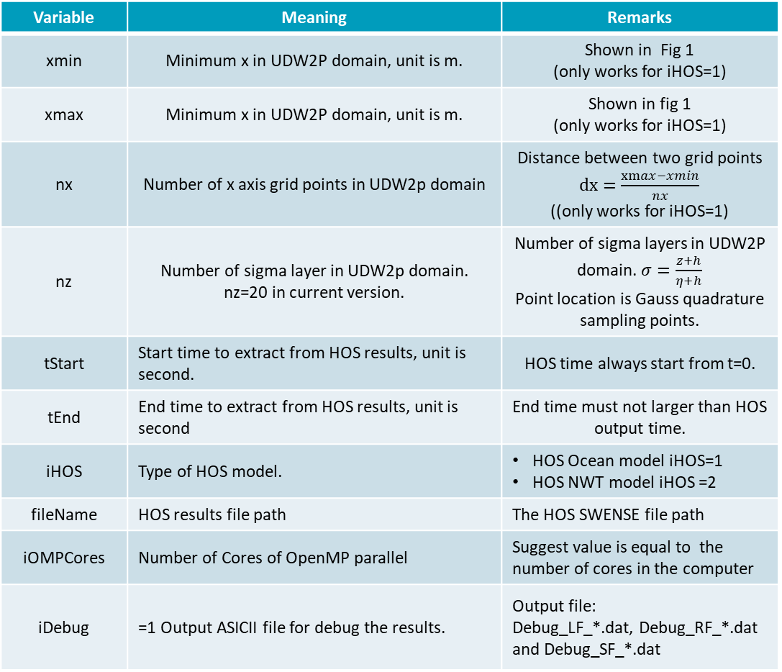
“input_converter.dat”
Variable | Meaning | Remarks
xmin | Minimum x in UDW2P domain, unit is m. | Shown in Fig 1 (only works for iHOS=1)
xmax | Minimum x in UDW2P domain, unit is m. | Shown in fig 1 (only works for iHOS=1)
nx | Number of x axis grid points in UDW2p domain | Distance between two grid points $dx=\frac{xmax−xmin}{nx}$ ((only works for iHOS=1)
nz | Number of sigma layer in UDW2p domain. nz=20 in current version. | Number of sigma layers in UDW2P domain. $σ=\frac{z+h}{η+h}$ Point location is Gauss quadrature sampling points.
tStart | Start time to extract from HOS results, unit is second. | HOS time always start from t=0.
tEnd | End time to extract from HOS results, unit is second | End time must not larger than HOS output time.
iHOS | Type of HOS model. | HOS Ocean model iHOS=1 HOS NWT model iHOS =2
fileName | HOS results file path | The HOS SWENSE file path
iOMPCores | Number of Cores of OpenMP parallel | Suggest value is equal to the number of cores in the computer
iDebug | =1 Output ASICII file for debug the results. | Output file: Debug_LF_*.dat, Debug_RF_*.dat and Debug_SF_*.dat

Slide 4
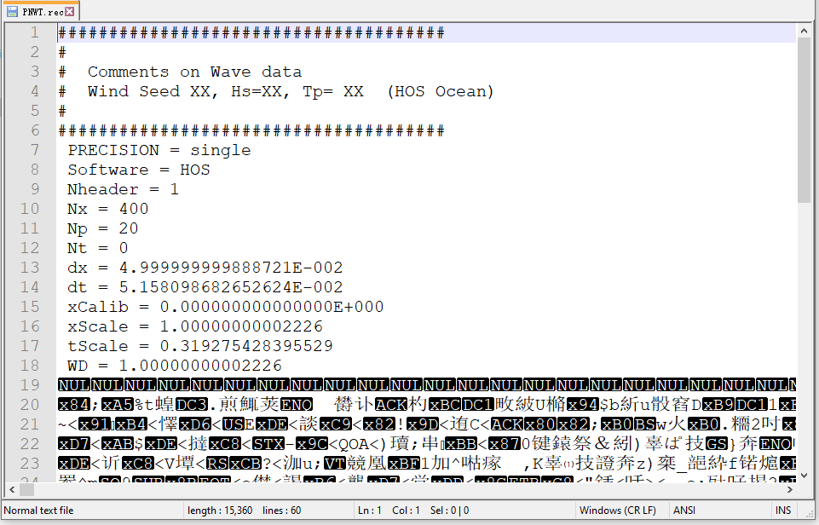
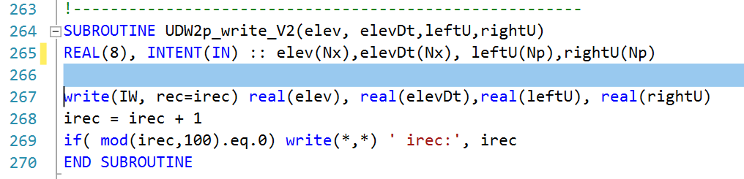

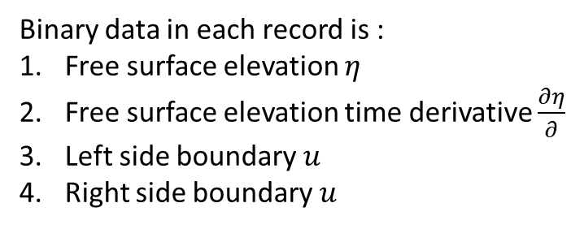

“PNWT.rec” file format
Binary data in each record is :
Free surface elevation $η$
Free surface elevation time derivative $\frac{∂η}{∂}$
Left side boundary $u$
Right side boundary $u$
Software change to HOS
ASCII data
Related Fortran subroutine
xCalib unknown, set to 0
xScale is water depth $h$, hence WD=h is 1
tScale =$\sqrt{gh}$
Binary data
Reference from NWT JIP

Slide 5
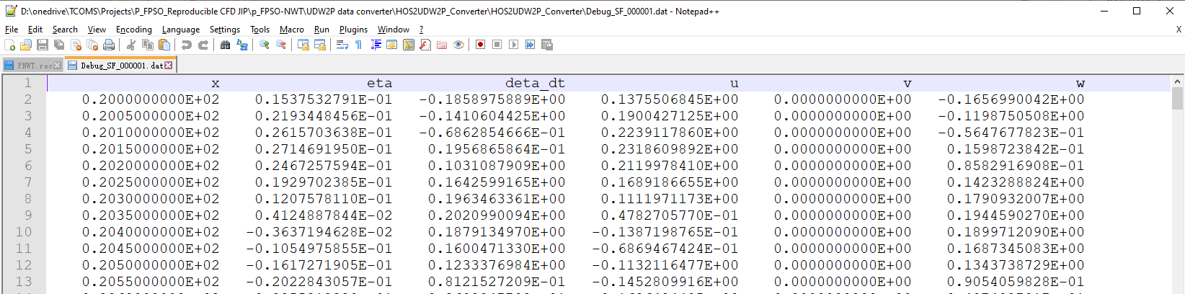
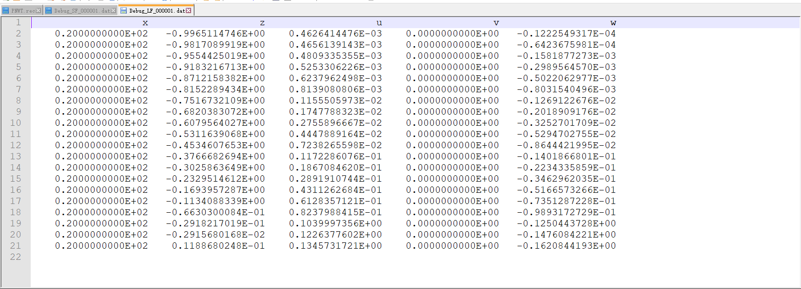
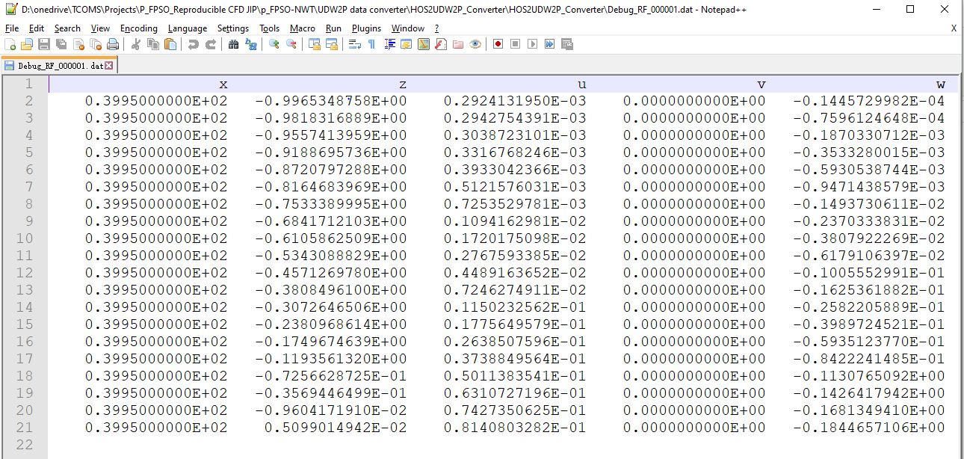
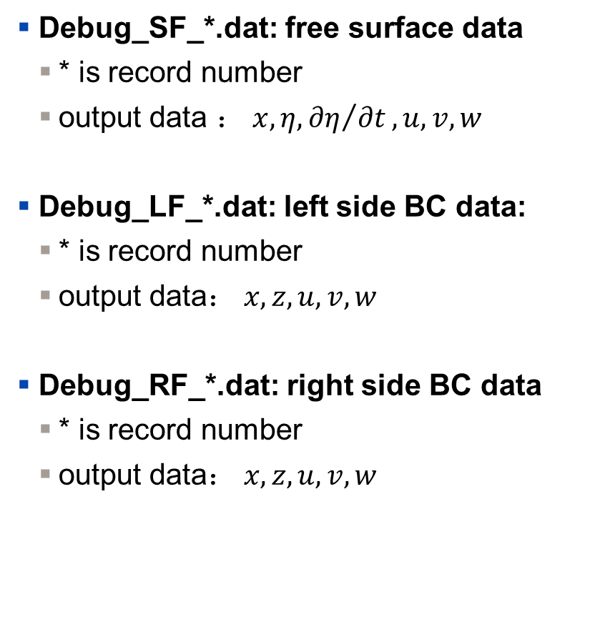
Debug file data
Debug_SF_*.dat: free surface data
* is record number
output data ：$x,η,{∂η}/{∂t},u,v,w$
Debug_LF_*.dat: left side BC data:
* is record number
output data：$x,z,u,v,w$
Debug_RF_*.dat: right side BC data
* is record number
output data：$x,z,u,v,w$

Slide 6
Benchmark data
Wave Parameters
Case | Case #2
Wave Height H (m) | 0.05
Depth D (m) | 1
Wave Length λ (m) | 1
Wave Period T (s) | 0.79049
Wave steepness H/λ | 5%
Domain Length L (m) | 60m
Simulation Time | 80s
HOS Left BC
(Periodic)
HOS Right BC
(Periodic)
UDW2P Domain
Wave From right BC
Wave to left BC
H=1.0m
L=60m
HOS Domain

Slide 7
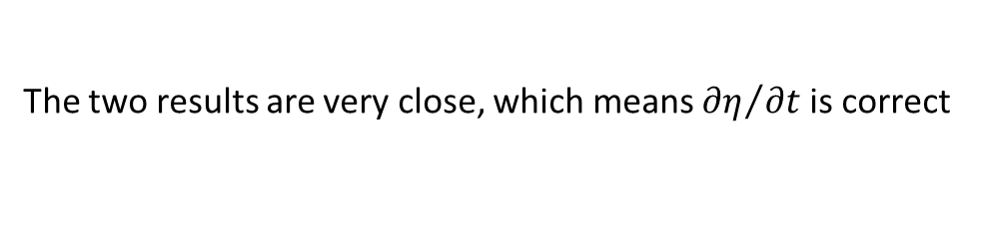
Compare ${∂η}/{∂t}$ with $w+u{∂η}/{∂x}$ at T=20s
The two results are very close, which means ${∂η}/{∂t}$ is correct

