Slide 1
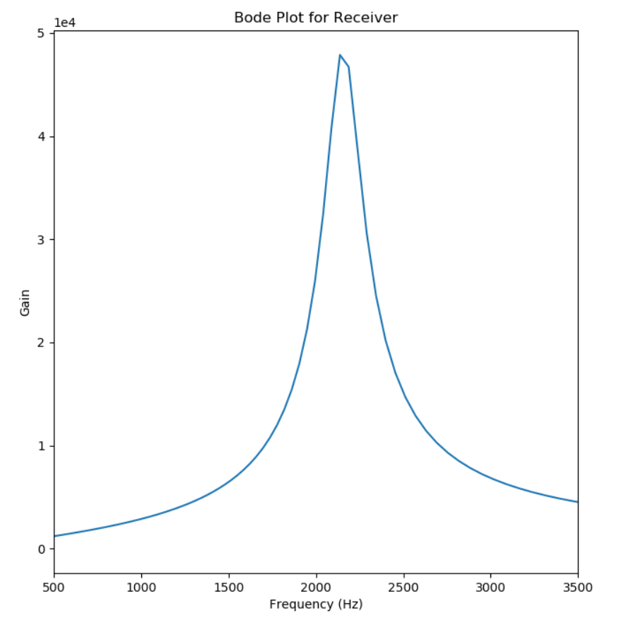
Receiver
Peak at 2138 kHz
Maximum Gain = 4784.0 (93.6 dB)

Slide 2
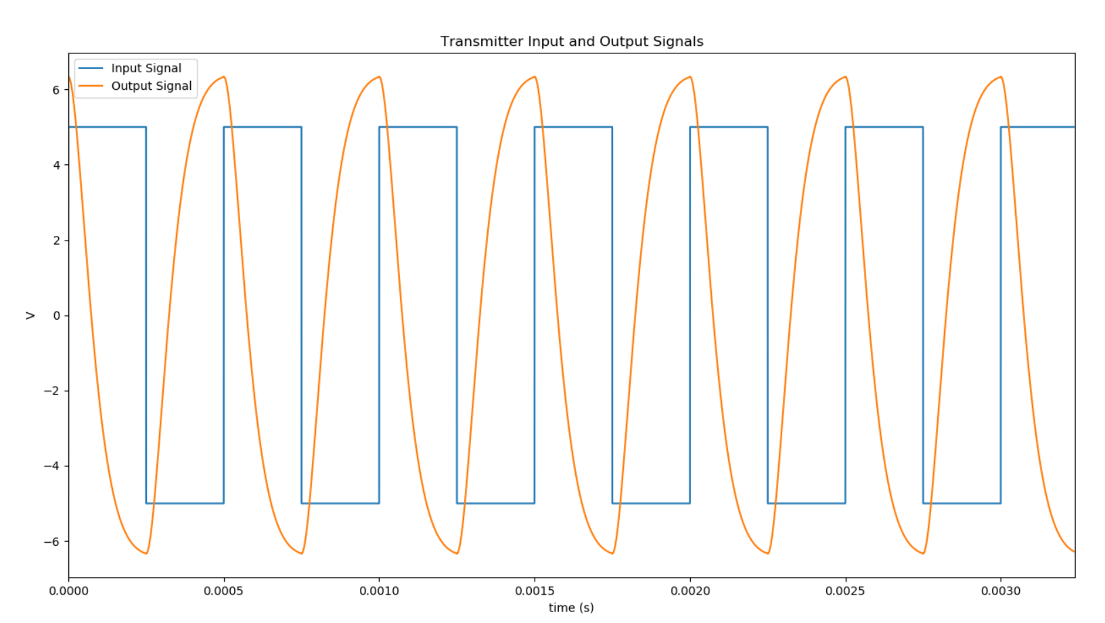
Transmitter
Used a 2KHz, 5V square wave as an input and received a smoothed inverted output with the same frequency.

