Slide 1

Notes:
Slide 1: Title [Title]
Up from 9:00 while people arrive.
Nothing to say. Greet people individually, get names, and notice who looks nervous about the laptop. Those are the ones you check on first at 10:40.

Slide 2
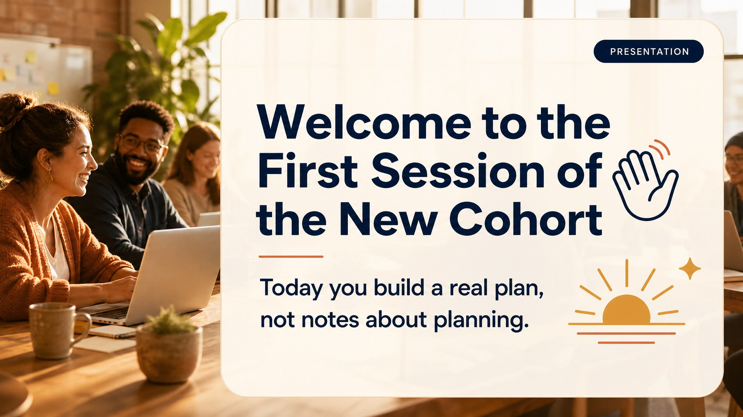
Notes:
Slide 2: Welcome [Presentation]
*Presentation.* 9:30. Official start.
Welcome. Some of you I know, some I am meeting today. Here is the one thing to understand before we start: you are not here to take notes about marketing. You are here to build a plan. At five o'clock you walk out with a 90-day campaign that has real dates on it.
Ninety seconds. The energy is "let's get to work," not "let me introduce myself."

Slide 3
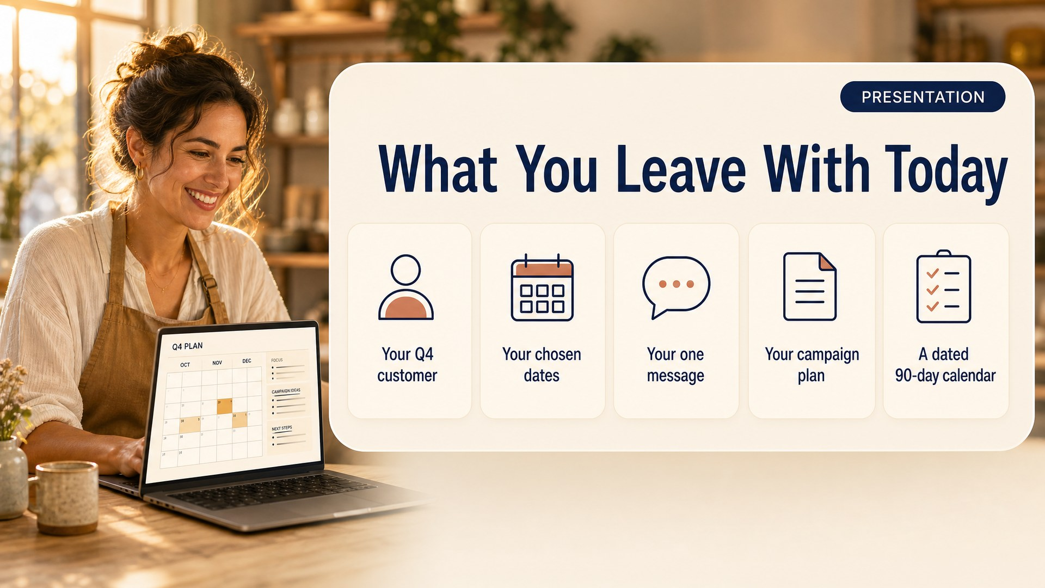
Notes:
Slide 3: What You Leave With [Presentation]
*Presentation.* 9:33.
Five things. Your Q4 customer, who is a different person than your normal customer. Your dates, three to five, picked on purpose. One message that carries all ninety days. Your campaign plan. And a dated calendar running to December 31.
Say the boundary plainly here, once:
We are not making flyers or videos today. That is a later session. Today is the harder half, the thinking and the plan. Anyone can make a flyer in twenty minutes once they know what it needs to say and when it needs to go out. Almost nobody can do this part.
That framing matters. Said well, nobody feels shortchanged.

Slide 4
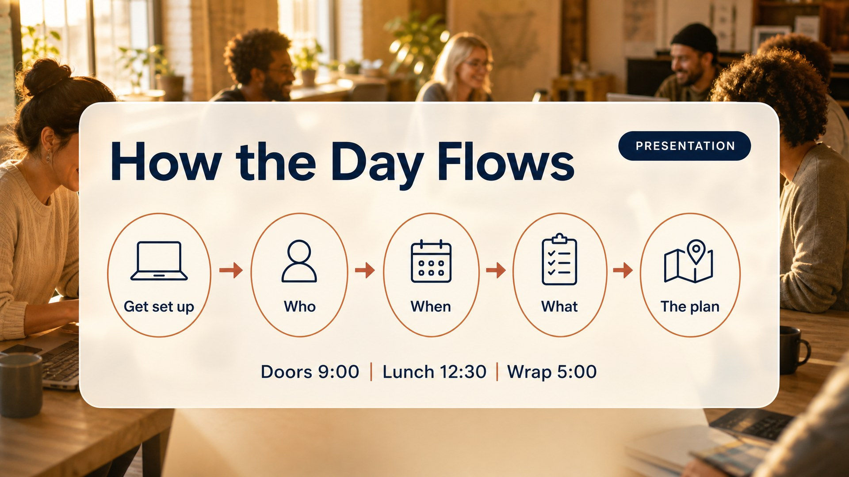
Notes:
Slide 4: How the Day Flows [Presentation]
*Presentation.* 9:36.
Five steps. Get set up, then four questions. Who are you selling to. When will you sell. What is the offer. Then the plan. That is the day, and it is the page you are about to open.
Put the hub URL on screen and have everyone open it. Say plainly: this website is the day. When I say Module 2, that is what I mean.
Then pair them. They use this partner three times: Share Out, Say It Out Loud, and trading plans at the close.

Slide 5
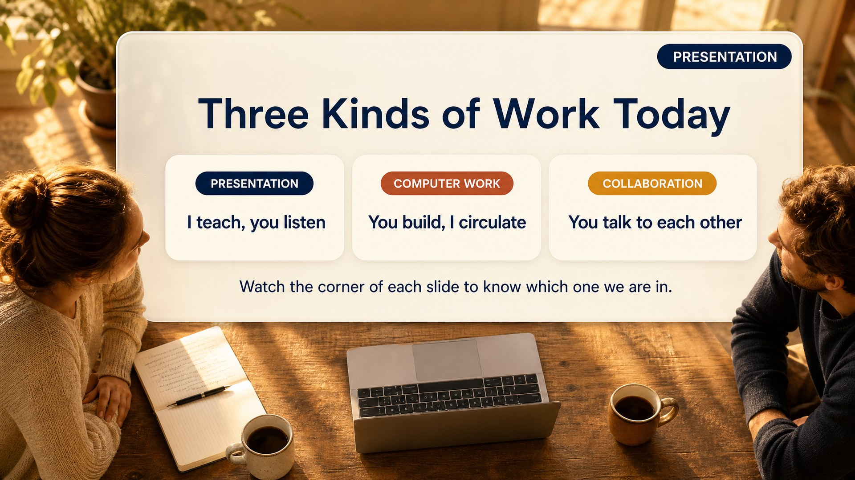
Notes:
Slide 5: Three Modes [Presentation]
*Presentation.* 9:40.
Today is three kinds of work and they need different things from you. Navy in the corner means I am talking and you can close the laptop. Terracotta means you are building and I am walking the room. Amber means laptops down, turn to a person. Watch the corner of every slide and you will always know which one we are in.
Worth thirty seconds and it saves you all day. You never again have to say "okay, laptops down."
---

Slide 6
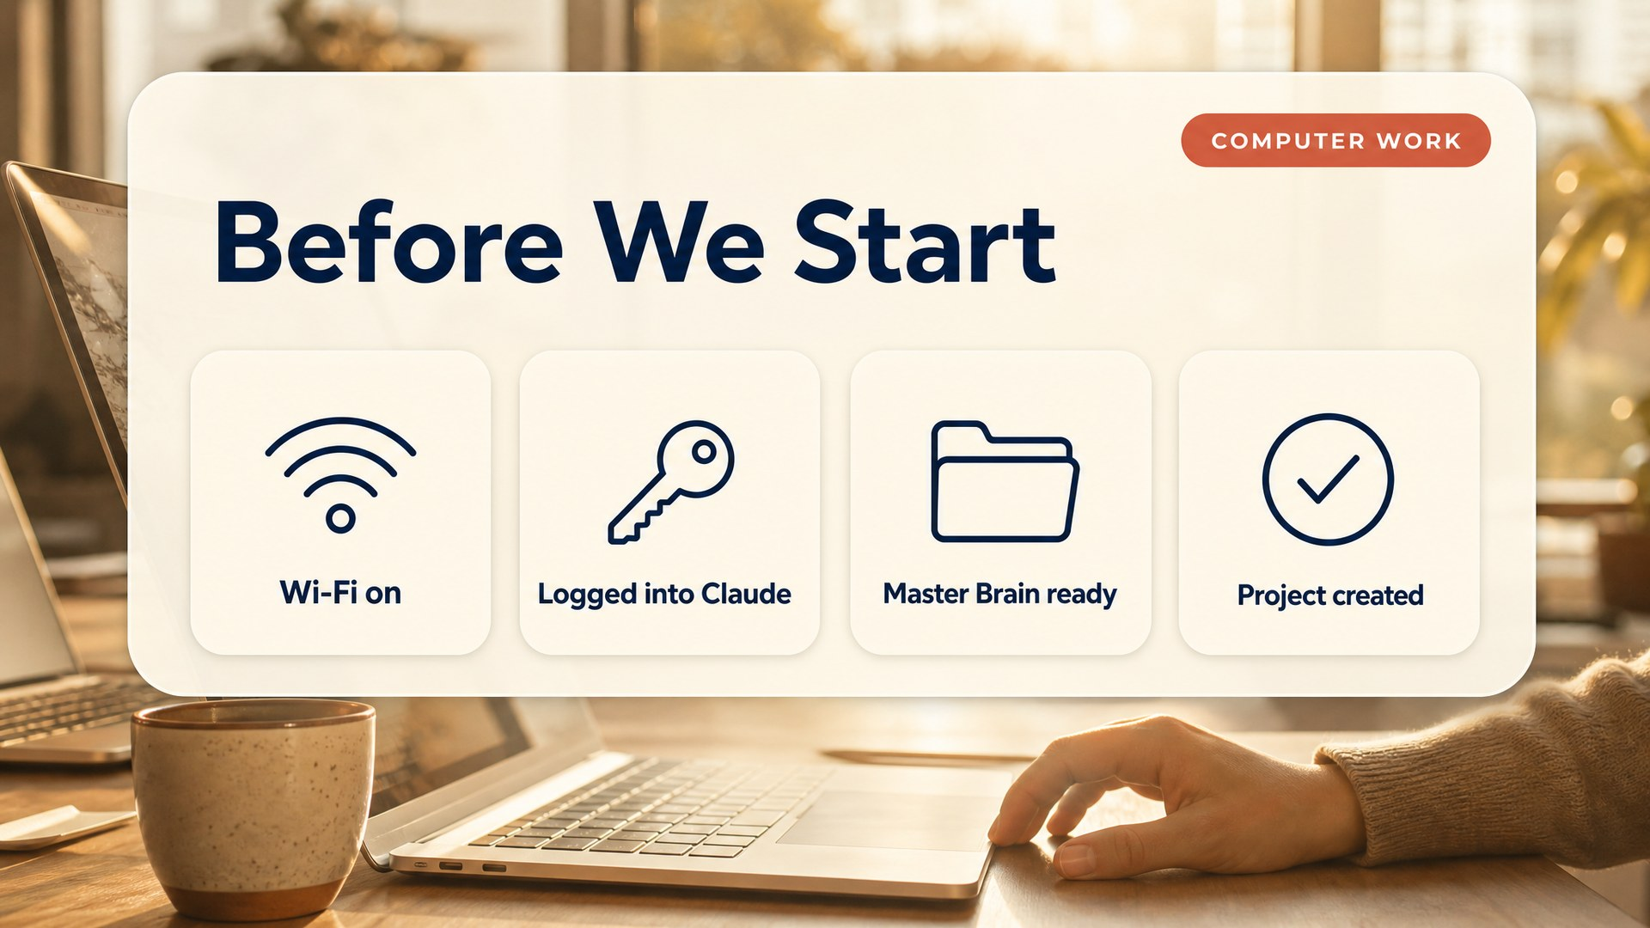
Notes:
Slide 6: Before We Start [Computer work]
*Computer work.* Flip to this at 9:10, the moment the second person sits down.
Four things before anything else. Wi-Fi on. Logged into Claude. Your Master Brain where you can reach it. And a project created called My 90-Day Campaign. If any of those is not true, hand up now, not at eleven.
This is the most important half hour of your day. Walk the room and physically look at screens. Do not ask "is everyone set?" because people say yes.
The one to demo on the projector, slowly, once: creating the Claude Project and uploading the Master Brain. Most have never made one. Name it exactly "My 90-Day Campaign" so that when you say it later, everyone knows what you mean.
Anyone without a Master Brain goes to Module 00b. Announce it to the whole room so nobody has to admit it.

Slide 7
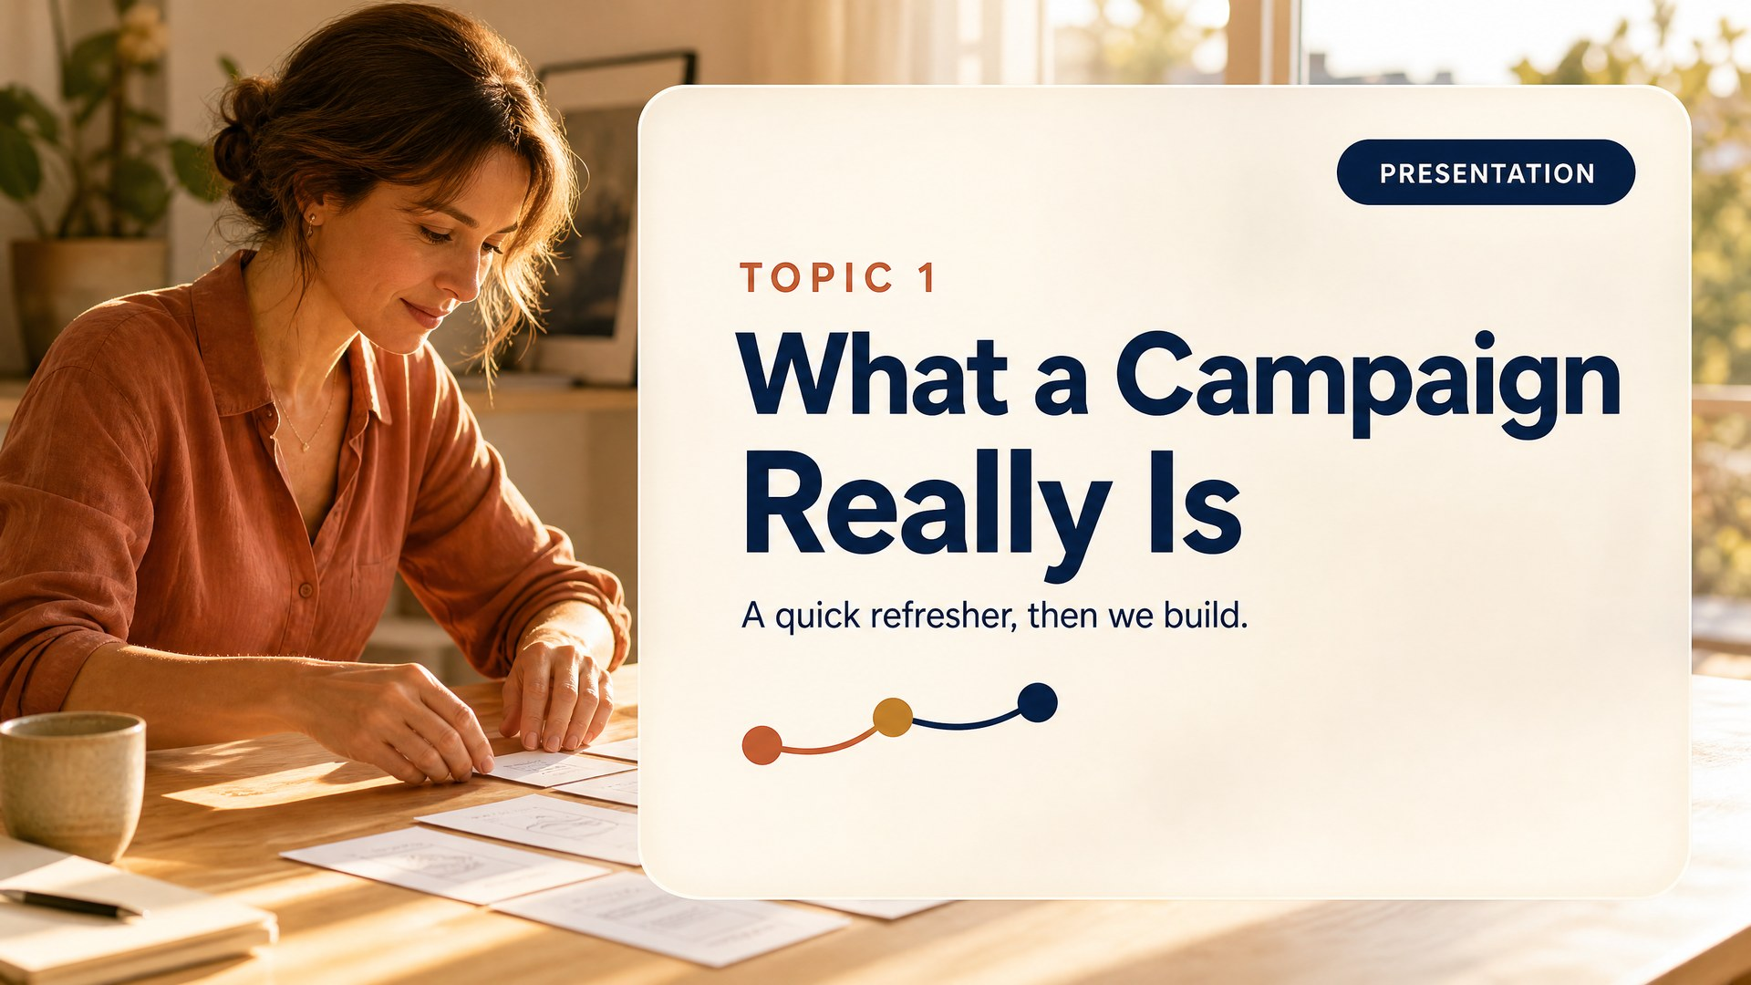
Notes:
Slide 7: T1 Divider [Presentation]
*Presentation.* 9:45.
Quick refresher, then you are working.

Slide 8
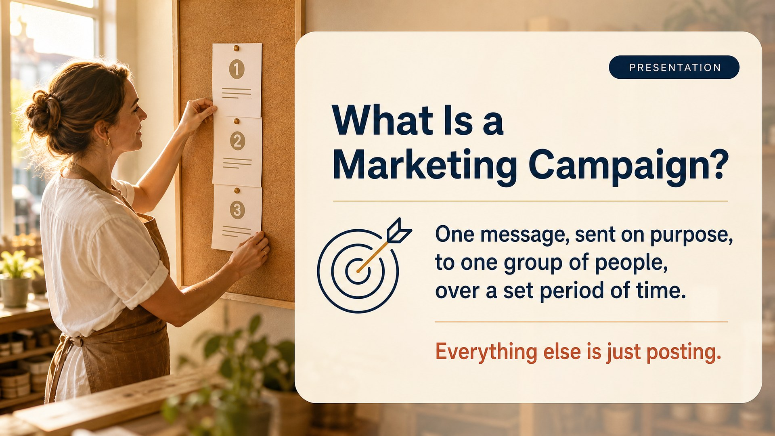
Notes:
Slide 8: What Is a Campaign [Presentation]
*Presentation.* 9:47.
One message, sent on purpose, to one group of people, over a set period of time. That is it. Everything else is just posting.
Let them read it twice. Then ask the room: "honestly, how many of us have been posting rather than running campaigns?" Hands go up. That admission is what makes the day land.

Slide 9
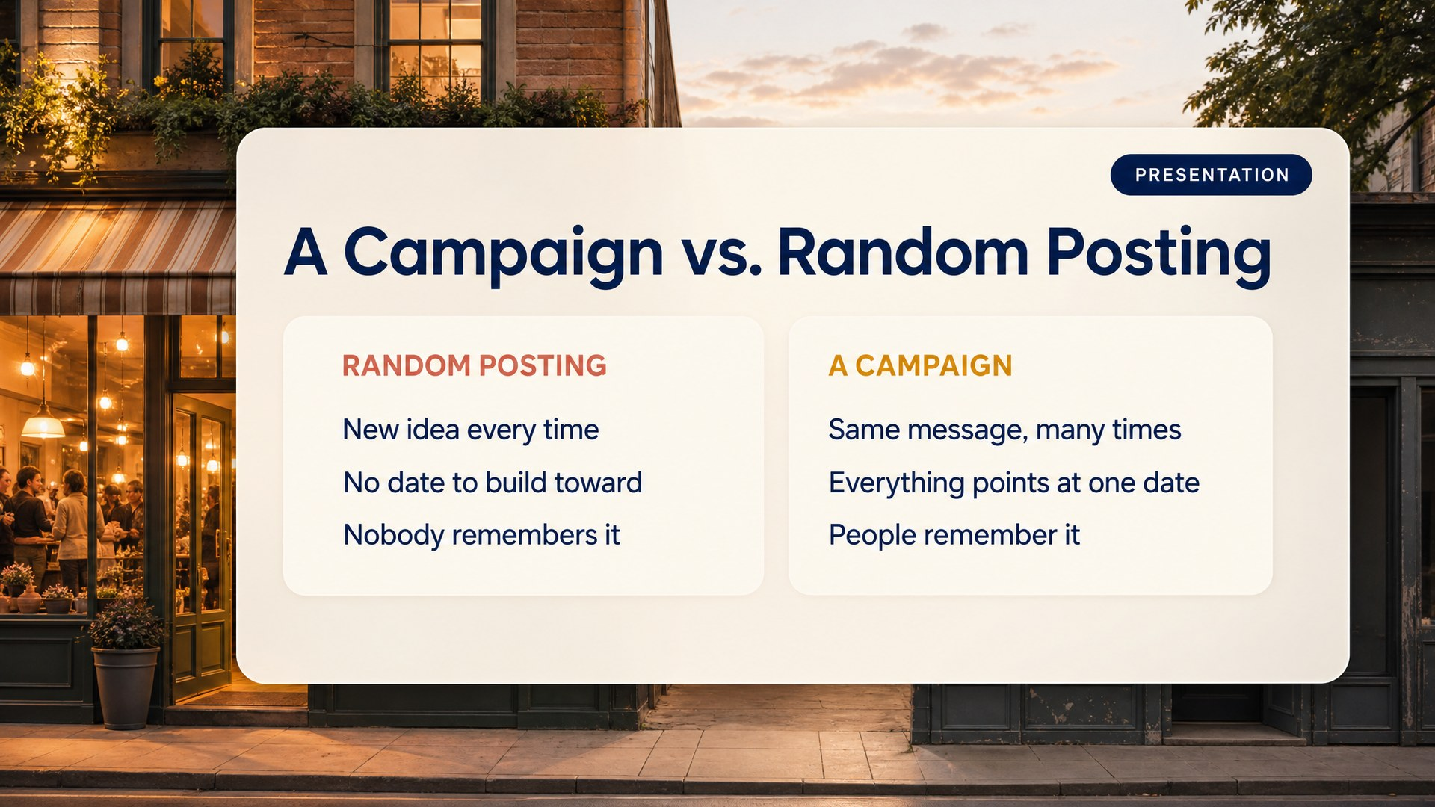
Notes:
Slide 9: Campaign vs Posting [Presentation]
*Presentation.* 9:52.
On the left is what most of us do. New idea every time you sit down. Nothing to build toward. And the honest result, nobody remembers it. On the right is a campaign. Same message, many times. Everything pointing at one date. People remember it, because repetition is what memory is made of.
Your strongest teaching slide. If you nail one before lunch, nail this one.

Slide 10
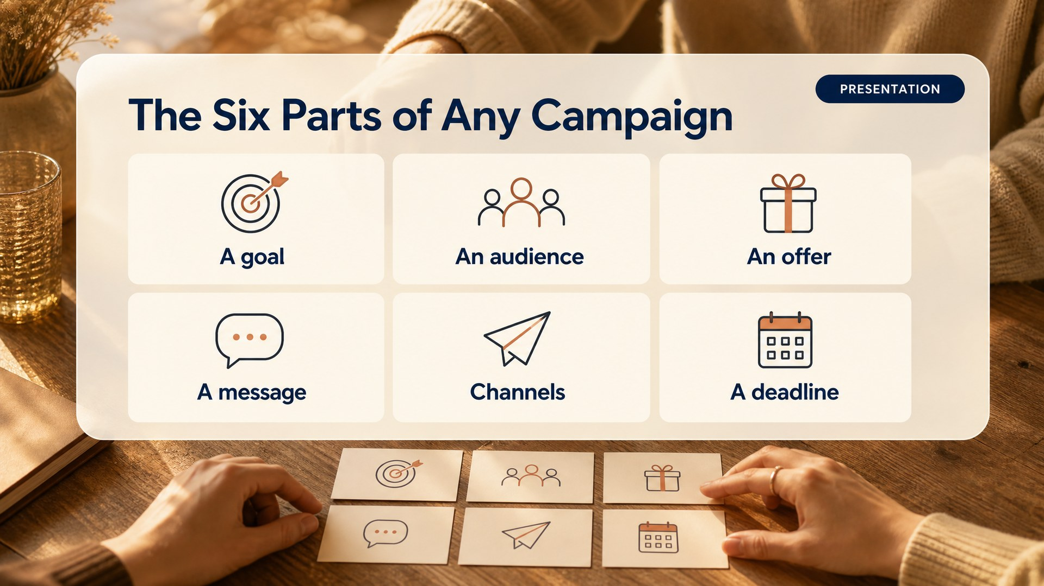
Notes:
Slide 10: Six Parts [Presentation]
*Presentation.* 9:58.
A goal, an audience, an offer, a message, channels, a deadline. Miss one and it is not a campaign yet. Usually the missing one is the deadline, which is why things drift.
Ninety seconds. Do not go deep, the day goes deep.

Slide 11
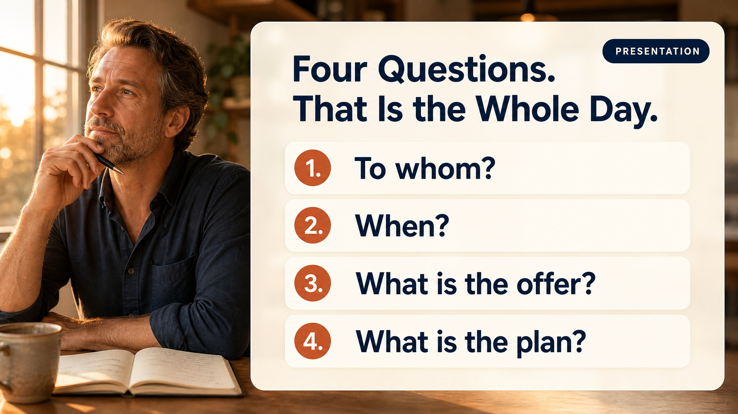
Notes:
Slide 11: Four Questions [Presentation]
*Presentation.* 10:01.
To whom. When. What is the offer. What is the plan. Four questions. Every module on that website is one of these. When you get lost today, come back here.
Say this is the only framework you will use all day.

Slide 12
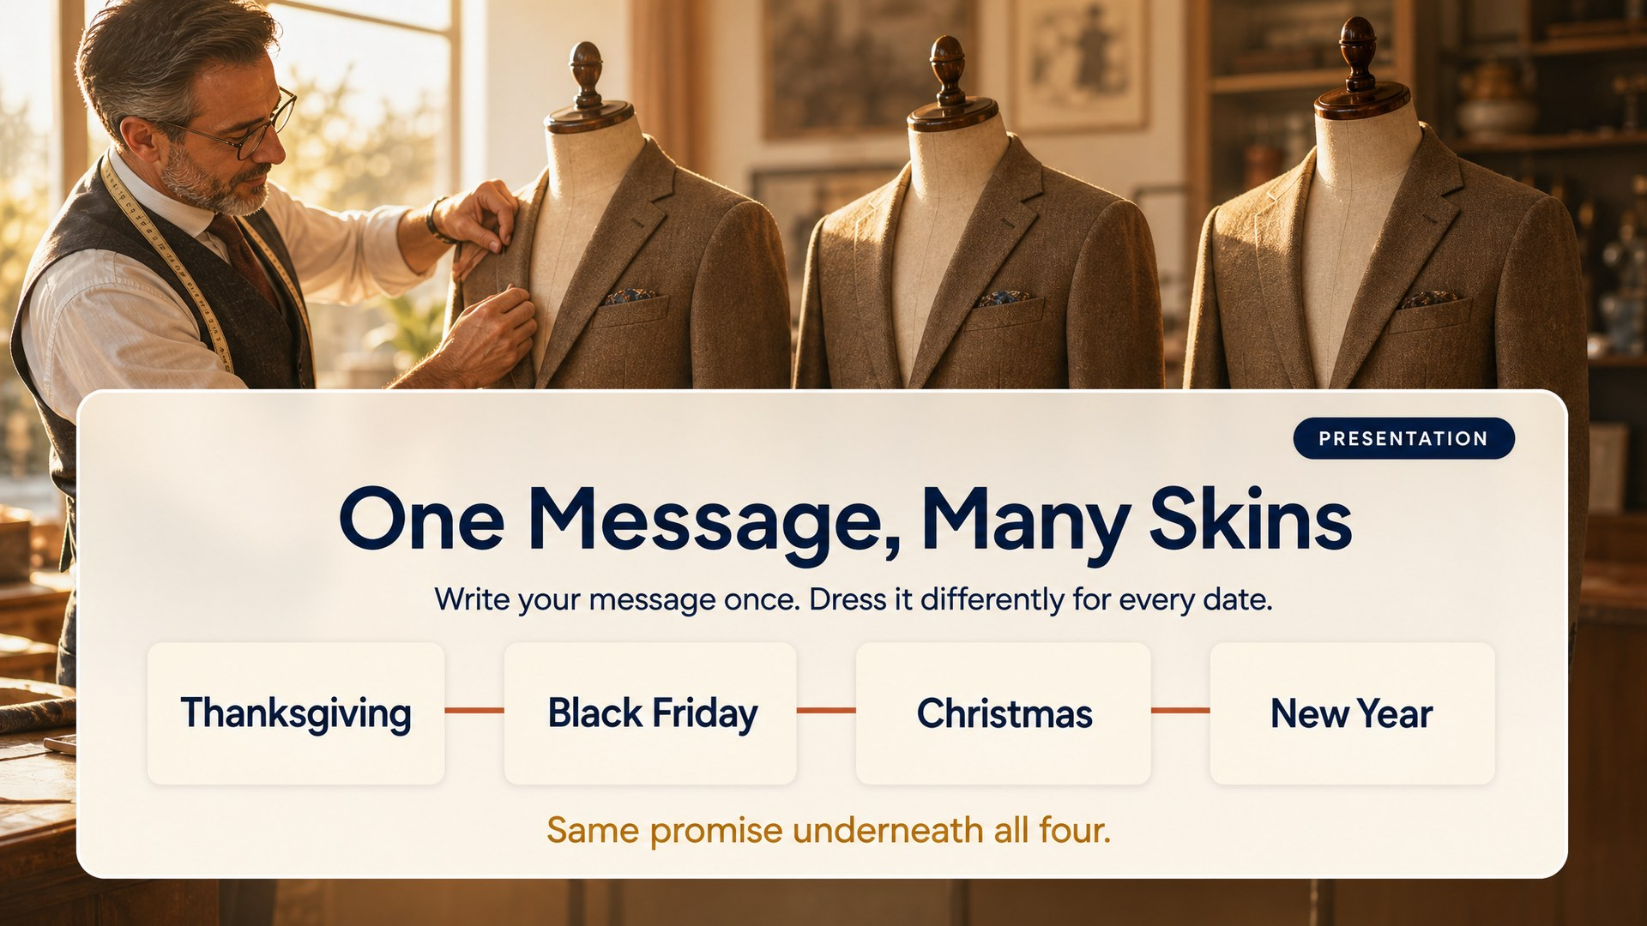
Notes:
Slide 12: One Message Many Skins [Presentation]
*Presentation.* 10:06.
Here is what saves your life in November. You are not building five campaigns. You are building one message and dressing it differently for each date. Same jacket, different mannequin. The Thanksgiving version and the Christmas version say the same thing underneath, which is why the second one takes twenty minutes instead of two hours.
The promise of the whole day. Tell them Module 04 hands them a re-skin guide that does exactly this.

Slide 13
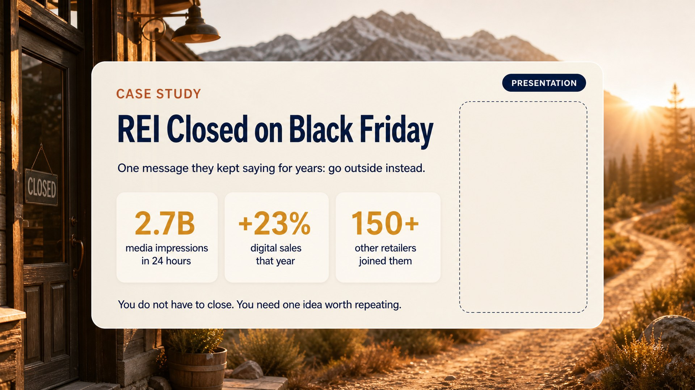
Notes:
Slide 13: Case Study 1 [Presentation]
*Presentation.* 10:12.
In 2015 REI did the unthinkable. They closed every single store on Black Friday, the biggest shopping day of the year, and paid all of their employees to go outside instead. They did not discount anything, they did not open online. They just said: go outside, we will be here Saturday.
And then, this is the important part, they did it again the next year. And the next. Same message, every November, for years. That is not a stunt. That is a campaign.
The numbers are on the slide: 2.7 billion media impressions in 24 hours, digital sales up 23% that year, and more than 150 other retailers closing too.
Then land it for this room, which is the whole reason the slide exists:
You are not REI and you are not closing your shop. That is not the lesson. The lesson is they found one idea they were willing to say every single year, and it got louder each time. What is yours?
Video, 2:21: youtube.com/watch?v=lMsxrJeJ8lU, "REI, #OptOutside Case Study". Open it in a browser tab, play it, come back. Sources and a backup video are in the Case Studies document.

Slide 14
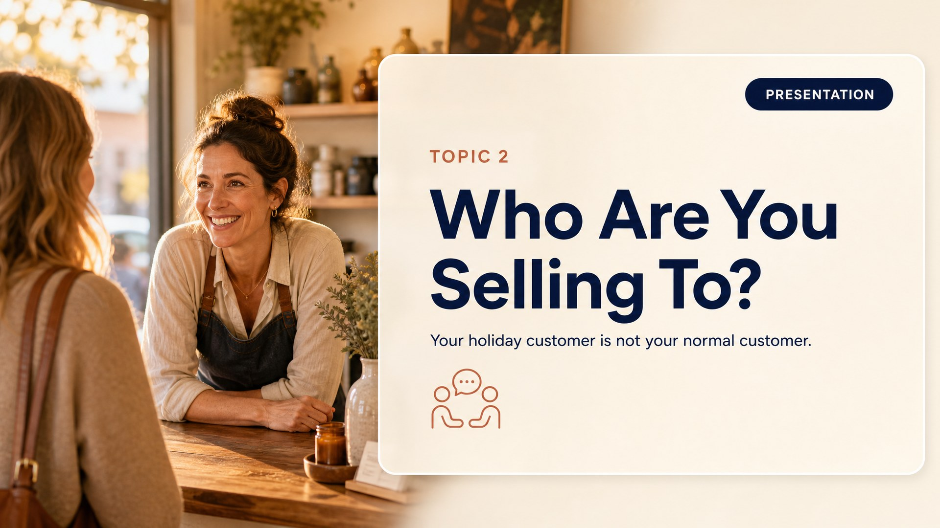
Notes:
Slide 14: T2 Divider [Presentation]
*Presentation.* 10:25.
First question. Who are you actually selling to between now and December 31. It is not who you think.

Slide 15
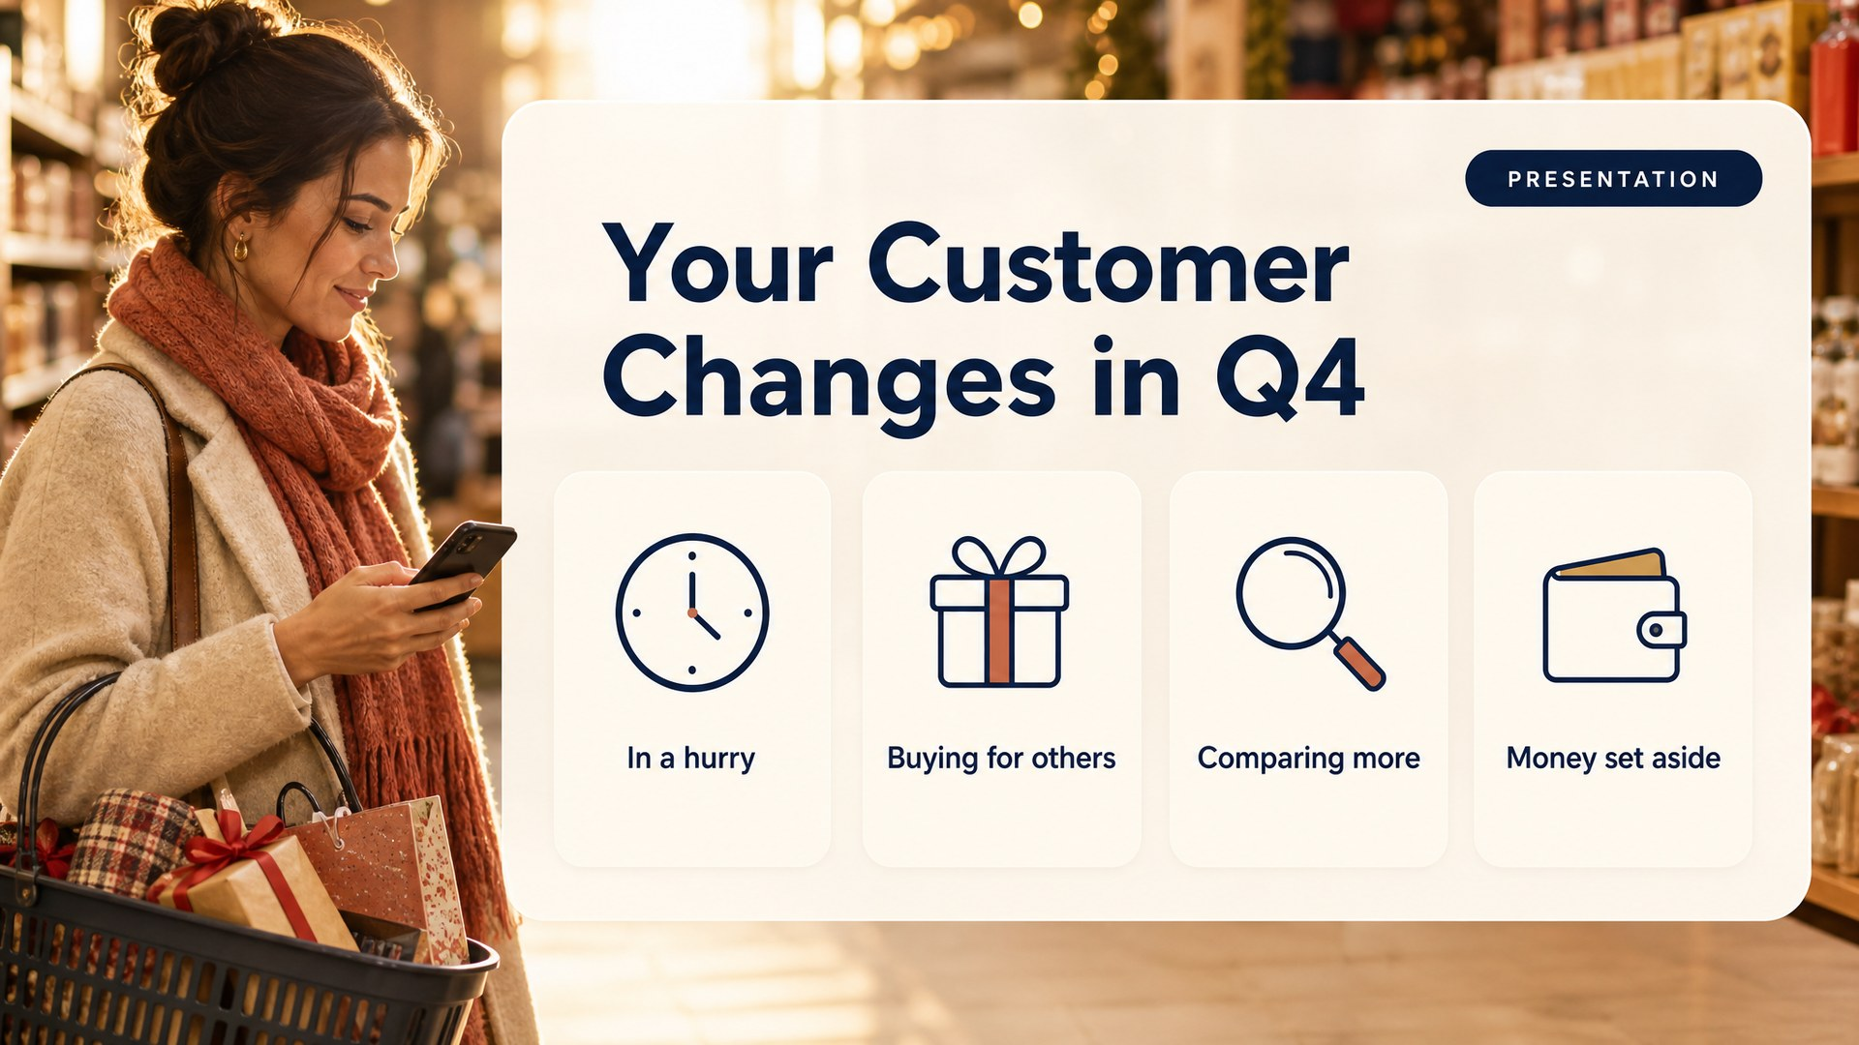
Notes:
Slide 15: Different in Q4 [Presentation]
*Presentation.* 10:27.
Your customer in November is not your customer in April. Same person, different mode. In a hurry. Buying for somebody else. Comparing more. And spending money they set aside months ago, which means the money already exists. The only question is whether it comes to you.
Pause on that last line. Q4 money is already budgeted. They are competing for planned spending, not creating it.

Slide 16
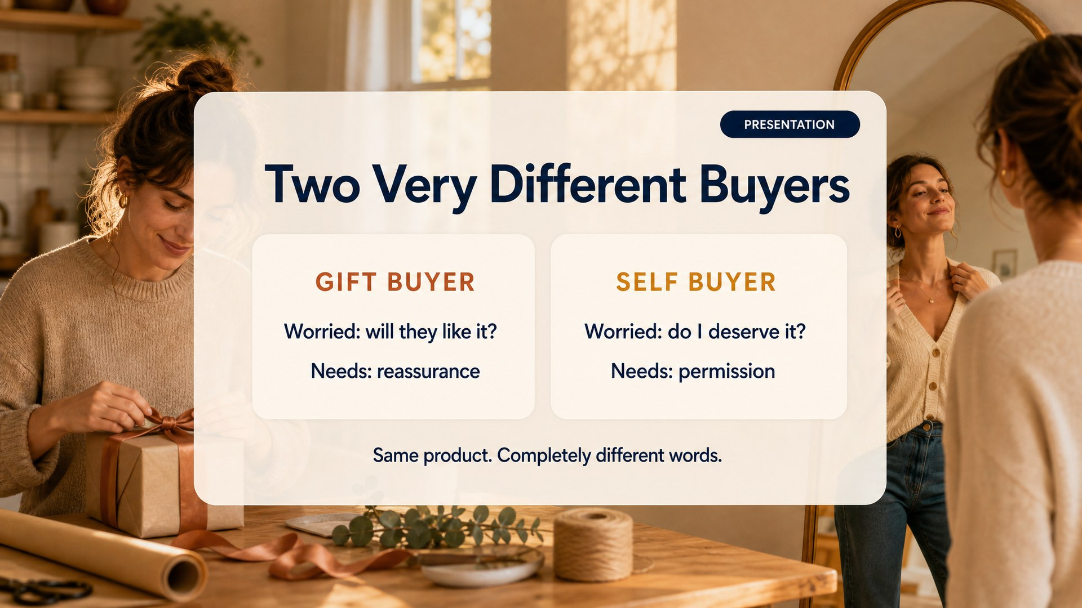
Notes:
Slide 16: Gift vs Self [Presentation]
*Presentation.* 10:31.
Almost nobody thinks about this. A gift buyer worries about one thing: will the person I am giving this to like it. A self buyer worries about something else entirely: do I deserve this. Same product, completely different words. Write one post for both and it lands for neither.
Ask two or three people which one is theirs. Most say "both," which is correct and is exactly why it matters.

Slide 17
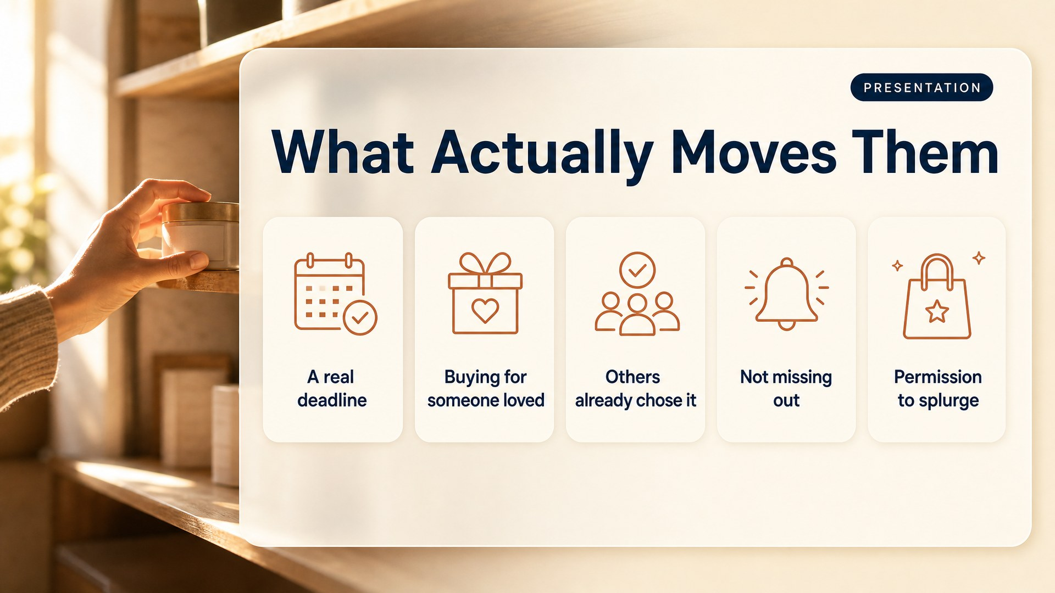
Notes:
Slide 17: What Moves Them [Presentation]
*Presentation.* 10:35.
Five things move people in Q4. A real deadline. Buying for someone they love. Seeing others already chose it. Not wanting to miss out. Permission to spend on something nice. Your report ranks these for your business and tells you which to lean on and which to stop wasting effort on.
Then straight into work.
---

Slide 18
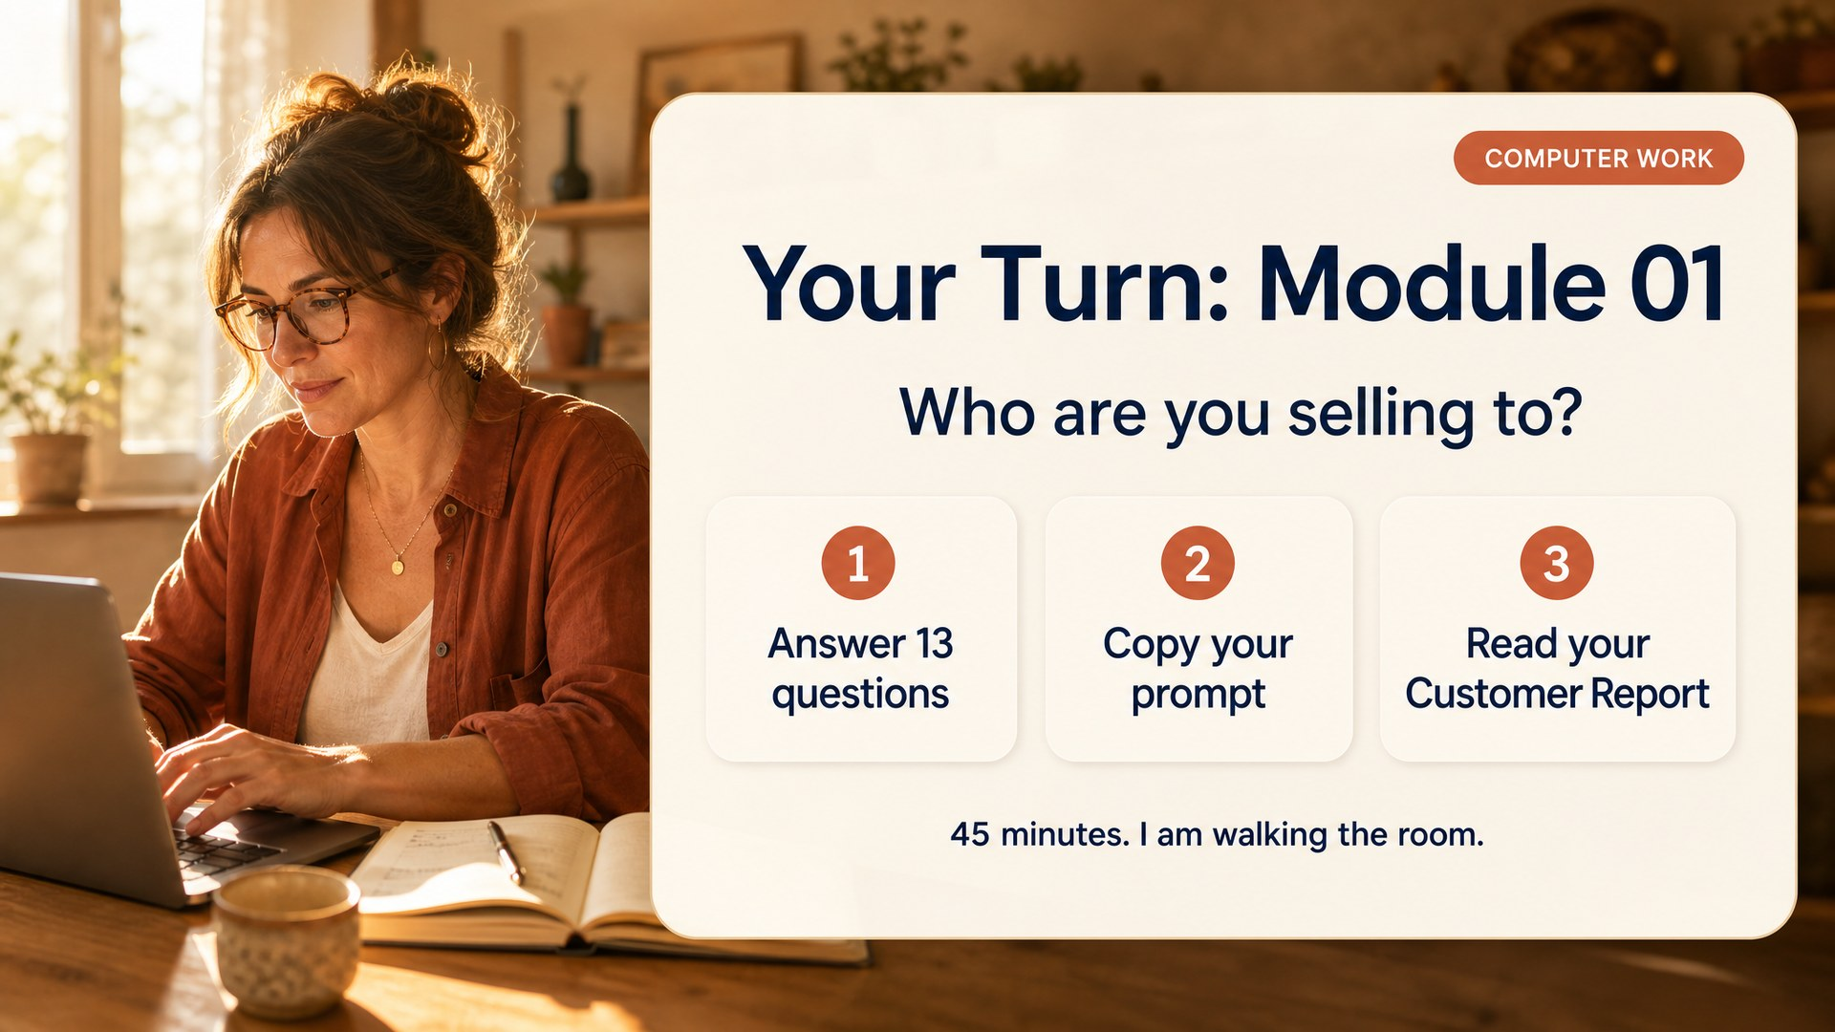
Notes:
Slide 18: Work Module 1 [Computer work]
*Computer work.* 10:40. Leave this slide up the whole block.
Module 01 on the page. Thirteen questions. Some will make you think, and that is on purpose. Forty-five minutes. I am walking the room.
First ten minutes, walk without talking. Look for blank screens, wrong module, missing Master Brain.
What to say when someone stalls:
- "I don't know the answer." Guess. Put "roughly" in front of it. An honest estimate beats a blank box.
- "Is this enough?" Read it back to them out loud. If it sounds like a real person talking about their real business, it is enough.
- "Question 9 is hard." Who is *not* your customer. It is supposed to be hard. Who wastes your time? Who haggles? Write that.
At 11:15: copy your prompt, paste it, let it run.

Slide 19
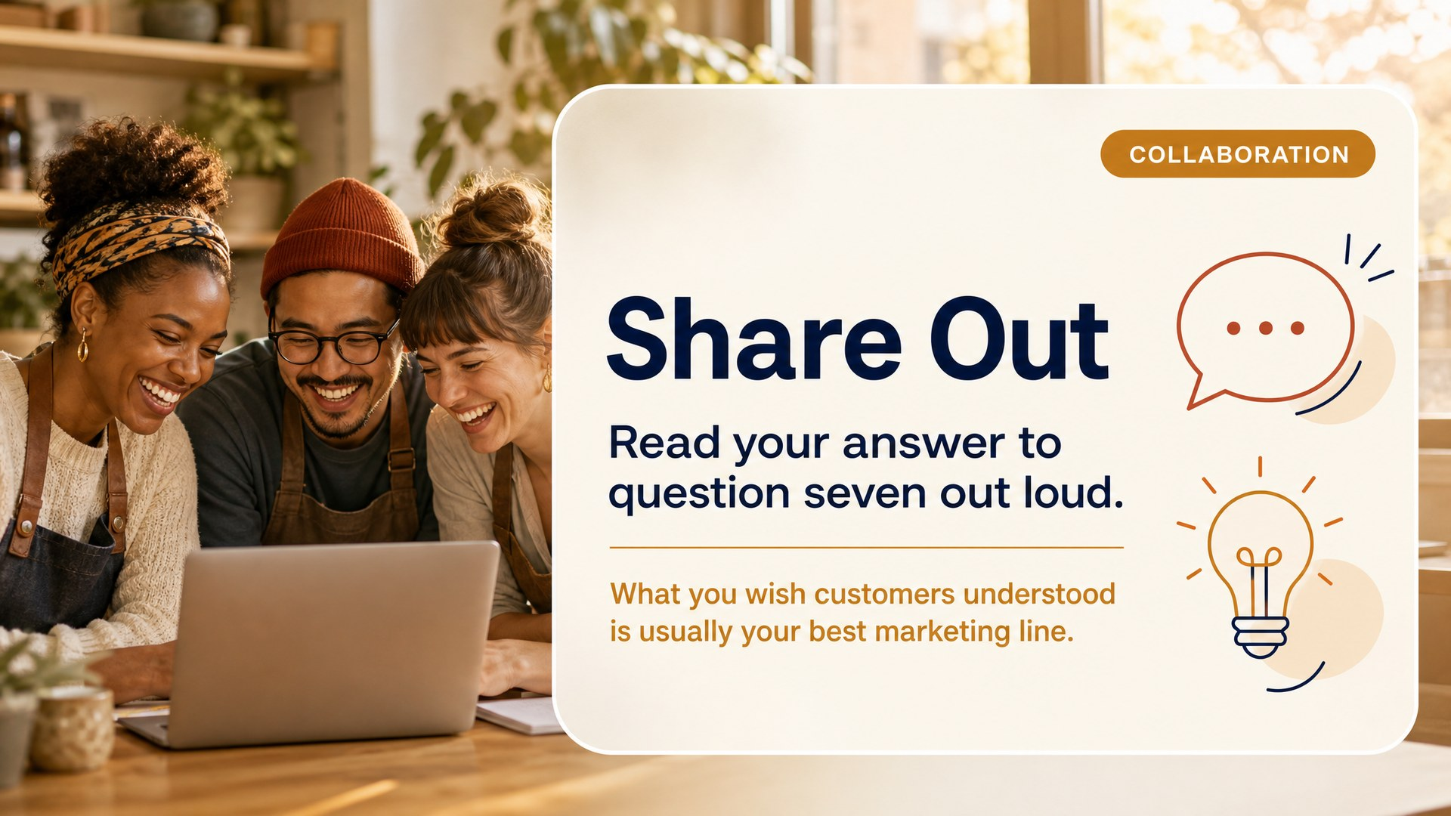
Notes:
Slide 19: Share Out 1 [Collaboration]
*Collaboration.* 11:25.
Laptops down. Three or four of you, read your answer to question seven out loud. What you wish customers understood.
Those answers are almost always the best marketing copy in the room, and hearing them makes everyone else's better. Fifteen minutes, then break.
---

Slide 20
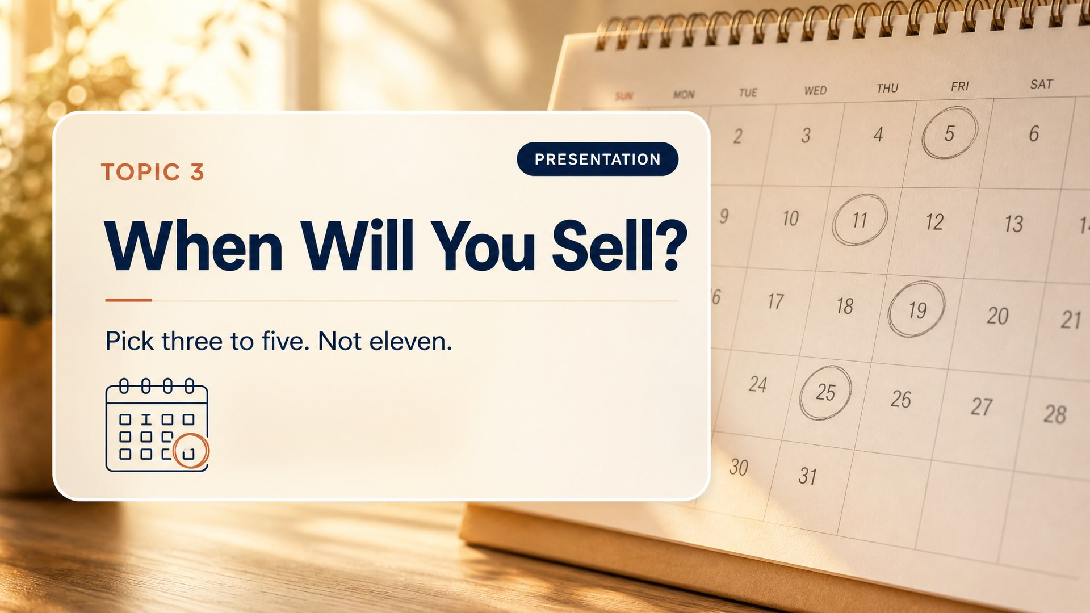
Notes:
Slide 20: T3 Divider [Presentation]
*Presentation.* 11:50.
Second question. When. And the answer is not "all of them."

Slide 21
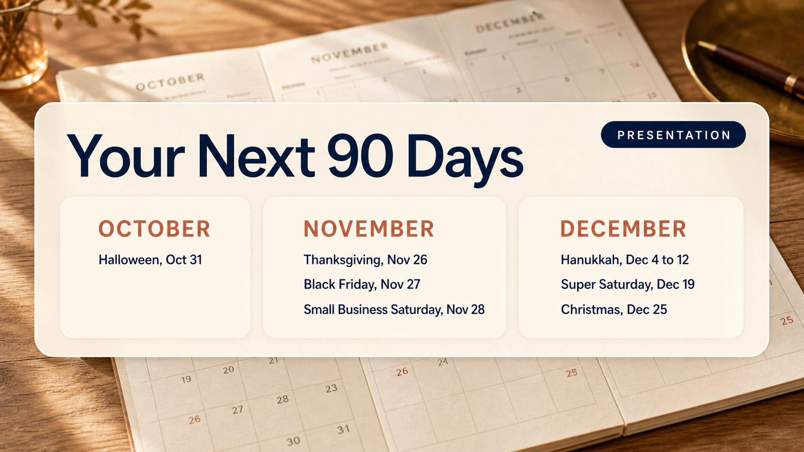
Notes:
Slide 21: Q4 Calendar [Presentation]
*Presentation.* 11:52.
October, November, December. Ninety-five days. Here are the dates on the table. You pick three to five. Not eleven.
Then name the anchor for the first time:
Everyone in this room builds Thanksgiving. November 26, eight and a half weeks out. Nobody is behind. We all build that one together, because gratitude is the one message that works for every business here without a discount.

Slide 22
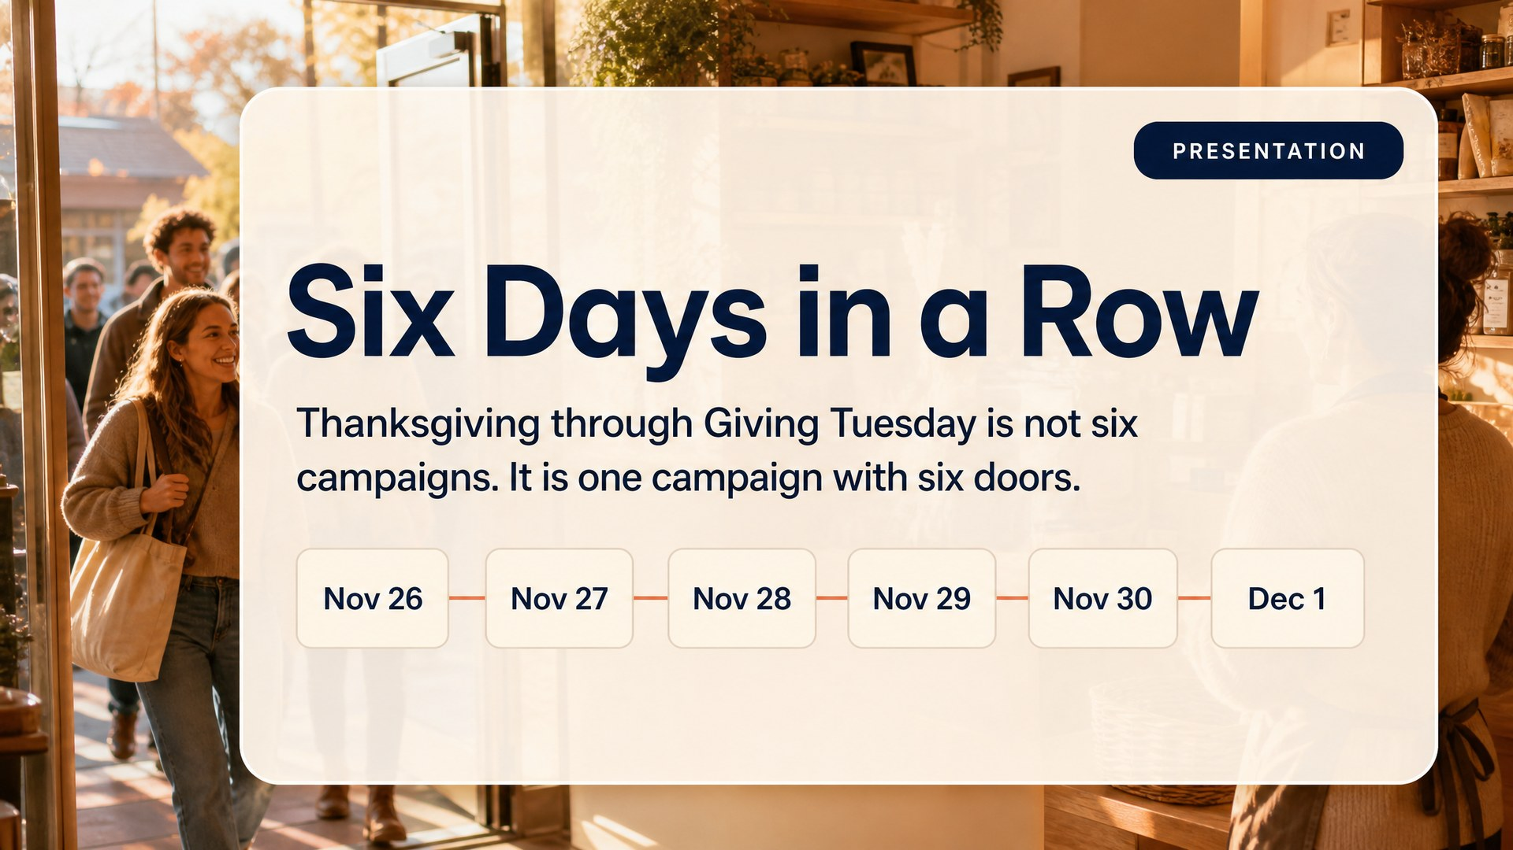
Notes:
Slide 22: Six Days [Presentation]
*Presentation.* 11:57.
Look at the end of November. Thanksgiving, Black Friday, Small Business Saturday, Cyber Monday, Giving Tuesday. Six days in a row. That is not six campaigns, that is one campaign with six doors. And the one in the middle, Small Business Saturday, is the best day of the year for everybody in this room, because that day the whole country is already talking about choosing local. You do not have to create the reason. You just have to be findable.
If you emphasise one date besides Thanksgiving, make it this one.
Thirty seconds worth spending here:
Small Business Saturday is not an old tradition. American Express made it up in 2010. It did not exist. There was Black Friday for the big stores and Cyber Monday for the internet, and nothing at all for the people in this room. So they invented a day and gave it a name. Fifteen years later it moves about twenty-two billion dollars, up from seventeen billion the year before.

Slide 23
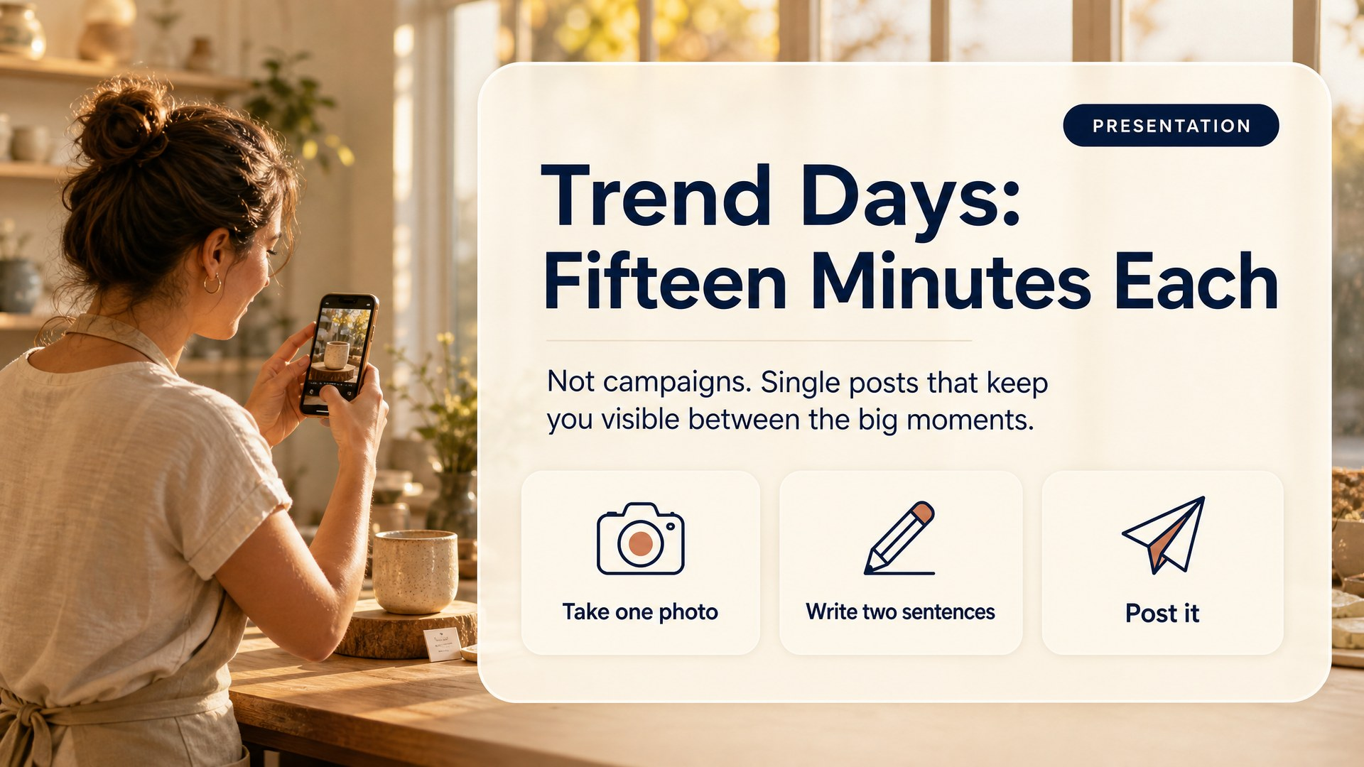
Notes:
Slide 23: Trend Days [Presentation]
*Presentation.* 12:03.
Not campaigns. Single posts. One photo, two sentences, post it, done. Their job is keeping you visible between the big moments, so when you do have something to sell you are not a stranger showing up with a discount.
The auto shop story:
One of the best-performing posts I have seen from a small business was an auto shop on National Entrepreneurs Day. A photo of the owner's father who opened the shop in 1994, next to the son standing in the same doorway today. Two sentences. He sold nothing. It was the most-shared thing he posted all year.
Trend days build the trust. The big moments collect on it.

Slide 24
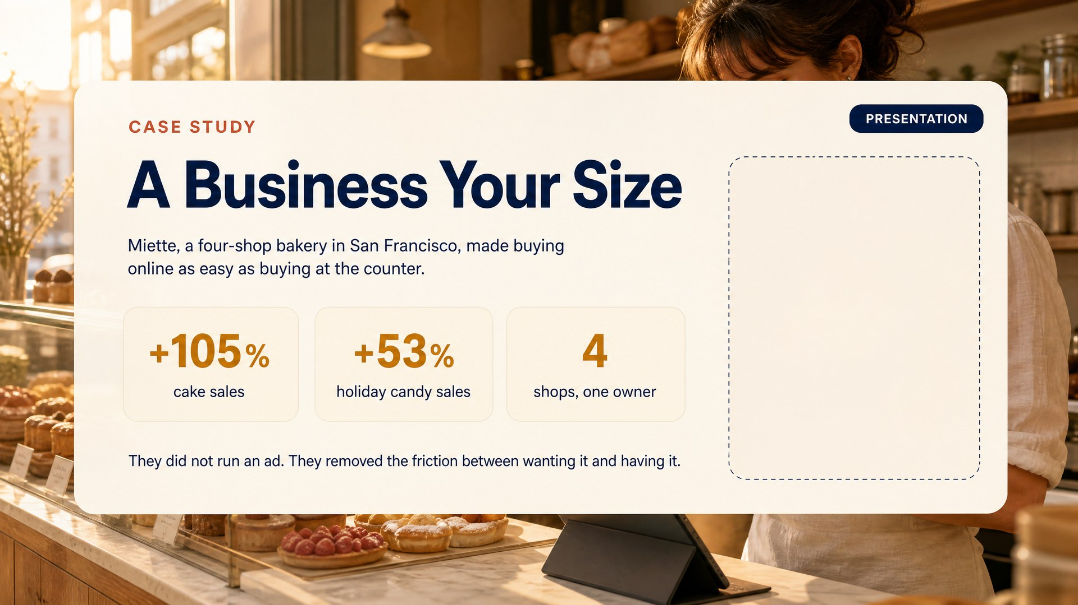
Notes:
Slide 24: Case Study 2 [Presentation]
*Presentation.* 12:09.
This is the one that makes the room lean in, because it is finally somebody their size. Use it deliberately as the counterweight to REI: that was a company with a marketing department, here is a bakery.
Meg Ray runs four small bakeries in San Francisco. Not a chain, no marketing department. Her problem was not that people did not want her cakes. It was that buying one online was harder than walking in. Different prices in different places, no way to see what was in stock, no easy pickup.
So she did not run a campaign at all. She made buying online as easy as buying at the counter. Same prices, real stock, order now and pick it up today.
Numbers on the slide: cake sales up 105%, holiday candy up 53%, across four shops.
Say this out loud, it costs nothing and buys credibility: Square published this case study, and Square sells the tools she used. It is a vendor case study, not independent reporting. Tell them that.
Then the bridge into the next slide:
Notice what she did not do. No discount, no ads, no posting more. She found the thing standing between wanting her cake and having her cake, and she removed it.
So before you plan a single post, ask the same question. If somebody decided right now that they wanted to buy from you, how hard would it be? Because if the answer is "they would have to message me and wait," then Cyber Monday is not really available to you yet. Worth knowing before you put it on your calendar.
Video, 2:10: youtube.com/watch?v=EYBbftM9LuY, a real shop owner on Small Business Saturday. Not Miette, but it puts a small shop owner's face on the screen, which is the point.

Slide 25
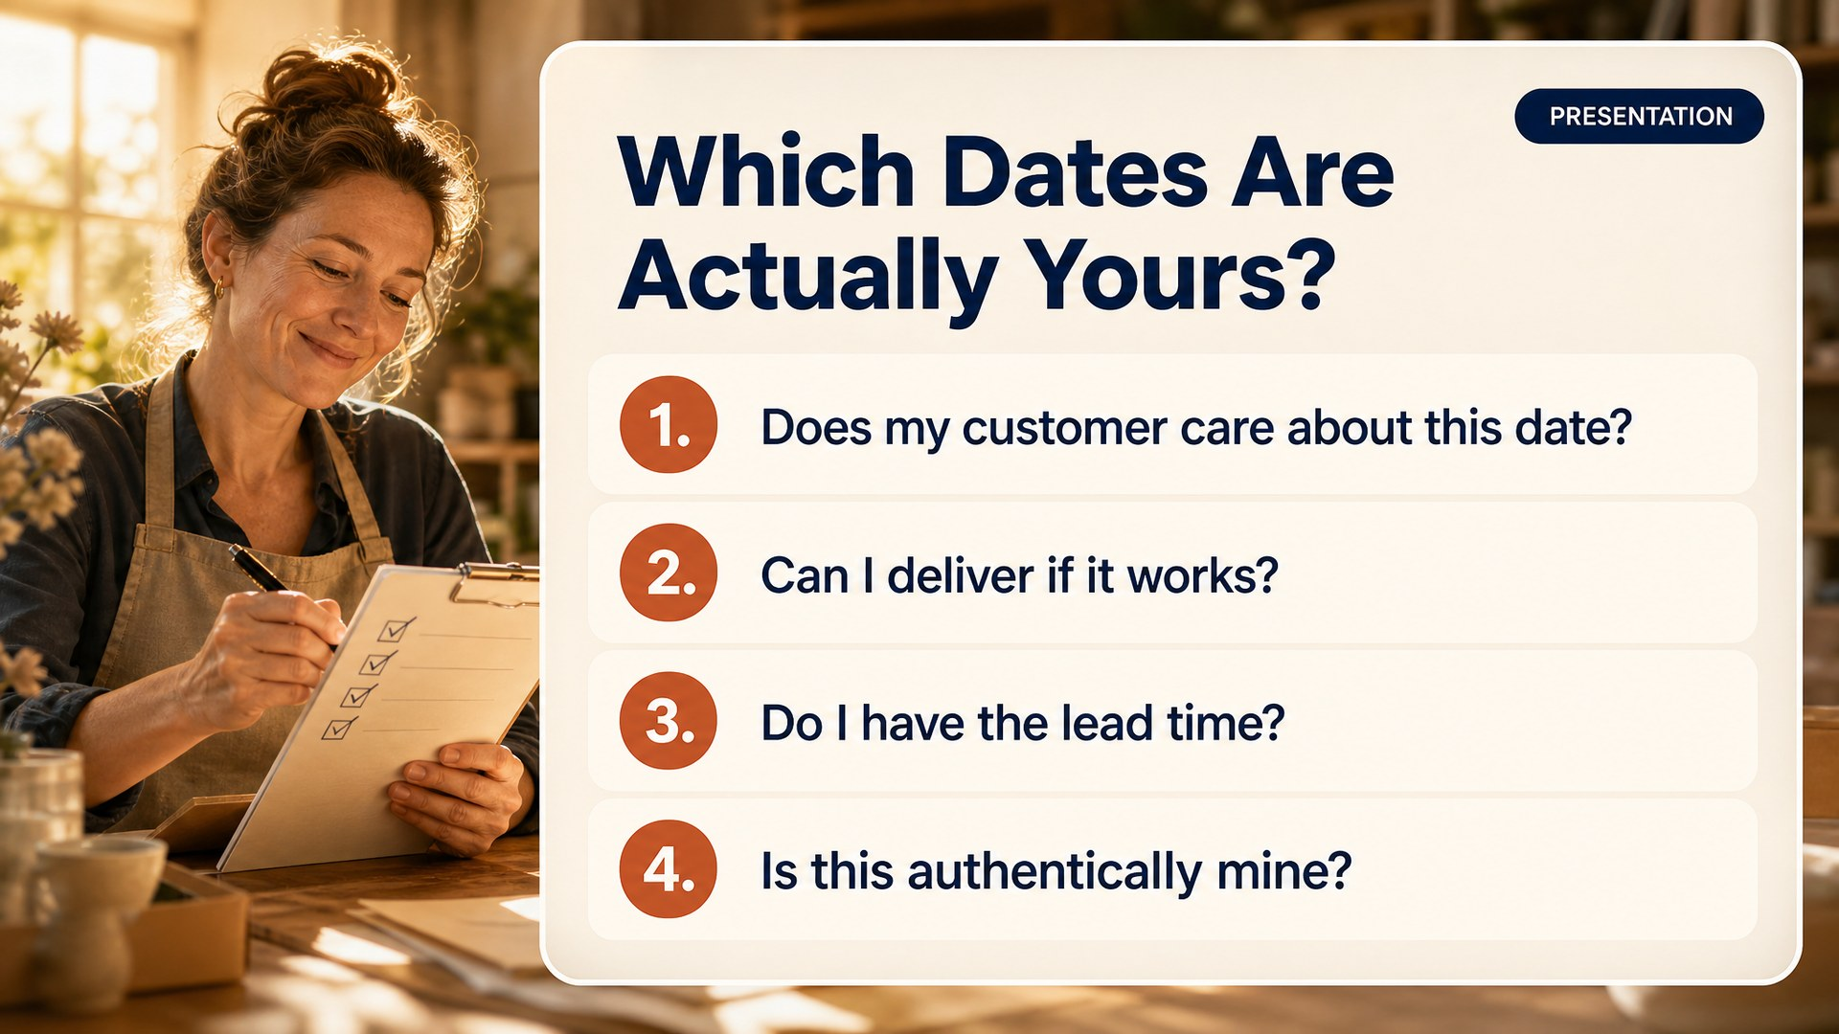
Notes:
Slide 25: Which Dates Fit [Presentation]
*Presentation.* 12:14.
Four questions for every date, and be honest on all four. Does my customer care about this date, not do I. Can I actually deliver if it works, because selling more than you can make loses you a customer. Do I have the lead time. And is this authentically mine, because a borrowed holiday reads as hollow and your regulars feel it.
Straight after lunch you pick. There is an information button next to every date on the page. If you do not know what Green Monday or Super Saturday is, click it.
---

Slide 26
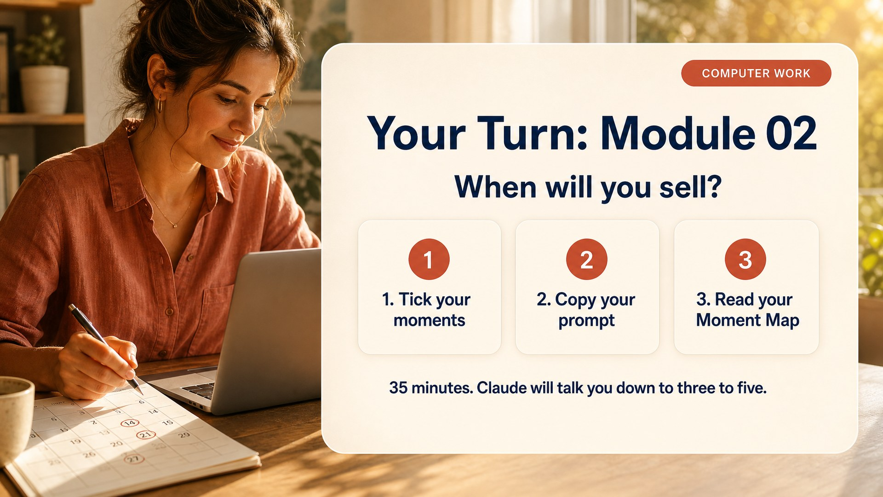
Notes:
Slide 26: Work Module 2 [Computer work]
*Computer work.* 1:30. Leave it up the whole block.
Module 02. Tick your moments, run the prompt. Thirty-five minutes. Pick freely, Claude will talk you down to three to five.
Common failure here is ticking everything. Let them. Being cut by Claude lands better than being cut by you.
What to watch:
- Anyone ticking nothing. They are overwhelmed. Sit down and pick two with them: Thanksgiving and Small Business Saturday. That is a complete quarter.
- Question 6, blackout dates. People skip it because it feels negative. Push them. A plan that ignores the week their kids are off school dies in December.
- Question 12, the goal and the why. They rush the why. The number is what they measure, the why is what keeps them posting in week nine.

Slide 27
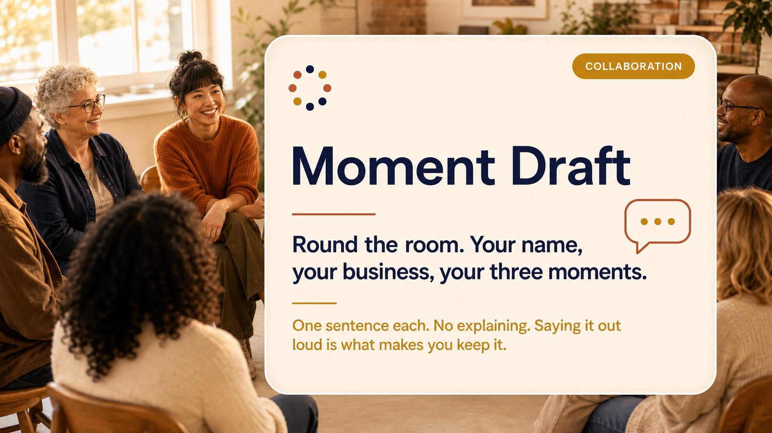
Notes:
Slide 27: Moment Draft [Collaboration]
*Collaboration.* 2:05.
Laptops down. Round the room. Your name, your business, your three moments. One sentence each. No explaining, no discussion.
Fast and rhythmic. Fifteen people in fifteen minutes. Saying a choice out loud in front of others is what makes people keep it, and it wakes the room after lunch, which is exactly when you need it. Short on time, take four volunteers.
---

Slide 28
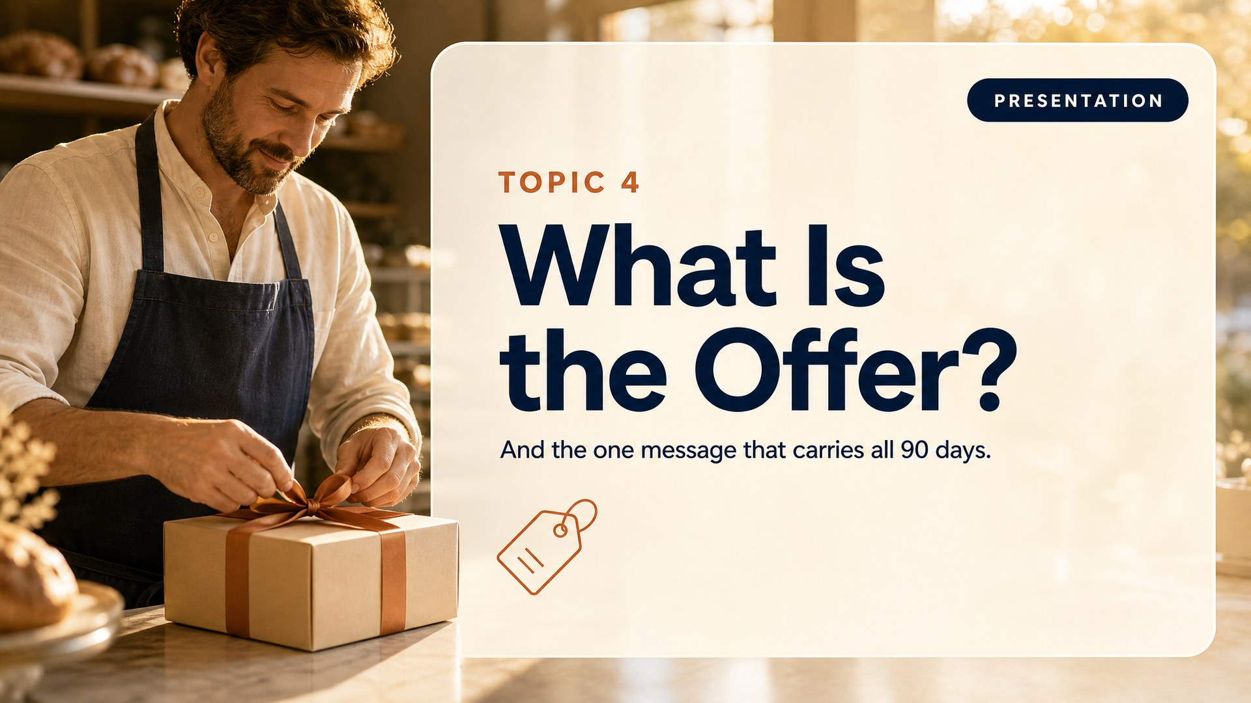
Notes:
Slide 28: T4 Divider [Presentation]
*Presentation.* 2:20.
Third question. What are you actually offering. Then the part most people skip, the one message that carries all ninety days.

Slide 29
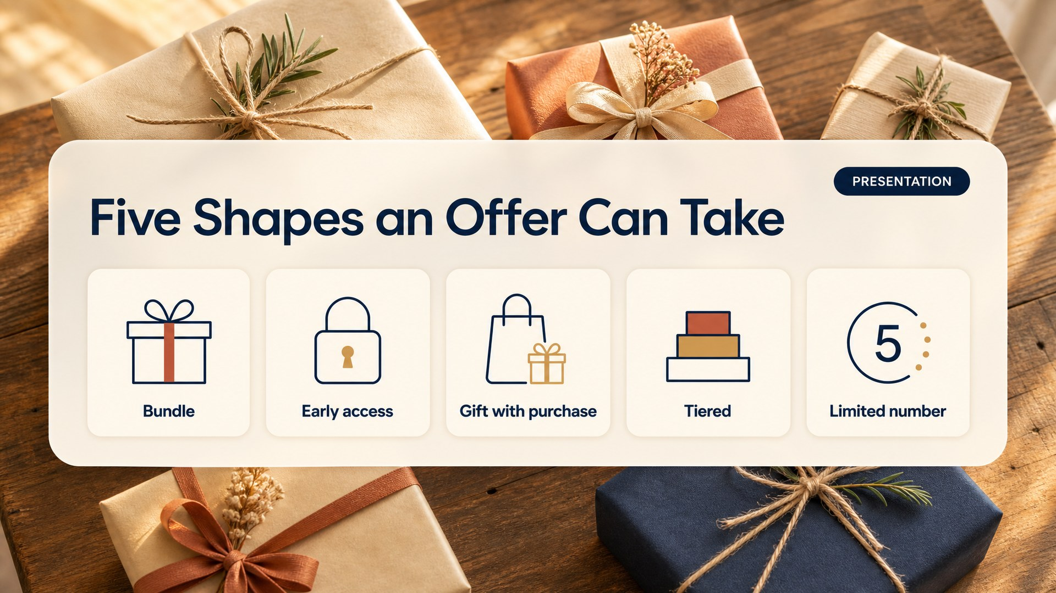
Notes:
Slide 29: Five Offer Shapes [Presentation]
*Presentation.* 2:22.
An offer does not mean a discount. A bundle. Early access, regulars go first. A gift with purchase. Tiered, good better best. Or a limited number, which is the most underused one in this room. Most of you are capacity-limited anyway, so "I am only taking twelve orders for Thanksgiving week" is not a marketing trick, it is just true. And true scarcity beats every discount.

Slide 30
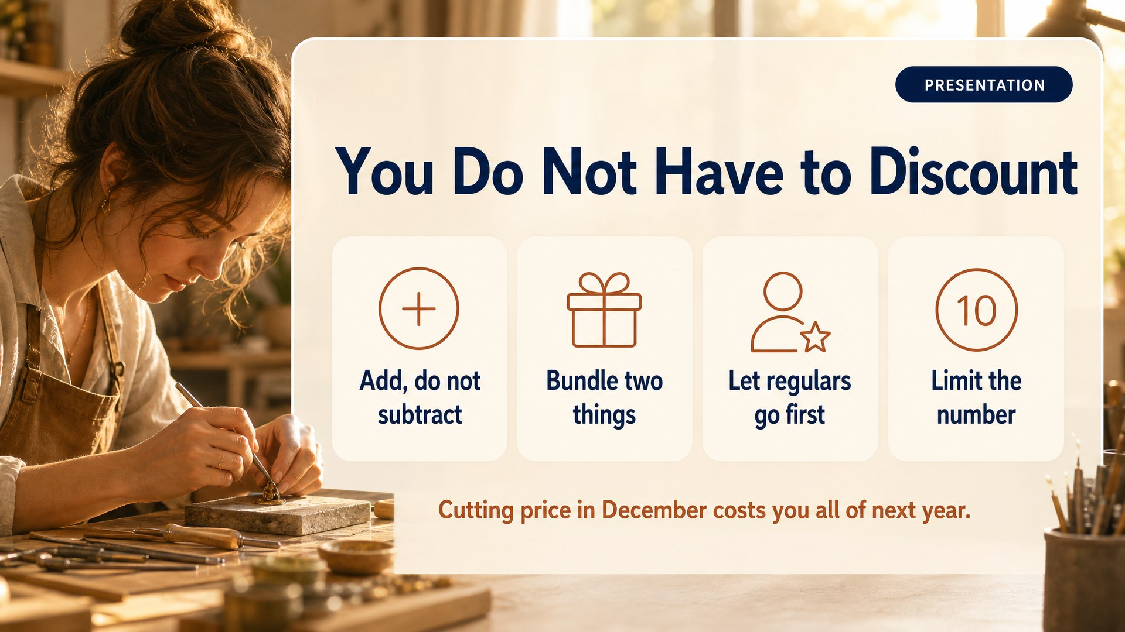
Notes:
Slide 30: Cant Discount [Presentation]
*Presentation.* 2:28.
If you sell something premium, or you sell your own time, listen closely. Cutting your price in December costs you all of next year, because every customer you win on a discount comes back next year expecting it. So instead: add rather than subtract. Bundle. Let regulars in first. Limit the number.
Ask who is afraid of discounting. Service businesses raise hands. Tell them Module 03 asks for their price floor and will never propose anything that breaks it.

Slide 31
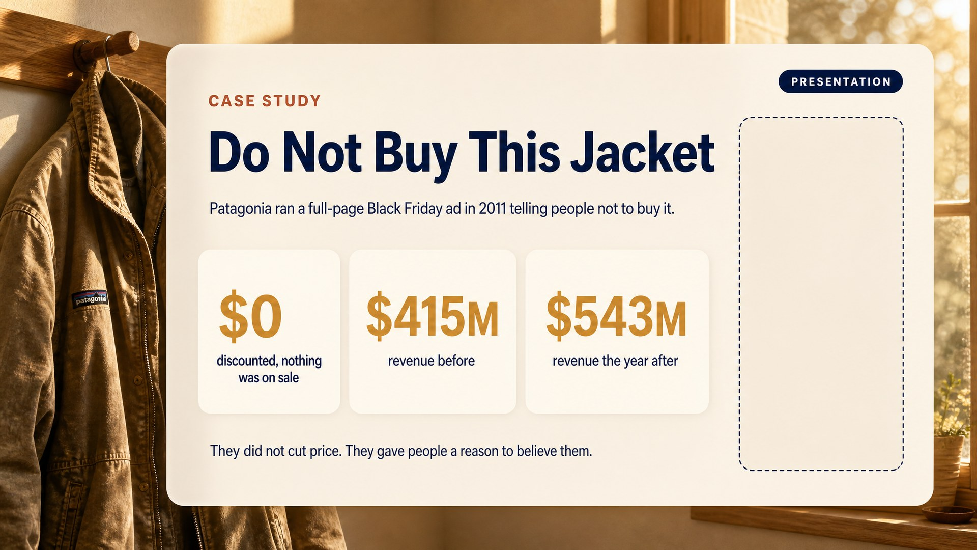
Notes:
Slide 31: Case Study 3 [Presentation]
*Presentation.* 2:34.
Black Friday, 2011. Patagonia buys a full page in the New York Times. And the ad says, in big letters, do not buy this jacket. Then it lists what the jacket costs the planet to make.
They did not put anything on sale. They ran the most anti-sale ad anybody had ever seen, on the biggest sale day of the year.
Numbers on the slide: nothing discounted, revenue about $415 million before, $543 million the year after.
A caution. You will see "sales rose 30%" quoted everywhere for this campaign. It is repeated constantly but poorly sourced and the causation is arguable, so I left it off the slide deliberately. If someone quotes it at you, that is a good moment to say you prefer numbers you can stand behind.
Then land it:
They did not cut their price. They gave people a reason to believe them. And that is available to every person in this room, at no cost, this quarter.
If you sell a service or something premium, this is your permission slip. You do not have to discount in December. You have to be worth believing.
Video, 0:29: youtube.com/watch?v=gtvqMBH0wS8. Twenty-nine seconds. Play it, do not describe it.

Slide 32
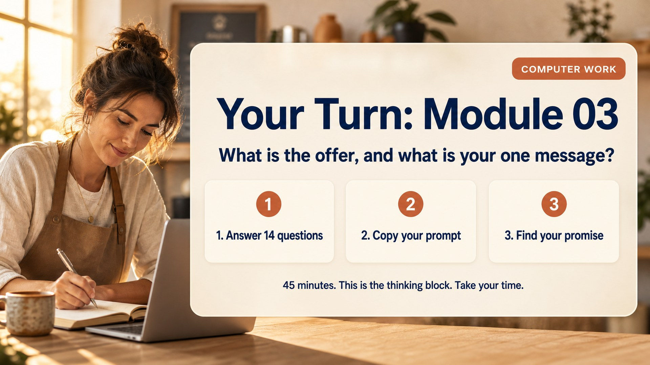
Notes:
Slide 32: Work Module 3 [Computer work]
*Computer work.* 2:45. The most important work block of the day. Protect it.
Module 03. Fourteen questions. This is the thinking module. Take your time, these answers become the actual words in your campaign.
This is where people go quiet and slightly uncomfortable, which means it is working. Do not fill the silence.
What to watch:
- Question 3, most profitable versus most popular. When someone realises those are different products, stop and make them say it out loud. Often the most valuable minute of their day.
- Question 12, the story they do not tell enough. They undersell this badly. Push: "why did you actually start this?" That answer becomes their proof points.
- Anyone writing brochure language. Ask them to say it to you like they would to a customer standing in front of them, then have them type that.

Slide 33

Notes:
Slide 33: Say It Out Loud [Collaboration]
*Collaboration.* 3:30.
Turn to your partner. Do not hand them your laptop. Say your promise out loud, from memory, in one breath. If you stumble, if you need a second sentence, if they look confused, it is not a promise yet. It is a paragraph. Go back and cut it.
A promise you cannot say is a promise your customer will never repeat. And them repeating it is the whole game.
Walk and listen. When you hear one that lands, ask that person to say it to the room. That is the moment everyone understands what a promise is.
---

Slide 34
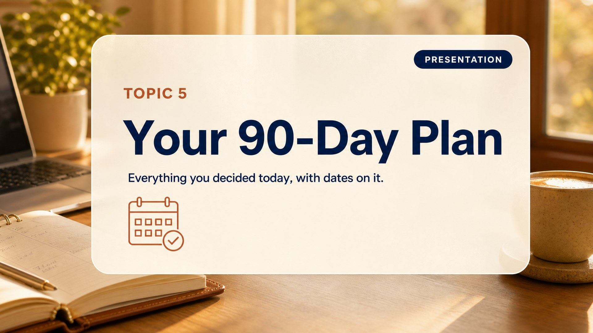
Notes:
Slide 34: T5 Divider [Presentation]
*Presentation.* 3:55.
Last question. Everything you decided today, with dates on it.

Slide 35
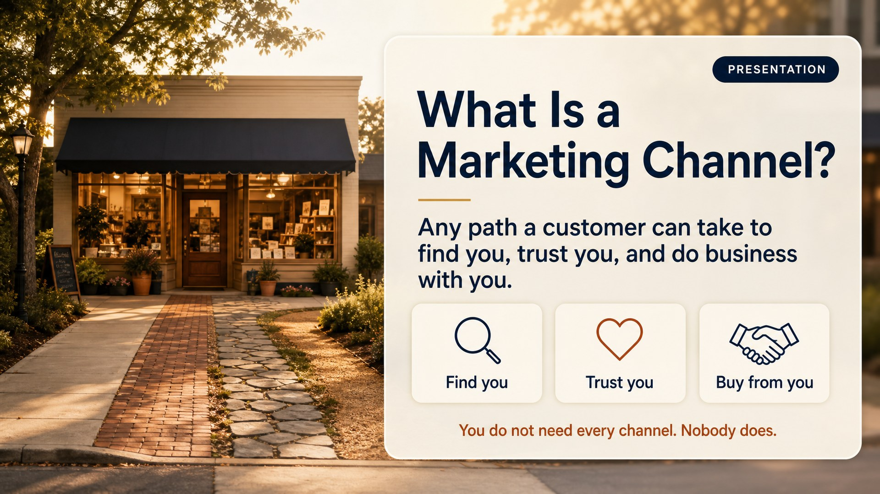
Notes:
Slide 35: What Is a Channel [Presentation]
*Presentation.* 3:57.
A marketing channel is any path a customer can take to find you, trust you, and do business with you. That is the whole definition. Your Instagram is a channel. So is the sign on your van. So is the neighbour who keeps recommending you.
And here is the part people get wrong: you do not need all of them. Nobody does. Not even the big companies.
Keep this short. It is a definition slide, not a lecture.

Slide 36
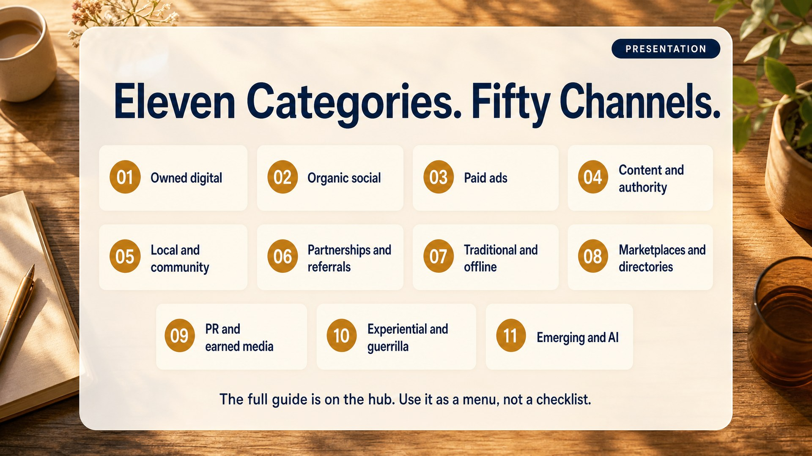
Notes:
Slide 36: Eleven Categories [Presentation]
*Presentation.* 4:00.
There are eleven categories and more than fifty channels available to a small business today. Owned digital, organic social, paid ads, content and authority, local and community, partnerships and referrals, traditional and offline, marketplaces and directories, PR and earned media, experiential and guerrilla, and the new AI ones.
I am not going to walk you through fifty. The full guide is on the hub and it is yours to keep, with a real small business example for every single one.
Point them at the download now, Module 04, top of the section. Tell them it is a menu, not a checklist. That phrase does a lot of work.
Worth saying out loud: most people in this room are quietly doing six channels badly and feeling guilty about four more. The guide exists to let them stop.

Slide 37
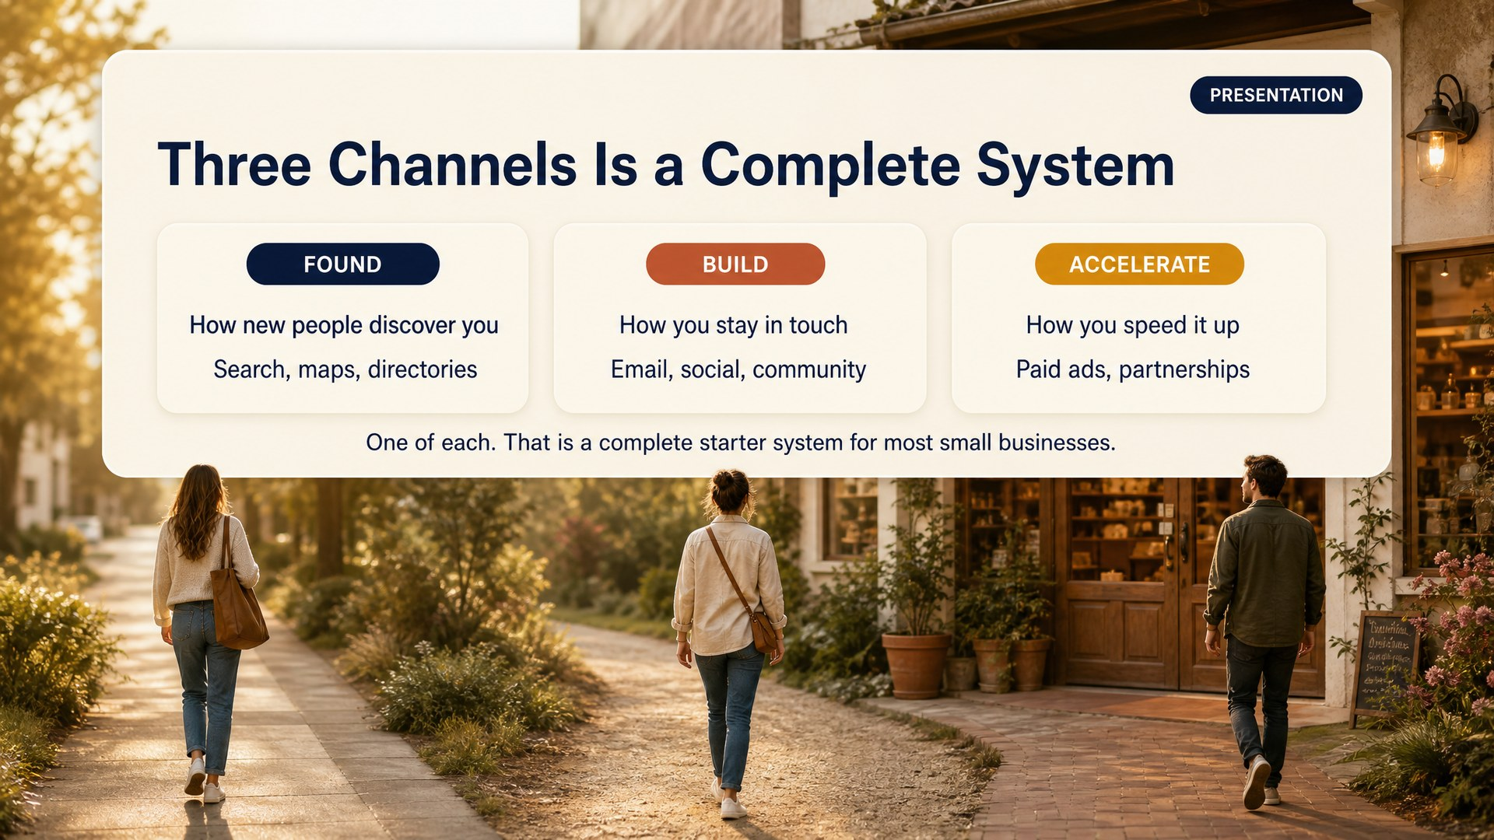
Notes:
Slide 37: Found Build Accelerate [Presentation]
*Presentation.* 4:03. This is the slide that matters in this section.
Here is the rule of thumb, and it is the only thing from this section you have to remember. One channel to be FOUND, so strangers can discover you: search, maps, directories, a market stall. One channel to BUILD, so the people who already know you keep hearing from you: email, text, one social platform. And one to ACCELERATE, if you have the budget or the partners: paid ads, a referral programme, a cross-promotion.
One of each. That is a complete marketing system. Not fifty channels. Three.
Ask the room, out loud: "which one of those three do you think most of you are missing?" It is almost always FOUND. People post constantly to an audience that already knows them, and nothing brings new people in.

Slide 38
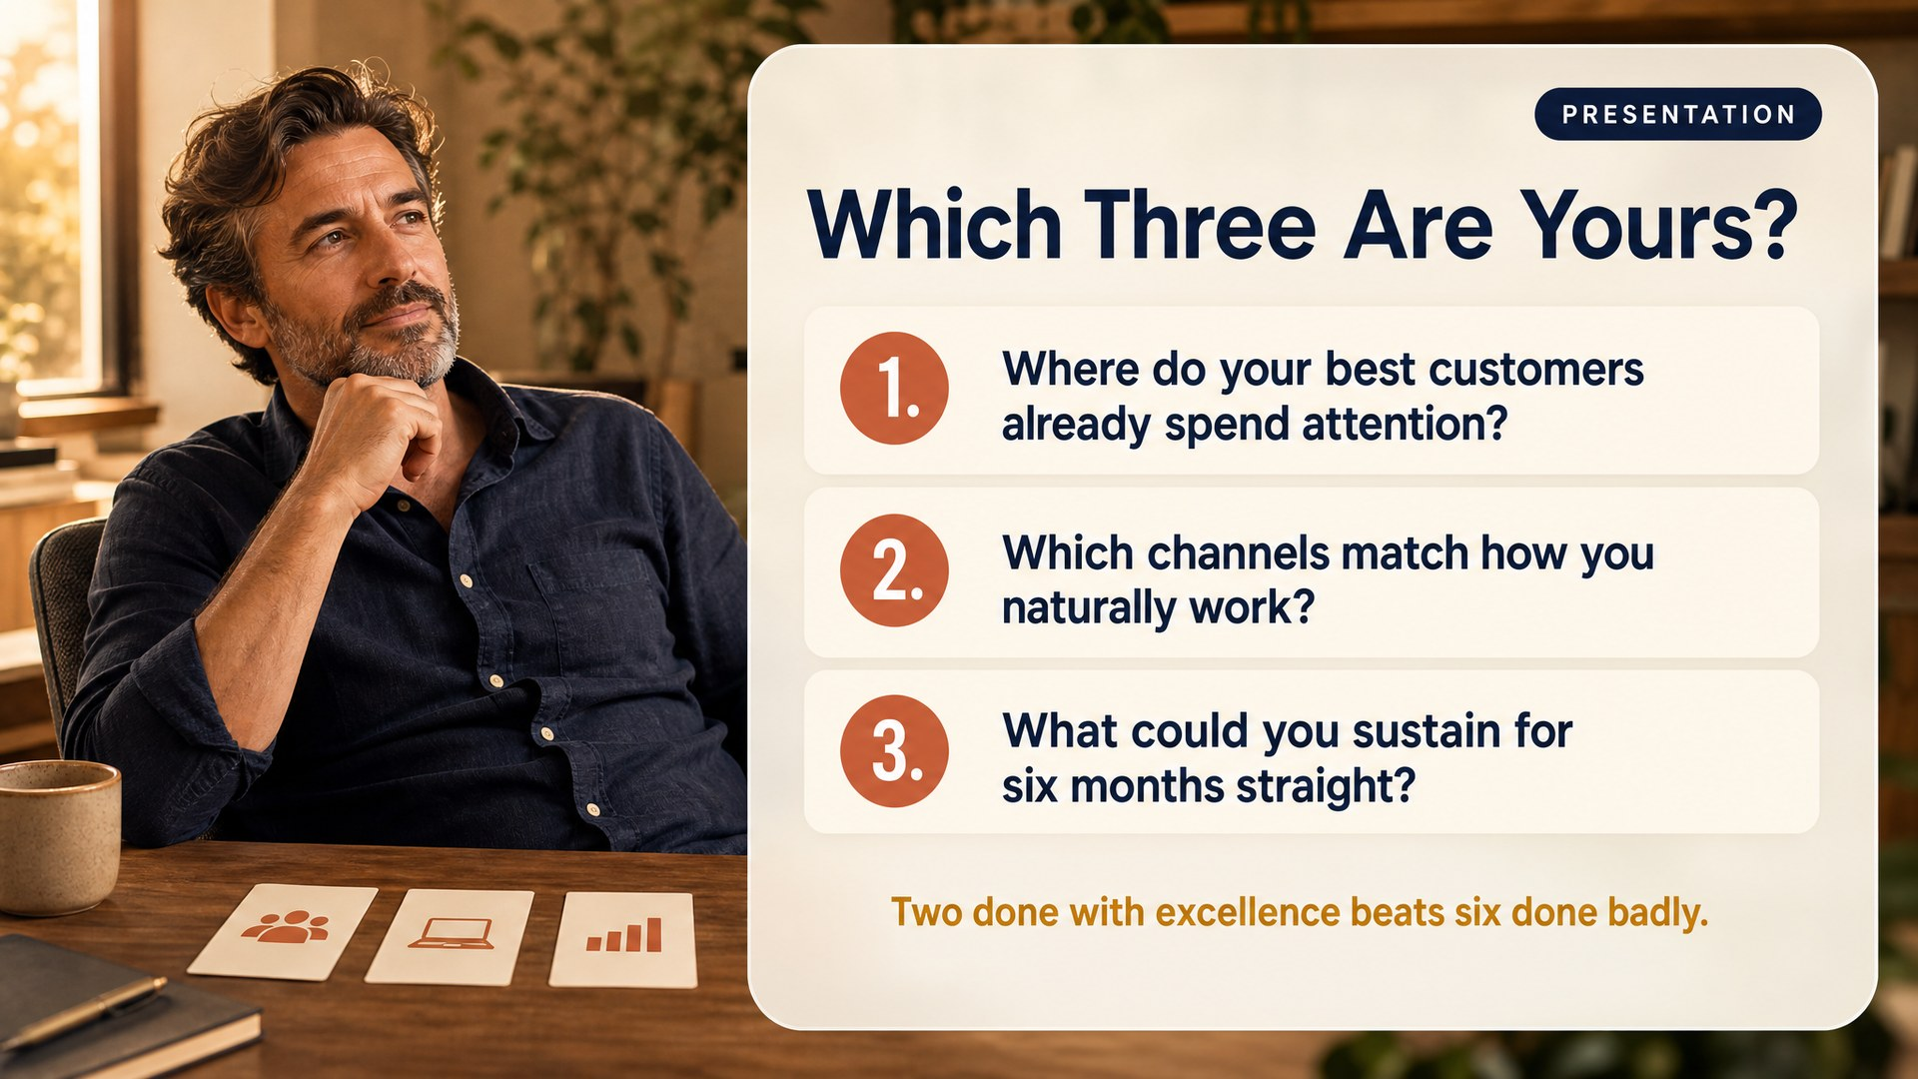
Notes:
Slide 38: Which Three [Presentation]
*Presentation.* 4:07.
Three questions to pick yours. Where do your best customers already spend their attention, not where do you enjoy spending yours. Which channels match how you naturally work, are you a talker, a writer, a maker, a connector. And what could you genuinely sustain for six months straight, not for two enthusiastic weeks in October.
Two channels done with excellence beat six done badly. Every time.
Then straight into Module 04, where the first three questions are exactly this.

Slide 39
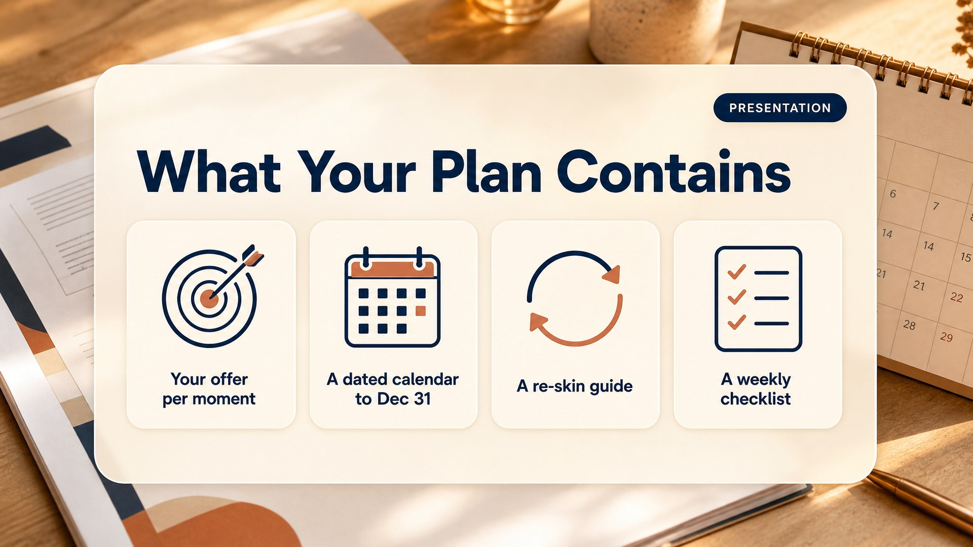
Notes:
Slide 39: What Your Plan Contains [Presentation]
*Presentation.* 3:57.
Four things. Your offer for each moment you picked. A dated calendar running to December 31. A re-skin guide. And a weekly checklist. That is the document you are walking out with.

Slide 40
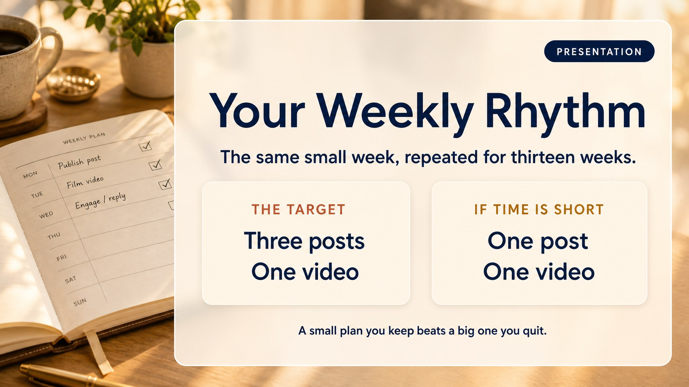
Notes:
Slide 40: Weekly Rhythm [Presentation]
*Presentation.* 4:00.
Three posts and one video a week, for thirteen weeks. And I want to be honest, because some of you just did the math and panicked. If you told the page you have three hours a week, your plan will say plainly whether that fits, and if it does not it hands you a smaller version instead. One post, one video.
Take the smaller one if that is your real life. A small plan you keep beats a big plan you quit. I would rather you post once a week until December 31 than four times a week until October 12.
Say clearly that this is the plan's cadence, starting this week, not something they produce today.

Slide 41
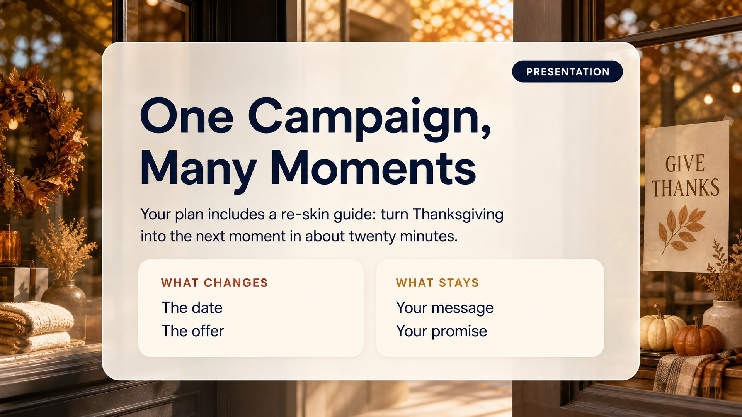
Notes:
Slide 41: Re Skin [Presentation]
*Presentation.* 4:05.
This is the payoff of the message you wrote in Module 03. Your plan includes a re-skin guide. Twenty minutes to turn your Thanksgiving campaign into the next moment. The date changes, the offer changes. Your message and your promise do not. That is why you did the hard thinking this afternoon.
---

Slide 42
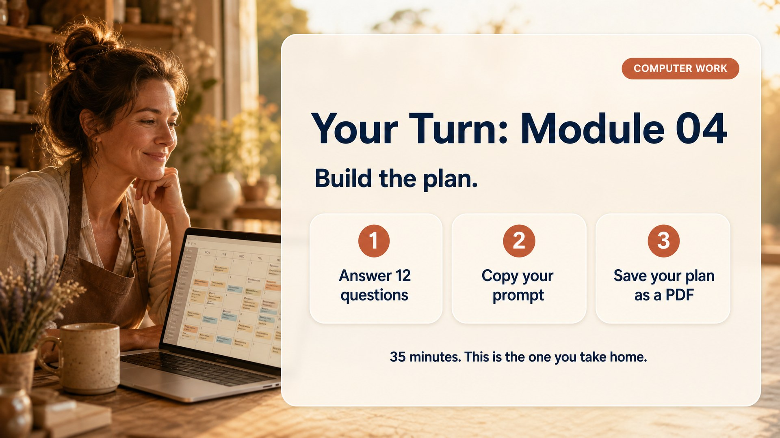
Notes:
Slide 42: Work Module 4 [Computer work]
*Computer work.* 4:10. Leave it up the whole block.
Module 04. Fourteen questions. The first three are your channels, found, build and accelerate, and there is an information button next to every option if you do not know what something is. The rest are quick. Run it, and save what comes back as a PDF. This is the one you take home.
At 4:15 tell them to read the Thanksgiving section first and ignore the calendar until it finishes generating, or they will get overwhelmed by the length.
If Claude will not produce a PDF, tell them to ask for "a single self-contained HTML page I can print," then Print, then Save as PDF. Have that line ready, you will use it more than once.
At 4:40: everyone saves their file, properly named, in a place they will find it. Do not let this slide.
---

Slide 43
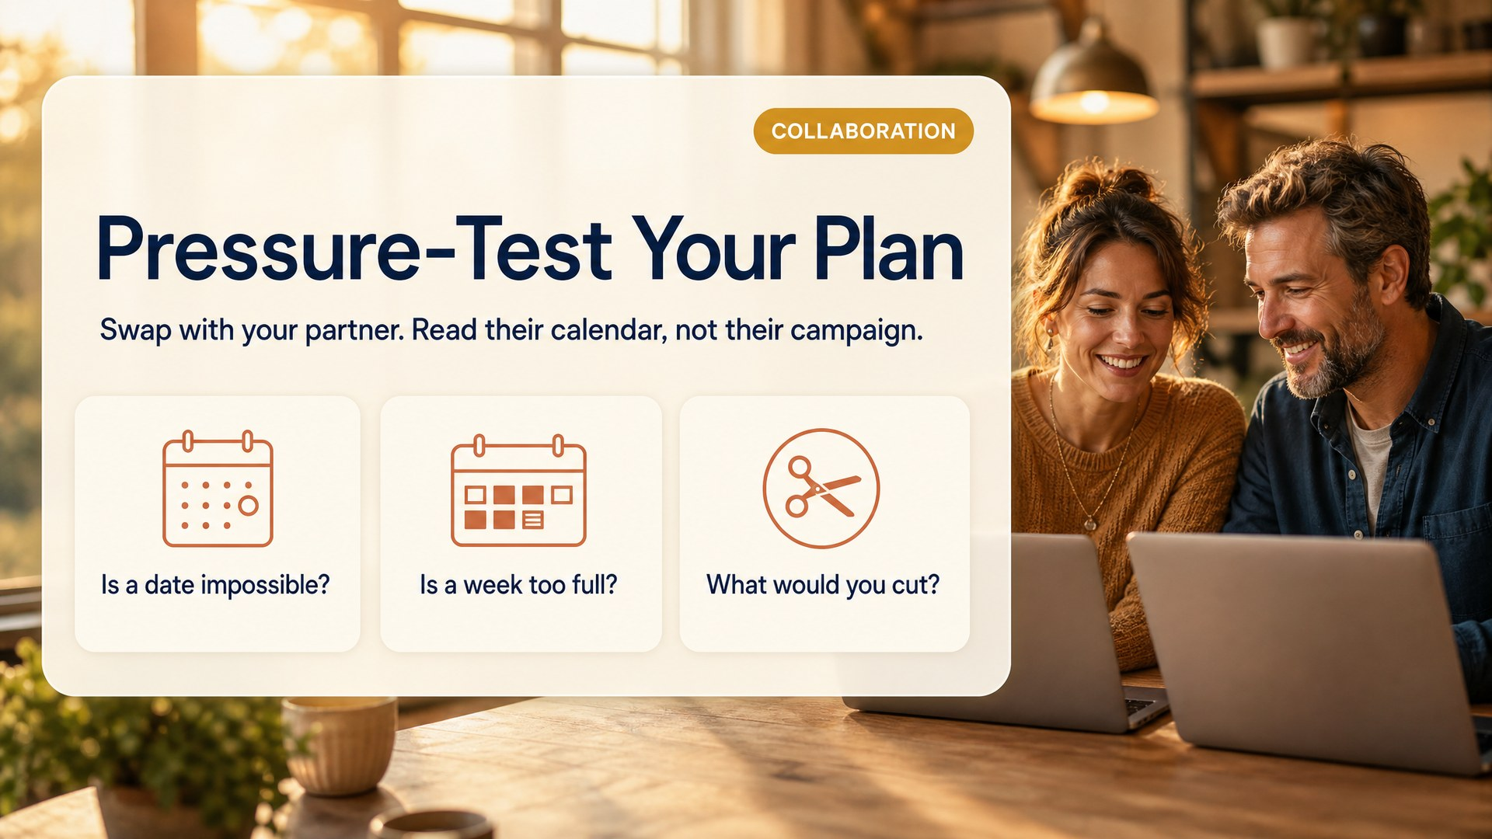
Notes:
Slide 43: Pressure Test [Collaboration]
*Collaboration.* 4:45.
Swap with your partner. Read their calendar, not their campaign. Three questions: is any date impossible, is any week too full, and what would you cut?
Five minutes. An outside eye catches the over-committed November that the owner cannot see.

Slide 44
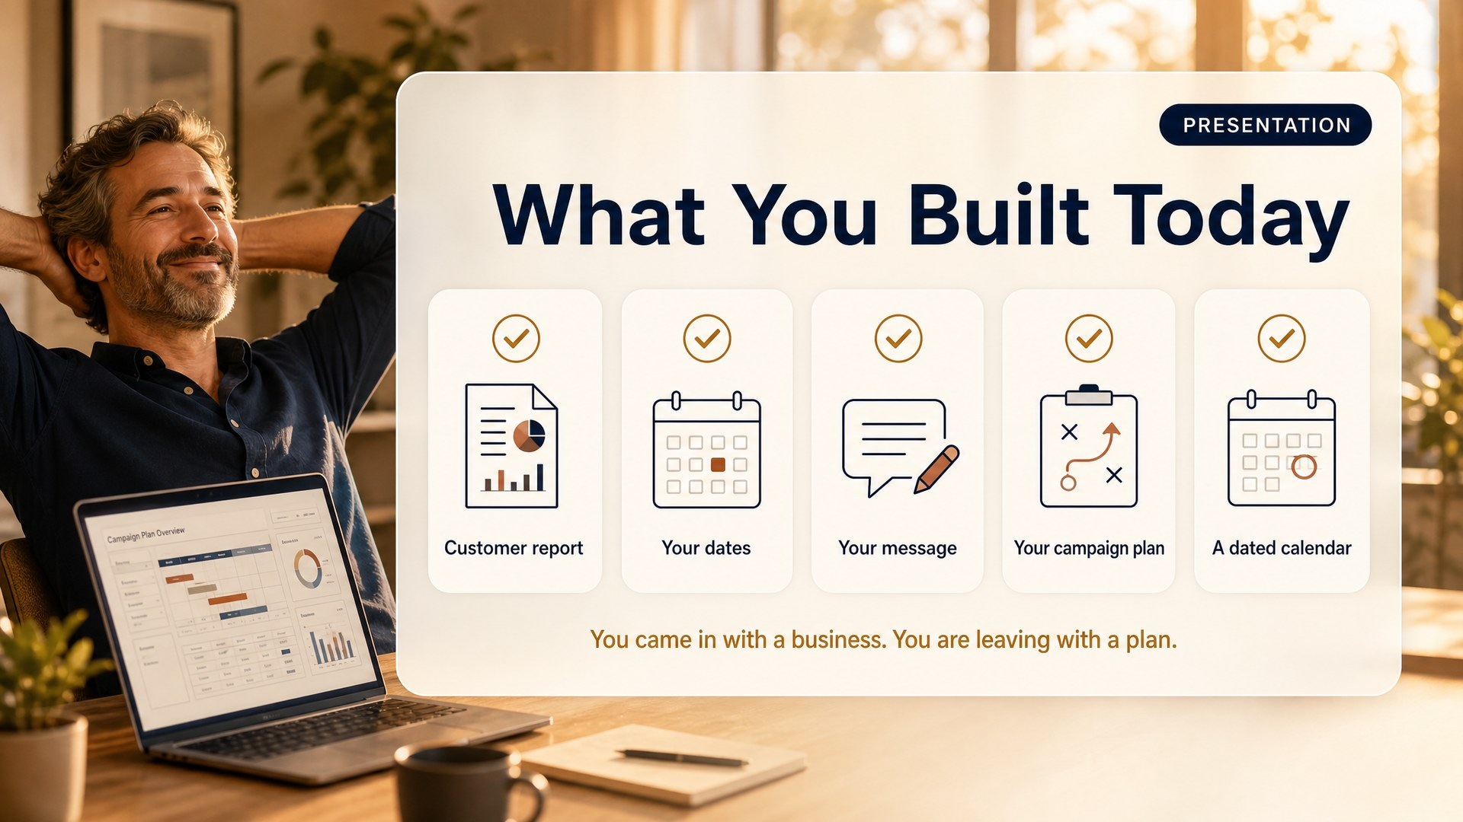
Notes:
Slide 44: What You Built [Presentation]
*Presentation.* 4:50.
Look at what is on your laptop. A customer report. Your dates. Your message. Your campaign plan. A dated calendar to December 31. You came in with a business and you are leaving with a plan.
And when we make your flyers and your videos in a future session, you will not be staring at a blank page. You will already know what they need to say and exactly when they go out.

Slide 45
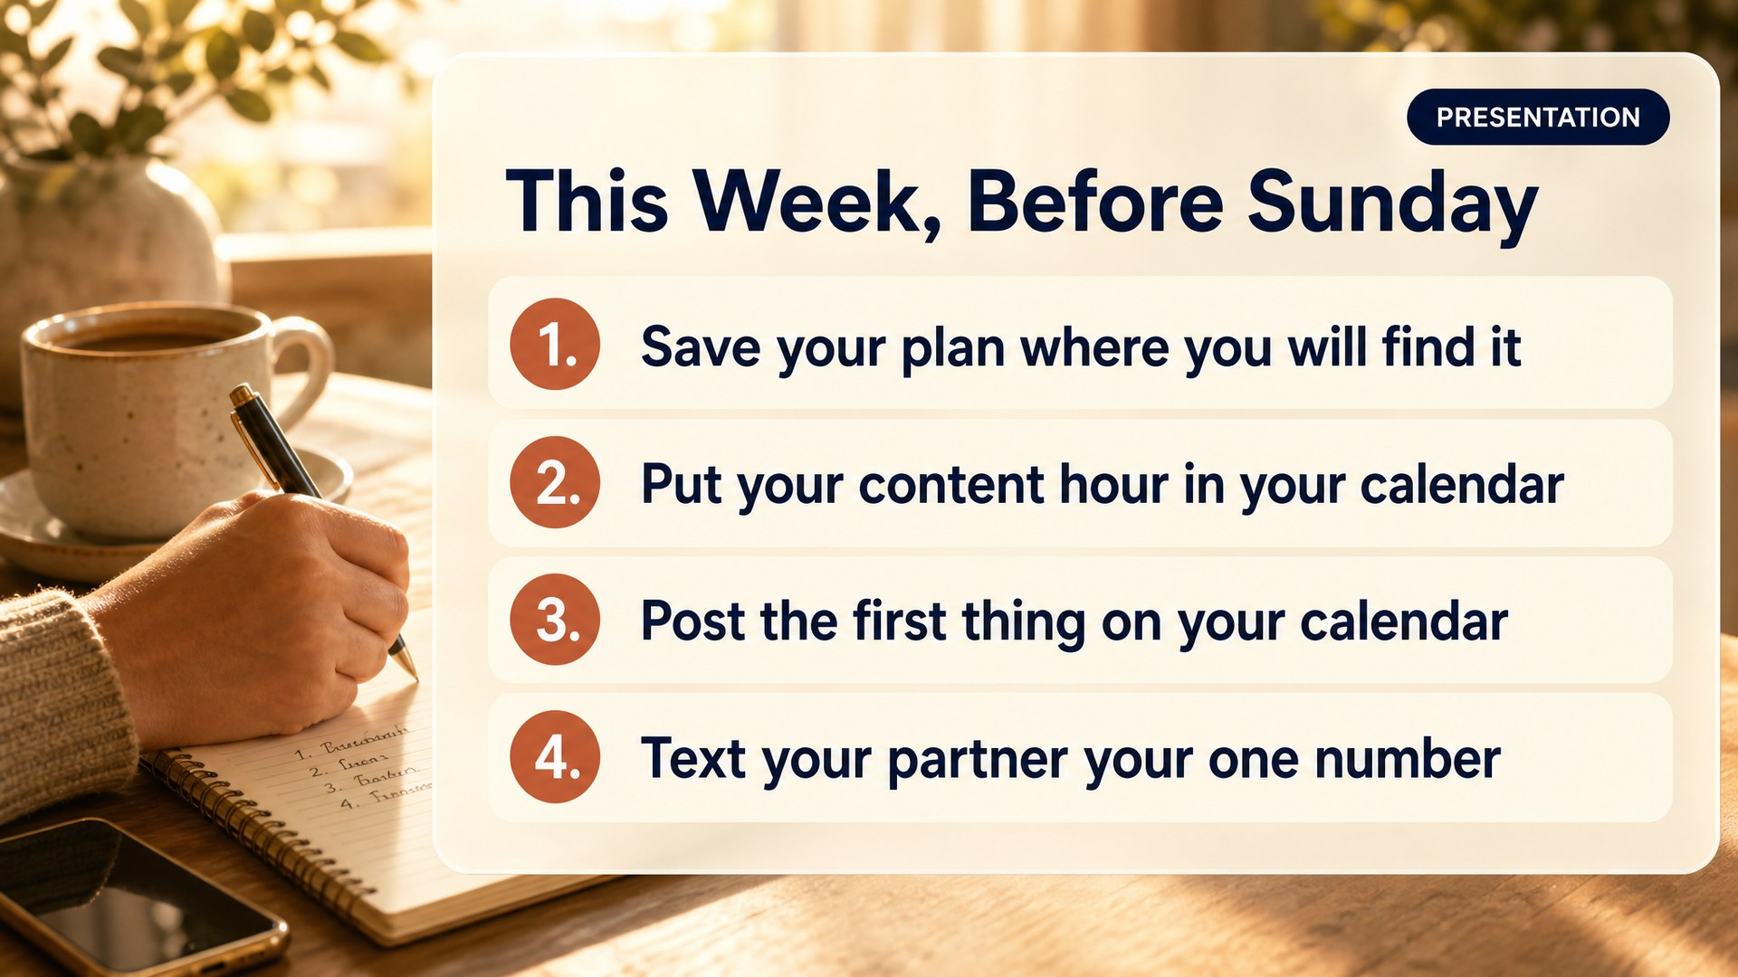
Notes:
Slide 45: Next Steps [Presentation]
*Presentation.* 4:53.
Four things. Save your plan where you will actually find it. Put your content hour in your phone as a repeating appointment, not a good intention. Post the first thing on your calendar. And text your partner your one number.

Slide 46
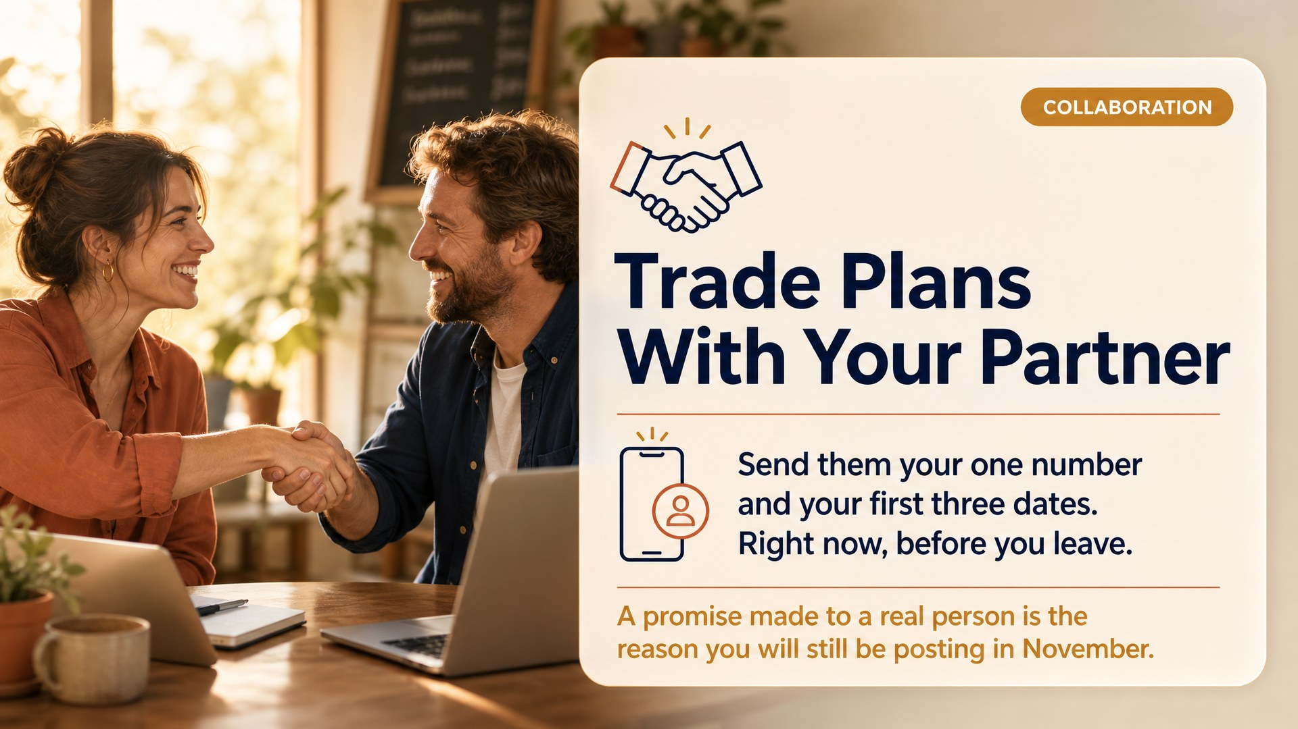
Notes:
Slide 46: Trade Plans [Collaboration]
*Collaboration.* 4:56.
Phones out. Right now, before anyone leaves. Send your partner your one number and your first three dates.
Make them actually do it in the room. A commitment sent to a real person is the single biggest predictor of who is still posting in November.

Slide 47
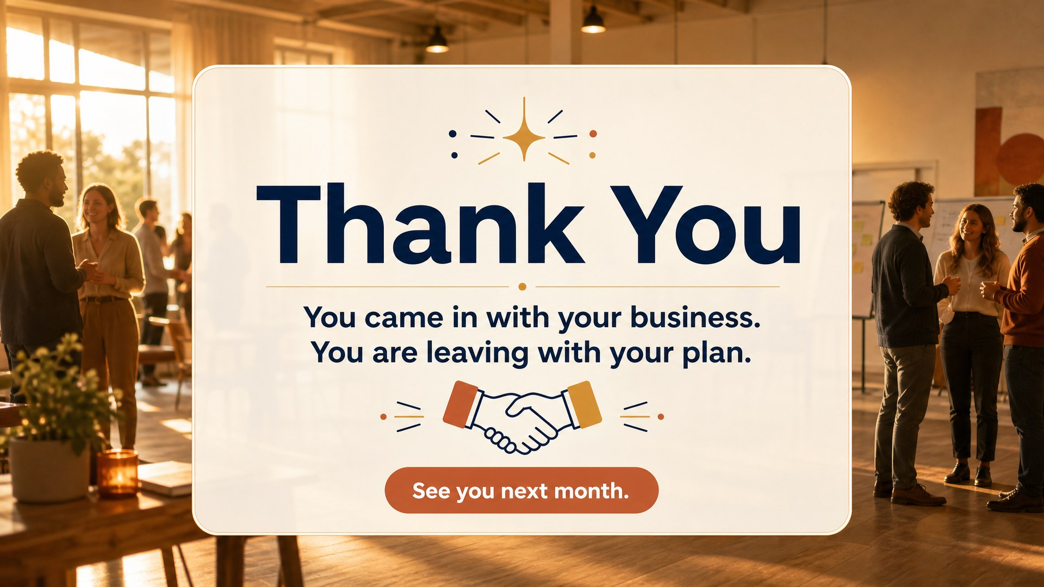
Notes:
Slide 47: Thank You [Title]
4:59.
You came in with your business. You are leaving with your plan. Everything is in your Claude Project and it stays there, so when you come back next month nothing starts from scratch.
Thank you for trusting me with your day.
Leave it up while people pack. Be at the front for the few who want to ask something they would not ask in front of the room. Often the most valuable fifteen minutes of their day.
---
*The Creative Strategist · A Branches B1 Program*

