Slide 1
Project 2
By Sebastian Augusthy, Cristian Pintor and Thon Ayuen

Slide 2
website
The website we got was the International Society for Universal Dialogue.
https://www.worldialogue.org/

Slide 3
Upgrading website
We are upgrading the website by fixing the 2018 congress page and the history page and adding a sign-up page and login.

Slide 4
2018 congress page
Things that needed to be fixed:
For the 2018 Congress page there are various issues that stand out and that need to be fixed. One of them is the way the photos are arranged on the page. The photos are not all the same size and would look better if they were in a slideshow instead of at the center of the page. This way the user can scroll through the photos and focus on the article text. The current placement of the page title and sub-title are also awkwardly placed. If the title were to be placed above the slideshow the user will know what the page is about, instead of having to scroll down midway and see the titles. After the user has read the title, subtitle and looked through the photos, the next natural action would be to continue scrolling down to the body of the page. This is where all of the text will be placed, and the length of the paragraphs will be cut in order to prevent them from looking too chunky.

Slide 5
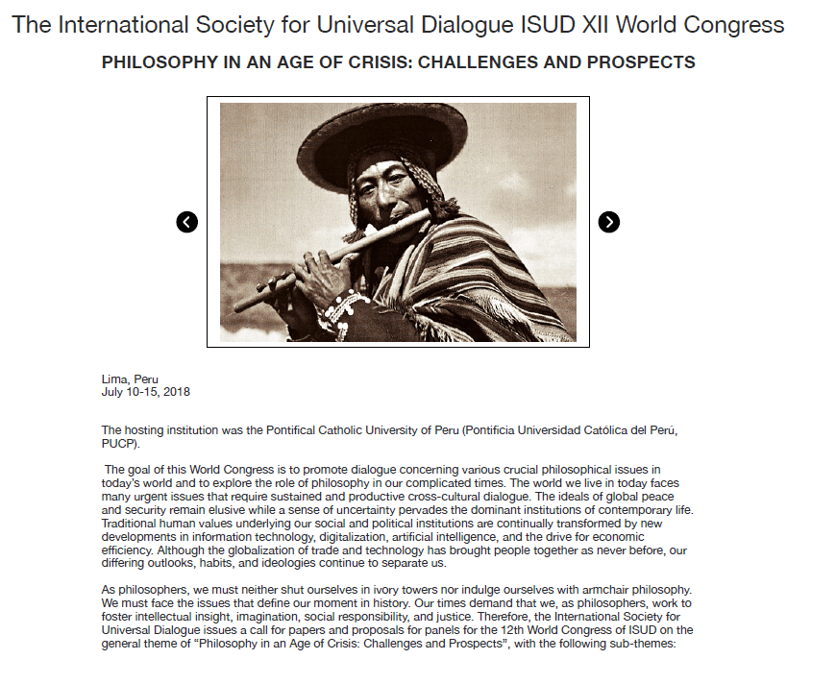
2018 congress page redesign

Slide 6
History page
For the history page, it follows the same headline format as the 2018 congress page. The text will be accompanied by a photo of the place where the organization was founded. It is important for users to connect a place to a company, such as it is important when asking a person what city they were born in and learn the history about the person/company.

Slide 7
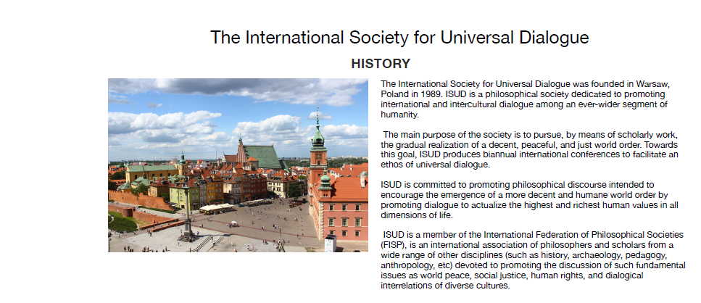
History page resign

Slide 8
Sign up page
The sign up page is made in a easy to use friendly way that is user friendly and easy to interact with.
To do this info about the organization will be on the side of the signup so people will be able to see understand what the organization is about
All the input fields of the signup have been made with contrasting colors so that people can understand what each field needs and the button is made a lighter color so that people will know that is the summit button.

Slide 9
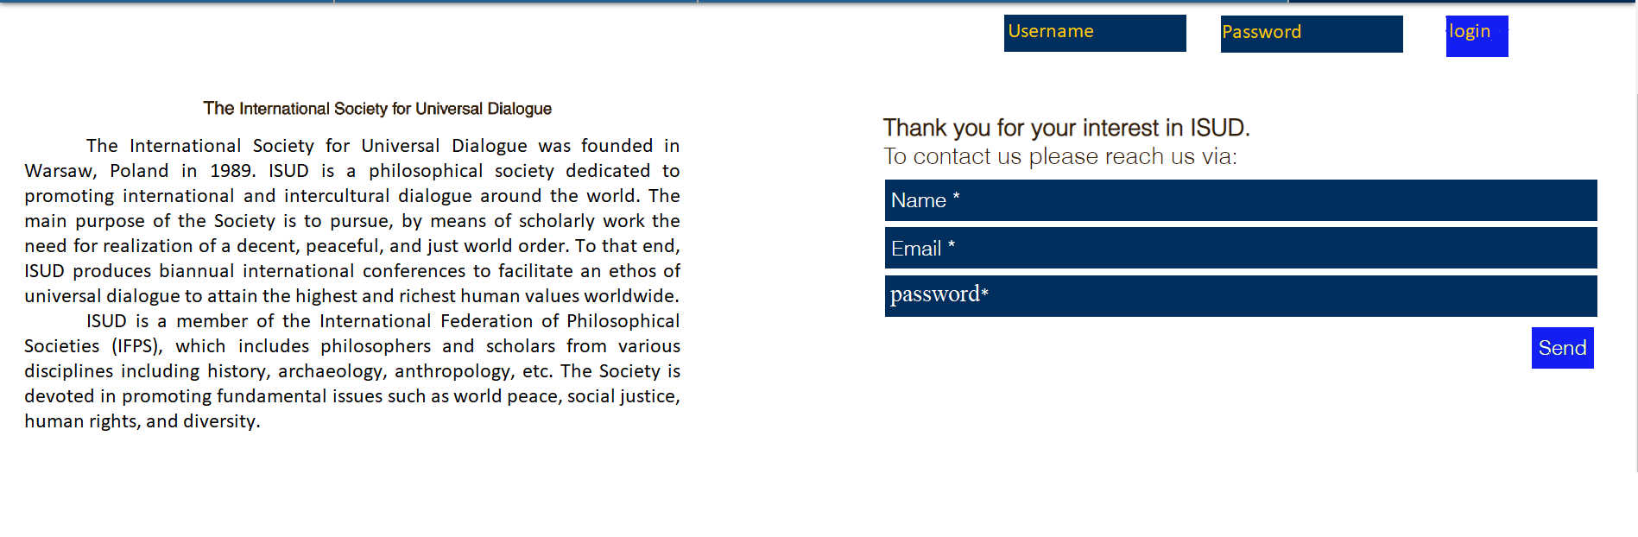
Sign up page layout

