Slide 1


Slide 2
Overview
What is Snowflake?
What are specials about Snowflake?
What are advantages of Snowflake?
Why chosen Snowflake?
Snowflake Tutorial

Slide 3
What is Snowflake?
Snowflake is a data warehouse vendor and its database solution is a cloud data warehouse available on Azure, AWS as well as Google Cloud. Snowflake is built entirely for cloud services, with no hardware and software to install, configure, and manage. So it's ideal for organizations that don't want to spend resources setting up, maintaining, and supporting internal servers. That means you just sign up for a Snowflake account, upload your data to Snowflake and focus on building the data, pay for what you use, and leave the rest to Snowflake.
Snowflake's difference comes from its architecture and data sharing capabilities.
Snowflake's architecture allows storage and compute to scale independently, so customers can use and pay for storage and compute separately.
Sharing functionality makes it easy for organizations to quickly share managed and secure data.

Slide 4
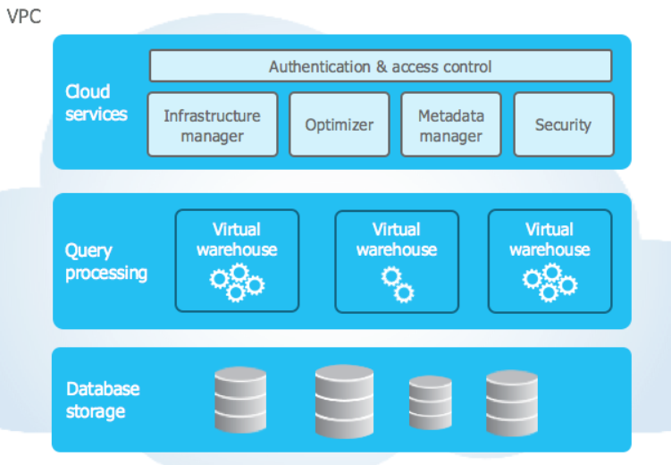
II. What is special about Snowflake?
Snowflake's architecture:
Snowflake decouples compute and storage functions, which means organizations with high storage needs but less CPU usage for compute, or vice versa, don't have to pay for an integrated package that requires them to pay. money for both. Users can scale up or down as needed and pay for the resources they use. Capacity is in terabytes stored per month and computation is billed per second. Snowflake's architecture is divided into 3 layers.

Slide 5
II. What is special about Snowflake?
Storage layer: this layer stores all data loaded into Snowflake, including structured and semi-structured data. Snowflake automatically manages all aspects of how data is stored such as organization, file size, structure, compression, metadata, statistics. This layer runs independently of computer resources
Compute layer: The compute layer is made up of virtual warehouses that execute processing tasks as needed for queries. Each virtual warehouse (or cluster) can access all the data in the storage layer, then operate independently, so the virtual repository does not share or compete for resources. This allows for automatic scaling without affecting running queries.
Service layer: This layer uses SQL and coordinates the entire system. It eliminates the need for manual inventory management and adjustment.

Slide 6
II. What is special about Snowflake?
2. Secure Data Sharing: A small example of the advantages of data sharing in Snowflake
Assume that your team of 5 people receives a request to develop, maintain and manage a database using SQL server. Then to work, the client must export the original database to send to your team, each person on your team needs to install the right tools to work with the SQL server, then import the data. This process is very time consuming and risky when the data is not consistent between members as well as during the installation process. Snowflake solves all those problems for you with just registering for each member an account, then the admin will share data for member accounts. All members can work directly with the database through the Snowflake web interface without having to install anything. Your team will have time to fully work with the database. This is just a small example of the advantages of data sharing in Snowflake, there is a lot more to be said about this feature, but we will not go into this in this section. If you want to know more please visit here

Slide 7
III. What are advantages of Snowflake?
Easy to install:
Like most “as-a-service” services in the cloud, the complexity of installation and setup is taken away from you. Simply complete an account registration on the Snowflake website and start building your data warehouse. Data backup, disaster recovery, high availability are all there for you, all you need to do is load the data into Snowflake and write SQL.
Extended features:
Like most other cloud services, Snowflake easily scales in real time according to your requirements. As demand grows, you can simply scale up your data warehouse to be able to handle all queries. If demand decreases, you can scale back the data warehouse. There are many warehouse sizes for you to choose from such as X-Small(1 credits/hour), Small(2 credits/hour), Medium(4 credits/hour), Large(8 credits/hour)… Suppose you run with the warehouse X-Small data most of the time. If no queries come in, the datastore is suspended and you don't have to pay any fees (except for storage). When the query comes in, the inventory starts to compute and you start paying per second of computation. If the demand is too large, you will move to a larger warehouse which means a larger amount of money to pay, but the calculation speed will be faster, so you may pay the same amount but the query faster with choosing a reasonable repository.

Slide 8
III. What are advantages of Snowflake?
One of Snowflake's best features is scaling your inventory up or down with no downtime. Queries continue to run, connections are not dropped, and once the warehouse has finished scaling, queries can take advantage. With an on-premises server, you need to buy a server, and then install it is very time consuming
3. Performance: try querying a large data
4. Backup and restore: as a cloud service, you can rest assured about Snowflake's backup and recovery capabilities. That is also the common advantage of cloud services
5. The ability to share data: as described before, it will make the management, maintenance and development of your data easier, safer and faster.

Slide 9
IV. Why chosen Snowflake?
Let's start with a story like this:
Company A specializes in online sales, has built a website and an app to serve customers. The number of transactions per minute of the company is about 100 orders per minute. The company uses an on-premises server. The company is doing better day by day, the number of customers increases and the number of orders increases, especially during the Covid 19 period, the number of orders increases sharply. In addition, the company often has promotions, only at the end of the month and holidays, so at that time the number of transactions also increased dramatically (sometimes more than 20 times normal). Because the number of transactions is so large, there have been times when the server is overloaded leading to bad customer experience. Previously, the company also had a solution to take the largest number of transactions of the year as a benchmark to be able to upgrade the server to that level, which looks fine but there are a few problems.
when you want to upgrade the server, it means that you will lose time shopping, installing .... Leads to the cost of money, time, and human resources.
The time when the number of transactions peaks only in a certain number of days such as on promotions or holidays, the remaining days the number of transactions is stable at normal levels, so the investment A terrible server just to serve a few days, the rest of the days not being used up is a waste.

Slide 10
IV. Why chosen Snowflake?
If in the future the number of customers increases, it will have to upgrade the server again, again and again… this is a waste of time and manpower.
The company asks your team to research to solve the above problems with the criteria required for a new solution including:
Performance
Ability of extension
Cost optimization
Backup and restore capabilities
Easy to install, manage and maintain
=> From the above requirements, choosing Snowflake is a right decision for you

Slide 11
V. Snowflake tutorial
Create a free Snowflake account: Please access here to the details
Snowflake’s User Interface:
Worksheet: As its name suggests, this is an interface to work with data, specifically writing SQL commands to query data.
Dashboards: where to display data analysis charts
Data: Where our data is managed
Database: database storage space
Private sharing: this is the place to create shares and view shared data for our account
Market place:
Activity: this is the place to refer to your activities including query history
Admin: this is the space to create datastores and settings for your account

Slide 12
3. Create Worksheet: worksheet is nothing but space to write query statements and display query data
4. Create a database:
5. Create a table:
6. Create a external stage: A stage specifies where data files are stored, an external stage refers to files stored outside of Snowflake. There are currently 3 supported cloud storage services:
Amazon S3 buckets
Google Cloud Storage buckets
Microsoft Azure containers
CREATE or replace STAGE SNOWFLAKE_DEMO_STAGE
URL='azure://cccdpadlsgen2main01.blob.core.windows.net/test-trung/',
credentials=(azure_sas_token='?sv=2020-08-04&ss=bfqt&srt=sco&sp=rwdlacupx&se=2022-12-15T11:55:28Z&st=2021-12-15T03:55:28Z&spr=https&sig=zO69nsPjNQF3MuutNmNbYkPUv%2FIHwynFEkgcAVBI%2FOg%3D');
7. Create a File Format: Before we can load the data into Snowflake, we must create a file format to match the data structure.
create or replace file format csv type='csv' compression = 'auto' field_delimiter = ',' record_delimiter = '\n'
skip_header = 0 field_optionally_enclosed_by = '\042' trim_space = false error_on_column_count_mismatch = false escape = 'none' escape_unenclosed_field = '\134' date_format = 'auto' timestamp_format = 'auto' null_if = ('') comment = 'file format for ingesting data for zero to snowflake';

Slide 13
8. Loading data:
To load data into Snowflake, we need to create a virtual warehouse and use the COPY INTO statement to load the structured data into the Snowflake table we created in the previous section.
Snowflake's virtual warehouses or compute nodes can be dynamically scaled up and down depending on the workload.
Go to the Warehouse section and create a virtual warehouse of the desired size, go back to the worksheet and select the newly created virtual warehouse. Then execute the following commands:
COPY INTO <table name> from @<stage name> file_format=<file format name> PATTERN = <pattern>
To check the data download process, you can access History to see details.
You can change the virtual repository size to larger size with the following command:
ALTER WAREHOUSE <WH_name> set WAREHOUSE=’larger’
9. Query data:

Slide 14
10. Using time travel:
Snowflake's time travel feature allows access to historical data as well as data objects at any point in time over a period of time. The default duration is 24 hours, and if you use the Enterprise Edition plan, it can be increased to 90 days.
Restoring dropped objects:
Run 2 commands as below:
Drop table <table name>
Select * from <table name> -> error
Undrop table <table name>
Select * from <table_name> -> success
Query historical objects:
Use the AT | BEFORE is specified in the FROM clause immediately after the past scoring table name to query previous versions of the data.
OFFSET:
Select * from employee at(offset => -60*5) // query data from 5 minutes ago
TIMESTAMP:
Select * from employee at(timestamp => ‘Sun, 06 Mar 2022 13:45:00 +0530’ ::timestamp_tz’)
STATEMENT( QUERY_ID ):
Select * from employee before(statement => <query_id>)
The Query Id used is of the Update statement we used earlier. Access to History to get query id

Slide 15
C. Cloning historical objects:
Using AT | BEFORE combines with offset, timestamp and statement to clone table from history
Create or replace table <table name> clone <table name> at(offset => -60*5)
Create or replace table <table name> clone <table name> at(timestamp => ‘Sun, 06 Mar 2022 13:45:00 +0530’ ::timestamp_tz’)
Create or replace table <table name> clone <table name> before(statement => <query id>)

Slide 16
Q&A

Slide 17
Thank you!

