Slide 1
Vue.js
https://vuejs.org

Slide 2
Overview
Basic concepts
Components
Reusability & Composition
Vue router
Vuex
Best practice
Q & A

Slide 3
Basic concepts
What is Vue.js:
Vue is a progressive framework for building user interfaces and single-page applications.
Vue applications are often organized into a tree of nested and reusable components.
How to install:
https://vuejs.org/v2/guide/installation.html

Slide 4
Basic concepts
Vue Instance:
Every Vue application starts by creating a new Vue instance with the Vue function.
var vm = new Vue({
// options
})
A Vue instance is the root of our application.
When you create a Vue instance, you pass into an option object.
The options detail please access here: ‘https://vuejs.org/v2/api/#Options-Data’.
Vue instance is also Vue component so we will discuss to the details about the options at Component

Slide 5
Basic concepts
Template syntax:
Intercalation: this is the process of adding a text, content, attribute ,.. to HTML tags using Vue.js.
Text: This is the most basic form in vue to bind data in text form with the syntax is two pairs of curly braces (mustache) adjacent to each other {{key}} Vue template will recognize any pair of curly braces and get the name that you have put inside, then compare with the list of keys that you declared in data to display the data.
Attributes: Parentheses cannot be used inside HTML tags, but instead to be able to add attributes to HTML tags with data in vue.js, you use the “v-bind” directive's syntax.
Javascript Expressions : we can completely use javascript code in the {{}} pair. However, we can only use the scopes declared by default in Vue such as data, computed, method… Note, it can only handle single statements that return a result, expression statements like if-else ... will not be processed.

Slide 6
Basic concepts
Template syntax:
Directives : Directives in vue.js are attributes set with v- prefixes (v-bind, v-on, v-if, v-else, v-else-if, v-model...). The values of these attributes are usually unique javascript expressions, except for v-for. We going to the details about directives later
Arguments: Some directives will allow us to pass parameters in. To pass parameters to these directives, you just need to separate the directives and the parameter with a comma : as v-bind:class, v-bind:style….
Modifiers: Modifier is a special suffix appended with a dot, the purpose of the modifier is to determine for the directive to behave in a particular way. For example, the .prevent modifier instructs the v-on to call event.preventDefault() when the event is fired.
Filters: Filter works as a data filter, so we can only use it in two places: inside curly braces {{}} and inside the v-bind directive. The filter will be added after the javascript expression and separated by a vertical dash |. You can use multiple filters at the same time by the dash “{{ message | filterA | filterB }}”

Slide 7
Basic concepts
Template syntax:
Shortened syntax:
v-bind : example: v-bind:class -> :class.
v-on: example: v-on:click=”onClickHandle” -> @click=”onClickHandle”

Slide 8
Basic concepts
Computed property : Computed property in Vuejs is represented as a method or an object containing setter and getter methods used to set data and get the data to give the template. When you call a computed property, you call it like a normal property. And then the actions in the computed property will be executed. In addition, we can also think that Computed Properties are functions (methods) used to process data displayed on the template, but more optimal than methods, its results will be stored (Cache) and updated only when needed. Set.
Computed syntax: we just need to put it in the computed key
Computed getter and setter : By default each computed will have two methods that are getter and setter, if you do not declare it, by default it will understand that you are using getter, so at the end of each computed there is always a return statement.

Slide 9
Basic concepts
Watcher: watcher has responsible for monitoring data changes and taking action accordingly.
Watcher syntax: we need to follow 2 rules:
Watcher’s name have to equal with data name need to watch
Watchers have to put into watch scope
Computed and Watcher: We can think of computed as an aggregation of many watchers

Slide 10
Basic concepts
Conditional Rendering (v-if, v-else-if, v-else and v-show) :
V-if, v-else-if, v-else directives: We use the v-if, v-else-if, v-else directives to “render” the template under a certain condition.
V-show directive: In addition to v-if for simple cases, we can use v-show instead. The value of v-show will decide whether to “show” the element or not.
Different between of v-show and v-if:
v-show only hides and shows HTML tags with CSS, and v-if removes and adds.
v-show cannot be used with templates, and cannot be combined with v-else and v-else-if.
With v-if if the initial value is false then the events inside will be destroyed, and will be recreated during the transition. v-show is much simpler, elements are always displayed whether true or false because it only changes the CSS. So with v-show, the rendering cost is higher than v-if but the conversion cost is lower
When to use v-if when to use v-show?
For the case where the data changes a lot in one run, you should choose v-show because it only renders for the first time at runtime.
As for the data that does not change in 1 run, choose v-if because it is more private.

Slide 11
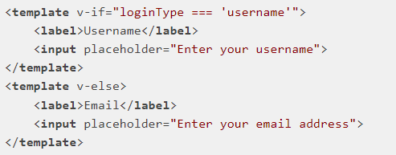
Basic concepts
Conditional Rendering (v-if, v-else-if, v-else and v-show) :
Note: Vue is very fast because it knows how to make use of all available data, meaning Vue will try to reuse what has been processed instead of having to run from scratch, which also has some benefits but also there are some disadvantages. Let's take a look at the following example:
If the value of loginType is username, the upper template will be rendered, otherwise the lower part will render. However, when you change the loginType from username to email, Vue will not take the input field below, but it will keep that input and only replace the value of the place-holder. To solve this problem, the input environment will give it a unique key (like ID). key=”uer-input” for input tag in username template and key=”email-input” for input tag in email template.

Slide 12
Basic concepts
List rendering:
V-for directive:
v-for=”item in list” or v-for=”item of list”
item is the variable assigned to the items in the array.
list is an array
v-for=”(item, index) in list” or v-for=”(item, index) of list”
index is the index of element item in array
Template v-for: In case you want to render a group of tags in each iteration, Vue.js also supports you to use tag templates to group those tags like v-if.
Object v-for: you can also use v-for to browse the elements inside the object
Note: you should not use a combination of v-for and v-if, you should instead use computed to filter the data to display

Slide 13
Basic concepts
Listen to Events: we use v-on to listen to events from DOM.

Slide 14
Basic concepts
Form input binding
Vue provides us with a v-model directive to create two-way data binding on input and text-area elements. Vue will automatically choose the appropriate way to update this element based on the input's type. V-model will ignore all initialization of value, checked or selected on form elements. Also, it always handles the data contained in the Vue instance, so you should declare your initialization values in the data scope.

Slide 15
Component
What is the component?
Components are reusable Vue instance with a name and options to group some html code, css and javascript for the purpose of displaying a single function making the code neat, simple and manageable
How to define a component?
There are many ways to define a component, we will discuss the most common way to define a component which is the single-file component. It is especially useful when applied in large projects by dividing each component into a separate .vue file to make the code shorter, neater, easier to manage and maintain. The name of the component should be in PascalCase or kebab-case. We should put it in a unified way

Slide 16
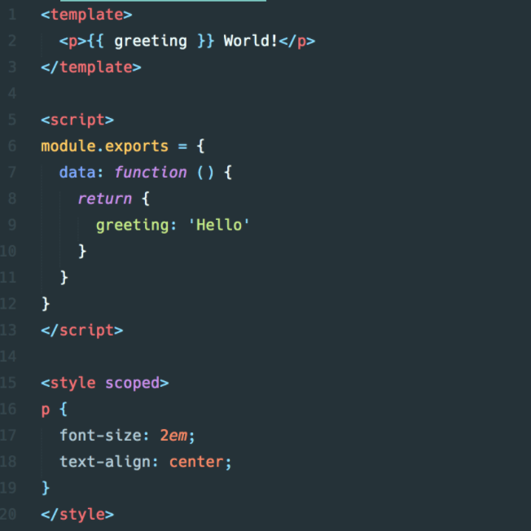
Component
Single-file component structure:
A components file will have 3 parts: HTML, CSS, and javascript are written separately

Slide 17
Component
Using components:
Global registration: import single-file component into the main file and using syntax Vue.component(‘component-name’, component) to register
Local registration: just declare component into the “components” key of Vue instance that need it

Slide 18
Component
Component Lifecycle:
Creating: this is the first process of the component, where we can perform actions with the component's data before they are actually added to the DOM. During this process we can set parameters, perform data manipulation before the component is put into the DOM.
beforeCreate: runs just before the process where a component is instantiated. In this process, the data that we declare is not reactive (changes itself when there are updates) and the events have not been initialized.
created(): as soon as the component is created, the create function can be used to manipulate the data in the data and the events you set can already be fired. But the template and the virtual DOM have not been mounted and rendered, ie, if you access the elements in the DOM at this time, it will not be able to and will report an error.
Mounting:
beforeMount(): is called after the component has been compiled and before the first render. At this stage, when you access the elements in the DOM, you will still get an error.
mounted(): In this process we have full access to data, template, DOM. we should not fetch data at this process because when we update data for component's data then the component re-render. So, we should fetch data at created() to avoid re-render component.
Updating:
beforeUpdate(): This process is called immediately after the data on the component is changed and before the component re-render
updated(): This happens after beforeUpdate, where the DOM has been updated again
Destroy:
beforeDestroy(): This process occurs just before our component is destroyed (for example when we switch from one component to another, or when we switch routes,...). Here the component is still full of elements such as data, events, ... We often use this function to remove unnecessary events after the component is destroyed.
destroyed(): At this process, almost everything on the component has been destroyed: directives are destroyed, listener events are discarded, child components are destroyed, watchers are destroyed. However, at this process, the data is still there, so we can still access it

Slide 19
Component
Data:
The data option for a component is a function and it returns an object, the component will be adds all the properties found in that object to “reactivity system”. When the values of those properties change, the view will “react”, updating to match the new values.

Slide 20
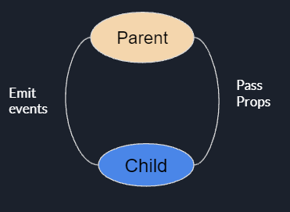
Component
Vuejs Parent Child Communication:
Parent component passes props to child component
Child Component responds to parent Component with Event by this.$emit(“event-name”)

Slide 21
Component
Props:
Props in Vuejs is a custom attribute used to pass data from parent component (parent component) to child components (child components). To be able to receive data from the parent component, the child component must declare the prop it wants to receive from the parent component, by naming the prop in the props scope.
Camelcase and kebab-case: If using the kebad-case style to define props in the parent component and pass it to the child component, the name of the props in the child component must be written in camelCase. Ex: prop to pass: 'my-title' => prop of Child component is 'myTitle'. Alternatively you can use the usual way of transmitting and receiving props with the same name.
Dynamic props: use v-bind to bind prop data on parent level. That means that when the data at the parent level changes, the child level also changes.
Literal and Dynamic: If you want to pass numeric data to the component, you will have to use v-bind, but if you use a regular prop, it will receive a string.
One-way data flow: The props in Vue.js are all one-way-down . That means when the data at the parent level changes, it will be bound down to the child level. In addition, if the data at the parent parent changes, the component child will update and get the latest value of that changed data. And true to the name one-way-down you cannot change a prop inside a child component.

Slide 22
Component
Props:
Prop validation:
Validation type: we have three ways to validation type:
props: { propName: type }
props: {propName: [ type1, type2, … typeN ] }
props: { propName: { type: typeName }}
Default value: props: { propName: { type: typeName, default: value } }
Prop required: props: { propName: { type: typeName, required: true} }
Custom validation: using ‘validator’ key to create a custom validation. Ex
props: {
point: {
validator(value){
return value > 10
}
}
}

Slide 23
Component
Slot and scoped slots: Normally in Vuejs we often use prop to pass data from parent component to child component. But sometimes we don't want to use prop but just want to insert HTML content inside the child component like how we write normal HTML => we use slot
Slot syntax: <slot></slot>
Fallback content slot: All content inside <slot></slot> will be used as fallback content when parent component doesn't insert anything into child component
Slots are named: slot in vuejs has a special attribute called name that allows us to name the slot. A component can contain multiple slots with different names, and Vue.js also allows an unnamed slot to contain content that doesn't match any slot name in the component.
Scoped slots: scoped slots are a special type of slot that allows you to pass data from the child component to the parent component by assigning data via properties (it's similar to putting data into the component's props).

Slide 24
Component
Dynamic component: Dynamic Component allows users to switch 2 or more components without routing. It is even possible to keep the state when converting back to a component. When you design UI, if you want to have dynamic form to show or hide components based on state. Dynamic Components handles this simply and efficiently, helping you to reduce the number of lines of code instead of using directives like v-if, v-else-if, v-else
Syntax: Vue exposes an element to Dynamic Component called component
<component v-bind:is=”currentComponent” />

Slide 25
Reusability & Composition
Mixin: Mixins are a flexible way to distribute reusable features to components. A mixin object can contain any of the component's options. When a component uses a mixin, all the options in the mixin are "mixed" into the component's options.
Merge options:
When a mixin and component contain overlapping options, these options are merged using appropriate strategies. For example, data objects will be merged one level deep (shallow merge), and when there is a conflict, the component's data will take precedence.
Hook functions with the same name are merged into an array so that all hook functions are called. Additionally, the hooks in the mixin will be called before the hooks in the component
Options that have an object value such as methods, components, and directives will be merged into the same object. If the key of the options is the same, the component's option will take precedence
Global Mixin: You can also apply a mixin at the global level. But be careful when using this, because a global mixin will affect all Vue objects that are instantiated later.

Slide 26
Reusability & Composition
Custom Directive: Besides the default directives that are v-model, v-show... Vue.js also allows users to register their own custom directives
Directive hooks:
bind: is called only once, when the directive is bound to the element. This is where you can do one-time installations.
inserted: is called when the element has been inserted (insert) into the parent element (this only ensures that the parent element has been created, not sure if it already exists in the DOM).
update: is called after the container element's VNode has updated, but possibly before the child elements are updated. The value of the directive may or may not have changed at this point, but you can ignore unnecessary changes by comparing the old and new values.
componentUpdated: called after the VNode of the containing element and the VNode of all children have been updated.
unbind: is called only once, when the directive is unbind from the element.
Directive hook parameter:
el: The element the directive binds to. This parameter can be used to modify the DOM directly.
vnode: Vnode is generated by Vue's compiler
oldVnode: VNode trước , chỉ tồn tại trong các hook update và componentUpdated.
binding: An object containing the following properties:
name: The name of the directive, without the v- prefix.
value: The value passed to the directive. For example with v-my-directive="1 + 1" the value will be 2.
oldValue: The previous value, which only exists in the update and componentUpdated hooks. oldValue will always be there whether the value is changed or not.
expression: The expression of the binding as a string. For example with v-my-directive="1 + 1", the expression will be "1 + 1".
arg: Parameters passed to the directive, if any. For example with v-my-directive:foo the arg would be "foo".
modifiers: An object containing modifiers, if any. For example with v-my-directive.foo.bar, the modifiers would be { foo: true, bar: true }.

Slide 27
Reusability & Composition
Plugin: Plugins are often used to add functionality to Vue at the global level, and there is no specific binding scope for a plugin.
How to use plugin: Vuejs lets us use a plugin by calling the Vue.use() global method. Vue.use automatically prevents a plugin from being used more than once, so even if we call Vue.use(MyPlugin) ten times, MyPlugin will only be installed once.

Slide 28
Vue Router
Vue Router is a module deeply integrated into Vue that makes it easy to create routes for your application.
Install: npm i --save vue-router

Slide 29
VueX
How to install: npm install vuex --save or yarn add vuex
How to import:
Step1: Initial store:
Create store.js file
Import store from “<path to store.js file>” into main.js file and add store into options of Vue instance
Step 2: Import VueX from “vuex” in store.js file
Step 3: Write Vue.use(VueX) statement in store.js to use vuex
Step4: Write export default new Vue.Store({ //option }) statement in store.js to create a new store instance to managed state. If you want to split vuex into small modules for easy state management, juts import modules and add option modules: { moduleA, moduleB...} to the store instance
Step5: define module
Vuex have 4 main property to managed state is ‘state, getters, actions, mutations’
If you use module in vuex, just add option “namespaced: true” into each module exported
Properties detail and how to use them: ‘https://vuex.vuejs.org’

Slide 30
Best Practice
Always use :key inside v-for
Data should always return a function
Validate props with good definitions
Do not mix v-if and v-for because v-for has a higher priority than v-if
Use of multiple V- condition: Never use multiple v-if condition to render multiple consecutive elements. You can use <div> tag to wrap the elements. But it will give an extra element which doesn’t have anything to do. So you can use <template> tag to wrap the elements.
Use of shorthands or never
Code splitting: you should separate the code into separate components by single-file component with separate functions for each component for easy code management, reuse and maintainability

Slide 31
Q & A

Slide 32
Thank you

