Slide 1


WRIT 20833 Intro to Coding in the Humanities
WRIT 20833
Intro to Coding
in the Humanities
Dr. Curt Rode
Dr. Brad Lucas

Slide 2
Semester Overview: Instruction, Readings, Assignments
December
SR3
Research
Project
November
Methods
& Web Dev Basics
Introduction to Cultural Analytics & Python
Jo
SR2
October
HW (10);
Journal Entries (12+)
Python Basics
September
SR1
Instruction
Readings
Assignments

Slide 3

Nick Montfort: On Learning to Code
According to Nick Montfort, learning how to code in the humanities:
Allows us to think in new ways
Offers us a better understanding of culture and media systems
Can help us improve society.
Exploratory Programming for the Arts and Humanities (321)

Slide 4

Douglas Rushkoff: Capabilities
“[T]he underlying capability of the computer era is actually programming—which almost none of us know how to do. We simply use the programs that have been made for us, and enter our text in the appropriate box on the screen. We teach kids how to use software to write, but not how to write software. This means they have access to the capabilities given to them by others, but not the power to determine the value-creating capabilities of these technologies for themselves.”
Douglas Rushkoff, qtd in Nick Montfort’s Exploratory Programming for the Arts and Humanities, 327-28

Slide 5
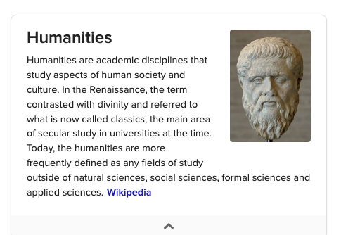
Humanities

Slide 6
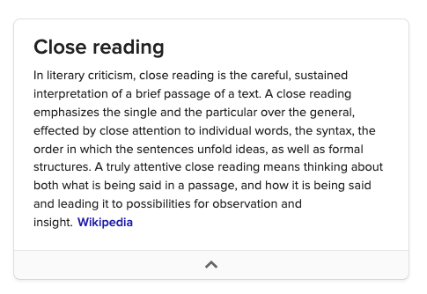
Close Reading

Slide 7
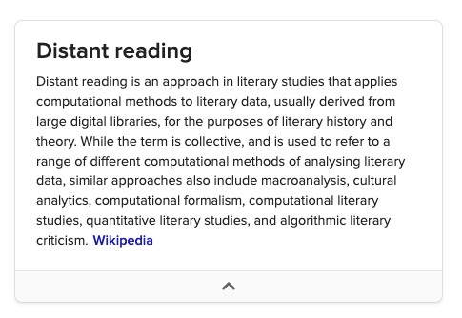
Distant Reading

Slide 8
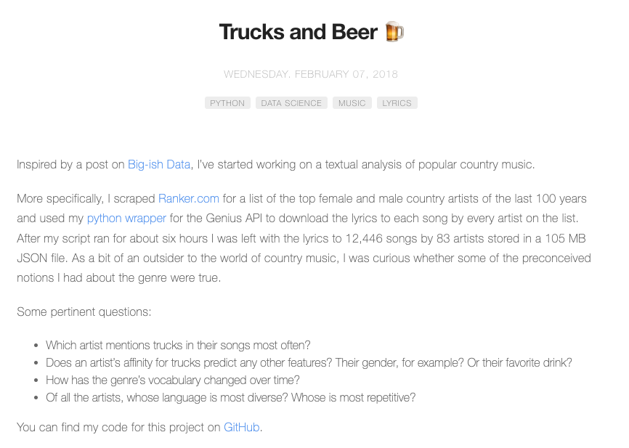
Trucks and Beer

Slide 9
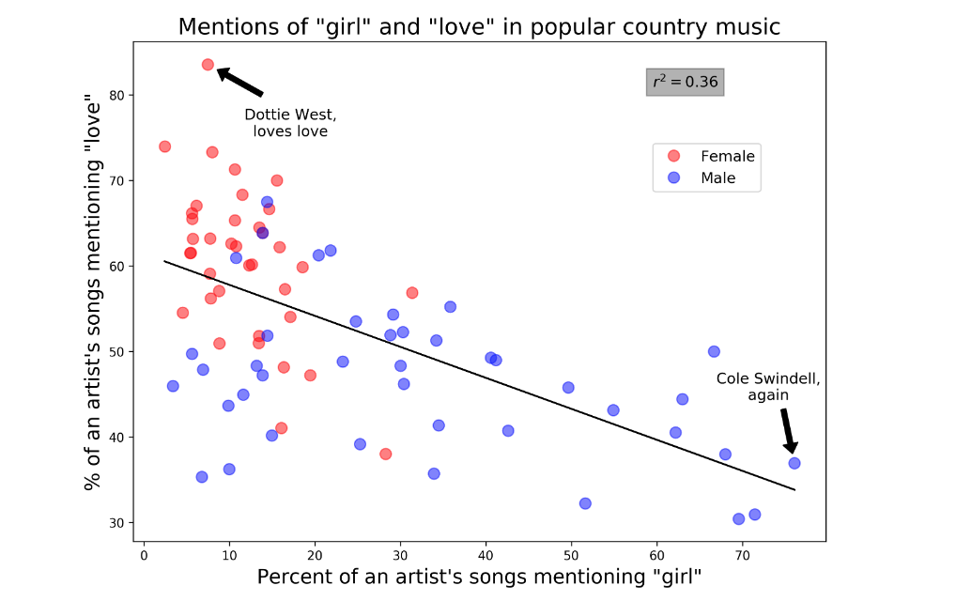
“Girl” and “Love” in Country Music

Slide 10
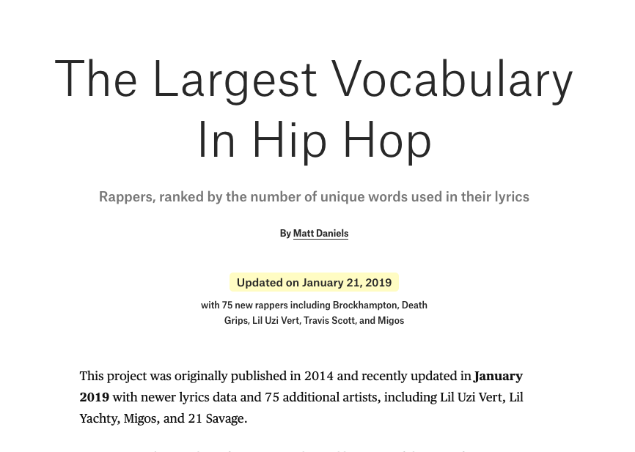
The Largest Vocabulary in Hip Hop

Slide 11
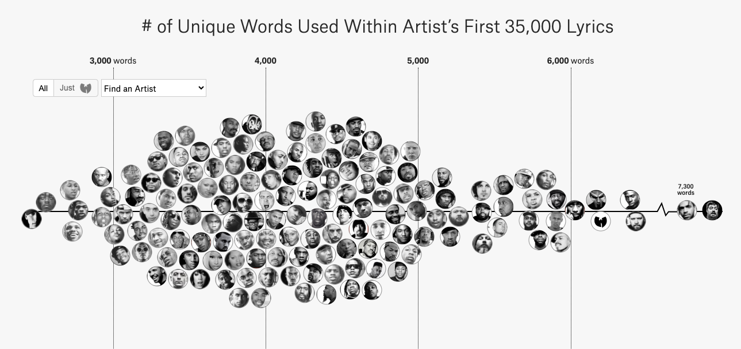
# of Unique Word in First 35K Lyrics

Slide 12
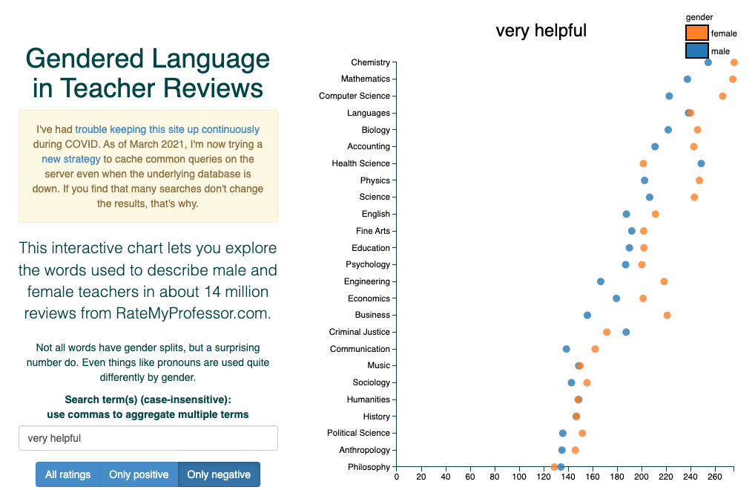
Gendered Language in Teacher Reviews

Slide 13
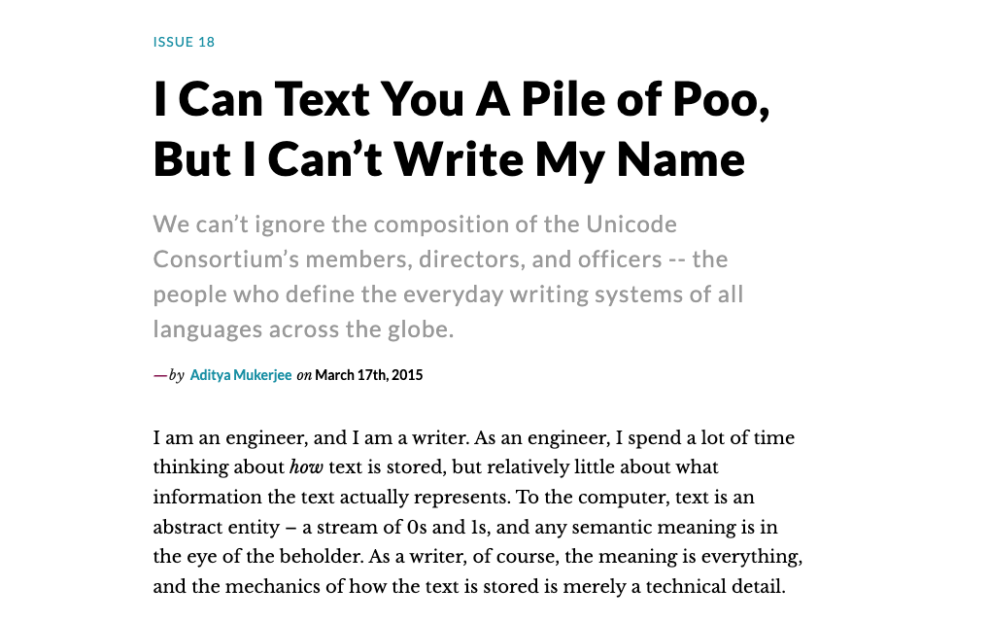
Text You A Pile of Poo

Slide 14

Second-Class Languages

Slide 15
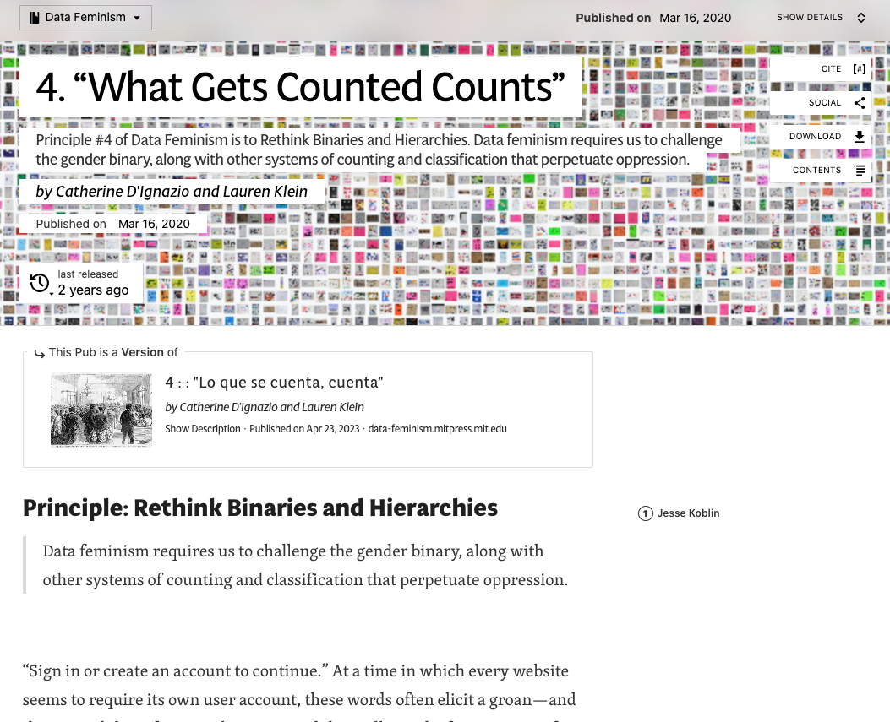
Rethink Binaries and Hierarchies
Notes:
https://data-feminism.mitpress.mit.edu/pub/h1w0nbqp/release/3

Slide 16
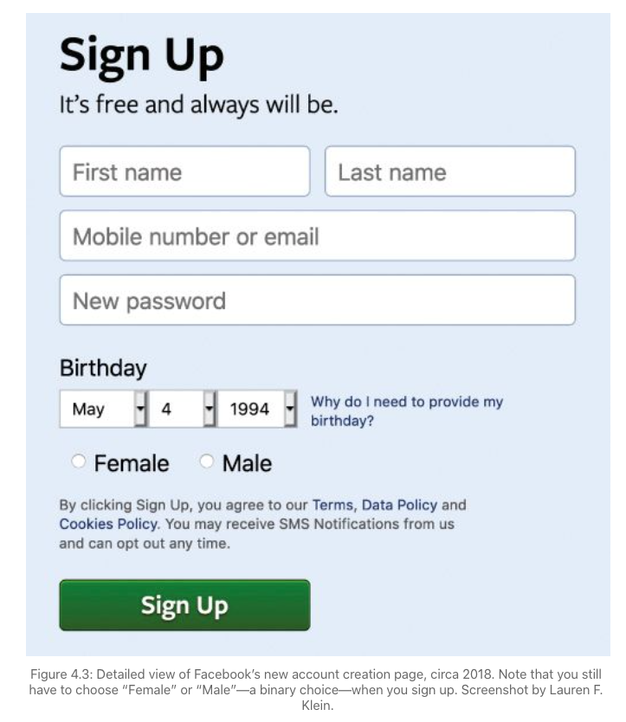
Facebook Account
Notes:
Facebook continues to resolve users’ genders into a binary: either “male” or “female.” Evidently, this decision was made so that Facebook could allow its primary clients—advertisers—to more easily market to one gender or the other. Put another way, even if you can choose the gender that you show to your Facebook friends, you can’t change the gender that Facebook provides to its paying customers (figure 4.3). https://data-feminism.mitpress.mit.edu/pub/h1w0nbqp/release/3

Slide 17
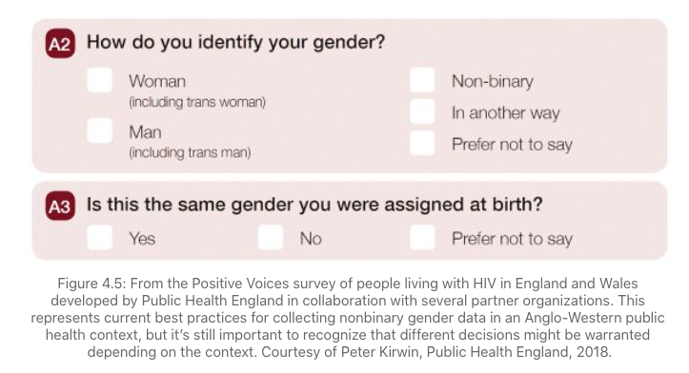
Positive Voices Survey
Notes:
One recent alternative to the binary, developed by Public Health England in collaboration with LGBTQ+ organizations in the United Kingdom, is in evidence in figure 4.5. This two-item questionnaire was designed for use in routine national surveillance of HIV in England and Wales to determine self-identified gender and cis or trans status in a public health context. The designers offer three named genders, a catch-all fourth category, and an option for not disclosing gender identity. In a separate question, they ask about gender at birth, again giving an option for not disclosing. The survey design uses sensitive wording and inclusive terminology to allow trans and genderqueer populations to be counted. These questions are being considered for expanded use across other national health records and data collection systems in the United Kingdom.
https://data-feminism.mitpress.mit.edu/pub/h1w0nbqp/release/3

Slide 18
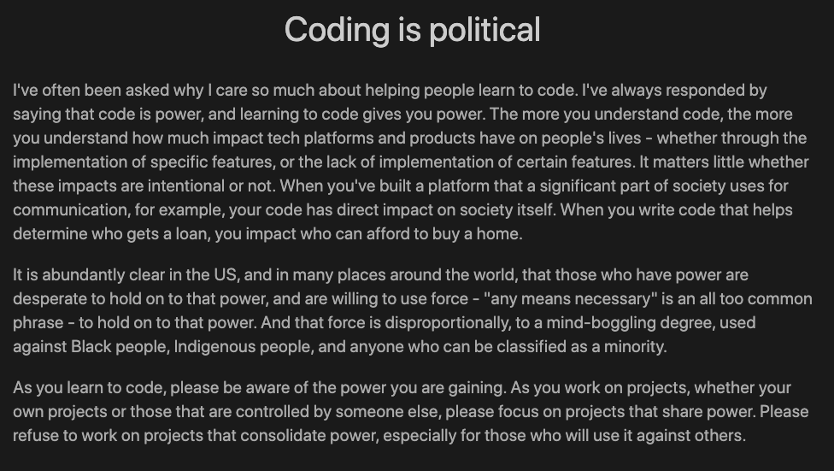
Coding is Political
(Eric Matthes)

