Slide 1

Data science for cyber security
Date : 13th May 2022
Notes:
I like this option. We should add some component for security.

Slide 2
What is cyber security?
What is Threats / attack?
What are the types of cyber
security?
Critical infrastructure security.
Application security.
Network security.
Cloud security.
Internet of Things (IoT) security

Slide 3
Vulnerability & Exploit
Organization Develops a system, software or site
Vulnerability Discovered
Vulnerability Disclosed
Manufacturer works on fixs
Deploy Patch or Fix
Patch or Update installed on Affected System or Device
Life Cycle of a Vulnerability
Can Be Exploited

Slide 4

CVE & CWE
What is a CVE?
Common Vulnerabilities and Exposures (CVE®) is a list of common identifiers for publicly known cyber security vulnerabilities.
Use of "CVE Identifiers (CVE IDs)," which are assigned by CVE Numbering Authorities (CNAs) from around the world,
ensures confidence among parties when used to discuss or share information about a unique software vulnerability,
provides a baseline for tool evaluation, and
enables data exchange for cyber security automation.
What is a CWE?
The Common Weakness Enumeration (CWE) is a category system for hardware and software weaknesses and vulnerabilities. It is sustained by a community project with the goals of understanding flaws in software and hardware and creating automated tools that can be used to identify, fix, and prevent those flaws.

Slide 5
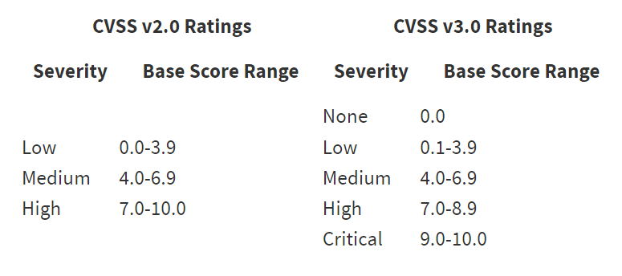

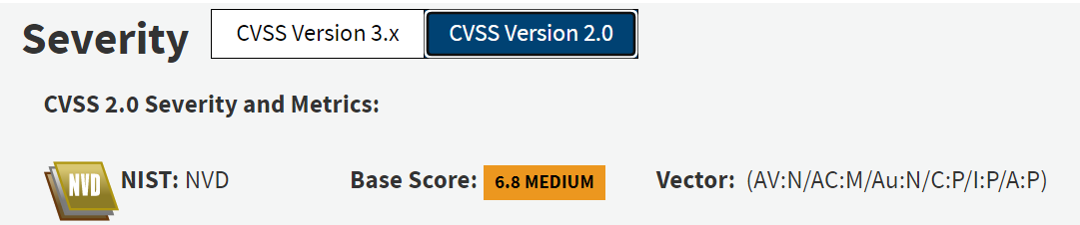
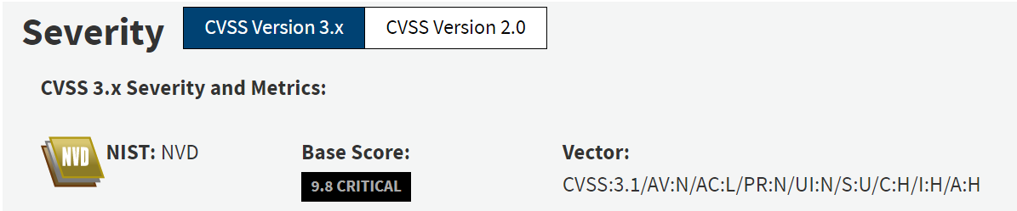
CVSS
The Common Vulnerability Scoring System (CVSS) provides an open framework for communicating the characteristics and impacts of IT vulnerabilities.

Slide 6
Prioritizing vulnerability

Slide 7
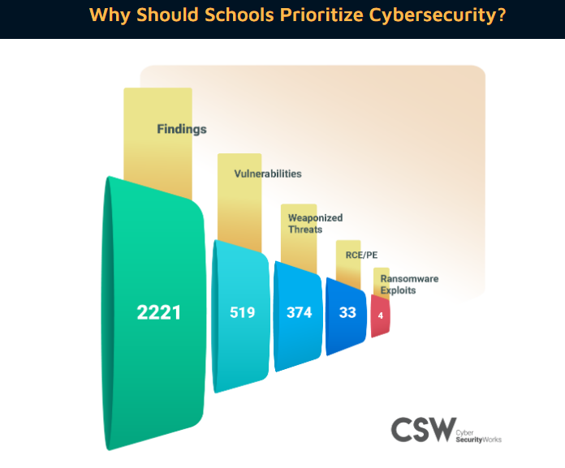
Why Cybersecurity

Slide 8
Our Services for protecting
Vulnerability Management
Penetration Testing
Payment Card Industry-Security Standards Council (PCI SSC)

Slide 9
Data science in cyber security
Cybersecurity data science is a relatively new method of implementing data science to detect, prevent and reduce cybersecurity threats.
Most cyber-attacks compromise an organization's stored data and put it to use in fraudulent activities
Cybersecurity uses data science to keep digital devices, services, systems, and software safe from cyberattacks

Slide 10





Latest books
https://www.coursera.org/learn/cybersecurity-for-data-science -University of Colorado Boulder

Slide 11
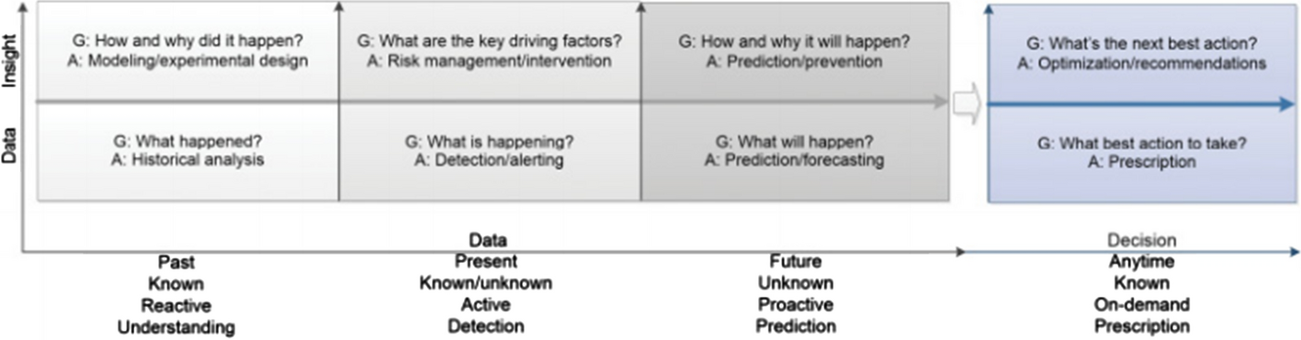
Data-to-insight-to-decision analytic stages in data science

Slide 12
Key terms | Description
Security incident or attack | An incident or cyber-attack, is any act that threatens the security, confidentiality, integrity, or availability of information assets, information systems, or the networks that deliver the information
Data breach | An intentional or unintentional release of secure data to an untrusted environment, which is also known as data spill or data leak
Cyber anomaly | Anomalies are data points, items, observations or events that do not conform to the expected pattern of a given group, such as cyber intrusions or fraud. Anomalies are also referred to as outliers, noise, deviations, and exceptions in cyber data
Security models | Models take features as inputs and they apply simple or hybrid machine learning algorithms to come up with a specific outcome for a cybersecurity use case for intelligent decision making
Threat intelligence | Deals with gathering raw data of threats, and then analyzes and filters the data to produce usable information for automated security control systems, i.e., evidence-based knowledge in cybersecurity
Behavioral analytics | Deals with the behavioral patterns of various security incidents or the malicious behavior in the data
Internet-of-Things (IoT) | A smart environment where an object that can represent itself becomes greater by connecting to surrounding objects and the extensive data flowing around it, in which the cyber criminals are associated with.

Slide 13
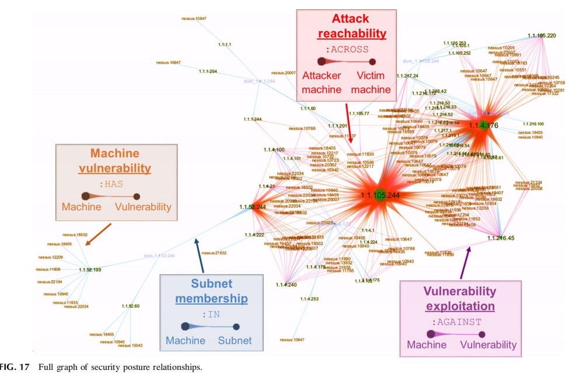
knowledge graph in cybersecurity
“The Knowledge Graph is a knowledge base used by Google to enhance its search engine's search results with semantic-search information gathered from a wide variety of sources.”
• Defines real world entities
• Provides relationships between them
Contains rules defines through ontologies
• Incomplete knowledge
– Missing entities
– Missing relations
– Limited entity and relation types
• Incorrect knowledge
– Wrong entity label recognition
– Wrong entity and relation type
– Wrong facts

Slide 14
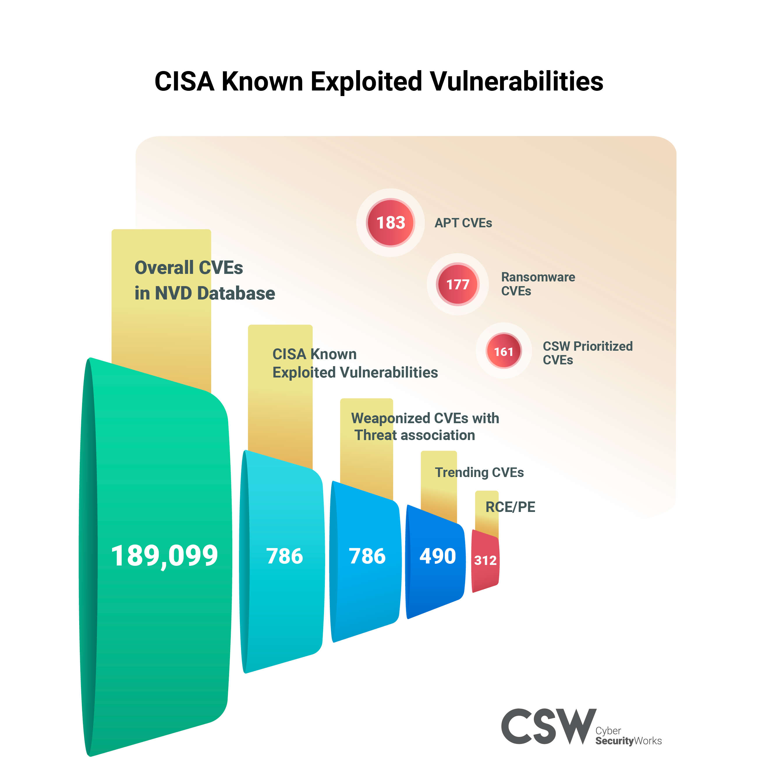
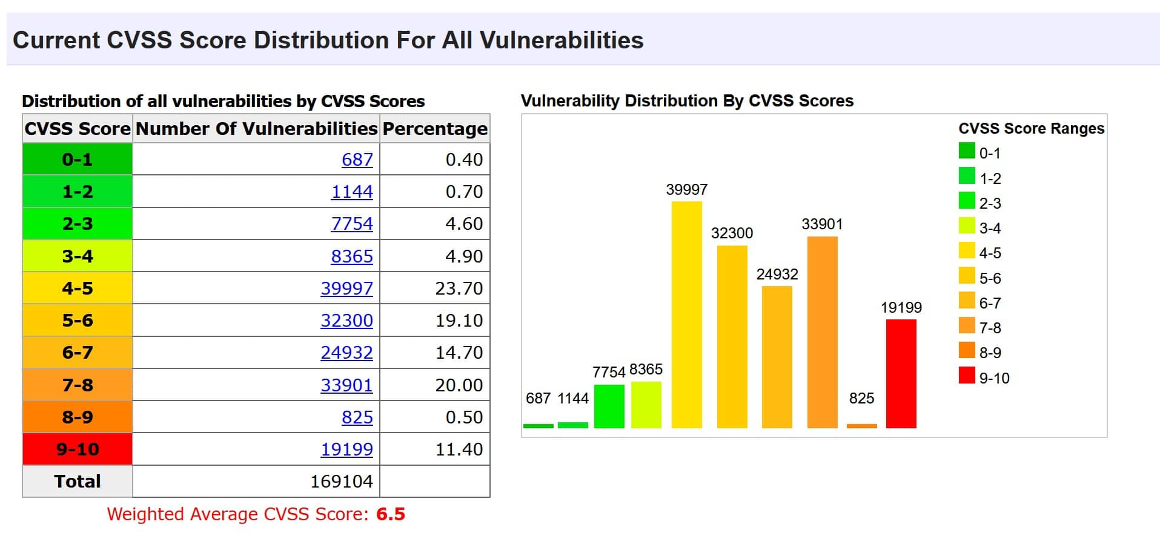
Prioritization of vulnarability and exploits

Slide 15
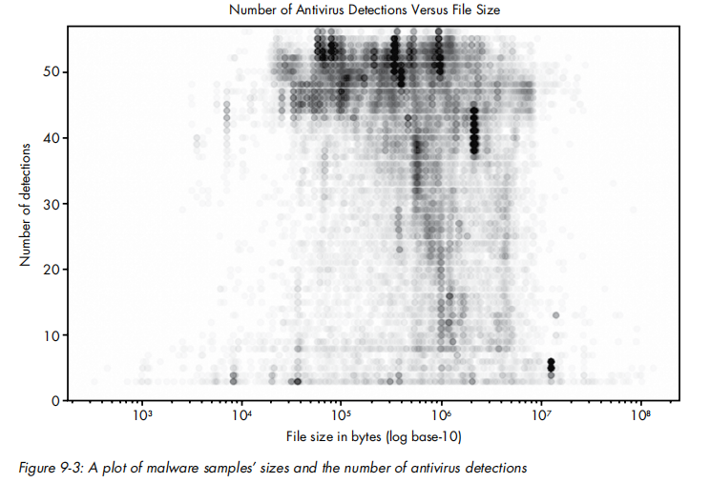
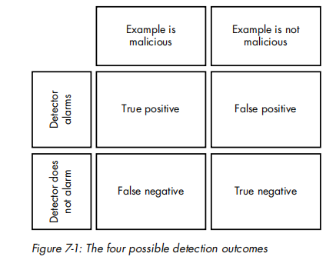
Malware malicious activity prediction

Slide 16

Dark web, Deep web and social media discussions
The core principle of Tor, onion routing, was developed in the mid-1990s by United States Naval Research Laboratory employees, mathematician Paul Syverson, and computer scientists Michael G. Reed and David Goldschlag, to protect American intelligence communications online.
Onion routing is implemented by means of encryption in the application layer of the communication protocol stack, nested like the layers of an onion.
Mention 1 :CVE-2022-0314 Microsoft SharePoint Server Remote Code Execution Vulnerability This CVE ID is unique from CVE CVSS Last Update
Mention 2 :CVE-2022-0522 Windows Kernel Denial of Service Vulnerability CVSS Last Update

Slide 17
THANK YOU

