Slide 1
Games and gaming

Slide 2
Matching pennies
The game is played between two players, Player A and Player B. Each player has a penny and must secretly turn the penny to heads or tails. The players then reveal their choices simultaneously. If the pennies match (both heads or both tails) Player A keeps both pennies, so wins one from Player B (+1 for A, -1 for B). If the pennies do not match (one heads and one tails) Player B keeps both pennies, so receives one from Player A (-1 for A, +1 for B).
What do you do if you want to win?

Slide 3
Tick tac toe
This is a paper-and-pencil game for two players, X and O, who take turns marking the spaces in a 3×3 grid. The player who succeeds in placing three of their marks in a horizontal, vertical, or diagonal row wins the game.
What do you do to win?

Slide 4
Blackjack
In blackjack, players don't play against each other, and they don't co-operate. The only competition is the dealer.
The aim of the game is to accumulate a higher point total than the dealer, but without going over 21.
At the start of the game, the players and the dealer receive two cards each. The players' cards are normally dealt face up, while the dealer has one face down (called the hole card) and one face up.
The best possible blackjack hand is an opening deal of an ace with any ten-point card. This is called a "blackjack", and the player holding this automatically wins unless the dealer also has a blackjack. If a player and the dealer each have a blackjack, the result is a push for that player. If the dealer has a blackjack, all players not holding a blackjack lose.
After the cards have been dealt, the game goes on with each player taking action.
The player can keep his hand as it is (stand) or take more cards from the deck (hit), one at a time, until either the player judges that the hand is strong enough to go up against the dealer's hand and stands, or until it goes over 21, in which case the player immediately loses (busts).
When all players have finished their actions, either decided to stand or busted, the dealer turns over his hidden hole card.
If the dealer has blackjack with his two cards, then all players lose, except players who also have a blackjack, in which case it is a push.
If the dealer doesn't have a blackjack , he hits or stands depending on the value of the hand. The dealer must hit if the value of the hand is lower than 17, otherwise the dealer will stand.
How do you win?

Slide 5
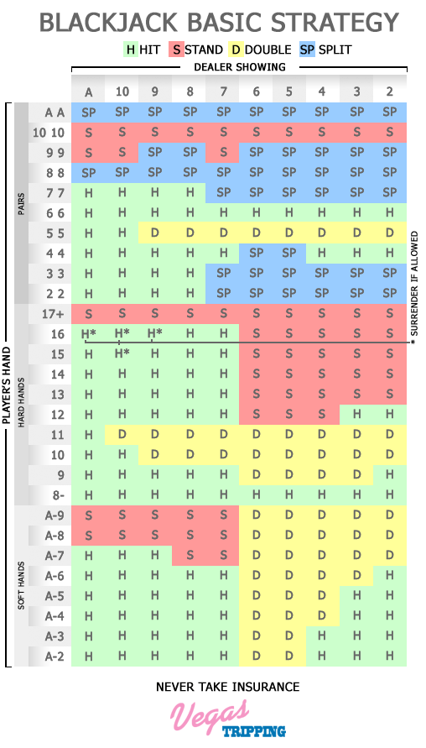
Blackjack answer

Slide 6
Poker
This is for Texas Holdem
To begin each player is dealt two hole (private) cards. There is a round of betting. Then the players remaining see a flop of three community cards. There is another round of betting. Then the players remaining see another community turn card. Another round of betting. Then the remaining players see a final community river card. Than a final round of betting. Selecting from the seven cards, the best five card hand wins.

Slide 7
Poker
First let’s look here http://www.pokerlistings.com/poker-rules
Now that is different!
Why? More than one person is making choices. The choices being made are interesting. The choices may or may not be robotic.

Slide 8
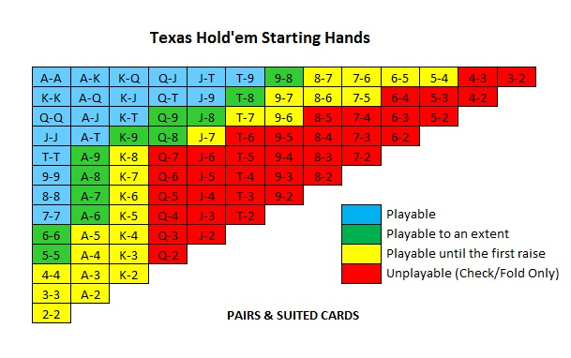
Cheat sheet

Slide 9
Pigs
Pictures
What to observe?
At least naive correspondence to work with
Does it look like a pig? Compare reference to source
Behavior
What to observe?
Mimic behaviors
I want the pig to eat at the trough. Why is my pig eating at the trough that is on fire?

Slide 10
Concluding transition
We can try to use methods that give a good shot at doing something that looks close to what is reasonable.
“But how do we do that without going the route of complete randomness of the Rock-Paper-Scissors player, the monotonous predictability of the Tic-Tac-Toe opponent, or the rigid mindlessness of the rule-bound Blackjack dealer? Somehow we have to be able to create the mind of the Poker player. We have to approach the game from the inside of the Poker player’s psyche”.

Slide 11
Finding factors
Observing is not enough if thought of as passive absorption.
Separate what is interesting from what is background.
We come with latent inhibition. If something is not thought of as important, it is ignored.
At times we may need to suppress latent inhibition.

Slide 12
Observation and order
Categories – assignment of observation
Relations – among categories
Weights – indication of importance (cardinal and ordinal)
Tendency to build cause and effect stories.

