Slide 1
Games and gaming - 6

Slide 2
Measuring utility
What we have said so far advances the idea of how we can build AI for NPCs that have realistic responses when making a decision.
However, this seems to depend on finding a way to measure utility.
Consider Bentham’s effort discussed in the text
The lesson to be learned is that decisions can be composed of many different factors that need to be scored (measured) and the relations among the factors that need to be defined.

Slide 3
Multi-attribute Utility Theory
Basic idea is this
identify what is important (hierarchy)
identify relative importance (weights)
identify how well each alternative does on each criterion (score)

Slide 4
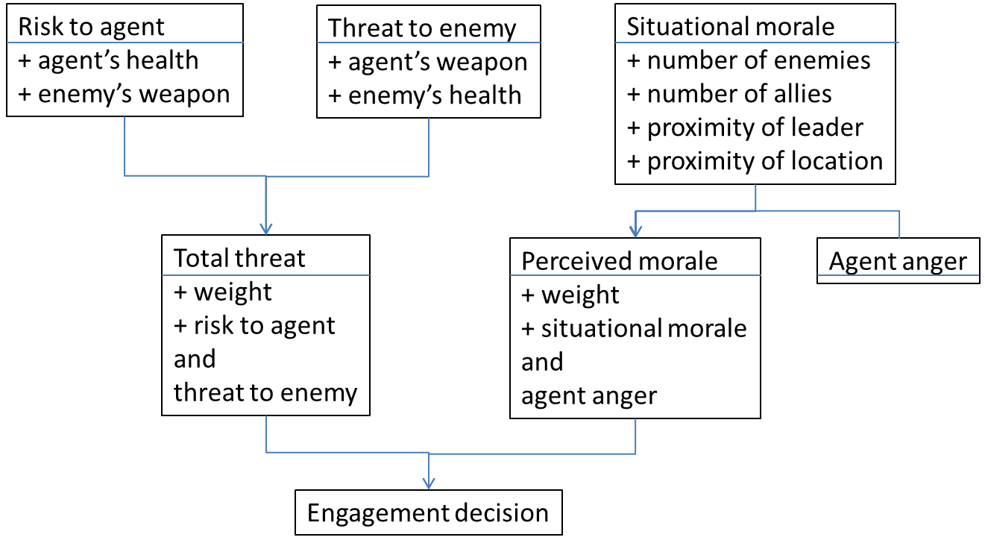
That sounds familiar

Slide 5
Attribute - Measures
Agent’s health – how healthy, how damaged
Enemy’s weapon – kind of weapon, damage per hit
Enemy’s health – kind of damage, how damaged
Agent’s weapon – kind of weapon, damage per hit
And so on for the remaining attributes
For each attribute there is at least one measure that yields a value and ideally it or in combination with other measures can be normalized for the attribute
So on a 100 point scale
Agent’s health = 80
Enemy’s weapon = 50

Slide 6
Combination in a hierarchy
Assemble the parts in a hierarchy
Risk to agent has parts Agent’s health and Enemy’s weapon
Total threat has parts Risk to agent and Threat to enemy
Engagement decision has parts Total threat and Perceived morale
Confidence in the lower parts begets confidence in the higher parts. Even with confidence, the ‘wrong’ decision is possible.

Slide 7
Coloring
That seems simple but …
From the measures (Enemy’s weapon = 50) we need to get to the utility in some way.
Note that the measures for the base attributes may not themselves be utility like at all. Suppose Enemy’s weapon = bow-caster.
Need some sort of scale.
Easy fix is to assign numerical values (Enemy’s weapon = 5,000 dolors) and normalize on a best-worst scale.
Caution!! There is much more to this. An engineer might laugh and an economist might simply shake his head. But it is good enough for what we want to do at least for the moment.

Slide 8
Coloring
Use weighted sums for the remainder of combinations to provide the color of importance.
If you happen to have nice descriptive curves use them for the color of marginal utility.
To see how you might apply this check https://onpace.osu.edu/posts/documents/Conducting%20a%20MAUT%20Analysis.pdf For The Ohio State career decision version

Slide 9
Cautionary tales
In the context of a game where there is a story, the transitions from measures to attributes and the colorings can be alarmingly confusing.
There are problems of individual relativity for both perceptions and understandings.
There are also some confusions that we might create for ourselves without knowing how to get out.

Slide 10
Disease outbreak
Imagine that the U.S. is preparing for the outbreak of an unusual Asian disease, which is expected to kill 600 people. Two alternative programs to combat the disease have been proposed.
Assume that the exact scientific estimates of the consequences of the programs are as follows:
If program A is adopted, 200 people will be saved.
If program B is adopted, there is a 1/3 probability that 600 people will be saved and a 2/3 probability that no people will be saved.
Which of the two programs would you favor?
Additionally, they presented the same scenario to a second group of people but with different choices:
If program C is adopted, 400 people will die.
If program D is adopted, there is a 1/3 probability that nobody will die, and a 2/3 probability that 600 people will die.
Which of the two programs would you favor?

Slide 11
Result of choices
For the first group, most people selected program A, stated as “If program A is adopted, 200 people will be saved.” Certainty it is better than rolling the dice.
For the second group most people selected program D, stated as “If program D is adopted, there is a 1/3 probability that nobody will die, and a 2/3 probability that 600 people will die.” Rolling the dice is better than certainty.

Slide 12
Rats and Giffen goods
The experiment involved placing rats in a box equipped with the equivalent of two liquid dispensers. Each machine would dispense a measured amount of liquid for the rats to drink for each press of the lever. Experimenters could change how many lever presses were available to the rats in each session.
Capping the number of lever presses available, sets the income level. Adjusting the amounts of liquid per lever press, sets the price for the liquid.
After learning how the levers worked, the rats invariably would head for the one that gave them the most liquid. Now that makes sense.

Slide 13
Root beer, quinine or both
The experimenters modified the box so that one lever produced root beer -a lab rat favorite - and the other water flavored with quinine – a rat dislike. All other things being equal, a rat would choose root beer over quinine. However, not all other things were equal!
The dispensers were set so that the amount of root beer provided was significantly less than the amount of quinine. Again, without a limit on lever presses, this decision is only slightly more complex. If you are a rat willing to work for it, the root beer is still available to you. However, the researchers did set a maximum number of times that the rat could press the two levers during a single session.
The final issue is that the rat is thirsty and is more thirsty than the total of small doses of root beer will satisfy. Some combination of quinine and root beer is required to satisfy the rat’s thirst. So what should be the mix of quinine and root beer?

Slide 14
Giffen goods
Over time, the rats worked out a balance that satisfied both their individual levels of thirst and their preferences for root beer relative to quinine. They learned that they would have to quench much of their thirst with the quinine and only occasionally get the root beer.
But when the price of the quinine was increased (less per press), the rats actually increased their intake of the quinine by selecting it more often. That also meant that they drank less root beer. But why would the rats use more of something inferior after the price went up?
Well it is a Giffen good. A Giffen good is an inferior product or commodity whose usage defies the principles of demand in that its usage increases as the price goes up and goes down as the price lowers. But really, why?

Slide 15
Smart rats
The “price” of the quinine changed but there are two other important factors to remember.
1. The rats have a fixed level of need (i.e., the amount of thirst per session).
2. The rats are on a fixed income (i.e., the number of lever presses per session)
When the price of the quinine was raised, neither of these two factors changed.
The rat still needed to drink something to satisfy the thirst need. The rat knew that it only had a limited number of presses available to it. The fixed values set the boundaries for the possible decisions made when the variable values change. The rat realized that to satisfy its thirst need, it had to use more lever presses on the quinine than formerly to get the same amount of liquid.

Slide 16
Smart rats
Define terms and the initial settings
P_{r} Number of root beer lever presses
P_{q} Number of quinine lever presses
P_{qr} Number of lever presses per session
A_{r} Amount of root beer per press
A_{q} Amount of quinine per press
A_{qr} Amount of quinine and root beer to be consumed per session (thirst)
A_{qr} = (P_{r} * A_{r}) + (P_{q} * A_{q})
P_{qr} = P_{r} + P_{q}

Slide 17
Smart rats
Convert to a quinine basis
P_{r} = P_{qr} – P_{q}
A_{qr} = ((P_{qr} – P_{q}) * A_{r}) + (P_{q} * A_{q})
Or
P_{q} = (A_{qr} – (A_{r} * P_{qr})) / (A_{q} – A_{r})
Now let P_{qr} = 25, A_{r} = 1 , and A_{qr} =200
For A_{q} = 100 need 2 quinine presses
For A_{q} = 36 need 5 quinine presses
For A_{q} = 10 need 20 quinine presses
Dang!

Slide 18
For fun
Convert to wizards and wands with a massive foe and little time. Throw in a second case where there the foe has a cold resistance ring.
Add a few other imaginative cases.
So could the NPIC wizard defeat the player’s massive creature?

Slide 19
And one more
Imagine that you are a medic for a platoon of soldiers. You have a number of seriously wounded squad-mates. Three of the injured are normal combatants. One of them, however, is the only demolitions expert in the group. Given the arrangement of the situation and the relative severity of the wounds, you must choose between saving the lives of the three normal soldiers or the life of the demolitions expert. You are also aware that the demolitions expert has the ability to destroy the enemy forces that are massing for a final assault that will assuredly wipe out the entire platoon.
As the medic, who should you tend to?
What should the NPIC medic you are building do?
Play the trolley game

