Slide 1
Movements (cont.)

Slide 2
Review
All game objects can be defined as having a position and an orientation.
In some game types a movement algorithm can directly update the position/orientation (e.g. tile-based). However, this will look unrealistic in other types of game (e.g. driving).
Kinematic movement algorithms operate using positions and orientations. The output is a target velocity (speed + orientation).
The speed may simply vary between full speed and stationary, i.e. kinematic algorithms do not use acceleration.

Slide 3
Kimematic
Need
Vector position
float orientation;
Vector velocity;
float rotation;
Updating (using Newton Euler equations)
velocity += acceleration * time_delta
rotation += angular_acc * time_delta
position += velocity * time_delta
orientation += rotation * time_delta
Assume that a suitable mathematics module/library is available

Slide 4
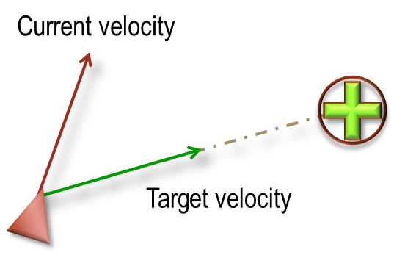
Kinematic seek
Seek
Seek ( Vector source, Vector target,float maxSpeed )
{Vector velocity = (target – source).normalise()* maxSpeed;
return velocity;
}
Orientation
DetermineOrientation(Vector velocity, float currentOrientation ) {
if( velocity.length() == 0 )
return currentOrientation;
else
return Math.atan2( -velocity.x, velocity.y)
}
The function atan2 is the arctangent function with two arguments. The purpose of using two arguments instead of one is to gather information on the signs of the inputs in order to return the appropriate quadrant of the computed angle. atan2 computes the arctangent of y/x in a range of (−π, π), i.e. it determines the counter clockwise angle (radians) between the x-axis and the vector <x,y> in 2D Euclidean space.

Slide 5
Kinematic flee
Flee( Vector source, Vector target, float maxSpeed ) {
Vector velocity
= (source – target).normalise() * maxSpeed;
return velocity;
}

Slide 6
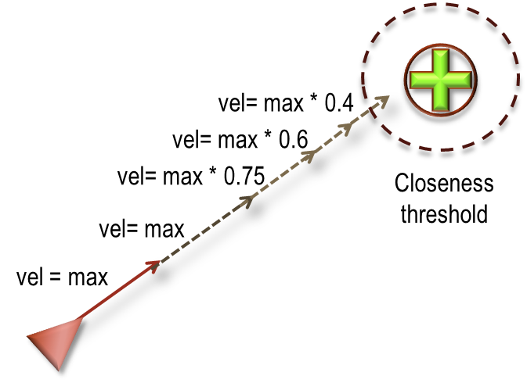
Kinematic arrive
Arrive ( Vector source, Vector target,
float maxSpeed, float nearRadius ) {
float slowingFactor = 0.2;
Vector velocity = [0,0,...];
Vector separation = (target – source);
if( separation.length() < nearRadius )
return velocity;
//Determine velocity, and cap at max speed if needed
velocity = separation / slowingFactor;
if( velocity.length() > maxSpeed )
velocity = velocity.normalise() * maxSpeed;
return velocity;
}

Slide 7
Steering movements
Steering behaviours extend the kinematic movement algorithms by determining acceleration (both forward movement and rotation)
In many game types (e.g. driving games) steering algorithms are often used. In other games, they may not be useful.
We will consider some of the following forms of steering behaviour:
Seek()
Flee()
Arrive()
Wander()
Pursue()
Evade()
Interpose()
Align()
Face()
Separate()
PathFollow()
AvoidObstacle()
Jump()

Slide 8
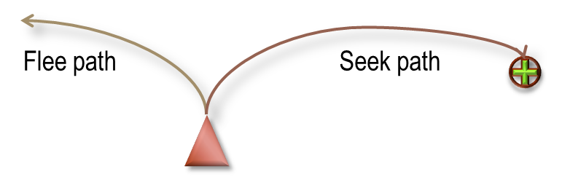
Flee and Seek
Basic steering algorithms operate by trying to match some kinematic property of the target to the source, e.g. this might be the target’s position, velocity, orientation, etc. Matching steering algorithms take source and target kinematic properties as input.
More advanced steering behaviours try to match a combination of properties, potentially with additional constraints.
Typically for each matching behaviour there is a readily defined opposite behaviour (e.g. Seek vs. Flee, etc.).

Slide 9
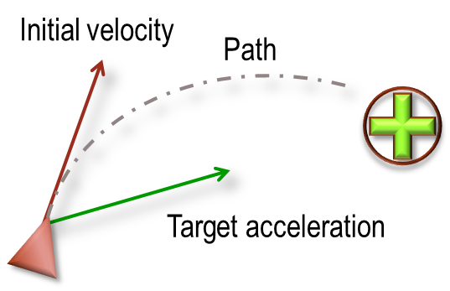
Steering seek
Seek will try to match the source position to a target location.
As with the kinematic seek the direction to the target is determined, and a corresponding maximum acceleration set towards the target.

Slide 10
Steering seek
Seek ( Vector source, Vector target, float maxAcc ) {
Vector acceleration = (target – source).normalise() * maxAcc;
return acceleration;
}
Seek will accelerate as fast as possible towards the target. Some means of dampening/reducing velocity will be needed as the target is approached – this is offered by other forms of steering behavior.

Slide 11
Steering seek
The output of Seek is used to update the position and velocity as follows:
UpdatePosition() {
//timeDelta amount of time since last update
velocity += acceleration * timeDelta;
rotation += angular_acc * timeDelta;
if( velocity.length() > maxSpeed )
velocity = velocity.normalise()*maxSpeed;
position += velocity * timeDelta;
orientation += rotation * timeDelta;
}
The Seek algorithm does not change the orientation, i.e. other forms of steering algorithm can be used to align orientation with direction of movement

Slide 12
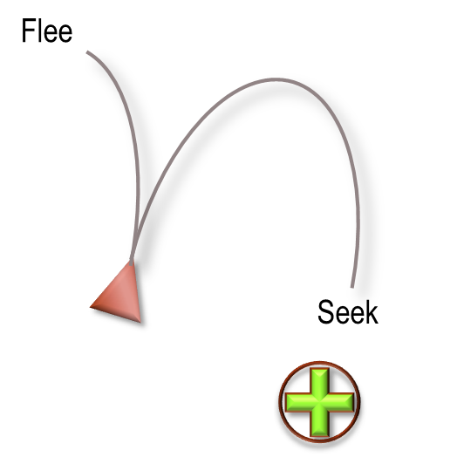
Steering flee
Flee is simply the opposite of Seek, with a maximum acceleration away from the target output.

Slide 13
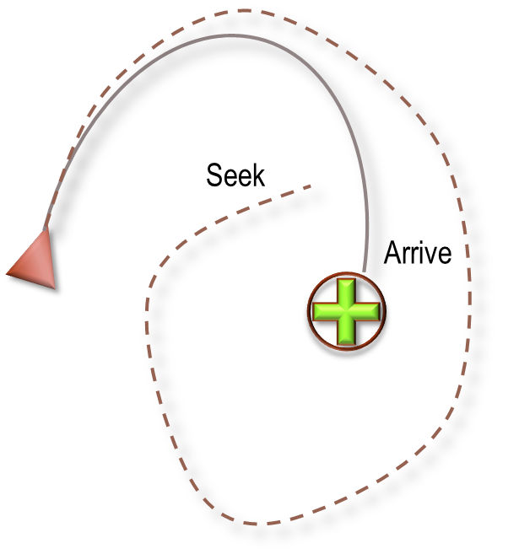
Steering Arrive
Arrive will control acceleration so that the velocity is zero once the target has been reached.
To do this, two radii are used: an arrival radius when the target can be considered as reached, and a larger slow radius used to control when the velocity should be reduced from the maximum.
The opposite to Arrive is Leave – although there is little need to have a behaviour that will slowly accelerate away from the target. It is more likely to have a behavior that accelerates away with maximum acceleration, i.e. Flee.

Slide 14
Steering arrive
Arrive(Vector source, Vector target,
Vector currentVelocity,
float maxAcceleration, float maxSpeed,
float arriveRadius, float slowRadius ) {
float slowingFactor = 0.2;
Vector acceleration = [0,0,.];
Vector direction = target – source;
float distance = direction.length();
if( distance < arriveRadius )
return acceleration;
{ Determine target velocity }
{ Determine acceleration }
return acceleration
}
Determine target velocity
//If outside slow radius, then max speed, else scale speed based on distance
float targetSpeed;
if( distance > slowRadius )
targetSpeed = maxSpeed;
else
targetSpeed = maxSpeed * distance / slowRadius;
Vector targetVelocity =
direction.normalise() * targetSpeed;
Determine acceleration
//Calculate acceleration so that it will slow down object near target
acceleration = targetVelocity – currentVelocity;
acceleration /= slowingFactor;
if( acceleration.length() > maxAcceleration )
acceleration = acceleration.normalise()
* maxAcceleration;

Slide 15
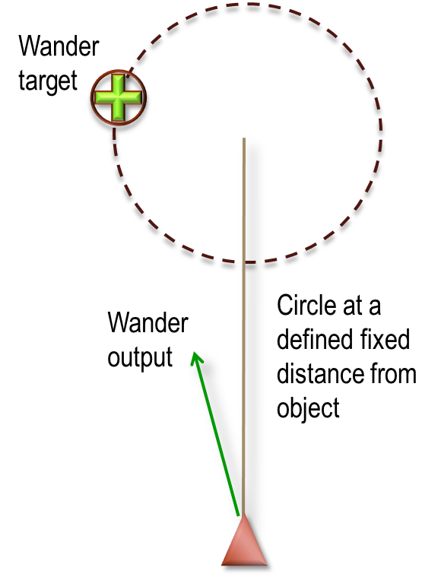
Steering wander
Wander will produce a movement that gives the impression of a random walk.
In order to avoid jittery behaviour a circle can be projected in front of the object with steering towards a target that is constrained to move along the perimeter.
Each update, the target is displaced by a small random amount (moving back and forth around the perimeter over time).
By controlling size of circle, distance from object and random displacement, a wide range of motion can be generated.

Slide 16
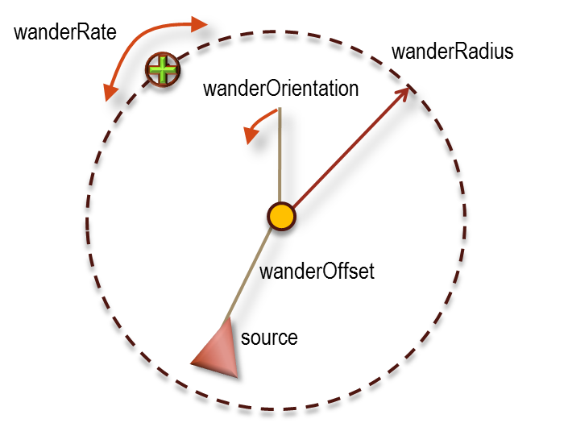
Steering wander
Wander( Vector source,
float sourceOrientation, float maxAcceleration,
float wanderOffset, float wanderRadius,
float wanderRate, float wanderOrientation ) {
//Work out new target orientation
wanderOrientation += wanderRate* randomBinomial();
//Any random function will suffice, binomial is smooth
targetOrientation = wanderOrientation + sourceOrientation;
Vector target = source + wanderOffset * asVector(sourceOrientation);
target += wanderRadius * asVector(targetOrientation)
{Return acceleration based on a Seek
towards the determine target location }
//Return a (2D) vector with the same orientation as the specified angle
Vector2 asVector( float angle ) {
return new Vector2(
(float)Math.Cos(angle),
(float)Math.Sin(angle) ); }

Slide 17
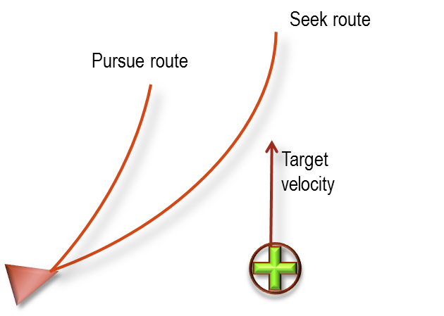
Steering pursuit
Seek will head directly towards the target. If the target is moving, it is better to aim towards where the target is likely to be in the future – a behaviour known as Pursuit.
Different algorithms can be used to predict the likely future position. A simple, yet effective, approach is to assume the target will continue to move with the same current velocity.
The target’s movement can then be used to calculate it’s future position, which is used as the seek position.

Slide 18
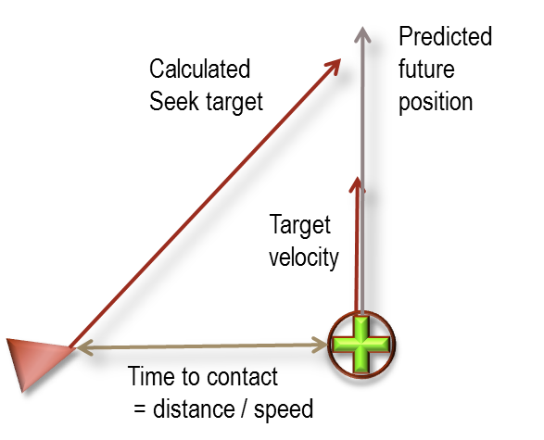
Steering pursuit and evade
Pursuit( Vector source, Vector target,
Vector sourceVel, Vector targetVel ) {
//Maximum future time in which to predict
float maxPrediction;
Vector direction = target – source;
float distance = direction.length();
float speed = sourceVel.length();
//If time to target is too long, then use maximum prediction time, else determine time to contact
if( speed <= distance / maxPrediction )
prediction = maxPrediction;
else prediction = distance / speed;
//Determine new target location and return Seek acceleration towards it
target += targetVel * prediction;
return Seek( source, target)
}
Evade
Evade is simply the opposite of Pursuit, i.e. the evaders flees from the projected future direction

