Slide 1
Rules

Slide 2
Rules are used to represent heuristics, or “rules of thumb.”
A rule is composed of an antecedent and a consequent.
The antecedent of a rule is also referred to as the if portion or the left-hand side (LHS) of the rule.
The consequent of a rule is also referred to as the then portion or the right-hand side (RHS) of the rule.

Slide 3
The antecedent of a rule is a set of conditions (or conditional elements) that must be satisfied for the rule to be applicable.
The conditions of a rule are satisfied based on the existence or non-existence of specified facts in the fact-list.
Patterns consist of a set of restrictions that are used to determine which facts satisfy the condition specified by the pattern.

Slide 4
The consequent of a rule is the set of actions to be executed when the rule is applicable.
The actions of applicable rules are executed when the inference engine is instructed to begin execution of applicable rules.
If more than one rule is applicable, the inference engine uses a conflict resolution strategy to select which rule should have its actions executed.

Slide 5
The process of matching facts to patterns is called pattern matching and the mechanism is called the inference engine, which automatically matches patterns against the current state of the fact-list and instance-list and determines which rules are applicable.
The actions of the selected rule are executed and the inference engine selects another rule and executes its actions. This process continues until no applicable rules remain.

Slide 6
The basic components of a rule-based system include a working memory, a knowledge base, and an inference engine.
The working memory contains the assertions or facts, the knowledge base contains the rules, and inference engine applies the rules to the facts or the facts to the rules.

Slide 7
Working memory, WM, is a representation
In which
Lexical: WM contains assertions (facts) and symbols
Structural: Assertions (facts) are lists of symbols
Semantic: Assertions denote facts about the world
With constructors
Add assertion to WM
Delete assertion from WM
With readers
Given a pattern, produce a list of matching assertions in WM

Slide 8
A knowledge base, KB, is a representation
In which
Lexical: There are rules
Structural: Rules contain if patterns and then actions
Semantic: Rules provide constraints for adding and
deleting assertion in WM
With constructors
Given condition-action pairs, builds rules
With readers
Given a rule, produce a list of if patterns
Given a rule produce a list of then patterns

Slide 9
WHILE not done
MATCH ->
Check facts in working memory; identify rules whose conditions are satisfied.
Update the agenda by adding these rules to it. (activation of a rule)
Identify those rules that were satisfied, but now are not satisfied.
Remove these rules form the agenda.
RESOLVE_CONFLICTS ->
If there are rules on the agenda, then apply a conflict resolution strategy that orders the rules in terms of highest to lowest priority.
ACT ->
Sequentially perform the actions on the right hand side of the rule.
Remove the rule from the agenda.
HALT -> If a halting action is performed, then signal done.
END-WHILE

Slide 10
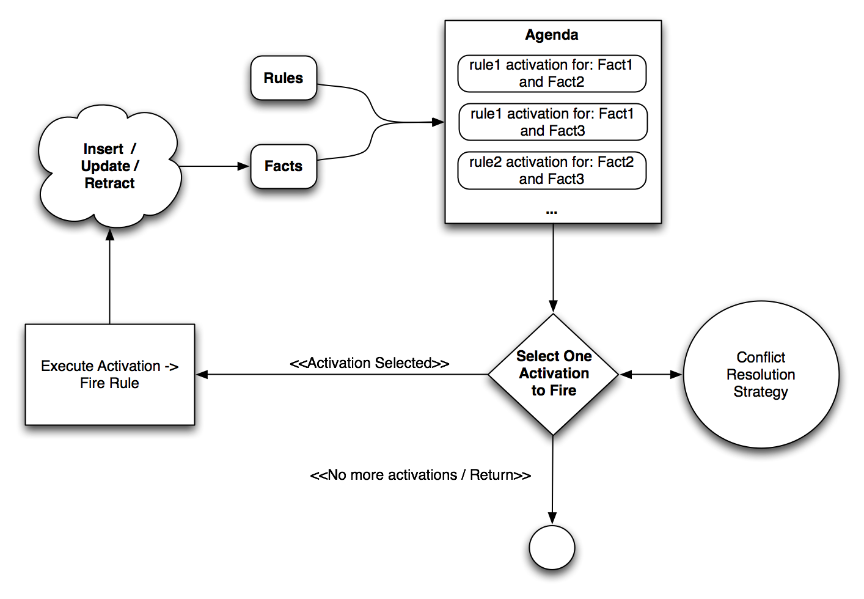

Slide 11
Simple version
See section 11.1 in the text.
Create and enumerated type for the values of memory variables
true, false
yes, no, maybe, unknown
Create the specific memory variables
Peasants, stonemason, and so on in the example
The memory variables are the working memory for the rule system

Slide 12
Simple version
Create the collection of rules as hard-coded items in the system
For example,
if(Woodcutter == Yes && Stonemason == Yes &&
Temple == Unknown)
Temple = Maybe;
The collection of rules is the knowledge base

Slide 13
Simple version
Each update the values of the rules are determined.
These are ‘matched’ against the rules which are hard-coded selector statements.
Good news! Easy and fast. Bad news hard to maintain and rather brittle.

Slide 14
Improved version
See section 11.2 in the text.
Hard coding the rules has several disadvantages.
The example in the text attempts to get around some of these and build in a bit of frequency-based learning.

Slide 15
Improved version
Enhance working memory
Supply an enumerated type for fact and action designations.
Note these are now not variable values as in the previous simple example. The exception might be that pesky unknown
Build a structure or class for the working memory that has places to hold the facts that are of the enumerated type.
Note in the example that fact and action are not separated. This could be improved

Slide 16
Improved version
Create a rule
This can be done by creating some structure to hold the rule parts: the condition – action pair.
This can be done by providing a field or feature for each rule condition, a field or feature for the single consequent action, and fields for administrative inference operations including at least a field indicating a match.
The example uses weight to both resolve conflicts and indicate frequency based learning.

Slide 17
Improved version
Following the text the matched “flag is set to true if the antecedents in the rule match the facts stored,in working memory. More specifically, for a given rule, if antecedentA equals WorkingMemory.strikeA and antecedentB equals WorkingMemory.strikeB, the rule is matched. It's possible that more than one rule will match a given set of facts. This matched member helps us keep track of those that do match so that we can pick one to fire during the conflict resolution phase.”
This can be generalized.
Note that the notions of strikeA and strikeB are really only relevant to the example because of the rotation of items in working memory.

Slide 18
Improved version
Again following the text the weight assigned to the rule has two purposes: conflict resolution and frequency based learning.
“The final member in TRule is weight. This is a weighting factor that we can adjust to reinforce or inhibit rules. In a sense it represents the strength of each rule. Looking at it from a different angle, the weight represents the computer's belief that a given rule is more or less applicable relative to other potentially matching rules. During the conflict resolution phase where more than one rule matches, we'll fire the one rule with the highest weight to make a strike prediction. If after the next strike is thrown, we see that we fired the wrong rule that is, we made a wrong prediction we'll decrement the fired rule's weight to suppress it. Further, we'll figure out which rule should have been fired and increment its weight to reinforce it.”
Can the two purposes be separated?

Slide 19
Improved version
Initialize the system
Read in all of the rules into a structure represent ting the collection of rules. This is the knowledge base
In the example this is a hard-coded array.
Set the values for the elements of working memory to unknown
In the example these are the three strike elements.
Initialize the other administrative element

Slide 20
Improved version
Run the engine! Match the facts to the rules. Fire an action.
In the example all of this is done in the ProcessMove function
Populate working memory
Check prediction from previous rule firing. Cahnge weight as needed
Find rules that match working memory
Pick the rule with the highest weight
Fire the rule by copying action to working memory and rotating the rule parts.

Slide 21
Questions
The condition and action parts of the rules will not change. Use a file? Separate from facts. Long term storage of weights?
When should the facts be purged?
Can matching be improved?
More modifications are possible.
Connection to rest of game.

