Slide 1
Movement

Slide 2
A big picture
Note sensing is missing in this one!

Slide 3
Starting with a classic
Steering Behaviors For Autonomous Characters by Craig W. Reynolds, Sony Computer Entertainment America (1999, approximately 1300 citations)
Now see: http://www.red3d.com/cwr/
Craig W. Reynolds (born March 15, 1953), is an artificial life and computer graphics expert, who created the Boids artificial life simulation in 1986. Reynolds worked on the film Tron (1982) as a scene programmer, and on Batman Returns (1992) as part of the video image crew. Reynolds won the 1998 Academy Scientific and Technical Award in recognition of “ his pioneering contributions to the development of three-dimensional computer animation for motion picture production." He is the author of the Open Steer library. Wikipedia.
See http://opensteer.sourceforge.net/

Slide 4
A starting point
Autonomous characters are a type of autonomous agent intended for use in computer animation and interactive media such as games and virtual reality. These agents represent a character in a story or game and have some ability to improvise their actions. This stands in contrast both to a character in an animated film, whose actions are scripted in advance, and to an avatar in a game or virtual reality, whose actions are directed in real time by a human player or participant. In games, autonomous characters are sometimes called non-player characters.

Slide 5
A simple locomotion model will be presented in order to make the discussion of steering behaviors more concrete. This locomotion model will be based on a simple idealized vehicle.
This vehicle model is based on a point mass approximation.

Slide 6
A point mass is defined by a position property and a mass property. In addition, the simple vehicle model includes a velocity property. The velocity is modified by applying forces. Because this is a vehicle, these forces are generally self-applied, and hence limited. For example, a typical force which adjusts a vehicle’s velocity is thrust, generated by the vehicle’s own power plant, and hence limited in magnitude by the capacity of the power plant. For the simple vehicle model, this notion is summarized by a single ‘maximum force’ parameter (max_force). Most vehicles are characterized by a top speed. Typically this limitation is due to the interaction between acceleration due to their finite thrust and the deceleration due to viscous drag, friction, or (in legged systems) the momentum of reciprocating parts. As an alternative to realistic simulation of all these limiting forces, the simple vehicle model includes a ‘maximum speed’ parameter (max_speed). This speed limit is enforced by a kinematic truncation of the vehicle’s velocity vector. Finally, the simple vehicle model includes an orientation, which taken together with the vehicle’s position form a velocity-aligned local coordinate space to which a geometric model of the vehicle can be attached. (The terms localize and globalize will be used in this paper to connote transforming vectors into and out of this local space.)

Slide 7
Simple Vehicle Model:
mass scalar
position vector
velocity vector
max_force scalar
max_speed scalar
orientation N basis vectors

Slide 8
The behaviors
seek and flee
pursue and evade
offset and arrive
obstacle avoidance
wander
follow path
arrive

Slide 9
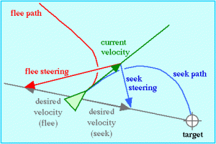
The behaviors: seek and flee
Seek (or pursuit of a static target) acts to steer the character towards a specified position in global space. This behavior adjusts the character so that its velocity is radially aligned towards the target.
Flee is simply the inverse of seek and acts to steer the character so that its velocity is radially aligned away from the target.

Slide 10
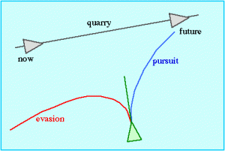
The behaviors: pursue and evade
Pursuit is similar to seek except that the quarry (target) is another moving character. Effective pursuit requires a prediction of the target’s future position. The approach taken here is to use a simple predictor and to reevaluate it each simulation step. Steering for pursuit is then simply the result of applying the seek steering behavior to the predicted target location.
Evasion is analogous to pursuit, except that flee is used to steer away from the predicted future position of the target character.

Slide 11
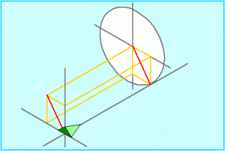
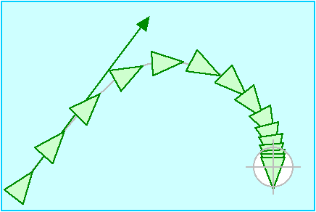
The behaviors: offset and arrive
Offset pursuit refers to steering a path which passes near, but not directly into a moving target. The basic idea is to dynamically compute a target point which is offset by a given radius R from the predicted future position of the quarry, and to then use seek behavior to approach that offset point.
Arrival behavior is identical to seek while the character is far from its target. But instead of moving through the target at full speed, this behavior causes the character to slow down as it approaches the target, eventually slowing to a stop coincident with the target.

Slide 12
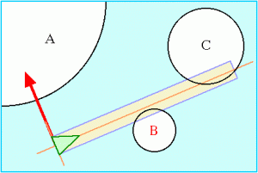
The behaviors: obstacle avoidance
Obstacle avoidance behavior gives a character the ability to maneuver in a cluttered environment by dodging around obstacles. There is an important distinction between obstacle avoidance and flee behavior. Flee will always cause a character to steer away from a given location, whereas obstacle avoidance takes action only when a nearby obstacle lies directly in front of the character.

Slide 13
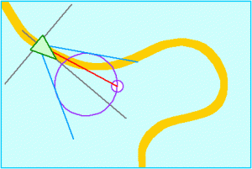
The behaviors: wander
Wander is a type of random steering. One easy implementation would be to generate a random steering force each frame, but this produces rather uninteresting motion. It is “twitchy” and produces no sustained turns. A more interesting approach is to retain steering direction state and make small random displacements to it each frame. Thus at one frame the character may be turning up and to the right, and on the next frame will still be turning in almost the same direction.

Slide 14
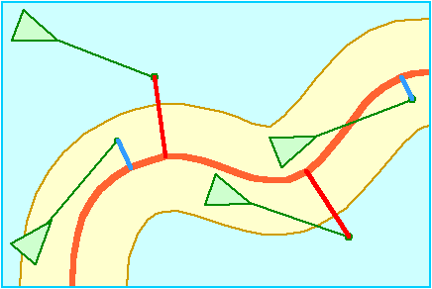
The behaviors: follow path
Path following behavior enables a character to steer along a predetermined path, such as a roadway, corridor or tunnel. This is distinct from constraining a vehicle rigidly to a path like a train rolling along a track. Rather path following behavior is intended to produce motion such as people moving down a corridor: the individual paths remain near, and often parallel to, the centerline of the corridor, but are free to deviate from it.

Slide 15
The behaviors: arrive
Arrival behavior is identical to seek while the character is far from its target. But instead of moving through the target at full speed, this behavior causes the character to slow down as it approaches the target, eventually slowing to a stop coincident with the target. The distance at which slowing begins is a parameter of the behavior. This implementation is similar to seek: a desired velocity is determined pointing from the character towards the target. Outside the stopping radius this desired velocity is clipped to max_speed, inside the stopping radius, desired velocity is ramped down (e.g. linearly) to zero.

Slide 16
Medium size picture
Input is geometric data. Represents both the agent's and world's states
Output is also geometric data representing the agent's and world's states
Actual parameters and outputs depend on context
Movement can be categorized as kinematic or dynamic (a steering behavior)

Slide 17
Kinematic
Does not consider acceleration
Is essentially one-speed
Agent starts at full speed, moves to desired location, and stops

Slide 18
Steering behavior
The behavior is dynamic since it changes with time. Physics-based
Called steering behavior because it controls direction of agent
Algorithm requires agent's current position, velocity, and forces acting on the agent
Output is resultant force or acceleration acting on agent
The output is used to modify the agent's current velocity
The overall behavior for an agent starting at rest:
The agent accelerates to speed
Cruises until it nears destination (target)
Decelerates to a stop

