Slide 1
CPE 323 Introduction to Embedded Computer Systems: The MSP430 Instruction Set Architecture
Instructor: Dr Aleksandar Milenkovic

Slide 2
Outline
MSP430 Architecture
Registers
Addressing Modes
Instruction Set
Instruction Formats and Encodings
Address Space
MSP430 Devices
Getting Started with EasyWeb2
MSP430 RISC core

Slide 3
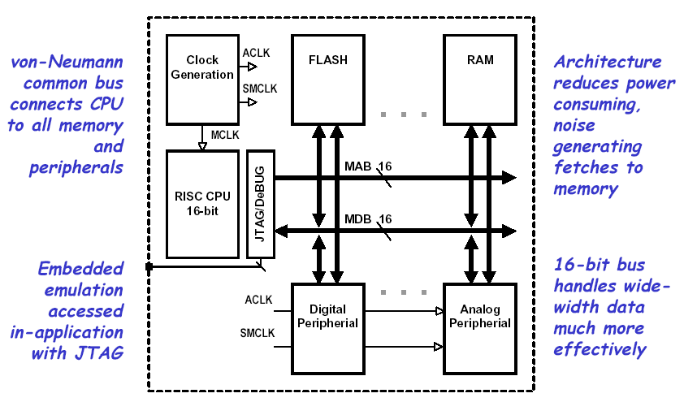
MSP 430 Modular Architecture

Slide 4
MSP430 16-bit RISC
Large 16-bit register file eliminates single accumulator bottleneck
High-bandwidth 16-bit data and address bus with no paging
RISC architecture with 27 instructions and 7 addressing modes
Single-cycle register operations with full-access
Direct memory-memory transfer designed for modern programming
Compact silicon 30% smaller than an ‘8051 saves power and cost

Slide 5
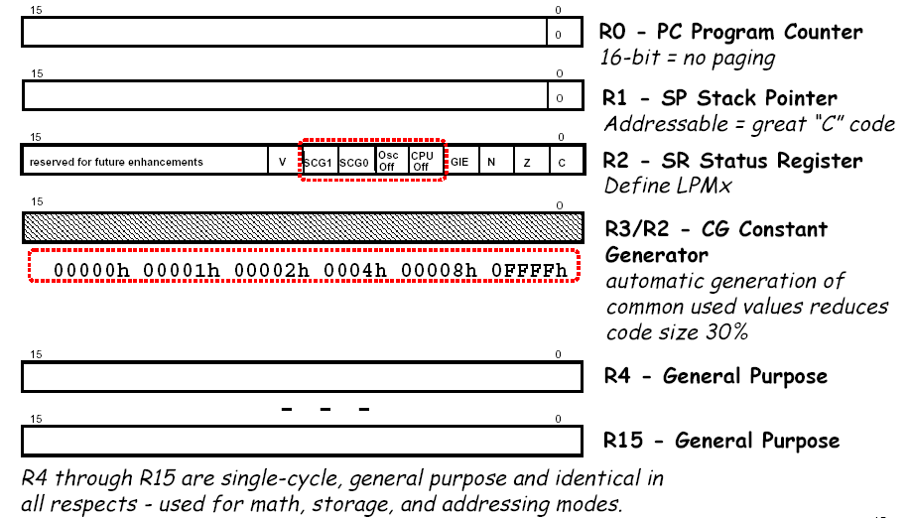
Registers

Slide 6
PC/R0 – Program Counter
The 16-bit program counter (PC/R0) points to the next instruction to be executed
Each instruction uses an even number of bytes (two, four, or six), and the PC is incremented accordingly. Instruction accesses in the 64-KB address space are performed on word boundaries, and the PC is aligned to even addresses
PC can be addressed by all instructions and all addressing modes
MOV #LABEL,PC ; Branch to address LABEL
MOV LABEL,PC ; Branch to address contained in LABEL
MOV @R14,PC ; Branch indirect to address in R14

Slide 7
SP/R1 – Stack Pointer
The stack pointer (SP/R1) is used by the CPU to store the return addresses of subroutine calls and interrupts. It uses a predecrement, postincrement scheme.
In addition, the SP can be used by software with all instructions and addressing modes.
Examples
MOV 2(SP),R6 ; Item I2 −> R6
MOV R7,0(SP) ; Overwrite TOS with R7
PUSH #0123h ; Put 0123h onto TOS
POP R8 ; R8 = 0123h
Question: Illustrate the stack contents after PUSH SP and POP SP instructions are executed?

Slide 8

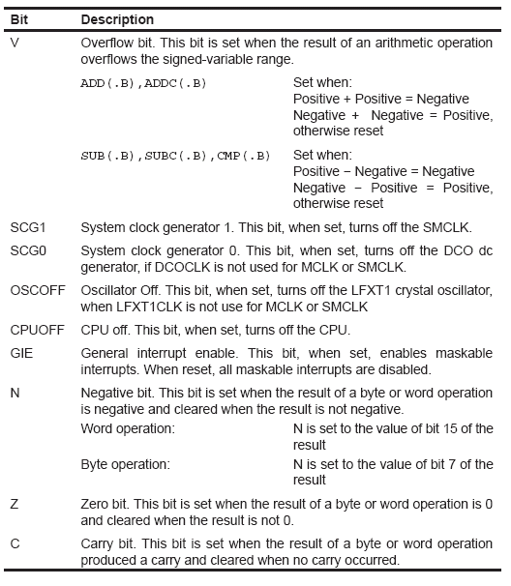
SR/R2 – Status Register
The status register (SR/R2), used as a source or destination register, can be used in the register mode only addressed with word instructions.
The remaining combinations of addressing modes are used to support the constant generator.

Slide 9
Constant Generation
Six commonly-used constants are generated with the constant generator registers R2 and R3,
Adv.: No special instructions, no special code, no extra memory access
Assembler uses the constant generator automatically if one of the six constants is used as an immediate source operand. Registers R2 and R3, used in the constant mode, cannot be addressed explicitly; they act as source-only registers.
The constants are selected with the source-register addressing modes (As), as described below.

Slide 10
Constant Generation
Constant generator allows for additional 24 instructions that are emulated
Examples
CLR dst MOV R3,dst
INC dst ADD 0(R3),dst

Slide 11
General-Purpose Registers
The twelve registers, R4−R15, are general-purpose registers. All of these registers can be used as data registers, address pointers, or index values and can be accessed with byte or word instructions as shown below

Slide 12
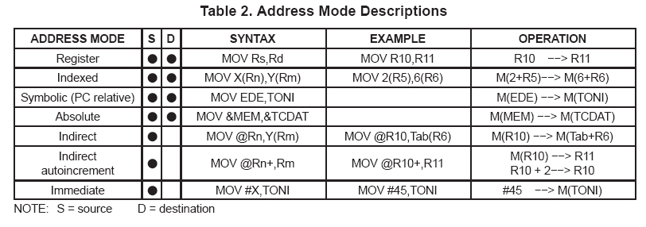
Addressing Modes
Seven addressing modes for the source operand and four addressing modes for the destination operand can address the complete address space with no exceptions.

Slide 13
Addressing Modes
The bit numbers in the table below describe the contents of the As (source) and Ad (destination) mode bits.

Slide 14
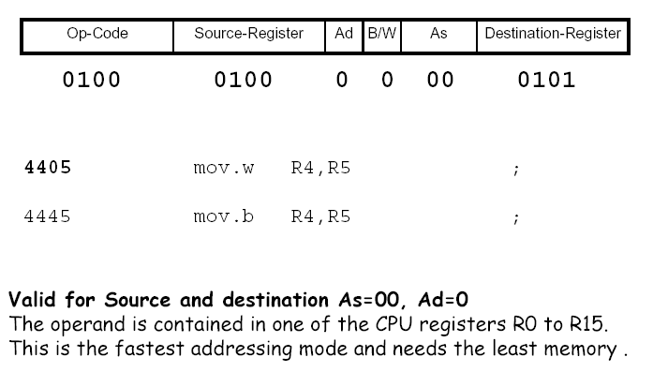
Register Addressing Mode

Slide 15
Register Addressing Mode (cont’d)

Slide 16
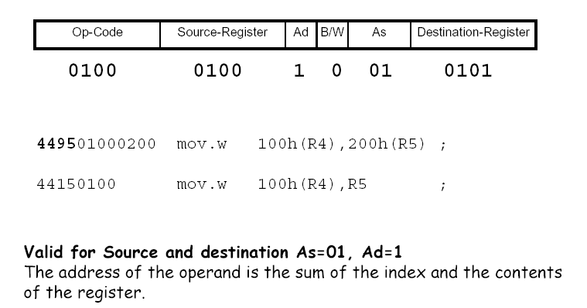
Register-Indexed Addressing Mode

Slide 17
Register-Indexed Addressing Mode (cont’d)

Slide 18
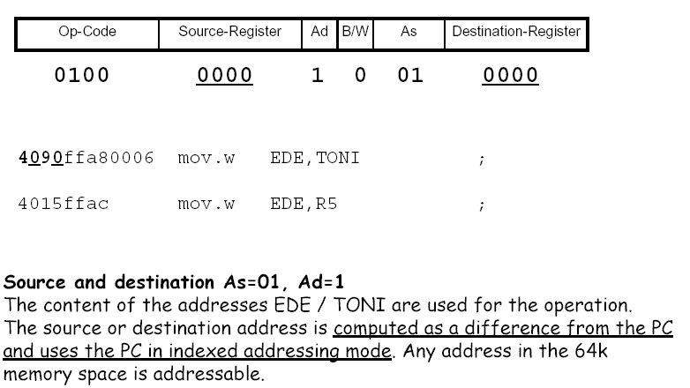
Symbolic Addressing Mode

Slide 19
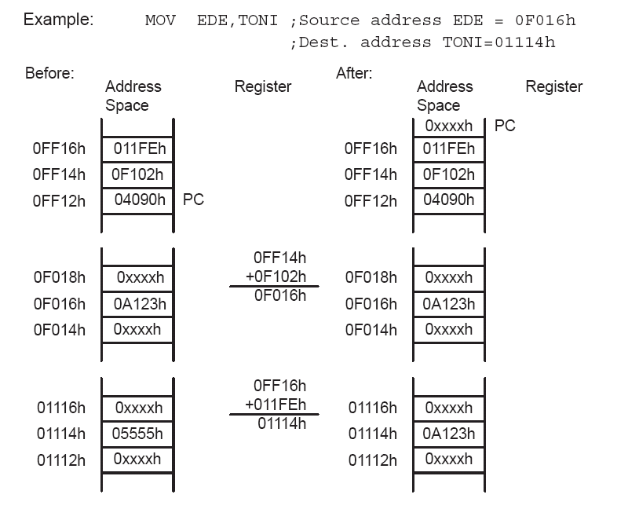
Symbolic Addressing Mode (cont’d)

Slide 20
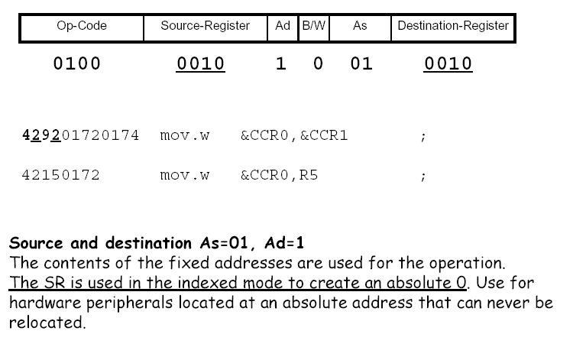
Absolute Addressing Mode

Slide 21
Absolute Addressing Mode (cont’d)

Slide 22
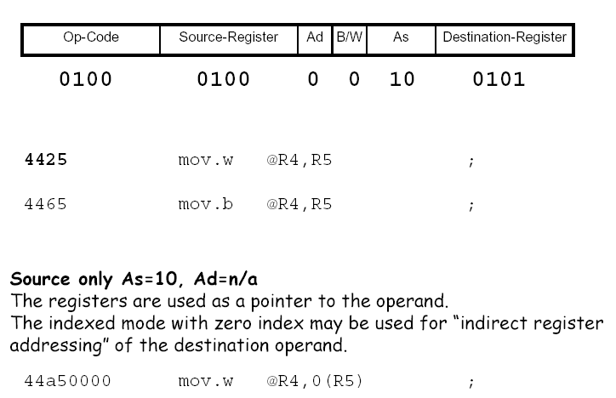
Register Indirect Addressing Mode

Slide 23
Register Indirect Addressing Mode (cont’d)

Slide 24
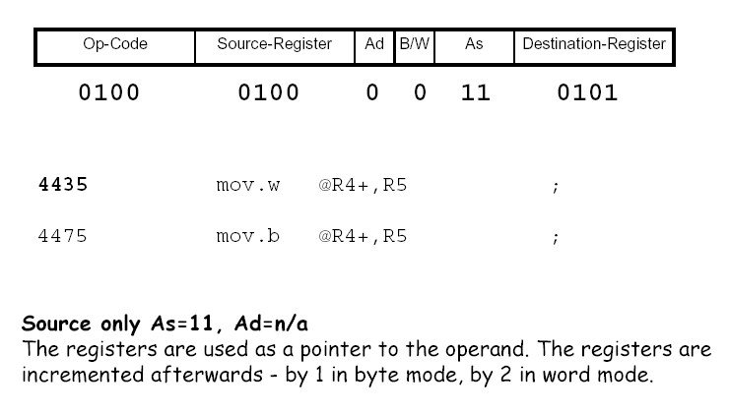
Register Indirect Autoincrement Addressing Mode

Slide 25
Register Indirect Autoincrement Addressing Mode (cont’d)

Slide 26
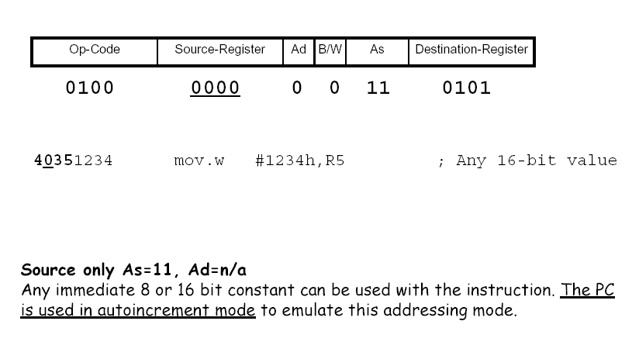
Immediate Addressing Mode

Slide 27
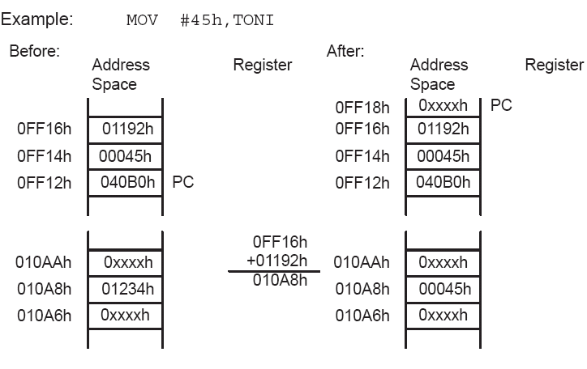
Immediate Addressing Mode (cont’d)

Slide 28
Instruction Set
27 core instructions
Have unique op-codes decoded by the CPU
24 emulated instructions
Make code easier to write and read, but do not have op-codes; instead an equivalent core instruction is generated
No code or performance penalty for using emulated instructions
3 core instruction formats
Dual-operand
Single-operand
Jump
All single- and dual-operand instructions can be byte or word instructions by using .B or .W (default) extensions
Byte instructions are used to access byte data or byte peripherals
Word instructions are used to access word data or word peripherals.

Slide 29
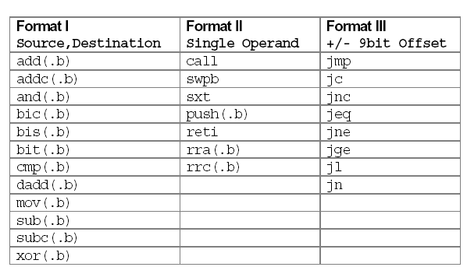
27 Core RISC Instructions

Slide 30
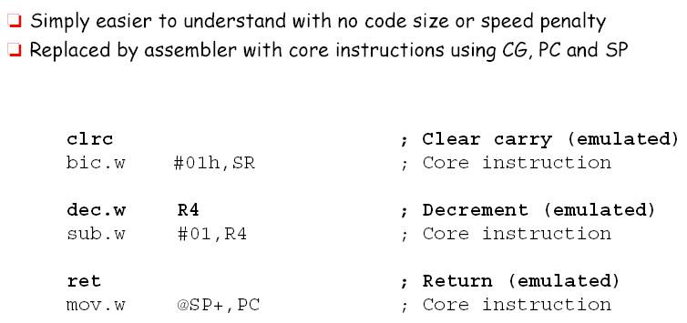
Emulated Instructions

Slide 31
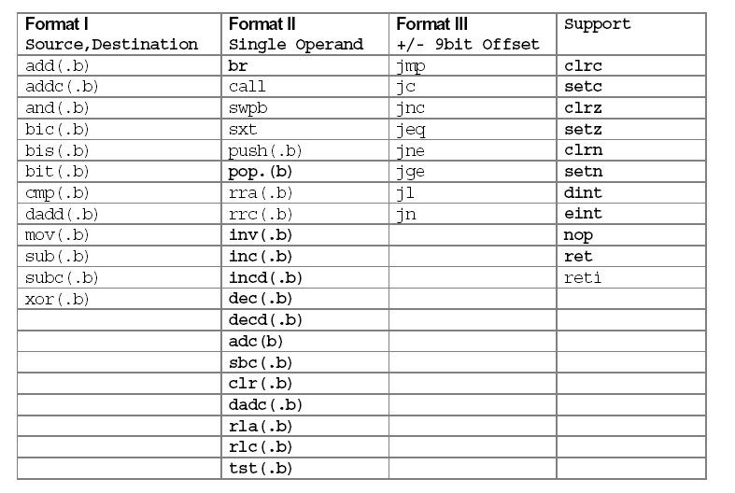
51 Total Instructions

Slide 32
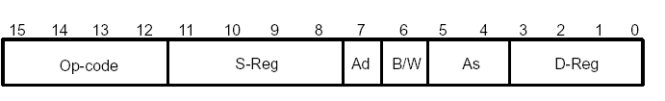
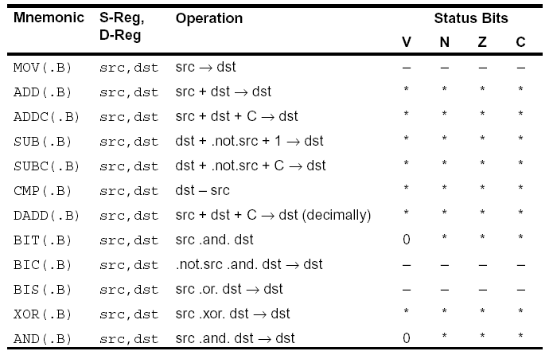
Double operand instructions

Slide 33

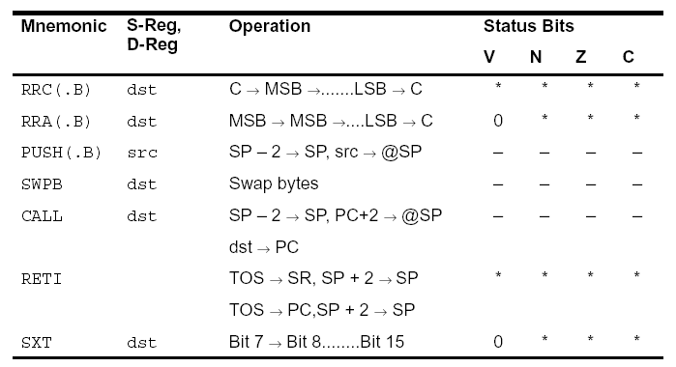
Single Operand Instruction

Slide 34

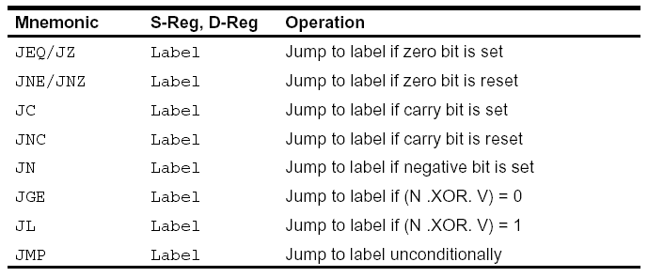
Jump Instructions

Slide 35
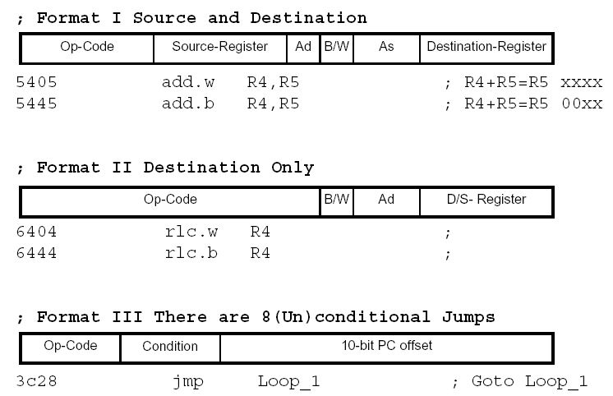
3 Instruction Formats

Slide 36
Instruction Cycles and Lengths
The number of CPU clock cycles required for an instruction depends on the instruction format and the addressing modes used - not the instruction itself
The number of clock cycles refers to the MCLK

Slide 37
Format I: Instruction Cycles and Length

Slide 38
Format II and Format III: Instruction Cycles and Length
Format III: all jump instructions take 2 clock cycles to execute and are 1 word long
Interrupt and reset cycles

Slide 39
Instruction Encoding

Slide 40
Address Space
The MSP430x1xx von-Neumann architecture has one address space shared with special function registers (SFRs), peripherals, RAM, and Flash/ROM memory as shown
Memory maps are device specific
Code access are always performed on even addresses.
Data can be accessed as bytes or words.
The addressable memory space is 64 KB with future expansion planned.

Slide 41
Address Space (cont’d)
Special Function Registers (SFRs)
Some peripheral functions are configured in the SFRs
The SFRs are located in the lower 16 bytes of the address space, and are organized by byte
SFRs must be accessed using byte instructions only. See the device-specific data sheets for applicable SFR bits
Peripheral modules (PM)
Peripheral modules are mapped into the address space
Address space 0100-01FFh is reserved for 16-bit PMs
Should be accessed with word instructions.
If byte instructions are used, only even addresses are permissible, and the high byte of the result is always 0.
Address space 010h-0FFh is reserved for 8-bit PMs
Should be accessed with byte instructions.
Read access of byte modules using word instructions results in unpredictable data in the high byte.
If word data is written to a byte module only the low byte is written into the peripheral register, ignoring the high byte.

Slide 42
Address Space (cont’d)
RAM
RAM starts at 0200h.
End address of RAM depends on the amount of RAM present and varies by device.
RAM can be used for both code and data
Flash/ROM
Start address of Flash/ROM depends on the amount of Flash/ROM present and varies by device.
End address for Flash/ROM is 0FFFFh
Flash can be used for both code and data. Word or byte tables can be stored and used in Flash/ROM without the need to copy the tables to RAM before using them.
Interrupt vector table
Is mapped into the upper 16 words of Flash/ROM address space, with the highest priority interrupt vector at the highest Flash/ROM word address (0FFFEh).

Slide 43
Memory Organization
Word alignment
Bytes are located at even or odd addresses
Words are only located at even addresses
Endianess (little-endian)
When using word instructions, only even addresses may be used. The low byte of a word is always an even address.
The high byte is at the next odd address.
For example, if a data word is located at address xxx4h, then the low byte of that data word is located at address xxx4h, and the high byte of that word is located at address xxx5h.

Slide 44
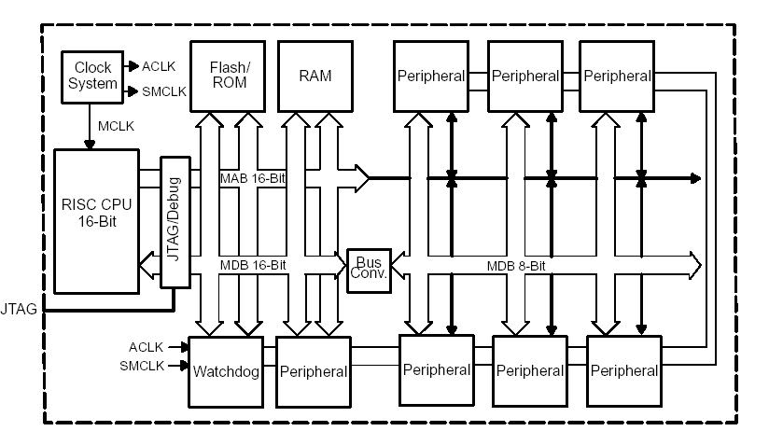
MSP 430 System Architecture: A Closer Look

