Slide 1
CPE 323 Introduction to Embedded Computer Systems: Watchdog Timer, Timer A, Timer B
Instructor: Dr Aleksandar Milenkovic Lecture Notes

Slide 2
MSP430: Watchdog Timer

Slide 3
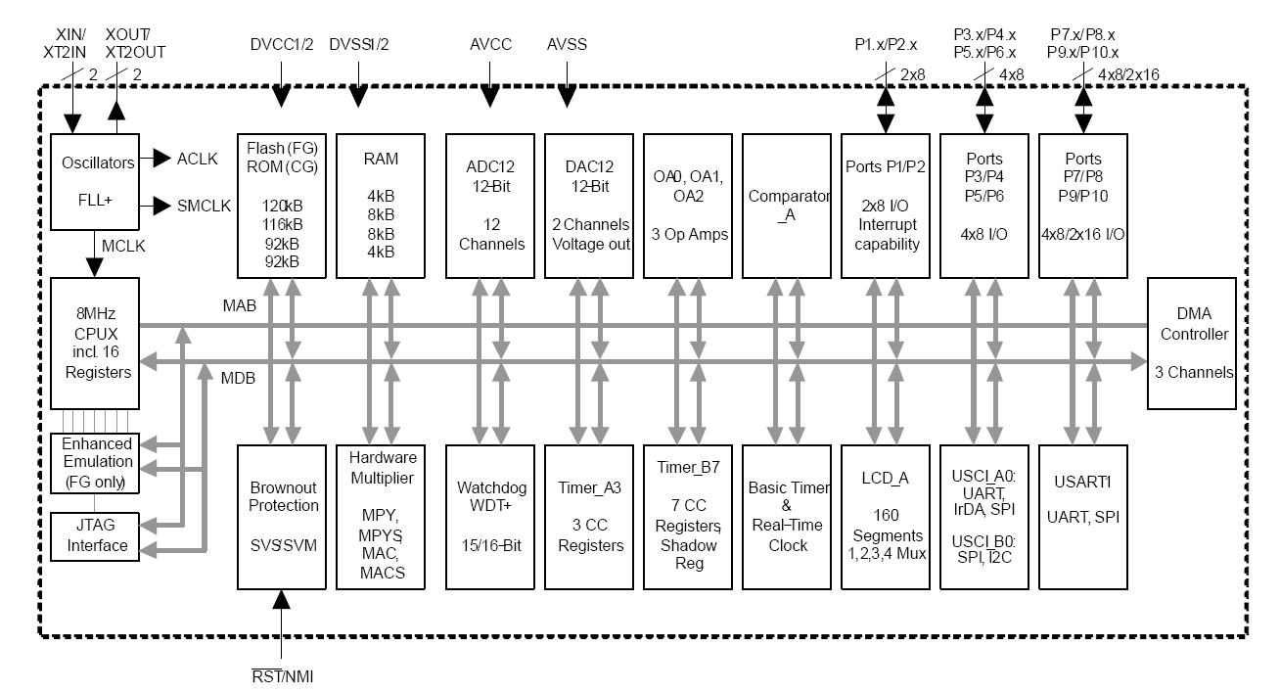
MSP430xG461x Microcontroller

Slide 4
Watchdog Timer Function
Primary function: WDT operation
Performs a controlled-system restart after a software problem occurs
If the selected time interval expires, a system reset is generated
Secondary function (if WDT functionality is not needed)
Can work as an interval timer, to generate an interrupt after the selected time interval

Slide 5
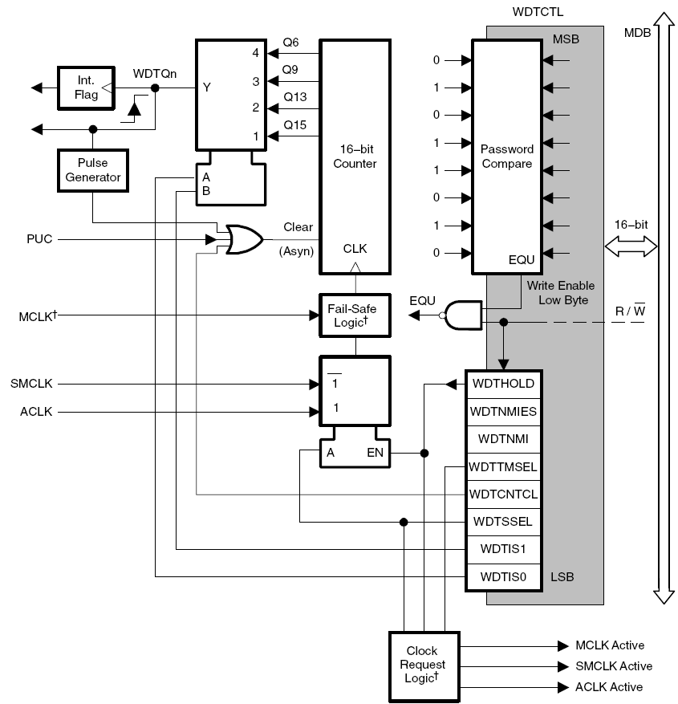
WDT Block Diagram
WDTCNT – 16-bit counter (not visible from SW)
Clock source: ACLK, SMCLK

Slide 6
WDT Startup Conditions
Important: It Powers Up Active
After a PUC, WDT is automatically configured in the watchdog mode with an initial 32768 clock cycle reset interval using the DCOCLK
=> User must setup or halt the WDT prior to the expiration of the initial reset interval

Slide 7
Watchdog Mode
Expiration of the selected time interval, sets WDTIFG and triggers a PUC => reset vector interrupt is sourced, and WDT goes to its default configuration
Security key violation does the same
WDTIFG can be used by the reset ISR to determine source of reset
If the flag is set, then WDT initiated the reset condition either by timing out or by a security key violation
If WDTIFG is cleared, the reset was caused by a different source

Slide 8
Interval Mode
Interval mode: WDTTMSEL is set to 1
In this mode, the WDT provides periodic interrupts
WDTIFG is set at the expiration of the selected time interval (no PUC is generated this time)
If the WDTIE bit and the GIE bit are set, the WDTIFG flag requests an interrupt
The interrupt vector address in interval timer mode is different from that in watchdog mode
The WDTIFG interrupt flag is automatically reset when its interrupt request is serviced, or may be reset by software

Slide 9
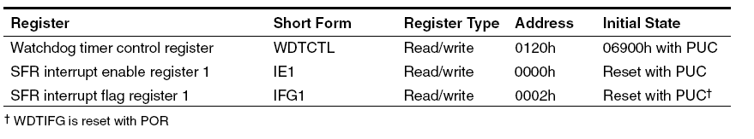
WDT Registers

Slide 10
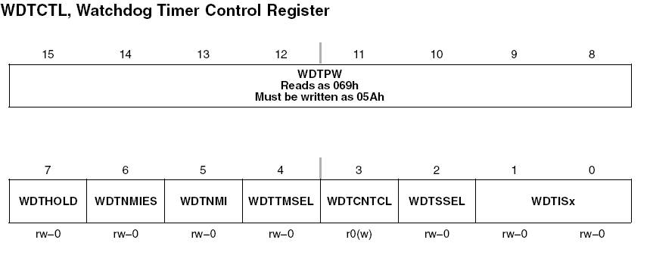
WDT Control Register
Contains control bits to configure WDT plus the RST/NMI pin
It is a 16-bit password-protected read/write register (WORD PERIPHERAL)
Writes must include the write password 05Ah in the upper byte
Otherwise it is a security key violation and triggers a PUC system reset regardless of timer mode
Reads of WDTCTL reads 069h in the upper byte

Slide 11
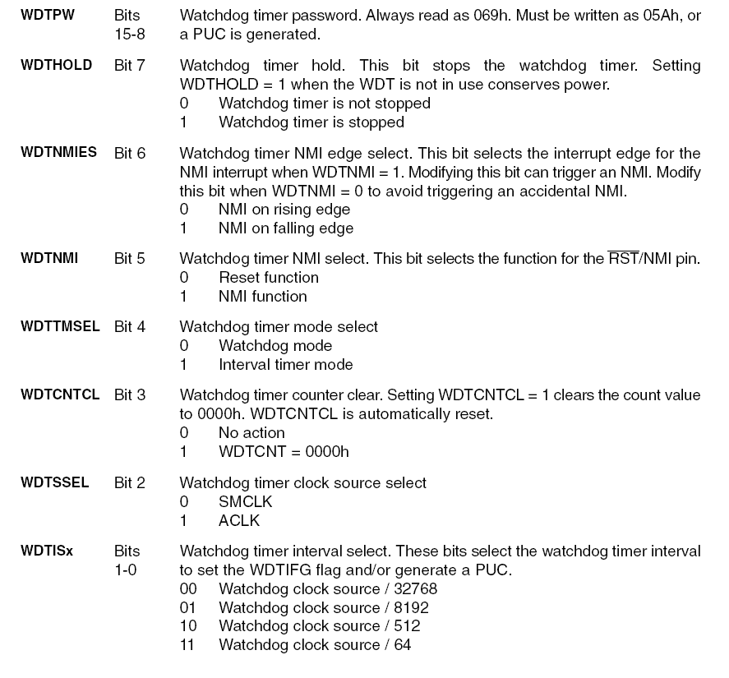
WDTCTL

Slide 12
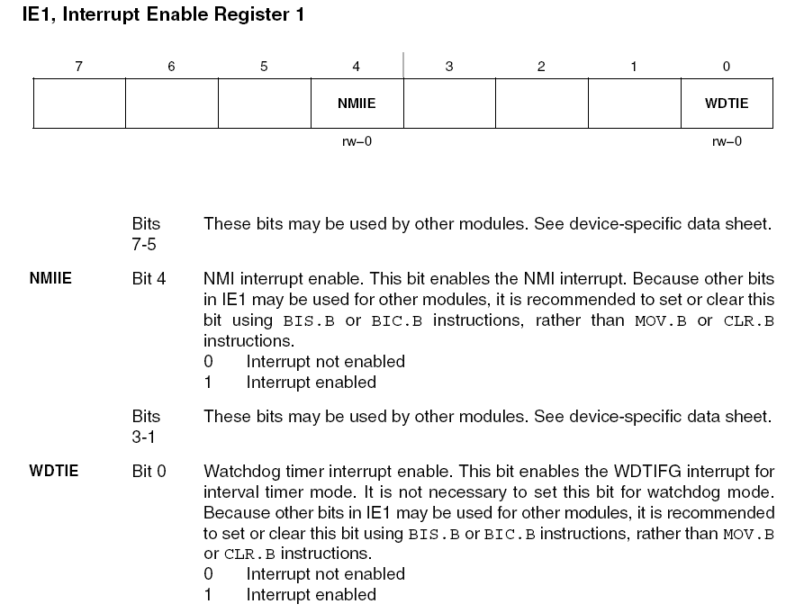
IE1

Slide 13
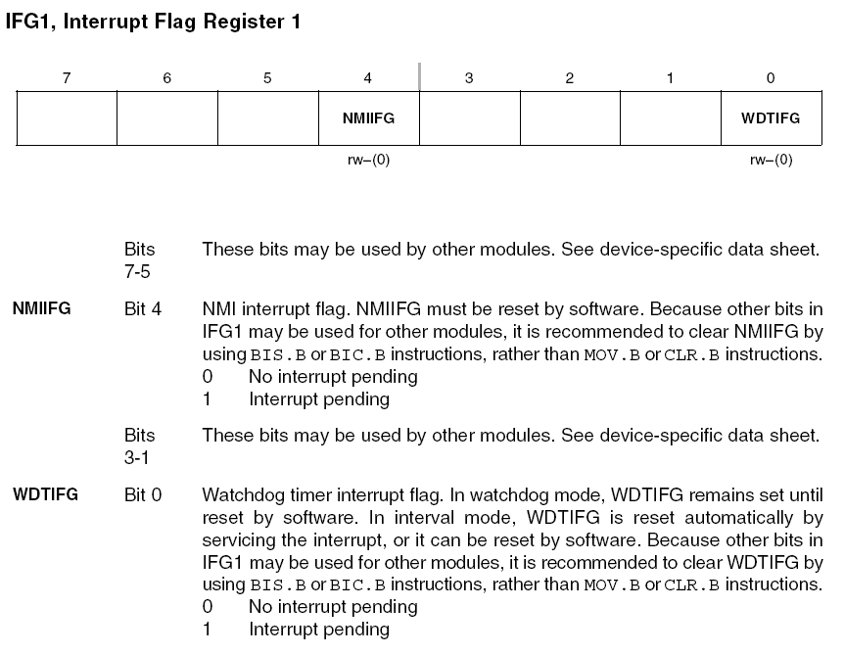
IFG1

Slide 14
Watchdog Timer-Examples
How to select timer mode
/* WDT is clocked by fACLK (assumed 32Khz) */
WDTCL=WDT_ADLY_250; // WDT 250MS/4 INTERVAL TIMER
IE1 |=WDTIE; // ENABLE WDT INTERRUPT
How to stop watchdog timer
WDTCTL=WDTPW + WDTHOLD ; // stop watchdog timer
Assembly programming
WDT_key .equ 05A00h ; Key to access WDT
WDTStop mov #(WDT_Key+80h),&WDTCTL ; Hold Watchdog
WDT250 mov #(WDT_Key+1Dh),&WDTCTL ; WDT, 250ms Interval

Slide 15
MSP430: Timer_A

Slide 16
MSP430xG461x Microcontroller

Slide 17
Timer_A
Most-versatile, general-purpose timer in MSP430
Features
16-bit counter with 4 operating modes
Selectable and configurable clock source
Three (five, seven) independently configurable capture/compare registers with configurable inputs
Three (five, seven) individually configurable output modules with 8 output modes
Multiple, simultaneous, timings; multiple capture/compares; multiple output waveforms such as PWM signals; and any combination of these
Interrupt capabilities
Each capture/compare block individually configurable

Slide 18
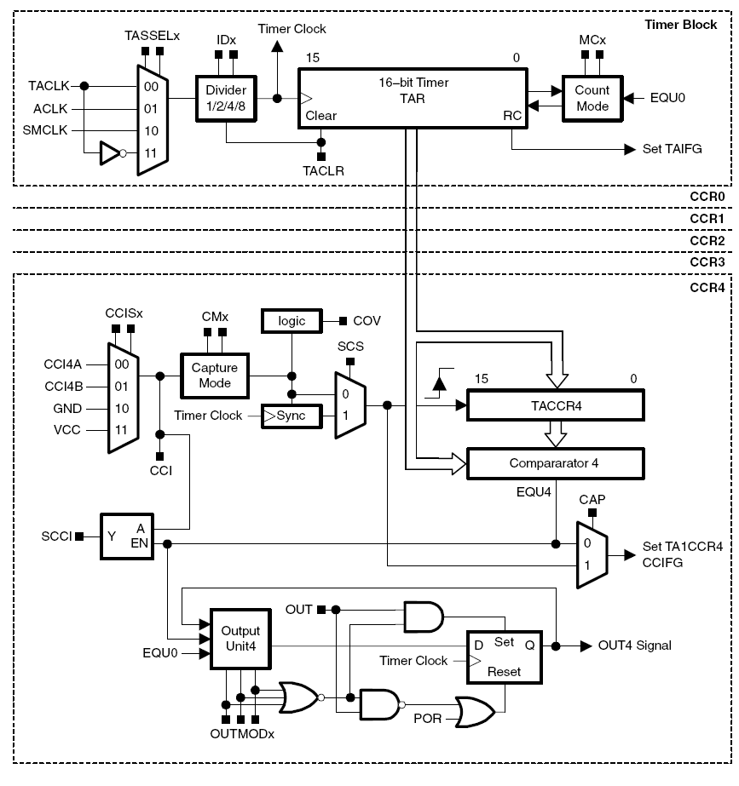
Timer_A: Block Diagram
Timer Block
(TAR)
Capture & compare channels
(TACCRx)
Notes:
Timer_A3

Slide 19
Timer_A Organization
Timer block (TAR)
up/down counter with a choice of clock sources that can be prescaled (divided)
TAIFG is raised when the counter returns to 0
Capture & compare channel
Capture: we capture an input, which means record the “time” (value in TAR) at which the input changes in TACCRn; the input can be internal (from another peripheral or SW) or external
Compare: the current value of TAR is compared to the value stored in TACCRn and the output is updated when they match; the output can be either internal or external
Request an interrupt on either capture or compare or by setting its CCIFG flag (e.g., from SW)
Sample an input at a compare event; useful if TimerA is used for serial communication

Slide 20
Timer_A Organization
Single Timer block, multiple Capture&Compare channels
We may have multiple Timer_A modules that can operate on independent time bases
Use HW (TimerA) for more precise timing and reserve software for the less critical tasks
TACCR0 is special
Used for UP and UP/DOWN mode and cannot be used for usual functions
Has its own interrupt vector with a higher priority than the other interrupts from TimerA, which all share a common vector

Slide 21
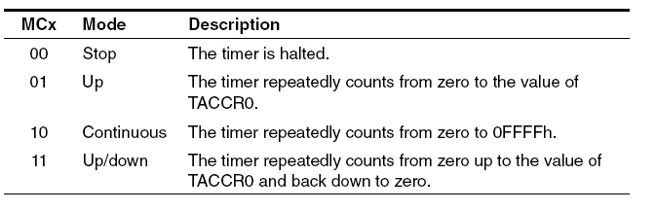
Timer_A Counting Modes
UP/DOWN Mode
Timer counts between 0 and CCR0 and 0
Stop/Halt Mode
Timer is halted with the next +CLK
UP Mode
Timer counts between 0 and CCR0
Continuous Mode
Timer continuously counts up
0FFFFh
CCR0
0h

Slide 22
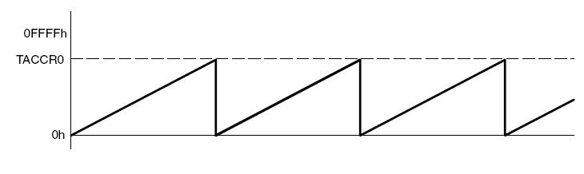
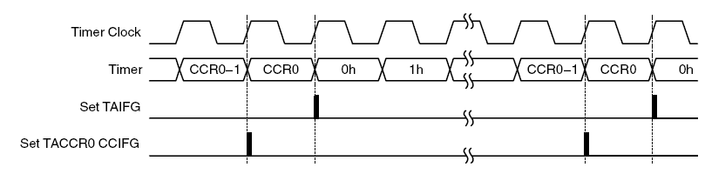
UP Mode
Counts up: 0, 1, …TACCR0, 0, 1 … (period is (TACCR0+1)Tclk

Slide 23
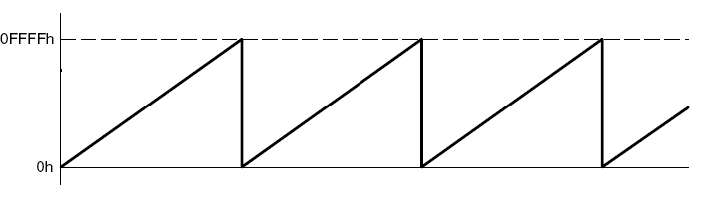
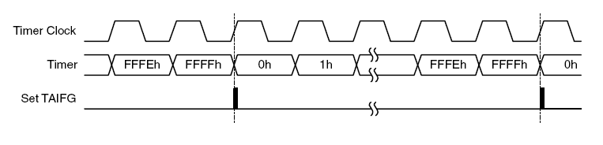
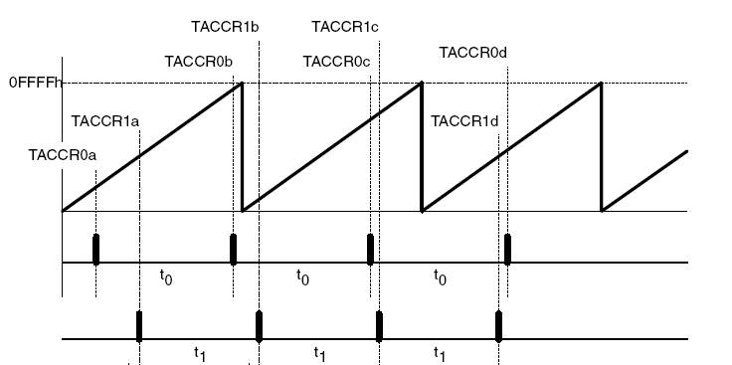
Continuous Mode
Counts up: 0, 1, …0xFFFF, 0, 1 … (period is (2^16)Tclk
Use of CM

Slide 24
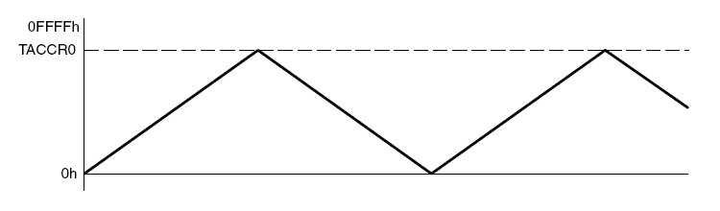
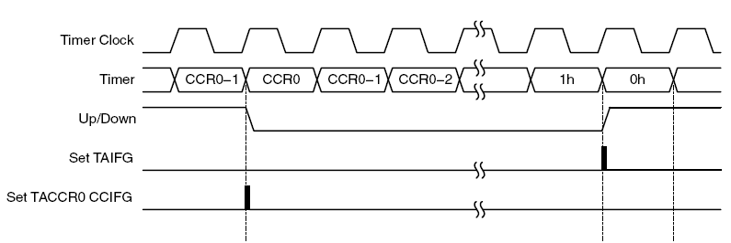
Up/Down Mode
Counts up: 0, 1, …TACCR0, TACCR0-1, … 2, 1, 0, 1, … (period is (2*TACCR0)Tclk

Slide 25
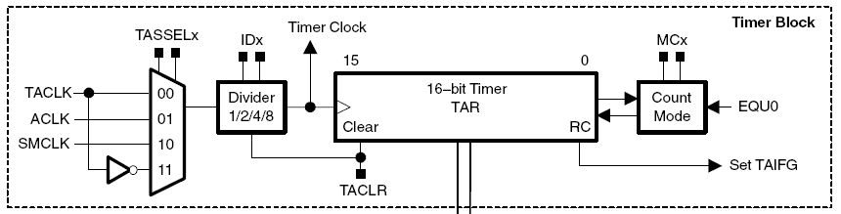
Timer_A 16-bit Counter
15
0
TACTL
unused
Input
Input
Mode
un-
TAIE
TAIFG
Select
Divider
Control
used
CLR
160h
rw-
rw-
rw-
rw-
rw-
rw-
rw-
rw-
rw-
rw-
rw-
rw-
rw-
(w)-
rw-
rw-
(0)
(0)
(0)
(0)
(0)
(0)
(0)
(0)
(0)
(0)
(0)
(0)
(0)
(0)
(0)
(0)
MC1
MC0
0
0
Stop Mode
TACLR – clears TAR and resets the direction of counting (it clears automatically itself)
TAIFG – set when the timer counts to 0; a maskable interrupt is requested if TAIE bit is set
0
1
Up Mode
1
0
Continuous Mode
ID1
ID0
1
1
Up/Down Mode
0
0
1/1, Pass
0
1
1/2
1
0
1/4
SSEL1
SSEL0
1
1
1/8
0
0
TACLK
0
1
ACLK
1
0
MCLK
1
1
INCLK (often = #TACLK)

Slide 26
Timer_A Capture Compare Blocks
Logic
Overflow x
Timer Bus
Capture Path
COVx
Data Bus
CCISx1
CCISx0
CMPx
CCIxA
0
15
0
CCIxB
1
Capture
1
GND
2
Mode
Capture/Compare Register CCRx
VCC
3
Timer
0
Capture
CMx1
CMx0
Clock
Synchronize
0
0
Disabled
Capture
SCSx
0
1
Pos. Edge
15
1
0
Neg. Edge
0
1
1
Both Edges
Comparator x
to Port0
EQUx
0
CAPx
Compare Path
1
Set_CCIFGx
EN
Y
SCCIx
CCIx
A
CCRx
15
0
0172h
15
0
to
2
2
017Eh
rw-
rw-
rw-
rw-
rw-
rw-
rw-
rw-
rw-
rw-
rw-
rw-
rw-
rw-
rw-
rw-
(0)
(0)
(0)
(0)
(0)
(0)
(0)
(0)
(0)
(0)
(0)
(0)
(0)
(0)
(0)
(0)
15
0
CCTLx
CAPTURE
INPUT
un-
CAP
OUTMODx
CCIFG
162h
MODE
SELECT
SCS
SCCI
used
CCIE
CCI
OUT
COV
to
rw-
rw-
rw-
rw-
rw-
rw-
rw-
rw-
rw-
rw-
rw-
rw-
r
rw-
rw-
rw-
16Eh
(0)
(0)
(0)
(0)
(0)
(0)
(0)
(0)
(0)
(0)
(0)
(0)
(0)
(0)
(0)

Slide 27
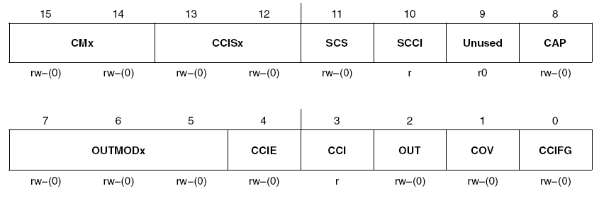
TACCTLn: Capture Control
CMx (Capture Mode)
00 – disabled
01 – positive edge
10 – negative edge
11 – both edges
CCISx (Capture Input Select)
00 – CCInA (outside timer)
01 – CCInB (outside timer)
10 – Gnd (pointless, but allows captures from SW)
11 – Vdd (pointless, but allows captures from SW)
(for SW-triggered captures: use CMx=11, set CCIS1=1, and toggle CCIS0)
SCS – synchronizer bit ensures synchronization with the timer clock (SHOULD always be set)
Race conditions: the selected input changes at the same time as the timer clock
CCI –the state of the selected input can be read at any time from SW
OUT- For output mode 0, this bit directly controls the state of the output

Slide 28
TACCTLn: Capture Control
CAP: Capture mode
0 - Compare mode
1 - Capture mode
Capture: TAR is copied into TACCRn, the channel flag CCIFGn is set, and a maskable interrupt is requested if bit CCIE in TACCTLx is set
COV: Capture Overflow (next capture occurs before the TACCRn has been read following the previous event)

Slide 29
TACCTLn: Compare Mode
Compare mode: produces an output and interrupt at the time stored in TACCRn
Actions when TAR reaches value in TACCRn
Internal EQU is set
CCIFGn flag is set and an interrupt is requested if enabled
Output OUTn is changed according to the mode set in OUTMODx bits in TACCTLn
Input signal to the capture HW, CCI, is latched into the SCCI bit
Use compare mode to trigger periodic events on other peripherals (e.g., DAC, ADC)

Slide 30
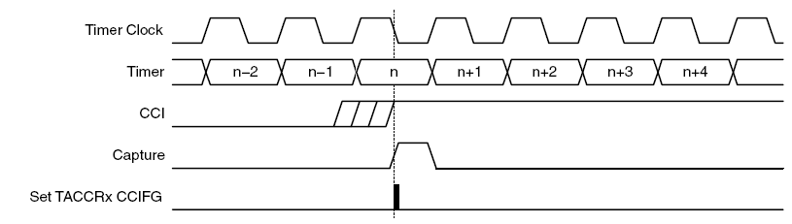
Capture Signal
The capture signal can be asynchronous to the timer clock and cause a race condition
=> Setting the SCS bit synchronizes the capture with the next timer clock

Slide 31
TACCTLn: Output Mode
OUTMODx: Output mode
000 OUT bit value
001 Set
010 Toggle/reset
011 Set/reset
100 Toggle
101 Reset
110 Toggle/set
111 Reset/set

Slide 32
Timer_A Output Units
Timer Clock
TAx
EQUx
Logic
OUTx (CCTLx.2)
Set
Output Signal Outx
EQU0
Output
D
Q
Timer Clock
To Output Logic TAx
Reset
POR
Output Mode 0
OUTx
OMx2 OMx1 OMx0
OMx2
OMx1
OMx0
Function
Operational Conditions
0
0
0
Output Mode
Outx signal is set according to Outx bit
0
0
1
Set
EQUx sets Outx signal clock synchronous with timer clock (single change)
0
1
0
PWM Toggle/Reset
EQUx toggles Outx signal, reset with EQU0, clock sync. with timer clock
0
1
1
PWM Set/Reset
EQUx sets Outx signal, reset with EQU0, clock synchronous with timer clock
1
0
0
Toggle
EQUx toggles Outx signal, clock synchronous with timer clock
1
0
1
Reset
EQUx resets Outx signal clock synchronous with timer clock (single change)
1
1
0
PWM Toggle/Reset
EQUx toggles Outx signal, set with EQU0, clock synchronous with timer clock
1
1
1
PWM Set/Reset
EQUx resets Outx signal, set with EQU0, clock synchronous with timer clock

Slide 33
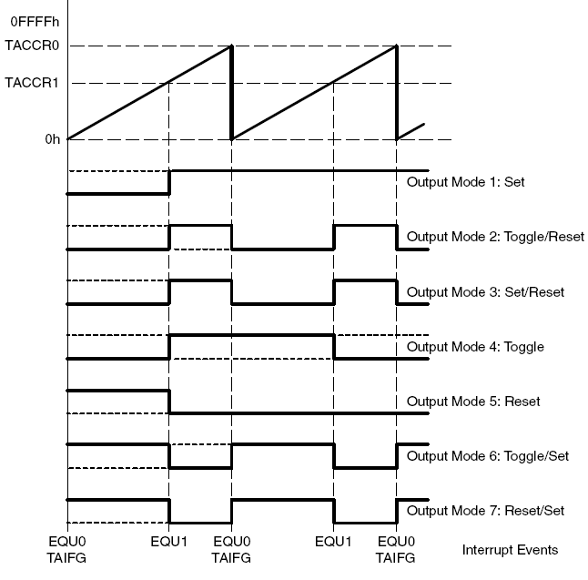
Output Mode Examples (UP Mode)

Slide 34
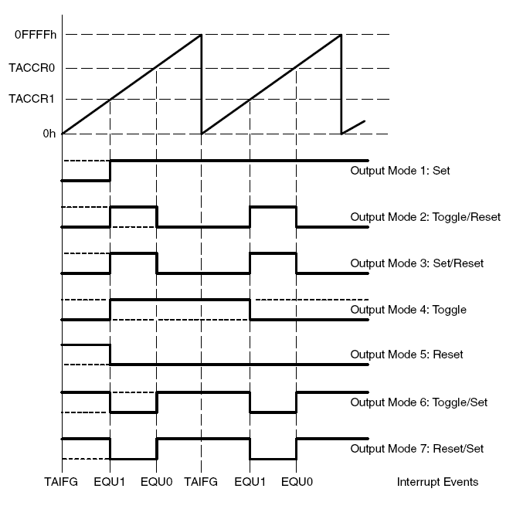
Output Mode Examples (Continuous Mode)

Slide 35
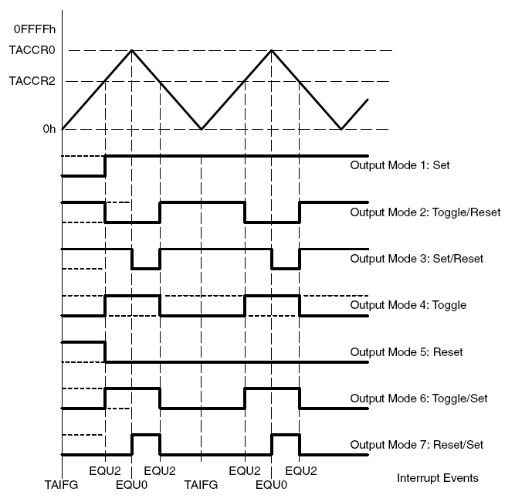
Output Mode Examples (UP/DOWN)

Slide 36
Timer_A Continuous-Mode Example
0FFFh
0h
TA0 Input
CCR0:
Px.x
Capture Mode: Positive Edge
TA1 Input
CCR1:
Px.y
Capture Mode: Both Edges
TA2 Input
CCR2:
Px.z
Capture Mode: Negative Edge
CCR0
CCR0
CCR1
CCR1
CCR1
CCR1
CCR1
CCR1
Interrupts can be generated
CCR2
Example shows three independent HW event captures. CCRx “stamps” time of event - Continuous-Mode is ideal.

Slide 37
Timer_A PWM Up-Mode Example
0FFFFh
CCR0
CCR1
CCR2
0h
CCR1: PWM Set/Reset
TA1 Output
Px.x
CCR2: PWM Reset/Set
TA2 Output
Px.y
CCR0: PWM Toggle
TA0 Output
Auto
Re-load
Px.z
EQU0
EQU2
EQU1
EQU0
EQU2
EQU1
EQU0
EQU2
Interrupts can be generated
Example shows three different asymmetric PWM-Timings generated with the Up-Mode
Output Mode 4: PWM Toggle

Slide 38
Timer_A PWM Up/Down Mode Example
0FFFFh
t
hlfper
CCR0
CCR2
CCR1
CCR3
0h
0 Degrees
TA1 Output
(0.5xVmotor)
Px.x
t
pw1
TA2 Output
+120 Degrees
t
(0.93xVmotor)
pw2
Px.y
-120 Degrees
t
pw3
TA0 Output
(0.07xVmotor)
Px.z
TIMOV
EQU0
TIMOV
EQU0
TIMOV
Interrupts can be generated
Example shows Symmetric PWM Generation - Digital Motor Control

Slide 39
Interrupts from Timer_A
Sources: when TAIFG and CCIFG bit in each TACCTLn is set (CCIFGn for short)
TACCR0 interrupt is privileged (has higher priority than others) and has its own vector TIMERA0_VECTOR (single source)
TIMERA1_VECTOR is shared by the others (TAIFG + CCIFGx, x=1,2, ...) (multi source)
Inspecting individual flags can take a lot of time in the ISR => Timer_A uses TAIV – interrupt vector register to identify the source of the interrupt rapidly
When one or more of the shared and enabled interrupts is set, TAIV is loaded with the value that corresponds to the highest priority

Slide 40
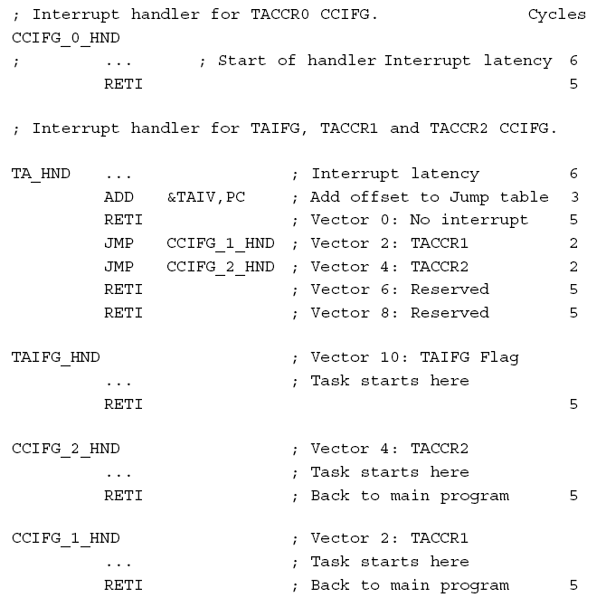
Timer_A Interrupt Service Routines

Slide 41
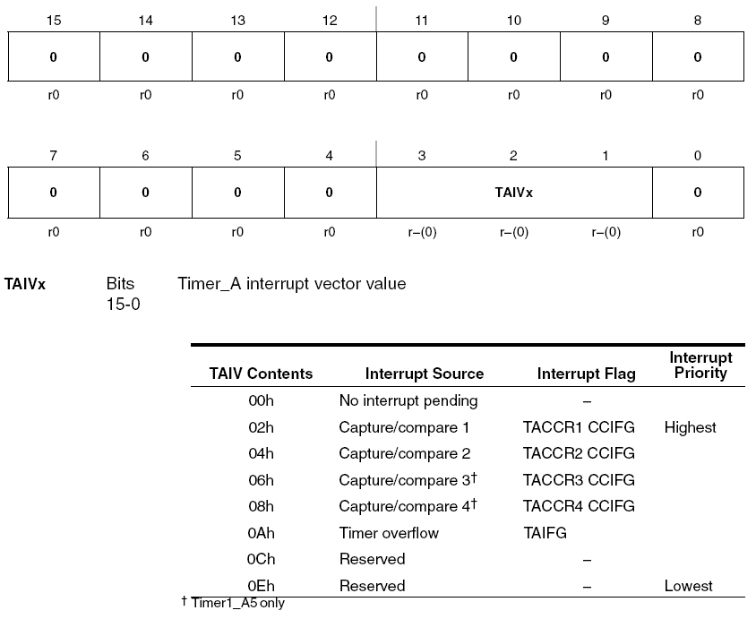
TAIV

Slide 42
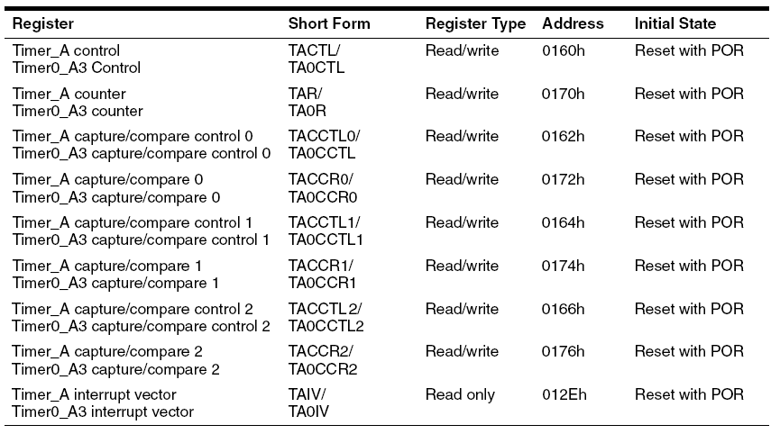
Timer_A Registers

Slide 43
C Examples, CCR0 Contmode ISR, TA_0 ISR
//***************************************************************
// MSP-FET430P140 Demo - Timer_A Toggle P1.0,
// CCR0 Contmode ISR, DCO SMCLK
// Description; Toggle P1.0 using software and TA_0 ISR. Toggle rate is
// set at 50000 DCO/SMCLK cycles. Default DCO frequency used for TACLK.
// Durring the TA_0 ISR P0.1 is toggled and 50000 clock cycles are added to
// CCR0. TA_0 ISR is triggered exactly 50000 cycles. CPU is normally off and
// used only durring TA_ISR.
// ACLK = n/a, MCLK = SMCLK = TACLK = DCO~ 800k
//
//
// MSP430F149
// ---------------
// /|\| XIN|-
// | | |
// --|RST XOUT|-
// | |
// | P1.0|-->LED
//
// M. Buccini
// Texas Instruments, Inc
// September 2003
// Built with IAR Embedded Workbench Version: 1.26B
// December 2003
// Updated for IAR Embedded Workbench Version: 2.21B
//**********************************************************************
#include <msp430x14x.h>
void main(void)
{
WDTCTL = WDTPW + WDTHOLD; // Stop WDT
P1DIR |= 0x01; // P1.0 output
CCTL0 = CCIE; // CCR0 interrupt enabled
CCR0 = 50000;
TACTL = TASSEL_2 + MC_2; // SMCLK, contmode
_BIS_SR(LPM0_bits + GIE); // Enter LPM0 w/ interrupt
}
// Timer A0 interrupt service routine
interrupt[TIMERA0_VECTOR] void TimerA(void)
{
P1OUT ^= 0x01; // Toggle P1.0
CCR0 += 50000; // Add Offset to CCR0
}

Slide 44
C Examples, CCR0 Upmode ISR, TA_0
//************************************************************************
// MSP-FET430P140 Demo - Timer_A Toggle P1.0, CCR0 upmode ISR, 32kHz ACLK
//
// Description; Toggle P1.0 using software and the TA_0 ISR. Timer_A is
// configured in an upmode, thus the the timer will overflow when TAR counts
// to CCR0. In this example, CCR0 is loaded with 1000-1.
// Toggle rate = 32768/(2*1000) = 16.384
// ACLK = TACLK = 32768, MCLK = SMCLK = DCO~ 800k
// //*An external watch crystal on XIN XOUT is required for ACLK*//
//
// MSP430F149
// ---------------
// /|\| XIN|-
// | | | 32kHz
// --|RST XOUT|-
// | |
// | P1.0|-->LED
//
// M. Buccini
// Texas Instruments, Inc
// October 2003
// Built with IAR Embedded Workbench Version: 1.26B
// December 2003
// Updated for IAR Embedded Workbench Version: 2.21B
//************************************************************************
#include <msp430x14x.h>
void main(void)
{
WDTCTL = WDTPW + WDTHOLD; // Stop WDT
P1DIR |= 0x01; // P1.0 output
CCTL0 = CCIE; // CCR0 interrupt enabled
CCR0 = 1000-1;
TACTL = TASSEL_1 + MC_1; // ACLK, upmode
_BIS_SR(LPM3_bits + GIE); // Enter LPM3 w/ interrupt
}
// Timer A0 interrupt service routine
#pragma vector=TIMERA0_VECTOR
Interrupt[TIMERA0_VECTOR] void Timer_A (void)
{
P1OUT ^= 0x01; // Toggle P1.0
}

Slide 45
C Examples, CCR1 Contmode ISR, TA_1
//*****************************************************************
// MSP-FET430P140 Demo –
// Timer_A Toggle P1.0, CCR1 Contmode ISR, CO SMCLK
// Description; Toggle P1.0 using using software and TA_1 ISR.
// Toggle rate is set at 50000 DCO/SMCLK cycles.
// Default DCO frequency used for TACLK.
// Durring the TA_1 ISR P0.1 is toggled and
// 50000 clock cycles are added to CCR1.
// TA_1 ISR is triggered exactly 50000 cycles.
// CPU is normally off and used only durring TA_ISR.
// ACLK = n/a, MCLK = SMCLK = TACLK = DCO ~ 800k
// Proper use of TAIV interrupt vector generator demonstrated.
//
// MSP430F149
// ---------------
// /|\| XIN|-
// | | |
// --|RST XOUT|-
// | |
// | P1.0|-->LED
//
// M. Buccini
// Texas Instruments, Inc
// September 2003
// Built with IAR Embedded Workbench Version: 1.26B
// December 2003
// Updated for IAR Embedded Workbench Version: 2.21B
//**************************************************************
#include <msp430x14x.h>
void main(void)
{
WDTCTL = WDTPW + WDTHOLD; // Stop WDT
P1DIR |= 0x01; // P1.0 output
CCTL1 = CCIE; // CCR1 interrupt enabled
CCR1 = 50000;
TACTL = TASSEL_2 + MC_2; // SMCLK, Contmode
_BIS_SR(LPM0_bits + GIE); // Enter LPM0 w/ interrupt
}
// Timer_A3 Interrupt Vector (TAIV) handler
#pragma vector=TIMERA1_VECTOR
__interrupt void Timer_A(void)
{
switch( TAIV )
{
case 2: // CCR1
{
P1OUT ^= 0x01; // Toggle P1.0
CCR1 += 50000; // Add Offset to CCR1
}
break;
case 4: break; // CCR2 not used
case 10: break; // overflow not used
}
}

Slide 46
C Examples, PWM, TA1-2 upmode
//***************************************************************************
// MSP-FET430P140 Demo - Timer_a PWM TA1-2 upmode, DCO SMCLK
//
// Description; This program will generate a two PWM outputs on P1.2/1.3 using
// Timer_A in an upmode. The value in CCR0, defines the period and the
// values in CCR1 and CCR2 the duty PWM cycles. Using ~ 800kHz SMCLK as TACLK,
// the timer period is ~ 640us with a 75% duty cycle on P1.2 and 25% on P1.3.
// ACLK = na, SMCLK = MCLK = TACLK = default DCO ~ 800kHz.
//
// MSP430F149
// -----------------
// /|\| XIN|-
// | | |
// --|RST XOUT|-
// | |
// | P1.2|--> CCR1 - 75% PWM
// | P1.3|--> CCR2 - 25% PWM
//
// M.Buccini
// Texas Instruments, Inc
// September 2003
// Built with IAR Embedded Workbench Version: 1.26B
// January 2004
// Updated for IAR Embedded Workbench Version: 2.21B
//*****************************************************
void main(void)
{
WDTCTL = WDTPW + WDTHOLD; // Stop WDT
P1DIR |= 0x0C; // P1.2 and P1.3 output
P1SEL |= 0x0C; // P1.2 and P1.3 TA1/2 options
CCR0 = 512-1; // PWM Period
CCTL1 = OUTMOD_7; // CCR1 reset/set
CCR1 = 384; // CCR1 PWM duty cycle
CCTL2 = OUTMOD_7; // CCR2 reset/set
CCR2 = 128; // CCR2 PWM duty cycle
TACTL = TASSEL_2 + MC_1; // SMCLK, up mode
_BIS_SR(LPM0_bits); // Enter LPM0
}

Slide 47
MSP430: Timer_B

Slide 48
Timer_B
Timer_B is identical to Timer_A with the following exceptions:
Timer_B length is programmable and can be 8, 10, 12, or 16 bits
Timer_B TBCCRx registers are double-buffered and can be grouped
All Timer_B outputs can be put into a high-impedance state
The SCCI bit function is not implemented in Timer_B

Slide 49
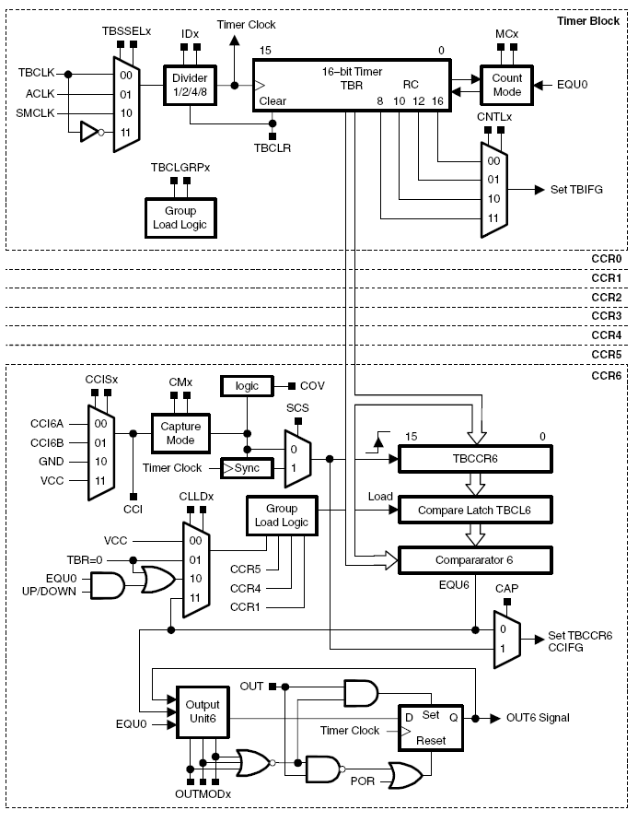
Timer_B

